Slide 1
Tornado Before/After EDA
Per-Channel Exploratory Analysis for All 14 Tornado Cases
Methodology and slide structure follow the project's original EDA work (Gloria Le, 02/12/2026), extended from 2 manually-analyzed cases to all 14.

Slide 2
Dataset Overview
All 14 cases have 6-channel BEFORE/AFTER raster pairs (Landsat-style surface reflectance: Blue/Green/Red/NIR/SWIR1/SWIR2)
Spatial resolutions and grid sizes vary case to case
Value ranges are mostly consistent (min ~-0.01 to -0.2, max ~1.60)
Source GeoTIFF tiles are frequently corrupted/truncated - per-pixel readability is computed and reported for every case below, not assumed
Readable-pixel coverage varies enormously: from under 2% (TOR16, TOR11) to over 90% (TOR5) - this drives how much each case's statistics can be trusted
Case | Readable %
TOR5 | 92.2%
TOR24 | 66.9%
TOR61 | 13.7%
TOR12 | 11.2%
TOR62 | 8.4%
TOR13 | 7.6%
TOR18 | 6.7%
TOR15 | 6.4%
TOR10 | 5.5%
TOR7 | 4.1%
TOR68 | 2.4%
TOR66 | 2.1%
TOR11 | 1.9%
TOR16 | 1.1%

Slide 3
TOR5: Dataset Statistics
TOR5_BEST_BEFORE_win20d.tif
TOR5_BEST_AFTER_win50d.tif
Grid: 402 x 639 Channels: 6 dtype: float32
Readable - Before: 98.4% After: 92.3% Both: 92.2%
Ch | Before min/max | Before mean/std | After min/max | After mean/std
0 | 0.0121 / 0.2515 | 0.0511 / 0.0143 | 0.0219 / 0.2766 | 0.0500 / 0.0106
1 | 0.0222 / 0.2918 | 0.0721 / 0.0207 | 0.0303 / 0.2916 | 0.0730 / 0.0176
2 | 0.0187 / 0.3260 | 0.0797 / 0.0262 | 0.0257 / 0.3656 | 0.0791 / 0.0212
3 | 0.0140 / 0.4792 | 0.1861 / 0.0594 | 0.0152 / 0.5647 | 0.2207 / 0.0735
4 | -0.0011 / 0.5482 | 0.2269 / 0.0744 | -0.0037 / 0.6036 | 0.2407 / 0.0630
5 | -0.0020 / 0.5503 | 0.1372 / 0.0493 | -0.0015 / 0.4657 | 0.1377 / 0.0419
AFTER channel correlation:
+1.00 +0.93 +0.92 +0.45 +0.71 +0.76
+0.93 +1.00 +0.91 +0.62 +0.70 +0.70
+0.92 +0.91 +1.00 +0.41 +0.81 +0.87
+0.45 +0.62 +0.41 +1.00 +0.53 +0.33
+0.71 +0.70 +0.81 +0.53 +1.00 +0.95
+0.76 +0.70 +0.87 +0.33 +0.95 +1.00

Slide 4
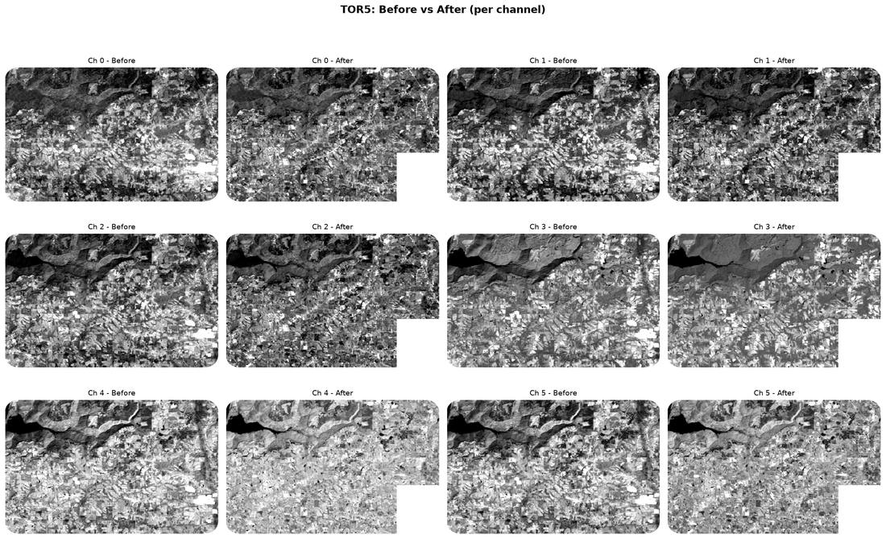
TOR5: Before vs After (per channel)

Slide 5
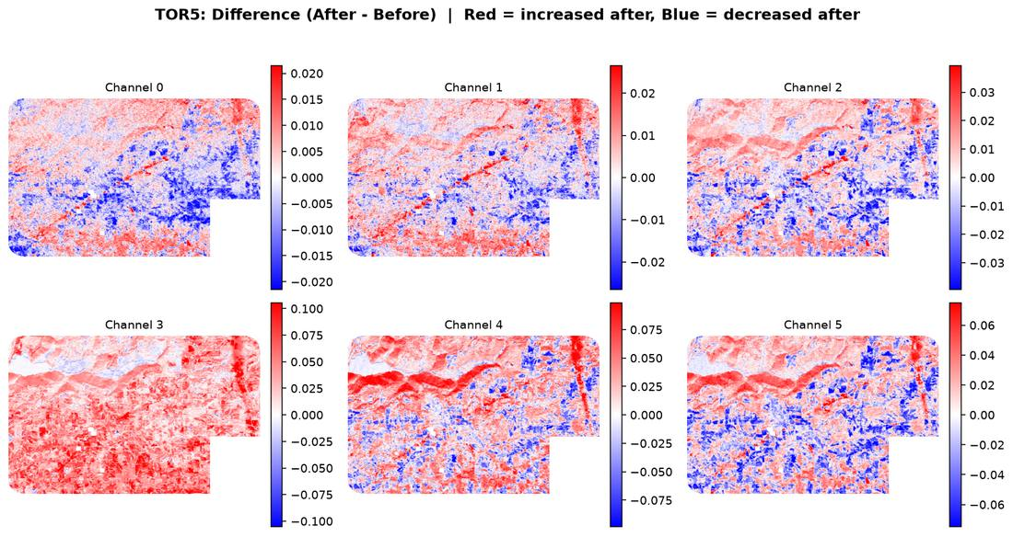
TOR5: Difference (After - Before)

Slide 6
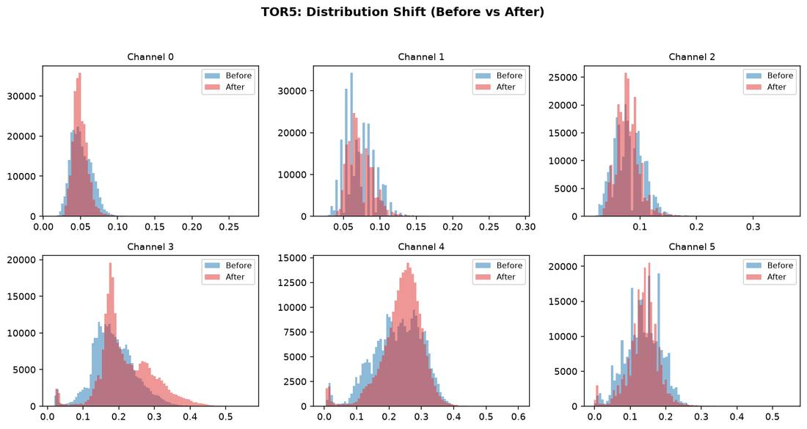
TOR5: Distribution Shift

Slide 7
TOR5: Interpretation
Readable coverage: 92.2% of the scene has usable BEFORE+AFTER data (the rest is corrupted/unreadable source imagery, excluded from every statistic).
1 of 6 channels show higher variance after the event than before.
Channel 3 shows the largest mean shift (+0.0346), making it the most informative single channel for this case.
Average AFTER cross-channel correlation is +0.71 - channels are moving together (simple, mostly redundant signal).

Slide 8
TOR7: Dataset Statistics
TOR7_BEST_BEFORE_win25d.tif
TOR7_BEST_AFTER_win45d.tif
Grid: 1618 x 2483 Channels: 6 dtype: float32
Readable - Before: 4.1% After: 4.2% Both: 4.1%
Ch | Before min/max | Before mean/std | After min/max | After mean/std
0 | 0.0144 / 1.6022 | 0.0511 / 0.0259 | 0.0106 / 1.6022 | 0.0380 / 0.0298
1 | 0.0197 / 0.5987 | 0.0736 / 0.0221 | 0.0144 / 0.5509 | 0.0627 / 0.0263
2 | 0.0172 / 0.6411 | 0.0785 / 0.0280 | 0.0146 / 0.6080 | 0.0605 / 0.0372
3 | 0.0150 / 0.7145 | 0.2550 / 0.0587 | 0.0253 / 0.7261 | 0.3544 / 0.0584
4 | 0.0026 / 0.5198 | 0.2377 / 0.0563 | 0.0027 / 1.6022 | 0.2389 / 0.0713
5 | -0.0021 / 0.4244 | 0.1360 / 0.0395 | -0.0027 / 0.6482 | 0.1236 / 0.0616
AFTER channel correlation:
+1.00 +0.77 +0.73 -0.22 +0.48 +0.56
+0.77 +1.00 +0.97 -0.36 +0.77 +0.87
+0.73 +0.97 +1.00 -0.43 +0.82 +0.92
-0.22 -0.36 -0.43 +1.00 -0.26 -0.40
+0.48 +0.77 +0.82 -0.26 +1.00 +0.95
+0.56 +0.87 +0.92 -0.40 +0.95 +1.00

Slide 9
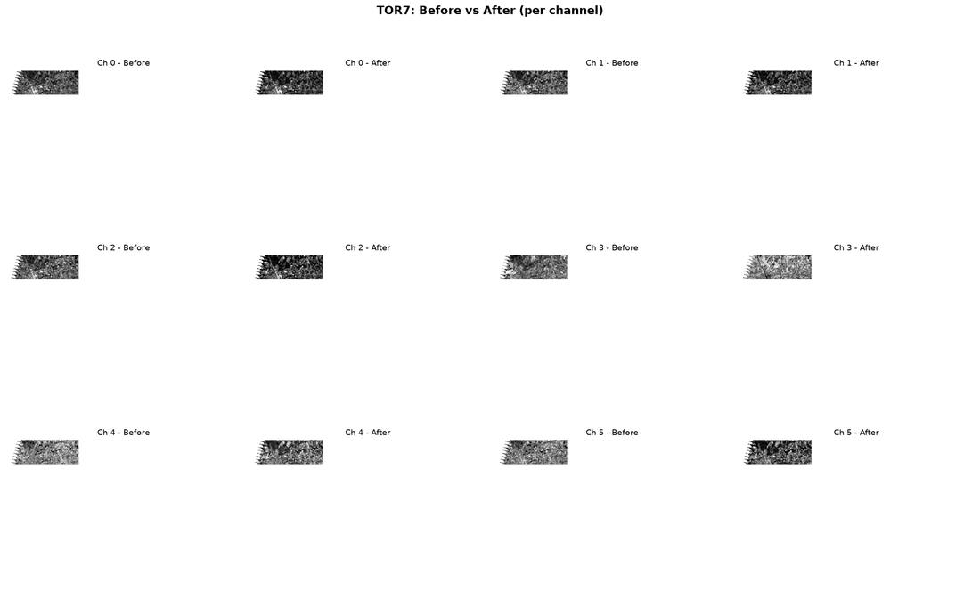
TOR7: Before vs After (per channel)

Slide 10
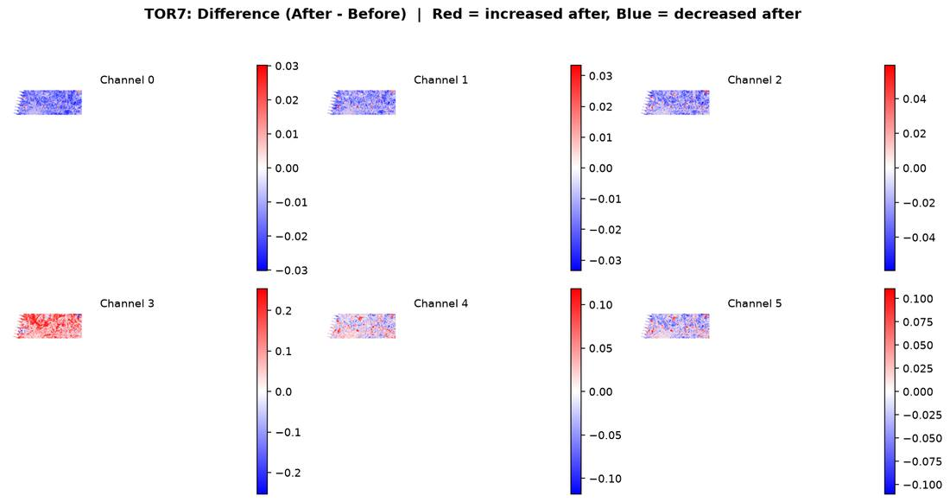
TOR7: Difference (After - Before)

Slide 11
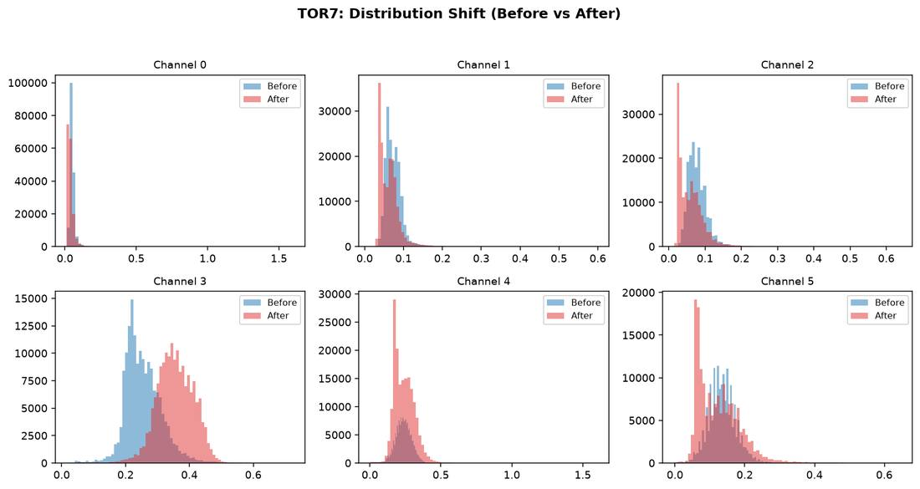
TOR7: Distribution Shift

Slide 12
TOR7: Interpretation
Readable coverage: 4.1% of the scene has usable BEFORE+AFTER data (the rest is corrupted/unreadable source imagery, excluded from every statistic).
5 of 6 channels show higher variance after the event than before.
Channel 3 shows the largest mean shift (+0.0995), making it the most informative single channel for this case.
Average AFTER cross-channel correlation is +0.41 - channels are not all moving together (richer, more independent signal across bands).

Slide 13
TOR10: Dataset Statistics
TOR10_BEST_BEFORE_win25d.tif
TOR10_BEST_AFTER_win10d.tif
Grid: 1301 x 2735 Channels: 6 dtype: float32
Readable - Before: 5.5% After: 5.5% Both: 5.5%
Ch | Before min/max | Before mean/std | After min/max | After mean/std
0 | 0.0137 / 0.2355 | 0.0431 / 0.0073 | 0.0106 / 0.2123 | 0.0253 / 0.0091
1 | 0.0174 / 0.2688 | 0.0613 / 0.0118 | 0.0183 / 0.2577 | 0.0504 / 0.0136
2 | 0.0160 / 0.2766 | 0.0735 / 0.0164 | 0.0173 / 0.2775 | 0.0374 / 0.0209
3 | 0.0149 / 0.5341 | 0.1982 / 0.0480 | 0.0337 / 0.5542 | 0.3755 / 0.0537
4 | 0.0092 / 0.4833 | 0.2477 / 0.0511 | 0.0050 / 0.4951 | 0.1743 / 0.0412
5 | -0.0013 / 0.4301 | 0.1520 / 0.0375 | 0.0016 / 0.4098 | 0.0741 / 0.0352
AFTER channel correlation:
+1.00 +0.92 +0.94 -0.50 +0.83 +0.90
+0.92 +1.00 +0.95 -0.40 +0.85 +0.88
+0.94 +0.95 +1.00 -0.55 +0.86 +0.94
-0.50 -0.40 -0.55 +1.00 -0.22 -0.44
+0.83 +0.85 +0.86 -0.22 +1.00 +0.95
+0.90 +0.88 +0.94 -0.44 +0.95 +1.00

Slide 14
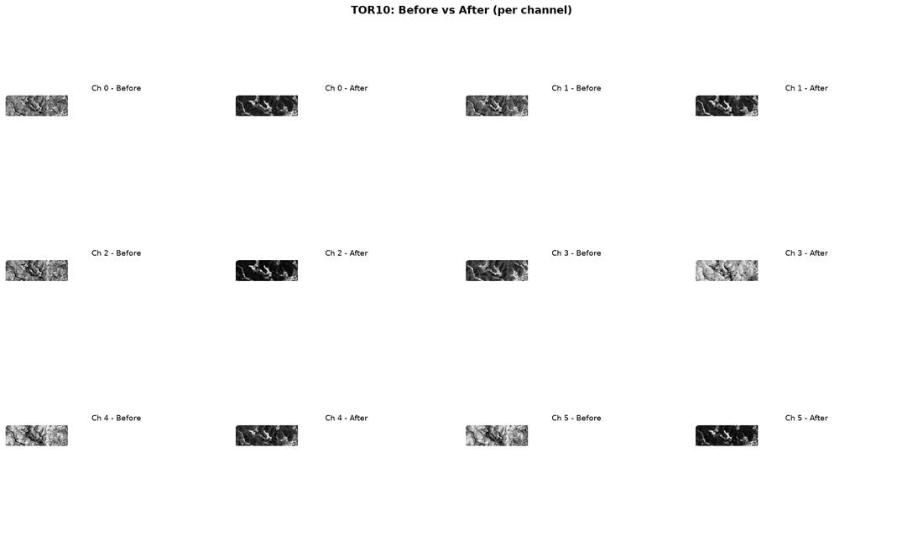
TOR10: Before vs After (per channel)

Slide 15
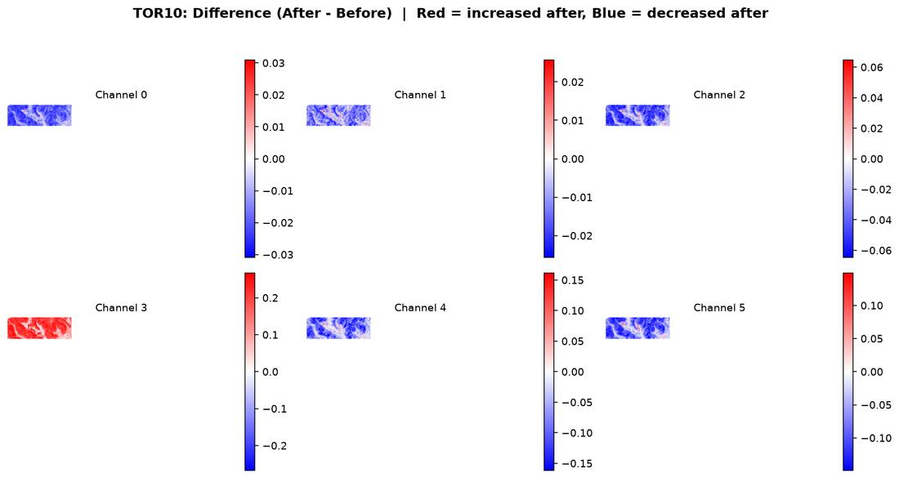
TOR10: Difference (After - Before)

Slide 16
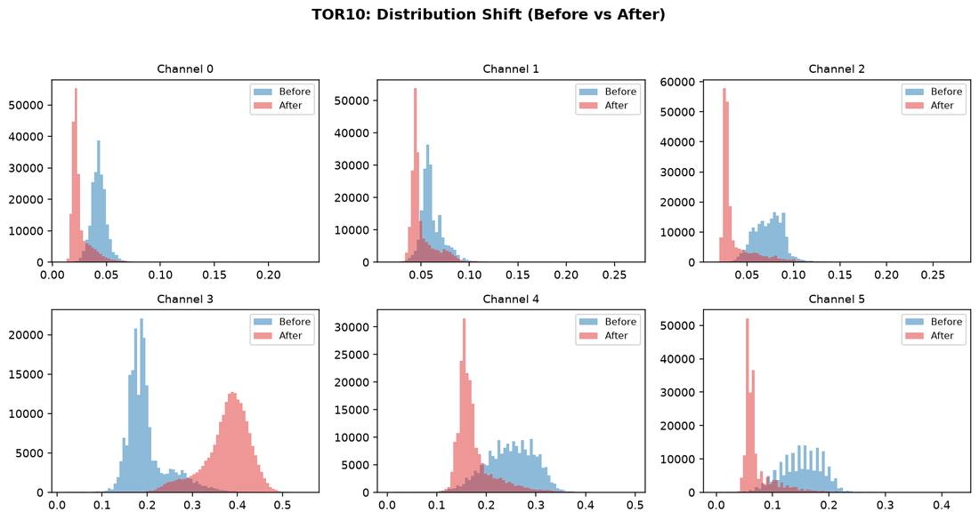
TOR10: Distribution Shift

Slide 17
TOR10: Interpretation
Readable coverage: 5.5% of the scene has usable BEFORE+AFTER data (the rest is corrupted/unreadable source imagery, excluded from every statistic).
4 of 6 channels show higher variance after the event than before.
Channel 3 shows the largest mean shift (+0.1773), making it the most informative single channel for this case.
Average AFTER cross-channel correlation is +0.46 - channels are not all moving together (richer, more independent signal across bands).

Slide 18
TOR11: Dataset Statistics
TOR11_BEST_BEFORE_win35d.tif
TOR11_BEST_AFTER_win35d.tif
Grid: 2299 x 4502 Channels: 6 dtype: float32
Readable - Before: 1.9% After: 2.5% Both: 1.9%
Ch | Before min/max | Before mean/std | After min/max | After mean/std
0 | 0.0169 / 0.2065 | 0.0396 / 0.0093 | 0.0096 / 1.6022 | 0.0241 / 0.0088
1 | 0.0258 / 0.2668 | 0.0556 / 0.0136 | 0.0158 / 0.3420 | 0.0455 / 0.0129
2 | 0.0249 / 0.3037 | 0.0625 / 0.0200 | 0.0153 / 0.4165 | 0.0356 / 0.0189
3 | 0.0285 / 0.4792 | 0.2008 / 0.0292 | 0.0296 / 0.5961 | 0.3479 / 0.0574
4 | 0.0114 / 0.5135 | 0.1944 / 0.0588 | 0.0045 / 0.5512 | 0.1642 / 0.0478
5 | 0.0020 / 0.3980 | 0.1101 / 0.0425 | 0.0015 / 0.4403 | 0.0682 / 0.0360
AFTER channel correlation:
+1.00 +0.88 +0.90 -0.19 +0.80 +0.86
+0.88 +1.00 +0.94 -0.03 +0.89 +0.91
+0.90 +0.94 +1.00 -0.25 +0.85 +0.94
-0.19 -0.03 -0.25 +1.00 +0.11 -0.13
+0.80 +0.89 +0.85 +0.11 +1.00 +0.95
+0.86 +0.91 +0.94 -0.13 +0.95 +1.00

Slide 19
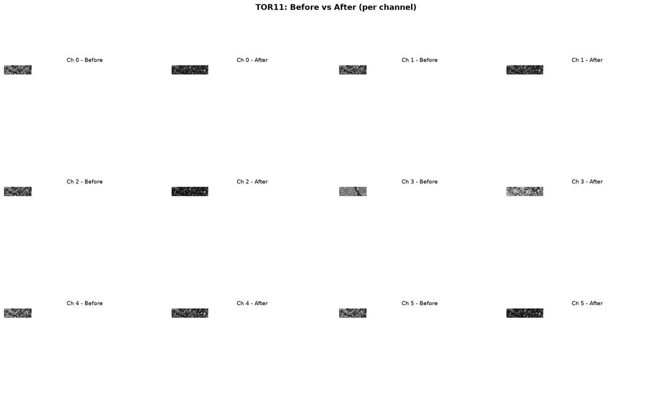
TOR11: Before vs After (per channel)

Slide 20
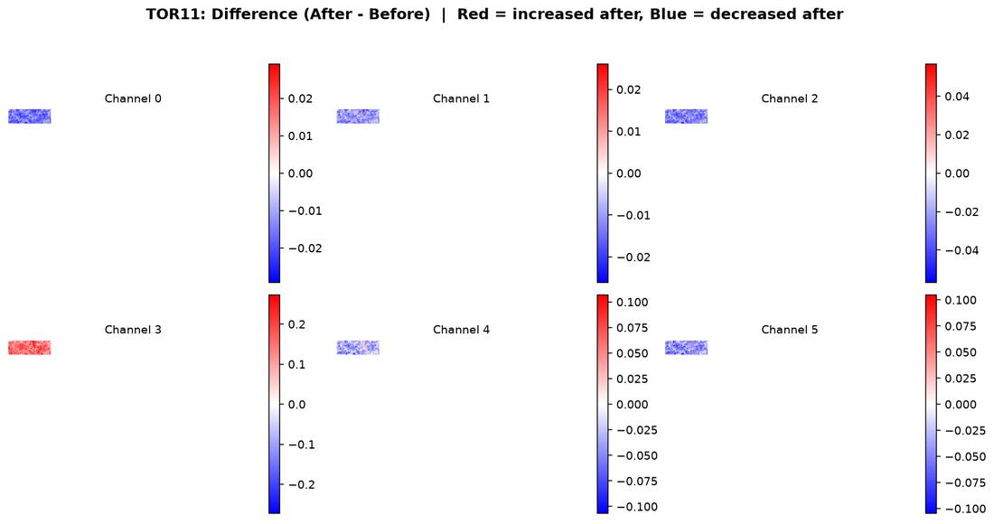
TOR11: Difference (After - Before)

Slide 21
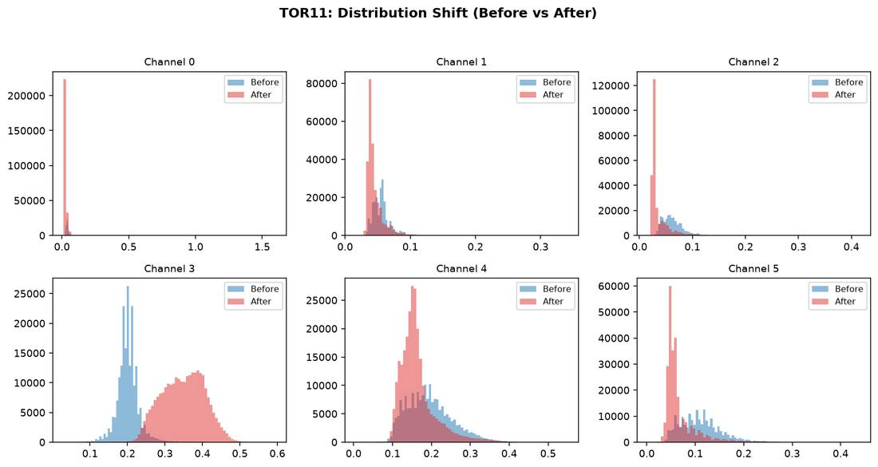
TOR11: Distribution Shift

Slide 22
TOR11: Interpretation
Readable coverage: 1.9% of the scene has usable BEFORE+AFTER data (the rest is corrupted/unreadable source imagery, excluded from every statistic).
1 of 6 channels show higher variance after the event than before.
Channel 3 shows the largest mean shift (+0.1471), making it the most informative single channel for this case.
Average AFTER cross-channel correlation is +0.56 - channels are not all moving together (richer, more independent signal across bands).

Slide 23
TOR12: Dataset Statistics
TOR12_BEST_BEFORE_win25d.tif
TOR12_BEST_AFTER_win10d.tif
Grid: 1089 x 1601 Channels: 6 dtype: float32
Readable - Before: 15.0% After: 11.2% Both: 11.2%
Ch | Before min/max | Before mean/std | After min/max | After mean/std
0 | 0.0141 / 1.6022 | 0.0429 / 0.0136 | 0.0100 / 0.2461 | 0.0253 / 0.0097
1 | 0.0213 / 0.5740 | 0.0602 / 0.0142 | 0.0195 / 0.2806 | 0.0512 / 0.0131
2 | 0.0161 / 0.6103 | 0.0734 / 0.0197 | 0.0101 / 0.3493 | 0.0368 / 0.0201
3 | 0.0111 / 0.6716 | 0.1930 / 0.0528 | 0.0208 / 0.5954 | 0.3790 / 0.0515
4 | -0.0009 / 0.5371 | 0.2446 / 0.0608 | 0.0099 / 1.6022 | 0.1737 / 0.0404
5 | -0.0049 / 0.5765 | 0.1514 / 0.0438 | 0.0049 / 0.7087 | 0.0733 / 0.0337
AFTER channel correlation:
+1.00 +0.92 +0.95 -0.44 +0.82 +0.90
+0.92 +1.00 +0.94 -0.33 +0.85 +0.89
+0.95 +0.94 +1.00 -0.50 +0.84 +0.94
-0.44 -0.33 -0.50 +1.00 -0.14 -0.38
+0.82 +0.85 +0.84 -0.14 +1.00 +0.95
+0.90 +0.89 +0.94 -0.38 +0.95 +1.00

Slide 24
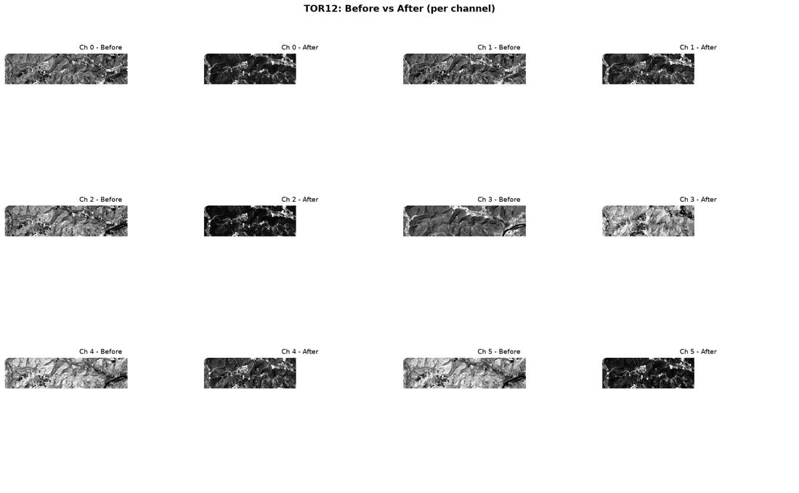
TOR12: Before vs After (per channel)

Slide 25
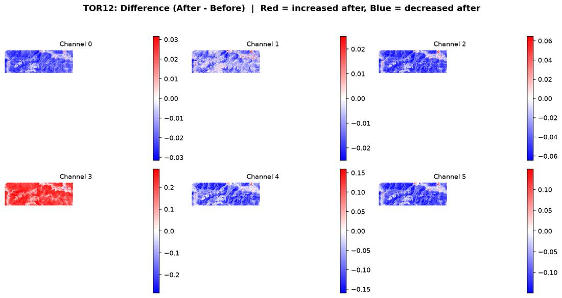
TOR12: Difference (After - Before)

Slide 26
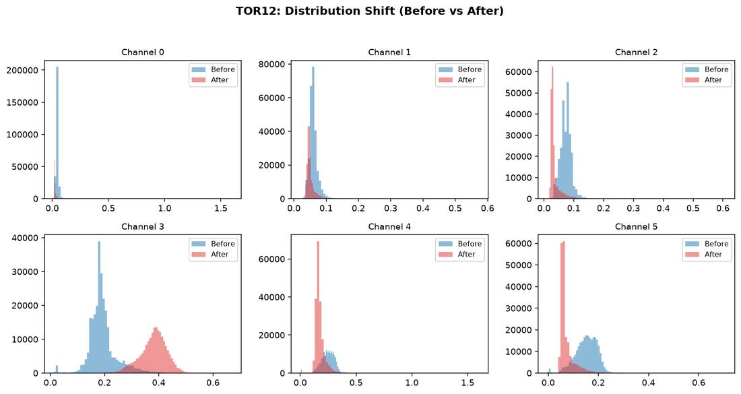
TOR12: Distribution Shift

Slide 27
TOR12: Interpretation
Readable coverage: 11.2% of the scene has usable BEFORE+AFTER data (the rest is corrupted/unreadable source imagery, excluded from every statistic).
1 of 6 channels show higher variance after the event than before.
Channel 3 shows the largest mean shift (+0.1860), making it the most informative single channel for this case.
Average AFTER cross-channel correlation is +0.48 - channels are not all moving together (richer, more independent signal across bands).

Slide 28
TOR13: Dataset Statistics
TOR13_BEST_BEFORE_win25d.tif
TOR13_BEST_AFTER_win10d.tif
Grid: 1461 x 1768 Channels: 6 dtype: float32
Readable - Before: 7.6% After: 7.6% Both: 7.6%
Ch | Before min/max | Before mean/std | After min/max | After mean/std
0 | 0.0084 / 0.3570 | 0.0392 / 0.0108 | 0.0081 / 1.6022 | 0.0298 / 0.0133
1 | 0.0136 / 0.3950 | 0.0587 / 0.0162 | 0.0141 / 0.4099 | 0.0527 / 0.0181
2 | 0.0127 / 0.4381 | 0.0622 / 0.0226 | 0.0120 / 0.4163 | 0.0451 / 0.0256
3 | 0.0075 / 0.5927 | 0.1988 / 0.0884 | 0.0127 / 0.5594 | 0.3020 / 0.1105
4 | -0.0033 / 1.6022 | 0.1886 / 0.0848 | -0.0021 / 1.6022 | 0.1615 / 0.0763
5 | -0.0052 / 0.6639 | 0.1077 / 0.0532 | -0.0081 / 1.6022 | 0.0764 / 0.0496
AFTER channel correlation:
+1.00 +0.87 +0.87 -0.01 +0.59 +0.74
+0.87 +1.00 +0.94 +0.21 +0.77 +0.86
+0.87 +0.94 +1.00 +0.03 +0.73 +0.88
-0.01 +0.21 +0.03 +1.00 +0.63 +0.36
+0.59 +0.77 +0.73 +0.63 +1.00 +0.94
+0.74 +0.86 +0.88 +0.36 +0.94 +1.00

Slide 29
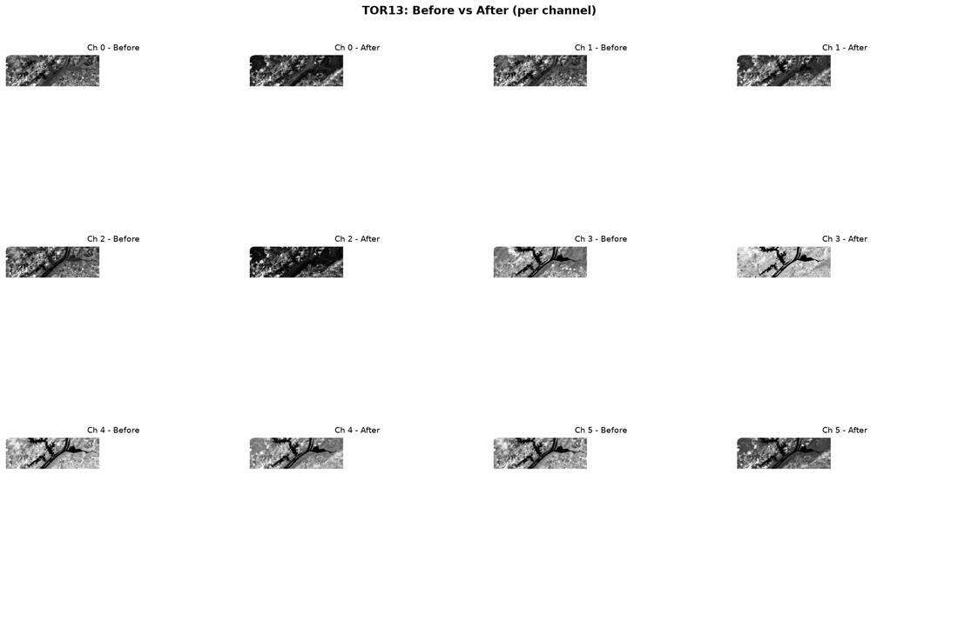
TOR13: Before vs After (per channel)

Slide 30
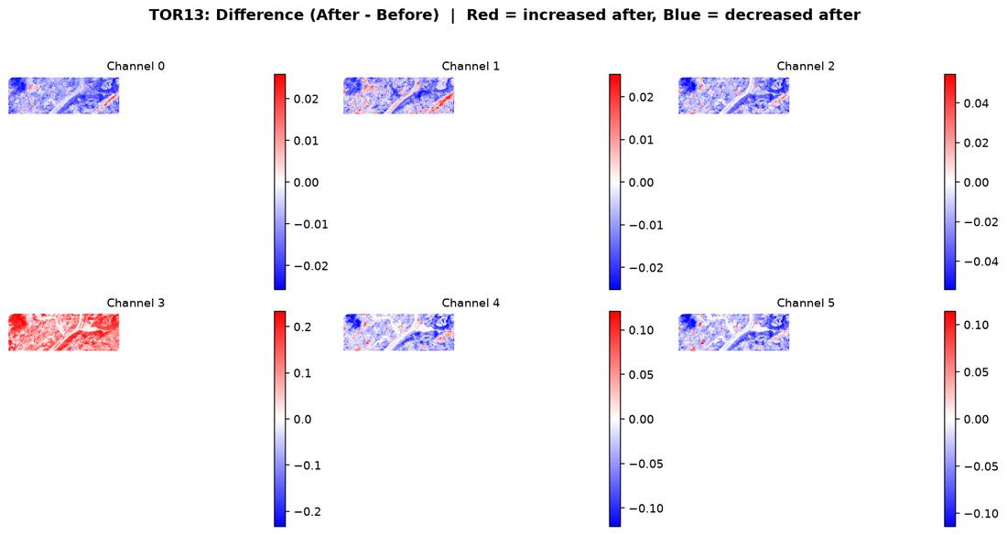
TOR13: Difference (After - Before)

Slide 31
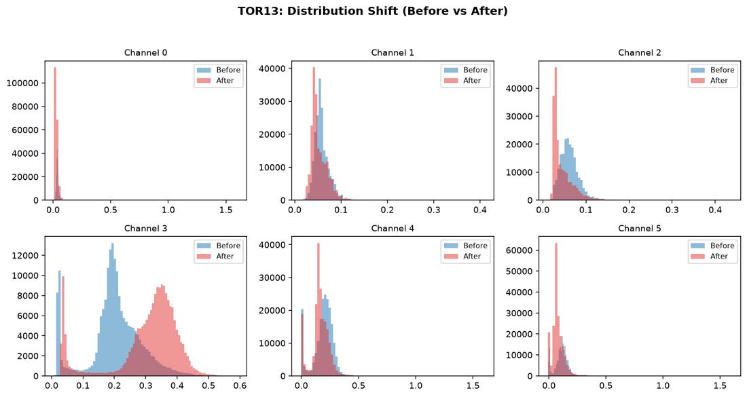
TOR13: Distribution Shift

Slide 32
TOR13: Interpretation
Readable coverage: 7.6% of the scene has usable BEFORE+AFTER data (the rest is corrupted/unreadable source imagery, excluded from every statistic).
4 of 6 channels show higher variance after the event than before.
Channel 3 shows the largest mean shift (+0.1031), making it the most informative single channel for this case.
Average AFTER cross-channel correlation is +0.63 - channels are moving together (simple, mostly redundant signal).

Slide 33
TOR15: Dataset Statistics
TOR15_BEST_BEFORE_win25d.tif
TOR15_BEST_AFTER_win45d.tif
Grid: 1189 x 2566 Channels: 6 dtype: float32
Readable - Before: 8.6% After: 6.4% Both: 6.4%
Ch | Before min/max | Before mean/std | After min/max | After mean/std
0 | 0.0146 / 1.6022 | 0.0373 / 0.0185 | 0.0136 / 1.6022 | 0.0285 / 0.0098
1 | 0.0200 / 0.6350 | 0.0564 / 0.0154 | 0.0232 / 0.6532 | 0.0486 / 0.0132
2 | 0.0185 / 0.6689 | 0.0618 / 0.0208 | 0.0190 / 0.5920 | 0.0422 / 0.0207
3 | 0.0112 / 0.7458 | 0.2070 / 0.0368 | 0.0389 / 0.7788 | 0.3294 / 0.0534
4 | -0.0032 / 1.6022 | 0.2046 / 0.0566 | 0.0110 / 1.6022 | 0.1739 / 0.0533
5 | -0.0013 / 0.7181 | 0.1124 / 0.0399 | 0.0079 / 1.6022 | 0.0768 / 0.0402
AFTER channel correlation:
+1.00 +0.90 +0.88 -0.23 +0.77 +0.85
+0.90 +1.00 +0.96 -0.16 +0.88 +0.93
+0.88 +0.96 +1.00 -0.30 +0.89 +0.95
-0.23 -0.16 -0.30 +1.00 -0.02 -0.21
+0.77 +0.88 +0.89 -0.02 +1.00 +0.96
+0.85 +0.93 +0.95 -0.21 +0.96 +1.00

Slide 34
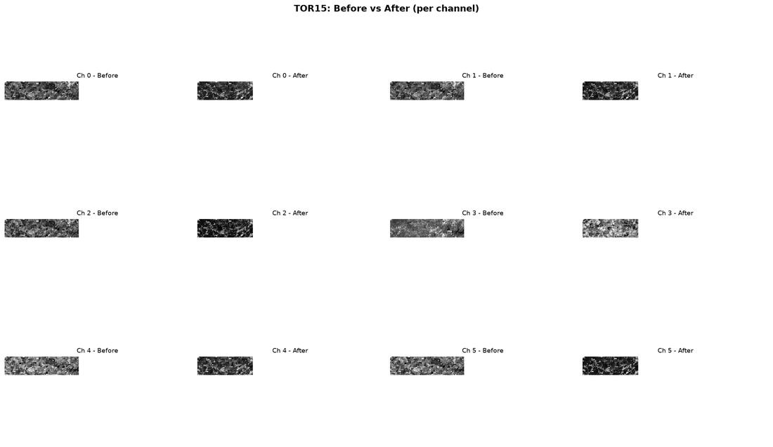
TOR15: Before vs After (per channel)

Slide 35
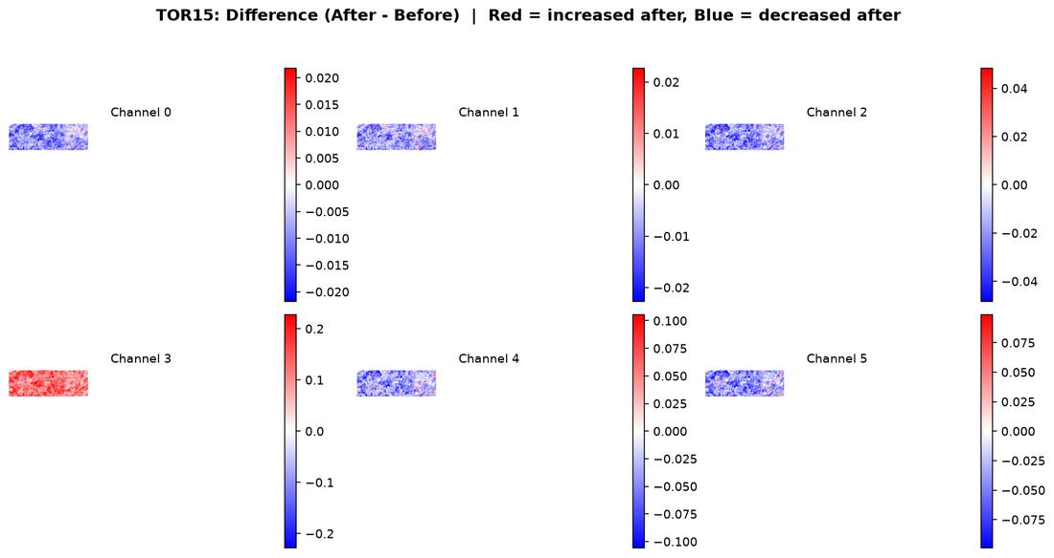
TOR15: Difference (After - Before)

Slide 36
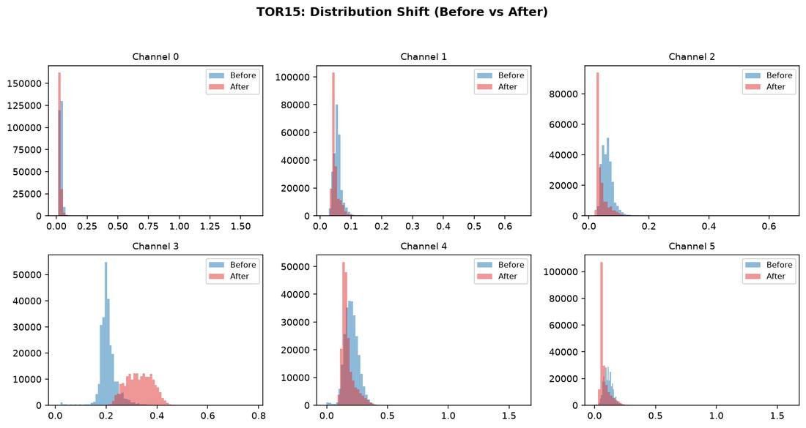
TOR15: Distribution Shift

Slide 37
TOR15: Interpretation
Readable coverage: 6.4% of the scene has usable BEFORE+AFTER data (the rest is corrupted/unreadable source imagery, excluded from every statistic).
2 of 6 channels show higher variance after the event than before.
Channel 3 shows the largest mean shift (+0.1224), making it the most informative single channel for this case.
Average AFTER cross-channel correlation is +0.54 - channels are not all moving together (richer, more independent signal across bands).

Slide 38
TOR16: Dataset Statistics
TOR16_BEST_BEFORE_win20d.tif
TOR16_BEST_AFTER_win15d.tif
Grid: 1174 x 4207 Channels: 6 dtype: float32
Readable - Before: 4.0% After: 3.6% Both: 1.1%
Ch | Before min/max | Before mean/std | After min/max | After mean/std
0 | -0.0460 / 0.5452 | 0.0267 / 0.0225 | -0.1982 / 0.5135 | 0.0312 / 0.0243
1 | -0.0184 / 0.6119 | 0.0323 / 0.0260 | -0.1922 / 0.5809 | 0.0397 / 0.0280
2 | 0.0091 / 0.6879 | 0.0501 / 0.0320 | -0.0398 / 0.6725 | 0.0630 / 0.0345
3 | 0.0086 / 0.7437 | 0.0586 / 0.0396 | -0.0072 / 0.7247 | 0.0692 / 0.0398
4 | -0.0056 / 0.7623 | 0.1995 / 0.0550 | -0.0123 / 0.7695 | 0.2299 / 0.0627
5 | -0.0006 / 0.4905 | 0.1081 / 0.0494 | 0.0005 / 0.8715 | 0.1294 / 0.0466
AFTER channel correlation:
+1.00 +0.99 +0.93 +0.93 +0.52 +0.58
+0.99 +1.00 +0.97 +0.96 +0.57 +0.62
+0.93 +0.97 +1.00 +0.98 +0.69 +0.68
+0.93 +0.96 +0.98 +1.00 +0.63 +0.76
+0.52 +0.57 +0.69 +0.63 +1.00 +0.60
+0.58 +0.62 +0.68 +0.76 +0.60 +1.00

Slide 39
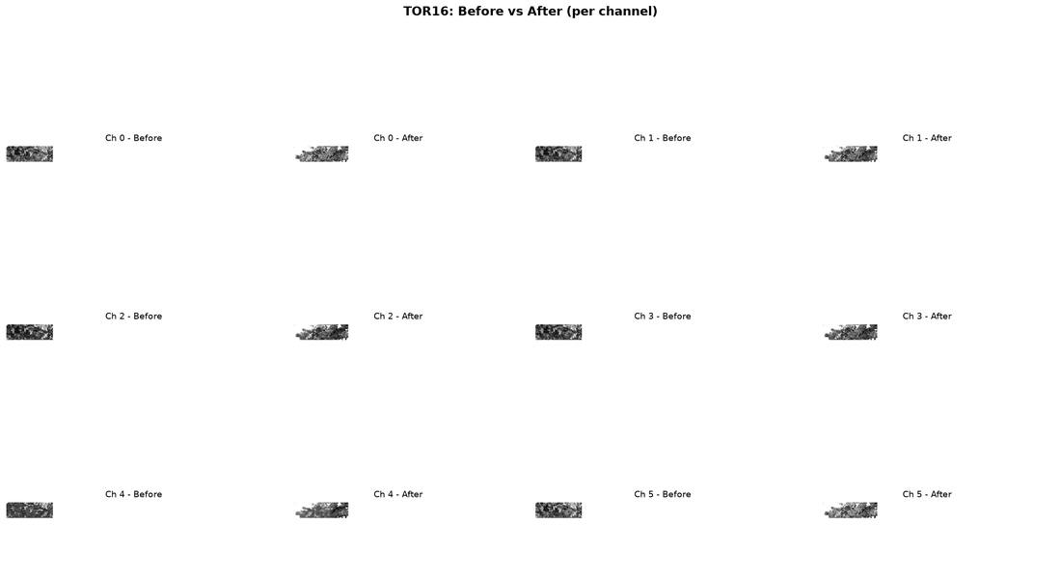
TOR16: Before vs After (per channel)

Slide 40
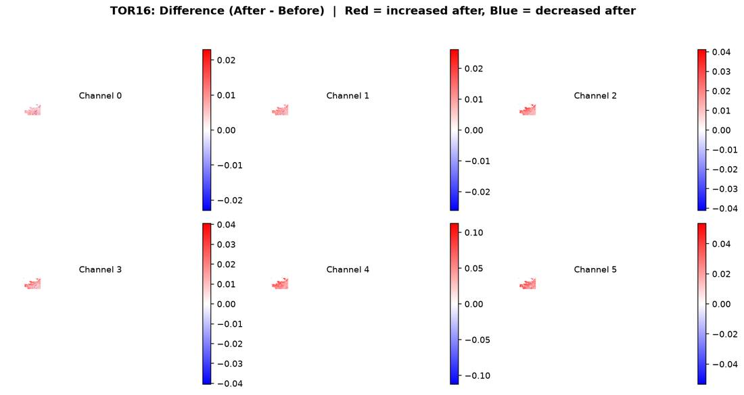
TOR16: Difference (After - Before)

Slide 41
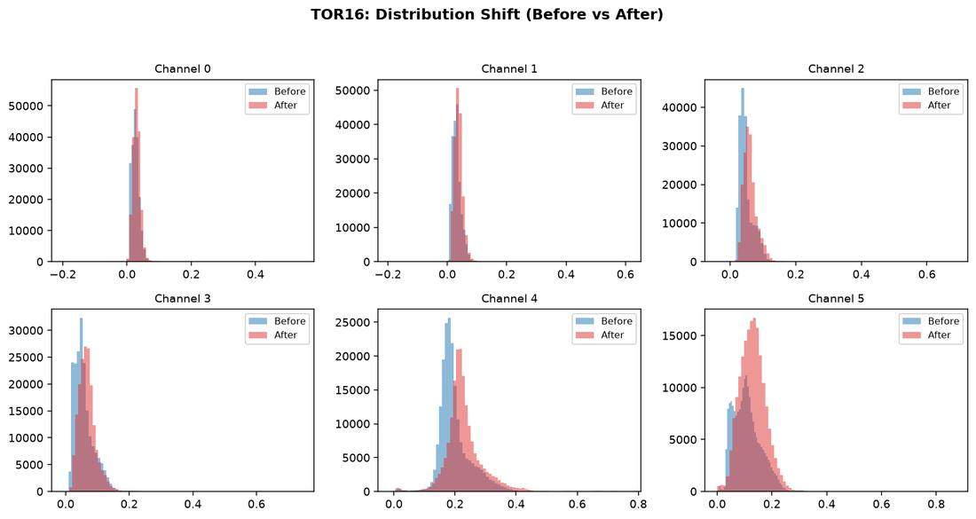
TOR16: Distribution Shift

Slide 42
TOR16: Interpretation
Readable coverage: 1.1% of the scene has usable BEFORE+AFTER data (the rest is corrupted/unreadable source imagery, excluded from every statistic).
5 of 6 channels show higher variance after the event than before.
Channel 4 shows the largest mean shift (+0.0304), making it the most informative single channel for this case.
Average AFTER cross-channel correlation is +0.76 - channels are moving together (simple, mostly redundant signal).

Slide 43
TOR18: Dataset Statistics
TOR18_BEST_BEFORE_win20d.tif
TOR18_BEST_AFTER_win20d.tif
Grid: 1600 x 2429 Channels: 6 dtype: float32
Readable - Before: 6.7% After: 6.7% Both: 6.7%
Ch | Before min/max | Before mean/std | After min/max | After mean/std
0 | 0.0110 / 0.1268 | 0.0266 / 0.0053 | 0.0158 / 0.1205 | 0.0299 / 0.0044
1 | 0.0339 / 0.1714 | 0.0514 / 0.0078 | 0.0275 / 0.1433 | 0.0465 / 0.0067
2 | 0.0188 / 0.2048 | 0.0339 / 0.0098 | 0.0168 / 0.1773 | 0.0334 / 0.0088
3 | 0.0495 / 0.5384 | 0.3583 / 0.0474 | 0.0660 / 0.5627 | 0.3695 / 0.0439
4 | 0.0081 / 0.4553 | 0.1650 / 0.0258 | 0.0055 / 0.4667 | 0.1748 / 0.0290
5 | 0.0043 / 0.3135 | 0.0645 / 0.0167 | 0.0033 / 0.3347 | 0.0679 / 0.0198
AFTER channel correlation:
+1.00 +0.73 +0.75 -0.18 +0.46 +0.62
+0.73 +1.00 +0.86 -0.10 +0.66 +0.78
+0.75 +0.86 +1.00 -0.26 +0.64 +0.85
-0.18 -0.10 -0.26 +1.00 +0.43 +0.02
+0.46 +0.66 +0.64 +0.43 +1.00 +0.88
+0.62 +0.78 +0.85 +0.02 +0.88 +1.00

Slide 44

TOR18: Before vs After (per channel)

Slide 45
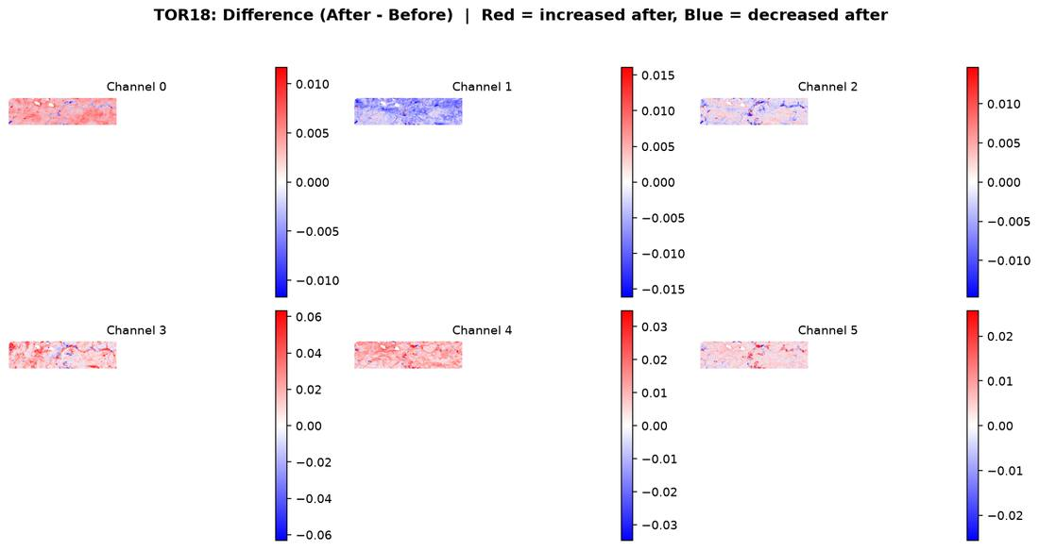
TOR18: Difference (After - Before)

Slide 46
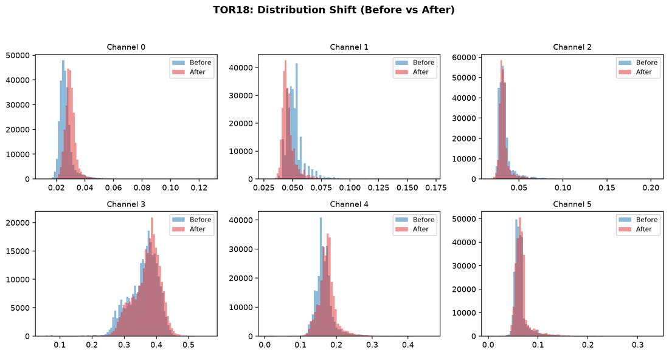
TOR18: Distribution Shift

Slide 47
TOR18: Interpretation
Readable coverage: 6.7% of the scene has usable BEFORE+AFTER data (the rest is corrupted/unreadable source imagery, excluded from every statistic).
2 of 6 channels show higher variance after the event than before.
Channel 3 shows the largest mean shift (+0.0112), making it the most informative single channel for this case.
Average AFTER cross-channel correlation is +0.48 - channels are not all moving together (richer, more independent signal across bands).

Slide 48
TOR24: Dataset Statistics
TOR24_BEST_BEFORE_win5d.tif
TOR24_BEST_AFTER_win10d.tif
Grid: 310 x 947 Channels: 6 dtype: float32
Readable - Before: 66.9% After: 66.9% Both: 66.9%
Ch | Before min/max | Before mean/std | After min/max | After mean/std
0 | -0.1927 / 0.5137 | 0.0263 / 0.0207 | -0.1949 / 0.5148 | 0.0264 / 0.0223
1 | -0.1923 / 0.5689 | 0.0320 / 0.0238 | -0.1823 / 0.5689 | 0.0314 / 0.0259
2 | -0.1372 / 0.6464 | 0.0547 / 0.0289 | -0.1698 / 0.6487 | 0.0559 / 0.0317
3 | -0.1471 / 0.7024 | 0.0538 / 0.0377 | -0.1225 / 0.7078 | 0.0531 / 0.0422
4 | 0.0030 / 0.7490 | 0.2318 / 0.0358 | 0.0079 / 0.7397 | 0.2509 / 0.0404
5 | 0.0026 / 0.5739 | 0.1091 / 0.0701 | 0.0041 / 0.5834 | 0.1085 / 0.0785
AFTER channel correlation:
+1.00 +1.00 +0.97 +0.96 +0.50 +0.83
+1.00 +1.00 +0.98 +0.97 +0.50 +0.85
+0.97 +0.98 +1.00 +0.98 +0.59 +0.86
+0.96 +0.97 +0.98 +1.00 +0.49 +0.92
+0.50 +0.50 +0.59 +0.49 +1.00 +0.42
+0.83 +0.85 +0.86 +0.92 +0.42 +1.00

Slide 49
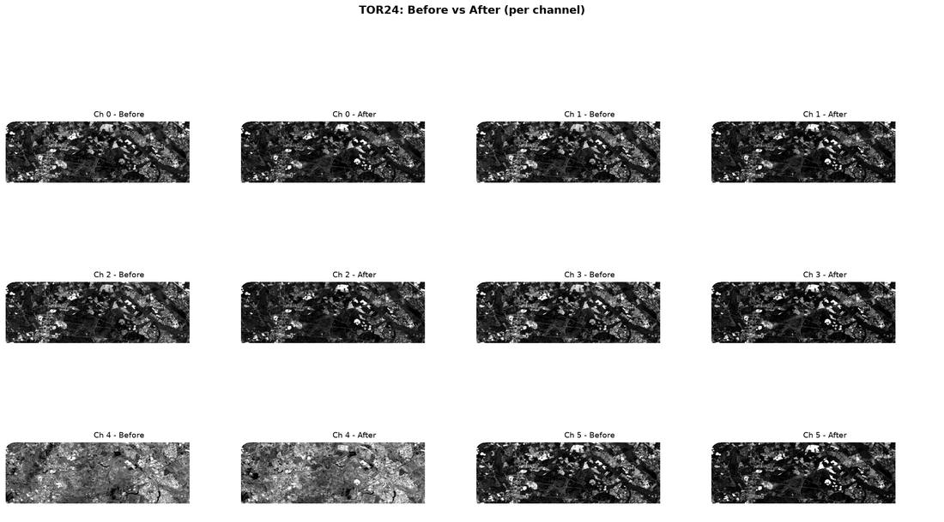
TOR24: Before vs After (per channel)

Slide 50
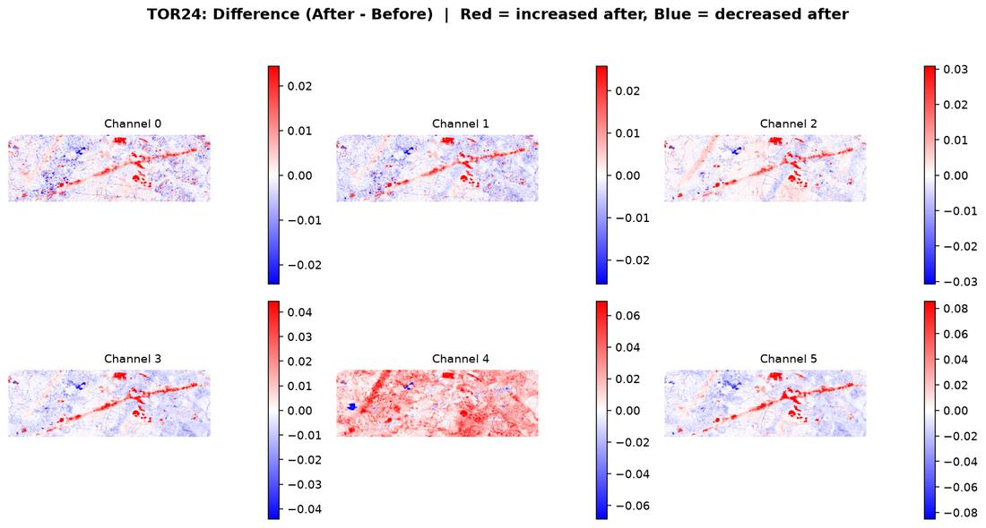
TOR24: Difference (After - Before)

Slide 51
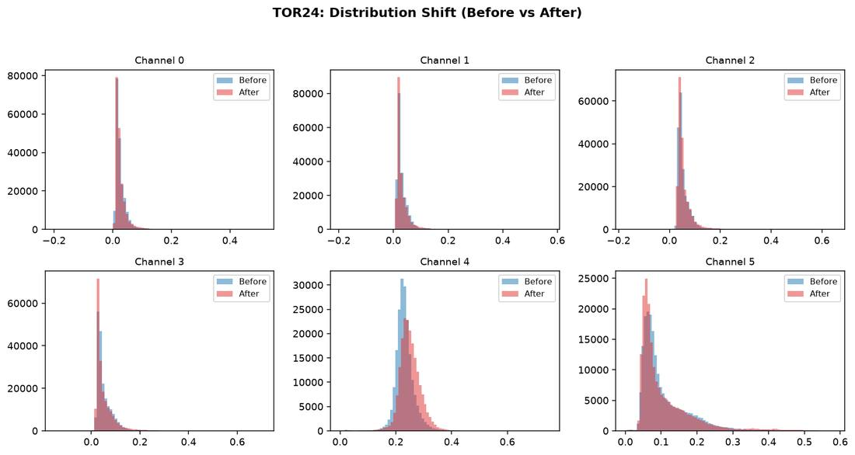
TOR24: Distribution Shift

Slide 52
TOR24: Interpretation
Readable coverage: 66.9% of the scene has usable BEFORE+AFTER data (the rest is corrupted/unreadable source imagery, excluded from every statistic).
6 of 6 channels show higher variance after the event than before.
Channel 4 shows the largest mean shift (+0.0191), making it the most informative single channel for this case.
Average AFTER cross-channel correlation is +0.79 - channels are moving together (simple, mostly redundant signal).

Slide 53
TOR61: Dataset Statistics
TOR61_BEST_BEFORE_win45d.tif
TOR61_BEST_AFTER_win40d.tif
Grid: 888 x 1607 Channels: 6 dtype: float32
Readable - Before: 13.7% After: 18.3% Both: 13.7%
Ch | Before min/max | Before mean/std | After min/max | After mean/std
0 | 0.0120 / 0.3386 | 0.0366 / 0.0119 | 0.0198 / 0.2403 | 0.0386 / 0.0092
1 | 0.0223 / 0.4284 | 0.0526 / 0.0179 | 0.0329 / 0.2969 | 0.0580 / 0.0144
2 | 0.0177 / 0.4389 | 0.0606 / 0.0242 | 0.0255 / 0.3371 | 0.0508 / 0.0233
3 | 0.0196 / 0.5784 | 0.1950 / 0.0471 | 0.0865 / 0.5022 | 0.3247 / 0.0451
4 | 0.0018 / 0.4826 | 0.1833 / 0.0691 | 0.0119 / 1.6022 | 0.1847 / 0.0738
5 | -0.0052 / 0.4346 | 0.1026 / 0.0462 | 0.0029 / 0.6424 | 0.0870 / 0.0587
AFTER channel correlation:
+1.00 +0.93 +0.93 -0.07 +0.82 +0.88
+0.93 +1.00 +0.97 -0.00 +0.89 +0.94
+0.93 +0.97 +1.00 -0.11 +0.89 +0.96
-0.07 -0.00 -0.11 +1.00 +0.10 -0.02
+0.82 +0.89 +0.89 +0.10 +1.00 +0.96
+0.88 +0.94 +0.96 -0.02 +0.96 +1.00

Slide 54
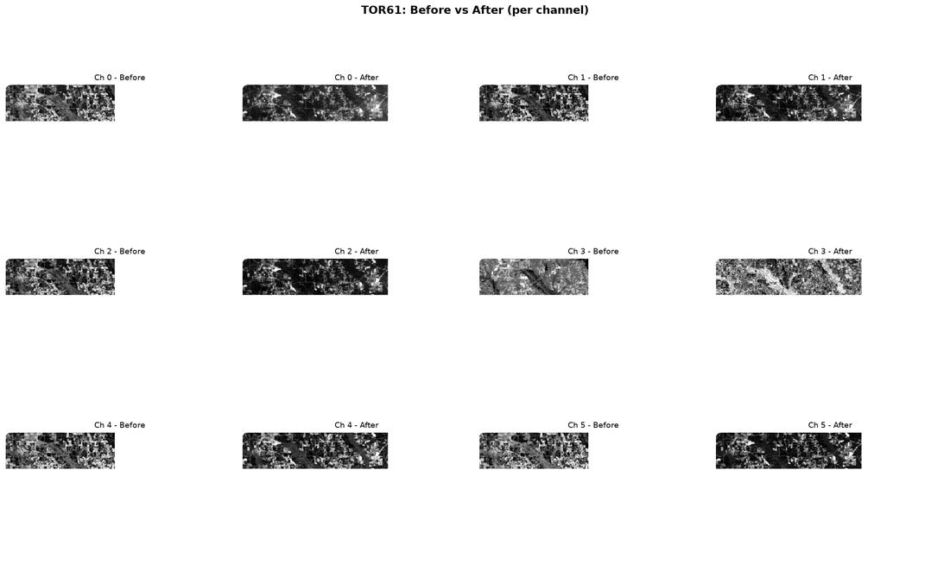
TOR61: Before vs After (per channel)

Slide 55
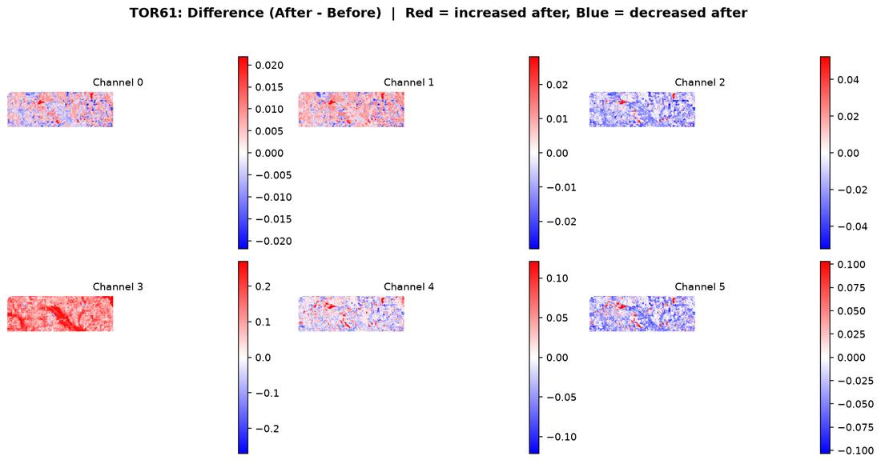
TOR61: Difference (After - Before)

Slide 56
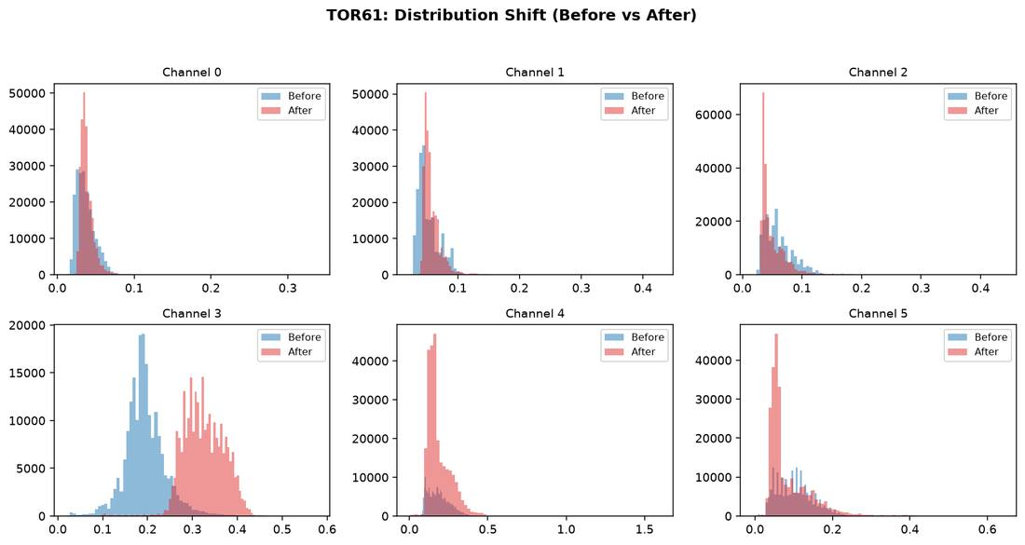
TOR61: Distribution Shift

Slide 57
TOR61: Interpretation
Readable coverage: 13.7% of the scene has usable BEFORE+AFTER data (the rest is corrupted/unreadable source imagery, excluded from every statistic).
2 of 6 channels show higher variance after the event than before.
Channel 3 shows the largest mean shift (+0.1297), making it the most informative single channel for this case.
Average AFTER cross-channel correlation is +0.60 - channels are moving together (simple, mostly redundant signal).

Slide 58
TOR62: Dataset Statistics
TOR62_BEST_BEFORE_win35d.tif
TOR62_BEST_AFTER_win35d.tif
Grid: 1096 x 2132 Channels: 6 dtype: float32
Readable - Before: 8.4% After: 8.4% Both: 8.4%
Ch | Before min/max | Before mean/std | After min/max | After mean/std
0 | 0.0180 / 0.4010 | 0.0496 / 0.0129 | 0.0121 / 1.6022 | 0.0298 / 0.0138
1 | 0.0265 / 0.4690 | 0.0665 / 0.0186 | 0.0199 / 0.4419 | 0.0529 / 0.0183
2 | 0.0235 / 0.5165 | 0.0751 / 0.0253 | 0.0162 / 0.4820 | 0.0431 / 0.0263
3 | 0.0172 / 0.6139 | 0.2142 / 0.0484 | 0.0288 / 0.6018 | 0.3690 / 0.0823
4 | -0.0007 / 0.5786 | 0.2185 / 0.0694 | 0.0003 / 1.6022 | 0.1854 / 0.0594
5 | -0.0103 / 0.8723 | 0.1293 / 0.0498 | -0.0027 / 0.6326 | 0.0824 / 0.0447
AFTER channel correlation:
+1.00 +0.90 +0.89 -0.25 +0.60 +0.76
+0.90 +1.00 +0.96 -0.17 +0.74 +0.87
+0.89 +0.96 +1.00 -0.30 +0.73 +0.89
-0.25 -0.17 -0.30 +1.00 +0.27 -0.04
+0.60 +0.74 +0.73 +0.27 +1.00 +0.93
+0.76 +0.87 +0.89 -0.04 +0.93 +1.00

Slide 59
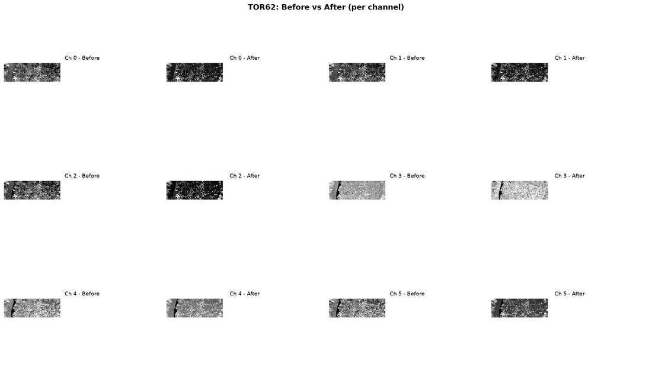
TOR62: Before vs After (per channel)

Slide 60
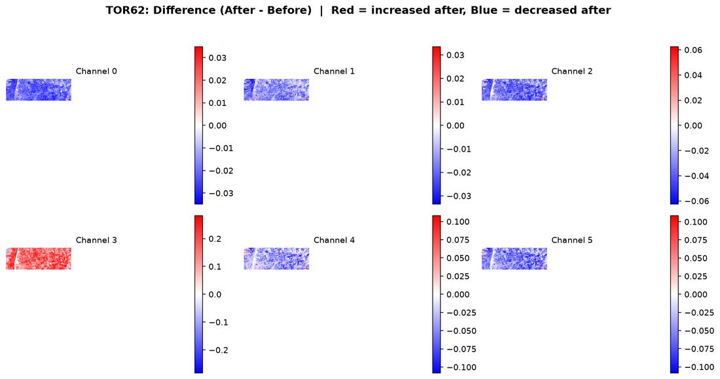
TOR62: Difference (After - Before)

Slide 61
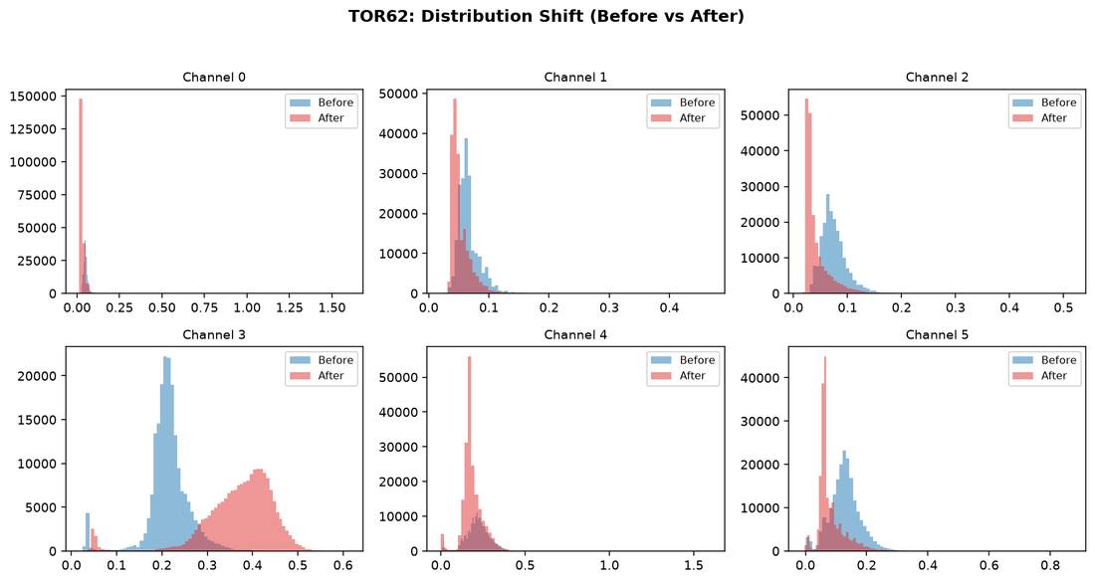
TOR62: Distribution Shift

Slide 62
TOR62: Interpretation
Readable coverage: 8.4% of the scene has usable BEFORE+AFTER data (the rest is corrupted/unreadable source imagery, excluded from every statistic).
3 of 6 channels show higher variance after the event than before.
Channel 3 shows the largest mean shift (+0.1548), making it the most informative single channel for this case.
Average AFTER cross-channel correlation is +0.52 - channels are not all moving together (richer, more independent signal across bands).

Slide 63
TOR66: Dataset Statistics
TOR66_BEST_BEFORE_win35d.tif
TOR66_BEST_AFTER_win50d.tif
Grid: 2124 x 4309 Channels: 6 dtype: float32
Readable - Before: 2.1% After: 2.1% Both: 2.1%
Ch | Before min/max | Before mean/std | After min/max | After mean/std
0 | -0.0185 / 0.2567 | 0.0286 / 0.0094 | -0.0205 / 0.2753 | 0.0392 / 0.0104
1 | -0.0052 / 0.2904 | 0.0331 / 0.0118 | -0.0038 / 0.2943 | 0.0453 / 0.0134
2 | 0.0107 / 0.3240 | 0.0519 / 0.0177 | 0.0095 / 0.3592 | 0.0636 / 0.0214
3 | 0.0047 / 0.3331 | 0.0617 / 0.0238 | 0.0052 / 0.4237 | 0.0791 / 0.0301
4 | -0.0141 / 0.5649 | 0.2088 / 0.0554 | -0.0114 / 0.5299 | 0.1964 / 0.0568
5 | -0.0030 / 0.4650 | 0.1186 / 0.0414 | -0.0051 / 0.5077 | 0.1551 / 0.0453
AFTER channel correlation:
+1.00 +0.94 +0.78 +0.81 +0.50 +0.81
+0.94 +1.00 +0.93 +0.94 +0.63 +0.86
+0.78 +0.93 +1.00 +0.98 +0.74 +0.81
+0.81 +0.94 +0.98 +1.00 +0.72 +0.87
+0.50 +0.63 +0.74 +0.72 +1.00 +0.72
+0.81 +0.86 +0.81 +0.87 +0.72 +1.00

Slide 64
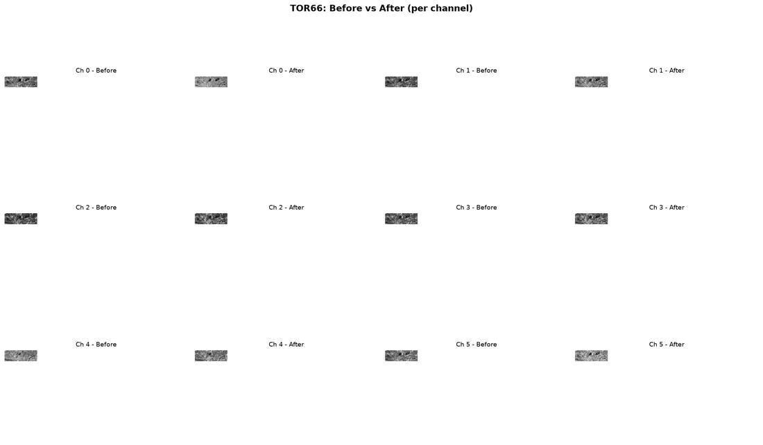
TOR66: Before vs After (per channel)

Slide 65
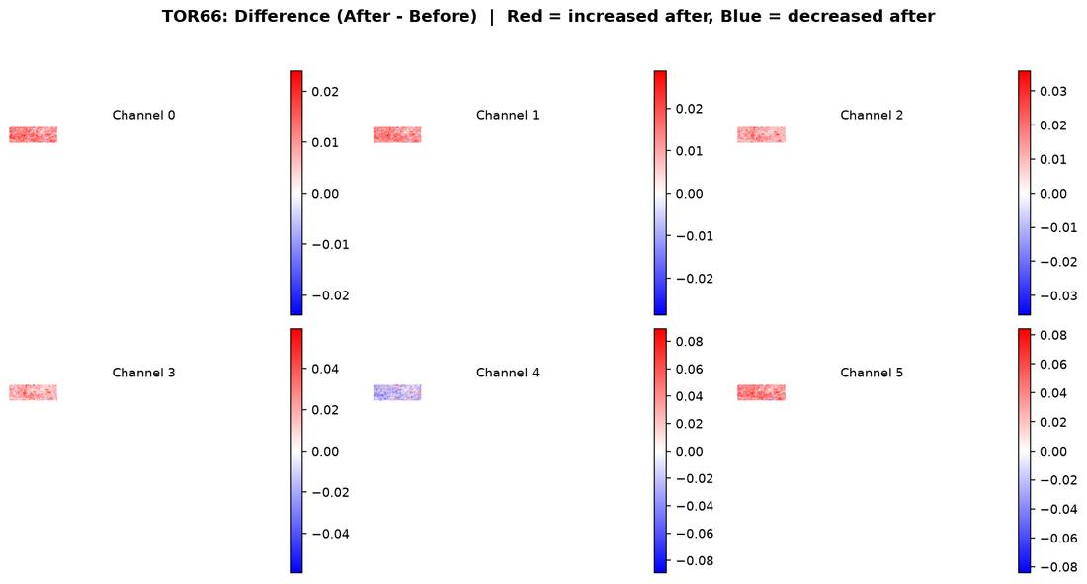
TOR66: Difference (After - Before)

Slide 66
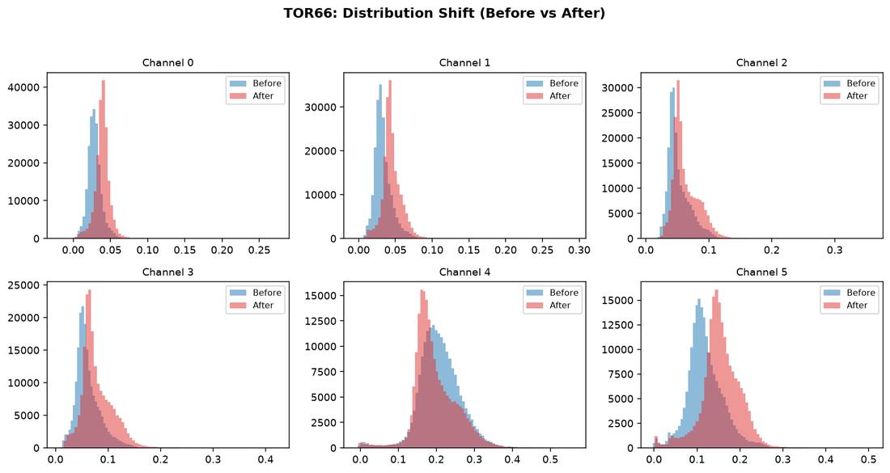
TOR66: Distribution Shift

Slide 67
TOR66: Interpretation
Readable coverage: 2.1% of the scene has usable BEFORE+AFTER data (the rest is corrupted/unreadable source imagery, excluded from every statistic).
6 of 6 channels show higher variance after the event than before.
Channel 5 shows the largest mean shift (+0.0364), making it the most informative single channel for this case.
Average AFTER cross-channel correlation is +0.80 - channels are moving together (simple, mostly redundant signal).

Slide 68
TOR68: Dataset Statistics
TOR68_BEST_BEFORE_win55d.tif
TOR68_BEST_AFTER_win30d.tif
Grid: 2324 x 3393 Channels: 6 dtype: float32
Readable - Before: 2.4% After: 2.5% Both: 2.4%
Ch | Before min/max | Before mean/std | After min/max | After mean/std
0 | -0.0402 / 0.1607 | 0.0165 / 0.0082 | -0.0152 / 0.2343 | 0.0201 / 0.0099
1 | -0.0120 / 0.1999 | 0.0209 / 0.0094 | -0.0127 / 0.2633 | 0.0229 / 0.0119
2 | 0.0072 / 0.2395 | 0.0378 / 0.0145 | 0.0107 / 0.2840 | 0.0467 / 0.0182
3 | 0.0041 / 0.2959 | 0.0381 / 0.0185 | 0.0031 / 0.3580 | 0.0331 / 0.0246
4 | -0.0075 / 0.5836 | 0.1892 / 0.0471 | -0.0054 / 0.6028 | 0.3341 / 0.0560
5 | -0.0027 / 0.3068 | 0.0719 / 0.0317 | -0.0031 / 0.4799 | 0.0728 / 0.0460
AFTER channel correlation:
+1.00 +0.98 +0.93 +0.92 +0.18 +0.94
+0.98 +1.00 +0.96 +0.97 +0.11 +0.96
+0.93 +0.96 +1.00 +0.96 +0.24 +0.95
+0.92 +0.97 +0.96 +1.00 +0.02 +0.97
+0.18 +0.11 +0.24 +0.02 +1.00 +0.13
+0.94 +0.96 +0.95 +0.97 +0.13 +1.00

Slide 69
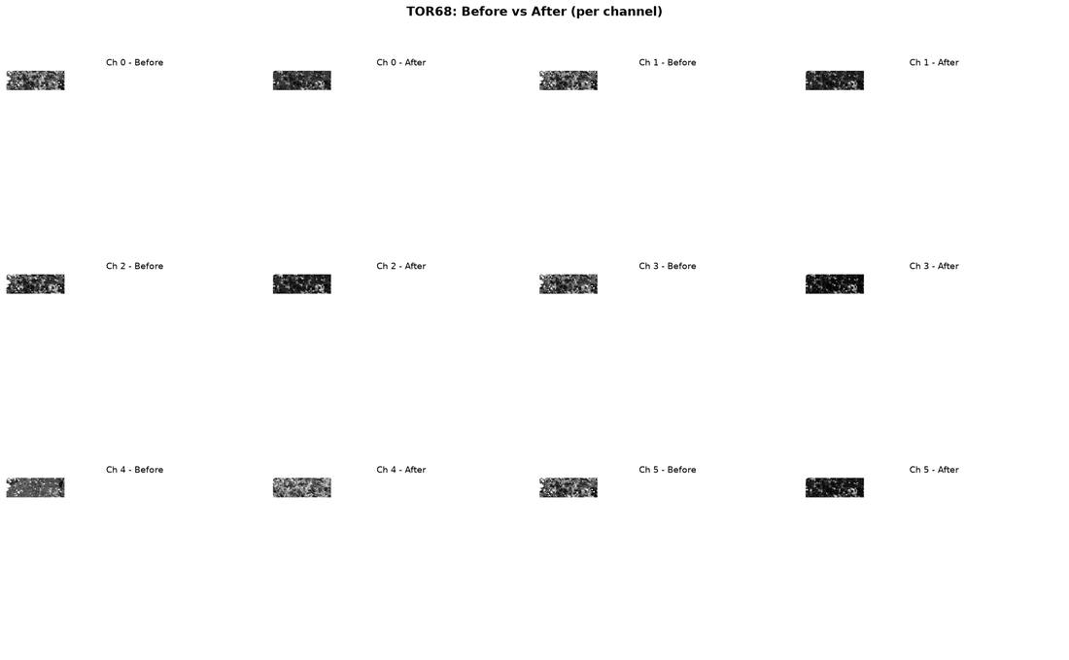
TOR68: Before vs After (per channel)

Slide 70
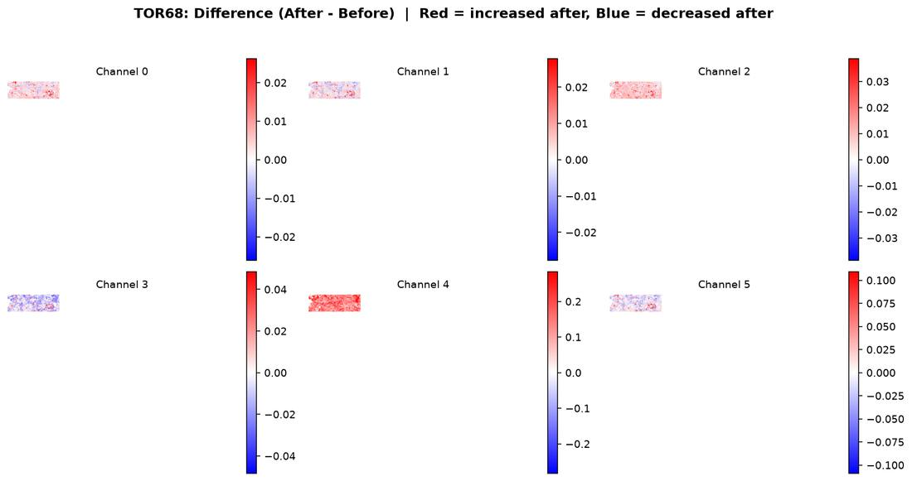
TOR68: Difference (After - Before)

Slide 71
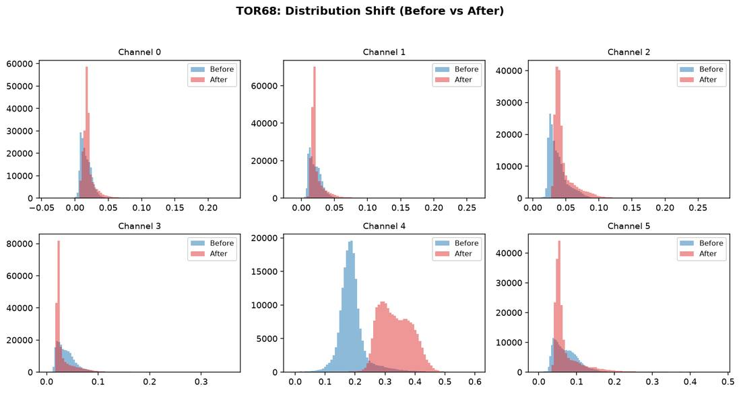
TOR68: Distribution Shift

Slide 72
TOR68: Interpretation
Readable coverage: 2.4% of the scene has usable BEFORE+AFTER data (the rest is corrupted/unreadable source imagery, excluded from every statistic).
6 of 6 channels show higher variance after the event than before.
Channel 4 shows the largest mean shift (+0.1449), making it the most informative single channel for this case.
Average AFTER cross-channel correlation is +0.68 - channels are moving together (simple, mostly redundant signal).

