Slide 1
CRM
An Introduction
Bryan Neville
Aviation Safety Inspector
Salt Lake City FSDO

Slide 2
CRM
The application of personal and team management concepts to enhance the safe operation of aircraft, both on the ground and in the air.
CRM includes not only the pilots, but the entire aircrew, ground crew, and all others who work together to operate the aircraft safely.

Slide 3
TCRM
Total Company Resource Management
  Management needs to be sensitive to and participate in human factors training for everyone involved with the operation of aircraft.
  CRM principles need to become part of the company philosophy.

Slide 4
Basic Concepts of CRM
Lasting Behavior Changes Take Time
Crewmembers are teams, not a collection of competent individuals
Behavior should foster crew effectiveness
There must be opportunities to practice
CRM is a normal behavior
    CRM is not just an emergency procedure

Slide 5

What is right, not who is right!
Understand why people do what they do.
Predict your performance.
Control your performance.

Slide 6
CRM Training Includes:
Team Building
Self Assessment
Information Transfer
Problem Solving (Conflict Resolution)
Decision Making
Maintaining Situational Awareness
Use of Automated Systems

Slide 7
Risk Factors
The People
  Pilots
  Mechanics
  Management
  Air Traffic Control
The Aircraft
The Environment
The Situation

Slide 8
High Risk Situations
Taking off with a known problem
Controlled flight into terrain
Unstabilized approach
Deviation from Standard Operating Procedure
Weather
Complacency

Slide 9

Pilot Workload

Slide 10
Percent of Accidents
Load, Taxi, Unload
Takeoff
Initial Climb
Climb
Cruise
Descent
Initial Approach
Final Approach
Landing
3.1%
12.2%
9.4%
6.4%
5.5%
7.6%
7.2%
22.9%
25.7%

Slide 11
Managing Risk
Supervision - Type, Quality, Quantity
Planning - Requires time
Crew Selection - Experience and Composition
Crew Fitness - Physical & Mental State
Environment - Physical Environment; Organizational Culture
Complexity - Mission, Job Task, Work Function

Slide 12
The Accident Sequence
Underlying Cause =
Basic Cause =
Immediate Cause =
Safety Defenses =
Consequences =
Management
System
Individual
Countermeasures
Accident, Incident, Close Call

Slide 13
Management
Planning: Defines organizational goals, and strategies for achieving those goals.
Organizing: Company structure
Directing: Motivating, directing, selecting
Controlling: Ensuring things are going as they should, including periodic evaluation
Staffing: Sufficient qualified individuals

Slide 14
Operating System
Task arrangement, demands on people, communications, time aspects
Material design, equipment, supplies
Work environment, sociological environment, weather, material assets
Training: Initial, Update, Remedial
People selection and motivation

Slide 15
Individual
Didn’t follow instructions
Blundered ahead without knowing how
Bypassed/ignored a rule or procedure
Failed to use protective equipment
Didn’t think ahead to consequences
Used the wrong equipment
        (continued on next slide)

Slide 16
Individual (continued)
Used equipment that needed repair
Didn’t look
Didn’t listen
Didn’t recognize limitations
Failed to use safeguards
Didn’t pay attention

Slide 17
Overconfidence
That funny feeling you get just before you know you’re wrong!
    Generally verbalized on the cockpit voice recorder with the words “Oh, s---!”)

Slide 18
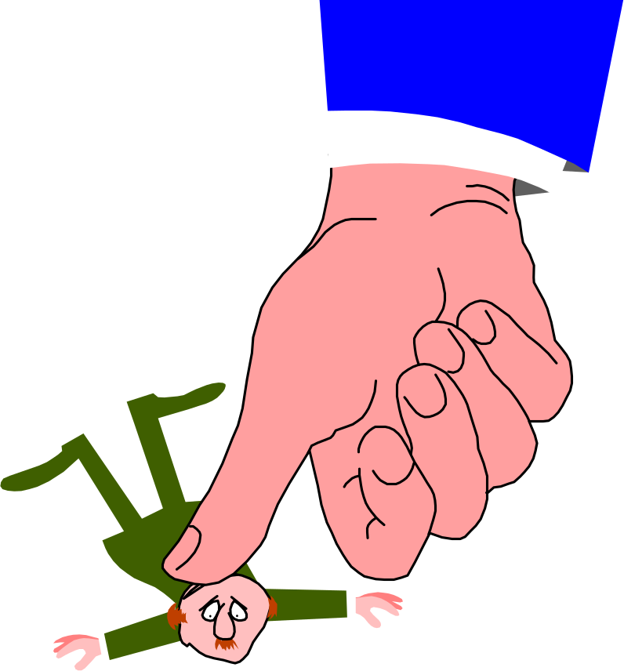
Evidence of a Bad Attitude
When the Captain calls the First Officer . . .
Self-Loading Baggage

Slide 19
Basic Bad Attitudes
Anti-Authority - No one tells me what to do!
Impulsiveness - Do something quickly, anything
Invulnerability - It won’t happen to me
Macho - I can do it!
Resignation - What’s the use

Slide 20
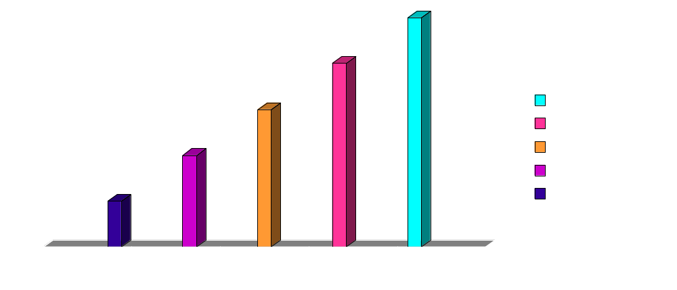
How Assertive Should You Be?

Slide 21
Countermeasures
Specifically targeted against the first three dominoes in the accident sequence (management, systems, individuals)
Designed to trap latent errors
If these work, the accident never occurs
  BUT, the latent error may still exist!

Slide 22
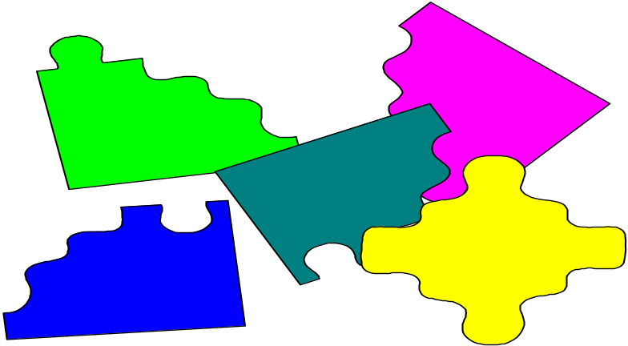
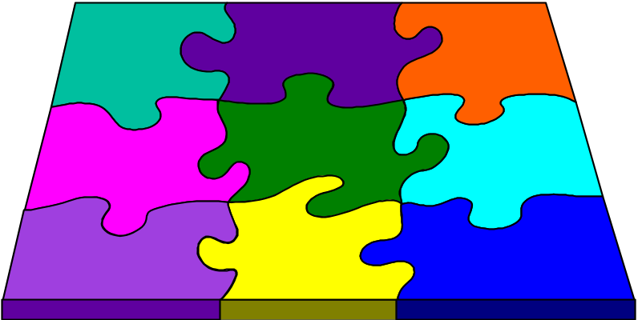
Situational Awareness
The ability to identify, process, and comprehend the critical elements of information about what is happening at a given point in time.
Knowing what is going on around you!

Slide 23
Factors Leading to Loss of Situational Awareness
Repetition
Stress
Demands from Management
Demands from PIC
Get There-itis
Proximity Rule
Peer Pressure
Sophisticated Aircraft Syndrome
New Situations
Critical Areas

Slide 24
Outward Signs of Loss of Situational Awareness
Distraction
Complacency
Unresolved Discrepancies
Confusion
Poor Communication
Improper Procedures
Fixation
No One Flying the Aircraft

Slide 25
Factors Affecting Information Processing
Input
  Temperature
  Noise
  Lighting
  Distractions
  Attention
  Workload
  Physical Condition
Processing
-- Anxiety
-- Fear
-- Fatigue
-- Stress
-- Conflict
-- Attitudes
Performance
  Temperature
  Vibration
  Distractions
  Attention
  Workload
  Physical Condition

Slide 26
Decision Making Methods
Minimizing
    Superficial search for an answer
Moralizing
    Decisions based on perceived moral obligation
Muddling
    Putting out fires; looks at symptoms
Scanning
    Classifies as important or unimportant
Denial
    Denies that problem exists
Optimizing
    Considers all choices; weighs consequences

Slide 27
Sources of Stress
Conflicts with other people
Threats to self-esteem
Confused priorities
Confused philosophies
Conflicting demands
Poor communication
Time zone changes
Loss of someone or something we care for
Deadline pressure
Unstable home life
Travel
Fatigue
Financial concerns
Inner conflicts
Illness/Health concerns
A life change
An important event
Conflicting expectations

Slide 28
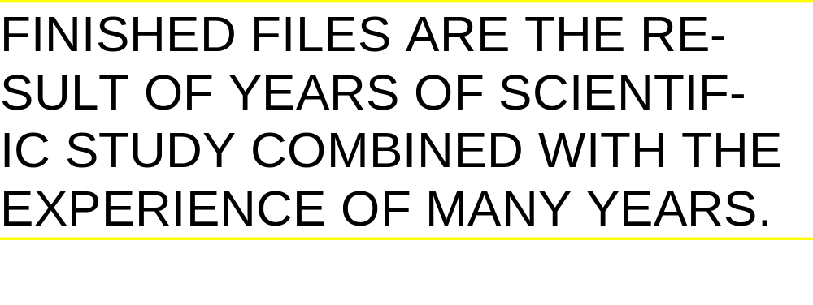
First, Read the Sentence in the Box Below
Now count the Fs in the sentence. Count them once and do not go back and count them again. Write down the number.

Slide 29


Slide 30
Tips for Managing Stress
Discussions Among Crew
Review Procedures
Follow the Checklist
Constant Cross Check
Rehearse
Plan
Review
Relax
Self-talk
Stringent Standards
Play What-if Games
Physical Condition
Get Adequate Rest
Nutritional Factors

Slide 31
Elements of a Good Briefing
Establishes open communications
Is interactive
Establishes “Team Concept”
Covers pertinent issues
Identifies potential problems
Provides guidelines for action
Sets expectations
Establishes guidelines for operation of automated systems
Specifies duties and responsibilities

Slide 32
Conclusion
Take these basic ideas and incorporate them into your company philosophy.
Safety can’t wait!

