Slide 1
Chapter 10, e-Customer Relationship Management
Outline
10.1 Introduction
10.2 Tracking and Analyzing Data
10.2.1 Log-File Analysis
10.2.2 Data Mining
10.2.3 Customer Registration
10.2.4 Cookies
10.3 Personalization
10.3.1 Intelligent Agents
10.3.2 Personalization vs. Privacy
10.4 Contact Centers
10.4.1 Frequently Asked Questions (FAQs)
10.4.2 e-Mail
10.4.3 Online Text Chatting
10.4.4 Speech Synthesis and Recognition; Natural Language Processing
10.4.5 Voice Communications
10.4.6 Sales-Force Automation
10.5 Business-to-Business e-CRM
10.6 Complete e-CRM Solutions

Slide 2
10.1 Introduction
Customer relationship management (CRM)
  Focuses on providing and maintaining quality service for customers, by effectively communicating and delivering products, services, information and solutions to address customer problems, wants and needs
  Can include:
    Call handling (the maintenance of outbound and inbound calls from customers and service representatives)
    Sales tracking (the tracking and recording of all sales made)
    Transaction support (the technology and personnel used for conducting business transactions)

Slide 3
10.1 Introduction
eCRM is the application of CRM to an e-business’ strategy
  Includes the personalization and customization of customers’ experiences and interactions with the e-business
Relationship between merchant and customers is distant
Less expensive to keep customers than to acquire new ones
Repeat customers have higher lifetime value than one-time buyers
  A customer’s lifetime value is the expected amount of profit derived from a customer over a designated length of time
Evaluate the potential to profit from a customer

Slide 4
10.2 Tracking and Analyzing Data
Employ tracking devices
  Personalize each visitor’s experience
  Find trends in customer use
  Measure the effectiveness of a Web site over time
  ID cards
    An ID card enables information to be sent to your computer from a Web site such as the numerical address of your PC on the Internet, your browser and your operating system
  Click-through banner advertisements
    Click-through advertisements enable visitors to view a service or product by clicking the advertisement
    Advertisers can learn what sites generate sales

Slide 5
10.2 Tracking and Analyzing Data
  Web Bugs, or clear GIFs
    A type of image file embedded in an image on the screen
    Site owners allow companies, especially advertising companies, to hide these information-collecting programs on various parts of their sites
    Every time a user requests a page with a Web bug on it, the Web bug sends a request to the Web bug’s company’s server, which then tracks where the user goes on the Web.
  Log-file analysis
  Data mining
  Customer registration
  Cookies

Slide 6
10.2.1 Log-File Analysis
When visiting a site, you are submitting a request for information from the site’s server and the request is recorded in a log file
  Log files consist of data generated by site visits, including each visitor’s location, IP address, time of visit, frequency of visits and other information
  Log-file analysis organizes and summarizes the information contained in the log files
    Can be used to determine the number of unique visitors
    Can show the Web-site traffic effects of changing a Web site or advertising campaign

Slide 7
10.2.1 WebTrends Feature
WebTrends provides solutions for tracking visitors
  User specifies source of log files, types of reports and location where data is stored
  The analysis is conducted automatically
Collected information can be used to evaluate e-commerce methods, customer service and Web-site design
Graphical interpretation of the log files can be presented
Can view demographic and geographic data, technical analysis of a Web site’s effectiveness and top-referring sites—sites that most frequently refer visitors to your site

Slide 8
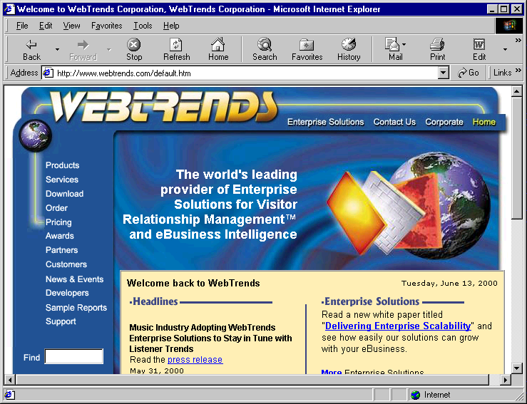
10.2.1 WebTrends Feature
    WebTrends home page. (Courtesy of © 2000 WebTrends Corporation. All rights reserved. WebTrends is a registered trademark of WebTrends Corporation.)

Slide 9
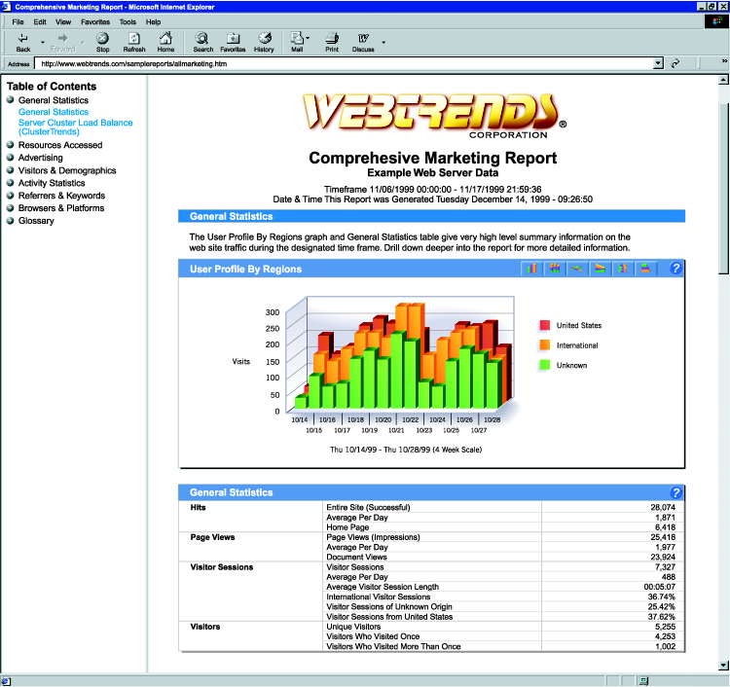
10.2.1 WebTrends Feature
    Example analysis from a WebTrends product. (Courtesy of 2000 WebTrends Corporation. All rights reserved. WebTrends is a registered trademark of WebTrends Corporation.)

Slide 10
10.2.2 Data Mining
Data mining
  Uses algorithms and statistical tools to find patterns in data gathered from customer visits
  Costly and time consuming to go through large amounts of data manually
  Use data-mining to analyze trends within their companies or in the marketplace
  Uncovered patterns can improve CRM and marketing campaigns
  Discover a need for new or improved services or products by studying the patterns of customers’ purchases
  Data mining software
    HNC Software Data Distilleries Applied Metrix Data Instincts and SmartDrill

Slide 11
10.2.3 Customer Registration
Customer registration
  Requiring visitors to fill out a form with personal information that is then used to create a profile
  Recommended when it will provide a benefit to the customer
  When customers log on using usernames and passwords, their actions can be tracked and stored in a database
Require only minimum information
Give customers an incentive to register
  Free-trial run or a free demonstration to familiarize the user
After customer registration, send an e-mail including customer usernames and welcoming them to your Web site

Slide 12
10.2.4 Cookies
Cookie
  A text file stored by a Web site on an individual’s personal computer that allows a site to track the actions of a
  Information collected is intended to be an anonymous account of log-on times, the length of stay at the site, purchases made on the site, the site previously visited and the site visited next
  Does not interact with other information stored on the system
  Can only be read by the host that sets them on a person’s computer

Slide 13
10.2.4 Cookies
Benefits
  Record passwords for returning visitors
  Keep track of shopping-cart materials
  Register preferences
  Assist companies in address target markets with greater accuracy
Negatives
  Customer privacy
  Can be misleading to site that places cookie on a computer
    Different people may use the same computer to surf the Web, and the cookie will not be able to differentiate the users

Slide 14
10.3 Personalization
Personalization
  Uses information from tracking, mining and data analysis to customize a person’s interactions with a company’s products, services, Web site and employees
    Allaire, Blaze Software, NetGenesis and Personify
Establish relationships that improve each time visitors return to site
Customers may enjoy individual attention and become more loyal

Slide 15
10.3 Personalization
Collaborative filtering
  Compares ratings of a present user’s interests and decisions with those of past users to offer content relative to the present user’s interests
Rules-based personalization
  The delivery of personalized content based on the subjection of a user’s profile to set rules or assumptions

Slide 16
10.3.1 Intelligent Agents
Intelligent agent
  A program that can be used on the Web to assist a user in the completion of a specified task, including searching for information and automating tasks
Can be used as personalization mechanisms by providing content related to the user’s interests
Can observe Web-surfing habits and purchasing behavior to recommend new products to buy or sites to visit
Can help e-businesses offer a level of customer service similar to person-to-person interaction

Slide 17
10.3.2 Personalization vs. Privacy
Some people feel personalization represents invasion of privacy and others may not be aware that data is being collected and personalization is occurring at a site
Marketers must be discrete about the way they use personal information gained from data research
Personalization Consortium
  An alliance of major Web sites attempting to accommodate those individuals who prefer to have their Web experiences tailored
  Released a study suggesting that most users actually prefer to have their information stored and actions tracked

Slide 18
10.4 Contact Centers
Traditional call centers house customer-service representatives who can be reached by an 800 number
Call center, e-contact center or multimedia contact center
  Purpose is the same—to provide a personal customer service experience that is individualized to each customer’s needs and questions
  Allow customers with Internet access to contact customer service representatives through e-mail, online text chatting or real-time voice communications
Integration of all customer service functions

Slide 19
10.4 Contact Centers
Change the culture of customer service representatives
  More technically knowledgeable to handle all forms of contact
  Provide a highly personalized experience that satisfies customers
New forms of contact can decrease costs
Outsource contact center services
  May be appropriate if a company cannot afford to implement a contact center due to the costs of equipment, office space, service representatives and technical support.
  Stream International, Inc. Sitel Corporation and TeleTech

Slide 20
10.4.1 Frequently Asked Questions (FAQs)
A Frequently Asked Questions (FAQ) section on the site
  Will help customers find answers to some of their questions
  Frees up time for CSRs to handle questions that can not be answered without human interaction
Self-service FAQ software and Web FAQ software
Place phone numbers and e-mail addresses nearby FAQ
Include a search engine on your site
  Allowing users to type in a word or phrase to find information on your site relevant to their particular question

Slide 21
10.4.2 e-Mail
E-mail can provide a less expensive customer service solution
  Customers can use e-mail to ask questions or comment on your company’s services or products
Only appropriate if you have resources to handle demands
Customers may be not be willing to wait long for an e-mail reply
Ideally, a response to a customer’s e-mail inquiry should be completed within forty-eight hours
Brightware RightNow Technologies , Servicesoft and Delano

Slide 22
10.4.3 Online Text Chatting
Online text chatting
  Provides a real-time form of communication between customers and service representatives
Service representatives may be able to handle more than one text chat at a time
Customers can continue to view the Web site as they chat with a service representative
  Allows the service representative to see what the customers are looking at as they pose their questions

Slide 23
10.4.3 Online Text Chatting
“Instantaneous”
  If representatives are busy with many chat sessions, customer may experience delay in responses
Can lose the dynamics of human communication
the meaning of a message may be misinterpreted
FaceTime Communications, CLICKiCHAT and LivePersonSM

Slide 24
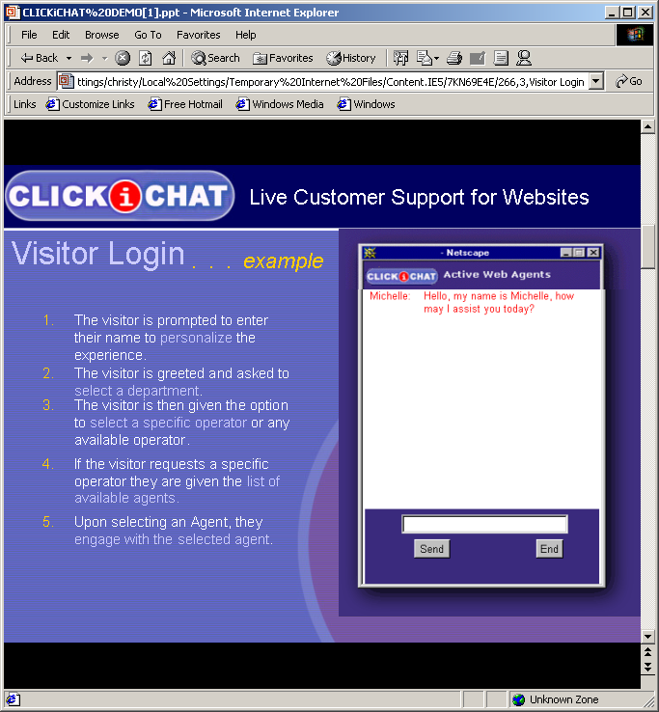
10.4.3 Online Text Chatting
    CLICKiCHAT’s online text chatting. (Courtesy of StartCall Corporation.)

Slide 25
10.4.4 Speech Synthesis and Recognition; Natural Language Processing
Speech synthesis
  The process of having a computer convert text to voice
  Mechanical-sounding voices have some human intonations and costs of these services are relatively low
Speech recognition
  When a computer listens to speech and is able to convert what is being said into text
  Different pronunciations, accents, intonations and languages can create difficulties
Natural language processing
  Attempts to understand text and respond with a proper answer
  Ask Jeeves, Eliza, Artificial Life

Slide 26
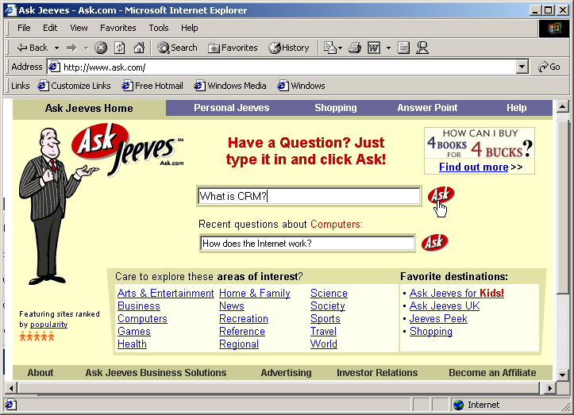
10.4.4 Speech Synthesis and Recognition; Natural Language Processing
    Ask Jeeves™ home page with a sample query. (Courtesy of Ask Jeeves, Inc.)

Slide 27
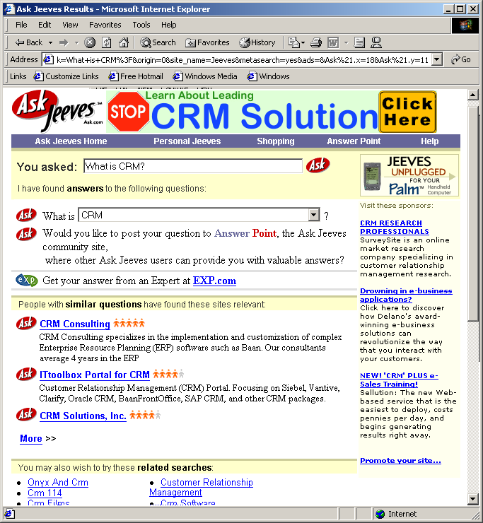
10.4.4 Speech Synthesis and Recognition; Natural Language Processing
    Ask Jeeves™ results page from sample query. (Courtesy of Ask Jeeves, Inc.)

Slide 28
10.4.4 Speech Synthesis and Recognition; Natural Language Processing
Continuous speech recognition (CSR)
  When a natural language comment or question is posed to a computer over a phone or directly from a person, the audio must first be converted to text through CSR
  Allows a person to speak fluently and quickly to a computer without losing the accuracy of the translation into text
Will impact the future of CRM applications
Will provide more accurate automated answers to customers’ inquiries, cutting customer service costs as the technology advances

Slide 29
10.4.4 Microsoft Agent Feature
Technology for adding interactive animated characters in a Windows application or World Wide Web page
  Four characters: Peedy the Parrot, Genie, Merlin, Robby the Robot
  Allow users to interact with the application using natural human-communication techniques
  Accepts both mouse and keyboard interactions, speaks and also supports speech recognition
    If a compatible text-to-speech engine is installed
  Create your own characters with Microsoft Agent Character Editor and the Microsoft Linguistic Sound Editing tool
    Both free for download from the Microsoft Agent Web site

Slide 30
10.4.5 Voice Communications
Internet provides another channel for human-to-human voice communication
Voice over Internet Protocol (VoIP)
  VoIP products and applications allow people to communicate with speech over the Internet
Internet telephony allows people to make phone calls over the Internet
  Quality of transmission yet to match regular telephone
  Many companies are using PC-to-phone communication because it is of higher quality than PC-to-PC
    A person speaks from a computer to another person who responds through another computer

Slide 31
10.4.5 Voice Communications
PC-to-phone (computer-to-phone) voice communication
  Allows a visitor to a Web site to continue browsing while talking to a customer-service representative over the Internet
  Allows dial-up Internet users who have only one phone line to chat with a CSR without having to disconnect from the Internet
  HearMe, RealCall, Web Call Back and ITXC
Wizard
  Software program that walks you through the steps needed to complete a task on your computer

Slide 32
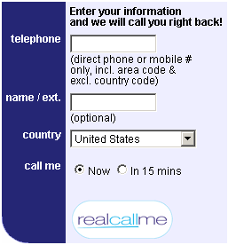
10.4.5 Voice Communications
    RealCall Alert Demonstration. (Courtesy of RealCall, Inc.)

Slide 33
10.4.6 Sales-Force Automation
Sales-force automation
  Assists companies in the sales process, including maintaining and discovering leads, managing contacts and other sales-force activities
  Can lighten the administrative load on the sales force
  Important information about products and customers can be accessed in real time, allowing salespeople to keep current on company and client information
Customers may want human contact at some point throughout the purchasing process, especially with higher-priced items
Salesforce.com, Sales.com Sales Logix and Clarify

Slide 34
10.5 Business-to-Business e-CRM
Key to (B2B) e-commerce is effective (CRM)
When selling to another business, you may be selling to someone who is not the direct user of your product
  Ask your contact to speak with the end users
Developing good partner relationship management (PRM) includes increasing efficiency in operations and processes between a business and its partners
  Partners can include resellers, distributors and businesses that improve your product or service
  Integrating systems to combine selling, buying and marketing operations of partners will streamline processes and provide technical conformity
  ChannelWave Software, Inc., Allegis and Partnerware

Slide 35
10.6 Complete e-CRM Solutions
Solutions, software or services that use and integrate all the tools of CRM provide a single view of a customer
  Costs include the price of the software or service itself, the integration into the current system, the maintenance of the system and employing the service representatives
  Solutions will continue to become more efficient
E.piphany
eGain
Siebel Systems
Kana Communications
Oracle Systems

