Slide 1
Software Prototyping
Rapid software development to validate requirements

Slide 2
Objectives
To describe the use of prototypes in different types of development project
To discuss evolutionary and throw-away prototyping
To introduce three rapid prototyping techniques - high-level language development, database programming and component reuse
To explain the need for user interface prototyping

Slide 3
Topics covered
Prototyping in the software process
Prototyping techniques
User interface prototyping

Slide 4
System prototyping
Prototyping is the rapid development of a system
In the past, the developed system was normally thought of as inferior in some way to the required system so further development was required
Now, the boundary between prototyping and normal system development is blurred and many systems are developed using an evolutionary approach

Slide 5
Uses of system prototypes
The principal use is to help customers and developers understand the requirements for the system
  Requirements elicitation. Users can experiment with a prototype to see how the system supports their work
  Requirements validation. The prototype can reveal errors and omissions in the requirements
Prototyping can be considered as a risk reduction activity which reduces requirements risks

Slide 6
Prototyping benefits
Misunderstandings between software users and developers are exposed
Missing services may be detected and confusing services may be identified
A working system is available early in the process
The prototype may serve as a basis for deriving a system specification
The system can support user training and system testing

Slide 7
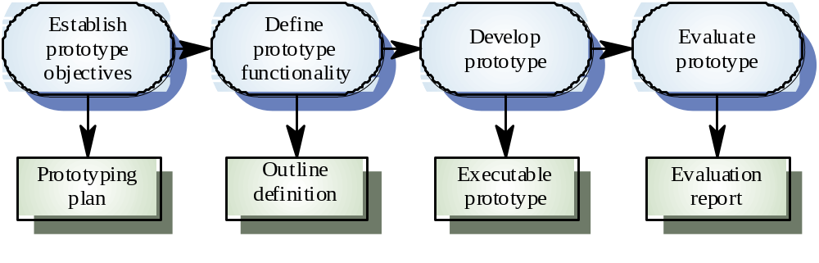
Prototyping process

Slide 8
Prototyping benefits
Improved system usability
Closer match to the system needed
Improved design quality
Improved maintainability
Reduced overall development effort

Slide 9
Prototyping in the software process
Evolutionary prototyping
  An approach to system development where an initial prototype is produced and refined through a number of stages to the final system
Throw-away prototyping
  A prototype which is usually a practical implementation of the system is produced to help discover requirements problems and then discarded. The system is then developed using some other development process

Slide 10
Prototyping objectives
The objective of evolutionary prototyping is to deliver a working system to end-users. The development starts with those requirements which are best understood.
The objective of throw-away prototyping is to validate or derive the system requirements. The prototyping process starts with those requirements which are poorly understood

Slide 11
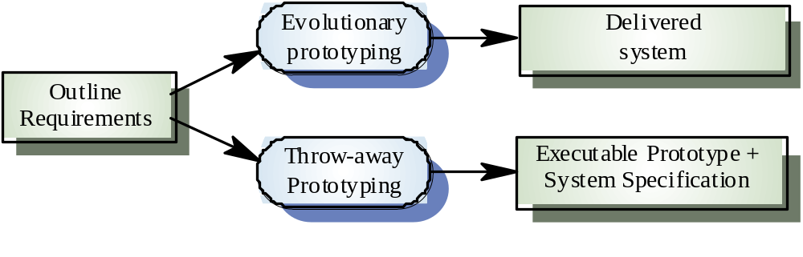
Approaches to prototyping

Slide 12
Evolutionary prototyping
Must be used for systems where the specification cannot be developed in advance e.g. AI systems and user interface systems
Based on techniques which allow rapid system iterations
Verification is impossible as there is no specification. Validation means demonstrating the adequacy of the system

Slide 13
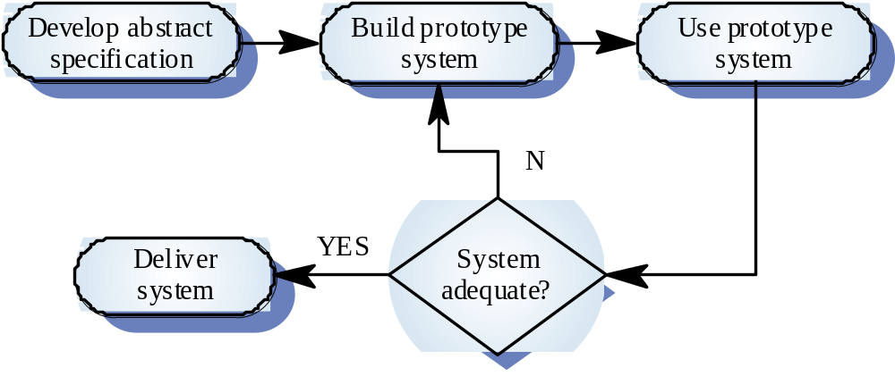
Evolutionary prototyping

Slide 14
Evolutionary prototyping advantages
Accelerated delivery of the system
  Rapid delivery and deployment are sometimes more important than functionality or long-term software maintainability
User engagement with the system
  Not only is the system more likely to meet user requirements, they are more likely to commit to the use of the system

Slide 15
Evolutionary prototyping
Specification, design and implementation are inter-twined
The system is developed as a series of increments that are delivered to the customer
Techniques for rapid system development are used such as CASE tools and 4GLs
User interfaces are usually developed using a GUI development toolkit

Slide 16
Evolutionary prototyping problems
Management problems
  Existing management processes assume a waterfall model of development
  Specialist skills are required which may not be available in all development teams
Maintenance problems
  Continual change tends to corrupt system structure so long-term maintenance is expensive
Contractual problems

Slide 17
Prototypes as specifications
Some parts of the requirements (e.g. safety-critical functions) may be impossible to prototype and so don’t appear in the specification
An implementation has no legal standing as a contract
Non-functional requirements cannot be adequately tested in a system prototype

Slide 18
Incremental development
System is developed and delivered in increments after establishing an overall architecture
Requirements and specifications for each increment may be developed
Users may experiment with delivered increments while others are being developed. therefore, these serve as a form of prototype system
Intended to combine some of the advantages of prototyping but with a more manageable process and better system structure

Slide 19
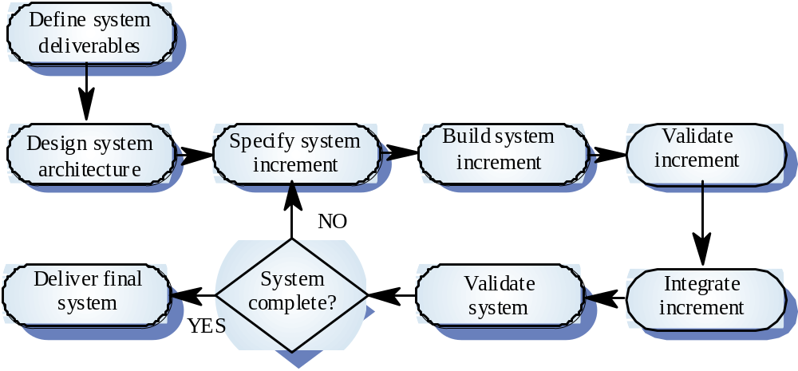
Incremental development process

Slide 20
Throw-away prototyping
Used to reduce requirements risk
The prototype is developed from an initial specification, delivered for experiment then discarded
The throw-away prototype should NOT be considered as a final system
  Some system characteristics may have been left out
  There is no specification for long-term maintenance
  The system will be poorly structured and difficult to maintain

Slide 21
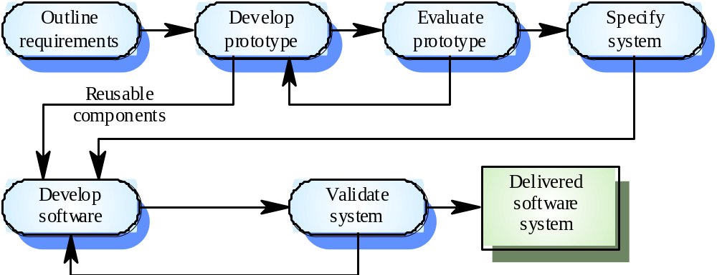
Throw-away prototyping

Slide 22
Prototype delivery
Developers may be pressurised to deliver a throw-away prototype as a final system
This is not recommended
  It may be impossible to tune the prototype to meet non-functional requirements
  The prototype is inevitably undocumented
  The system structure will be degraded through changes made during development
  Normal organisational quality standards may not have been applied

Slide 23
Rapid prototyping techniques
Various techniques may be used for rapid development
  Dynamic high-level language development
  Database programming
  Component and application assembly
These are not exclusive techniques - they are often used together
Visual programming is an inherent part of most prototype development systems

Slide 24
Dynamic high-level languages
Languages which include powerful data management facilities
Need a large run-time support system. Not normally used for large system development
Some languages offer excellent UI development facilities
Some languages have an integrated support environment whose facilities may be used in the prototype

Slide 25
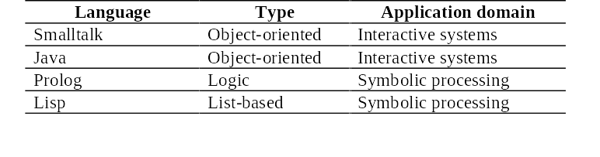
Prototyping languages

Slide 26
Choice of prototyping language
What is the application domain of the problem?
What user interaction is required?
What support environment comes with the language?
Different parts of the system may be programmed in different languages. However, there may be problems with language communications

Slide 27
Database programming languages
Domain specific languages for business systems based around a database management system
Normally include a database query language, a screen generator, a report generator and a spreadsheet.
May be integrated with a CASE toolset
The language + environment is sometimes known as a fourth-generation language (4GL)
Cost-effective for small to medium sized business systems

Slide 28
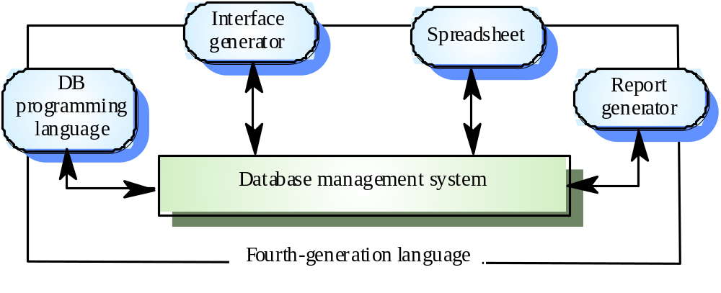
Database programming

Slide 29
Component and application assembly
Prototypes can be created quickly from a set of reusable components plus some mechanism to ‘glue’ these component together
The composition mechanism must include control facilities and a mechanism for component communication
The system specification must take into account the availability and functionality of existing components

Slide 30
Prototyping with reuse
Application level development
  Entire application systems are integrated with the prototype so that their functionality can be shared
  For example, if text preparation is required, a standard word processor can be used
Component level development
  Individual components are integrated within a standard framework to implement the system
  Frame work can be a scripting language or an integration framework such as CORBA

Slide 31
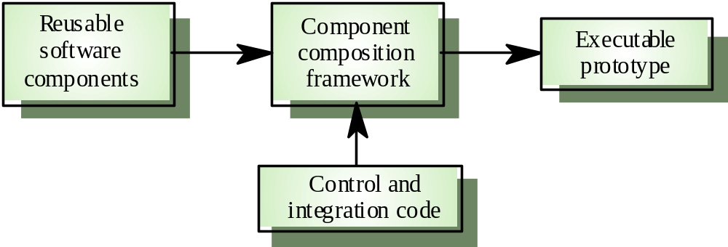
Reusable component composition

Slide 32
Compound documents
For some applications, a prototype can be created by developing a compound document
This is a document with active elements (such as a spreadsheet) that allow user computations
Each active element has an associated application which is invoked when that element is selected
The document itself is the integrator for the different applications

Slide 33
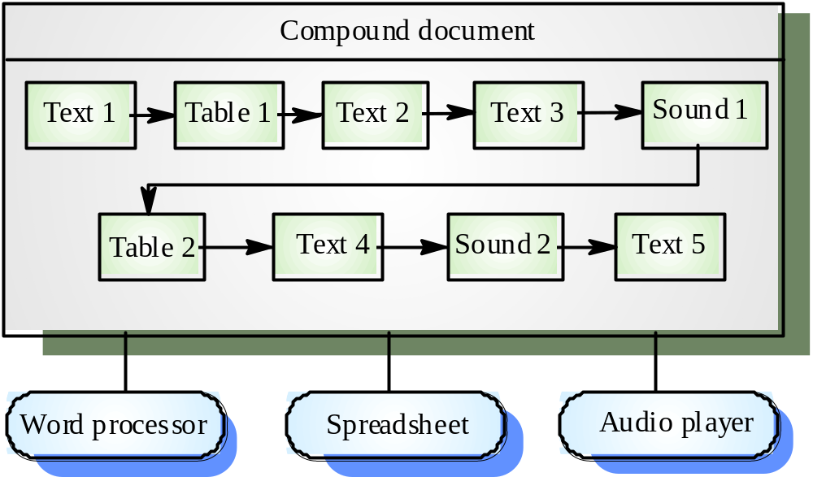
Application linking in compound documents

Slide 34
Visual programming
Scripting languages such as Visual Basic support visual programming where the prototype is developed by creating a user interface from standard items and associating components with these items
A large library of components exists to support this type of development
These may be tailored to suit the specific application requirements

Slide 35
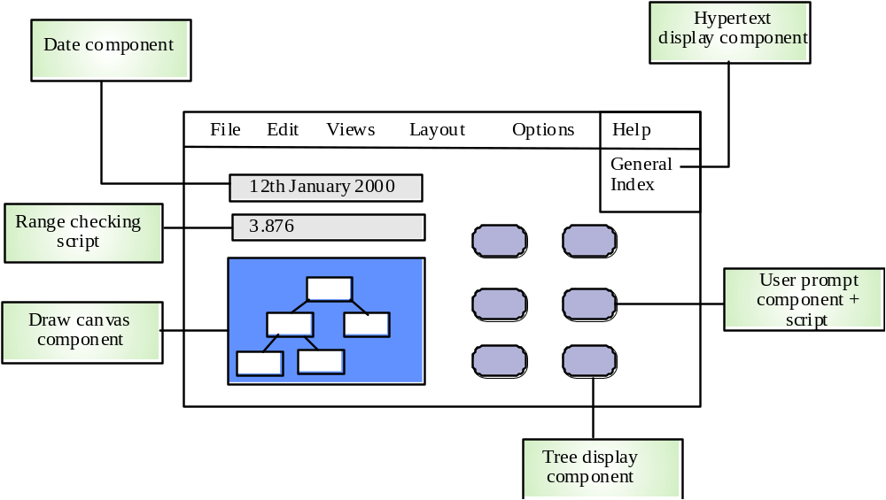
Visual programming with reuse

Slide 36
Problems with visual development
Difficult to coordinate team-based development
No explicit system architecture
Complex dependencies between parts of the program can cause maintainability problems

Slide 37
User interface prototyping
It is impossible to pre-specify the look and feel of a user interface in an effective way. prototyping is essential
UI development consumes an increasing part of overall system development costs
User interface generators may be used to ‘draw’ the interface and simulate its functionality with components associated with interface entities
Web interfaces may be prototyped using a web site editor

Slide 38
Key points
A prototype can be used to give end-users a concrete impression of the system’s capabilities
Prototyping is becoming increasingly used for system development where rapid development is essential
Throw-away prototyping is used to understand the system requirements
In evolutionary prototyping, the system is developed by evolving an initial version to the final version

Slide 39
Key points
Rapid development of prototypes is essential. This may require leaving out functionality or relaxing non-functional constraints
Prototyping techniques include the use of very high-level languages, database programming and prototype construction from reusable components
Prototyping is essential for parts of the system such as the user interface which cannot be effectively pre-specified. Users must be involved in prototype evaluation

