Slide 1
US-China Trade War Bullish ELN
Structuring overview prepared for client

Slide 2
Equity Filters
Election outcome with elevated trade friction -> prioritise defence, reshoring, and secure tech supply chains. Filters:
LMT: Defense prime with minimal China revenue exposure; poised to benefit from elevated Indo-Pacific security spending under aggressive trade stances.
INTC: U.S.-based semiconductor manufacturer supported by CHIPS Act incentives and strategic realignment of advanced node supply chains.
CSCO: Critical networking supplier benefiting from federal security procurement and restrictions on Chinese telecom equipment.
NUE: Domestic steel leader with electric arc capacity that benefits from U.S. infrastructure and reshoring themes amid tariff barriers.

Slide 3
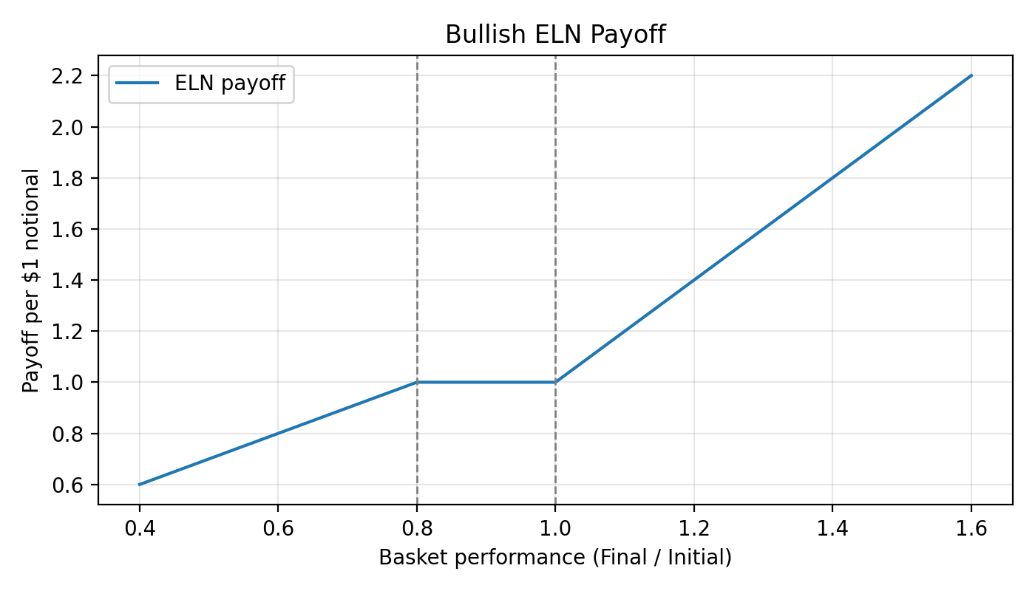
Payoff Mechanics

Slide 4
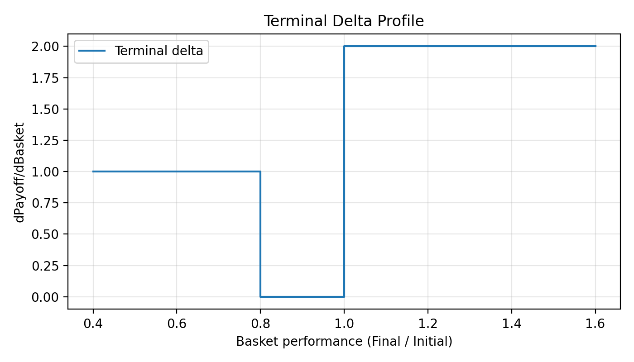
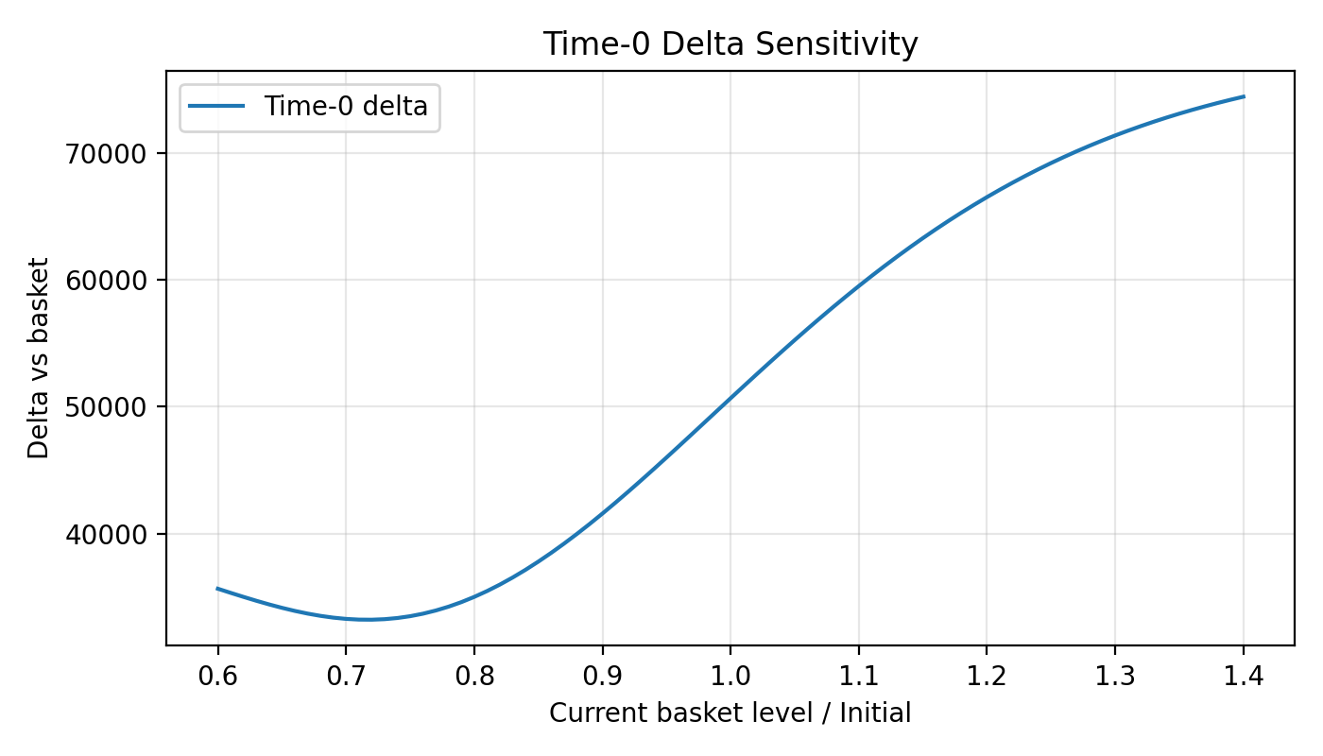
Delta Profiles

