Slide 1
Rel-SA: Tumor’s Disease Detection using Relevance-augmented Self Attention
TEAM 2
Mahindra Manohar Alla - R11975196
Bhanu Sankar Ravi – R11971600
Chepuri Madhukanthi – R11971602
Sai Ruthvik Munugoti – R11940989
Venkata Revanth Manideep Kallagunta – R12021348

Slide 2
INTRODUCTION
This project focuses on brain tumour detection and classification using MRI images.
The system combines deep learning and explainable AI to identify tumour regions effectively.
Uses Convolutional Neural Networks (CNNs) enhanced with Relevance-Attention mechanisms and Grad-CAM visualisation for interpretability.
Our approach replaces atlas-based regions with data-driven Grad-CAM relevance
Goal: Improve diagnostic accuracy and model transparency for clinical use

Slide 3
BASE PAPER Key idea
Clinically, Alzheimer’s Disease progression is documented by atrophy in landmark regions (hippocampus, etc.) spread across brain.
MRI processing technique localize various brain regions through atlases.
The paper introduces Rel-SA (Relevance-Augmented Self-Attention) for Alzheimer’s Disease detection using MRI scans.
Standard Vision Transformers (ViTs) treat all brain regions equally, but doctors know some areas (like the hippocampus) are more important.
Rel-SA integrates clinical and anatomical knowledge to guide the model’s focus toward key brain regions.

Slide 4
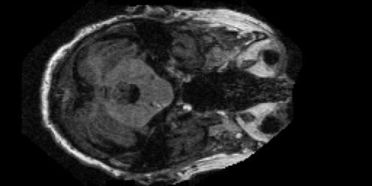
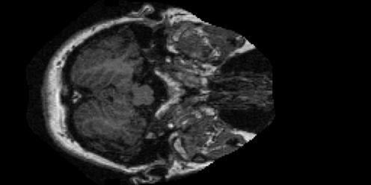
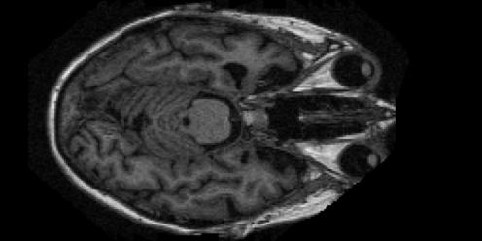
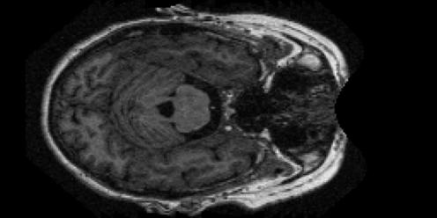
SAMPLE DATASET
4 Classes of Data:
Mild Dementia
Moderate Dementia
Very Mild Dementia
Non Demented

Slide 5
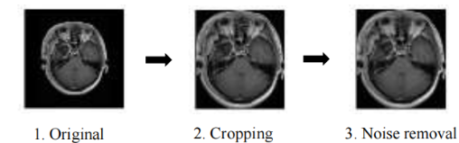
DATASET AND PREPROCESSING
Dataset: Brain MRI (4 classes – Glioma, Meningioma, No Tumour, Pituitary)
Image Size: 200×200 | Split: Training / Testing
Steps:
Cropping: Removed background using contours (focus on tumour region).
Noise Removal: Applied a bilateral filter to smooth images.
Colour Mapping: Used COLORMAP_BONE for pseudo-colour enhancement.
Resizing & Normalisation: Standardised inputs, scaled pixels → [0, 1].

Slide 6
Build baseline CNN model
Use ResNet-18 as backbone (pretrained on ImageNet). Modify the final layer for a 4-class classification model on preprocessed images
Build a Convolutional Neural Network (CNN) for initial tumour classification
Layers: convolution, pooling, batch normalisation, and dense layers
Trained on preprocessed MRI dataset (200×200 images).
This model serves as a foundation for applying advanced modules

Slide 7
Relevance-Attention Module
For each class, collect correctly predicted samples. Generate Grad-CAM heatmaps using the last convolutional layer
Aggregate class-specific heatmaps, then Average all heatmaps per class
Integrated a Relevance-Augmented Attention mechanism (Rel-SA) inspired by the base paper.
Combines self-attention with clinical and anatomical priors to highlight critical regions.
Helps model focus on important tumour features rather than background noise.
Improves both accuracy and model trustworthiness.

Slide 8
Generate Grad-CAM Heatmap
Used Grad-CAM (Gradient-weighted Class Activation Mapping) for explainability.
Visualises which parts of the MRI contributed most to the classification decision.
Heatmaps confirm that the model correctly focuses on tumour-affected areas.
Allows medical experts to interpret and validate the AI’s decision-making process.

Slide 9
Comparison with Base Paper(1/2)
The base paper, Rel-SA, uses a 3D DenseNet combined with a Vision Transformer to detect diseases from volumetric MRI scans.
In contrast, our model employs a 2D CNN with a custom Relevance-Attention module, which significantly reduces computational complexity while maintaining strong performance.
While the base paper generates relevance maps based on fixed brain regions.
The current method produces Grad-CAM heatmaps that directly highlight tumour areas, providing more intuitive and visually interpretable explanations.

Slide 10
Comparison with Base Paper(2/2)
Aspect | Paper (Rel-SA) | Our Approach
Relevance Source | Fixed brain atlases :AAL3, JHU | Data-driven Grad-CAM heatmaps
Classification Task | Binary (AD vs CN) | 4-class severity staging
Relevance Adaptation | Static single bias | Class-specific bias per stage
Input Modality | 3D sMRI : volumetric | 2D MRI slices : lighter, faster

Slide 11
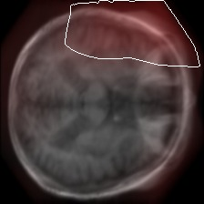
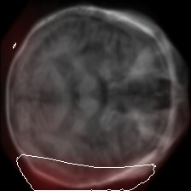
RESULTS
Mild Dementia
Moderate Dementia

Slide 12
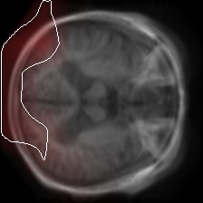
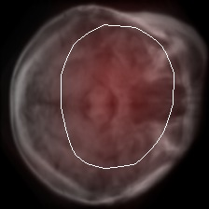
RESULTS
Very mild Dementia
Non Demented

Slide 13
reSULTS

Slide 14
future WORK

Slide 15
conclusion

Slide 16
references
Alzheimer’s Disease International. Dementia statistics, 2024. Accessed: 2024-11-11.
Randall J. Bateman et al. Clinical and biomarker changes in dominantly inherited alzheimer’s disease. New England Journal of Medicine, 367(9):795–804, 2012.
Randy L. Buckner et al. Cortical hubs revealed by intrinsic functional connectivity: mapping, assessment of stability, and relation to alzheimer’s disease. Journal of Neuroscience, 29(6):1860–1873, 2009
A. Qiu, L. Xu, C. Liu, and Alzheimer’s Disease Neuroimaging Initiative. Predicting diagnosis 4 years prior to alzheimer’s disease incident. NeuroImage: Clinical, 34: 102993, 2022.

Slide 17
THANK YOU..

