Slide 1
Cloud
Services and solutions that are delivered and consumed in real time over internet are cloud services.

Slide 2
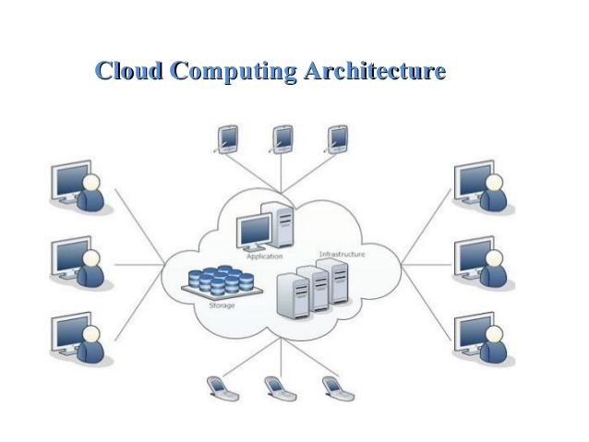

Slide 3
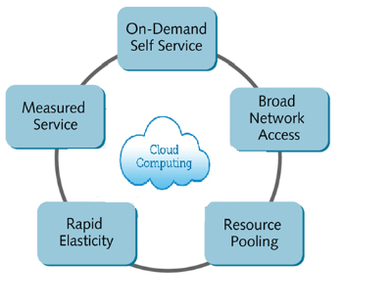
Characteristic of Cloud Computing
On demand service
Ubiquitous network access
Location independent resource pooling
Rapid Elasticity
Pay as you go

Slide 4
Working models
Deployment Models
Service Models

Slide 5
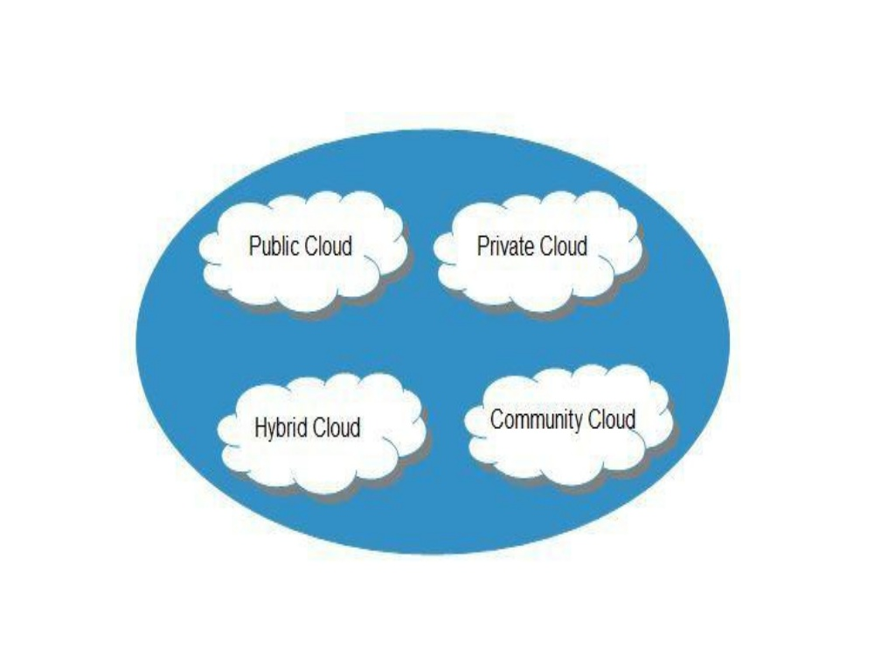
Deployment Models
It defines the type of access to the cloud. Cloud can have any of the four types of access: Public ,Private, Hybrid and Community

Slide 6
Service Models
These models are the reference models on which cloud computing is based. These can Be categorized into three basic service models as listed below:
1.IaaS
2.PaaS
3.SaaS

Slide 7
Advantages
Lower computer costs
Improved performance
Reduced software cost
Easier group collaboration
Latest version availability
Device independence

