Slide 1
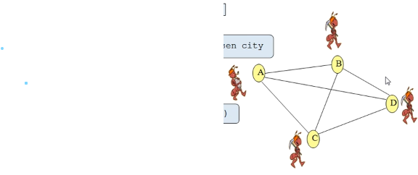
TRAVELING SALESMAN PROBLEM USING ANT COLONY OPTIMIZATION METHOD
Team members:
1.N.MAHENDRANATHREDDY
2.G.VINEELKUMAR REDDY
3.K.ASHRITH
4.S.SAISANTHOSH REDDY

Slide 2
INTRODUCTION:
Ant Colony Optimization technique is purely inspired from the foraging behavior of ant colonies, first introduced by Marco Dorigo in the 1990s.
Ants live in community nests and the underlying principle of ACO is to observe the movement of the ants from their nests in order to search for food in the shortest possible path. Initially, ants start to move randomly in search of food around their nests. This randomized search opens multiple routes from the nest to the food source. Now, based on the quality and quantity of the food, ants carry a portion of the food back with necessary pheromone concentration on its return path. Depending on these pheromone trials, the probability of selection of a specific path by the following ants would be a guiding factor to the food source.

Slide 3
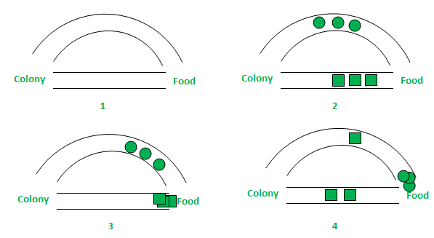
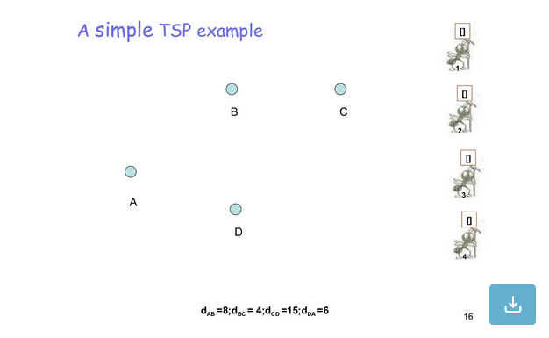
LITERATURE STUDY:
EXAMPLE STUDY:
QUS: INTHIS BELOW EXAMPLE DISTANCCE BETWEEN POINTS WILL BE
A TO B =8
B TO C =4
C TO D = 15
D TO A = 6
ANT COLONY METHOD

Slide 4
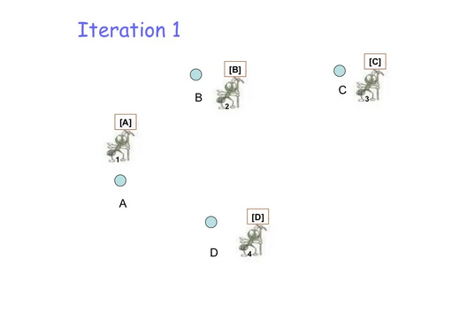
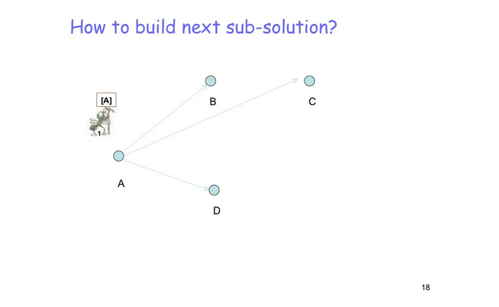
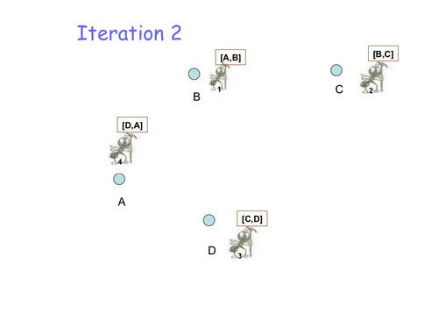
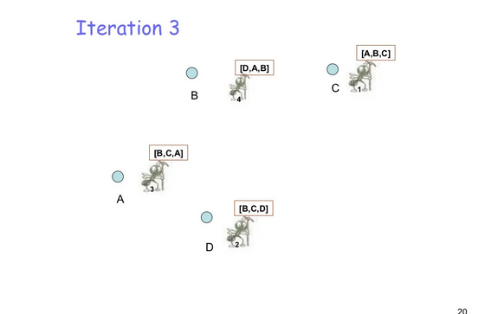
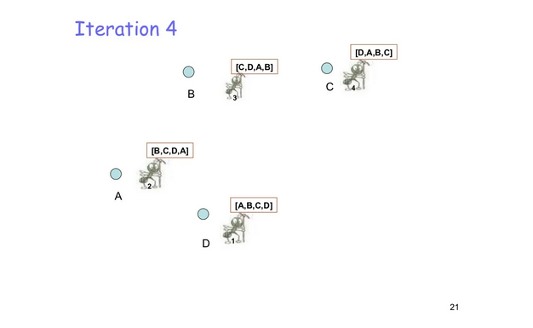
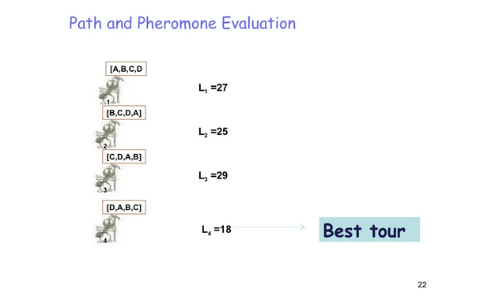
LITERATURE STUDY

Slide 5
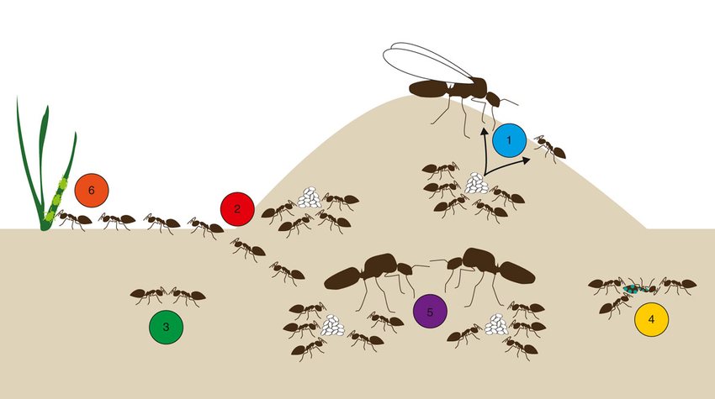
PROBLEM STATEMENT:
A TRAVELLER TRAVEL 52 LOCATIONS IN BERLIN IN DIFFERENT ROADWAYS THEIR NODE RECOGNIZATION OF DATA SET IS TAKEN THEN FIND THE SHORTEST PATH FOR TRAVELLING ALL 52 LOCATIONS USING PYTHON EXPLAIN IN GRAPHICAL WAY

Slide 6
Ant colony optimization
Scope of problem
To apply ACO, the optimization problem is transformed into the problem of finding the best path on a weighted graph. The traveler incrementally build solutions by moving on the graph. The solution construction process is stochastic and is biased by a pheromone model, that is, a set of parameters associated with graph components (either nodes or edges) whose values are modified at runtime by the ants.
Solving process:
In the first step of solving a problem, each ant generates a solution. In the second step, paths found by different are compared. And in the third step, paths value or pheromone is updated. There are many optimization problems where you can use ACO for finding the optimal solution.

Slide 7
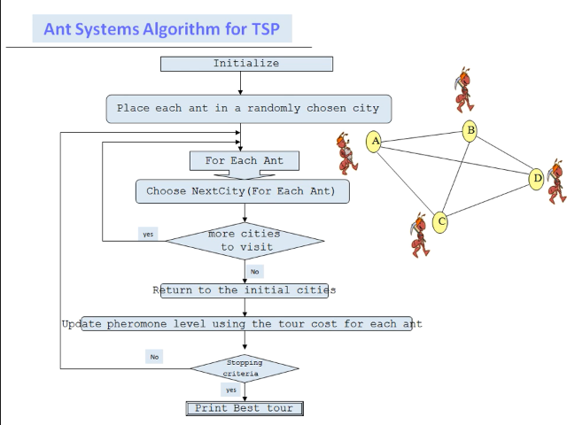



Algorithm :
probability of selection path:
In accordance with path length –
In accordance with evaporation rate of pheromone –

Slide 8
Programming language:
Python
datasets:
berlin52.tsp
Kroa1 00.tsp
( taken from internet)

