Slide 1
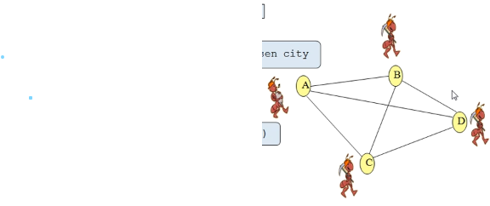
TRAVELING SALESMAN PROBLEM USING ANT COLONY OPTIMIZATION METHOD
Team members:
1.N.MAHENDRANATHREDDY
2.G.VINEELKUMAR REDDY
3.K.ASHRITH
4.S.SAISANTHOSH REDDY

Slide 2
INTRODUCTION:
Ant Colony Optimization technique is purely inspired from the foraging behavior of ant colonies, first introduced by Marco Dorigo in the 1990s.
Ants live in community nests and the underlying principle of ACO is to observe the movement of the ants from their nests in order to search for food in the shortest possible path. Initially, ants start to move randomly in search of food around their nests. This randomized search opens multiple routes from the nest to the food source. Now, based on the quality and quantity of the food, ants carry a portion of the food back with necessary pheromone concentration on its return path. Depending on these pheromone trials, the probability of selection of a specific path by the following ants would be a guiding factor to the food source.

Slide 3
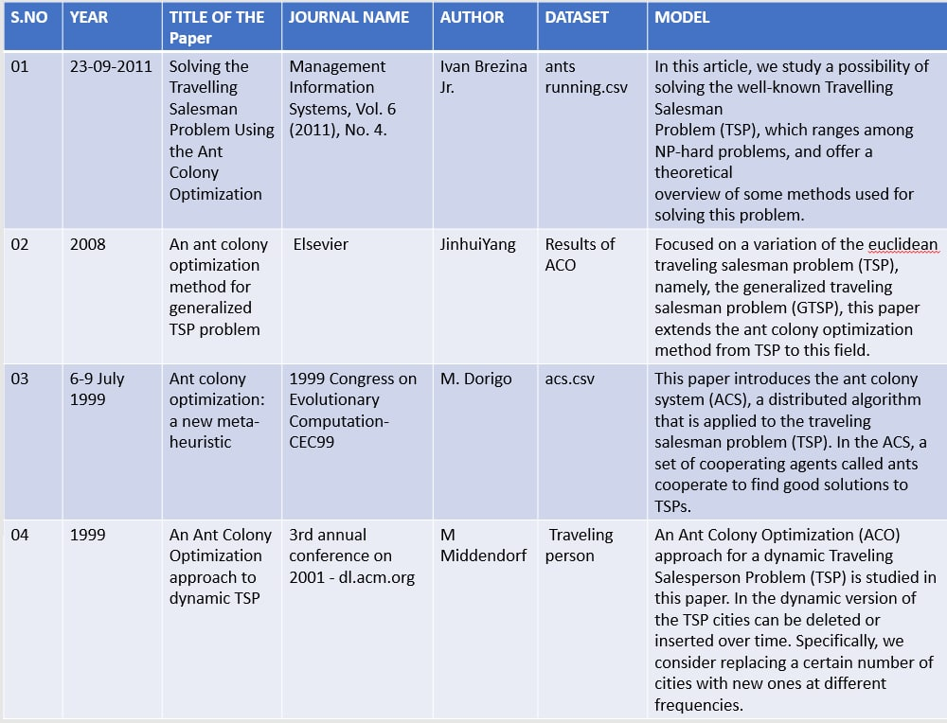
Literature study

Slide 4
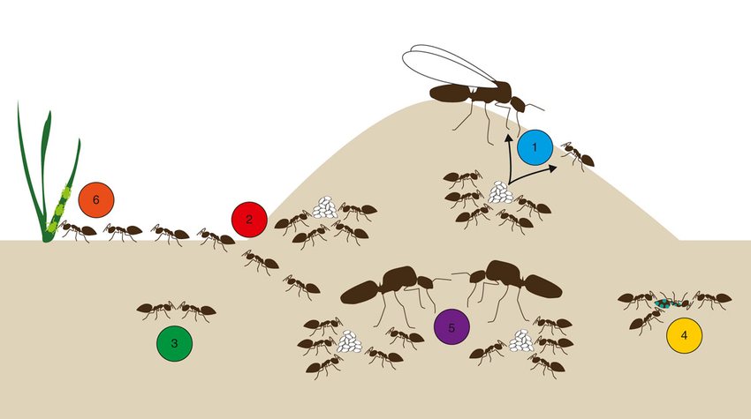
PROBLEM STATEMENT:
A TRAVELLER TRAVEL 52 LOCATIONS IN BERLIN IN DIFFERENT ROADWAYS THEIR NODE RECOGNIZATION OF DATA SET IS TAKEN THEN FIND THE SHORTEST PATH FOR TRAVELLING ALL 52 LOCATIONS USING PYTHON EXPLAIN IN GRAPHICAL WAY

Slide 5
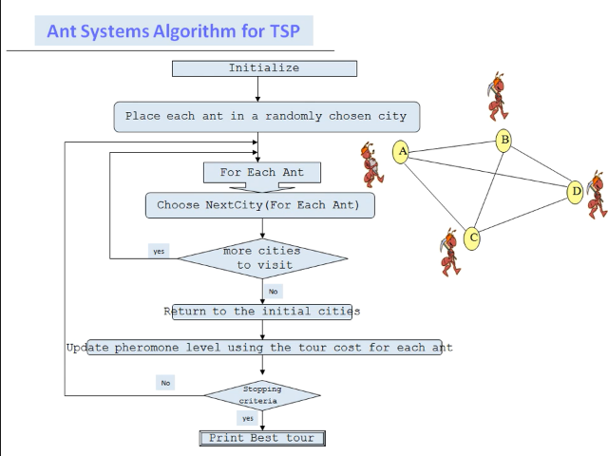



Algorithm :
probability of selection path:
In accordance with path length –
In accordance with evaporation rate of pheromone –

Slide 6
Model description:
Scope of problem
To apply ACO, the optimization problem is transformed into the problem of finding the best path on a weighted graph. The traveler incrementally build solutions by moving on the graph. The solution construction process is stochastic and is biased by a pheromone model, that is, a set of parameters associated with graph components (either nodes or edges) whose values are modified at runtime by the ants.
Solving process:
In the first step of solving a problem, each ant generates a solution. In the second step, paths found by different are compared. And in the third step, paths value or pheromone is updated. There are many optimization problems where you can use ACO for finding the optimal solution.

Slide 7
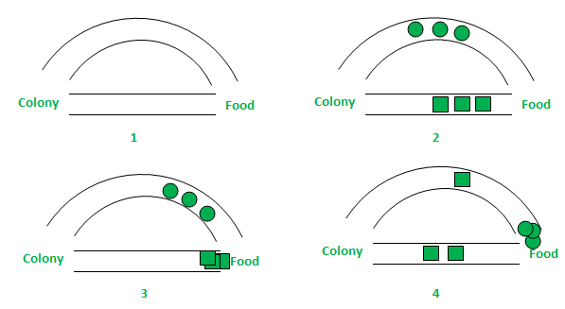
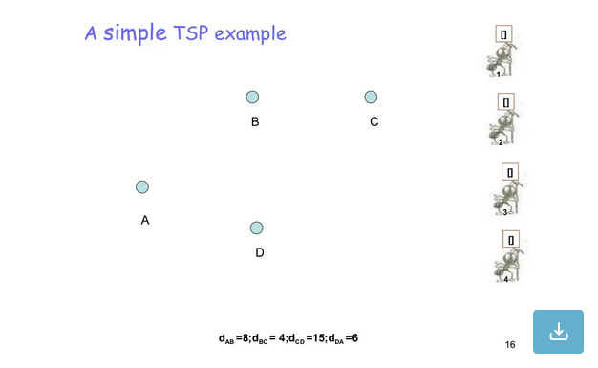
PROBLEM SOLOVING STUDY:
EXAMPLE STUDY:
QUS: INTHIS BELOW EXAMPLE DISTANCCE BETWEEN POINTS WILL BE
A TO B =8
B TO C =4
C TO D = 15
D TO A = 6
ANT COLONY METHOD

Slide 8
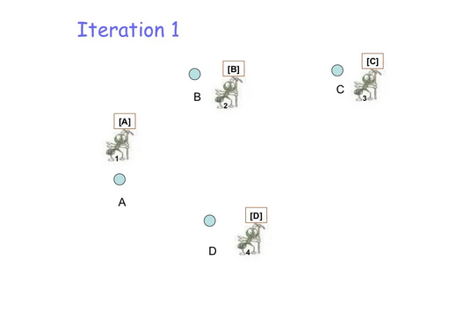
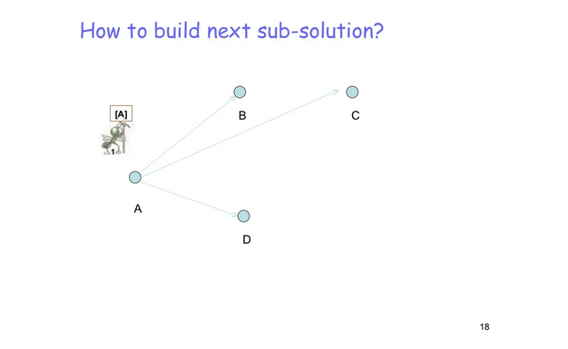
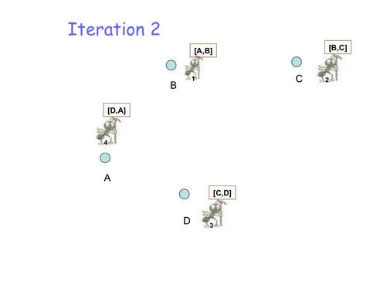
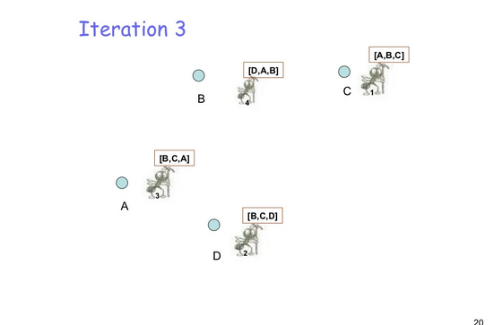
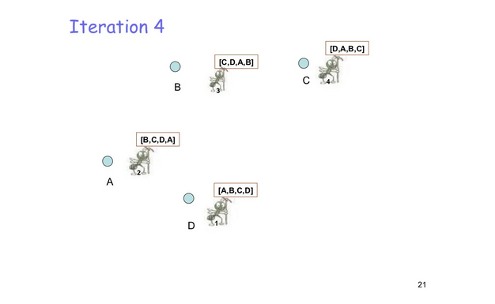
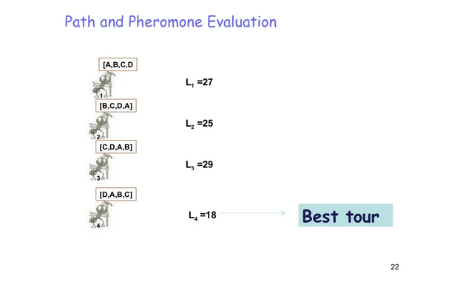
SOLVING STUDY

Slide 9


Methodology:
STEPS FOR ANT COLONY OPTIMIZATION:
1. Initialize Ants:
First it required to select a given (or arbitrary) number of ants, placed in random positions of the given TSP space
2. Ants moving via probability:
Then for each of the ants we complete a closed path i.e., from start, covering all the nodes and without repeating any of the nodes. To move an ant from one node to the next we use the following formula.
Where (tau) is the amount of pheromones and (eta) is the inverse of the distance ( ). (alpha) and (beta) are the algorithm's parameters. They are used to give weight to the distance or pheromones while selecting the next node.
3. Deposit of Pheromones: When an ant moves from a node to the next, it leaves a trail for the next ant to follow, the more ants follow the same path, the stronger the pheromone trail gets. Pheromone trails are incremented by.

Slide 10

Where (delta_tau) is a parameter and is the iteration number.
4. Evaporation of Pheromones:
After each iteration, the pheromones also tend to evaporate. The evaporation of pheromones are given as.
where (rho) is the evaporation rate.
5. Ending condition:
We can use any condition to terminate the search, such as a distance below a certain threshold. In this implementation, the ending condition
will be the number of iterations

Slide 11
Model evaluation components:
In this project we are designed the shortest path for a traveller to travel who travels over Berlin and kroA.
We are using the probability method to find the shortest path over the cities based on there latitudes and longitudes.
We are having 3 start points to visit all the 52 locations according to ACO to get the minimum distance from each start points.
In feature we will expand this project in google maps so that the traveller can easily choose the best path for travelling among which places the traveller visit.

Slide 12
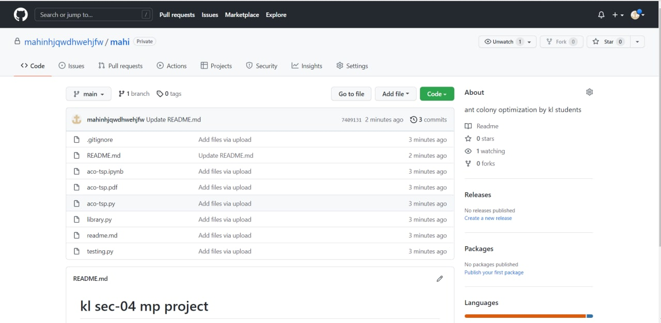
GitHub commits:

Slide 13
Programming language:
Python
datasets:
berlin52.tsp
Kroa1 00.tsp
( taken from internet)

