Slide 1

Result Management System
Group members
Himu Roy (210201011)
Mahin Reza (210201016)
Muammar Tejwar(210201024)
Fahmid Faisal Fahim(210201030)
Supervisor:
Hasan Muhammad Kafi
Assistant Professor
Department of Computer Science and Engineering
Bangladesh Army University of Science and Technology

Slide 2
Introduction
Welcome to this presentation of our future project on Result Management in PHP language
In this presentation, we will explore the use of Database in results, common challenges faced for making result and best practices for Result Management and tools that can help simplify the process.

Slide 3
Objectives
Make results easy to maintain of an institution
Makes result Review and publish Much easier
Easy for students to access

Slide 4
🔨 Tools
HTML
CSS
Boostrap 5
PHP
MYSQL
JavaScript

Slide 5
Problem Definition
In traditional way of managing result can be tough. The problems it faces mainly are:
Lost of data due to keeping record in traditional paper
Miscalculations during calculating total result, grade etc.
Data corruption
Hard for students to access result whenever they need
Editing previously mistaken data

Slide 6
Solution
Solving Pervious problems through Database:
We can solve these problems easily by including database and a user friendly interface. The improvements over manual result managements will be:
Less chance to loose data permanently
Lesser chance of data corruption
Easy to manage and edit data of the students
Students can see their results whenever they want

Slide 7
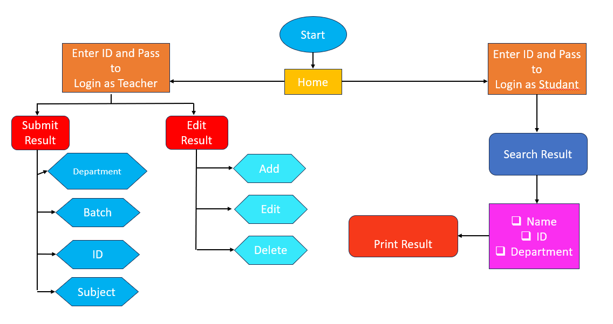

Slide 8
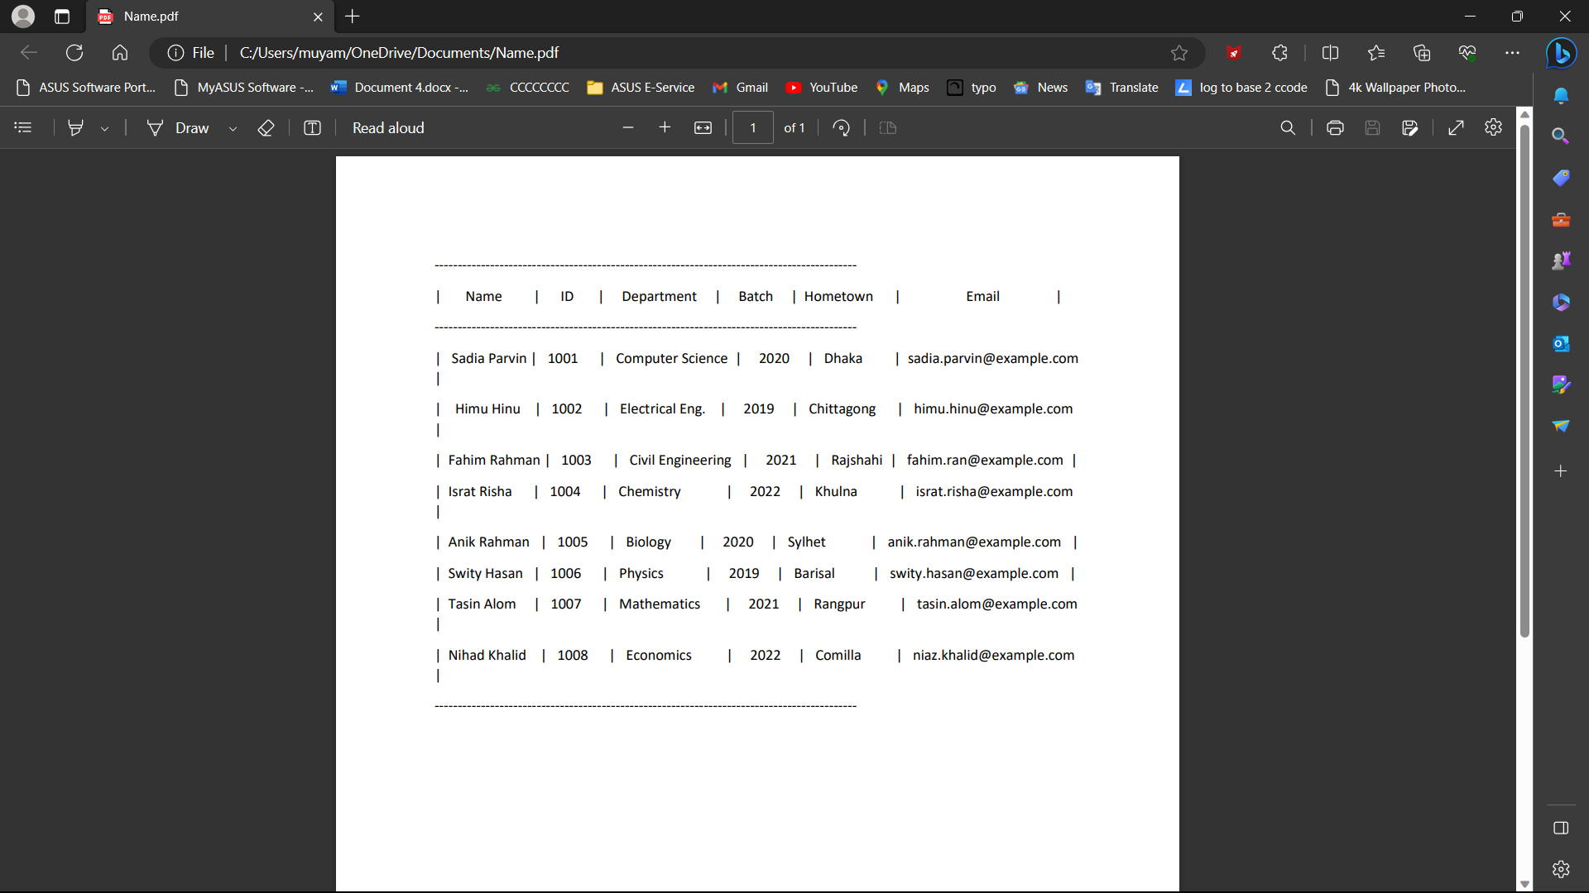
A vartual Reprentation of a Database

Slide 9
Related Available Project
Office Management System
School Management System
Bank Management System
Hotel Management System
Library Management System

Slide 10
Conclution
In conclusion, we have learned that Database is critical aspect result management and any system that involves data processing.
Using PHP for result management has many benefits, including its ease of use, versatility, and robustness.
Other programming languages are used in result management system to make it efficient, reliable, and secure.

Slide 11
Referance
www.google.com
www.mysqltutorial.org
www.youtube.com
www.w3schools.com
www.tutorialspoint.com
www.codeacademy.com
www.researchgate.net

Slide 12
THANK YOU!

