Slide 1
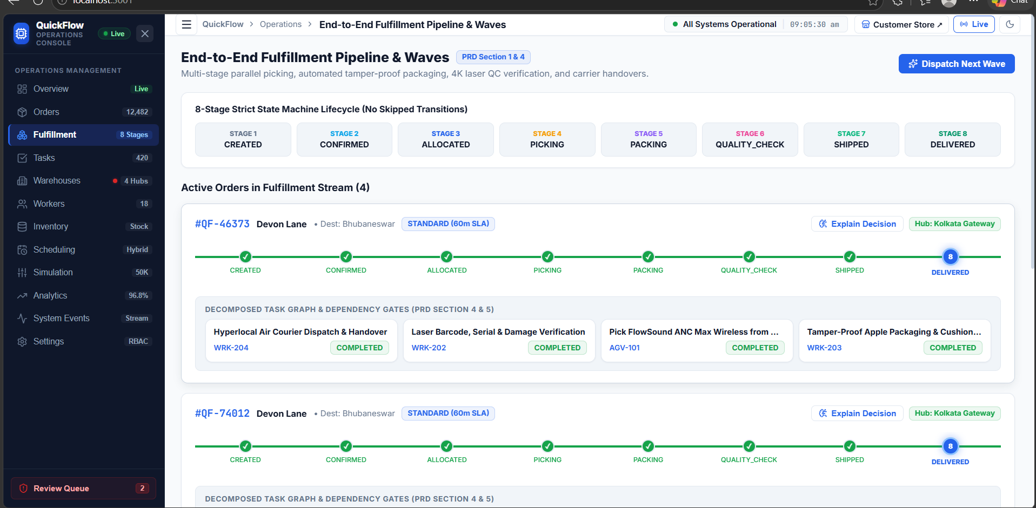
QUICKFLOW
QuickFlow
Logistics & Fulfillment Engine
A connected workflow for order fulfillment, smart scheduling, warehouse routing and live operations.
ORDER
›
ROUTE
›
SCHEDULE
›
FULFILL
›
DELIVER
PROJECT WORKFLOW PRESENTATION

Slide 2
PROBLEM STATEMENT
Managing large-scale order fulfillment is difficult when operations are spread across multiple hubs, workers and delivery deadlines.
HIGH ORDER VOLUME
FRAGMENTED OPERATIONS
Thousands of orders must be processed together without queue delays.
Inventory, warehouse capacity, workers and tasks must stay coordinated.
ROUTING & BOTTLENECKS
SLA & VISIBILITY
Poor hub or route selection increases transit time and overloads capacity.
Static queues and limited live tracking can cause late orders and slow issue handling.
NEED: One coordinated system connecting order state, task scheduling, shortest-path routing, hub capacity and live monitoring.

Slide 3
ORDER FULFILLMENT | 8-STAGE LIFECYCLE
01
Every order moves through the same strict sequence — no stage is skipped.
1
2
3
4
5
6
7
8
CREATED
CONFIRMED
ALLOCATED
PICKING
PACKING
QUALITY CHECK
SHIPPED
DELIVERED
Order enters system
Order verified
Hub + stock assigned
Items collected
Tamper-proof pack
Barcode + damage scan
Carrier handover
Order completed
LIVE ORDER TRACKING → stage status updates continuously from CREATED to DELIVERED
SCAN / PICK FAILURE
QUARANTINED QUEUE
ADMIN REVIEW
Barcode mismatch or damaged item
Order paused for review
Resolve issue → re-route / resume
Dashboard views: Orders • Fulfillment • Tasks • Inventory • Review Queue

Slide 4
TASK SCHEDULING | PRIORITY & DEADLINE FLOW
02
The scheduler chooses the next task from one shared queue and can re-order work dynamically.
TASK QUEUE
SCHEDULER
WORKER / AGV
TASK UPDATE
New picking, packing and QC tasks
Evaluate urgency + deadline
Dispatch selected task
Complete → queue refresh
FOUR SCHEDULING POLICIES
FIFO
PRIORITY
DEADLINE (EDF)
HYBRID
Arrival order
Value / urgency
Earliest due time
Priority + deadline
Simple chronological processing
VIP and high-value tasks first
Protect delivery SLA cutoffs
Dynamic score; active strategy
DEADLINE ESCALATION
≤ 15 min cutoff
Priority +4 levels
≤ 30 min cutoff
Priority +2 levels
> 30 min remaining
Normal weighting

Slide 5
WHAT-IF SIMULATION | CAPACITY & SCHEDULER OPTIMIZATION
03
Before a workload is executed, the system tests different order volumes and scheduling strategies.
INPUT PARAMETERS
RUN SIMULATION
COMPARE 4 POLICIES
RECOMMEND
Order volume • workforce • strategy
Up to 50,000 orders
FIFO • Priority • EDF • Hybrid
Select best configuration
EST. COMPLETION
PREDICTED LATE
THROUGHPUT
UTILIZATION
8.2 hours
225 orders
6,098 /hr
94.2%
OPTIMIZATION LOOP
Simulated hub load
& bottleneck detection
Adjust workforce,
volume or strategy
Re-run until SLA + throughput
meet target
Output feeds the live scheduling configuration.

Slide 6
WAREHOUSE NETWORK | CAPACITY & SHORTEST-PATH ROUTING
04
Orders are assigned to a suitable hub; capacity alerts can trigger load balancing.
DELHI SUPERHUB
MUMBAI MEGAPORT
HYDERABAD HUB
KOLKATA GATEWAY
72% occupied
84% occupied
61% occupied
96% critical
14 staff • 45 AGVs
18 staff • 62 AGVs
12 staff • 38 AGVs
13 staff • 37 AGVs
ORDER DESTINATION
DIJKSTRA ENGINE
SELECT HUB
DISPATCH
Bhubaneswar gateway
Compare route cost
Shortest / optimal vector
Send to hub queue
ROUTE COMPARISON → SELECT LOWEST-COST VALID PATH
MUMBAI
DELHI
HYDERABAD
KOLKATA
1,640 km • 1.4 ms
1,500 km • 1.2 ms
1,050 km • 0.7 ms
440 km • 0.5 ms
Higher cost
Higher cost
Alternative
SHORTEST PATH
KOLKATA NEAR CAPACITY → SHIFT BUFFER VOLUME TO HYDERABAD

Slide 7
QUICKFLOW | COMPLETE OPERATIONS WORKFLOW
One connected flow from order intake to delivery, with scheduling, routing and monitoring.
ORDER
INVENTORY
HUB ROUTING
SCHEDULING
EXECUTION
DISPATCH
DELIVERY
Created + confirmed
Reserve stock
Dijkstra selects hub
Hybrid queue orders tasks
Pick → Pack → QC
Carrier handover
Close order
SIMULATION & OPTIMIZATION
LIVE MONITORING & EXCEPTION HANDLING
Test 50K workloads → compare schedulers → tune capacity → update active strategy
Track orders, tasks, workers, inventory, hubs, analytics and system events
EXCEPTION: scan / pick failure → quarantine queue → admin review → re-route or resume order

