Slide 1

E commerce
KEY TO HAPPINESS

Slide 2
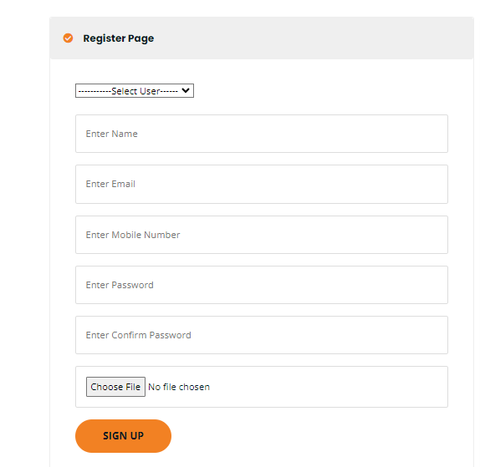
Sign up
Login
Registration
View category
View sub category
View payment
Logout

Slide 3
Project Module
Admin module
User module
Buyer and Seller

Slide 4

Customer login
Login
Registration

Slide 5
introduction
e-commerce Finder is an user friendly website which enables the people to easily locate authorized e-comm only.
Time has been an important factor in everyone's life and when people move to different places to study or to work they definitely have to waste time in searching for e-comm OR HOME.
This website turns to be very time saving for us.
The proposed PG finder will be easier to find new hostel/room in unknown places.

Slide 6
Tools T
Processor | Intel Core i5 12th gen
RAM | 16 GB
Hard Disk | 512 GB

Slide 7
Technology
Operating System | Windows 11
Front end | HTML 5,CSS 3
Back end | Mysql , Python
Framework | Django

Slide 8
ABOUT PROJECT
Ecommerce is a method of buying and selling goods and services online. The definition of ecommerce business can also include tactics like affiliate marketing. You can use ecommerce channels such as your own website.

Slide 9
Existing System
Due to lack of information like price, exact location, security measures, the customer is unable to find the best of their choice ON A TIME.
Often the customer may be misguided.
IT’S A VERY TIME TAKEN AND USER INTRACT WITH WEBSITE IS SO DIFFICULT

Slide 10
Admin
Login
Carts
Wishlists
products

Slide 11
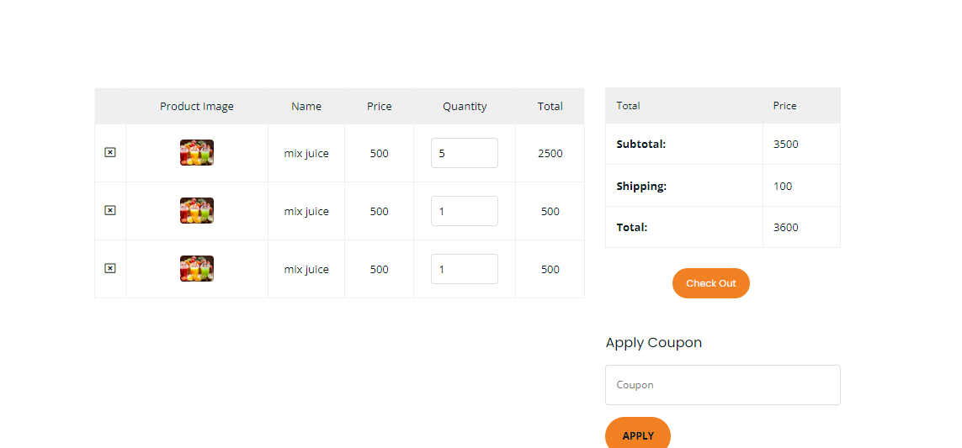
Add to cart

Slide 12
THANK YOU

