Slide 1
Space
Technology
Here is where your presentation begins

Slide 2
Problem
Statement.
Possible Asteroid Impacts with Earth
Climate change

Slide 3
Table of contents
1
Introduction
Data collection & preparation
2
3
Descriptive statistics
4
Visualization of data
5
Predictive modeling
6
Case studies
7
Conclusion & References

Slide 4
1
Introduction

Slide 5
Introduction
Possible Asteroid Impacts with Earth
An asteroid's orbit is determined by fitting an elliptical path around the sun to match observed positions over time. As more observations improve the orbit's accuracy, future positions become more predictable. Upon discovery, the Minor Planet Center prioritizes impact risk analysis. If necessary, the asteroid is queued for further analysis based on its potential impact likelihood.

Slide 6
Introduction
Climate change
There have been many studies documenting that the average global temperature has been increasing over the last century. The consequences of a continued rise in global temperature will be dire. Rising sea levels and an increased frequency of extreme weather events will affect billions of people.

Slide 7
Data collection & preparation
2

Slide 8
Dataset & Prediction
Data set
We collect data form Kaggle website and the data is like Name, orbit, and year range for impacts predicted by Sentry system

Slide 9
3
Descriptive statistics

Slide 10
Descriptive statistics
Data Cleaning Preprocessing Handling Missing Data Outliers Descriptive Statistics

Slide 11
Visualization of data
4

Slide 12
Visualization of data
Histograms and Box Plots of Asteroid Sizes Scatter Plots of Distance vs. Size and Speed Time Series Plots of Asteroid Approaches Heatmaps for Close Approaches by Region Risk Assessment

Slide 13
5
Predictive modeling

Slide 14
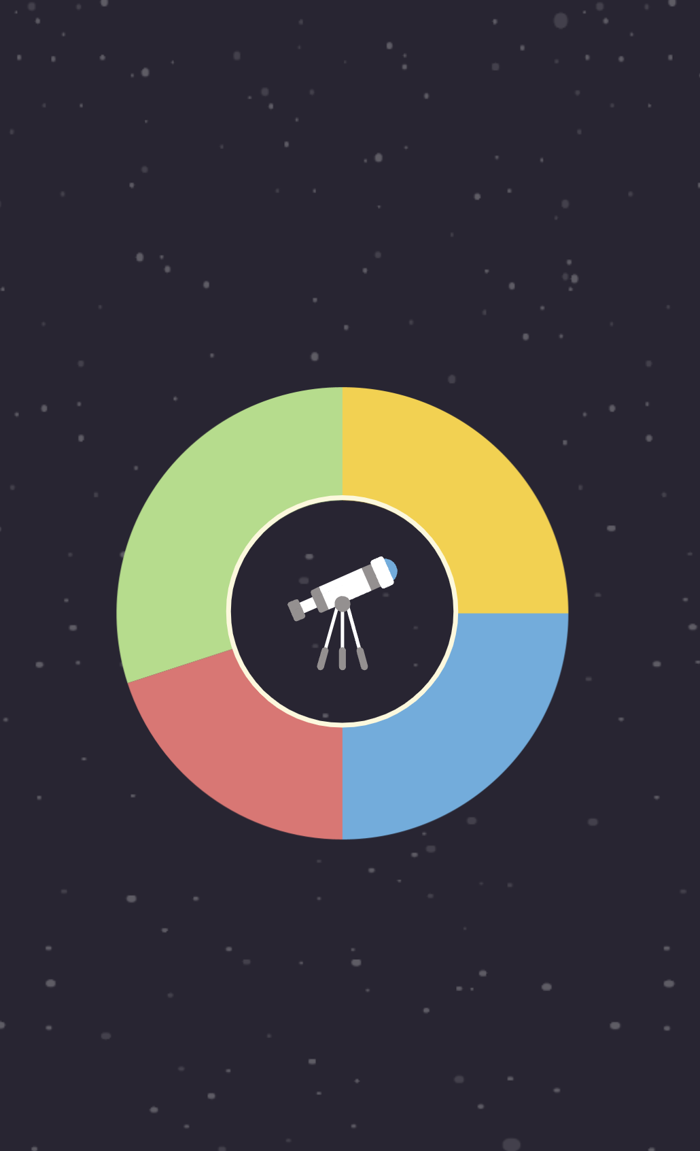
Predictive modeling
Regression Analysis for Predicting Close Approaches Machine Learning Models for Impact Risk Prediction Validation and Testing of Predictive Models Case Studies

Slide 15
6
Conclusion & References

Slide 16
Case studies
Interpretation of Results Limitations and Assumption simplications for Public Policy and Safety Conclusion

Slide 17
Conclusion & References
7

Slide 18
Conclusion & References
During which year is Earth at the highest risk of an asteroid impact? How do asteroid impact predictions change over time? Which possible asteroid impact would be the most devastating, given the asteroid's size and speed?

Slide 19
Team name : TECHEON
Shailee
Diya
Mahi
Bhumi

