Slide 1
Tool Page Decision Descriptions
What follows are detailed screenshots of the Tool, with comments calling out the specific functionality, relationship, or other clarifier of each the Tool’s variable features.
If you have any questions, please reach out directly to sagar.bansal@bts.com and trevor.ladd@bts.com for the most immediate response. THANK YOU!

Slide 2
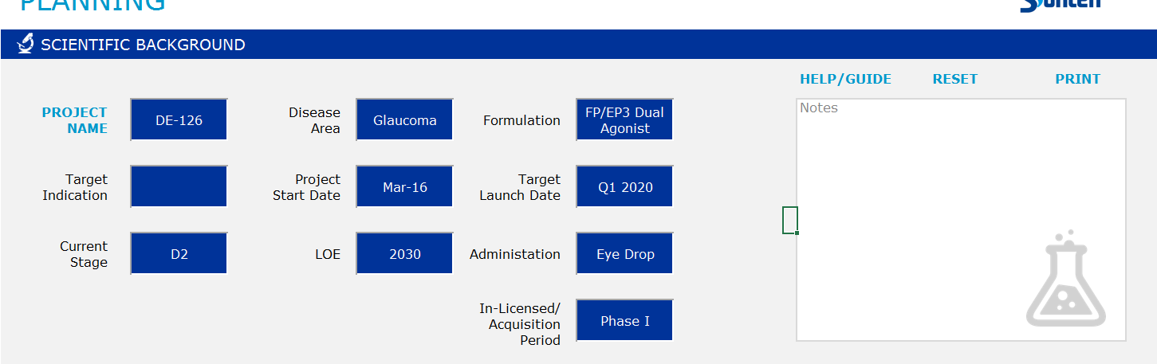
Would pull up the .pdf Guide to be attached.
Would want comment boxes, “tool tips,” on each label below, i.e. “Disease Area, Formulation, Start Date, etc.”
Drop-down input with 3 options
Drop-down input with 4 options
Wipes all decisions after checking to make sure the user is “SURE”
All other decisions cells in green here can be “free entry” cells without restriction for the users reference only.
Would print summary sheet of planning page; see word.doc separate
Free-flow text box where they can make remarks up to 5 – 6 sentences.
The year entered in this cell will be referenced in the model, so perhaps this is a dropdown from 2017 – 2040?

Slide 3
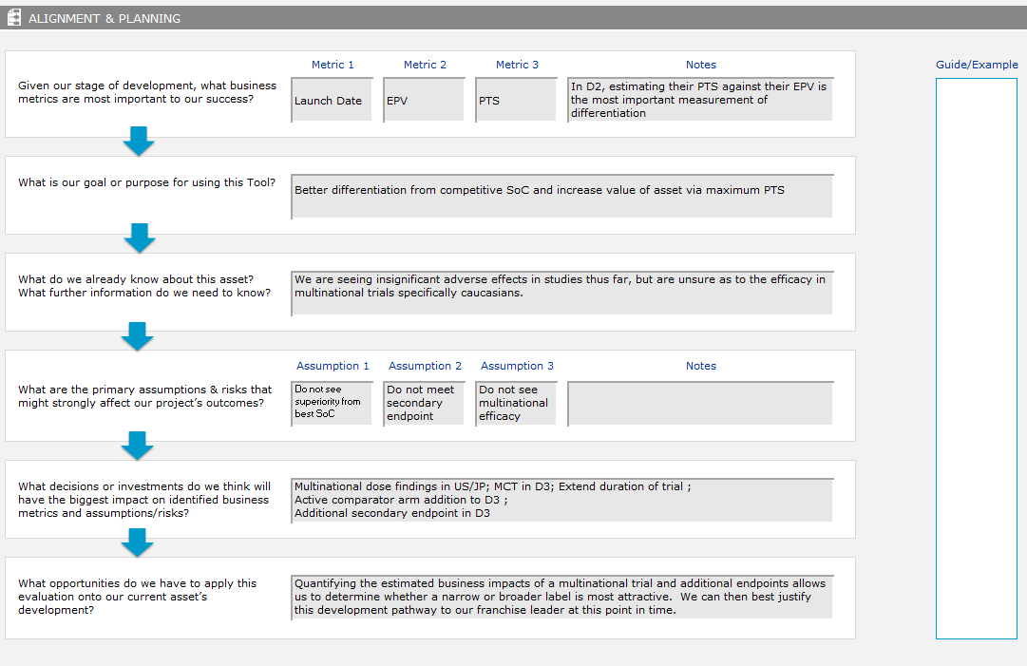
Each of these three is a drop-down with XX options (TBD)
What are we doing with this site space for “examples”?
Each of these assumptions will need to be long enough for approx. 2 sentences of text.
All other text boxes on this page are free text cells, with enough room for 4 – 5 sentences of text.

Slide 4
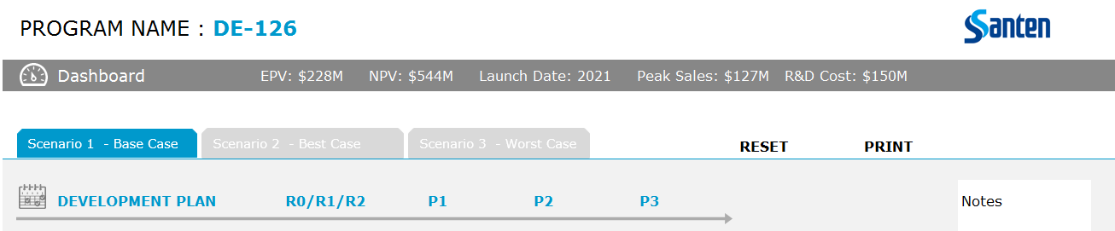
Project Name refers to the name entered next to “Project Name” on the first slide.
Dashboard metrics only display the three metrics that the planning page (previous slide) shows from the dropdown.
Baselines all decisions after checking to make sure the user is “SURE”
All decisions made on the Base Case tab should become the “baselines” for other two tabs, such that the user can then adjust those other pages from that starting place. Do we need a commit button for that to operate? Where?
Would print summary sheet of decisions page; see word.doc separate

Slide 5
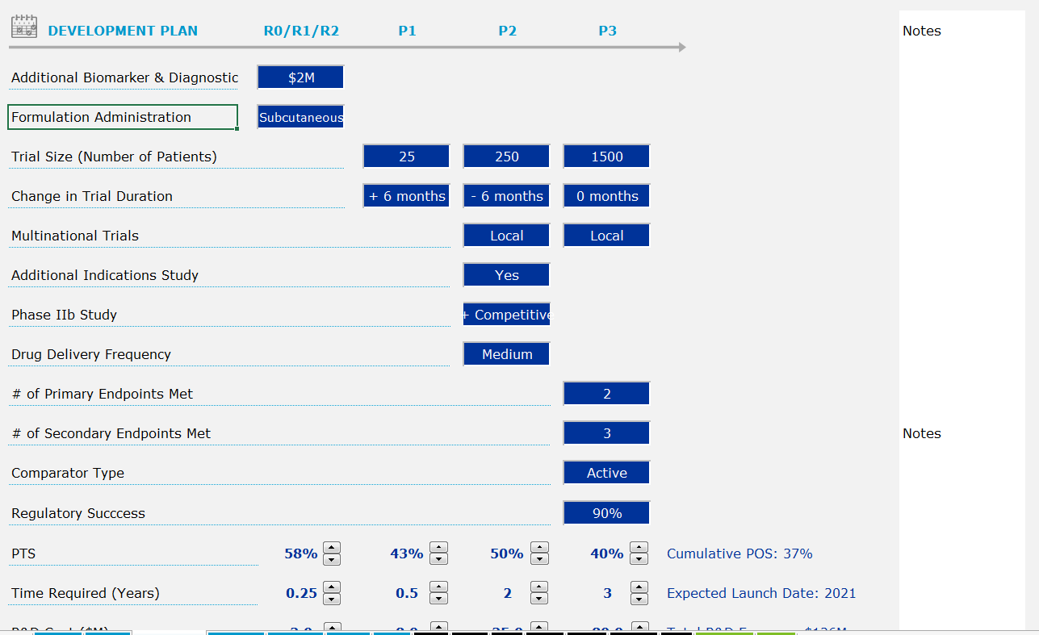
Each of these will be drop-down menus with between 3 and 5 options at most
Would want comment boxes, “tool tips” on each of these labels
Provide for a free-flow notes section to the side to allow for the user to make comments on decisions throughout
This will be a manual input between 1% and 100%, baseline at 90%

Slide 6
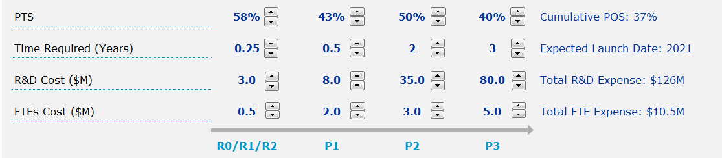
Would want comment boxes, “tool tips” on each of these labels
Each of these will be outputs of the decisions just above, with baselines & adjustments provided by the tool’s backend. However, after making the adjustments above, the user also has flexibility to manually increase or decrease each by 1%, 0.25, 0.1, and 0.1 respectively.
Each of these are simply the average (POS) or sum (all others) of the columns before.

Slide 7
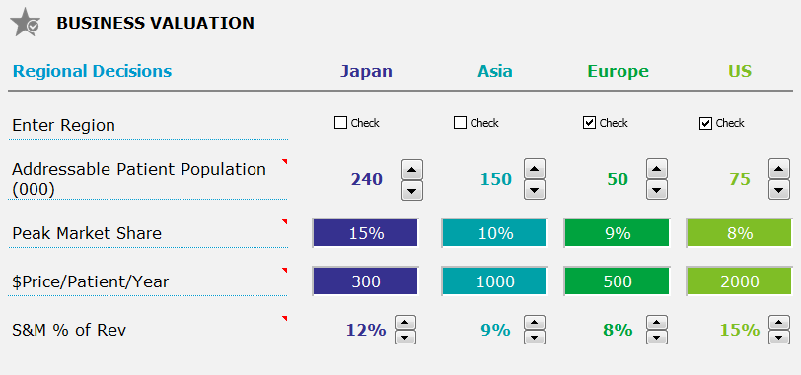
Check boxes either activate, or deactivate, each of these four columns. Only active columns will feed into the model.
Output from a baseline, affected by certain decisions cells above, and manually adjusted by 5 units
This row is free input cells bound between 1% and 100% and with variable baselines defined by the backend model.
Would want comment boxes, “tool tips” on each of these labels
This row is free input cells bound between 1 and 100,000 and with variable baselines defined by the backend model.
This row will be manually adjustable with variable baselines defined by the backend model.

Slide 8
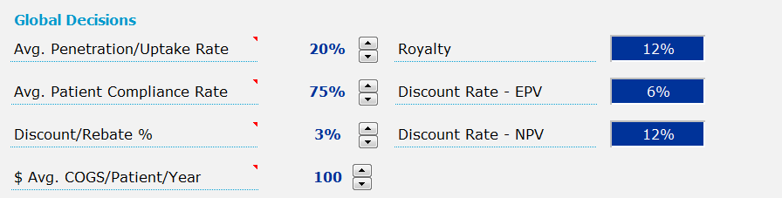
Manually adjustable outputs, defined by baselines in the backend model, adjustable by units of 1%
Manually adjustable outputs, defined by baselines in the backend model, adjustable by units of 1%
Manually adjustable outputs, defined by baselines in the backend model, adjustable by units of 1%
Manual inputs, in percentage format. Will always start at 0%, 6%, and 12% respectively.
Manual inputs, in percentage format. Will always start at 0%, 6%, and 12% respectively.
Manual inputs, in percentage format. Will always start at 0%, 6%, and 12% respectively.
Would want comment boxes, “tool tips” on each of these labels
Manually adjustable outputs, defined by baselines in the backend model, adjustable by units of 1
Would want comment boxes, “tool tips” on each of these labels

Slide 9
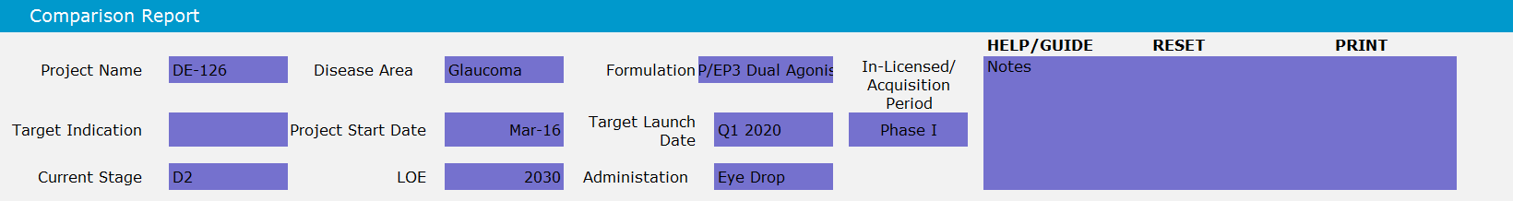
This whole sections should be a duplicate of the very first page. These are not input cells but are direct outputs of text from the first page’s inputs, as a header to the reports below.
Would print summary sheet of reports page; reports TBD

Slide 10
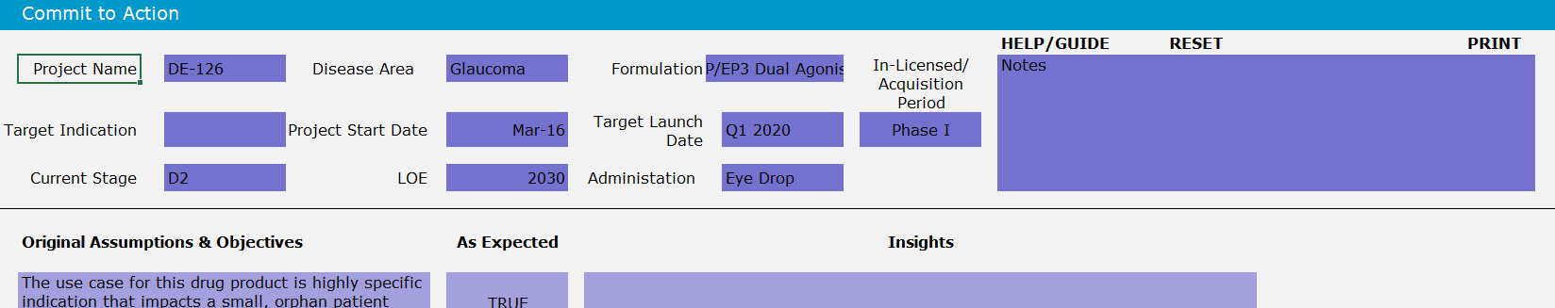
Similarly, this whole sections should be a duplicate of the very first page. These are not input cells but are direct outputs of text from the first page’s inputs, as a header to the fill-ins below.
Would print summary sheet of commitment page; see word.doc separate

Slide 11
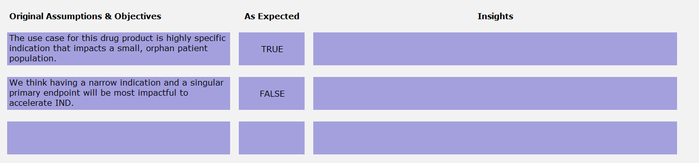
This column should pull from the first page each of the three metrics that the user chose in planning, and each of the three assumptions that the user described verbatim. Each should be its own row (6 rows in total).
Simple dropdown menu of True / False for each row.
Free text to allow the user to type 4 -5 sentences of text for each row.

Slide 12
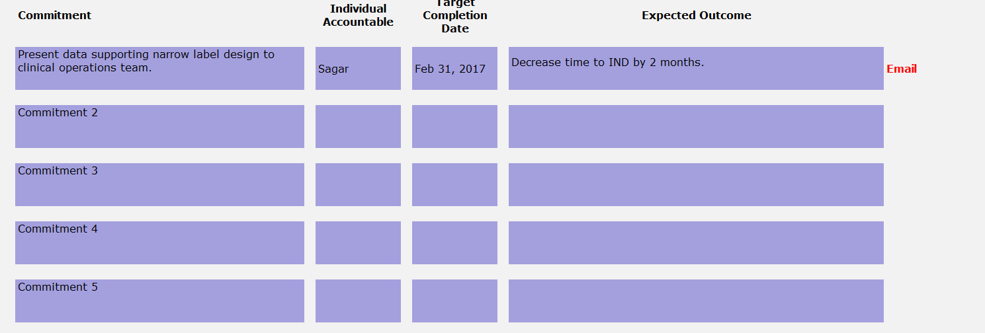
Somewhere, we would have a button that captures the text just in this section, opens the users Outlook or default e-mail, and pastes that text into the body or attachment.
All cells are decisions cells, free text. Allowing user 2 sentences in “Commitment” and “Expected Outcome.” Individual names and dates to be typed in middle two columns.

Slide 13
Additional Tool Functionality Summary
Pop-up comments, or tool tips, on most decisions on the base case
Report printing on each page, see separate reports mockups
Link to separate .pdf guide on each page with independent pages of text and images
E-mail prompt in commitments section
Landing page with multiple versions per user
“Copy button” or other means of turning decisions from Scenario 1 into the baselines for Scenarios 2 & 3 on each version of the Tool

