Slide 1
SFDC Deal Strategy BA2 Mockup

Slide 2
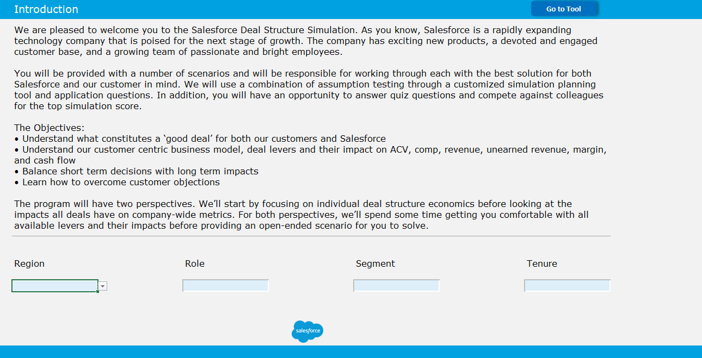
This is the intro page for the Tool. Participants will answer the 4 questions from a drop-down and the data will be used to organize participant results into different categories.
Click “Go to Tool”

Slide 3
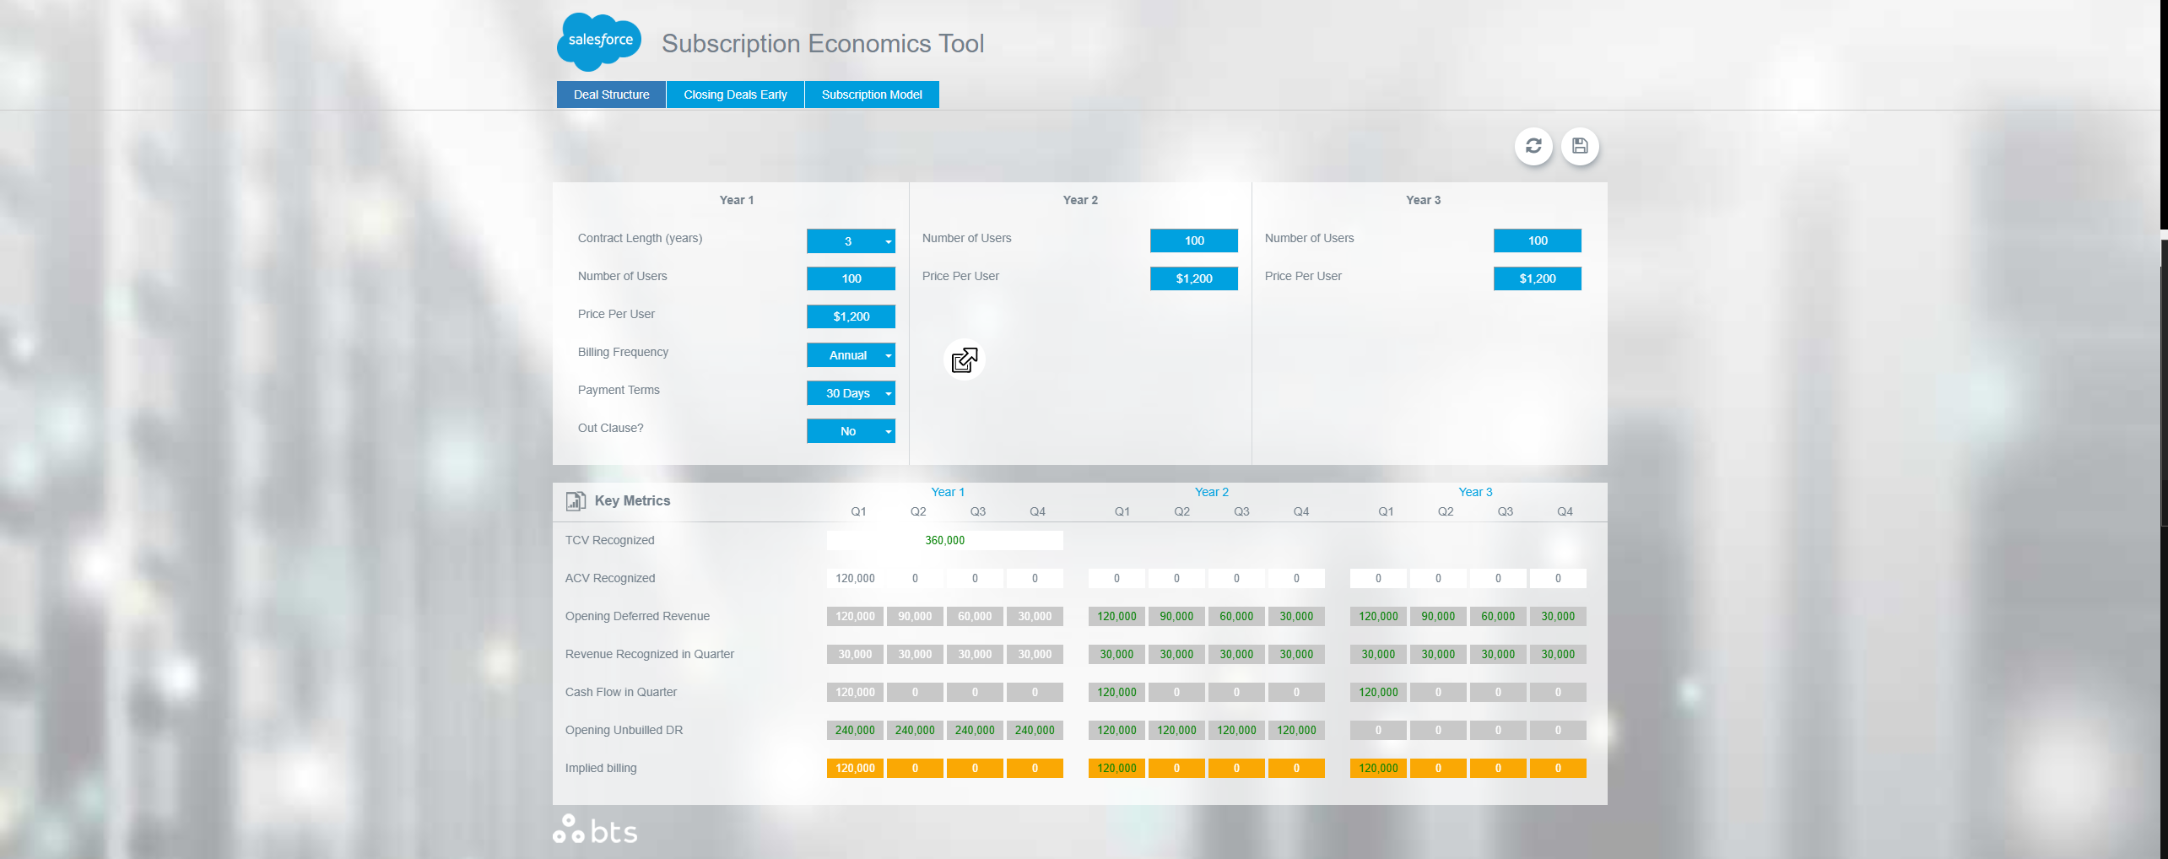
Current Tool:

Slide 4
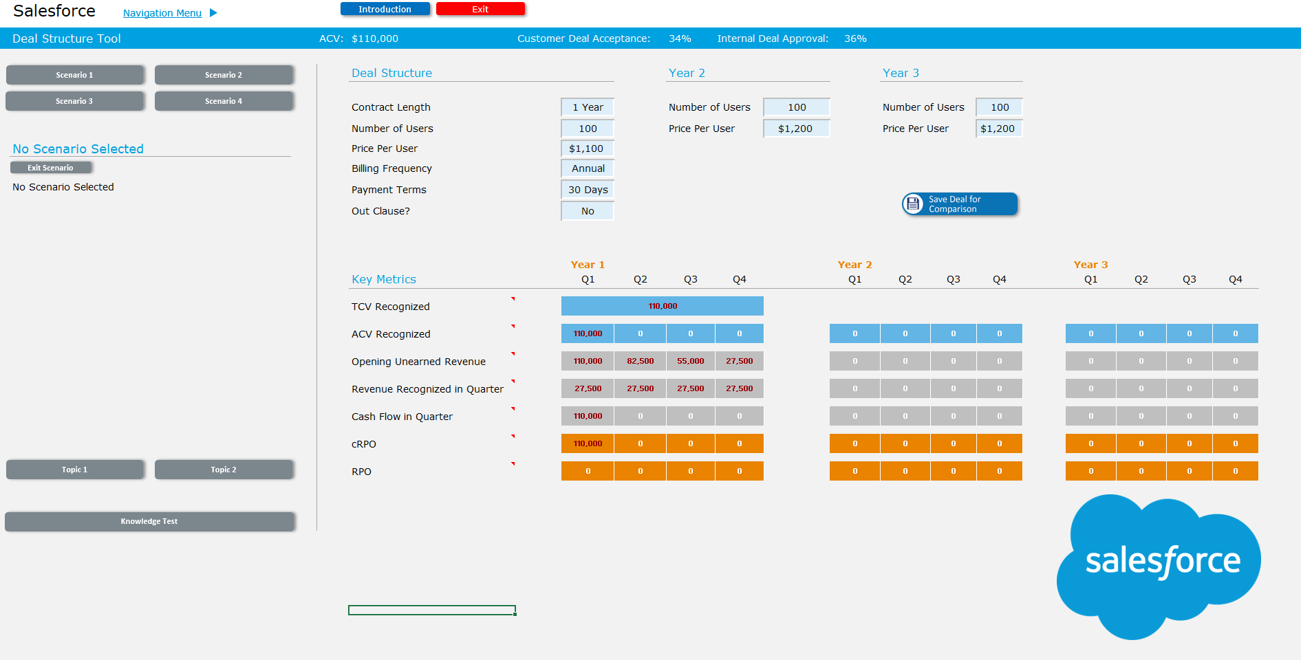
Current Excel Tool

Slide 5
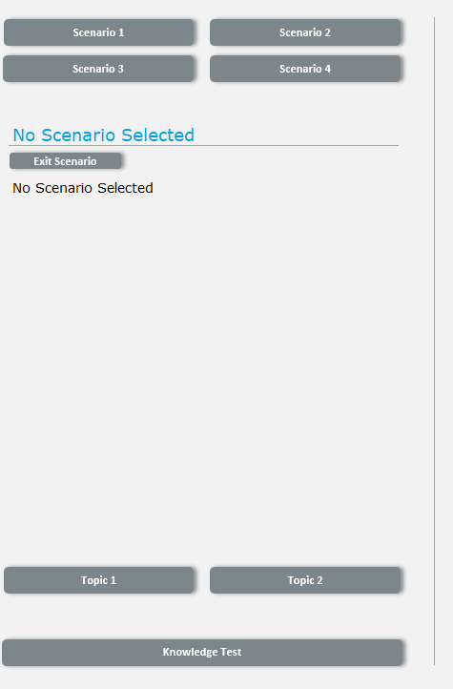
Mockup
Insert Scenario Button, Topic Button, and Explanation
Remove these buttons
Insert Dashboard from Tool

Slide 6
Mockup
Remove these buttons
Click Scenario 1 Button
Insert Dashboard from Tool
Clicking Scenario 2, 3, or 4 without completing Scenario 1 will give an error: “Please complete the previous Scenarios first”

Slide 7
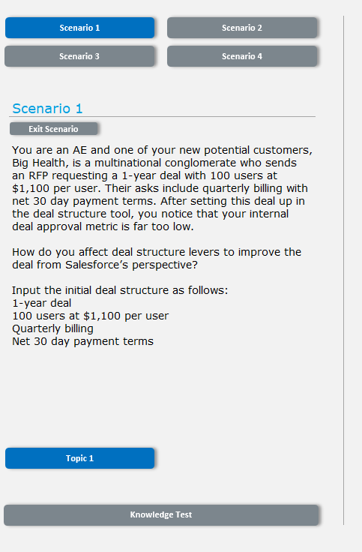
Mockup
Scenario 1 turns blue, all others remain gray
Remove these buttons
Insert Dashboard from Tool
Section Populates with information and only topic 1 button appears, and turns blue, Knowledge test still gray

Slide 8
Mockup
Remove these buttons
Insert Dashboard from Tool
Click Topic 1

Slide 9
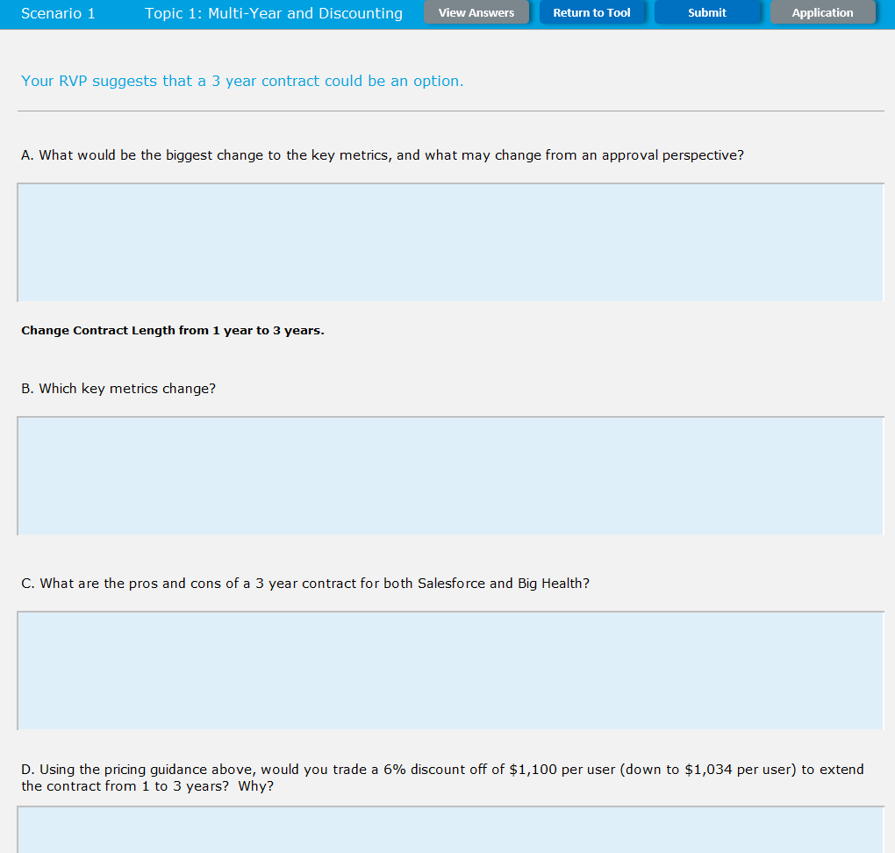
Participants are taken to a topic form where they fill out the questions
“Application” is grayed out as it is NOT available yet
“View Answers” is also grayed out and not available yet
Clicking Return to tool Returns them to the previous tool
There will be a variable number of questions in each topic.
Scenario 1 has 1 topic.
Scenario 2 has 2 topics
Scenario 3 has 1 topic
Scenario 4 has 2 topics.
Next, we click submit

Slide 10
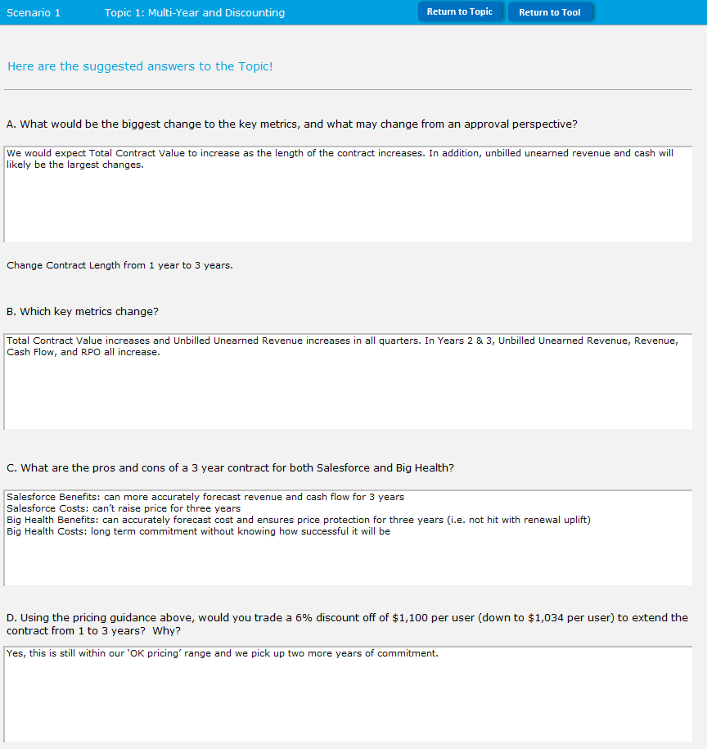
Participants will be taken to a debrief page that has all of the suggested answers to the topic question
Participants can then click return to topic to go back to the previous page.
Click “Application”

Slide 11
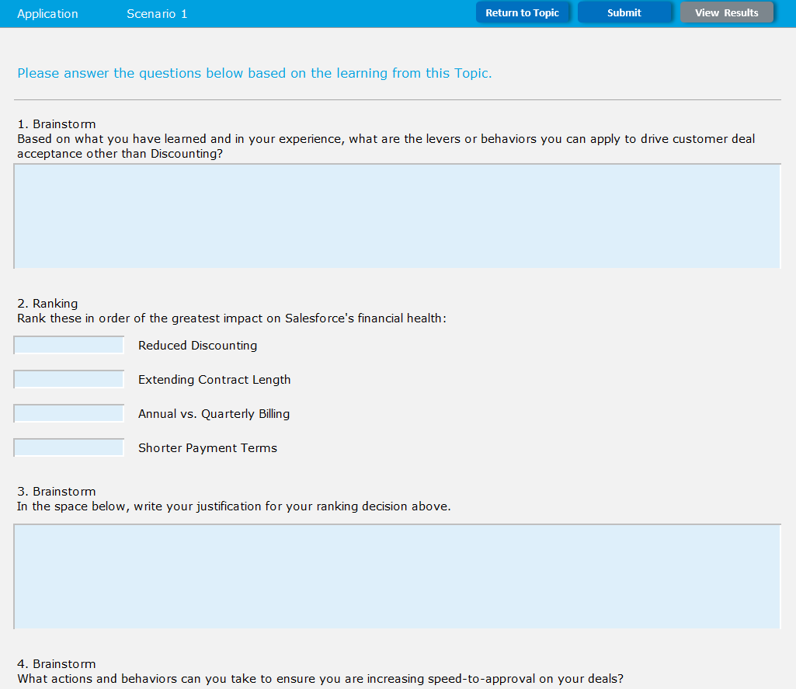
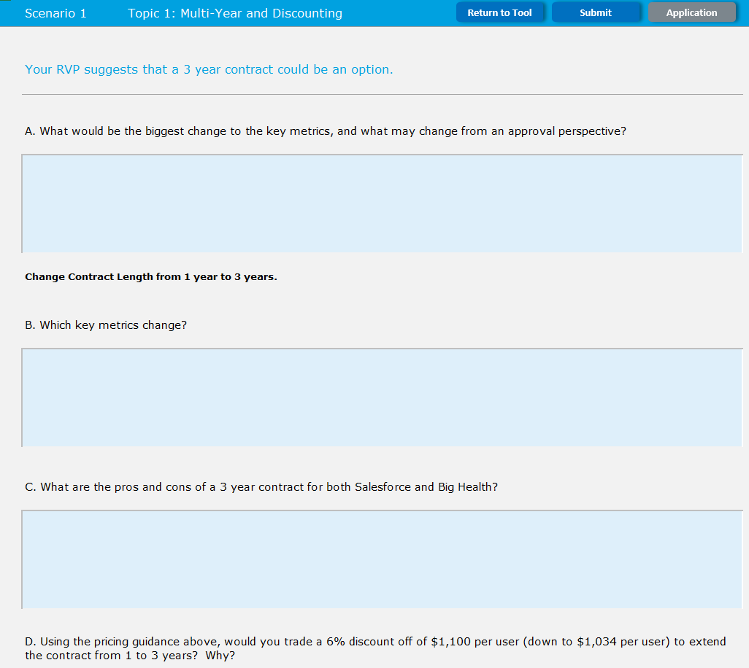
Participants will go to another section, called application, with questions.
Each application will have around 3-4 questions.
There is one application per scenario
Clicking “Return to Topic” will take them back to the Topic Page with answers filled out
Now click submit

Slide 12
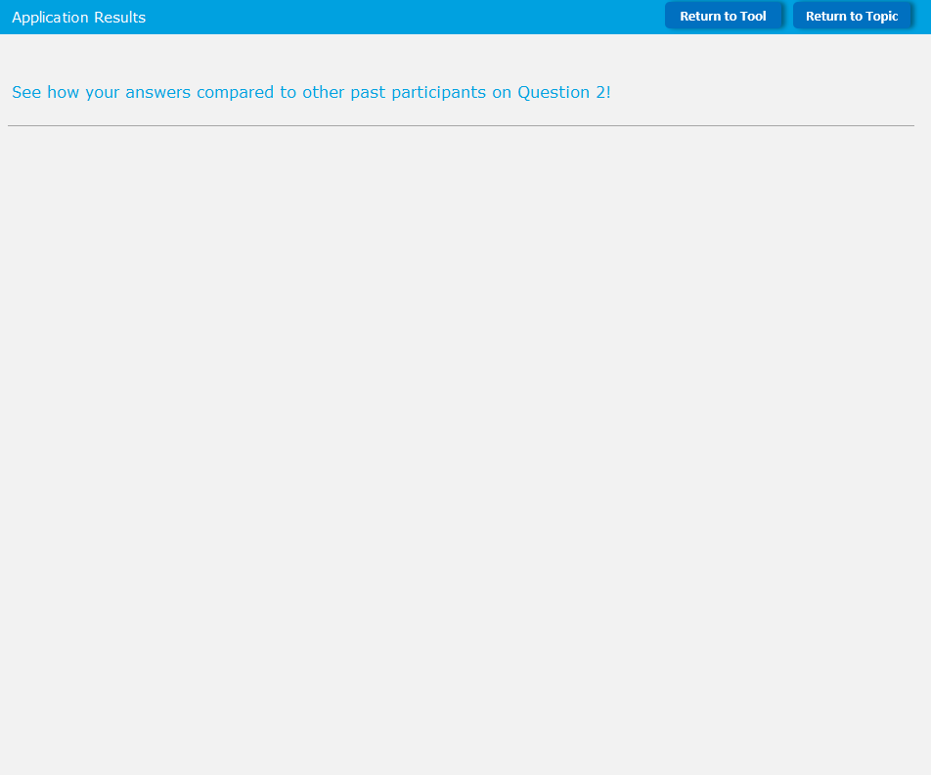
Participants will be taken to a results page that shows how their answers compared to past participants (we will talk through this later).
Clicking “Return to Tool” returns participants to the main tool
Clicking “Return to Topic” will return participants to the previous topic.
Let’s click “Return to Topic”
Topic
tool

Slide 13
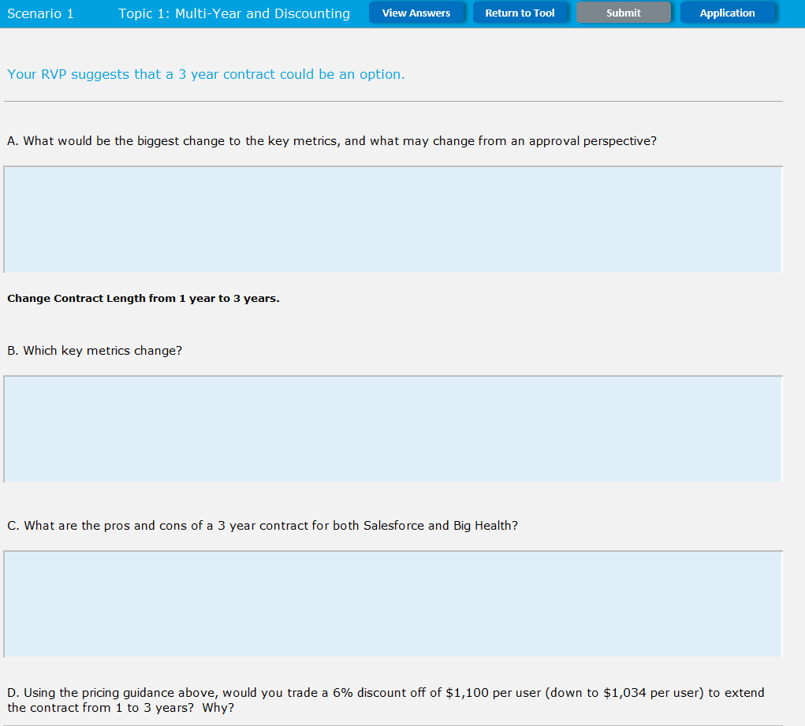
Participants return to the topic page
“Submit” has turned gray since the page was already submitted
“Application” turns blue
“view Answers” also turns blue
Now we click “Return to Tool”

Slide 14
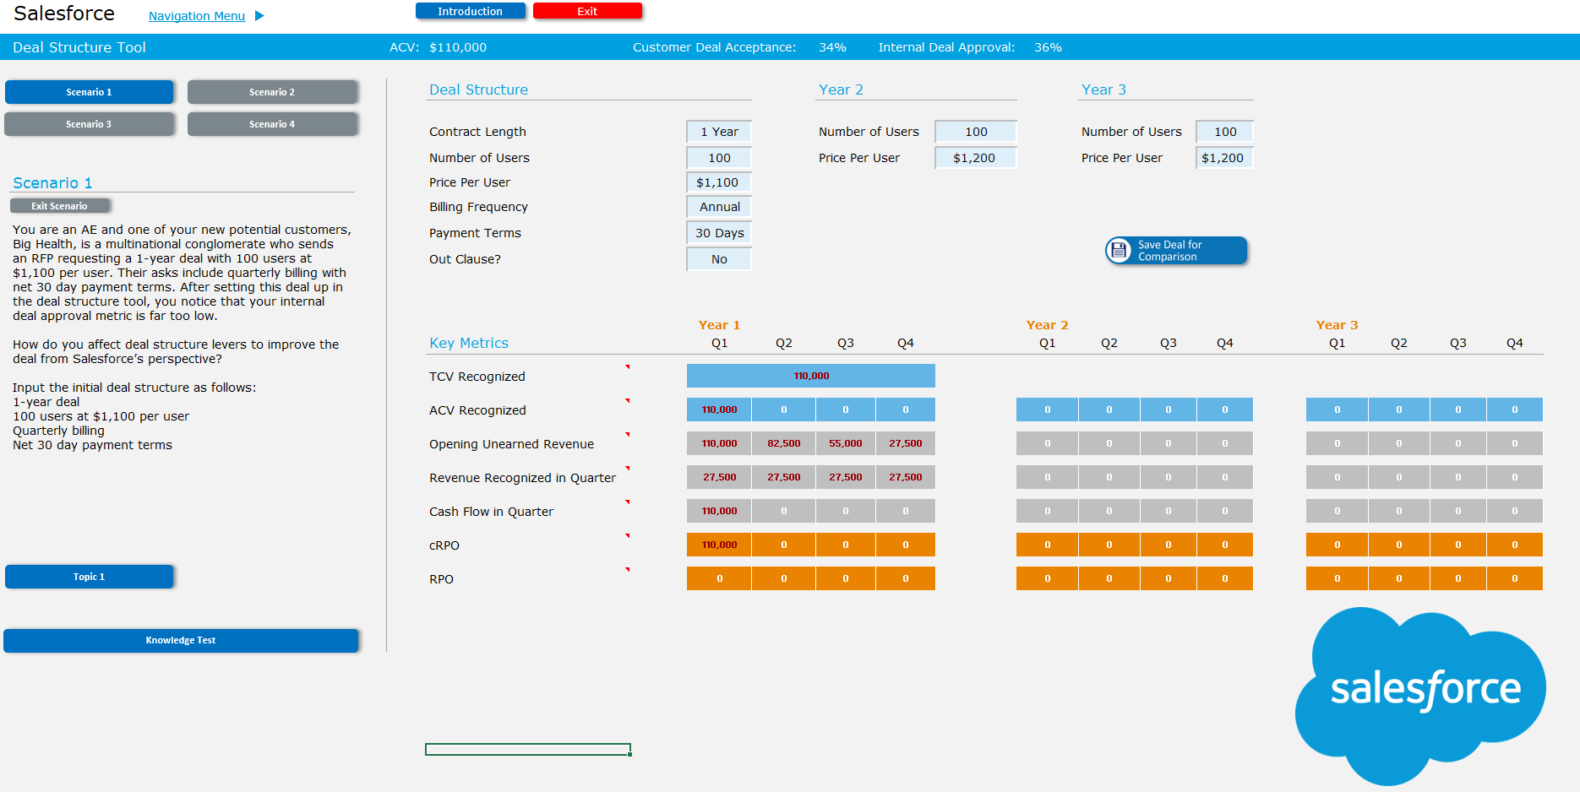
Participants return to this page. Knowledge Test has now turned blue because they have finished the Application for Scenario 1. We then click the Knowledge Test

Slide 15
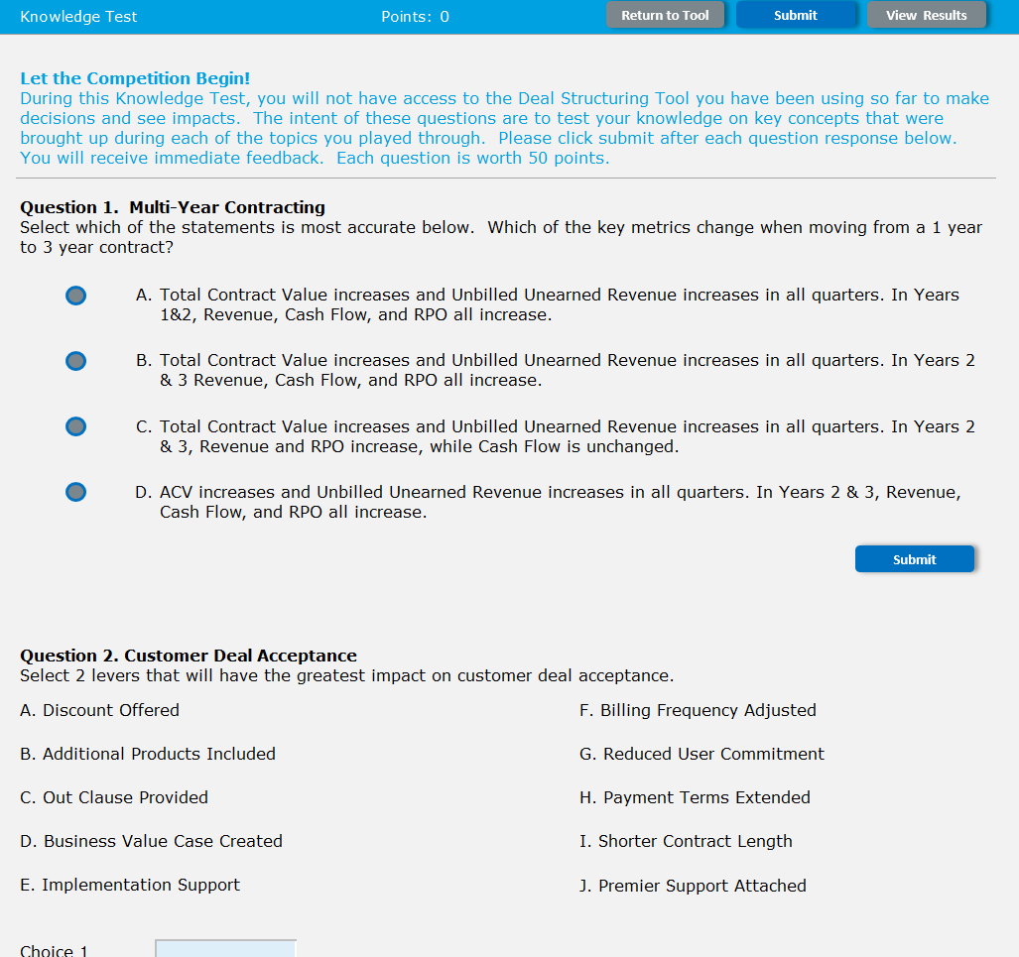
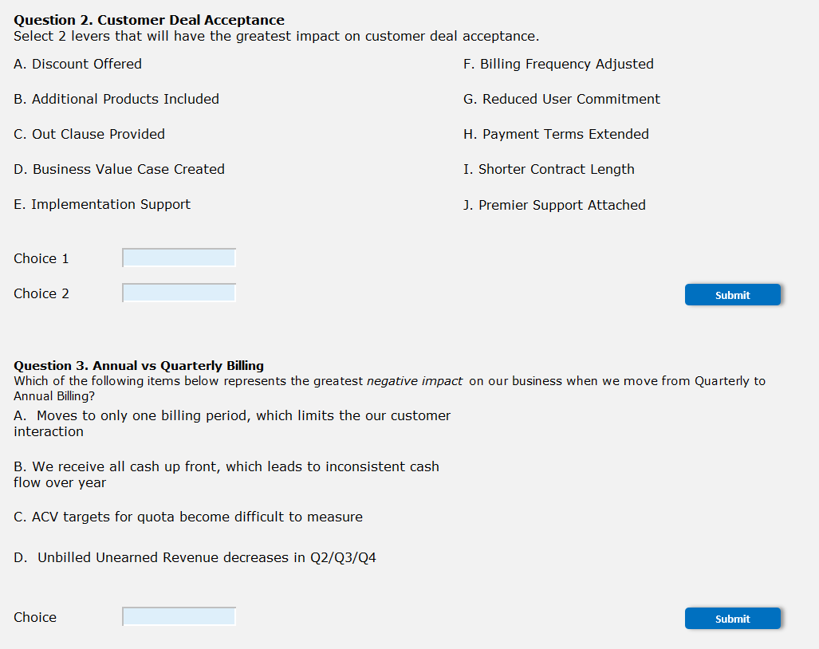
Participants are taken to a quiz with 3 different answer types:
Radial Multi-Select (Question 1)
Double Drop down (Question 2.)
Single Drop down (Question 3)
There will be 3 quiz questions for each knowledge test.
There is ONE knowledge test per scenario
12 questions total
“Return to Tool” will be grayed out – participants will not be able to exit the knowledge test until they complete it

Slide 16
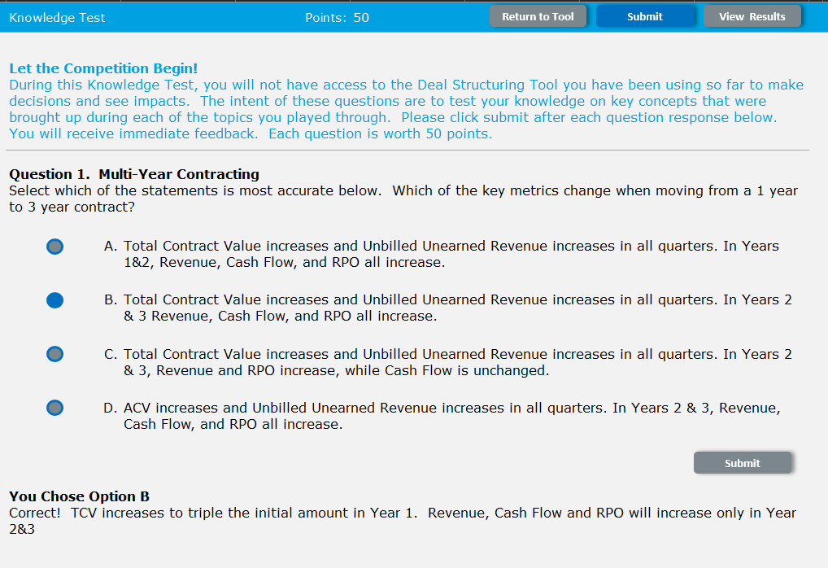
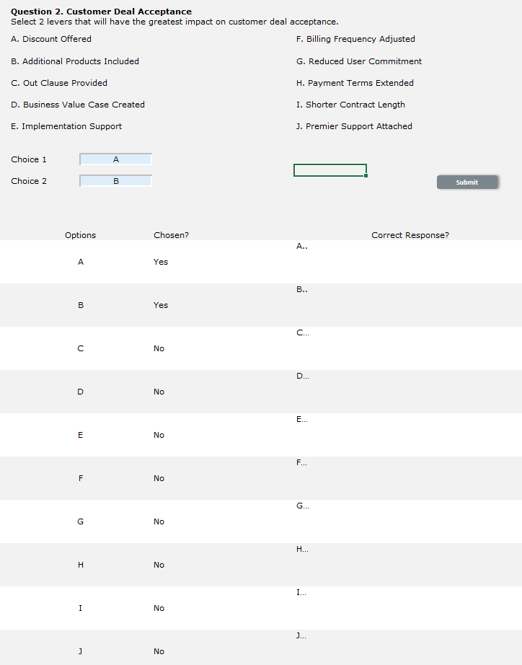
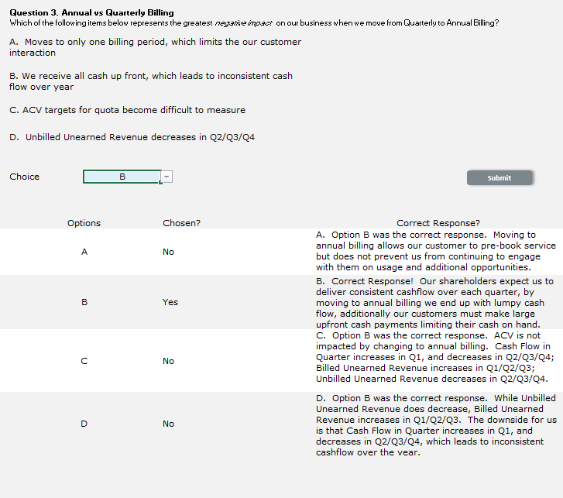
Clicking “Submit” will turn the button gray and give feedback based on the response given.

Slide 17
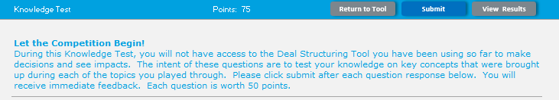
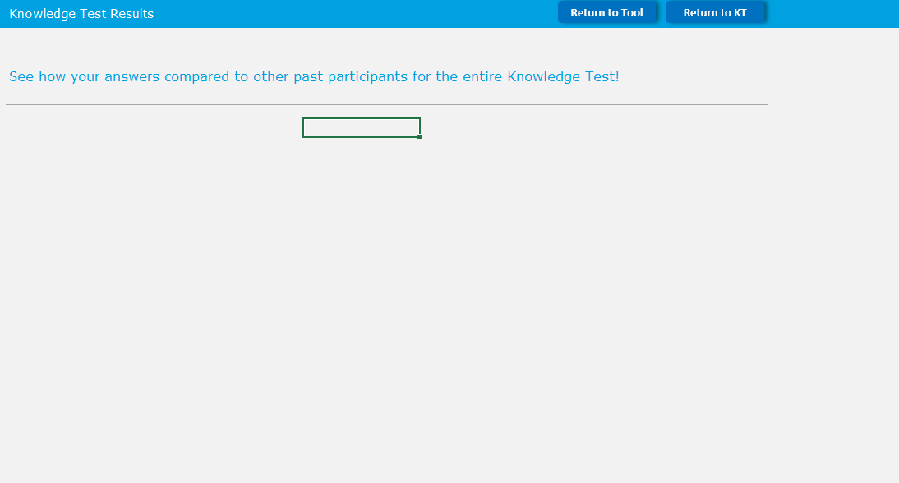
After all questions are submitted, participants can then click “Submit”
Participants will then get another screen graphically representing how their answers compared to past participants (will discuss more later)
“Return to KT” takes them back to the knowledge test
“Return to Tool” takes them back to the tool
Click “Return to KT”

Slide 18
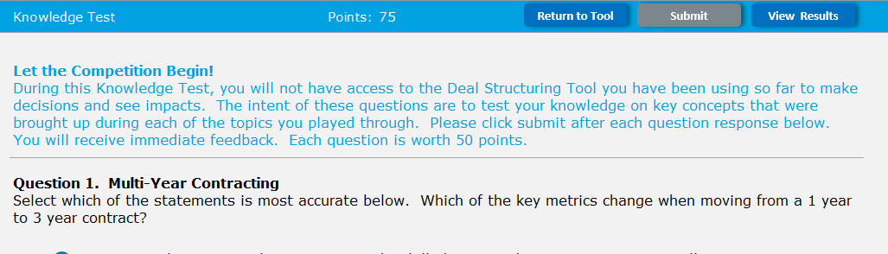
Participants will be taken back to the knowledge test page
Submit is now grayed out and when clicked will tell participants “You have already submitted the answers to this Knowledge Test.”
“View Results” will take the participant back to the graph
Now we click “Return to Tool”

Slide 19
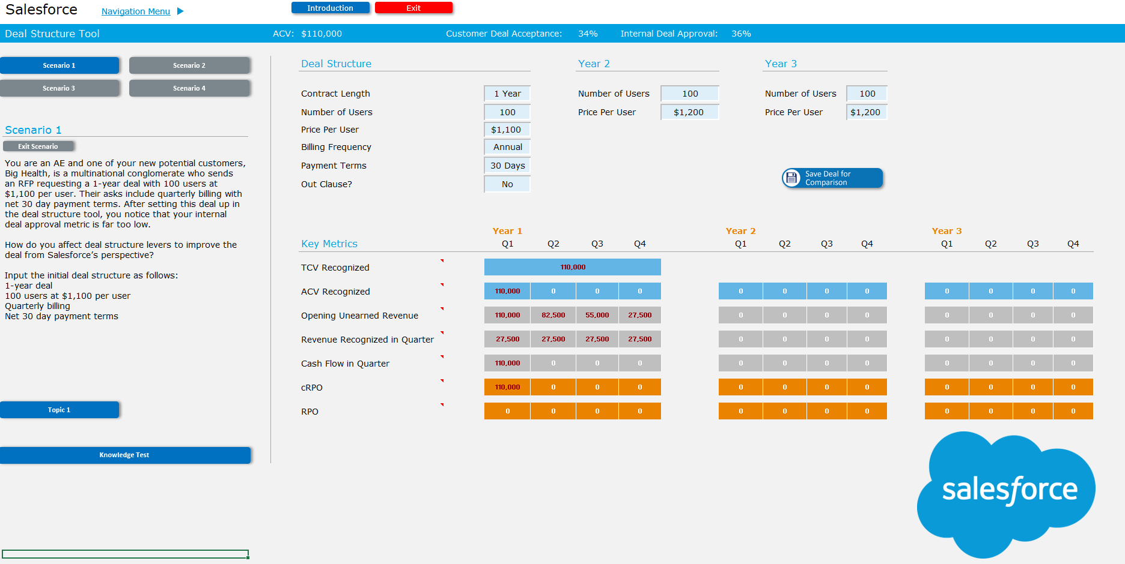
Scenario 2 is now unlocked
Please add a popup saying “Scenario 2 is now available” once the Knowledge test for Scenario 1 is completed.
Click Scenario 2

Slide 20
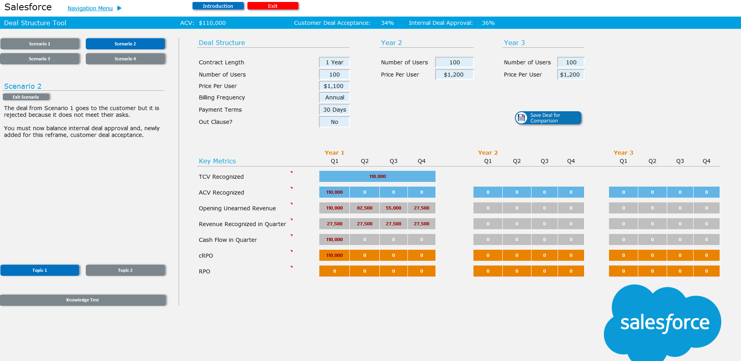
There will be a different Scenario Explanation once Scenario 2 is clicked.
Topics 1 and 2 buttons will appear, but only topic 1 will be blue.
Clicking Topic 2 will ask participants to complete the previous topic first.
The knowledge test is also gray and unavailable
Click Topic 1.

Slide 21
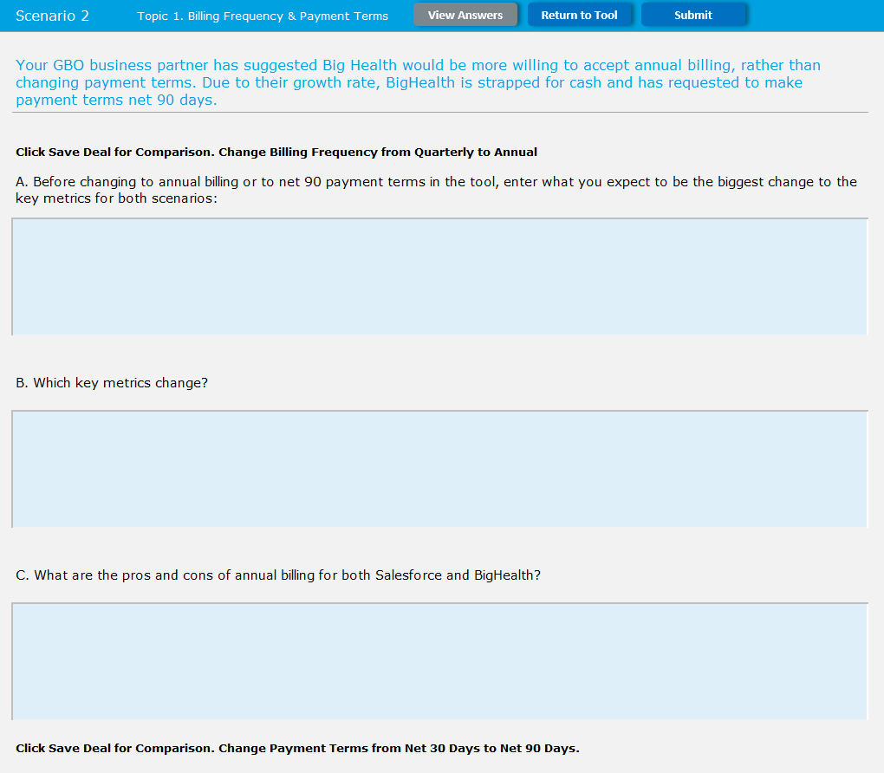
This will look identical to clicking ‘Topic 1’ in Scenario 1. However, the “Application” button will not be available.
All other functionality is the same.
Click Submit

Slide 22
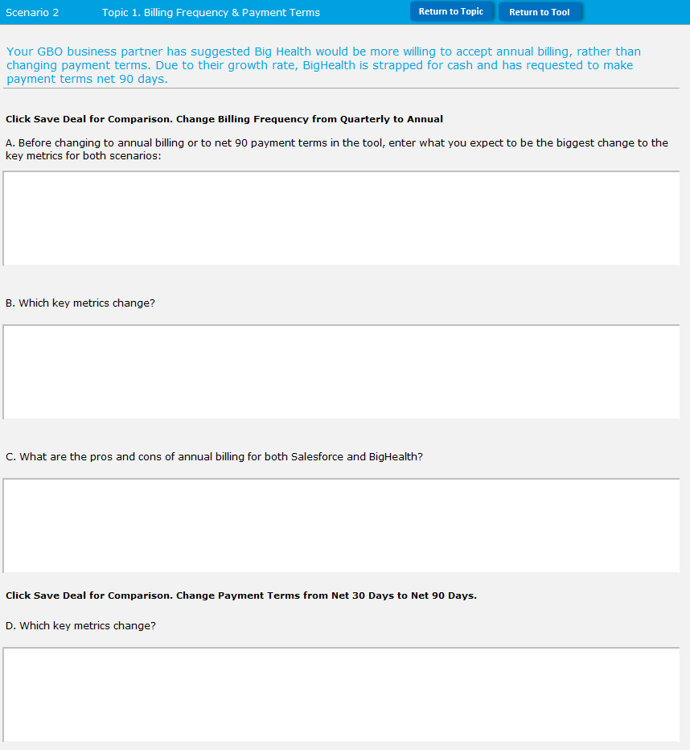
Participants will be shown the a results page with suggested answers to their questions. However, they will not have the “Application” button. This will be unlocked after completing Scenario 2, Topic 2
Click “Return to Tool”

Slide 23
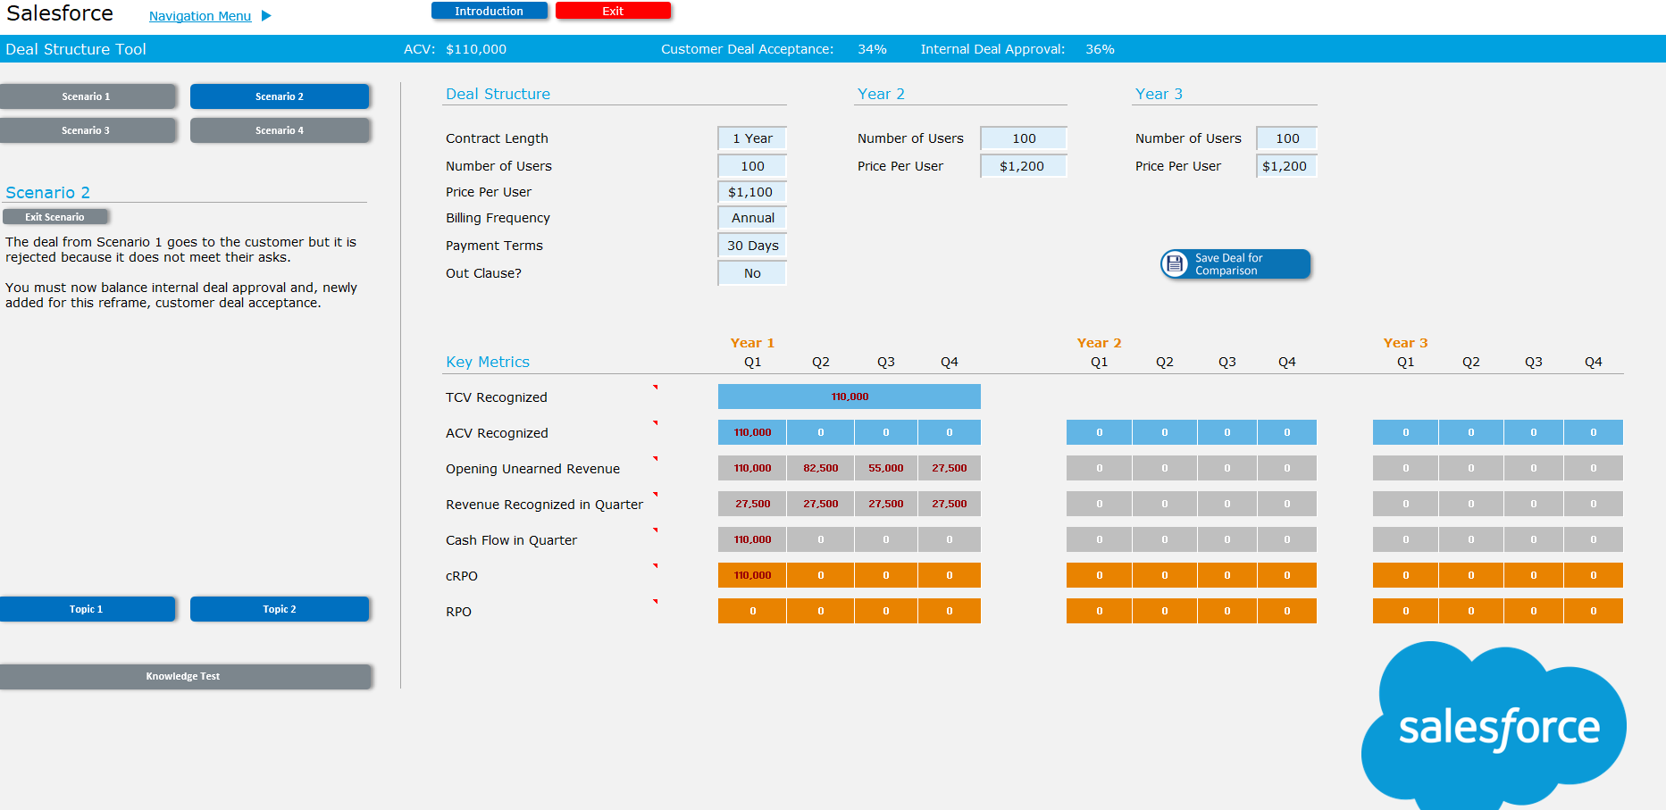
Topic 2 will now be unlocked
Click Topic 2

Slide 24
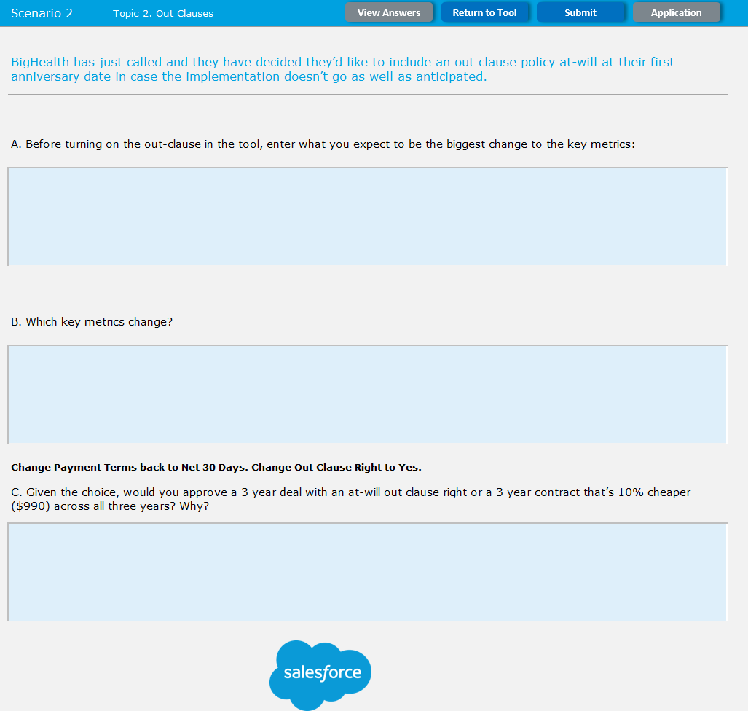
Participants will again have a topic page to answer questions.
Application has returned but it is grayed out
Click Submit

Slide 25
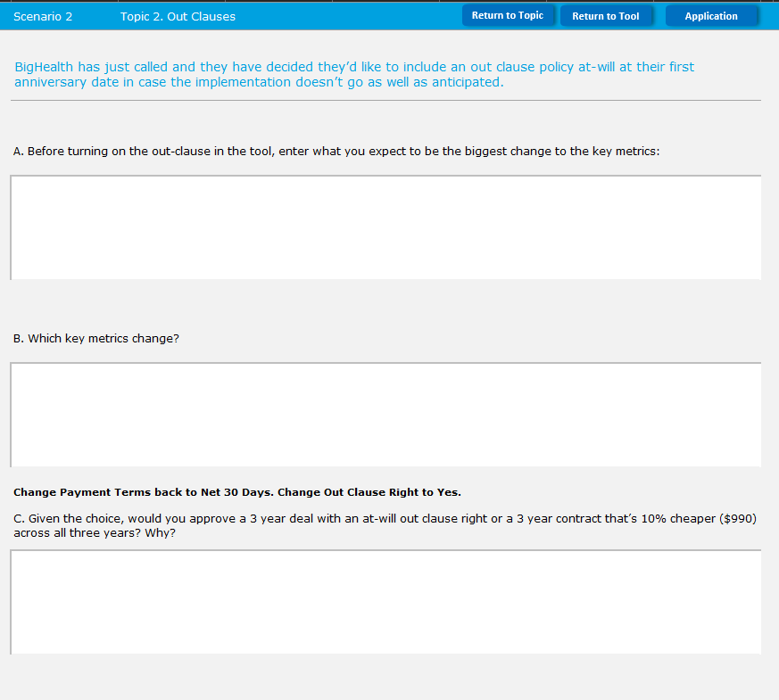
Participants will see the suggested answers to their question
Application has returned and is now blue
Click Application

Slide 26
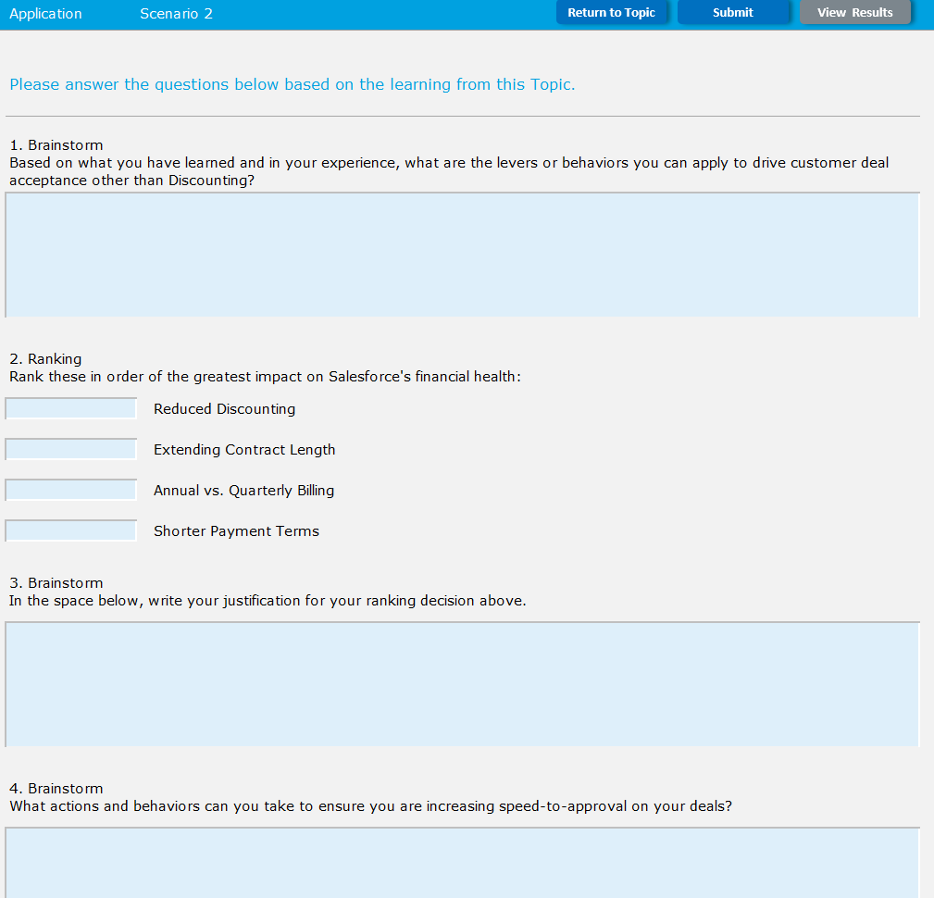
Participants will now complete the Scenario Application for Scenario 2
These questions types are unfortunately not finalized yet so their format may change. Apologies.
Click Submit

Slide 27
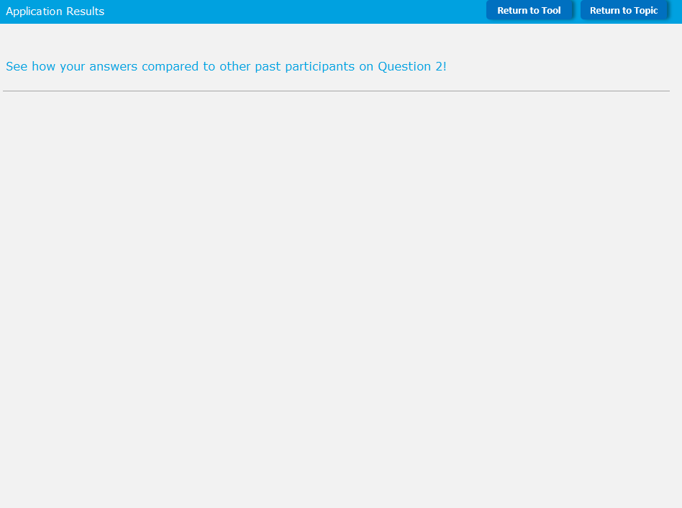
Participants will see another graph illustrating how their answers compared to peers
Click Return to tool

Slide 28
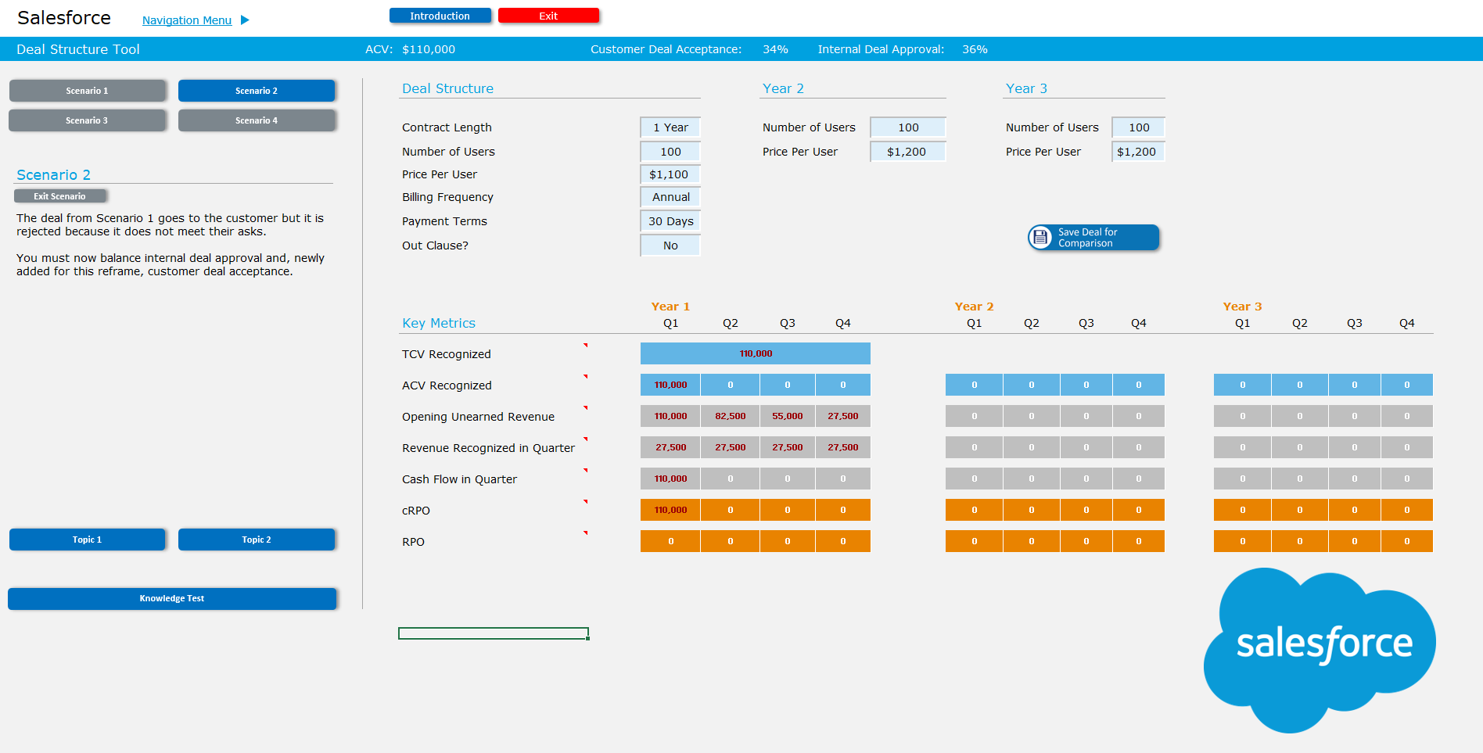
The Knowledge Test for Scenario 2 is now unlocked and ready
Click Knowledge Test

Slide 29
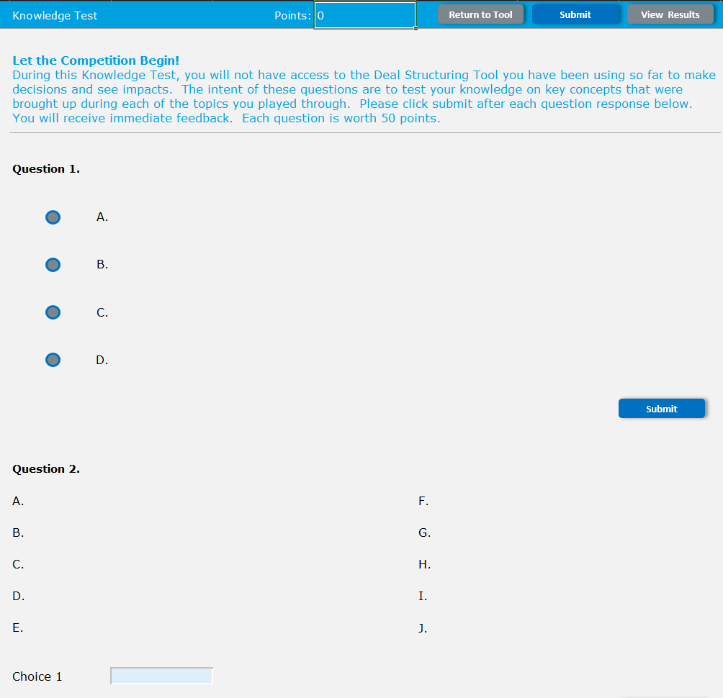
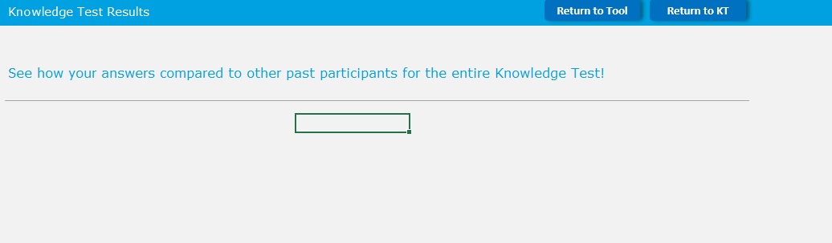
Participants will now enter the knowledge test for Scenario 2. This functions the same as Scenario 1.
Click Submit
Participants will again see the graph displaying their results
Click “return to tool”

Slide 30
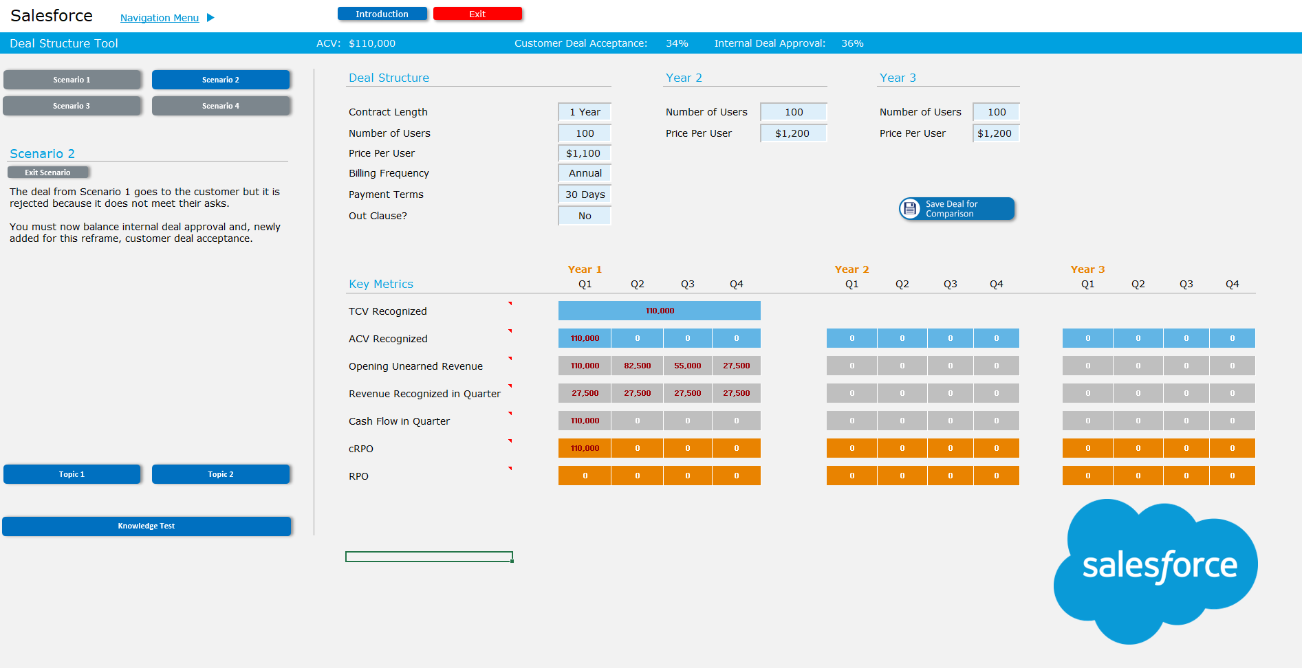
Scenario 3 will now be unlocked.
Please add a pop-up saying “Scenario 3 is now available.”
Click Scenario 3

Slide 31
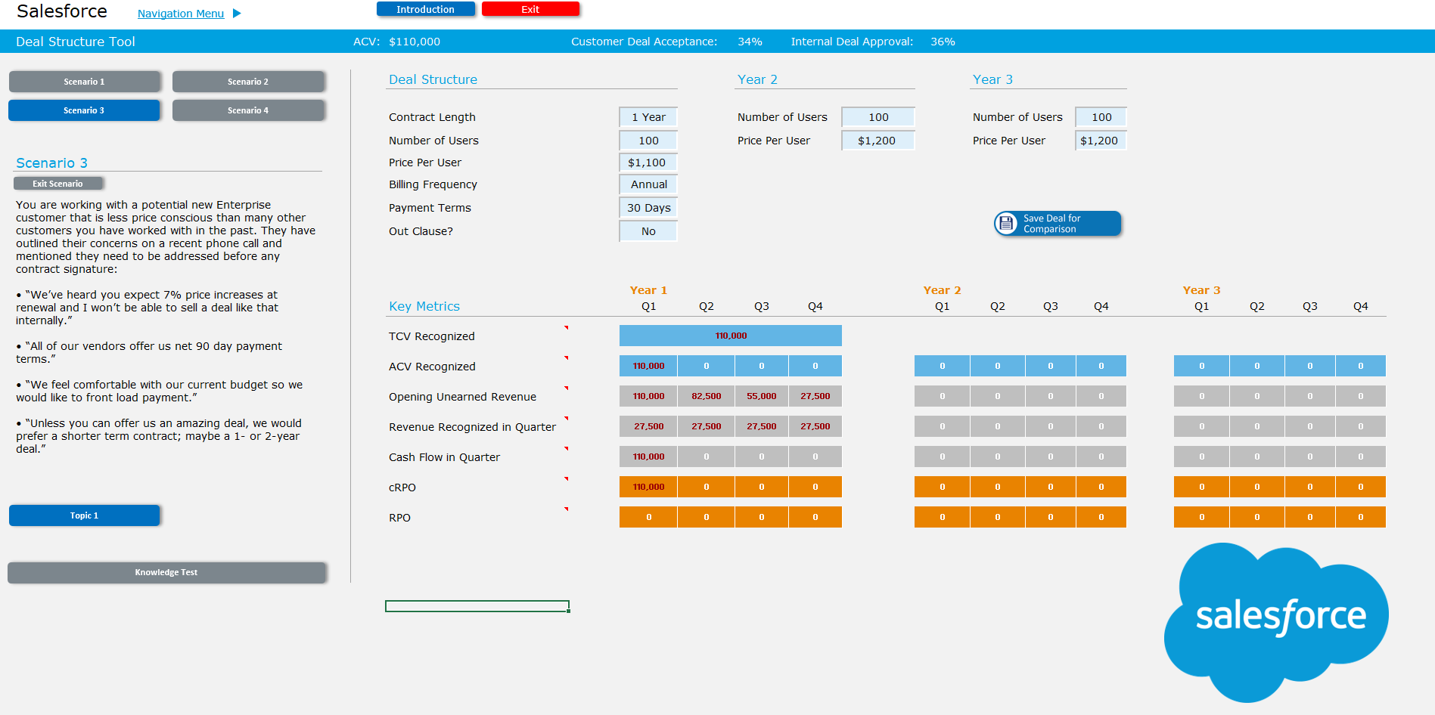
Scenario 3 will now display on the left.
The Topic, Application, and Knowledge Test for Scenario 3 will function the same as Scenario 1, so it will be skipped in this PPT. Please let me know if you would like me to go over it in detail.

Slide 32
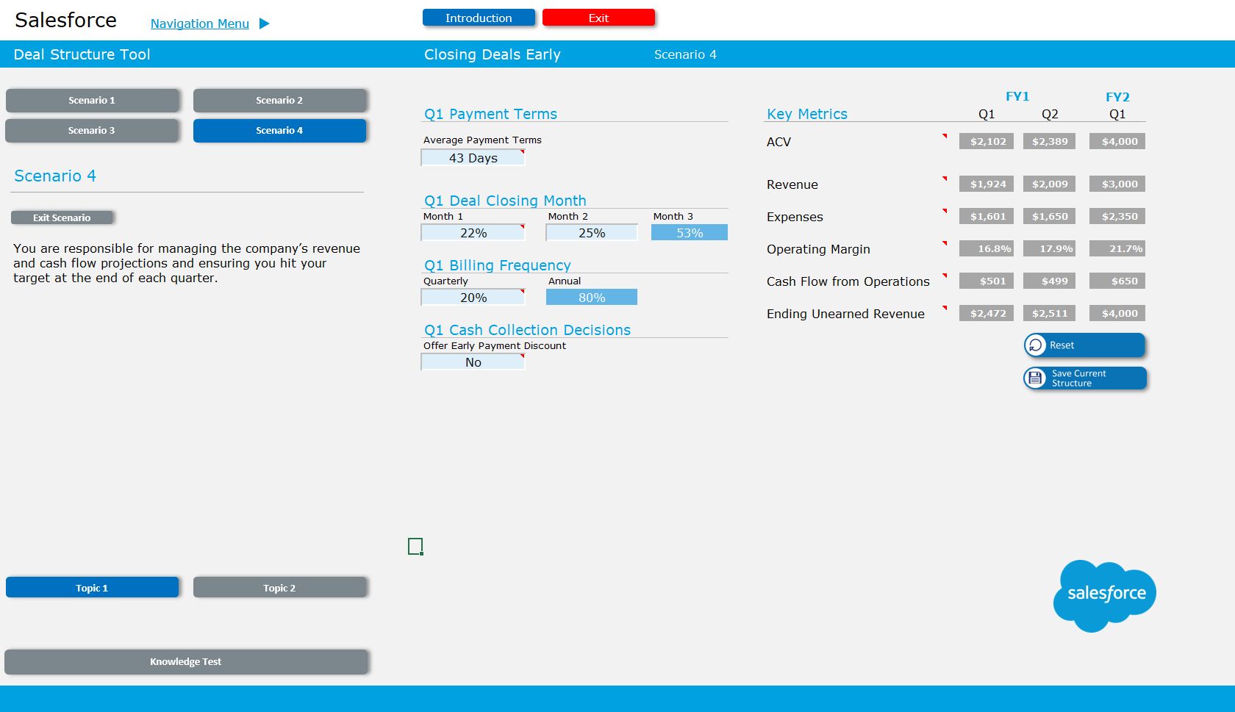
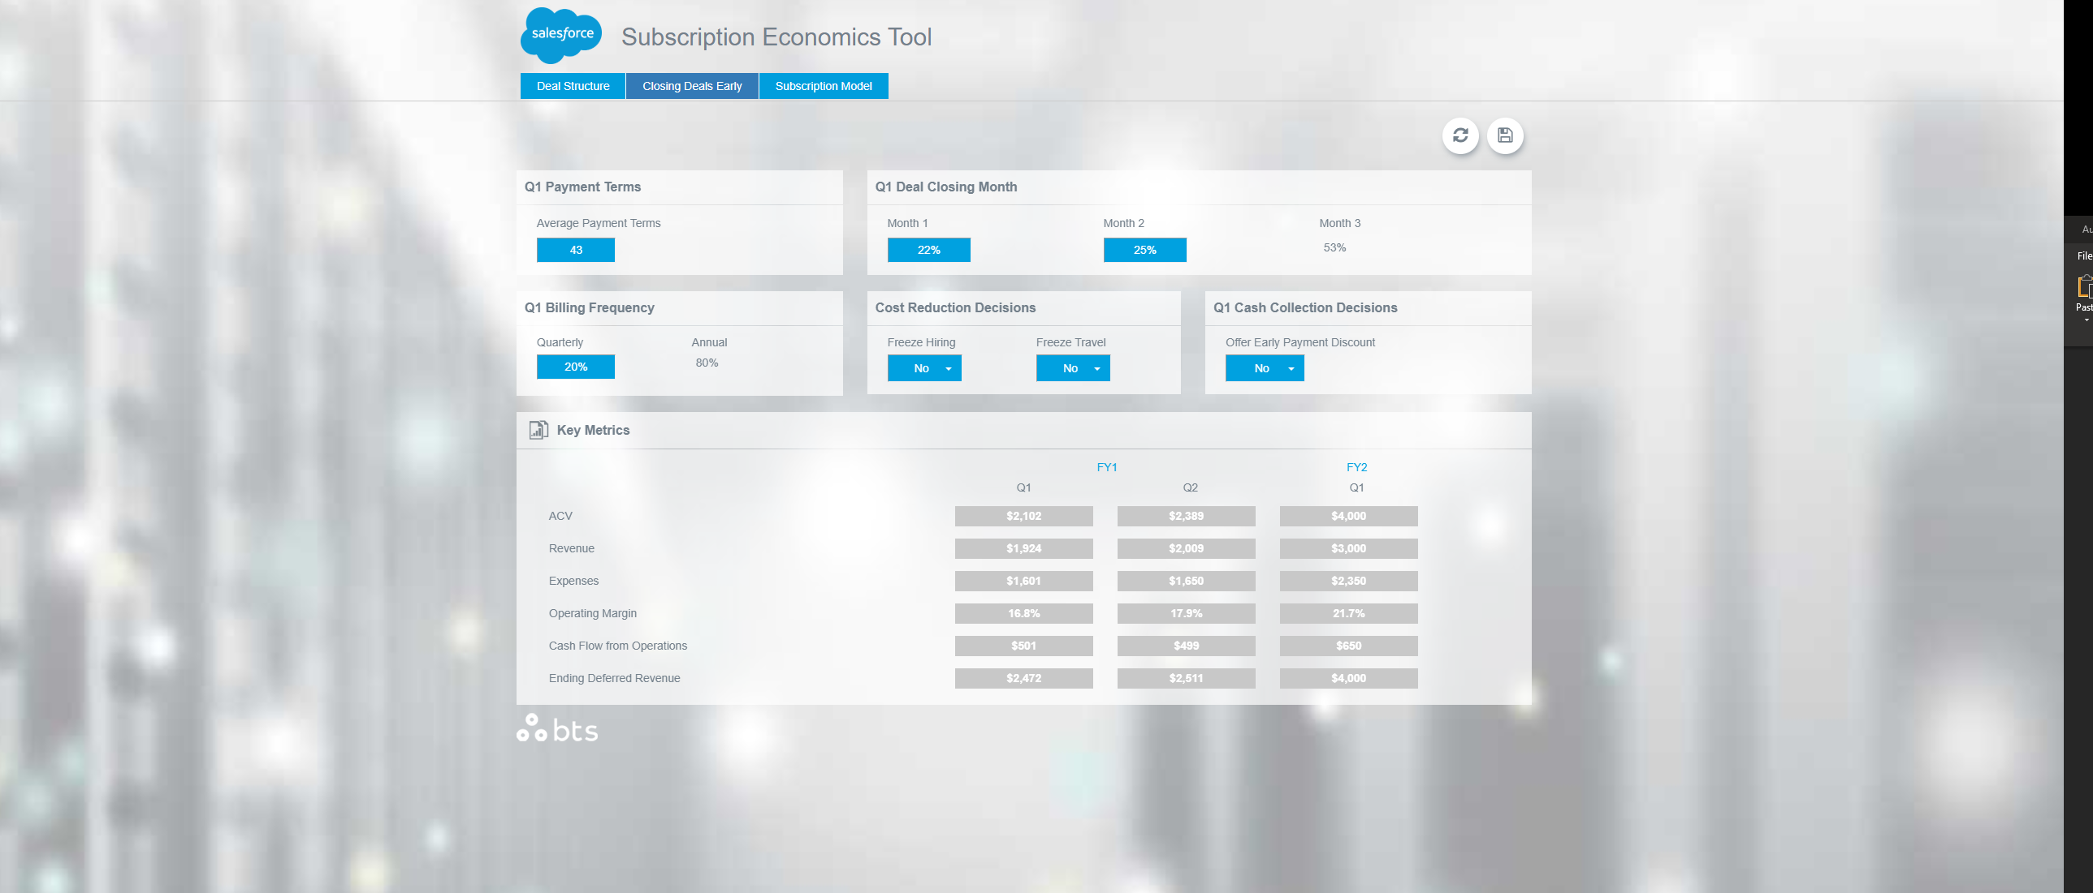
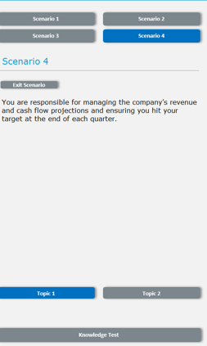
Upon clicking Scenario 4 after completing Scenario 3’s knowledge test, I will be taken to this page.
The image from the button is how this page currently exists in the Isomer tool.
Please notice the removal of the circled Decisions
Please add the scenario navigation to this page, and remove the buttons at the top
Remove

Slide 33
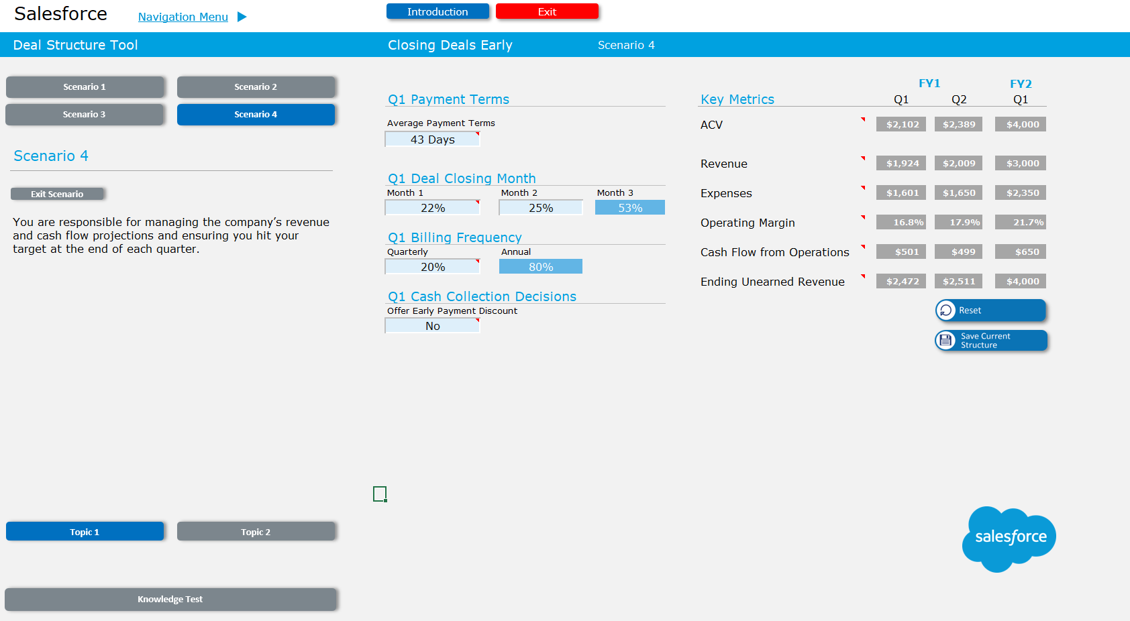
Clicking the Topic 1 Button here will begin another sequence of Topic 1 -> Topic 1 Results -> Tool Page -> Topic 2 -> Topic 2 Results -> Application -> Knowledge test that was stated earlier in the walkthrough for Scenario 2.
Please let me know if you would like to go over this in detail.

Slide 34
Once participants have completed the Scenario 4 Knowledge Test, they will be taken to a reports tab in the simulation that will outline all of their answers across the simulation.
This is currently still being built. This report will be used to for post-simulation actions and reflection for the participants.

