Slide 1
TUTORIAL
Guide to
Winning in Business

Slide 2
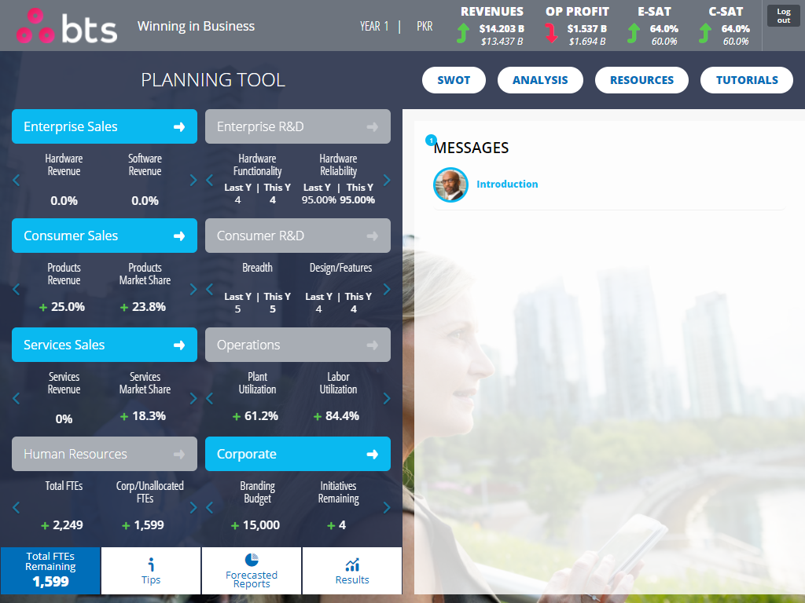
TUTORIAL - Guide
Homepage
Welcome. This Guide is designed to illustrate the various components of the decision-making process you will follow.
This page will be your home base. From here, you will interact with colleagues and access information, resources and tools that will help you make important decisions.

Slide 3
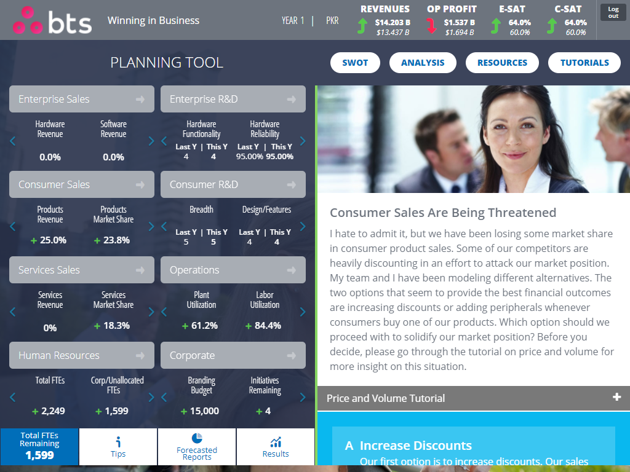
TUTORIAL - Guide
Situations
Your colleagues will contact you seeking your advice on key situations. Using the information, tools and resources at your disposal, you will provide guidance through the decisions you make. As choices for each decision are presented to you, you will choose the one you believe to be the best course of action. You will receive follow-up information about the outcomes of your decision.

Slide 4
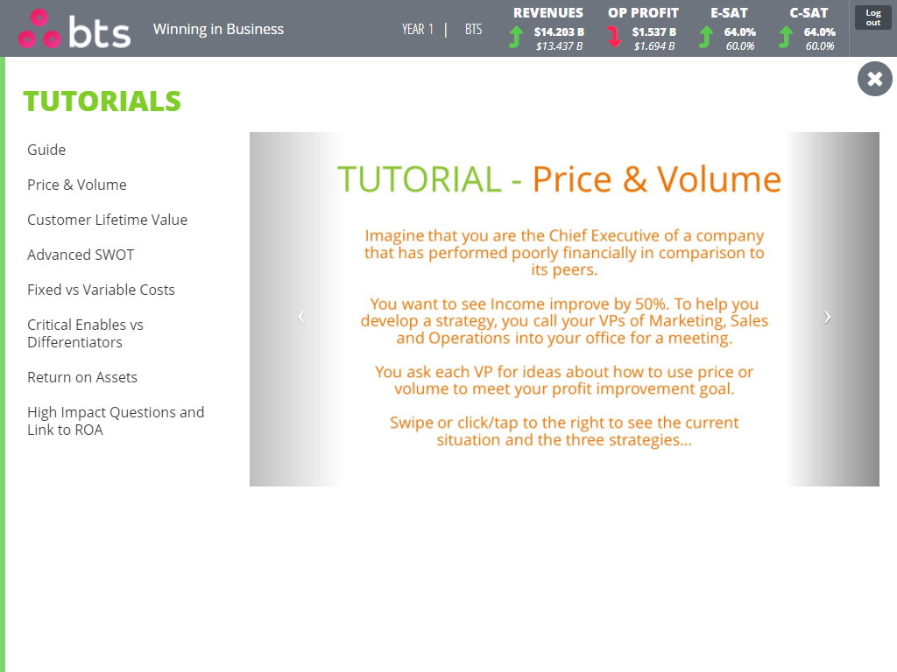
TUTORIAL - Guide
Tutorials
Tutorials are designed to provide you with insight on important business topics. They highlight the trade-offs involved with the choices presented to you and help you make informed decisions.
Initially, you will access Tutorials through your decision tool app. They are also available to you at anytime from the Homepage.

Slide 5
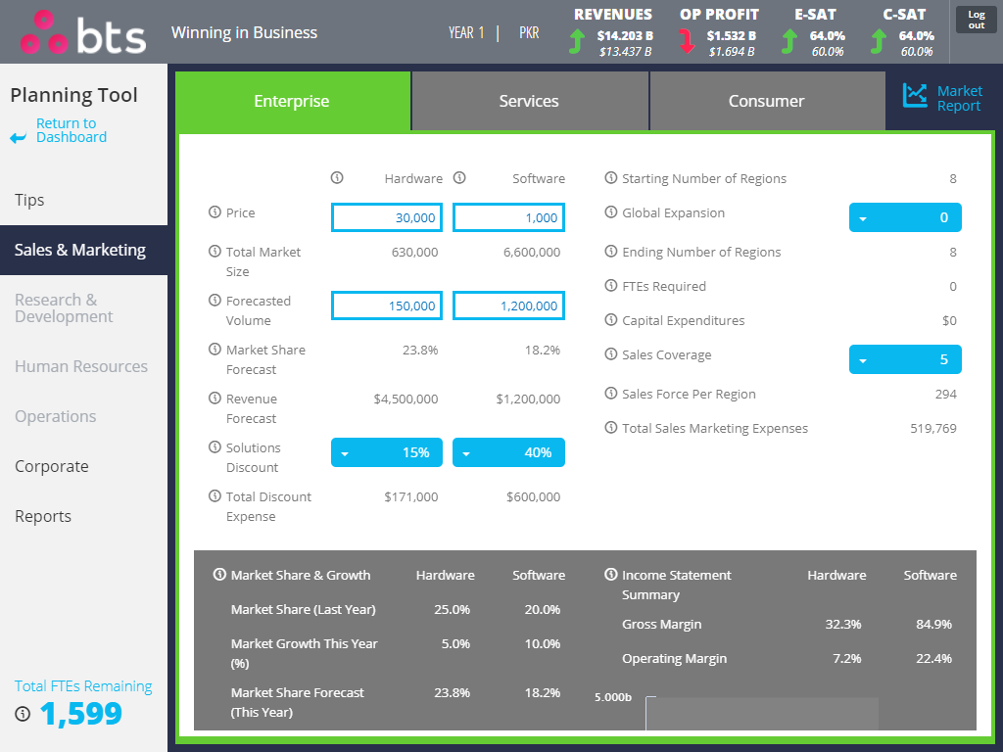
TUTORIAL - Guide
Planning Tool
The Planning Tool helps you create your strategic plan for each period and enables you to make decisions across the business. The impacts of your decisions will be clearly visible on the dashboard at the top of your screen and also in the reports that will be provided to you.
As you make your decisions in the Planning Tool, be sure to consider competitor information, the impacts of the decisions and choices you’ve made and your overall strategy.
You can access the Planning Tool by clicking the Planning button located on the Homepage. And you can revisit it as many times as you like, until you submit your final decisions to the marketplace.

Slide 6
TUTORIAL - Guide
Feedback
At the end of each period, you will receive a feedback presentation on how well the marketplace received your plan. Each presentation gives you an overview of the impacts of your decisions that you’ve made in each situation and in the Planning Tool.
The presentations also give you additional insight into how you can make more effective decisions for better business results. You can access and review previous presentations from the Homepage.

