Slide 1
Project Title: 3-Way Relay Control using Arduino and GSM module
Course Teacher: Protik Parvez Sheikh
Senior Lecturer
Department of Electrical and Electronic Engineering
SL # | Students ID | Students Name | Program
1 | 22-49485-3 | Sajid Hasan Mahir | BSc in CSE
2 | 23-50346-1 | Dip Khastagir | BSc in CSE
3 | 22-49222-3 | Md. Mainul Islam | BSc in CSE
4 | 22-49298-3 | A.K.M. Tamim Rahman | BSc in CSE
5 | 22-49228-3 | Fahmida Sultana Oishi | BSc in CSE
6 | 22-46705-1 | Malek Al Julkar Nine | BSc in CSE

Slide 2

Outline of the Presentation
Objectives (slide no-3)
Introduction (slide no-4)
Working Method(slide no- 5 ,6)
Description of the Work (slide no-7,8,9,10)
Results and Discussions (slide no- 11,12,13,14)
Conclusions (slide no-15)
Future Works (slide no-16)

Slide 3
Objectives of the Work
The main objective of the project is to
1. Develop a 3-way relay control system using button, remote, and SMS.
2. Enable global relay control via GSM module.
3. Implement toggle logic for seamless control.
4. Provide real-time relay status feedback via SMS.
5.Simulate in Proteus Software
6.Successfully build and observe the results.

Slide 4
Introduction
• Motivation:
- Increase convenience and accessibility for controlling appliances.
- Enable global control of devices using SMS commands.
-Need for remote control in rural and urban areas.
• Significance:
- Demonstrates IoT integration through GSM module and Arduino.
- Provides a practical and scalable solution for smart systems.
• Features of the Project:
- 3 control methods: Button, Remote, SMS.
- Status feedback via SMS for global accessibility.
- Uses toggle logic for intuitive control.

Slide 5
Working Method
• System includes:
- GSM Module: Sends/Receives SMS.
- Arduino: Controls relays based on SMS commands.
- Relay Module: Switches devices on/off.
• Flow:
SMS Command → GSM Module → Arduino → Relay Module
• Toggle Logic:
- Each signal triggers a state change (ON to OFF, or OFF to ON).
• GSM Module:
- Processes incoming SMS commands.
- Sends back relay status as SMS.

Slide 6
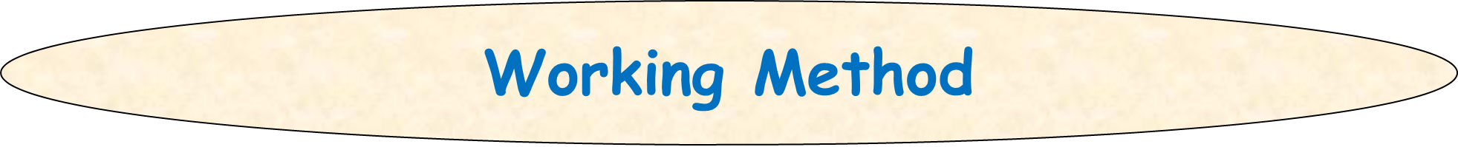
• Control Methods:
- Button: Local hardware-based control.
- Remote: IR-based control.
- SMS: Global control via GSM.
• GSM module communicates with Arduino via UART protocol.
• SMS commands are sent to control relays.
• SMS parsing and execution logic ensure reliable operations.

Slide 7
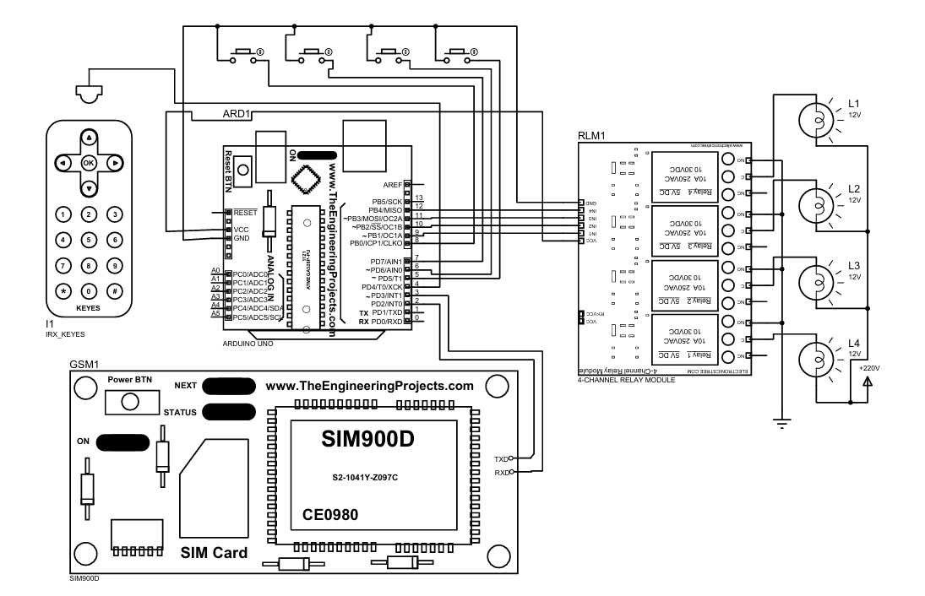
Description of the Work
Circuit Diagram

Slide 8
Description Of the work
• Components Used:
- GSM Module SIM900A
- Arduino Uno
- 4-Channel Relay Module, Push button, IR receiver, IR remote
• Connections:
- GSM TX/RX to Arduino RX/TX.
- Relay control pins to Arduino digital pins.
• Arduino Code:
- Initializes GSM module communication at 9600 baud rate.
- Reads and parses incoming SMS commands.
- Executes relay control commands.

Slide 9
Description Of the work
• Access Control:
- Verifies authorized phone numbers.
- Provides feedback via SMS.
• Only pre-registered phone numbers can send commands.
• Unauthorized commands are ignored.
• Status updates sent to the registered number upon command execution.
• Button Control:
- Local hardware buttons toggle relay state.

Slide 10
• Remote Control:
- IR remote sends signals to toggle the relay.
• SMS Control:
- SMS command toggles relay state.
- Sends relay status via SMS for user confirmation.

Slide 11
Results and Discussions:Commands
• Tested system with various SMS commands:
- Turn ON Relay 1: Successful.
- Turn OFF Relay 2: Successful.
- Unauthorized SMS: Ignored.
• Average response time: 2 seconds.
• Reliability:
- 98% success rate in executing valid commands.
• Security:
- Unauthorized users blocked effectively.
• Efficiency:
- Low power consumption (Arduino + GSM module).

Slide 12
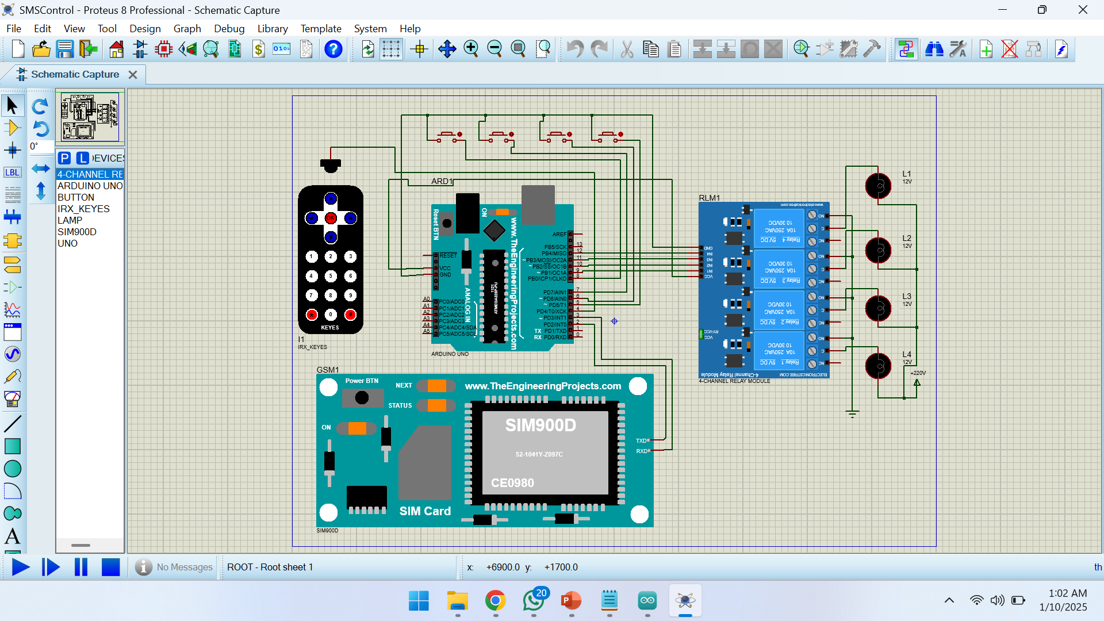
Results and Discussions : Proteus Simualtion

Slide 13
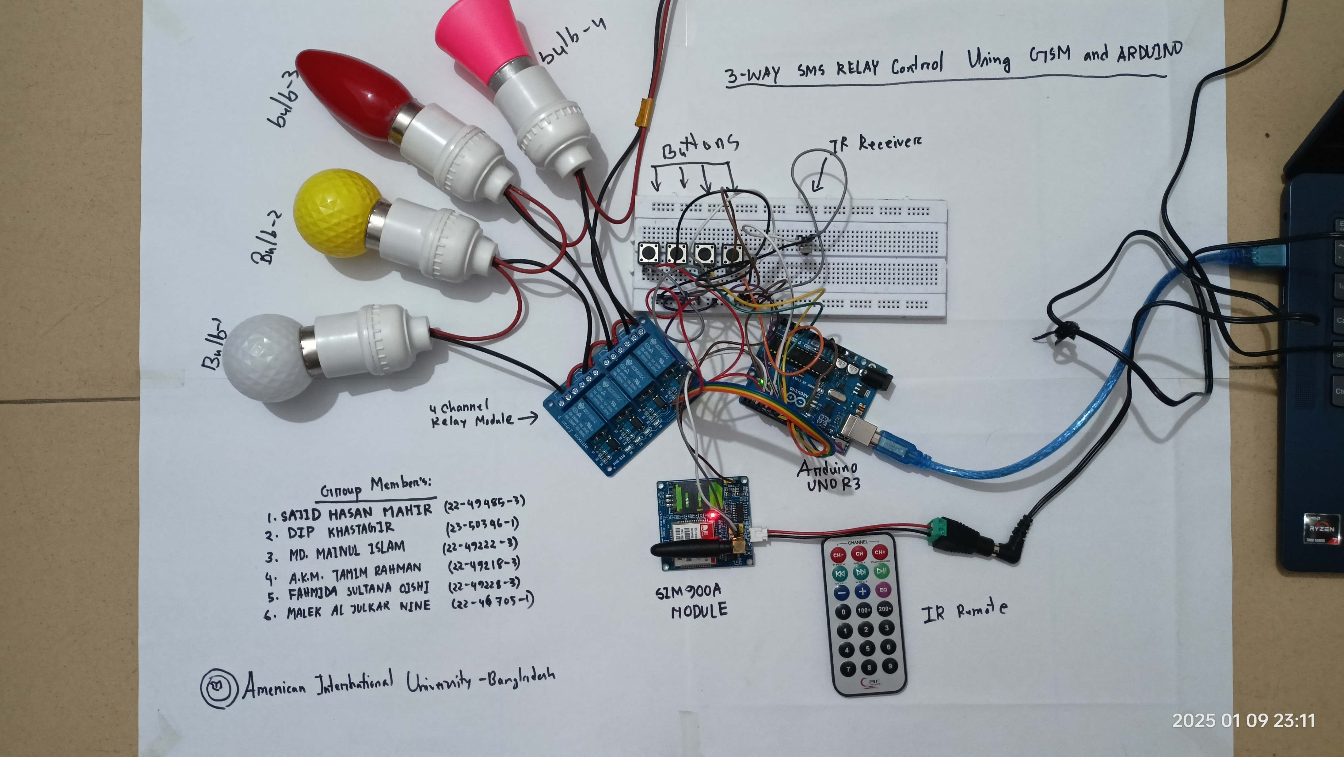
Results and Discussions : Setup Image

Slide 14
Results and Discussions :Operating Video

Slide 15
Conclusions
• The project successfully demonstrates:
- 3-way relay control (button, remote, SMS).
- Global accessibility through GSM module.
- Real-time feedback of relay status.
• Practical and scalable for smart home or industrial applications and rural farming.

Slide 16
Future Scopes
• Enhance security by adding authentication mechanisms.
• Expand to control multiple devices simultaneously.
• Integrate with IoT platforms for advanced monitoring and control.
• Add features like voice control or scheduling.

Slide 17
Thanks for listening our presentation….
?

