Slide 1
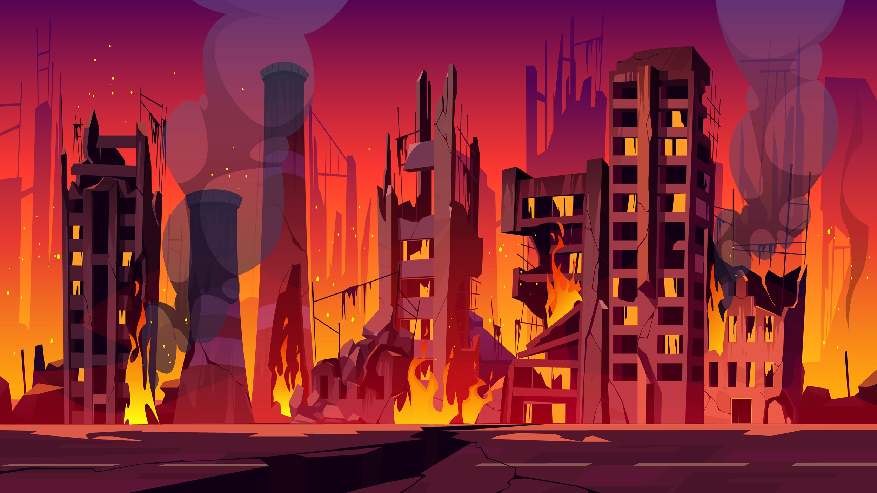
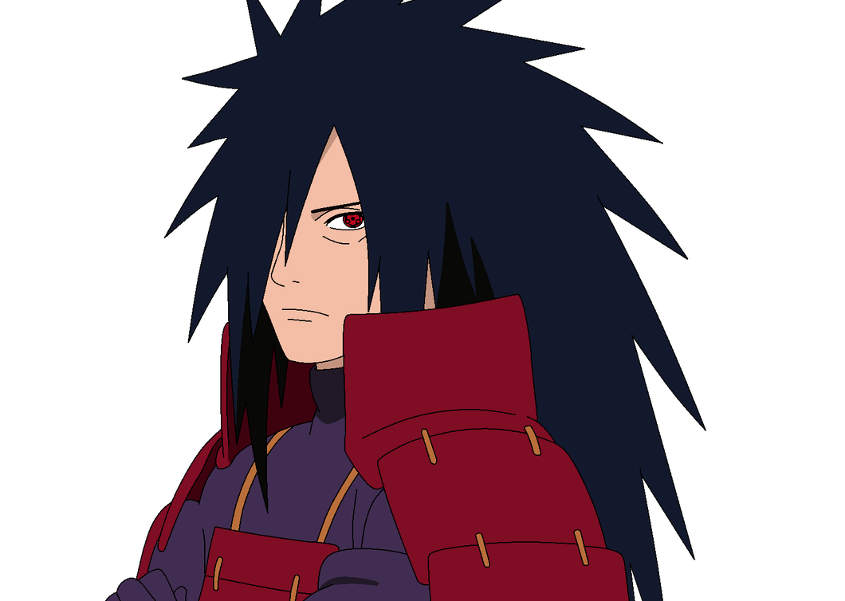
Hashirama, your presence is clear, but I won't allow your plan to succeed. I'll stand firm to protect my planet from destruction..

Slide 2
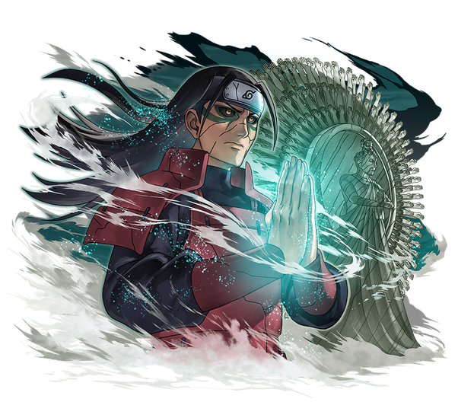
I am Hashirama the conqueror of 24 planets, sets sights on Earth as the 25th target in their relentless quest for domination you.

Slide 3
I won't allow you to harm my people. As long as I breathe, I'll protect them. Hashirama, be prepared for the consequences.

Slide 4
Facing my armies is your first challenge to reach me. Succeed in the consecutive rounds, and only then can you attempt to end me.

Slide 5
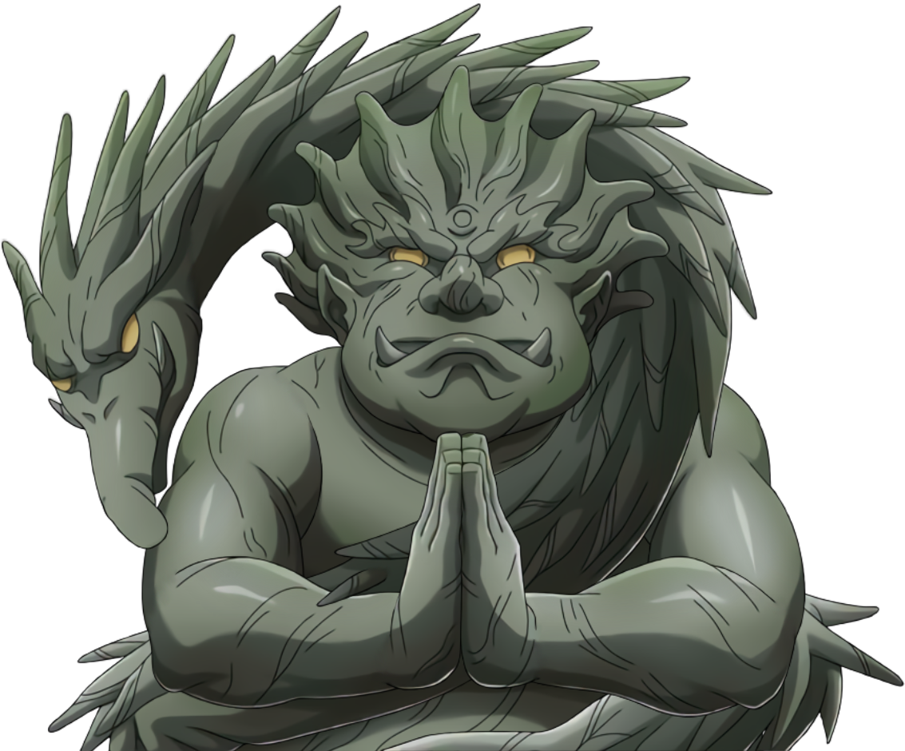
Hey Madara, to defeat my master, you must go through me first.

Slide 6

Hey Madara, If you lucky enough then will face me.After deafeating me then will face my master.

Slide 7
Having conquered my armies, your final trial awaits – me. HAHAHA! If you believe it's a simple task to end me, make your moves. I eagerly await your attempt!

Slide 8
Commence the countdown. I won't prolong your anticipation.

