Slide 1
Lecture 1: Introduction

Slide 2
What is DevOps
DevOps = Development + Operations
A culture, practice, and mindset that improves collaboration between:
  Software Developers
  IT Operations
Goal: Faster, reliable, and continuous delivery of software

Slide 3
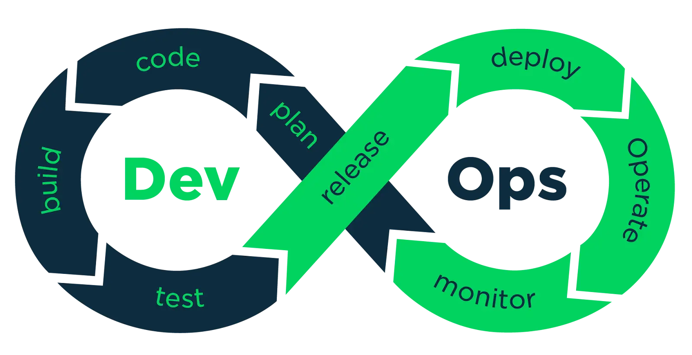
What is DevOps

Slide 4
Why DevOps is Needed
Traditional Software Development Problems
Long release cycles
Manual deployments
Frequent failures in production
Poor communication between teams
DevOps Solution
Automation
Continuous feedback
Faster releases
Improved quality

Slide 5
Traditional vs DevOps Approach
Traditional Model | DevOps Model
Separate teams | Collaborative teams
Manual testing & deployment | Automated pipelines
Slow releases | Rapid & frequent releases
Reactive fixes | Proactive monitoring

Slide 6
DevOps Culture
DevOps is not a tool, it is a culture based on:
Collaboration
Ownership
Automation
Continuous improvement
CAMs Model
Culture
Automation
Measurement
Sharing

Slide 7
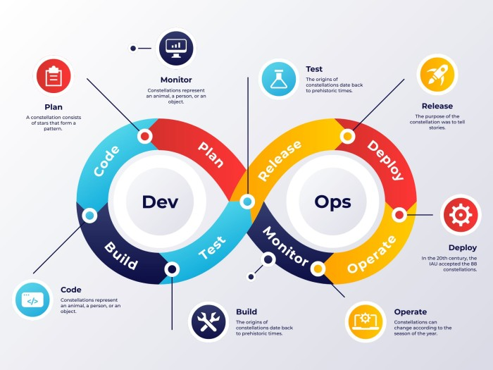
DevOps Lifecycle

Slide 8
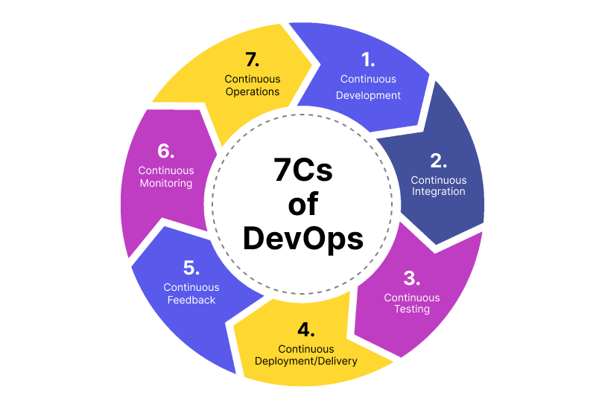
DevOps Lifecycle

Slide 9
Key DevOps Practices
Continuous Integration (CI)
Continuous Testing (CT)
Continuous Deployment (CD)
Infrastructure as Code (IaC)
Configuration Management
Continuous Monitoring

Slide 10
Continuous Integration (CI)
Developers frequently merge code into a shared repository
Automated:
  Build
  Unit testing
Detects bugs early
Benefits
Faster feedback
Reduced integration issues

Slide 11
Continuous Deployment (CD)
Automatically deploys tested code to production
Uses:
  Containers
  Automation scripts
Enables multiple releases per day

Slide 12
DevOps Toolchain Overview
Common DevOps Tools
Version Control: Git
CI/CD: Jenkins, GitHub Actions
Containers: Docker
Orchestration: Kubernetes
Monitoring: Nagios, Prometheus
Cloud: AWS, Azure, GCP

Slide 13
Benefits of DevOps
Faster time to market
Improved software quality
Reduced deployment failures
Better team collaboration
Continuous customer feedback

Slide 14
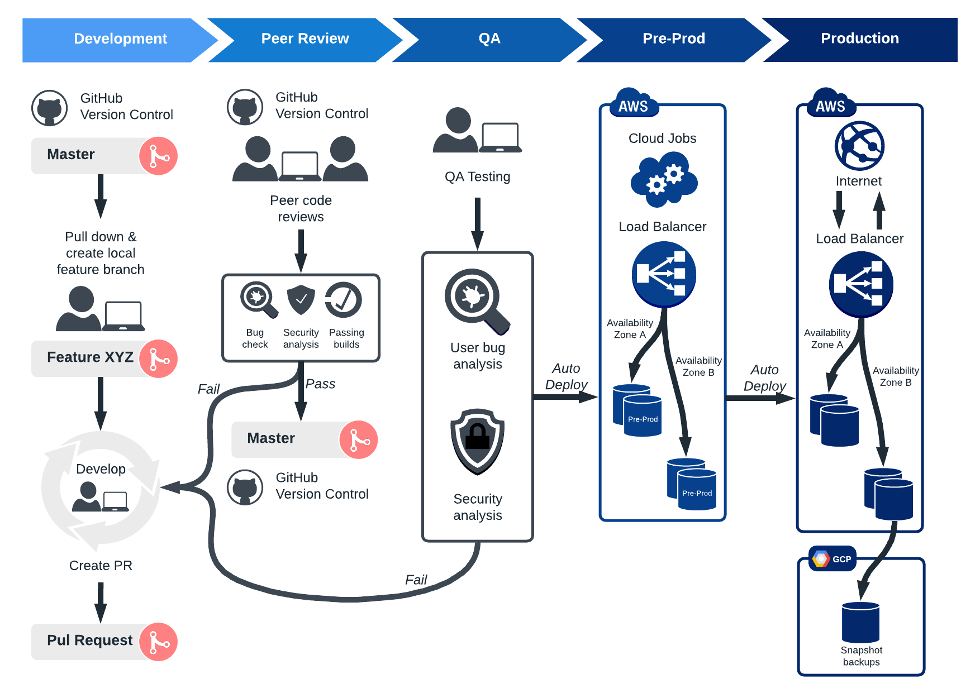
DevOps in Industry

Slide 15
DevOps in Industry
Used by
IT Services Companies
Startups
Product-based companies
Cloud-native organizations
Adopted in
Web applications
Mobile apps
Cloud platforms
Microservices architecture

Slide 16
DevOps Skills Required
Linux basics
Git & version control
CI/CD pipelines
Containers & cloud
Scripting (Shell, Python)
Monitoring & troubleshooting

Slide 17
DevOps Job Roles
DevOps Engineer
Site Reliability Engineer (SRE)
Cloud Engineer
Release Engineer
Automation Engineer

Slide 18
Summary
DevOps is a culture + automation + continuous delivery
Bridges gap between development and operations
Focuses on speed, quality, and reliability
Backbone of modern software delivery

Slide 19
Thank You

