Slide 1
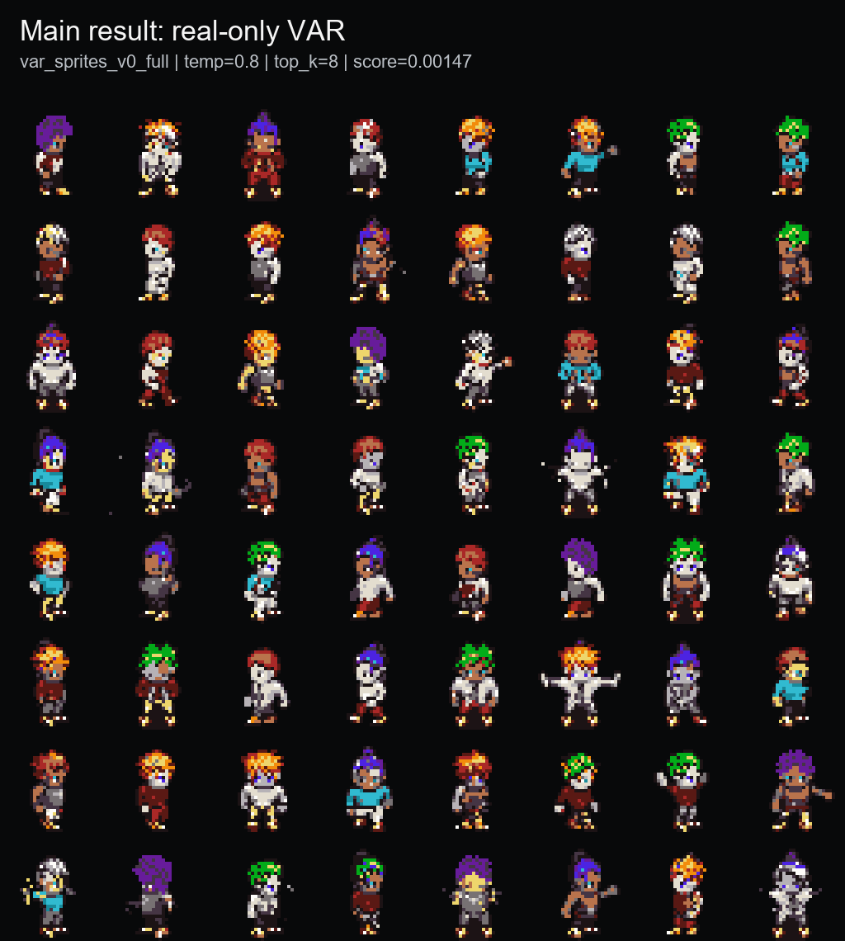
PixelVAR
Coarse-to-fine pixel-art sprite generation via palette tokens
Rubric-aligned final presentation | COMP547 Deep Unsupervised Learning | June 2026
32x32
16+alpha
0.00147
sprite output
palette-token vocab
best sprite-feature score
Thesis: generate transparent pixel-art sprites directly in discrete palette-index space, then evaluate honestly with baselines, ablations, and memorization audit.
Opening
1/14 main

Slide 2
PROBLEM + MOTIVATION
Pixel art is not just low-resolution RGB.
Why it matters
Why it is hard
Our framing
Game sprites are labor-intensive assets. A usable generator should produce compact transparent characters, not just pretty pixel-ish pictures.
Every pixel is visible. Small palette changes, anti-aliasing, noisy backgrounds, or broken silhouettes can make an output unusable.
Instead of generating continuous RGB and quantizing later, PixelVAR learns to generate palette-index tokens directly.
Transparent background is part of the object, not cleanup.
Palette consistency should be native to generation, not a post-hoc repair.
A single misplaced pixel can break outlines or pose readability.
Rubric: problem statement and motivation
2/14 main

Slide 3
RELATED WORK
PixelVAR sits between pixel-art-specific generators and hierarchical image-token models.
Area
Representative work
What it contributes
Gap for this project
Pixel-art GANs
Coutinho & Chaimowicz; MDIGAN
Character sprite generation / pose imputation
Often conditional or paired-pose, not unconditional sampling
Pixel diffusion
SD-piXL; PixDiff-PIG; SDXL LoRAs
Low-res or pixel-art-like generation
Often continuous/image-first or prompt-conditioned
Discrete image tokens
Pixel VQ-VAE; VQ-style tokenizers
Pixel-art representation learning
Tokenizer quality and generation prior remain hard
Hierarchical AR
VAR, M-VAR, HMAR
Coarse-to-fine image-token generation
Mostly high-res natural images with large codebooks
Flat token baselines
Raster AR, MaskGIT
Simple sequence or masked final-grid decoding
Good contrast to hierarchy; can memorize or fail coverage
Main novelty in our project context: applying next-scale prediction to tiny, transparent, palette-constrained sprites and auditing it against close baselines.
Rubric: related work
3/14 main

Slide 4
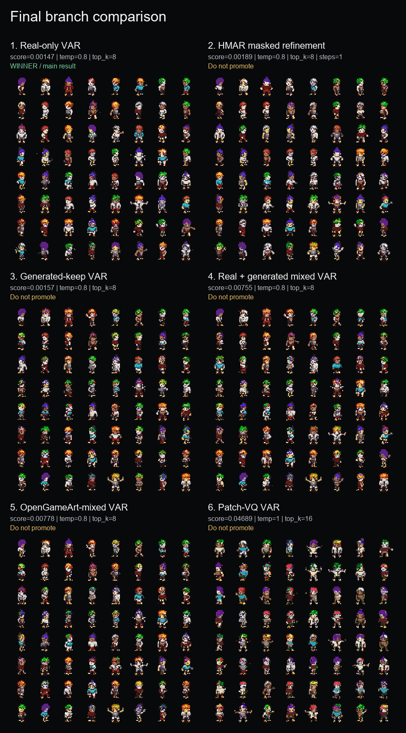
GOAL AND SCOPE
The proposal target was a 32x32 palette-token generator plus HMAR and baseline comparisons.
Proposal component
Final status
Evidence
Dataset curation + 32x32 preprocessing
DONE
MSD replacement, Pokemon path, OpenGameArt path
Palette-index generation
DONE
Transparent token 0 + palette tokens 1..16
VAR Option A
DONE
Main checkpoint: var_sprites_v0_full
HMAR Option B
DONE
1/2/4/8 refinement-step ablation
Baselines + metrics
DONE
Flat AR, MaskGIT, FID/KID/PRDC/MS-SSIM, external baselines
Neural VQ-VAE, user study, 64x64
PARTIAL / FUTURE
Disclosed as limitations/future work
This deck is intentionally audit-adjusted: we do not claim broad SOTA, and we do not hide failed or incomplete proposal items.
Rubric: methodology overview
4/14 main

Slide 5
EXPERIMENTAL SETUP
Evaluation uses a fixed 32x32 sprite protocol, grouped splits, and multiple metrics.
93,312
74,664
9,360
9,288
MSD replacement sprites
train
validation
test
Data protocol
Metrics
Baselines
All main outputs are 32x32 transparent RGBA sprites decoded from palette-token maps. Splits are grouped by character attributes to reduce leakage.
Sprite-feature score, palette consistency, opaque ratio, edge density, FID, KID, precision/recall, density/coverage, MS-SSIM, exact-match audit.
HMAR, generated/mixed data, Patch-VQ, Flat AR, Flat MaskGIT, SD-piXL, SSD-1B practical diffusion, Pokemon sprite LoRA.
Important: Inception metrics are reported, but not trusted alone for 32x32 pixel art. The memorization audit is part of the evaluation, not an afterthought.
Rubric: experimental setup
5/14 main

Slide 6
METHOD
PixelVAR generates a six-scale palette-token pyramid from coarse silhouette to final sprite.
1x1
1
Model path
Generation rule
Role
2x2
4
PixelVAR
Predict each next scale conditioned on coarser scales
main result
4x4
16
HMAR
Mask/refine tokens within each scale for T steps
proposal Option B
8x8
64
16x16
256
Flat AR
Raster-scan final 32x32 grid
simple baseline
32x32
1024
Flat MaskGIT
Masked final-grid parallel decoding
masked baseline
Total sequence length is 1,365 tokens. The final 32x32 map is both the last scale and the training target for visible sprite detail.
Rubric: methodology
6/14 main

Slide 7
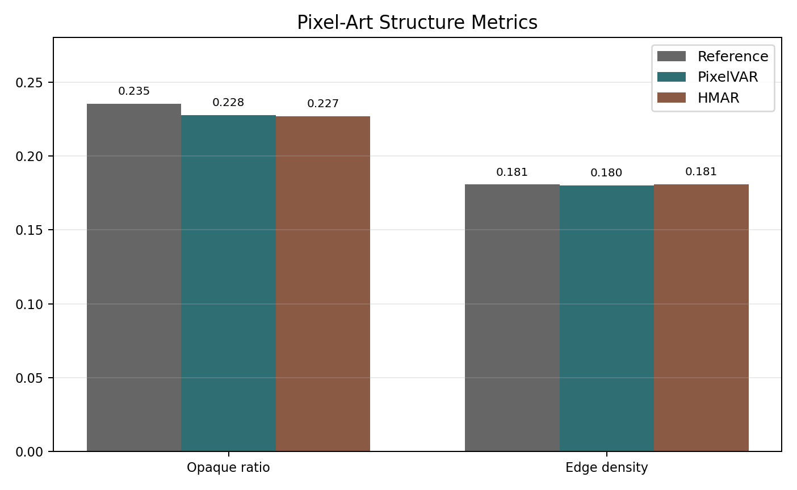
MAIN RESULT
The selected PixelVAR checkpoint produces compact, palette-safe 32x32 sprites.
0.00147
1.0000
0.1808
sprite-feature score
palette consistency
edge density
lower is better
expected from tokens
real val 0.1811
Best sampling: temperature=0.8, top_k=8. Palette consistency is important, but it is expected from the discrete representation, so we do not oversell it.
Rubric: experimental results
7/14 main

Slide 8
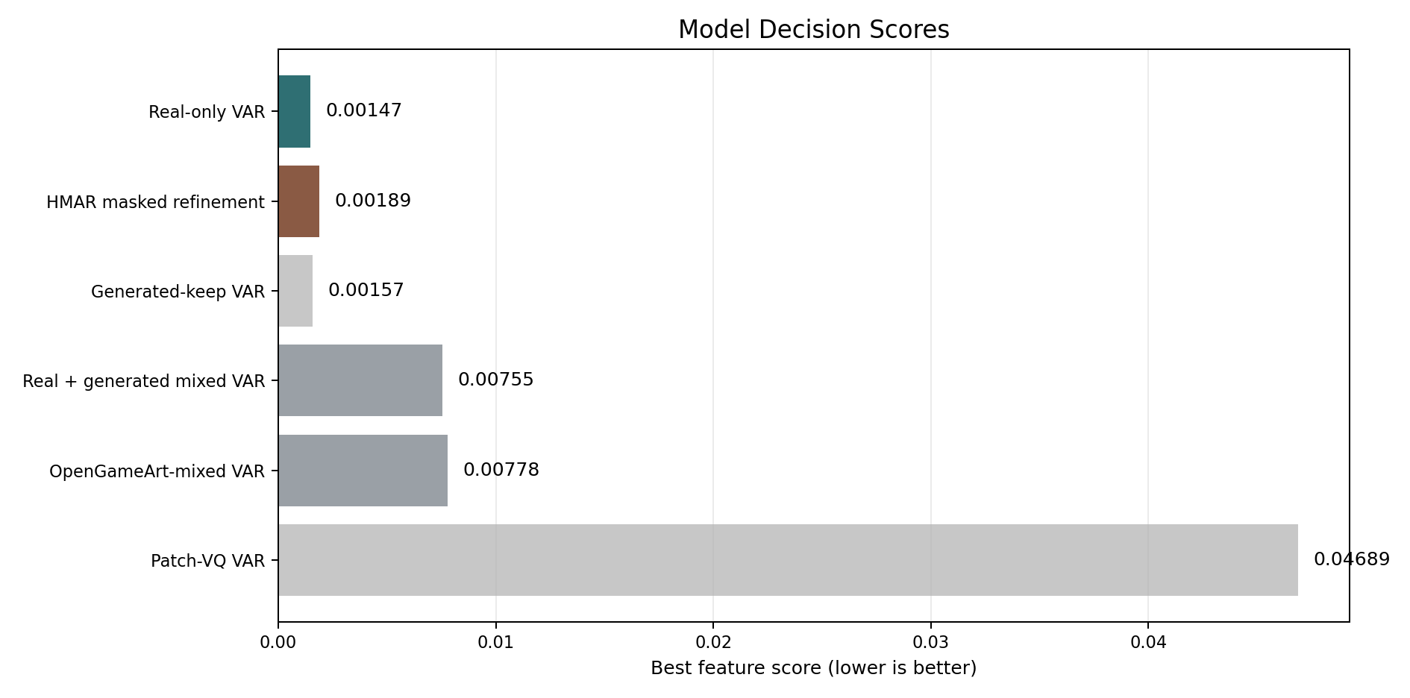
ABLATIONS
HMAR was close, but the main real-only PixelVAR branch stayed strongest on the sprite-feature evaluator.
PixelVAR main
0.00147
HMAR step 1
0.00189
HMAR step 2
0.00374
HMAR step 4
0.00366
HMAR step 8
0.00822
Branch
Decision
Generated/mixed data
larger data did not improve real-validation score
Main lesson: more refinement and more data were not automatically better in this low-resolution palette-token regime.
OpenGameArt mixed
pipeline useful, distribution mismatch
Patch-VQ
learned-token path worked but was blockier
Rubric: ablation study
8/14 main

Slide 9
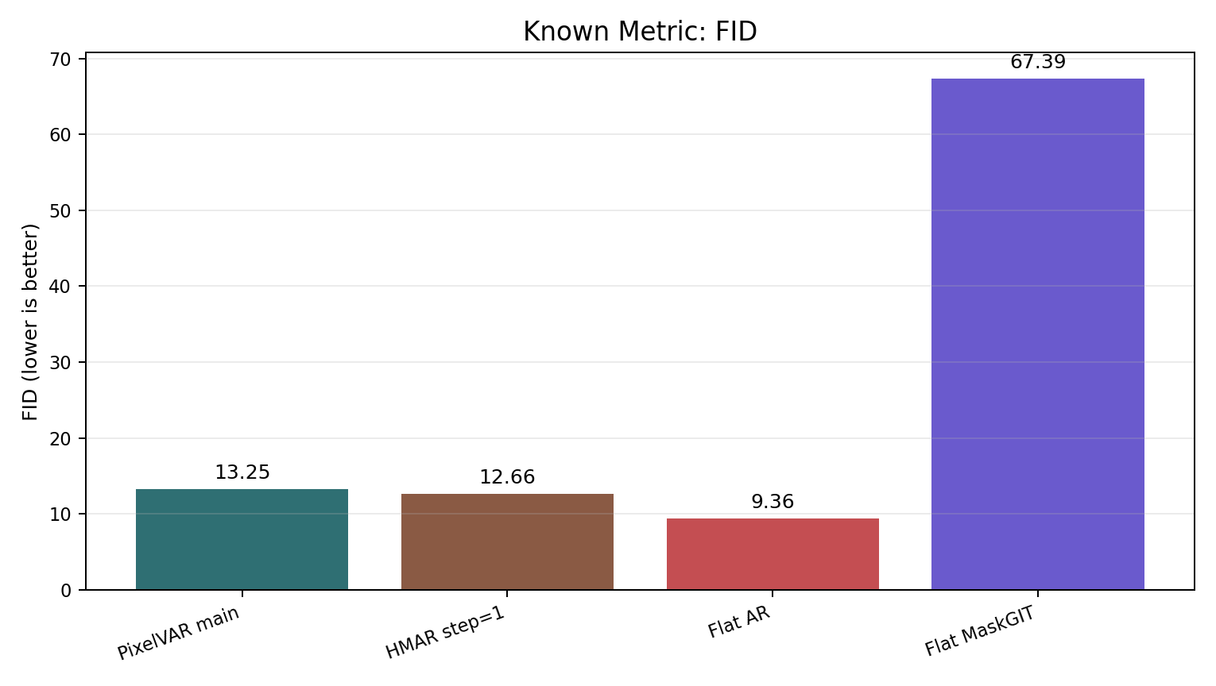
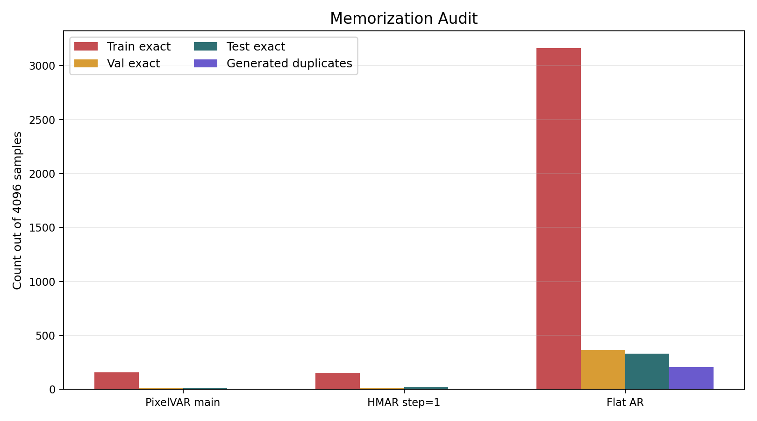
METRICS + AUDIT
Raw FID would pick Flat AR; the exact-match audit changes the conclusion.
Method
FID
Val exact
Test exact
Audit-adjusted read
Flat raster AR
9.36
365
333
memorizing
HMAR step=1
12.66
15
22
keep, disclose
PixelVAR main
13.25
13
11
keep, main result
Flat MaskGIT
67.39
0
0
weak coverage
The dataset had zero cross-split exact duplicate hashes, so held-out exact matches are not explained by simple split leakage.
Rubric: quantitative results
9/14 main

Slide 10
EXTERNAL BASELINES
External diffusion-style generators did not beat PixelVAR under the normalized 32x32 protocol.
PixelVAR 256
46.5
Baseline
Why included
Outcome
Pokemon LoRA 256
154.0
SD-piXL
most targeted low-res palette method
valid attempt, poor adapted run
SSD-1B diffusion 256
158.6
SD-piXL 16
497.7
SSD-1B
generic practical diffusion baseline
recognizable sometimes; low precision
Pokemon LoRA
best accessible sprite-specific practical generator
best external visual, still far behind
PixelVAR 256
0.891
Pokemon LoRA 256
0.051
MDIGAN
related sprite work
conditional pose task; cited only
SSD-1B diffusion 256
0.035
SD-piXL 16
0.000
Rubric: baseline comparison
10/14 main

Slide 11
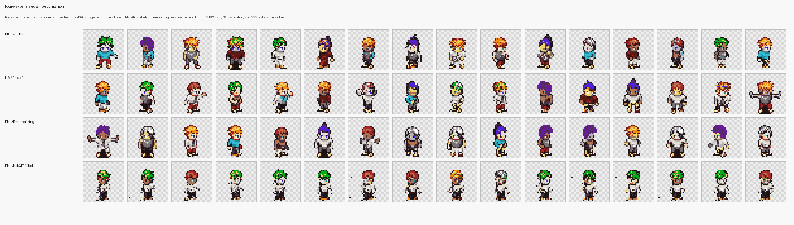
QUALITATIVE EVIDENCE
Samples support the metrics, but the deck keeps qualitative claims modest.
PixelVAR and HMAR produce coherent transparent character sprites.
Flat AR looks visually strong, but exact-match counts make it a memorizing baseline.
External diffusion baselines often create frames, fragments, lineups, or style-mismatched sprites.
Rubric: qualitative results
11/14 main

Slide 12
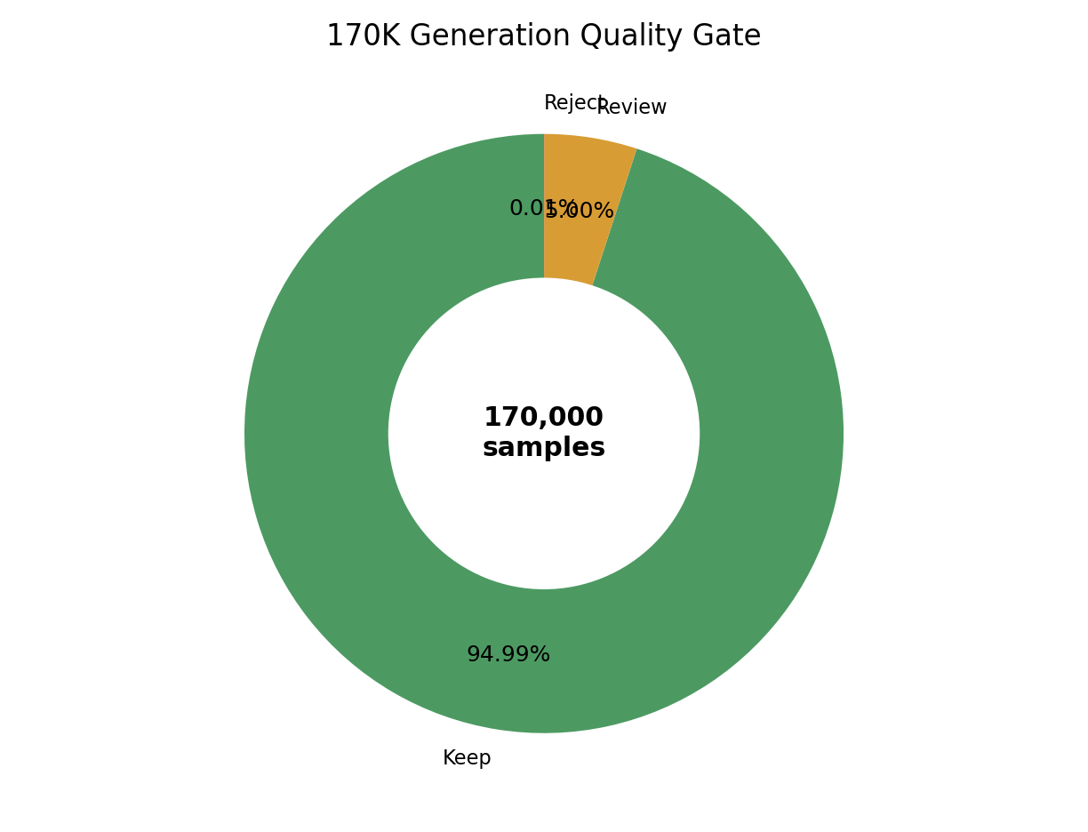
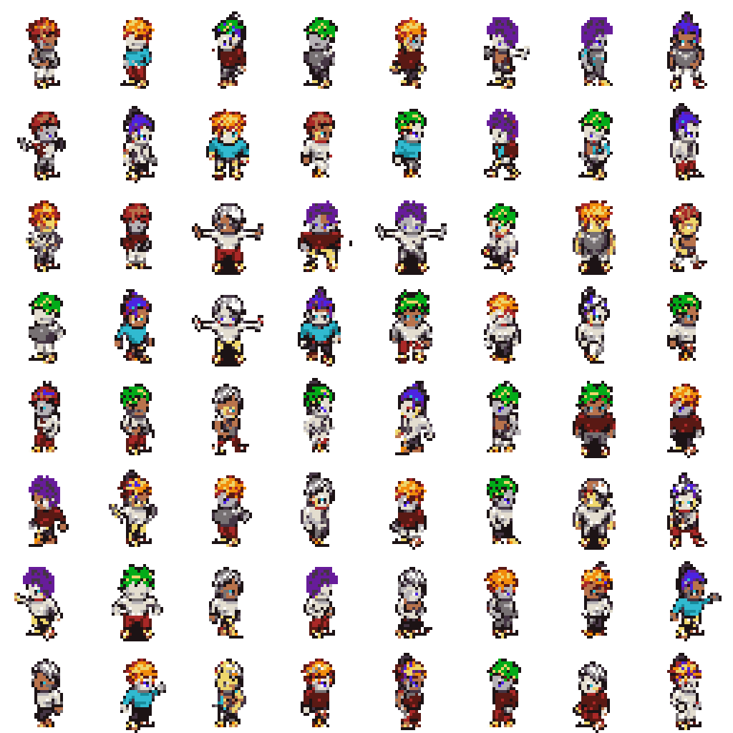
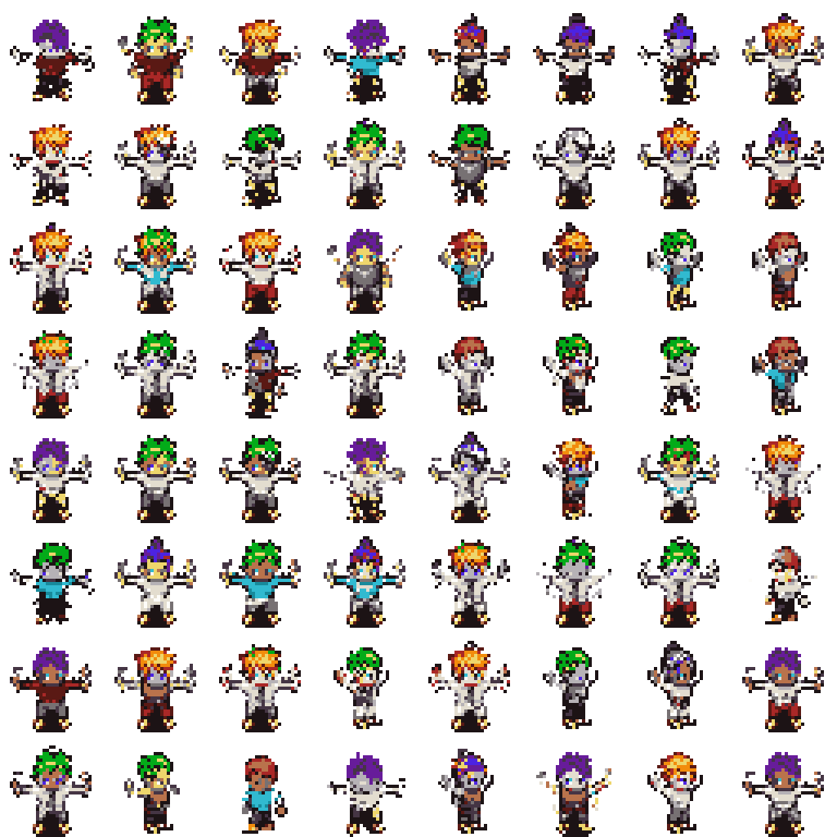
SCALE RESULT
A 170K generation pass shows the sampler remained stable at proposal scale.
170,000
161,479
generated samples
automatic keep
94.99%
8,500
21
review bucket
reject bucket
5.00%
0.01%
This is an automatic quality gate, not a human preference study. The honest claim is large-scale usable generation, not perfect manual approval.
Rubric: experimental results
12/14 main

Slide 13
LIMITATIONS
The strongest version of the project is honest about what did not finish.
Item
Status
Why
Neural multi-scale VQ-VAE
PARTIAL
implemented but reconstructions were too soft/ghosted for pixel art
64x64 cost
8/16/32 palette ablation
SETUP DONE
8-color and 32-color runners exist; GPU metrics pending
1,365
4-scale ablation
SETUP DONE
runner exists; GPU metrics pending
tokens at 32x32
User study n >= 20
NOT DONE
requires separate survey/randomization/collection workflow
5,461
tokens at 64x64
64x64 generation
NOT RUN
sequence length grows from 1,365 to 5,461 tokens
Rubric: limitations
13/14 main

Slide 14
FINAL TAKEAWAYS
PixelVAR completed the core 32x32 palette-token generator and reported it with the audits needed to avoid misleading conclusions.
Methodology: coarse-to-fine palette-token generation works for transparent 32x32 sprites.
Results: PixelVAR is the best comparable proposal branch on the sprite-feature evaluator.
Caution: raw FID alone would incorrectly promote a memorizing Flat AR baseline.
Future: run pending palette/scale ablations, then user study and 64x64 as next-stage work.
Main talk ends here. Backup slides follow for Q&A.
Conclusion
14/14 main

Slide 15
BACKUP: PROPOSAL CHECKLIST
Detailed DONE / PARTIAL / NOT DONE mapping.
Proposal item
Status
Notes
Dataset curation
DONE
MSD replacement selected after original Kaggle source failed
16-color palette-token generation
DONE
transparent token + 16 palette colors
VAR Option A
DONE
main result
HMAR Option B
DONE
refinement ablation complete
Flat AR / MaskGIT baselines
DONE
measured; Flat AR memorizes
External baselines
PARTIAL DONE
SD-piXL, SSD-1B, Pokemon LoRA; PixDiff-PIG no runnable code
User study
NOT DONE
future work
Backup
backup 1/38

Slide 16
BACKUP: METRIC GLOSSARY
What the reported metrics mean.
Metric
Meaning
Caveat
Sprite-feature score
Frechet-style distance over sprite-specific features
main internal selector, not Inception FID
Palette consistency
share of opaque pixels in fixed palette
expected 1.0 for token models
FID / KID
Inception-feature distribution distance
standard but imperfect for tiny pixel art
Precision / recall
fidelity and distribution coverage
must be read with audit
Density / coverage
PRDC-style neighborhood coverage
higher is better
MS-SSIM
sample diversity proxy
compare alongside reference
Exact-match audit
generated token maps copied from train/val/test
critical for suspicious raw winners
Backup
backup 2/38

Slide 17
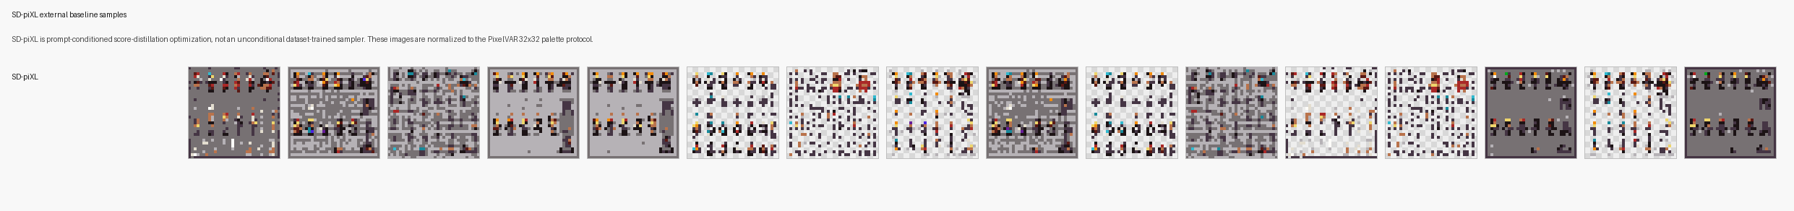
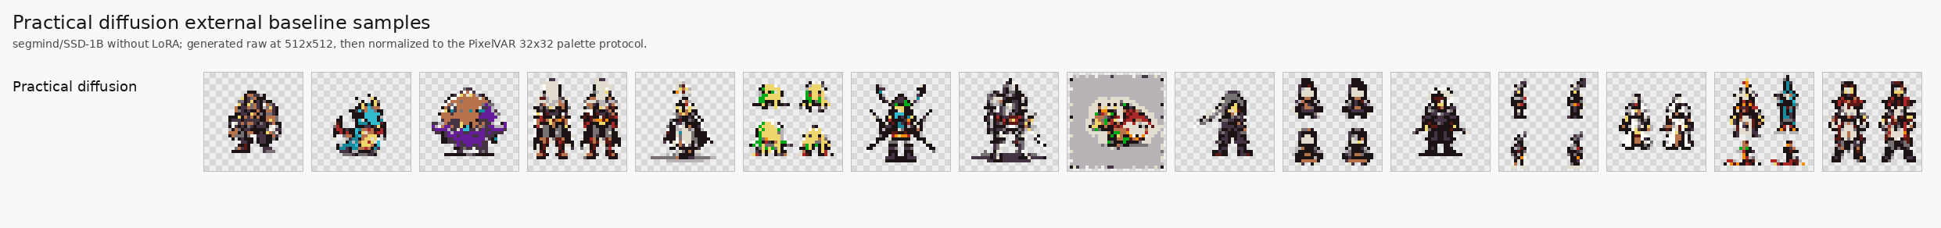
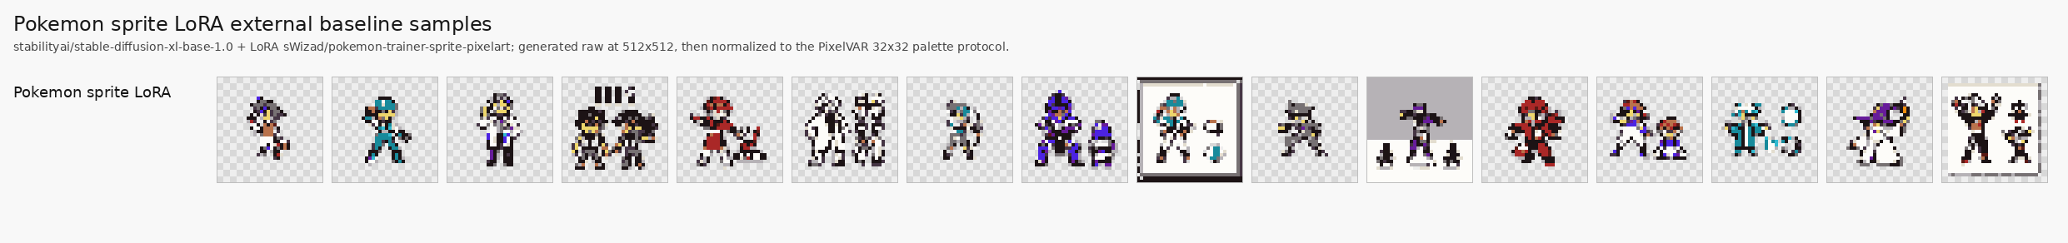
BACKUP: EXTERNAL SAMPLES
External baseline visuals and caveats.
Method
Visual read
Main caveat
SD-piXL
noisy tiled color fields
adapted prompt/image optimization, 16-image metric batch
SSD-1B diffusion
some sprites, many lineup/crop failures
generic prompt-based generator
Pokemon LoRA
best-looking external baseline
Pokemon style, fragments/frames remain
MDIGAN
not metric row
conditional paired-pose imputation
Backup
backup 3/38

Slide 18
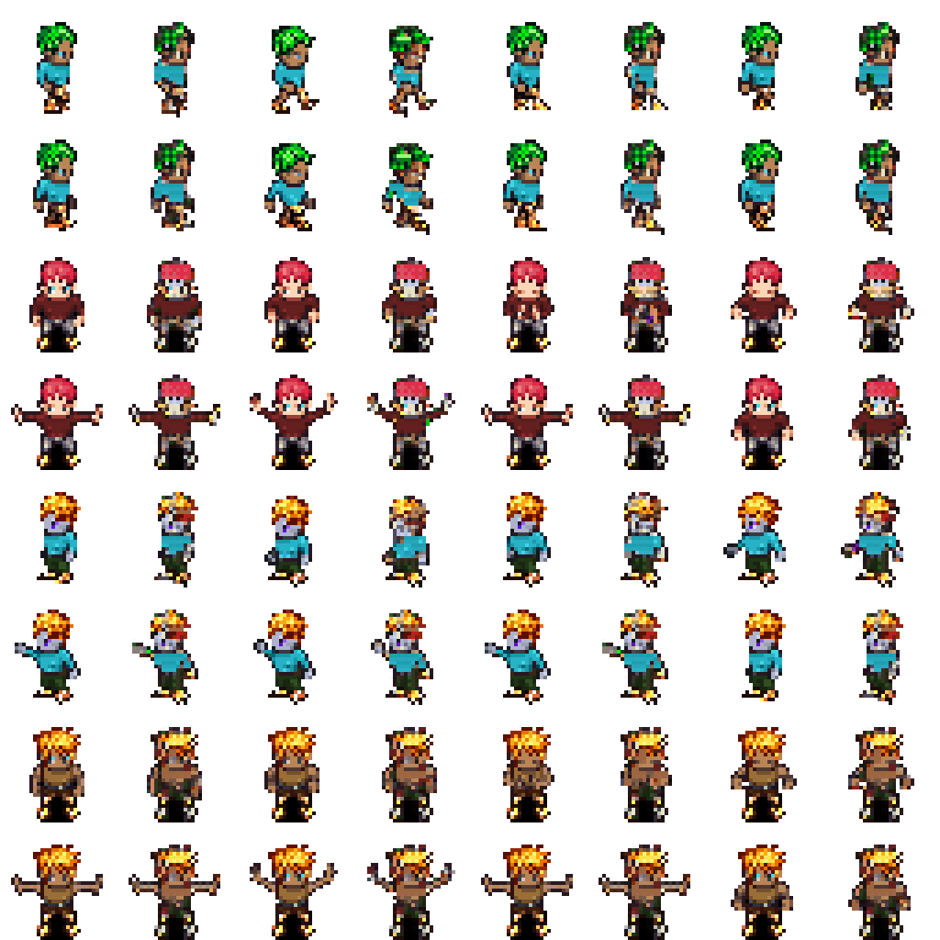
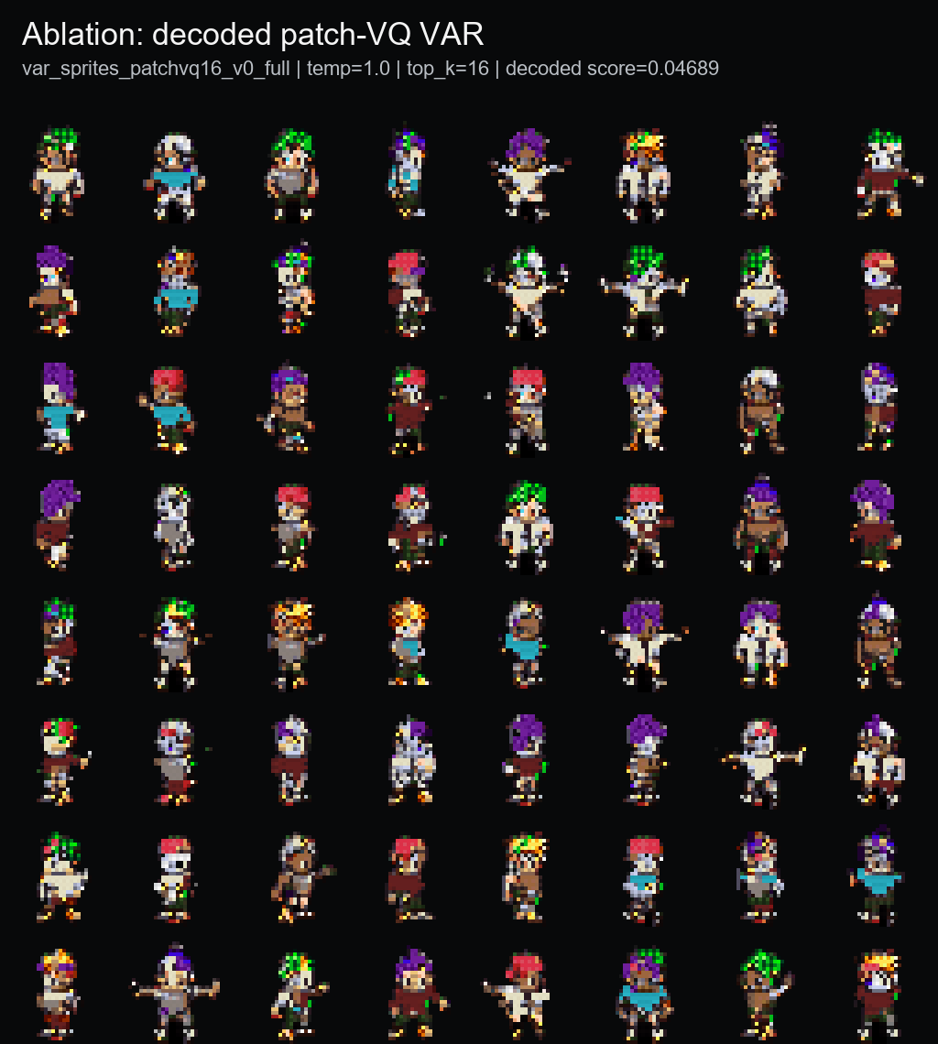
BACKUP: LEARNED TOKENS AND DATA MIXING
Why the final model stayed deterministic and real-only.
Ablation
Result
Decision
Neural VQ-VAE
soft/ghosted reconstructions
not promoted
Patch-VQ
143/512 codes used; coherent but blocky
learned-token ablation
Generated-keep
good self-reference score
not direct real-validation winner
Real + generated
0.00755 real-val score
worse than real-only
OpenGameArt mixed
0.00778 real-val score
worse than real-only
Backup
backup 4/38

Slide 19
BACKUP: REPRODUCIBILITY
Where the evidence and next commands live.
Evidence
Artifact
Pending stretch runs
Main narrative
reports/final/final_report_narrative.md
Internal decision table
reports/final/model_decision_table.md
modal run modal_train.py --action prepare-sprites-palette8
modal run modal_train.py --action train-sprites-palette8-ladder
modal run modal_train.py --action prepare-sprites-palette32
modal run modal_train.py --action train-sprites-palette32-ladder
modal run modal_train.py --action train-sprites-scale4-ladder
Known metrics
reports/final/known_metrics_comparison.md
External baselines
reports/final/external_baseline_comparison.md
Memorization audit
reports/final/memorization_audit_summary.md
Stretch plan
reports/final/proposal_leftovers_stretch_plan.md
Commands
reports/final/reproducibility_commands.md
Branch: codex/pixelvar-external-baselines
Backup
backup 5/38

Slide 20
MASTER EVIDENCE TODO
What was missing or too compressed in the short deck.
Priority
Missing / compressed item
Added in this master deck
1
Full proposal-to-final mapping
Original proposal, final status, and deterministic-token pivot
2
Full sampling sweeps
PixelVAR, HMAR 1/2/4/8, generated-keep, mixed, OGA, Patch-VQ
3
Full known metrics
FID, KID, PRDC, MS-SSIM, palette/domain metrics
4
Full memorization audit
Train/val/test exacts, generated duplicates, split-duplicate caveat
5
External baseline detail
SD-piXL, SSD-1B, Pokemon LoRA, MDIGAN, PixDiff-PIG, VQ-diffusion
6
170K generation evidence
8192 pre-run, 170K package, keep/review/reject sheets
7
Implementation work
Models, scripts, Modal actions, tests, evaluators, adapters
8
Infrastructure and limitations
Kaggle replacement, Lightning/Modal friction, pending 8/32/4-scale/user/64x64
Intent: over-document the work now. The front 14 slides remain the short talk; everything after this can be trimmed later.
Master appendix roadmap
backup 6/38

Slide 21
ORIGINAL PROPOSAL CONTRACT
The proposal promised a palette-token VAR project with HMAR, baselines, ablations, and user evaluation.
Proposal section
Original commitment
Final read
Stage 1 tokenizer
Multi-scale VQ-VAE with 16-32 codebook entries
Neural path partial; deterministic palette tokens became main v0
Stage 2a Option A
VAR-style next-scale generation
Done; main result var_sprites_v0_full
Stage 2b Option B
HMAR-style intra-scale masked refinement
Done; refinement-step ablation completed
Data
Sprites 170K, Pokemon sprites, OpenGameArt
MSD replacement main; Pokemon and OGA paths built/used
Baselines
PixDiff-PIG, SD LoRA, flat MaskGIT, raster AR
Flat AR/MaskGIT done; SD-piXL/SSD/Pokemon LoRA run; PixDiff-PIG not runnable
Metrics
FID, palette consistency, edge crispness, user study
Known metrics and audits done; user study not run
Ablations
8/16/32 colors, scale count, refinement steps
Refinement done; 8/32 and 4-scale made runnable, metrics pending
Proposal source: PixelVAR_Proposal.pdf
backup 7/38

Slide 22
PROPOSAL-TO-FINAL STATUS
The completed work is strong, but not every proposal item became a finished result.
Item
Status
Evidence / reason
Dataset curation and 32x32 preprocessing
DONE
MSD replacement, Pokemon path, OGA curation, grouped splits
Transparency-preserving tokens
DONE
Token 0 transparent; palette tokens 1..K; no white-background hack
VAR Option A
DONE
Best sprite-feature score 0.00147 at temp=0.8, top_k=8
HMAR Option B
DONE
Steps 1/2/4/8 evaluated; step=1 best at 0.00189
Flat raster AR / Flat MaskGIT
DONE
4096-image known-metrics run plus memorization audit
External baselines
PARTIAL DONE
SD-piXL, SSD-1B, Pokemon LoRA run; MDIGAN/PixDiff-PIG not direct runnable rows
Neural VQ-VAE tokenizer
PARTIAL
Implemented/tried, but reconstructions too soft for pixel art
8/32 palette and 4-scale ablations
SETUP DONE
Configs and Modal actions exist; GPU metrics pending
User study n >= 20
NOT DONE
Needs survey design, randomization, collection, and analysis workflow
64x64 generation
NOT RUN
Token count jumps from 1,365 to 5,461; postponed after core proposal work
Proposal mapping
backup 8/38

Slide 23
TOKENIZER PIVOT
The main path moved from neural VQ-VAE to deterministic palette tokens because pixel quality mattered more than latent elegance.
Proposal idea
What happened
Why it was defensible
Train a multi-scale neural VQ-VAE, freeze it, and generate learned palette-sized codes with VAR/HMAR.
A deterministic palette pyramid already matched the target semantics: transparent token plus fixed palette colors at six scales.
Neural reconstructions were too soft/ghosted for pixel art. Patch-VQ worked as an ablation but was blockier.
Path
Result
Decision
Deterministic palette tokens
Crisp, native palette, 0.00147 main score
main result
Neural multi-scale VQ-VAE
implemented, reconstruction quality not good enough
partial / not promoted
Patch-VQ KMeans tokenizer
143/512 codes used, coherent but blocky, score 0.04689
learned-token ablation
Method decision
backup 9/38

Slide 24
TOKEN AND TRANSPARENCY CONTRACT
The final implementation made transparency and palette membership explicit model tokens.
Contract element
Final value
Why it matters
1x1
1
Transparent token
0
background is part of the sprite structure, not cleanup
2x2
4
Palette tokens
1..16
model predicts fixed palette indices directly
4x4
16
Reserved mask token
separate from transparent for HMAR
masked refinement does not confuse missing with background
8x8
64
16x16
256
Scale schedule
1, 2, 4, 8, 16, 32
six-scale coarse-to-fine pyramid
32x32
1024
Total sequence
1,365 tokens
sum of all scale maps; final 32x32 contributes 1,024
Split rule
grouped by character/sheet fields
reduces train/validation leakage
This is why palette consistency reaches 1.0000 for token models: it is an expected property of the representation, not a standalone quality miracle.
Method detail
backup 10/38

Slide 25
DATASET REALITY
The original Kaggle source failed, so the final study used a live replacement plus auxiliary Pokemon and OpenGameArt paths.
93,312
74,664
9,360
9,288
MSD replacement sprites
train
validation
test
Source / set
Role
Outcome
Original brentspell Kaggle sprites
proposal target
blocked: inaccessible/forbidden; page unavailable
TalBarami/msd_sprites replacement
main dataset
used for final train/val/test protocol
Pokemon sprites
debug/prototype path
used for early pipeline validation
OpenGameArt curated public set
mixed-data stretch
4,659 frames, 105 groups; useful pipeline, distribution mismatch
Generated 170K keep set
data expansion experiment
large generation worked, but generated/mixed training did not beat real-only
Experimental setup detail
backup 11/38

Slide 26
IMPLEMENTATION INVENTORY
The project includes models, data tooling, external adapters, audits, and tests beyond the headline model.
Area
Implemented artifacts
Models
VAR transformer, HMAR transformer, flat AR, flat MaskGIT, VQ-VAE, Patch-VQ path
Training
Lightning modules for VAR/HMAR/flat/VQ, checkpoint helpers, overfit/debug/full configs
Data
transparent preprocessing, grouped splits, deterministic tokenizer, palette extraction, dataset mixing
Evaluation
sprite-feature evaluator, decoded Patch-VQ evaluator, image-folder FID/KID/PRDC/MS-SSIM evaluator
Audits
exact-match memorization audit, nearest-neighbor artifacts, sample-sheet builders
External baselines
SD-piXL adapter, SSD-1B practical diffusion, Pokemon sprite LoRA, image normalization
Modal
B200 actions for preparation, training, evaluation, generation, baselines, audits, downloads
Tests
tokenizer, splits, palette/transparency, dataset, model, curation, VQ-VAE, external adapters
Implementation work
backup 12/38

Slide 27
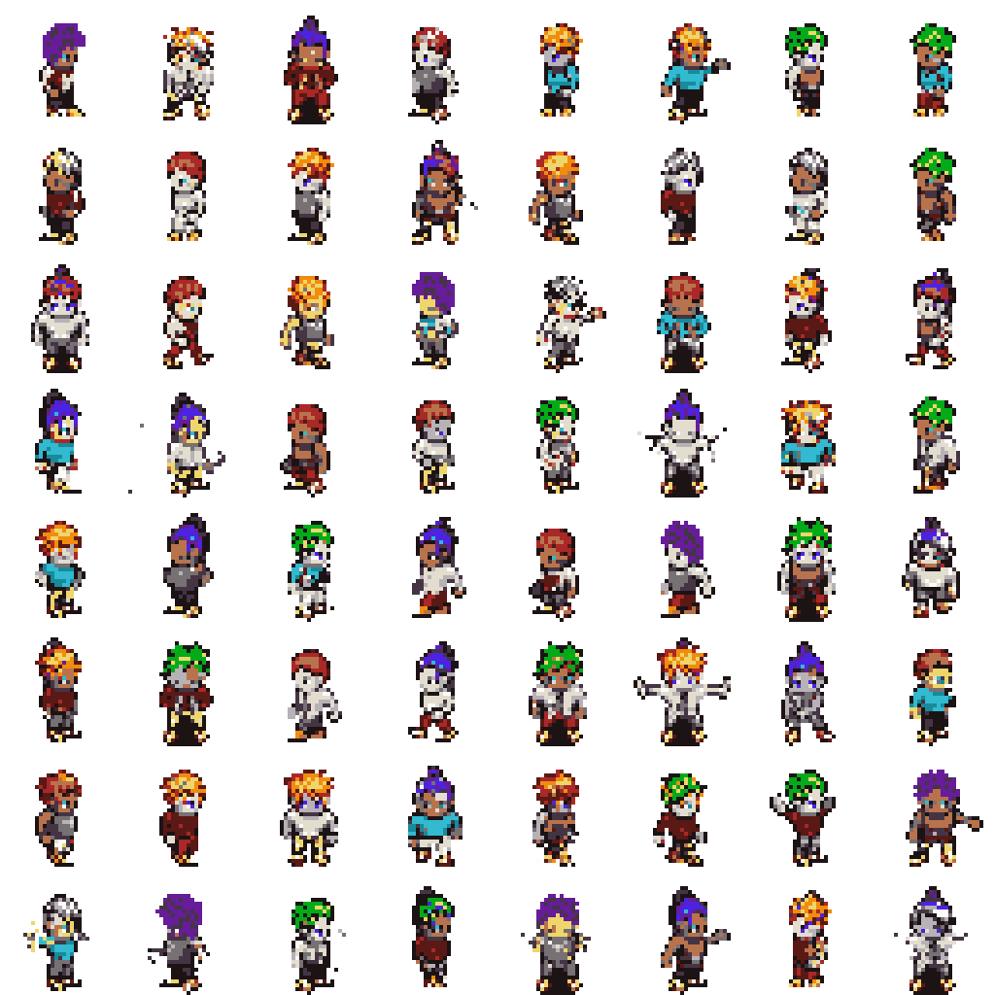
MAIN PIXELVAR SAMPLING SWEEP
The selected checkpoint was chosen from a temperature/top-k sweep, not a single cherry-picked setting.
Temp
Top-k
Feature score
Palette
Opaque
Edge
0.8
8
0.00147
1.0000
0.2291
0.1808
1.0
16
0.00299
1.0000
0.2381
0.1865
0.8
16
0.00392
1.0000
0.2311
0.1829
1.0
8
0.00402
1.0000
0.2335
0.1838
0.8
none
0.00596
1.0000
0.2220
0.1761
1.0
none
0.00637
1.0000
0.2459
0.1917
0.6
none
0.00659
1.0000
0.2172
0.1724
0.6
16
0.00856
1.0000
0.2164
0.1716
0.6
8
0.00956
1.0000
0.2172
0.1740
Reference validation: opaque ratio 0.2354, edge density 0.1811, palette consistency 1.0000. The best score also keeps structure close to reference.
Sampling sweep
backup 13/38

Slide 28
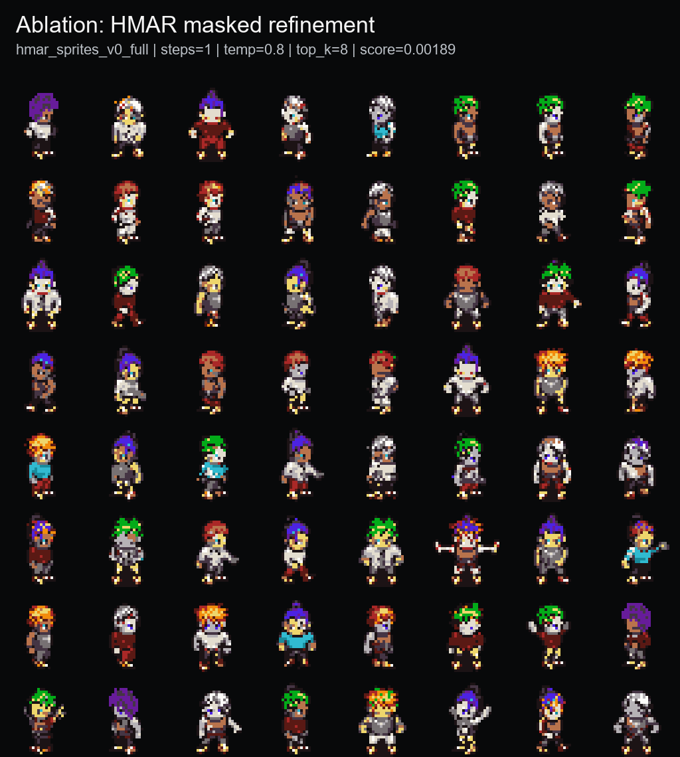
HMAR REFINEMENT SUMMARY
HMAR worked, but more masked refinement did not improve this low-resolution palette-token regime.
Refinement steps
Best temp
Best top-k
Best score
Opaque
Edge
Decision
1
0.8
8
0.00189
0.2315
0.1833
closest HMAR result
2
0.8
16
0.00374
0.2297
0.1831
worse than step 1
4
0.8
16
0.00366
0.2264
0.1823
slightly better than step 2, still worse
8
1.0
none
0.00822
0.2191
0.1747
over-refinement hurts
Option B was implemented and trained successfully.
Step=1 is the only HMAR branch close to main PixelVAR on the sprite-feature evaluator.
The hypothesis that more refinement would fix tiny outlines was not supported here.
HMAR ablation
backup 14/38

Slide 29
FULL HMAR SWEEPS: STEPS 1 AND 2
The step=1 and step=2 HMAR runs were each swept across temperature and top-k settings.
s1 temp
top-k
score
opaque
edge
s2 temp
top-k
score
opaque
edge
0.8
8
0.00189
0.2315
0.1833
0.8
16
0.00374
0.2297
0.1831
1.0
8
0.00471
0.2379
0.1888
1.0
16
0.00435
0.2386
0.1892
1.0
16
0.00638
0.2382
0.1870
1.0
none
0.00594
0.2354
0.1884
0.8
16
0.00647
0.2313
0.1831
1.0
8
0.00650
0.2359
0.1864
1.0
none
0.00775
0.2450
0.1923
0.8
8
0.00933
0.2268
0.1813
0.8
none
0.00968
0.2205
0.1755
0.8
none
0.00961
0.2274
0.1831
0.6
16
0.00978
0.2152
0.1728
0.6
16
0.01018
0.2142
0.1713
0.6
none
0.01174
0.2146
0.1725
0.6
8
0.01443
0.2101
0.1692
0.6
8
0.01419
0.2153
0.1738
0.6
none
0.01836
0.2105
0.1688
Step=1 wins across the HMAR family. Step=2 does not improve the best sample-quality score, even though some structure metrics remain close.
HMAR detailed sweep
backup 15/38

Slide 30
FULL HMAR SWEEPS: STEPS 4 AND 8
Longer masked refinement had more chances to edit tokens, but the measured result got worse.
s4 temp
top-k
score
opaque
edge
s8 temp
top-k
score
opaque
edge
0.8
16
0.00366
0.2264
0.1823
1.0
none
0.00822
0.2191
0.1747
1.0
16
0.00472
0.2378
0.1885
1.0
8
0.00840
0.2266
0.1830
1.0
none
0.00490
0.2369
0.1891
0.8
16
0.01136
0.2185
0.1762
0.8
none
0.00575
0.2254
0.1783
0.8
none
0.01267
0.2165
0.1745
0.8
8
0.00751
0.2305
0.1852
0.8
8
0.01272
0.2206
0.1781
1.0
8
0.00865
0.2395
0.1912
1.0
16
0.01278
0.2226
0.1796
0.6
none
0.01200
0.2153
0.1728
0.6
none
0.01322
0.2118
0.1711
0.6
16
0.01295
0.2130
0.1710
0.6
16
0.01432
0.2104
0.1704
0.6
8
0.01324
0.2135
0.1724
0.6
8
0.02329
0.2088
0.1688
The important interpretation is negative: iterative refinement did not become the final model even though the proposal made it a serious Option B.
HMAR detailed sweep
backup 16/38

Slide 31
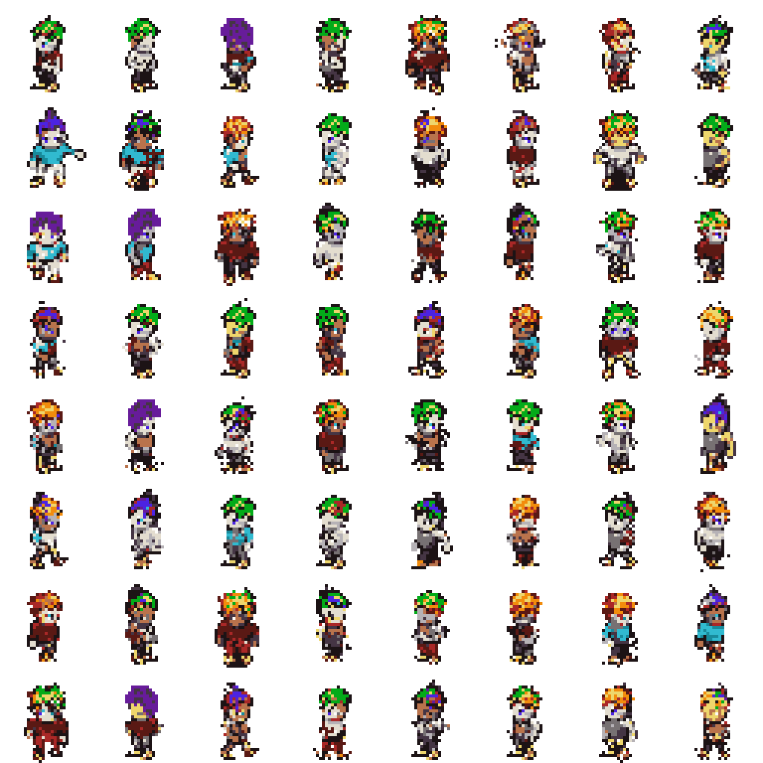
GENERATED-KEEP SWEEP
A generated-only keep set scored well against its own reference, but it was not a direct real-validation winner.
Temp
Top-k
Feature score
Palette
Opaque
Edge
0.8
8
0.00157
1.0000
0.2181
0.1761
0.8
16
0.00394
1.0000
0.2157
0.1748
0.6
8
0.00482
1.0000
0.2082
0.1674
0.6
16
0.00673
1.0000
0.2052
0.1662
0.6
none
0.00835
1.0000
0.2080
0.1684
0.8
none
0.00977
1.0000
0.2097
0.1719
1.0
16
0.01473
1.0000
0.2277
0.1871
1.0
8
0.01510
1.0000
0.2235
0.1837
1.0
none
0.01690
1.0000
0.2291
0.1879
Caveat: this branch uses generated-keep validation as its reference, so the low score is useful but not an apples-to-apples winner comparison.
Data expansion ablation
backup 17/38

Slide 32
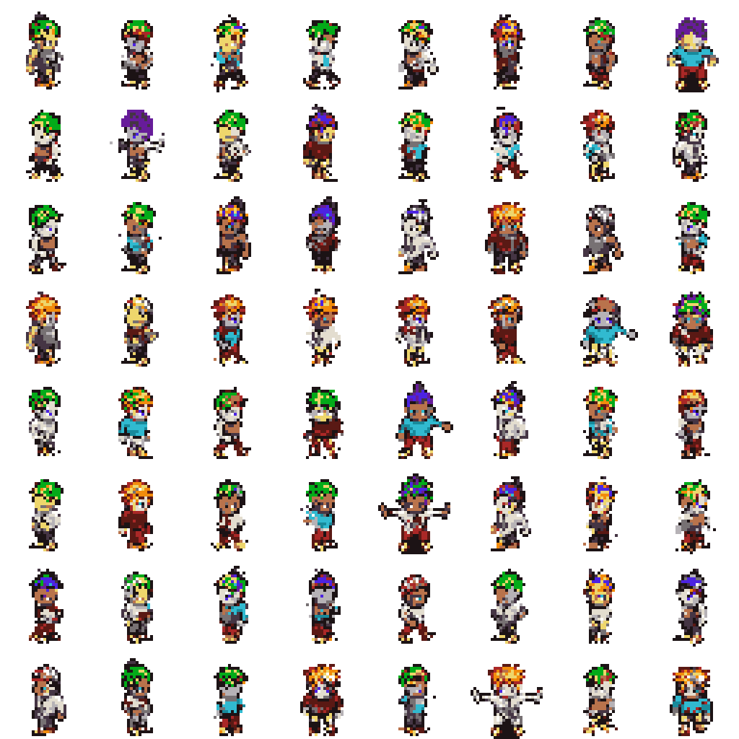
REAL + GENERATED MIXED SWEEP
Adding generated keep samples to real data made training larger, but did not improve the real-validation score.
Temp
Top-k
Feature score
Palette
Opaque
Edge
0.8
8
0.00755
1.0000
0.2220
0.1797
0.8
16
0.01047
1.0000
0.2215
0.1782
1.0
16
0.01548
1.0000
0.2292
0.1884
0.6
8
0.01813
1.0000
0.2096
0.1694
0.8
none
0.01904
1.0000
0.2132
0.1743
1.0
8
0.02043
1.0000
0.2297
0.1885
0.6
none
0.02101
1.0000
0.2090
0.1684
0.6
16
0.02127
1.0000
0.2080
0.1678
1.0
none
0.02438
1.0000
0.2358
0.1940
Main lesson: more samples were not automatically better. The final real-only VAR score stayed far stronger at 0.00147.
Data expansion ablation
backup 18/38

Slide 33
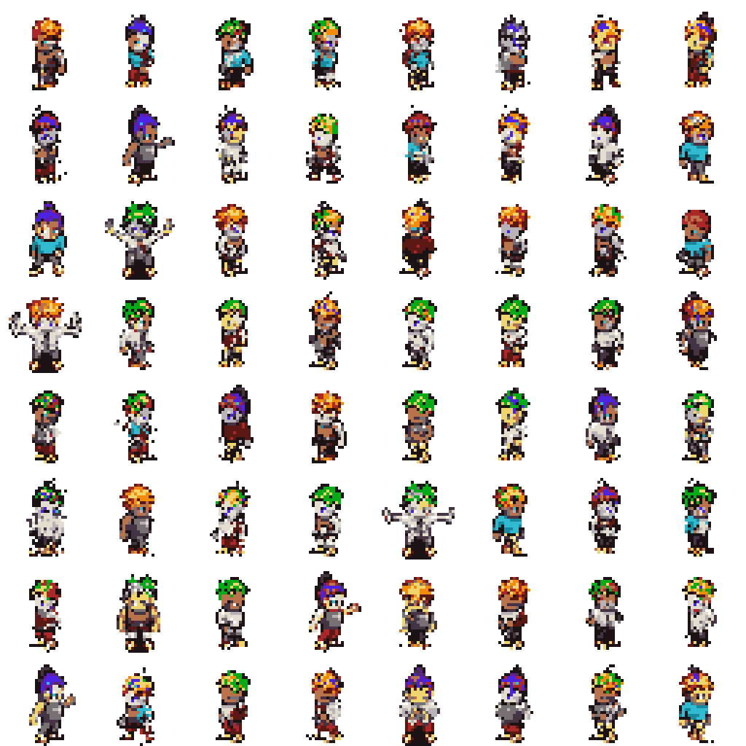
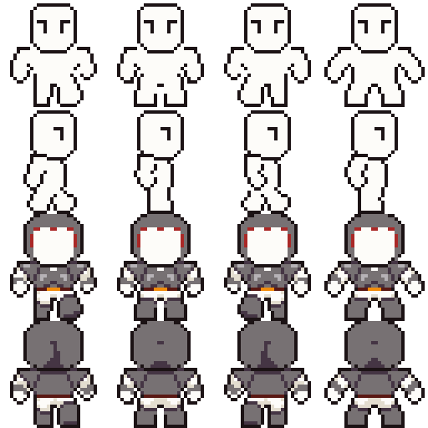
OPENGAMEART-MIXED SWEEP
The public OpenGameArt path worked technically, but its distribution did not improve the main MSD validation result.
Temp
Top-k
Feature score
Palette
Opaque
Edge
0.8
8
0.00778
1.0000
0.2200
0.1777
0.8
16
0.01234
1.0000
0.2202
0.1779
1.0
8
0.01629
1.0000
0.2287
0.1880
0.6
8
0.01652
1.0000
0.2094
0.1691
0.6
16
0.01689
1.0000
0.2087
0.1688
1.0
16
0.02012
1.0000
0.2318
0.1889
0.6
none
0.02145
1.0000
0.2081
0.1666
0.8
none
0.02284
1.0000
0.2122
0.1728
1.0
none
0.02584
1.0000
0.2358
0.1932
OpenGameArt curated set: 4,659 frames, 105 groups, train 3,493, validation 502, test 664. Useful source, not a quality win here.
Data expansion ablation
backup 19/38

Slide 34
PATCH-VQ LEARNED-TOKEN SWEEP
Patch-VQ verified the learned-token direction, but the decoded samples were blockier and used a separate evaluator.
Temp
Top-k
Decoded score
Opaque
Alpha edge
RGB edge
Entropy
1.0
16
0.04689
0.2364
0.0526
0.1348
3.4266
1.0
64
0.05271
0.2361
0.0524
0.1360
3.4488
1.0
32
0.05403
0.2337
0.0519
0.1351
3.4667
0.8
32
0.06289
0.2240
0.0500
0.1290
3.4780
0.8
16
0.07695
0.2201
0.0490
0.1275
3.5117
0.6
64
0.07905
0.2094
0.0463
0.1206
3.5017
0.8
64
0.07954
0.2176
0.0496
0.1276
3.5221
0.6
32
0.09294
0.2074
0.0461
0.1205
3.5217
0.6
16
0.10577
0.2080
0.0472
0.1221
3.5459
Patch-VQ: token map (93,312, 16, 16), vocabulary 512, used codes 143/512, VAR val loss 0.10122, val accuracy 0.96905.
Learned-token ablation
backup 20/38

Slide 35
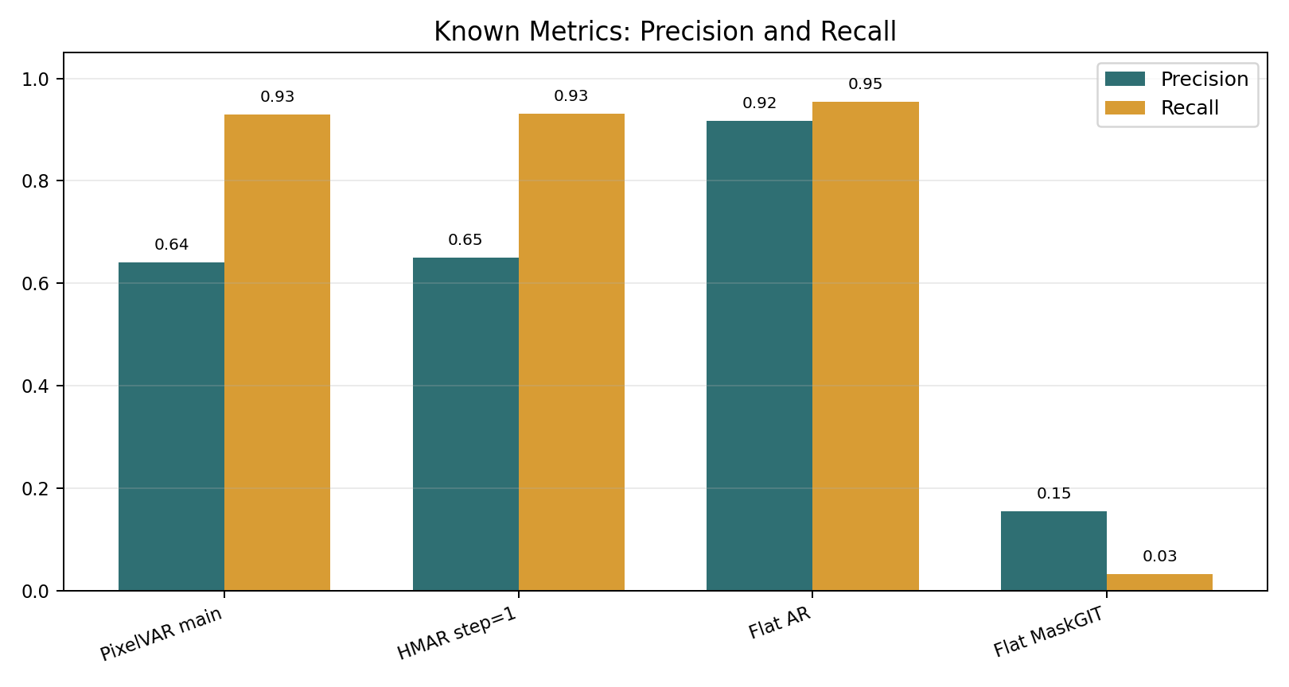
KNOWN IMAGE METRICS: FULL INTERNAL TABLE
Raw Inception metrics favor Flat AR, but that result is not trustworthy without the audit.
Method
FID
KID
Prec.
Recall
Density
Coverage
MS-SSIM
Exact rate
Flat raster AR
9.3558
0.002975
0.9172
0.9541
0.7654
0.8518
0.8281
0.0112
HMAR step=1
12.6555
0.005209
0.6494
0.9314
0.4136
0.6165
0.8309
0.0005
PixelVAR main
13.2516
0.006010
0.6406
0.9292
0.4093
0.6050
0.8323
0.0007
Flat MaskGIT
67.3908
0.061825
0.1545
0.0317
0.0455
0.0454
0.9426
0.0000
Conservative reading: HMAR and PixelVAR are the strongest non-memorizing candidates measured; PixelVAR wins sprite-feature, HMAR slightly wins some Inception metrics.
Known metrics
backup 21/38

Slide 36
PIXEL-ART DOMAIN METRICS: FULL INTERNAL TABLE
Palette consistency is perfect by construction; structure and exact-match metrics carry more interpretive weight.
Method
Palette
Opaque
Ref opaque
Edge
Ref edge
Unique colors
Pixel NN L2
Exact rate
PixelVAR main
1.0000
0.2276
0.2353
0.1802
0.1807
11.9294
5.2384
0.000732
HMAR step=1
1.0000
0.2269
0.2353
0.1809
0.1807
11.8301
5.2180
0.000488
Flat raster AR
1.0000
0.2321
0.2353
0.1790
0.1807
11.0378
3.4928
0.011230
Flat MaskGIT
1.0000
0.1942
0.2353
0.1631
0.1807
11.8718
9.5599
0.000000
How to read it
PixelVAR and HMAR match reference edge density closely. Flat AR has great-looking metrics partly because it reproduces data. MaskGIT under-fills sprites and loses coverage.
Domain metrics
backup 22/38

Slide 37
METRIC INTERPRETATION
The serious read uses metric families together, not a single leaderboard number.
Metric family
What it tells us
How we used it
Sprite-feature score
Frechet-style distance over sprite-specific palette, silhouette, entropy, and edge features
main internal selector for VAR/HMAR/data branches
FID / KID
standard Inception-feature real-vs-generated distribution distance
reported for credibility, but caveated for tiny pixel art
Precision / recall
fidelity and distribution coverage
read together with memorization audit
Density / coverage
PRDC neighborhood coverage
external baselines are far below PixelVAR here
MS-SSIM
sample diversity proxy
lower alone is not always better if samples are malformed
Palette metrics
palette compliance, unique colors, opaque ratio, edge density
domain checks; palette consistency is expected for token outputs
Exact-match audit
generated token maps copied from train/val/test or duplicated internally
decides whether Flat AR is a clean winner or a memorizer
Metrics caveats
backup 23/38

Slide 38
MEMORIZATION AUDIT: FULL TABLE
Flat AR's raw metric advantage collapses under exact-match auditing.
Model
Train exact
Val exact
Test exact
Generated duplicates
Status
PixelVAR main
157
13
11
4
low exact-match rate; disclose and keep
HMAR step=1
154
15
22
5
low exact-match rate; disclose and keep
Flat AR
3162
365
333
206
memorizing; disqualify as clean winner
Split check
The processed dataset has zero cross-split exact duplicate hashes. Held-out exact matches are not explained by exact duplicate leakage between train/val/test.
Memorization audit
backup 24/38

Slide 39
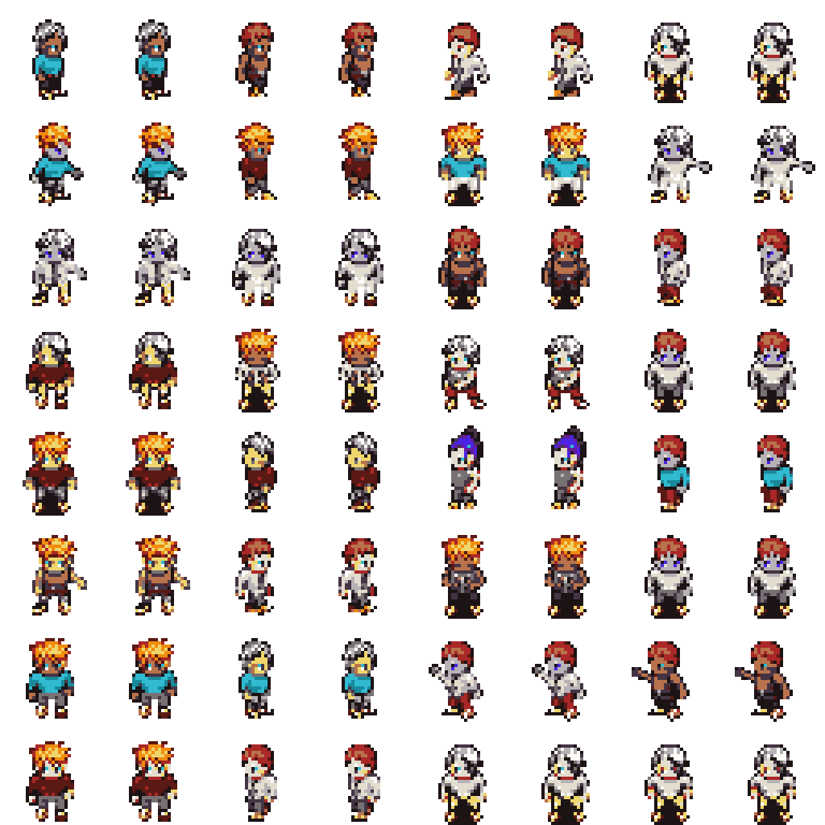
FLAT AR CAUTION VISUAL
The suspiciously strong baseline is useful because it exposes memorization risk.
Read
Evidence
Raw winner
FID 9.3558, KID 0.002975, precision 0.9172, recall 0.9541
Audit failure
3162/4096 generated samples exactly match train images
Held-out issue
365 validation and 333 test exact matches despite zero cross-split exact duplicates
Final decision
Report it as a memorizing baseline, not as a clean generative winner
Memorization evidence
backup 25/38

Slide 40
EXTERNAL BASELINE STATISTICAL STRENGTH
External rows are serious attempts, but they do not all have equal sample count or task fit.
Baseline
Images
Why included
Main caveat
Decision
SD-piXL
16
most targeted low-res/palette released-code method
per-image prompt/image optimization; visually failed after adaptation
keep as targeted attempted baseline
SSD-1B diffusion smoke
64
generic practical diffusion comparison
text-to-image, prompt-sensitive, many malformed crops
smoke result only
SSD-1B diffusion primary
256
scaled generic practical comparison
still far below PixelVAR
keep generic external row
Pokemon sprite LoRA smoke
64
more targeted practical sprite generator
Pokemon trainer style, not MSD; frames/fragments remain
smoke result
Pokemon sprite LoRA primary
256
best accessible practical sprite-specific generator
not architecture-equivalent; still below PixelVAR
primary practical external row
MDIGAN
not run
direct character-sprite related work
conditional paired-pose imputation, not unconditional sampling
cite, not numeric row
External baselines
backup 26/38

Slide 41
EXTERNAL METRICS: FULL COMPARISON TABLE
Every external output was normalized to the same 32x32 RGBA PixelVAR palette protocol before evaluation.
External baseline
N
PV FID
Ext FID
PV KID
Ext KID
PV Prec
Ext Prec
PV Rec
Ext Rec
PV Cov
Ext Cov
Ext MS
SD-piXL
16
151.0927
497.7065
0.014713
0.517647
1.0000
0.0000
0.9375
0.0000
1.0000
0.0000
0.4926
SSD-1B smoke
64
87.8128
196.9628
0.007124
0.092097
0.8125
0.0312
0.9375
0.6719
0.9219
0.0469
0.3935
SSD-1B primary
256
46.4794
158.5819
0.007480
0.102159
0.9102
0.0547
0.8711
0.4922
0.8906
0.0352
0.4107
Pokemon LoRA smoke
64
87.8128
184.3101
0.007124
0.130036
0.8125
0.3125
0.9375
0.2812
0.9219
0.1094
0.5171
Pokemon LoRA primary
256
46.4794
154.0150
0.007480
0.136589
0.9102
0.1172
0.8711
0.1211
0.8906
0.0508
0.5421
Palette consistency is 1.0000 after normalization for these rows; that confirms protocol compliance, not native palette learning by the external models.
External metrics
backup 27/38

Slide 42
SD-PIXL BASELINE DETAILS
SD-piXL was the most targeted released-code external attempt, but it failed under our adapted 32x32 sprite protocol.
Item
Detail
Why serious
SIGGRAPH Asia 2024 low-resolution quantized imagery / pixel-art-related method
Run scale
smoke completed, then corrected 16-image metric batch
Metric result
External FID 497.7065, KID 0.517647, precision/recall/coverage all 0.0000
Visual result
noisy tiled color fields, not centered character sprites
B200 fix
torch stack moved to 2.8.0 / CUDA 12.8-compatible wheels
Palette fix
hex export changed from CSS #RRGGBB to bare RRGGBB
Protocol fix
batch count respected explicit num_samples; old output folders cleared; corner transparency cleanup added
External baseline detail
backup 28/38

Slide 43
SSD-1B PRACTICAL DIFFUSION DETAILS
The generic practical diffusion baseline produced some recognizable sprites but remained far below PixelVAR.
Run
FID
KID
Precision
Recall
Coverage
Read
64 smoke
196.9628
0.092097
0.0312
0.6719
0.0469
recognizable sometimes, weak precision
256 primary
158.5819
0.102159
0.0547
0.4922
0.0352
not competitive
Optional LoRA smoke
nerijs/pixel-art-xl loaded with many unexpected adapter keys against SSD-1B's distilled UNet and did not clearly improve the visual result, so the default stayed no-LoRA SSD-1B.
External baseline detail
backup 29/38

Slide 44
POKEMON SPRITE LORA DETAILS
The Pokemon trainer LoRA is the best-looking practical external generator, but it still does not close the metric gap.
Run
FID
KID
Precision
Recall
Coverage
Read
64 smoke
184.3101
0.130036
0.3125
0.2812
0.1094
best visual smoke, still weak coverage
256 primary
154.0150
0.136589
0.1172
0.1211
0.0508
primary external row
Trained for Pokemon trainer-style sprites, not our MSD Sprites distribution.
Failure modes: side fragments, decorative frames, paired characters, sprite-sheet leftovers.
Useful for external visual comparison; not architecture-equivalent to PixelVAR.
External baseline detail
backup 30/38

Slide 45
RELATED BASELINES THAT WERE EXCLUDED OR BLOCKED
Several related methods were checked, but forcing them into the metric table would be misleading.
Method
Why related
Why not a direct numeric row now
MDIGAN
character sprite generation with released code
conditional paired-pose imputation; receives reference poses PixelVAR does not get
Generating Pixel Art Character Sprites using GANs
direct pixel-art character sprite work
pose-to-pose / conditional framing; cite as related work
PixDiff-PIG
palette-informed diffusion for pixel art
targeted search found no runnable public repository or weights
achsaf/vq-diffusion-pixelart-16x16
architecture-adjacent discrete diffusion over 16x16 pixel-art characters
model files returned HTTP 401 and native resolution is 16x16
Full SDXL LoRA alternatives
practical external image generators
prompt/model sensitivity; only the strongest accessible Pokemon LoRA promoted
This is a seriousness point: we did not omit MDIGAN/PixDiff-PIG randomly; we separated related work from fair unconditional-generation metrics.
External baseline decisions
backup 31/38

Slide 46
GENERATION-SCALE EVIDENCE
The sampler was tested first at 8,192 samples, then at the proposal-scale 170,000 sample pass.
Run
Samples
Opaque mean
Opaque std
Edge mean
Edge std
Token range
Package
pre-run
8,192
0.2281
0.0317
0.1808
0.0254
0..16
zip + tokens.npy + index_maps.npy
proposal-scale
170,000
0.2276
0.0314
0.1803
0.0250
0..16
zip + tokens.npy + index_maps.npy
Inspection run
Keep
Review
Reject
Largest component mean
Component p95
8,192
7,782
410
0
0.9983
3.0
170,000
161,479
8,500
21
0.9982
3.0
The automatic gate supports large-scale sampling stability. It is not a human preference study and should not be worded as manual approval.
Large-scale generation
backup 32/38

Slide 47
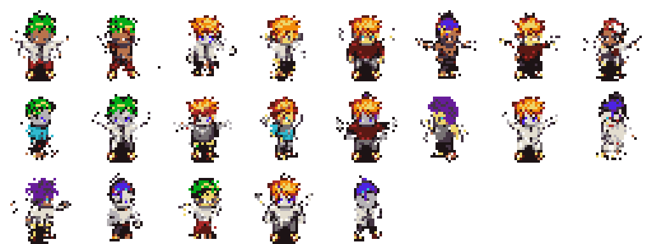
170K VISUAL INSPECTION SHEETS
The final generation pass kept examples, review examples, and the small reject bucket visible.
Bucket
Count
Rate
Interpretation
Keep
161,479
94.99%
passes automatic usability gate
Review
8,500
5.00%
unusual or high-score samples for human checking
Reject
21
0.01%
obvious automatic failures retained for honesty
Large-scale generation visuals
backup 33/38

Slide 48
MODAL AND REPRODUCIBILITY COMMAND MAP
The final work is reproducible through grouped Modal actions and local report builders.
Workstream
Representative commands / actions
Main VAR
prepare-sprites; train-sprites-overfit32; train-sprites-debug1k; train-sprites-v0-full; eval-sprites
HMAR
train-sprites-hmar-overfit32; train-sprites-hmar-debug1k; train-sprites-hmar-v0-full; eval-hmar-refinement-ablation
Generated/mixed
generate-sprites-selected --num-samples 170000; prepare-sprites-generated-keep; prepare-sprites-mixed
OpenGameArt
prepare-opengameart-public; prepare-sprites-mixed-opengameart; train-sprites-mixed-oga-v0-full
Patch-VQ
prepare-patch-vq-sprites; train-sprites-patchvq16-v0-full; eval-patch-vq-decoded
External
run-sd-pixl-batch; run-practical-diffusion-batch; run-pokemon-sprite-lora-batch; evaluate_image_folders
Audits
benchmark-main-hmar-flat-known-metrics; audit-flat-ar-memorization; audit-main-hmar-memorization
Artifacts
build_final_artifacts.py; build-four-way-sample-sheet; modal volume get ... reports/final
Reproducibility
backup 34/38

Slide 49
FULL LIMITATIONS AND REASONS
The limitations are not hidden; each incomplete item has a concrete reason.
Item
Status
Reason / evidence
Neural multi-scale VQ-VAE
PARTIAL
implemented, but reconstructions were too soft/ghosted for pixel art
Patch-VQ learned tokens
ABLATION ONLY
worked technically; 143/512 codes used; blockier decoded samples
8/32 palette ablation
SETUP DONE
configs and actions added; GPU metrics pending
4-scale hierarchy ablation
SETUP DONE
runnable; metrics pending
User study n >= 20
NOT DONE
requires separate survey, randomization, collection, and analysis
64x64 generation
NOT RUN
sequence length increases from 1,365 to 5,461; postponed after 32x32 proposal completion
Original Kaggle dataset
REPLACED
forbidden/unavailable; live MSD replacement used
Lightning/Modal friction
DISCLOSED
job handling, spend/GPU limits, B200 compatibility, local command/runtime issues
Broad SOTA claim
NOT CLAIMED
external baselines are useful but not exhaustive enough for broad SOTA
Limitations
backup 35/38

Slide 50
PENDING PROPOSAL-LEFTOVER COMMANDS
The remaining lightweight ablations are already wired; they need GPU runs and inspection before promotion.
modal run modal_train.py --action prepare-sprites-palette8
modal run modal_train.py --action train-sprites-palette8-ladder
modal run modal_train.py --action eval-sprites-palette8 --num-samples 128
modal run modal_train.py --action prepare-sprites-palette32
modal run modal_train.py --action train-sprites-palette32-ladder
modal run modal_train.py --action eval-sprites-palette32 --num-samples 128
modal run modal_train.py --action train-sprites-scale4-ladder
modal run modal_train.py --action eval-sprites-scale4 --num-samples 128
Interpretation rule: compare feature score, opaque ratio, edge density, token entropy, and sample sheets. Do not promote a palette ablation from palette consistency alone.
Future work
backup 36/38

Slide 51
EVIDENCE INDEX
The deck points back to the detailed artifacts so every claim can be checked.
Evidence
Artifact
Narrative
reports/final/final_report_narrative.md
Internal decision table
reports/final/model_decision_table.md / .csv
Known metrics
reports/final/known_metrics_comparison.md / .csv
External baselines
reports/final/external_baseline_comparison.md
External plan/history
reports/final/external_baseline_and_metrics_plan.md
MDIGAN decision
reports/final/mdigan_decision.md
Memorization audit
reports/final/memorization_audit_summary.md and reports/memorization_audit/*
Visual result deck
reports/final/visual_results_deck.md
Stretch plan
reports/final/proposal_leftovers_stretch_plan.md
Commands
reports/final/reproducibility_commands.md and docs/modal_b200.md
Artifact index
backup 37/38

Slide 52
MASTER EVIDENCE CLOSE
The short presentation is rubric-aligned; this master version adds the full evidence trail so nothing important is hidden.
Keep for short talk: problem, method, main result, audit, external baselines, limitations.
Use for Q&A: full sweeps, metric caveats, memorization tables, external run details.
Do not overclaim: PixelVAR is a strong 32x32 proposal result, not a broad SOTA result.
Next proof to add later: completed 8/32 palette and 4-scale ablation metrics, user study, 64x64.
Closing
backup 38/38

