Slide 1
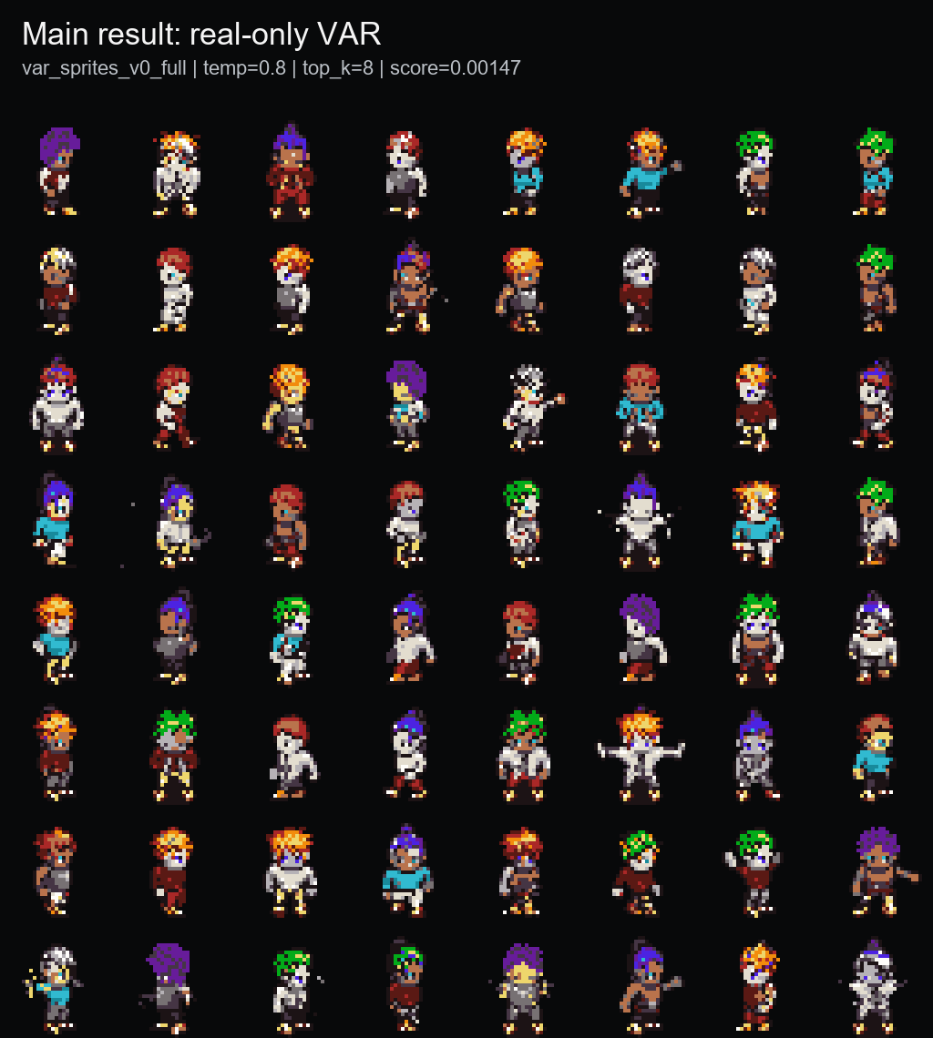
PixelVAR
Coarse-to-fine pixel-art sprite generation via palette tokens
Rubric-aligned final presentation | COMP547 Deep Unsupervised Learning | June 2026
32x32
16+alpha
0.00147
sprite output
palette-token vocab
best sprite-feature score
Thesis: generate transparent pixel-art sprites directly in discrete palette-index space, then evaluate honestly with baselines, ablations, and memorization audit.
Opening
1/12 main

Slide 2
PROBLEM + MOTIVATION
Pixel art is not just low-resolution RGB.
Why it matters
Why it is hard
Our framing
Game sprites are labor-intensive assets. A usable generator should produce compact transparent characters, not just pretty pixel-ish pictures.
Every pixel is visible. Small palette changes, anti-aliasing, noisy backgrounds, or broken silhouettes can make an output unusable.
Instead of generating continuous RGB and quantizing later, PixelVAR learns to generate palette-index tokens directly.
Transparent background is part of the object, not cleanup.
Palette consistency should be native to generation, not a post-hoc repair.
A single misplaced pixel can break outlines or pose readability.
Rubric: problem statement and motivation
2/12 main

Slide 3
RELATED WORK
PixelVAR sits between pixel-art-specific generators and hierarchical image-token models.
Family
Example
Why it is not enough
Pixel-art GANs
Coutinho / MDIGAN
conditional or pose-based; not the same unconditional generation task
Diffusion
SD-piXL, PixDiff-PIG, LoRAs
continuous, prompt-first, or image-first; needs repair/normalization
Discrete tokenizers
Pixel VQ-VAE
useful representation direction, but not a complete generator by itself
Hierarchical AR
VAR / HMAR
strong coarse-to-fine idea, but not aimed at tiny transparent palette sprites
Our niche: next-scale prediction for tiny transparent palette-constrained sprites.
Flat AR and MaskGIT still matter, but they belong in the baseline/evaluation section, not the opening literature table.
Rubric: related work
3/12 main

Slide 4
PROPOSAL CONTRACT AND FINAL PIVOT
What we promised, what changed, what we completed.
Proposal component
Final state
Evidence / reason
Tokenizer pivot
32x32 sprite dataset + preprocessing
DONE
MSD replacement, grouped splits, Pokemon/OpenGameArt support paths
Proposed neural multi-scale VQ-VAE -> implemented/tried, but reconstructions were too soft or ghosted for pixel art. Main result uses deterministic palette-token pyramids because crisp exact pixels are the domain requirement.
VAR Option A
DONE
main checkpoint: var_sprites_v0_full
HMAR Option B
DONE
1/2/4/8 refinement-step ablation
Baselines + known metrics
DONE
Flat AR, MaskGIT, metrics, audit, external rows
User study / 64x64
FUTURE
not claimed; disclosed as next proof
Code state
Present codex/pixelvar-external-baselines as the final working branch. Do not describe main as the final code state; main is older than the completed reports, Modal actions, evaluation artifacts, scripts, and tests.
This slide prevents the wrong interpretation: the VQ-VAE path was not hidden; it was tested, judged too soft for the domain, and kept as a learned-token ablation rather than the main result.
P1 0:45 - proposal contract
4/12 main

Slide 5
METHOD
PixelVAR generates a six-scale palette-token pyramid from coarse silhouette to final sprite.
1x1
1
Path
Generation rule
Role
2x2
4
PixelVAR
predict each next scale conditioned on coarser scales
main result
4x4
16
HMAR
mask/refine tokens within each scale for T steps
proposal Option B
8x8
64
16x16
256
Flat AR
raster-scan final 32x32 grid
simple baseline
32x32
1024
Flat MaskGIT
masked final-grid parallel decoding
masked baseline
Token contract
Meaning
Why this matters
0
transparent background
The model never has to repair palette membership or alpha afterward. The representation makes transparency and color membership native parts of generation.
1..16
fixed palette colors
mask
HMAR missing token, separate from transparency
This is the core 30-point methodology slide: representation, hierarchy, and baseline paths in one place.
1,365
total tokens across 1x1..32x32 scales
P2 1:05 - methodology
5/12 main

Slide 6
EXPERIMENTAL SETUP
Evaluation uses a fixed 32x32 sprite protocol, grouped splits, and three layers of metrics.
93,312
74,664
9,360
9,288
MSD replacement sprites
train
validation
test
Data protocol
Metrics
Baselines
All main outputs are 32x32 transparent RGBA sprites decoded from palette-token maps. Splits are grouped by character attributes to reduce leakage.
Three layers: sprite-specific feature score, standard image metrics, and exact-match audit. Acronyms stay in backup unless asked.
Internal: HMAR, Flat AR, Flat MaskGIT, generated/mixed, Patch-VQ. External: SD-piXL, SSD-1B, Pokemon sprite LoRA.
The audit is not an appendix-only detail; for tiny sprites it is part of whether a quantitative conclusion is trustworthy.
P2 0:45 - setup
6/12 main

Slide 7
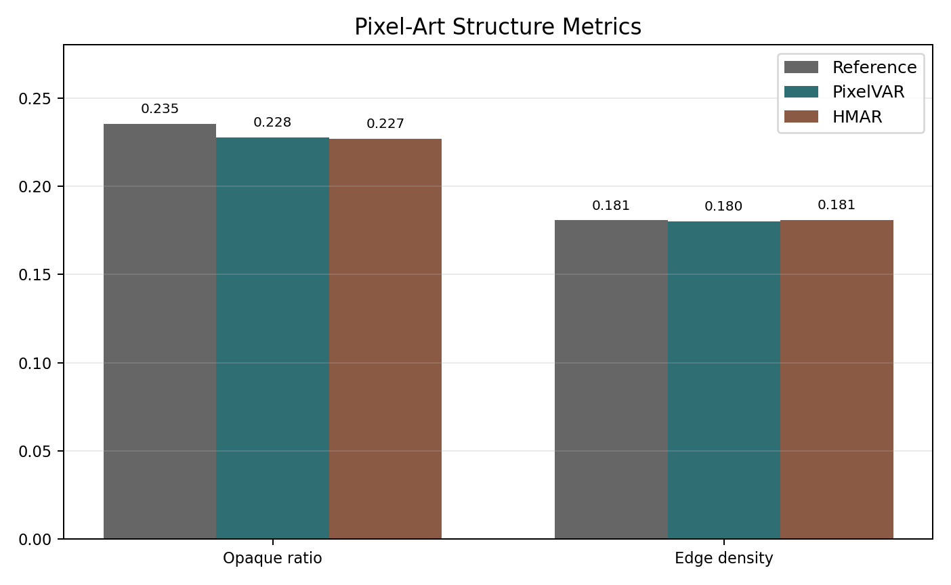
MAIN RESULT
The selected PixelVAR checkpoint produces compact, palette-safe 32x32 sprites.
0.00147
1.0000
0.1808
sprite-feature score
palette consistency
edge density
lower is better
expected from tokens
real val 0.1811
Best sampling: temperature=0.8, top_k=8. Palette consistency is important, but it is expected from the discrete representation, so we do not oversell it.
P2 0:55 - main result
7/12 main

Slide 8
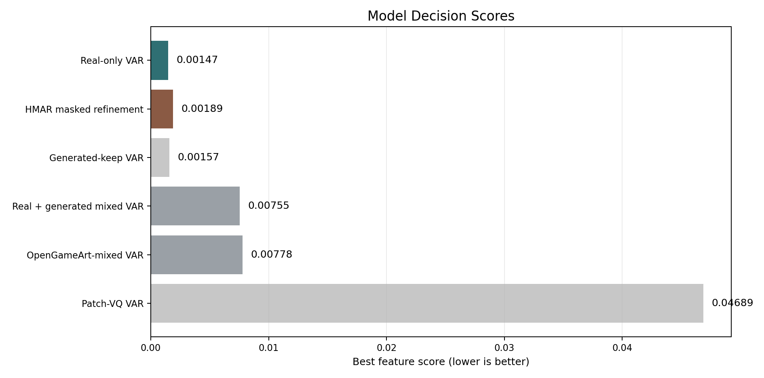
ABLATIONS
HMAR worked, but more refinement did not help.
PixelVAR main
0.00147
HMAR step 1
0.00189
HMAR step 2
0.00374
HMAR step 4
0.00366
HMAR step 8
0.00822
Branch
Decision
Generated/mixed data
larger data did not improve real-validation score
Main lesson: more refinement and more data were not automatically better in this low-resolution palette-token regime.
OpenGameArt mixed
pipeline useful, distribution mismatch
Patch-VQ
learned-token path worked but was blockier
P3 0:50 - ablations
8/12 main

Slide 9
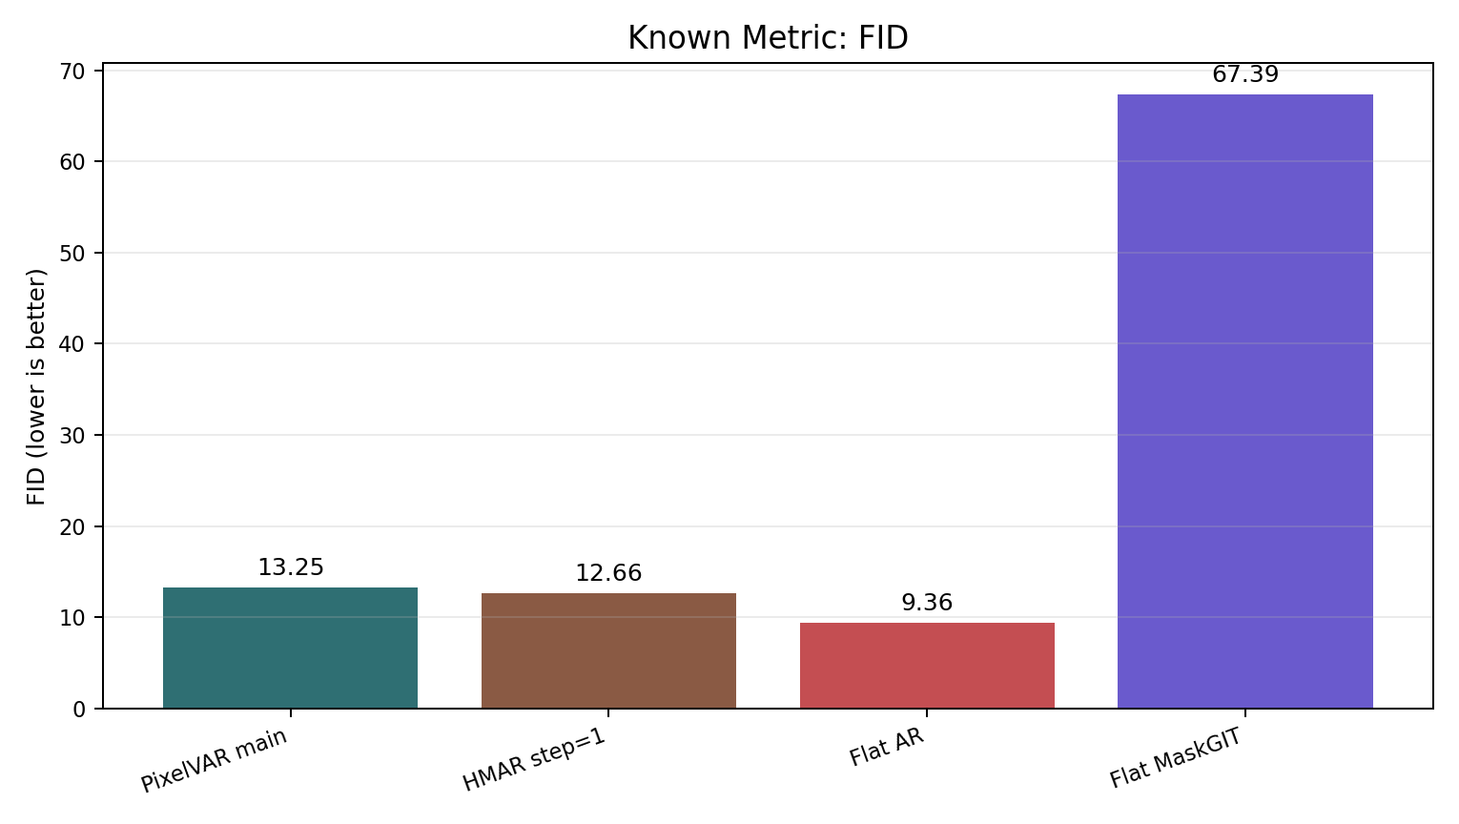
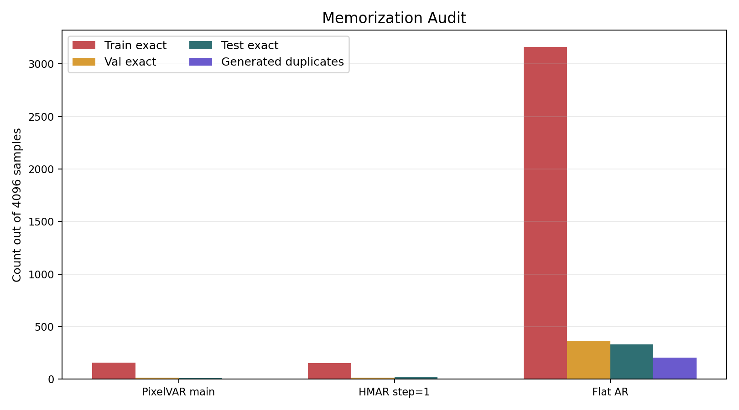
METRICS + AUDIT
Raw FID would pick Flat AR; the exact-match audit changes the conclusion.
Method
FID
Val exact
Test exact
Audit-adjusted read
Flat raster AR
9.36
365
333
memorizing
HMAR step=1
12.66
15
22
keep, disclose
PixelVAR main
13.25
13
11
keep, main result
Flat MaskGIT
67.39
0
0
weak coverage
The dataset had zero cross-split exact duplicate hashes, so held-out exact matches are not explained by simple split leakage.
P3 1:10 - centerpiece result
9/12 main

Slide 10
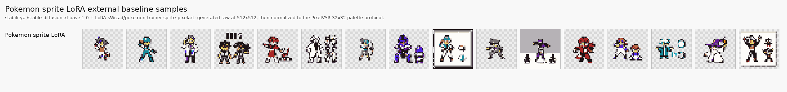
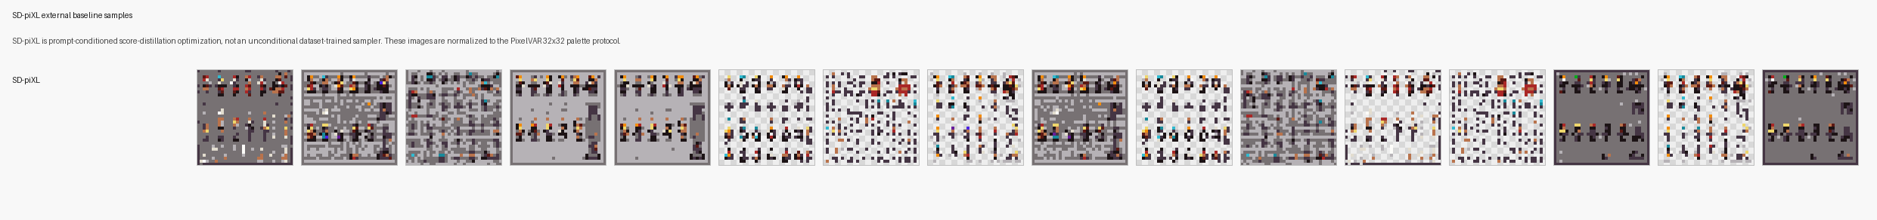
EXTERNAL BASELINES
External generators failed the normalized 32x32 sprite protocol.
PixelVAR 256
46.5
PixelVAR
clean
Pokemon LoRA 256
154.0
SSD-1B diffusion 256
158.6
SD-piXL 16
497.7
FID lower is better
Pokemon
frames
PixelVAR 256
0.891
Pokemon LoRA 256
0.051
SSD-1B diffusion 256
0.035
SD-piXL 16
0.000
SD-piXL
failure
Coverage higher is better
We do not claim perfectly equal baselines. The safe claim is narrower: accessible diffusion-style baselines did not beat PixelVAR under our normalized 32x32 RGBA protocol.
P3 0:55 - external baselines
10/12 main

Slide 11
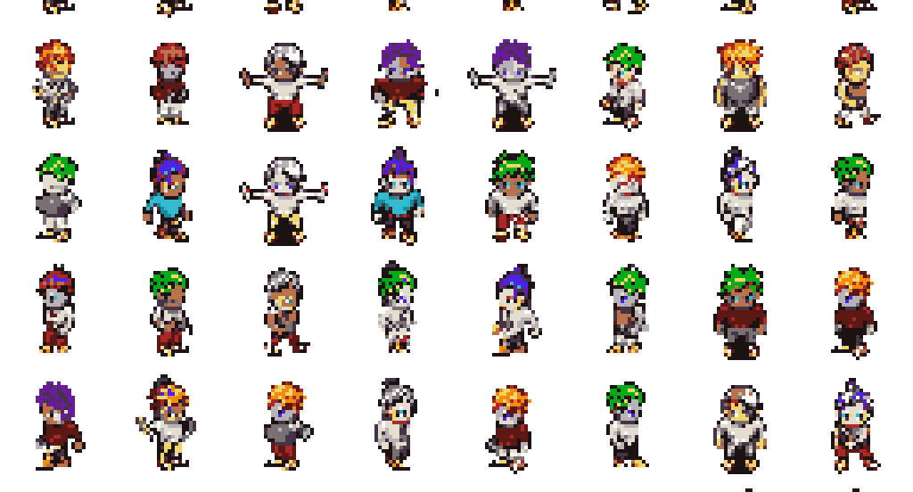
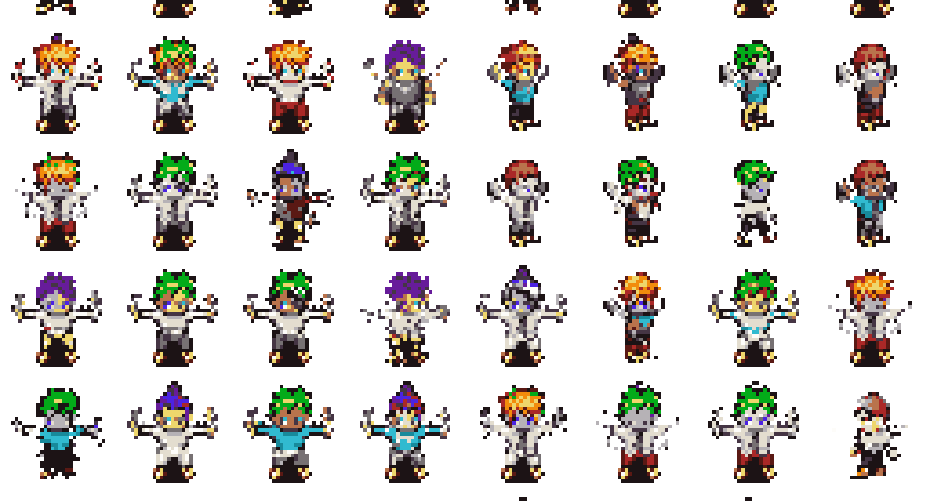
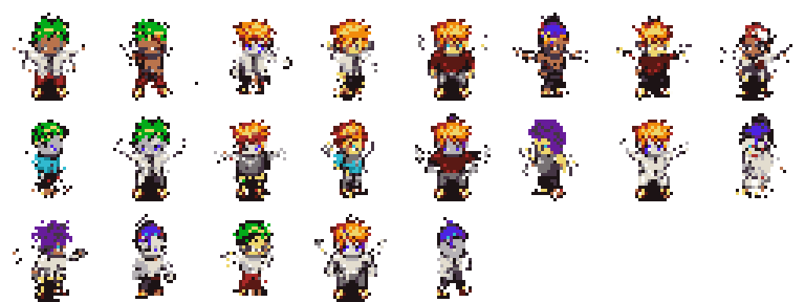
SCALE RESULT
A 170K generation pass shows the sampler remained stable at proposal scale.
170,000
161,479
8,500
21
generated samples
automatic keep
review bucket
reject bucket
94.99%
5.00%
0.01%
This is not a human preference study. It only shows the sampler stayed stable at the proposal-scale generation volume and that the automatic gate found very few obvious rejects.
P3 0:30 - generation scale
11/12 main

Slide 12
LIMITATIONS AND NEXT PROOF
The final claim is intentionally narrow: strong 32x32 palette-token generation with audit-aware evaluation.
Finished
Not finished
Next proof
VAR main model, HMAR refinement path, Flat AR/MaskGIT baselines, known metrics, memorization audit, external attempts, and 170K generation.
User study, completed 8/32 palette metrics, completed 4-scale metrics, and 64x64 generation. These are not claimed as results.
Run remaining ablations, inspect metrics and sample sheets, collect user study, then revisit 64x64 once the 32x32 story is finished.
Main talk ends here. Curated Q&A backup follows.
Safe claim boundary
What to say
Main claim
strongest completed comparable proposal branch on our sprite-feature evaluator
Audit claim
raw FID promotes Flat AR, but exact-match audit shows memorization
External claim
accessible diffusion-style baselines did not beat PixelVAR under normalized 32x32 protocol
SOTA claim
do not claim broad SOTA
P1 0:55 - close
12/12 main

Slide 13
BACKUP: PROPOSAL CHECKLIST
Detailed DONE / PARTIAL / NOT DONE mapping.
Proposal item
Status
Notes
Dataset curation
DONE
MSD replacement selected after original Kaggle source failed
16-color palette-token generation
DONE
transparent token + 16 palette colors
VAR Option A
DONE
main result
HMAR Option B
DONE
refinement ablation complete
Flat AR / MaskGIT baselines
DONE
measured; Flat AR memorizes
External baselines
PARTIAL DONE
SD-piXL, SSD-1B, Pokemon LoRA; PixDiff-PIG no runnable code
User study
NOT DONE
future work
Backup
backup 1/19

Slide 14
BACKUP: METRIC GLOSSARY
What the reported metrics mean.
Metric
Meaning
Caveat
Sprite-feature score
Frechet-style distance over sprite-specific features
main internal selector, not Inception FID
Palette consistency
share of opaque pixels in fixed palette
expected 1.0 for token models
FID / KID
Inception-feature distribution distance
standard but imperfect for tiny pixel art
Precision / recall
fidelity and distribution coverage
must be read with audit
Density / coverage
PRDC-style neighborhood coverage
higher is better
MS-SSIM
sample diversity proxy
compare alongside reference
Exact-match audit
generated token maps copied from train/val/test
critical for suspicious raw winners
Backup
backup 2/19

Slide 15
TOKENIZER PIVOT
The main path moved from neural VQ-VAE to deterministic palette tokens because pixel quality mattered more than latent elegance.
Proposal idea
What happened
Why it was defensible
Train a multi-scale neural VQ-VAE, freeze it, and generate learned palette-sized codes with VAR/HMAR.
A deterministic palette pyramid already matched the target semantics: transparent token plus fixed palette colors at six scales.
Neural reconstructions were too soft/ghosted for pixel art. Patch-VQ worked as an ablation but was blockier.
Path
Result
Decision
Deterministic palette tokens
Crisp, native palette, 0.00147 main score
main result
Neural multi-scale VQ-VAE
implemented, reconstruction quality not good enough
partial / not promoted
Patch-VQ KMeans tokenizer
143/512 codes used, coherent but blocky, score 0.04689
learned-token ablation
Method decision
backup 3/19

Slide 16
TOKEN AND TRANSPARENCY CONTRACT
The final implementation made transparency and palette membership explicit model tokens.
Contract element
Final value
Why it matters
1x1
1
Transparent token
0
background is part of the sprite structure, not cleanup
2x2
4
Palette tokens
1..16
model predicts fixed palette indices directly
4x4
16
Reserved mask token
separate from transparent for HMAR
masked refinement does not confuse missing with background
8x8
64
16x16
256
Scale schedule
1, 2, 4, 8, 16, 32
six-scale coarse-to-fine pyramid
32x32
1024
Total sequence
1,365 tokens
sum of all scale maps; final 32x32 contributes 1,024
Split rule
grouped by character/sheet fields
reduces train/validation leakage
This is why palette consistency reaches 1.0000 for token models: it is an expected property of the representation, not a standalone quality miracle.
Method detail
backup 4/19

Slide 17
DATASET REALITY
The original Kaggle source failed, so the final study used a live replacement plus auxiliary Pokemon and OpenGameArt paths.
93,312
74,664
9,360
9,288
MSD replacement sprites
train
validation
test
Source / set
Role
Outcome
Original brentspell Kaggle sprites
proposal target
blocked: inaccessible/forbidden; page unavailable
TalBarami/msd_sprites replacement
main dataset
used for final train/val/test protocol
Pokemon sprites
debug/prototype path
used for early pipeline validation
OpenGameArt curated public set
mixed-data stretch
4,659 frames, 105 groups; useful pipeline, distribution mismatch
Generated 170K keep set
data expansion experiment
large generation worked, but generated/mixed training did not beat real-only
Experimental setup detail
backup 5/19

Slide 18
IMPLEMENTATION INVENTORY
The project includes models, data tooling, external adapters, audits, and tests beyond the headline model.
Area
Implemented artifacts
Models
VAR transformer, HMAR transformer, flat AR, flat MaskGIT, VQ-VAE, Patch-VQ path
Training
Lightning modules for VAR/HMAR/flat/VQ, checkpoint helpers, overfit/debug/full configs
Data
transparent preprocessing, grouped splits, deterministic tokenizer, palette extraction, dataset mixing
Evaluation
sprite-feature evaluator, decoded Patch-VQ evaluator, image-folder FID/KID/PRDC/MS-SSIM evaluator
Audits
exact-match memorization audit, nearest-neighbor artifacts, sample-sheet builders
External baselines
SD-piXL adapter, SSD-1B practical diffusion, Pokemon sprite LoRA, image normalization
Modal
B200 actions for preparation, training, evaluation, generation, baselines, audits, downloads
Tests
tokenizer, splits, palette/transparency, dataset, model, curation, VQ-VAE, external adapters
Implementation work
backup 6/19

Slide 19
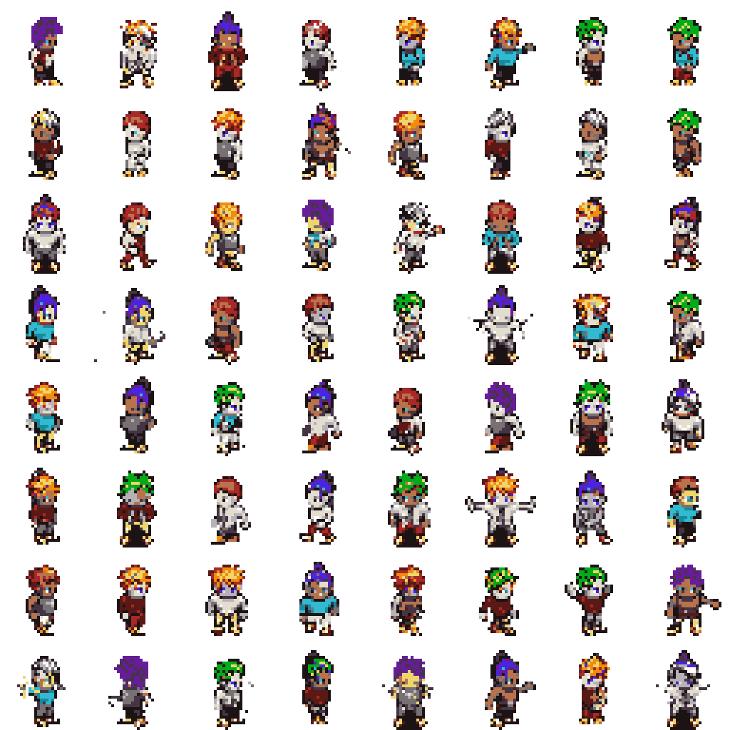
MAIN PIXELVAR SAMPLING SWEEP
The selected checkpoint was chosen from a temperature/top-k sweep, not a single cherry-picked setting.
Temp
Top-k
Feature score
Palette
Opaque
Edge
0.8
8
0.00147
1.0000
0.2291
0.1808
1.0
16
0.00299
1.0000
0.2381
0.1865
0.8
16
0.00392
1.0000
0.2311
0.1829
1.0
8
0.00402
1.0000
0.2335
0.1838
0.8
none
0.00596
1.0000
0.2220
0.1761
1.0
none
0.00637
1.0000
0.2459
0.1917
0.6
none
0.00659
1.0000
0.2172
0.1724
0.6
16
0.00856
1.0000
0.2164
0.1716
0.6
8
0.00956
1.0000
0.2172
0.1740
Reference validation: opaque ratio 0.2354, edge density 0.1811, palette consistency 1.0000. The best score also keeps structure close to reference.
Sampling sweep
backup 7/19

Slide 20
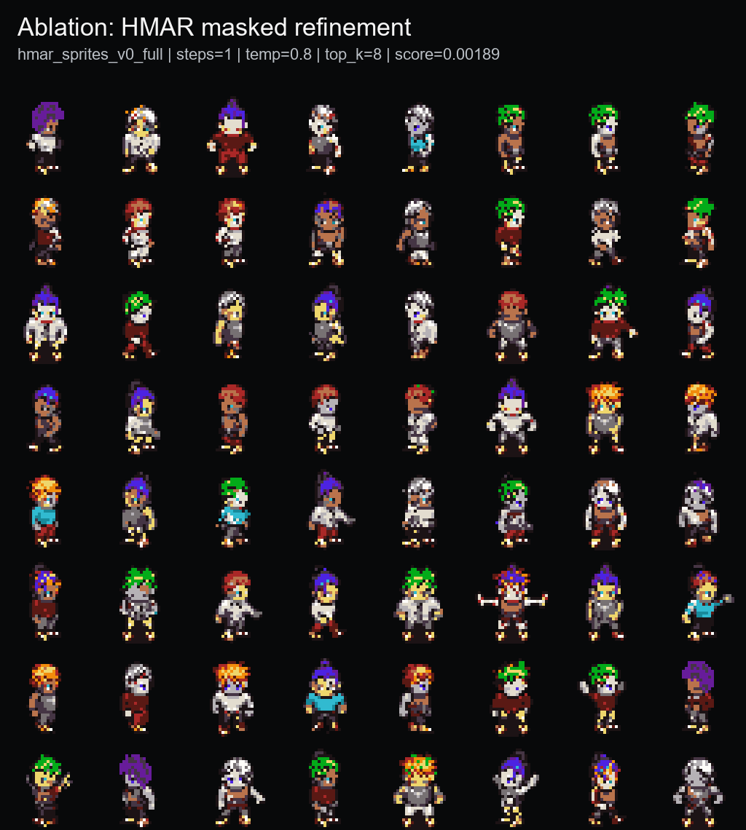
HMAR REFINEMENT SUMMARY
HMAR worked, but more masked refinement did not improve this low-resolution palette-token regime.
Refinement steps
Best temp
Best top-k
Best score
Opaque
Edge
Decision
1
0.8
8
0.00189
0.2315
0.1833
closest HMAR result
2
0.8
16
0.00374
0.2297
0.1831
worse than step 1
4
0.8
16
0.00366
0.2264
0.1823
slightly better than step 2, still worse
8
1.0
none
0.00822
0.2191
0.1747
over-refinement hurts
Option B was implemented and trained successfully.
Step=1 is the only HMAR branch close to main PixelVAR on the sprite-feature evaluator.
The hypothesis that more refinement would fix tiny outlines was not supported here.
HMAR ablation
backup 8/19

Slide 21
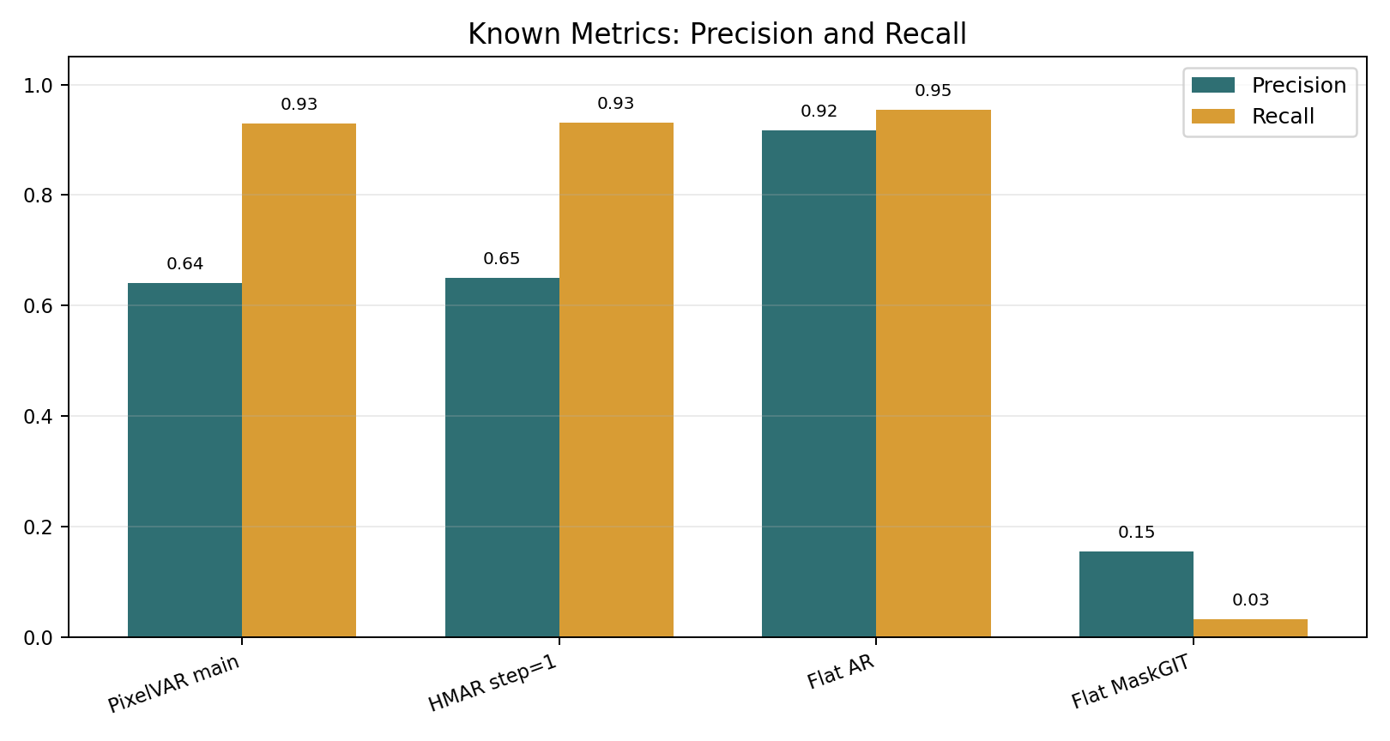
KNOWN IMAGE METRICS: FULL INTERNAL TABLE
Raw Inception metrics favor Flat AR, but that result is not trustworthy without the audit.
Method
FID
KID
Prec.
Recall
Density
Coverage
MS-SSIM
Exact rate
Flat raster AR
9.3558
0.002975
0.9172
0.9541
0.7654
0.8518
0.8281
0.0112
HMAR step=1
12.6555
0.005209
0.6494
0.9314
0.4136
0.6165
0.8309
0.0005
PixelVAR main
13.2516
0.006010
0.6406
0.9292
0.4093
0.6050
0.8323
0.0007
Flat MaskGIT
67.3908
0.061825
0.1545
0.0317
0.0455
0.0454
0.9426
0.0000
Conservative reading: HMAR and PixelVAR are the strongest non-memorizing candidates measured; PixelVAR wins sprite-feature, HMAR slightly wins some Inception metrics.
Known metrics
backup 9/19

Slide 22
PIXEL-ART DOMAIN METRICS: FULL INTERNAL TABLE
Palette consistency is perfect by construction; structure and exact-match metrics carry more interpretive weight.
Method
Palette
Opaque
Ref opaque
Edge
Ref edge
Unique colors
Pixel NN L2
Exact rate
PixelVAR main
1.0000
0.2276
0.2353
0.1802
0.1807
11.9294
5.2384
0.000732
HMAR step=1
1.0000
0.2269
0.2353
0.1809
0.1807
11.8301
5.2180
0.000488
Flat raster AR
1.0000
0.2321
0.2353
0.1790
0.1807
11.0378
3.4928
0.011230
Flat MaskGIT
1.0000
0.1942
0.2353
0.1631
0.1807
11.8718
9.5599
0.000000
How to read it
PixelVAR and HMAR match reference edge density closely. Flat AR has great-looking metrics partly because it reproduces data. MaskGIT under-fills sprites and loses coverage.
Domain metrics
backup 10/19

Slide 23
METRIC INTERPRETATION
The serious read uses metric families together, not a single leaderboard number.
Metric family
What it tells us
How we used it
Sprite-feature score
Frechet-style distance over sprite-specific palette, silhouette, entropy, and edge features
main internal selector for VAR/HMAR/data branches
FID / KID
standard Inception-feature real-vs-generated distribution distance
reported for credibility, but caveated for tiny pixel art
Precision / recall
fidelity and distribution coverage
read together with memorization audit
Density / coverage
PRDC neighborhood coverage
external baselines are far below PixelVAR here
MS-SSIM
sample diversity proxy
lower alone is not always better if samples are malformed
Palette metrics
palette compliance, unique colors, opaque ratio, edge density
domain checks; palette consistency is expected for token outputs
Exact-match audit
generated token maps copied from train/val/test or duplicated internally
decides whether Flat AR is a clean winner or a memorizer
Metrics caveats
backup 11/19

Slide 24
MEMORIZATION AUDIT: FULL TABLE
Flat AR's raw metric advantage collapses under exact-match auditing.
Model
Train exact
Val exact
Test exact
Generated duplicates
Status
PixelVAR main
157
13
11
4
low exact-match rate; disclose and keep
HMAR step=1
154
15
22
5
low exact-match rate; disclose and keep
Flat AR
3162
365
333
206
memorizing; disqualify as clean winner
Split check
The processed dataset has zero cross-split exact duplicate hashes. Held-out exact matches are not explained by exact duplicate leakage between train/val/test.
Memorization audit
backup 12/19

Slide 25
EXTERNAL BASELINE STATISTICAL STRENGTH
External rows are serious attempts, but they do not all have equal sample count or task fit.
Baseline
Images
Why included
Main caveat
Decision
SD-piXL
16
most targeted low-res/palette released-code method
per-image prompt/image optimization; visually failed after adaptation
keep as targeted attempted baseline
SSD-1B diffusion smoke
64
generic practical diffusion comparison
text-to-image, prompt-sensitive, many malformed crops
smoke result only
SSD-1B diffusion primary
256
scaled generic practical comparison
still far below PixelVAR
keep generic external row
Pokemon sprite LoRA smoke
64
more targeted practical sprite generator
Pokemon trainer style, not MSD; frames/fragments remain
smoke result
Pokemon sprite LoRA primary
256
best accessible practical sprite-specific generator
not architecture-equivalent; still below PixelVAR
primary practical external row
MDIGAN
not run
direct character-sprite related work
conditional paired-pose imputation, not unconditional sampling
cite, not numeric row
External baselines
backup 13/19

Slide 26
EXTERNAL METRICS: FULL COMPARISON TABLE
Every external output was normalized to the same 32x32 RGBA PixelVAR palette protocol before evaluation.
External baseline
N
PV FID
Ext FID
PV KID
Ext KID
PV Prec
Ext Prec
PV Rec
Ext Rec
PV Cov
Ext Cov
Ext MS
SD-piXL
16
151.0927
497.7065
0.014713
0.517647
1.0000
0.0000
0.9375
0.0000
1.0000
0.0000
0.4926
SSD-1B smoke
64
87.8128
196.9628
0.007124
0.092097
0.8125
0.0312
0.9375
0.6719
0.9219
0.0469
0.3935
SSD-1B primary
256
46.4794
158.5819
0.007480
0.102159
0.9102
0.0547
0.8711
0.4922
0.8906
0.0352
0.4107
Pokemon LoRA smoke
64
87.8128
184.3101
0.007124
0.130036
0.8125
0.3125
0.9375
0.2812
0.9219
0.1094
0.5171
Pokemon LoRA primary
256
46.4794
154.0150
0.007480
0.136589
0.9102
0.1172
0.8711
0.1211
0.8906
0.0508
0.5421
Palette consistency is 1.0000 after normalization for these rows; that confirms protocol compliance, not native palette learning by the external models.
External metrics
backup 14/19

Slide 27
RELATED BASELINES THAT WERE EXCLUDED OR BLOCKED
Several related methods were checked, but forcing them into the metric table would be misleading.
Method
Why related
Why not a direct numeric row now
MDIGAN
character sprite generation with released code
conditional paired-pose imputation; receives reference poses PixelVAR does not get
Generating Pixel Art Character Sprites using GANs
direct pixel-art character sprite work
pose-to-pose / conditional framing; cite as related work
PixDiff-PIG
palette-informed diffusion for pixel art
targeted search found no runnable public repository or weights
achsaf/vq-diffusion-pixelart-16x16
architecture-adjacent discrete diffusion over 16x16 pixel-art characters
model files returned HTTP 401 and native resolution is 16x16
Full SDXL LoRA alternatives
practical external image generators
prompt/model sensitivity; only the strongest accessible Pokemon LoRA promoted
This is a seriousness point: we did not omit MDIGAN/PixDiff-PIG randomly; we separated related work from fair unconditional-generation metrics.
External baseline decisions
backup 15/19

Slide 28
FULL LIMITATIONS AND REASONS
The limitations are not hidden; each incomplete item has a concrete reason.
Item
Status
Reason / evidence
Neural multi-scale VQ-VAE
PARTIAL
implemented, but reconstructions were too soft/ghosted for pixel art
Patch-VQ learned tokens
ABLATION ONLY
worked technically; 143/512 codes used; blockier decoded samples
8/32 palette ablation
SETUP DONE
configs and actions added; GPU metrics pending
4-scale hierarchy ablation
SETUP DONE
runnable; metrics pending
User study n >= 20
NOT DONE
requires separate survey, randomization, collection, and analysis
64x64 generation
NOT RUN
sequence length increases from 1,365 to 5,461; postponed after 32x32 proposal completion
Original Kaggle dataset
REPLACED
forbidden/unavailable; live MSD replacement used
Lightning/Modal friction
DISCLOSED
job handling, spend/GPU limits, B200 compatibility, local command/runtime issues
Broad SOTA claim
NOT CLAIMED
external baselines are useful but not exhaustive enough for broad SOTA
Limitations
backup 16/19

Slide 29
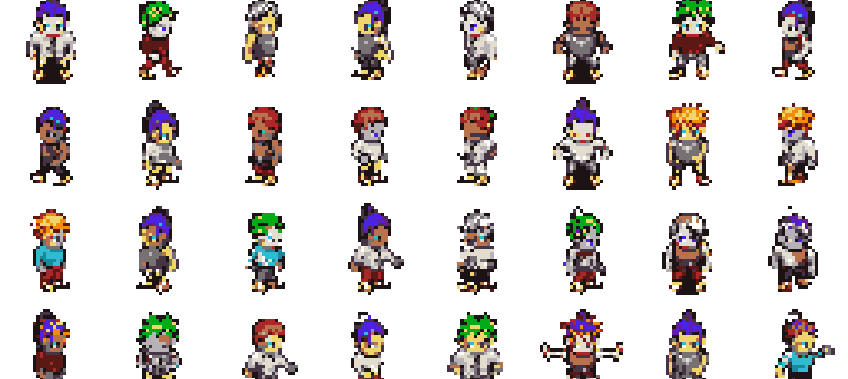
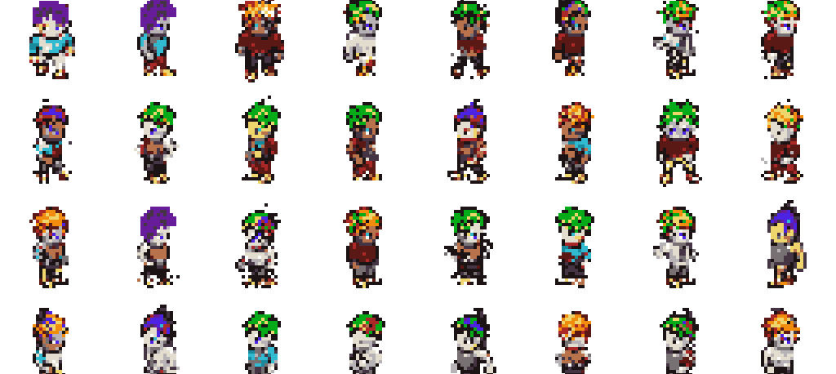
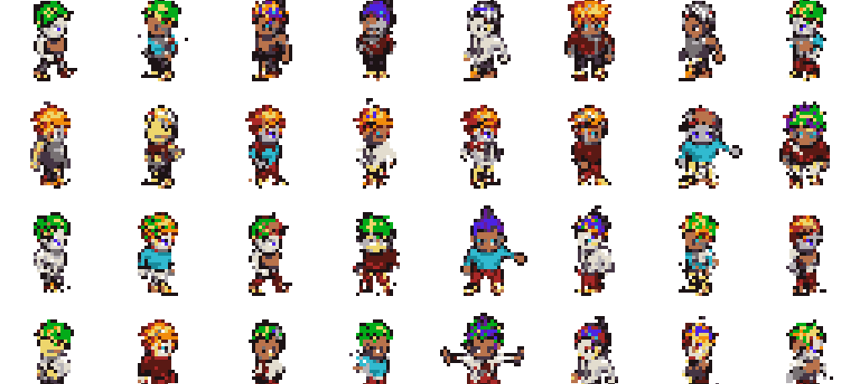
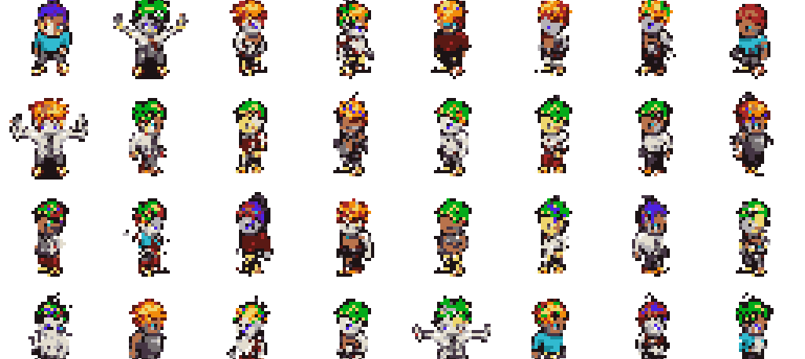
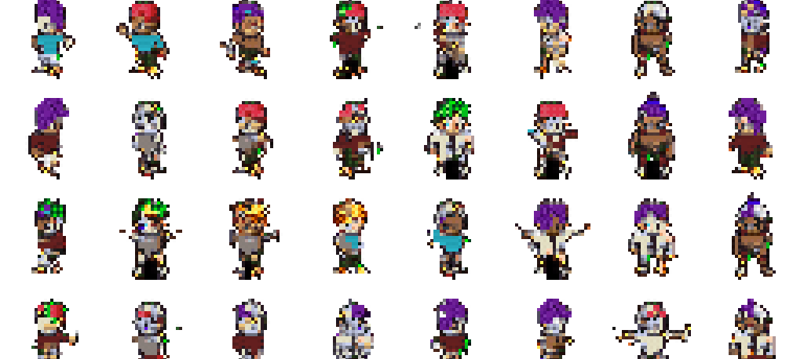
INTERNAL SAMPLE COMPARISON
The selected model was chosen against several implemented branches, not one cherry-picked grid.
Real-only VAR
HMAR step=1
Generated-keep VAR
0.00147, main result
0.00189, close but behind
0.00157 self-reference; not direct real-val winner
Real + generated VAR
OpenGameArt-mixed VAR
Patch-VQ VAR
0.00755, larger data did not help
0.00778, public-data path worked but mismatched
0.04689, learned-token ablation was blockier
Read: these are qualitative examples tied to the model-decision table. Only the real-validation comparable branches should be used for the main winner claim.
Q&A: more sample images
backup 17/19

Slide 30
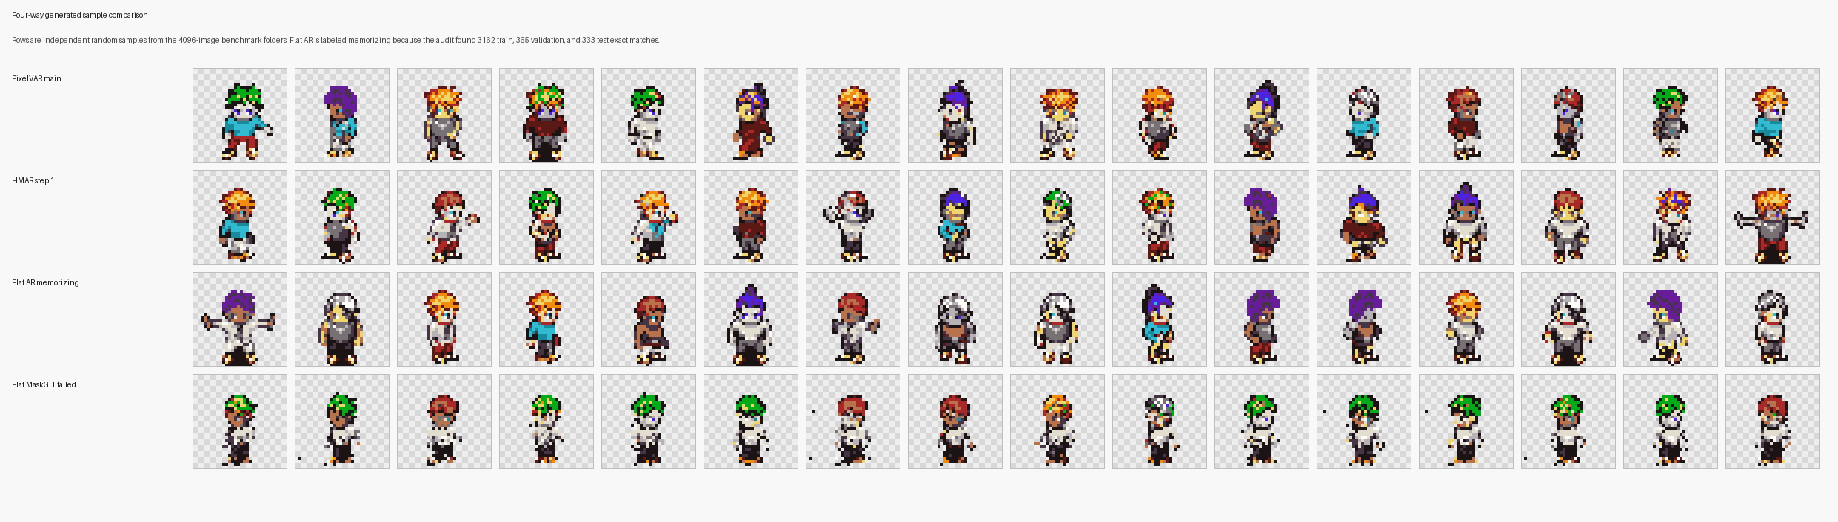
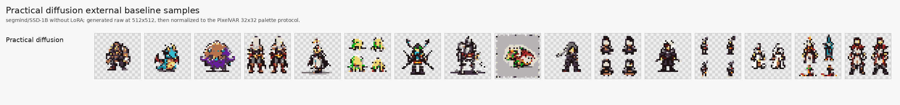
BASELINE SAMPLE COMPARISON
The visuals explain why the metric table needs audit and task-fit caveats.
Internal baselines
PixelVAR and HMAR both produce coherent sprites. Flat AR looks deceptively good but memorizes. Flat MaskGIT has poor coverage and repeated forms.
SD-piXL: tiled/noisy failure
SSD-1B: recognizable sometimes
Pokemon LoRA: best visual external row
Safe read: external rows are useful pressure tests, not perfectly equal architecture comparisons. PixelVAR still wins the normalized 32x32 protocol rows.
Q&A: baseline visuals
backup 18/19

Slide 31
EXPANDED METRIC SCOREBOARD
More metrics make the conclusion stronger only when the audit is included.
Internal model
Feat.
FID
KID
Prec.
Rec.
Cov.
MS
Exact
Read
PixelVAR main
0.00147
13.25
0.00601
0.641
0.929
0.605
0.832
13 val / 11 test
main selected branch
HMAR step=1
0.00189
12.66
0.00521
0.649
0.931
0.616
0.831
15 val / 22 test
close non-memorizing branch
Flat AR
-
9.36
0.00298
0.917
0.954
0.852
0.828
3162 train; 365 val; 333 test
raw-metric winner, audit failure
Flat MaskGIT
-
67.39
0.06183
0.155
0.032
0.045
0.943
0 exact
weak coverage
External row
N
FID
KID
Prec.
Rec.
Cov.
MS
Read
PixelVAR paired
256
46.48
0.00748
0.910
0.871
0.891
-
same sample count reference row
Pokemon LoRA
256
154.02
0.13659
0.117
0.121
0.051
0.542
best practical external visual row
SSD-1B diffusion
256
158.58
0.10216
0.055
0.492
0.035
0.411
recognizable sometimes, low precision
SD-piXL
16
497.71
0.51765
0.000
0.000
0.000
0.493
targeted attempt, failed adapted protocol
Do not compare every row as apples-to-apples: internal rows use the 4096-image known-metrics audit; external rows are normalized image-folder comparisons with different sample counts.
Q&A: more metrics
backup 19/19

