Slide 1
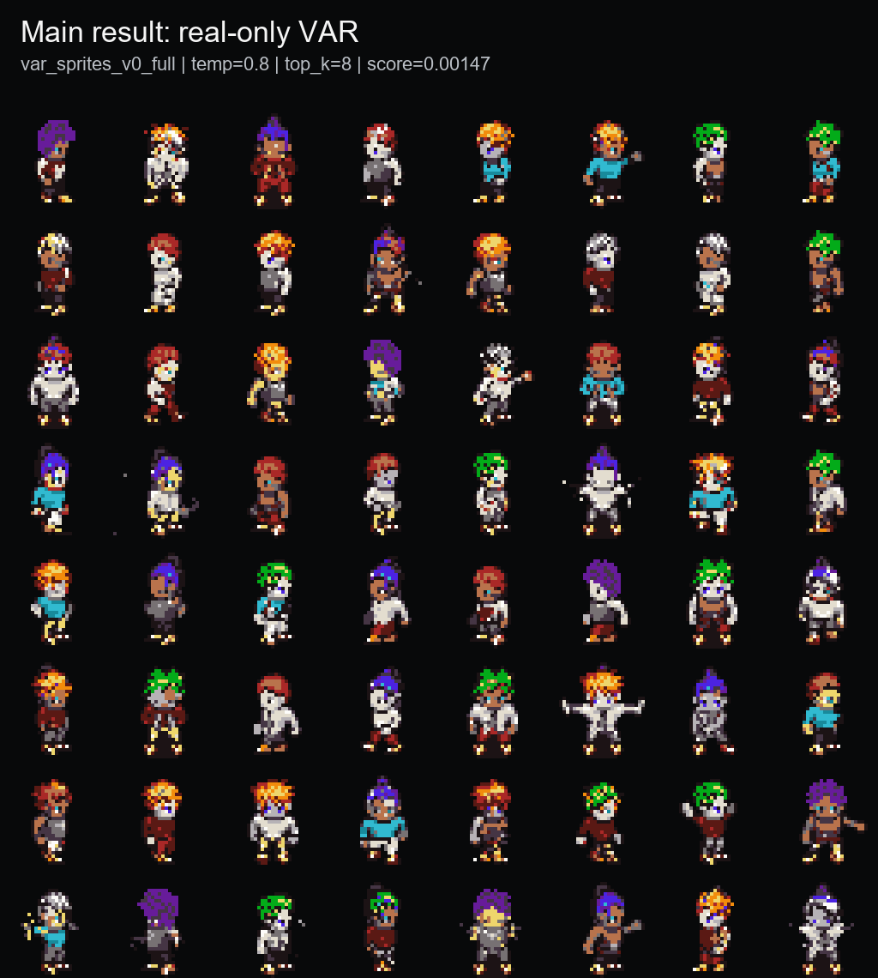
PixelVAR
Coarse-to-fine pixel-art sprite generation via palette tokens
COMP547 Deep Unsupervised Learning | June 2026
Eyüp Ahmet Başaran
Kübra Rengin Çetin
Mahir Tilkicioğlu

Slide 2
PROBLEM + MOTIVATION
Pixel art is not just low-resolution RGB.
Why it matters
Why it is hard
Our framing
Game sprites are labor-intensive assets. A usable generator should produce compact transparent characters, not just pretty pixel-ish pictures.
Every pixel is visible. Small palette changes, anti-aliasing, noisy backgrounds, or broken silhouettes can make an output unusable.
Instead of generating continuous RGB and quantizing later, PixelVAR learns to generate palette-index tokens directly.
Transparent background is part of the object, not cleanup.
Palette consistency should be native to generation, not a post-hoc repair.
A single misplaced pixel can break outlines or pose readability.

Slide 3
RELATED WORK
PixelVAR sits between pixel-art-specific generators and hierarchical image-token models.
Family
Example
Why it is not enough
Pixel-art GANs
Coutinho / MDIGAN
conditional or pose-based; not the same unconditional generation task
Diffusion
SD-piXL, PixDiff-PIG, LoRAs
continuous, prompt-first, or image-first; needs repair/normalization
Discrete tokenizers
Pixel VQ-VAE
useful representation direction, but not a complete generator by itself
Hierarchical AR
VAR / HMAR
strong coarse-to-fine idea, but not aimed at tiny transparent palette sprites
Our niche: next-scale prediction for tiny transparent palette-constrained sprites.

Slide 4
PROPOSAL CONTRACT AND FINAL PIVOT
What we aimed for, what changed, what we completed.
Proposal component
Final state
Evidence / reason
32x32 sprite dataset + preprocessing
DONE
MSD replacement, grouped splits, Pokemon/OpenGameArt support paths
Tokenizer pivot
VAR Option A
DONE
main checkpoint: var_sprites_v0_full
Proposed neural multi-scale VQ-VAE -> implemented/tried, but reconstructions were too soft or ghosted for pixel art. Main result uses deterministic palette-token pyramids because crisp exact pixels are the domain requirement.
HMAR Option B
DONE
1/2/4/8 refinement-step ablation
Baselines + known metrics
DONE
Flat AR, MaskGIT, metrics, audit, external rows
64x64 extension
FUTURE
not claimed; disclosed as next work

Slide 5
METHOD
PixelVAR generates a six-scale palette-token pyramid from coarse silhouette to final sprite.
Path
Generation rule
Role
PixelVAR
predict each next scale conditioned on coarser scales
main result
HMAR
mask/refine tokens within each scale for T steps
proposal Option B
1x1
1
2x2
4
Flat AR
raster-scan final 32x32 grid
simple baseline
4x4
16
Flat MaskGIT
masked final-grid parallel decoding
masked baseline
8x8
64
16x16
256
Token contract
Meaning
32x32
1024
0
transparent background
1..16
fixed palette colors
mask
HMAR missing token, separate from transparency
1,365
total tokens across 1x1..32x32 scales

Slide 6
EXPERIMENTAL SETUP
Evaluation uses a fixed 32x32 sprite protocol, grouped splits, and three layers of metrics.
93,312
74,664
9,360
9,288
MSD replacement sprites
train
validation
test
Data protocol
Metrics
Baselines
All main outputs are 32x32 transparent RGBA sprites decoded from palette-token maps. Splits are grouped by character attributes to reduce leakage.
Three layers: sprite-specific feature score, standard image metrics, and exact-match audit. Acronyms stay in backup unless asked.
Internal: HMAR, Flat AR, Flat MaskGIT, generated/mixed, Patch-VQ. External: SD-piXL, SSD-1B, Pokemon sprite LoRA.

Slide 7
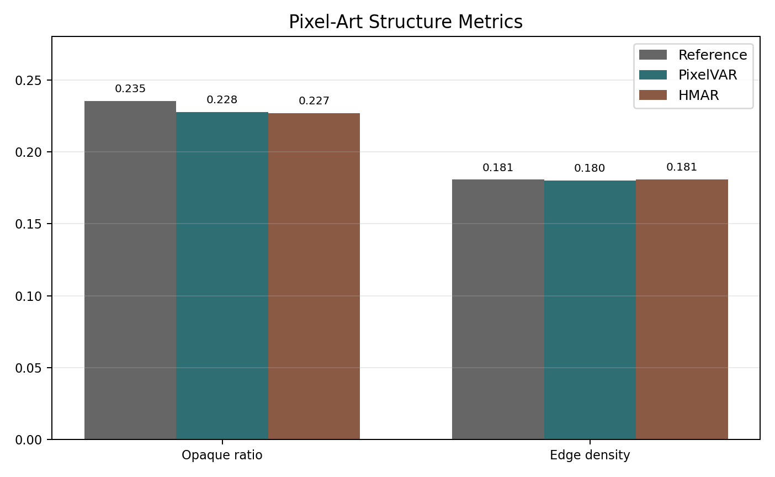
MAIN RESULT
The selected PixelVAR checkpoint produces compact, palette-safe 32x32 sprites.
0.00147
1.0000
0.1808
sprite-feature score
palette consistency
edge density
lower is better
expected from tokens
real val 0.1811
Best sampling: temperature=0.8, top_k=8. Palette consistency is expected from the discrete representation.

Slide 8
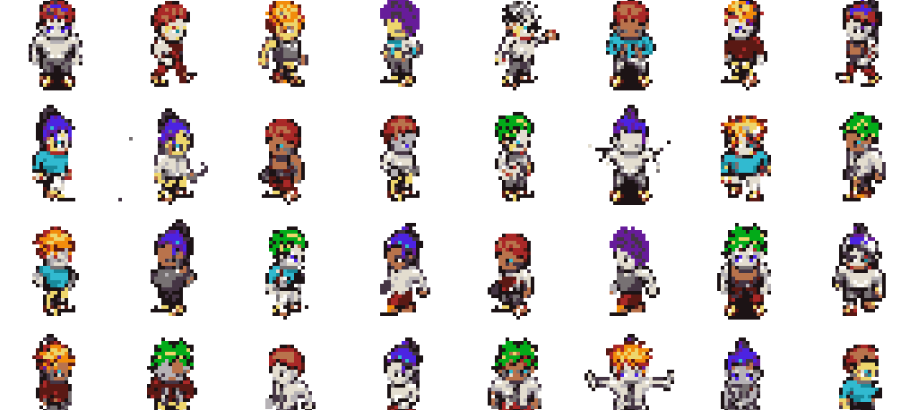
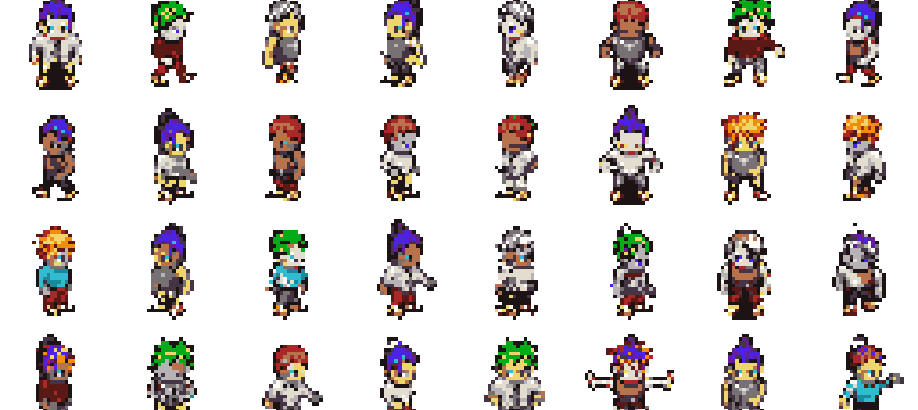
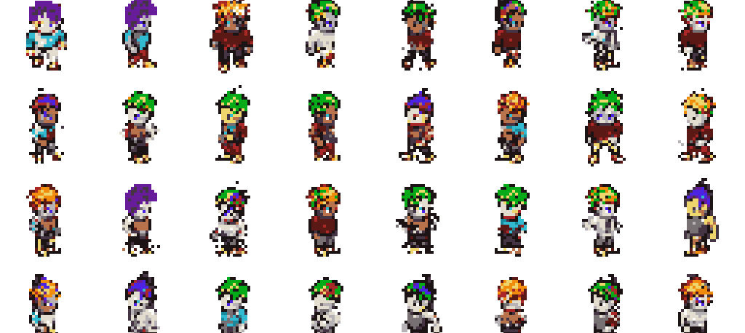
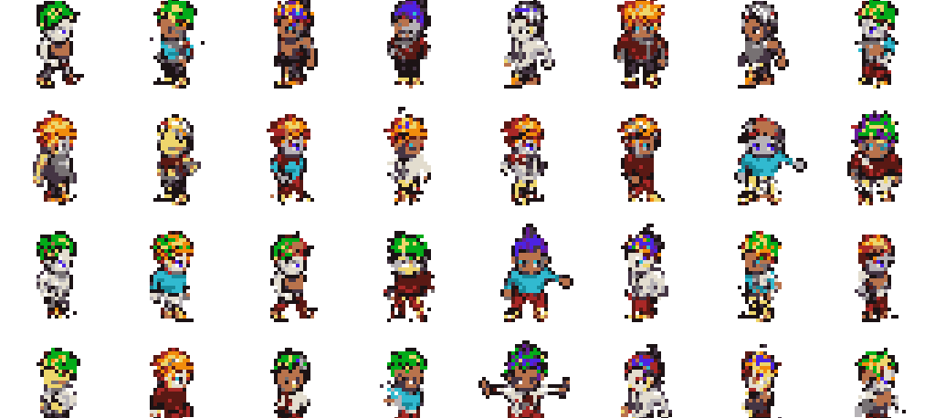
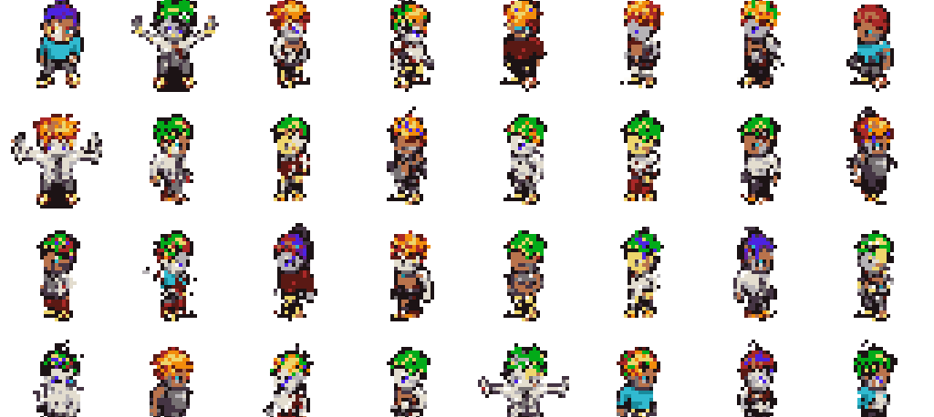
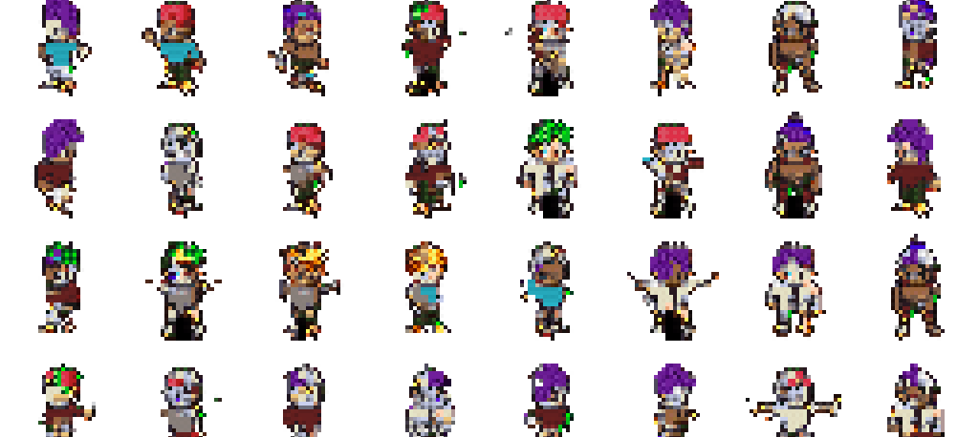
INTERNAL SAMPLE COMPARISON
The selected model was chosen against several implemented branches.
Real-only VAR
HMAR step=1
Generated-keep VAR
0.00147, main result
0.00189, close but behind
0.00157 self-reference; not direct real-val winner
Real + generated VAR
OpenGameArt-mixed VAR
Patch-VQ VAR
0.00755, larger data did not help
0.00778, public-data path worked but mismatched
0.04689, learned-token ablation was blockier

Slide 9
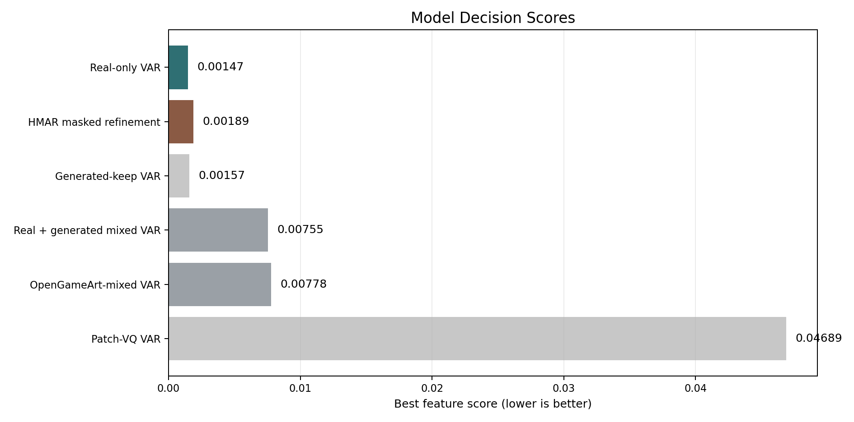
ABLATIONS
HMAR worked, but more refinement did not help.
PixelVAR main
0.00147
HMAR step 1
0.00189
HMAR step 2
0.00374
HMAR step 4
0.00366
HMAR step 8
0.00822
Branch
Decision
Generated/mixed data
larger data did not improve real-validation score
More refinement and more data were not automatically better in this low-resolution palette-token regime.
OpenGameArt mixed
pipeline useful, distribution mismatch
Patch-VQ
learned-token path worked but was blockier

Slide 10
PIXEL-ART DOMAIN METRICS: FULL INTERNAL TABLE
Palette consistency is perfect by construction; structure and exact-match metrics carry more interpretive weight.
Method
Palette
Opaque
Ref opaque
Edge
Ref edge
Unique colors
Pixel NN L2
Exact rate
PixelVAR main
1.0000
0.2276
0.2353
0.1802
0.1807
11.9294
5.2384
0.000732
HMAR step=1
1.0000
0.2269
0.2353
0.1809
0.1807
11.8301
5.2180
0.000488
Flat raster AR
1.0000
0.2321
0.2353
0.1790
0.1807
11.0378
3.4928
0.011230
Flat MaskGIT
1.0000
0.1942
0.2353
0.1631
0.1807
11.8718
9.5599
0.000000
PixelVAR and HMAR match reference edge density closely. Flat AR has great-looking metrics partly because it reproduces data. MaskGIT under-fills sprites and loses coverage.

Slide 11
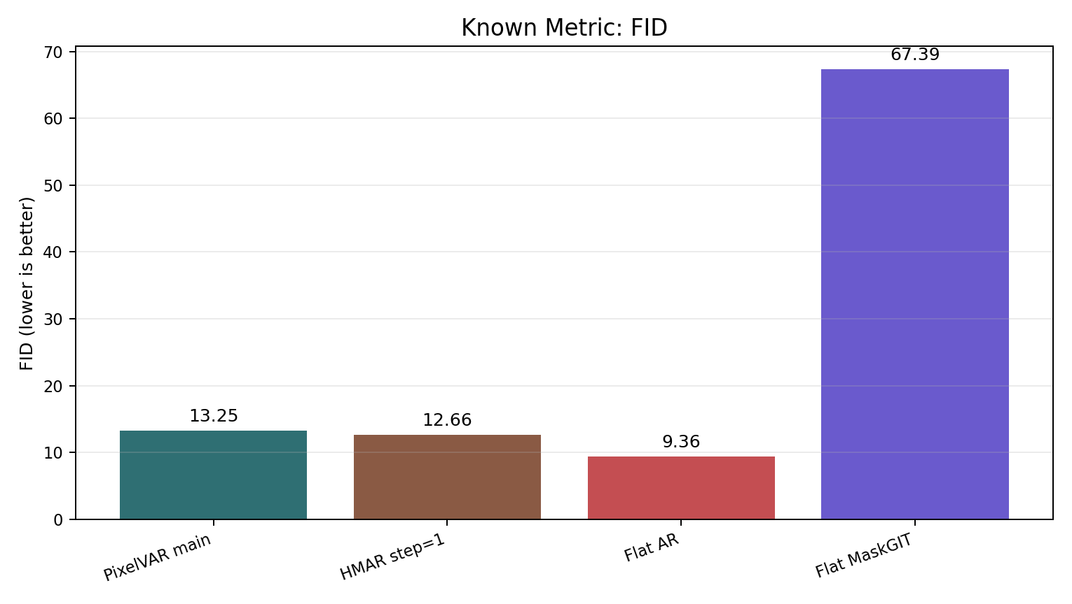
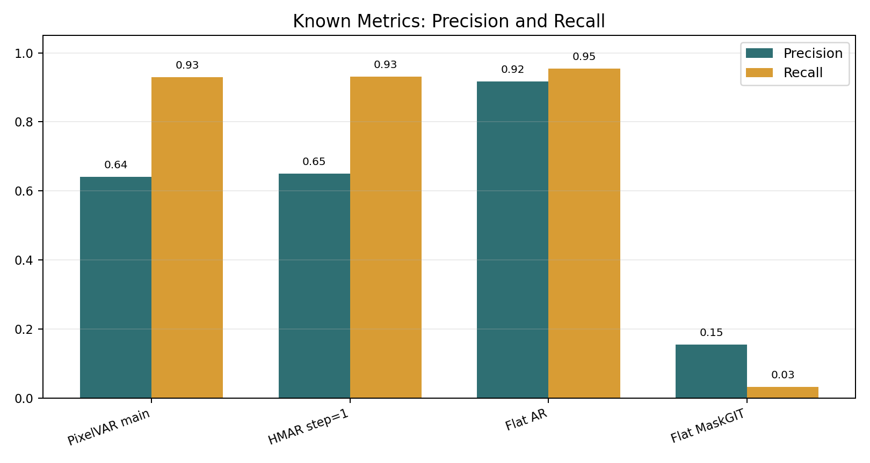
KNOWN IMAGE METRICS: FULL INTERNAL TABLE
Raw Inception metrics favor Flat AR, but that result is not trustworthy without the audit.
Method
FID
KID
Prec.
Recall
Density
Coverage
MS-SSIM
Exact rate
Flat raster AR
9.3558
0.002975
0.9172
0.9541
0.7654
0.8518
0.8281
0.0112
HMAR step=1
12.6555
0.005209
0.6494
0.9314
0.4136
0.6165
0.8309
0.0005
PixelVAR main
13.2516
0.006010
0.6406
0.9292
0.4093
0.6050
0.8323
0.0007
Flat MaskGIT
67.3908
0.061825
0.1545
0.0317
0.0455
0.0454
0.9426
0.0000

Slide 12
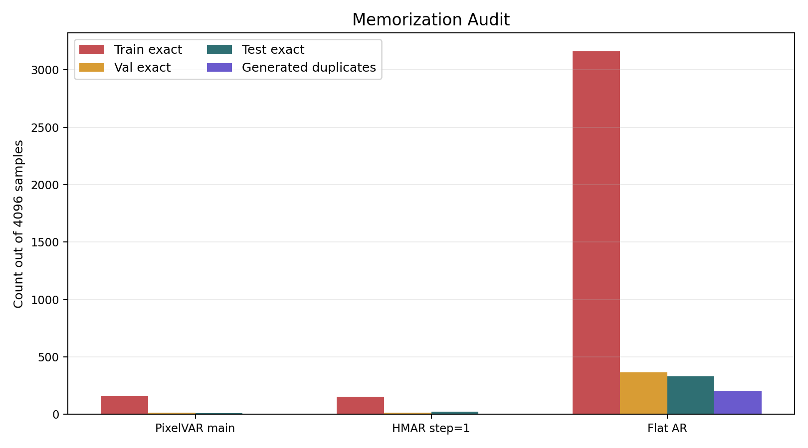
METRICS + AUDIT
Raw FID would pick Flat AR; the exact-match audit changes the conclusion.
Method
FID
Val exact
Test exact
Audit-adjusted read
Flat raster AR
9.36
365
333
memorizing
HMAR step=1
12.66
15
22
keep, disclose
PixelVAR main
13.25
13
11
keep, main result
Flat MaskGIT
67.39
0
0
weak coverage

Slide 13
EXPANDED METRIC SCOREBOARD
Internal model
Feat.
FID
KID
Prec.
Rec.
Cov.
MS
Exact
Read
PixelVAR main
0.00147
13.25
0.00601
0.641
0.929
0.605
0.832
13 val / 11 test
main selected branch
HMAR step=1
0.00189
12.66
0.00521
0.649
0.931
0.616
0.831
15 val / 22 test
close non-memorizing branch
Flat AR
-
9.36
0.00298
0.917
0.954
0.852
0.828
3162 train; 365 val; 333 test
raw-metric winner, audit failure
Flat MaskGIT
-
67.39
0.06183
0.155
0.032
0.045
0.943
0 exact
weak coverage
External row
N
FID
KID
Prec.
Rec.
Cov.
MS
Read
PixelVAR paired
256
46.48
0.00748
0.910
0.871
0.891
-
same sample count reference row
Pokemon LoRA
256
154.02
0.13659
0.117
0.121
0.051
0.542
best practical external visual row
SSD-1B diffusion
256
158.58
0.10216
0.055
0.492
0.035
0.411
recognizable sometimes, low precision
SD-piXL
16
497.71
0.51765
0.000
0.000
0.000
0.493
targeted attempt, failed adapted protocol

Slide 14
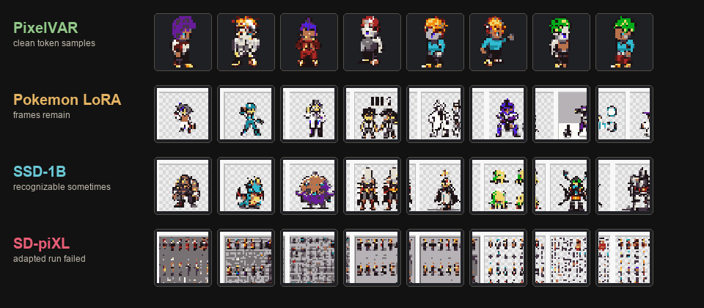
EXTERNAL BASELINES
External generators failed the normalized 32x32 sprite protocol.
Known metrics under the same normalized output protocol
FID lower is better
PixelVAR
46.5
Pokemon LoRA
154.0
SSD-1B
158.6
SD-piXL
497.7
Coverage higher is better
PixelVAR
0.891
Pokemon LoRA
0.051
SSD-1B
0.035
SD-piXL
0.000
External generators are useful pressure tests, not broad SOTA evidence: all rows are normalized to 32x32 RGBA before scoring.

Slide 15
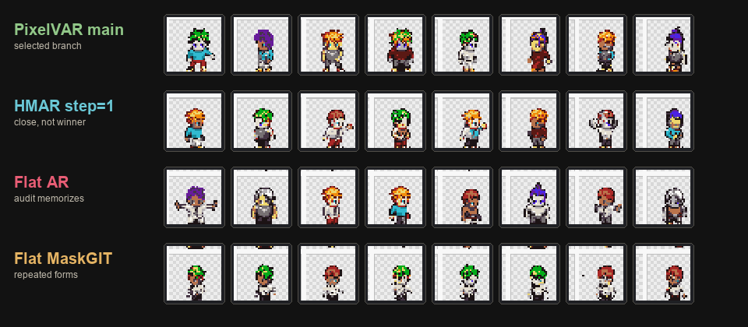
BASELINE SAMPLE COMPARISON
The visuals explain why the metric table needs audit and task-fit caveats.
Visual quality alone is not enough: Flat AR can look plausible, but the exact-match audit exposes memorization; Flat MaskGIT repeats forms and loses coverage.

Slide 16
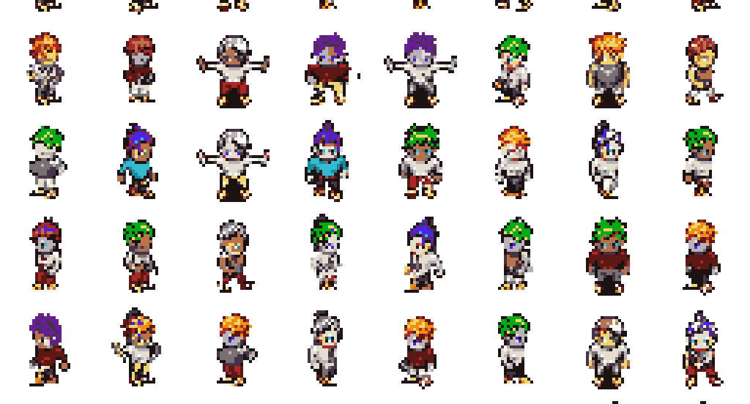
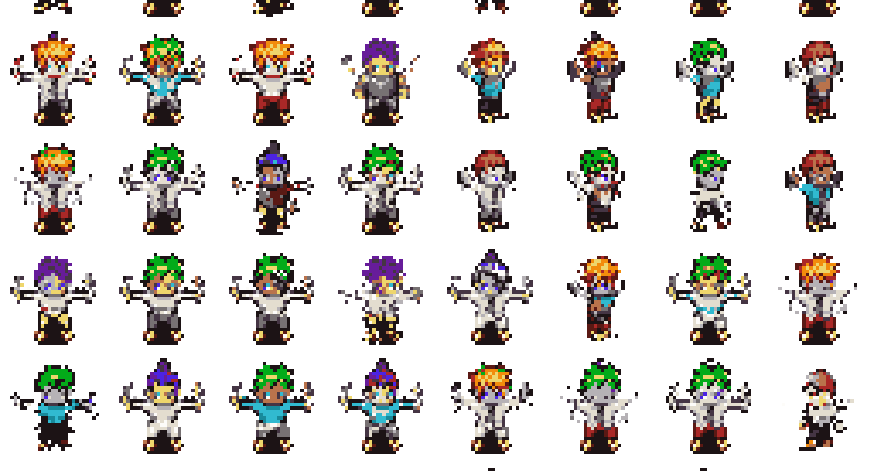
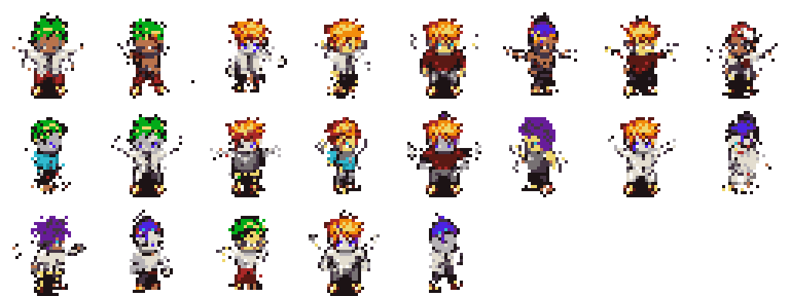
SCALE RESULT
A 170K generation pass shows the sampler remained stable at proposal scale.
170,000
161,479
8,500
21
generated samples
automatic keep
review bucket
reject bucket
94.99%
5.00%
0.01%

Slide 17
LIMITATIONS AND NEXT PROOF
Final claim: PixelVAR works because the representation matches the domain.
Core result
Audit result
Scale evidence
32x32, 16-color-plus-alpha sprites generated directly as palette tokens. Real-only VAR is the selected branch with sprite-feature score 0.00147.
Raw FID favors Flat AR, but exact-match audit exposes memorization. The final conclusion is audit-aware, not leaderboard-only.
170,000 generated samples; 161,479 passed the automatic gate with only 21 rejects, showing stable proposal-scale sampling.
Next proof
Complete the 8/32 palette and 4-scale ablation metrics, inspect sample sheets, then revisit 64x64 generation with a realistic compute budget.
Bounded takeaway: coarse-to-fine palette-token generation is a defensible 32x32 transparent-sprite generator when evaluated with memorization-aware metrics.

