Slide 1
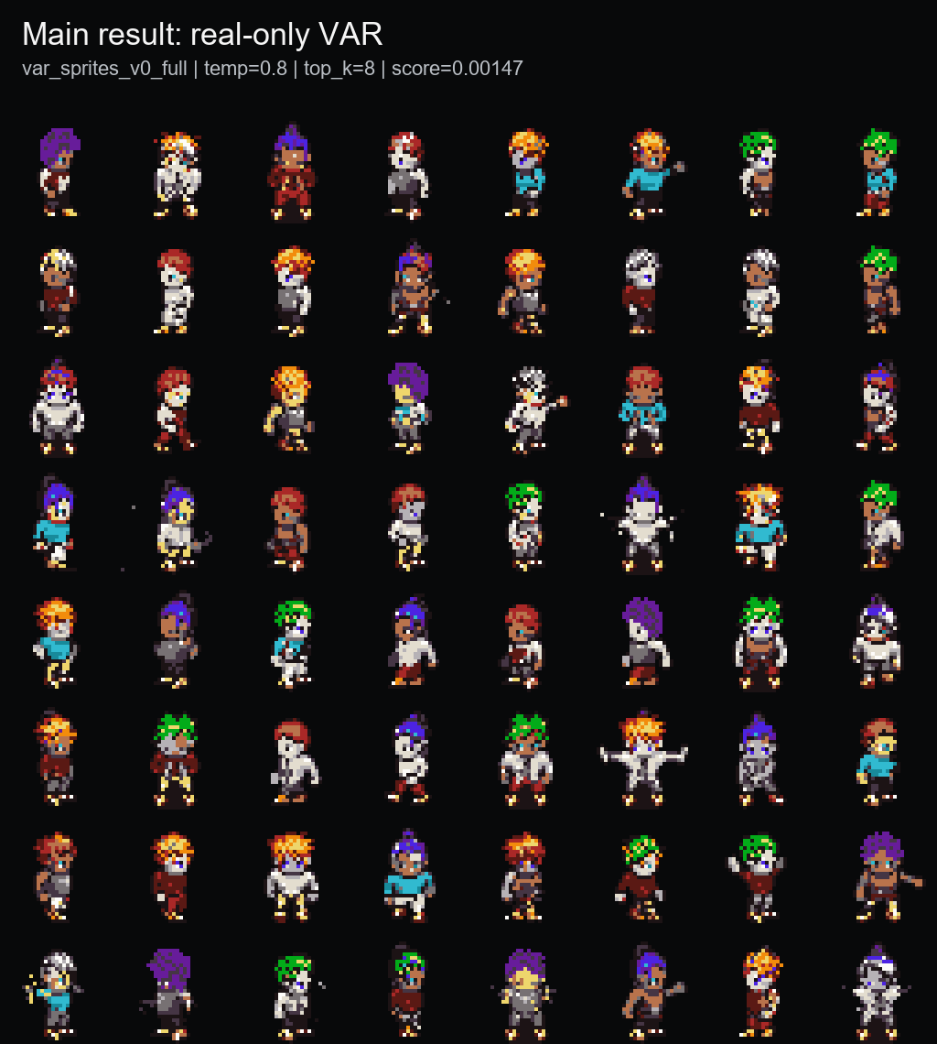
PixelVAR
Coarse-to-fine pixel-art sprite generation via palette tokens
Rubric-aligned final presentation | COMP547 Deep Unsupervised Learning | June 2026
32x32
16+alpha
0.00147
sprite output
palette-token vocab
best sprite-feature score
Thesis: generate transparent pixel-art sprites directly in discrete palette-index space, then evaluate honestly with baselines, ablations, and memorization audit.
Opening
1/14 main

Slide 2
PROBLEM + MOTIVATION
Pixel art is not just low-resolution RGB.
Why it matters
Why it is hard
Our framing
Game sprites are labor-intensive assets. A usable generator should produce compact transparent characters, not just pretty pixel-ish pictures.
Every pixel is visible. Small palette changes, anti-aliasing, noisy backgrounds, or broken silhouettes can make an output unusable.
Instead of generating continuous RGB and quantizing later, PixelVAR learns to generate palette-index tokens directly.
Transparent background is part of the object, not cleanup.
Palette consistency should be native to generation, not a post-hoc repair.
A single misplaced pixel can break outlines or pose readability.
Rubric: problem statement and motivation
2/14 main

Slide 3
RELATED WORK
PixelVAR sits between pixel-art-specific generators and hierarchical image-token models.
Area
Representative work
What it contributes
Gap for this project
Pixel-art GANs
Coutinho & Chaimowicz; MDIGAN
Character sprite generation / pose imputation
Often conditional or paired-pose, not unconditional sampling
Pixel diffusion
SD-piXL; PixDiff-PIG; SDXL LoRAs
Low-res or pixel-art-like generation
Often continuous/image-first or prompt-conditioned
Discrete image tokens
Pixel VQ-VAE; VQ-style tokenizers
Pixel-art representation learning
Tokenizer quality and generation prior remain hard
Hierarchical AR
VAR, M-VAR, HMAR
Coarse-to-fine image-token generation
Mostly high-res natural images with large codebooks
Flat token baselines
Raster AR, MaskGIT
Simple sequence or masked final-grid decoding
Good contrast to hierarchy; can memorize or fail coverage
Main novelty in our project context: applying next-scale prediction to tiny, transparent, palette-constrained sprites and auditing it against close baselines.
Rubric: related work
3/14 main

Slide 4
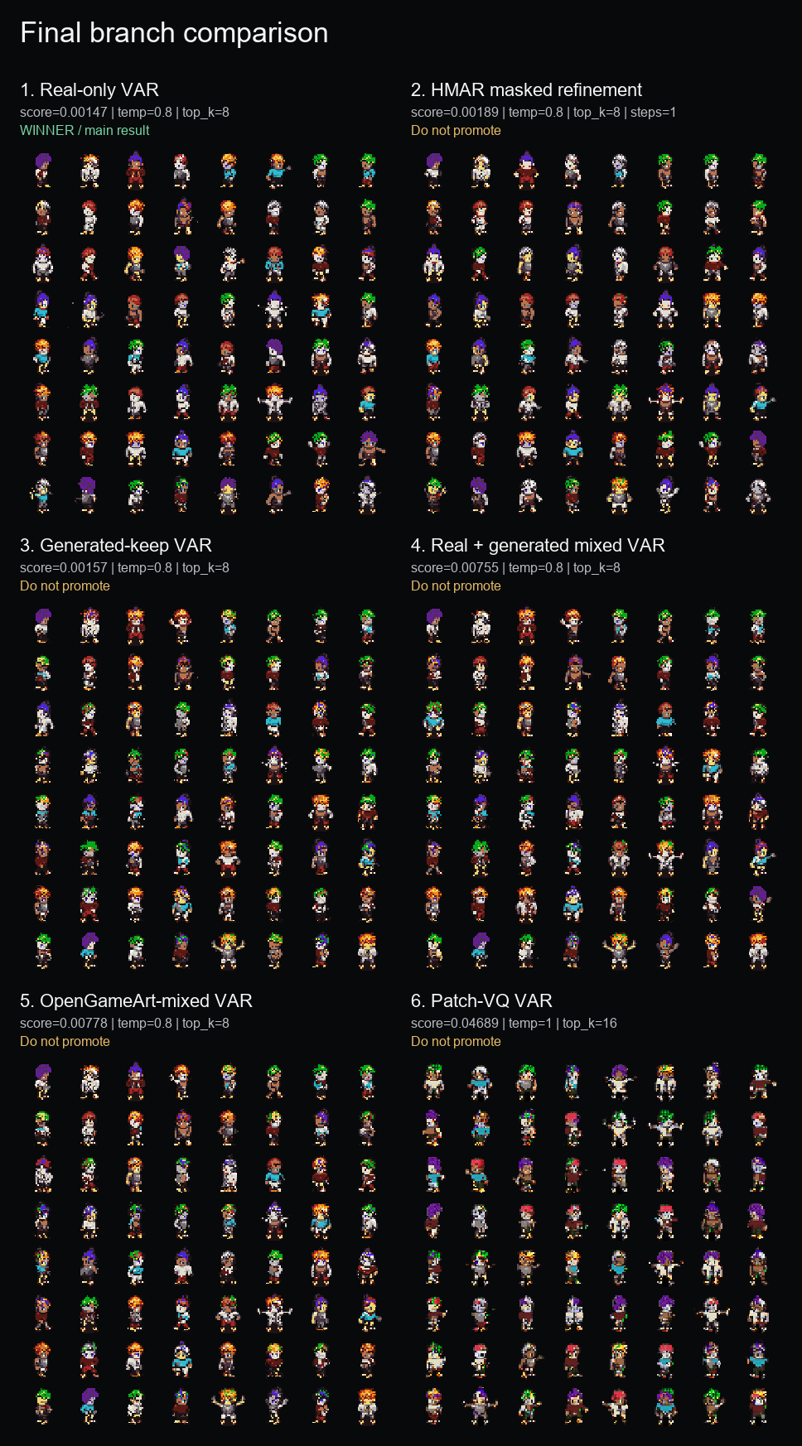
GOAL AND SCOPE
The proposal target was a 32x32 palette-token generator plus HMAR and baseline comparisons.
Proposal component
Final status
Evidence
Dataset curation + 32x32 preprocessing
DONE
MSD replacement, Pokemon path, OpenGameArt path
Palette-index generation
DONE
Transparent token 0 + palette tokens 1..16
VAR Option A
DONE
Main checkpoint: var_sprites_v0_full
HMAR Option B
DONE
1/2/4/8 refinement-step ablation
Baselines + metrics
DONE
Flat AR, MaskGIT, FID/KID/PRDC/MS-SSIM, external baselines
Neural VQ-VAE, user study, 64x64
PARTIAL / FUTURE
Disclosed as limitations/future work
This deck is intentionally audit-adjusted: we do not claim broad SOTA, and we do not hide failed or incomplete proposal items.
Rubric: methodology overview
4/14 main

Slide 5
EXPERIMENTAL SETUP
Evaluation uses a fixed 32x32 sprite protocol, grouped splits, and multiple metrics.
93,312
74,664
9,360
9,288
MSD replacement sprites
train
validation
test
Data protocol
Metrics
Baselines
All main outputs are 32x32 transparent RGBA sprites decoded from palette-token maps. Splits are grouped by character attributes to reduce leakage.
Sprite-feature score, palette consistency, opaque ratio, edge density, FID, KID, precision/recall, density/coverage, MS-SSIM, exact-match audit.
HMAR, generated/mixed data, Patch-VQ, Flat AR, Flat MaskGIT, SD-piXL, SSD-1B practical diffusion, Pokemon sprite LoRA.
Important: Inception metrics are reported, but not trusted alone for 32x32 pixel art. The memorization audit is part of the evaluation, not an afterthought.
Rubric: experimental setup
5/14 main

Slide 6
METHOD
PixelVAR generates a six-scale palette-token pyramid from coarse silhouette to final sprite.
1x1
1
Model path
Generation rule
Role
2x2
4
PixelVAR
Predict each next scale conditioned on coarser scales
main result
4x4
16
HMAR
Mask/refine tokens within each scale for T steps
proposal Option B
8x8
64
16x16
256
Flat AR
Raster-scan final 32x32 grid
simple baseline
32x32
1024
Flat MaskGIT
Masked final-grid parallel decoding
masked baseline
Total sequence length is 1,365 tokens. The final 32x32 map is both the last scale and the training target for visible sprite detail.
Rubric: methodology
6/14 main

Slide 7
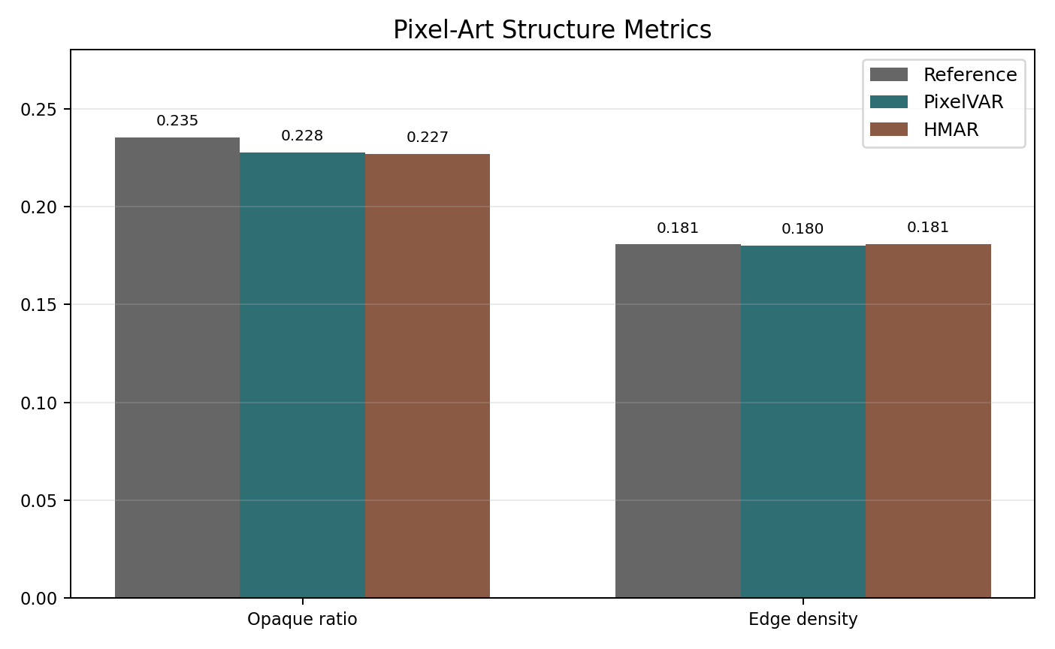
MAIN RESULT
The selected PixelVAR checkpoint produces compact, palette-safe 32x32 sprites.
0.00147
1.0000
0.1808
sprite-feature score
palette consistency
edge density
lower is better
expected from tokens
real val 0.1811
Best sampling: temperature=0.8, top_k=8. Palette consistency is important, but it is expected from the discrete representation, so we do not oversell it.
Rubric: experimental results
7/14 main

Slide 8
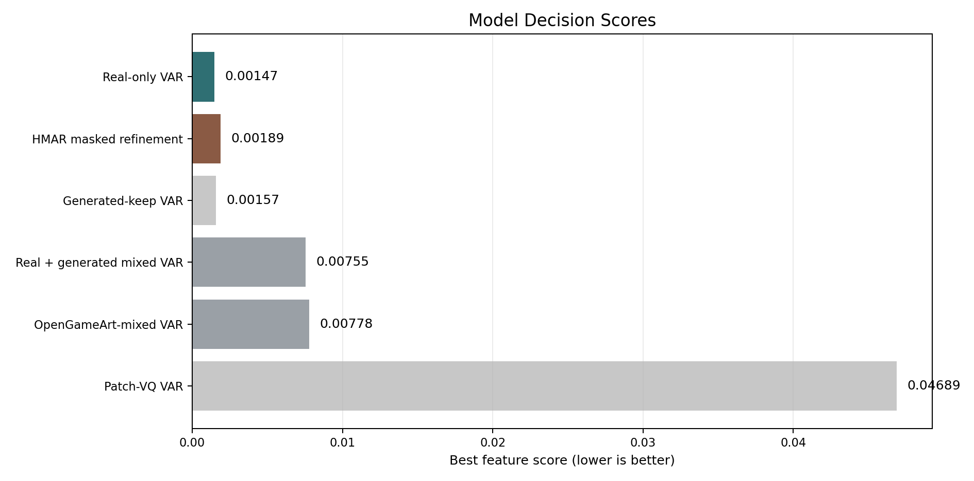
ABLATIONS
HMAR was close, but the main real-only PixelVAR branch stayed strongest on the sprite-feature evaluator.
PixelVAR main
0.00147
HMAR step 1
0.00189
HMAR step 2
0.00374
HMAR step 4
0.00366
HMAR step 8
0.00822
Branch
Decision
Generated/mixed data
larger data did not improve real-validation score
Main lesson: more refinement and more data were not automatically better in this low-resolution palette-token regime.
OpenGameArt mixed
pipeline useful, distribution mismatch
Patch-VQ
learned-token path worked but was blockier
Rubric: ablation study
8/14 main

Slide 9
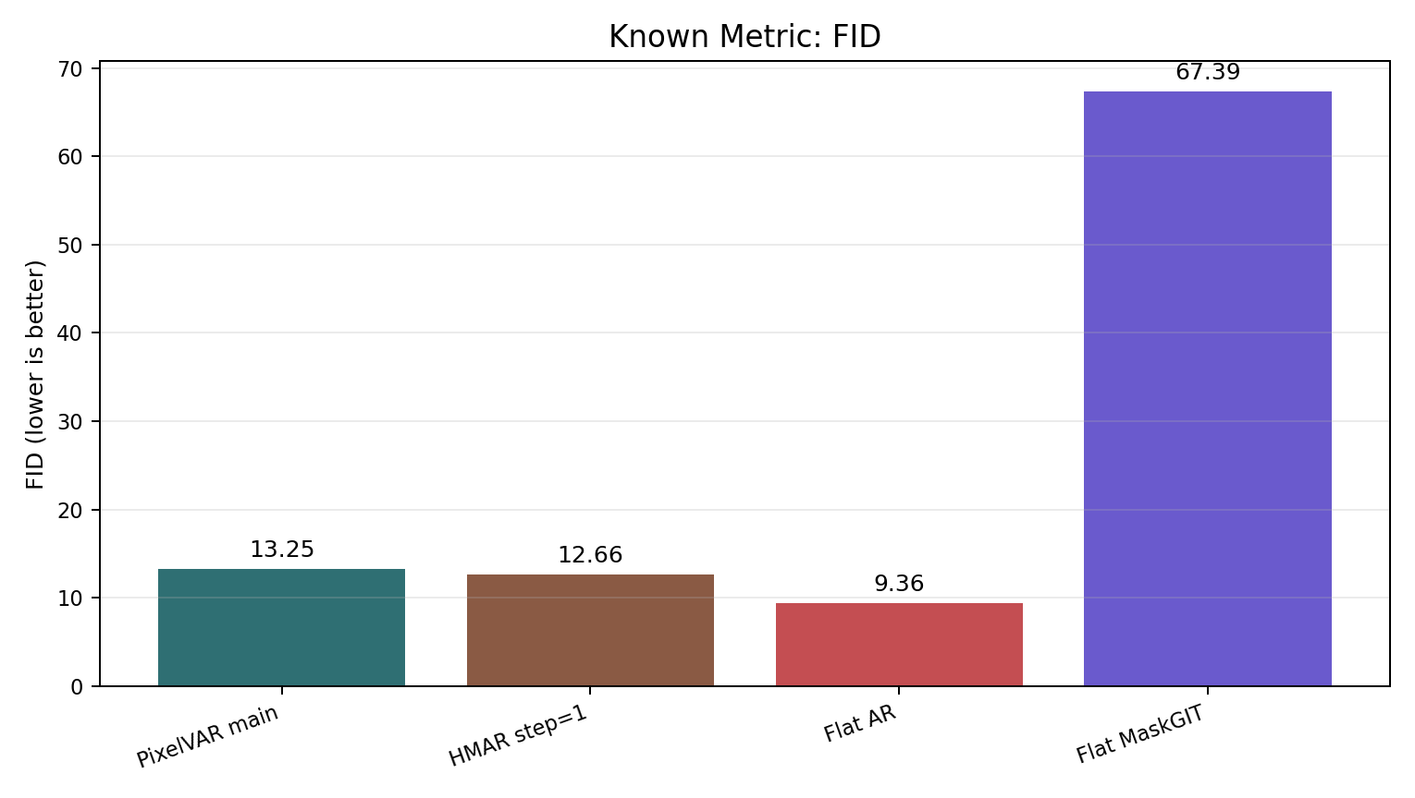
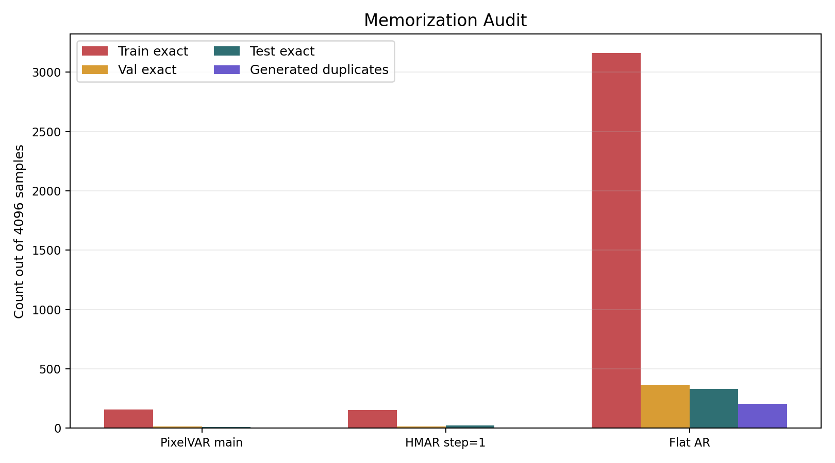
METRICS + AUDIT
Raw FID would pick Flat AR; the exact-match audit changes the conclusion.
Method
FID
Val exact
Test exact
Audit-adjusted read
Flat raster AR
9.36
365
333
memorizing
HMAR step=1
12.66
15
22
keep, disclose
PixelVAR main
13.25
13
11
keep, main result
Flat MaskGIT
67.39
0
0
weak coverage
The dataset had zero cross-split exact duplicate hashes, so held-out exact matches are not explained by simple split leakage.
Rubric: quantitative results
9/14 main

Slide 10
EXTERNAL BASELINES
External diffusion-style generators did not beat PixelVAR under the normalized 32x32 protocol.
PixelVAR 256
46.5
Baseline
Why included
Outcome
Pokemon LoRA 256
154.0
SD-piXL
most targeted low-res palette method
valid attempt, poor adapted run
SSD-1B diffusion 256
158.6
SD-piXL 16
497.7
SSD-1B
generic practical diffusion baseline
recognizable sometimes; low precision
Pokemon LoRA
best accessible sprite-specific practical generator
best external visual, still far behind
PixelVAR 256
0.891
Pokemon LoRA 256
0.051
MDIGAN
related sprite work
conditional pose task; cited only
SSD-1B diffusion 256
0.035
SD-piXL 16
0.000
Rubric: baseline comparison
10/14 main

Slide 11
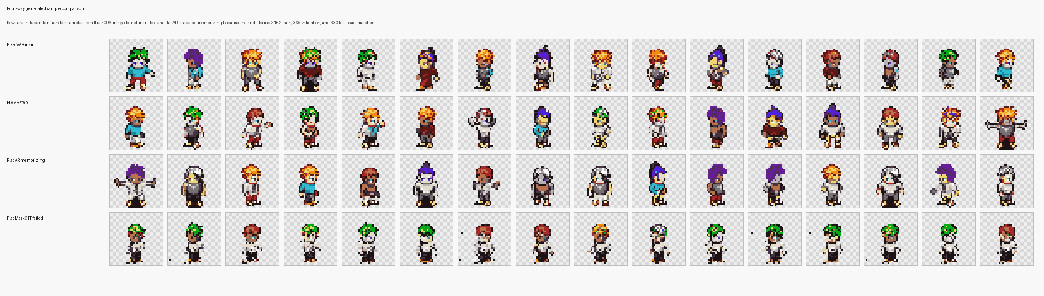
QUALITATIVE EVIDENCE
Samples support the metrics, but the deck keeps qualitative claims modest.
PixelVAR and HMAR produce coherent transparent character sprites.
Flat AR looks visually strong, but exact-match counts make it a memorizing baseline.
External diffusion baselines often create frames, fragments, lineups, or style-mismatched sprites.
Rubric: qualitative results
11/14 main

Slide 12
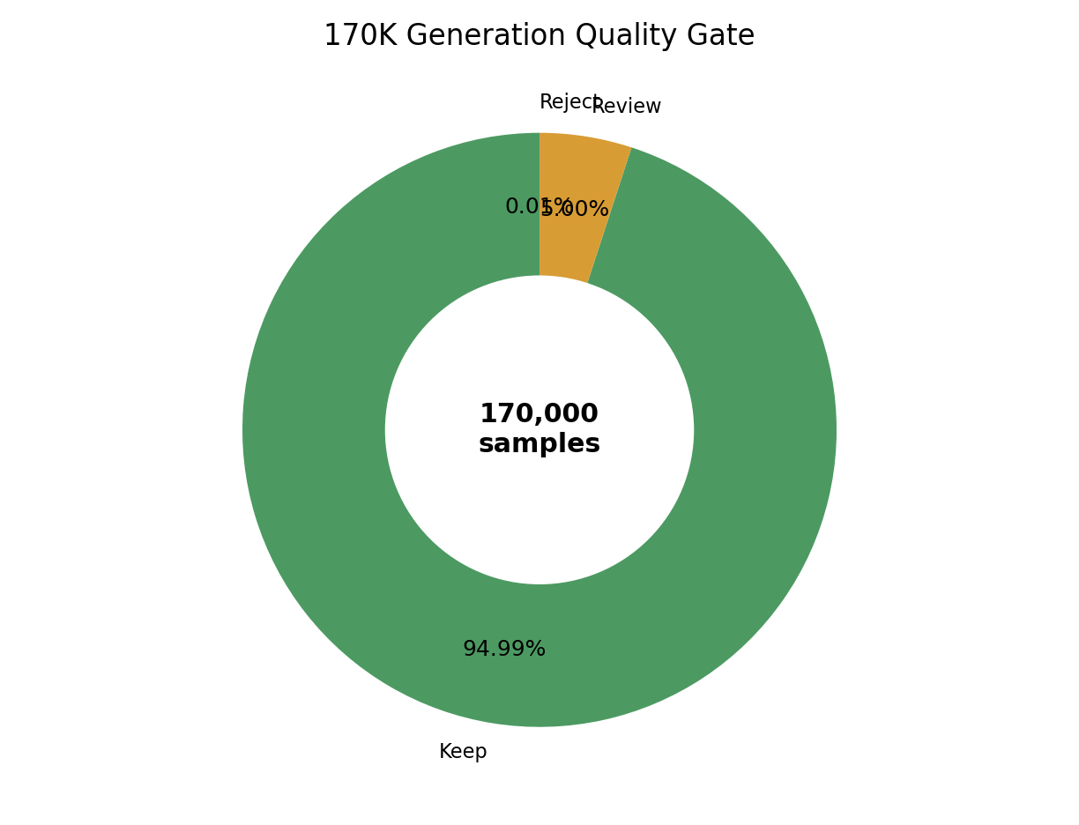
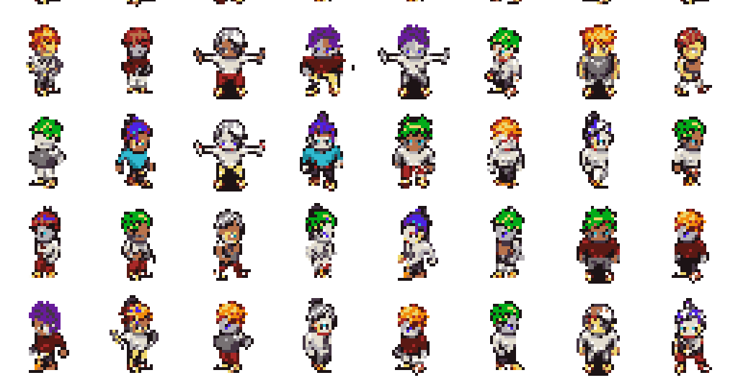
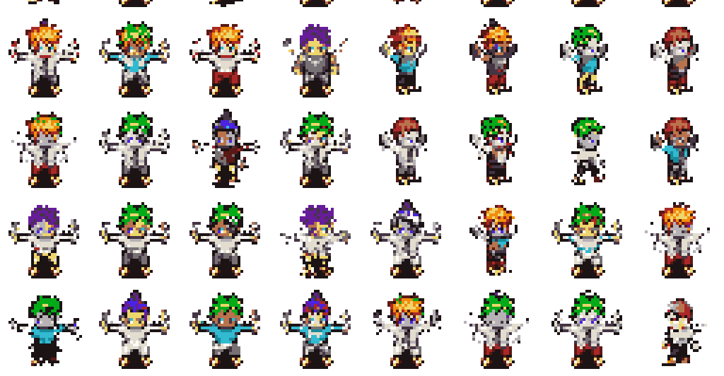
SCALE RESULT
A 170K generation pass shows the sampler remained stable at proposal scale.
170,000
161,479
generated samples
automatic keep
94.99%
8,500
21
review bucket
reject bucket
5.00%
0.01%
This is an automatic quality gate, not a human preference study. The honest claim is large-scale usable generation, not perfect manual approval.
Rubric: experimental results
12/14 main

Slide 13
LIMITATIONS
The strongest version of the project is honest about what did not finish.
Item
Status
Why
Neural multi-scale VQ-VAE
PARTIAL
implemented but reconstructions were too soft/ghosted for pixel art
64x64 cost
8/16/32 palette ablation
SETUP DONE
8-color and 32-color runners exist; GPU metrics pending
1,365
4-scale ablation
SETUP DONE
runner exists; GPU metrics pending
tokens at 32x32
User study n >= 20
NOT DONE
requires separate survey/randomization/collection workflow
5,461
tokens at 64x64
64x64 generation
NOT RUN
sequence length grows from 1,365 to 5,461 tokens
Rubric: limitations
13/14 main

Slide 14
FINAL TAKEAWAYS
PixelVAR completed the core 32x32 palette-token generator and reported it with the audits needed to avoid misleading conclusions.
Methodology: coarse-to-fine palette-token generation works for transparent 32x32 sprites.
Results: PixelVAR is the best comparable proposal branch on the sprite-feature evaluator.
Caution: raw FID alone would incorrectly promote a memorizing Flat AR baseline.
Future: run pending palette/scale ablations, then user study and 64x64 as next-stage work.
Main talk ends here. Backup slides follow for Q&A.
Conclusion
14/14 main

Slide 15
BACKUP: PROPOSAL CHECKLIST
Detailed DONE / PARTIAL / NOT DONE mapping.
Proposal item
Status
Notes
Dataset curation
DONE
MSD replacement selected after original Kaggle source failed
16-color palette-token generation
DONE
transparent token + 16 palette colors
VAR Option A
DONE
main result
HMAR Option B
DONE
refinement ablation complete
Flat AR / MaskGIT baselines
DONE
measured; Flat AR memorizes
External baselines
PARTIAL DONE
SD-piXL, SSD-1B, Pokemon LoRA; PixDiff-PIG no runnable code
User study
NOT DONE
future work
Backup
backup 1/5

Slide 16
BACKUP: METRIC GLOSSARY
What the reported metrics mean.
Metric
Meaning
Caveat
Sprite-feature score
Frechet-style distance over sprite-specific features
main internal selector, not Inception FID
Palette consistency
share of opaque pixels in fixed palette
expected 1.0 for token models
FID / KID
Inception-feature distribution distance
standard but imperfect for tiny pixel art
Precision / recall
fidelity and distribution coverage
must be read with audit
Density / coverage
PRDC-style neighborhood coverage
higher is better
MS-SSIM
sample diversity proxy
compare alongside reference
Exact-match audit
generated token maps copied from train/val/test
critical for suspicious raw winners
Backup
backup 2/5

Slide 17
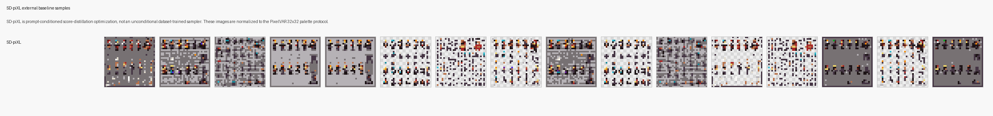
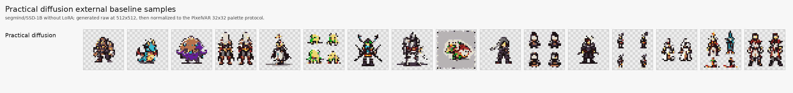
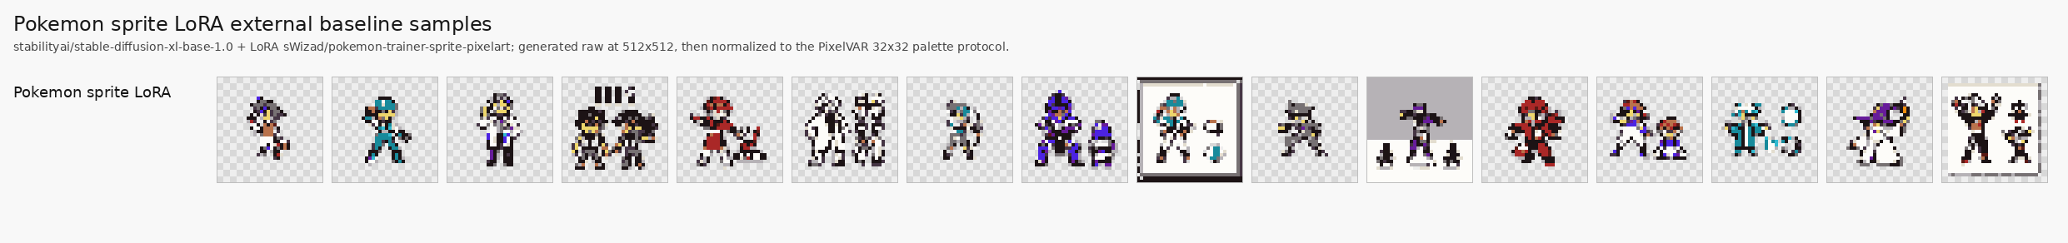
BACKUP: EXTERNAL SAMPLES
External baseline visuals and caveats.
Method
Visual read
Main caveat
SD-piXL
noisy tiled color fields
adapted prompt/image optimization, 16-image metric batch
SSD-1B diffusion
some sprites, many lineup/crop failures
generic prompt-based generator
Pokemon LoRA
best-looking external baseline
Pokemon style, fragments/frames remain
MDIGAN
not metric row
conditional paired-pose imputation
Backup
backup 3/5

Slide 18
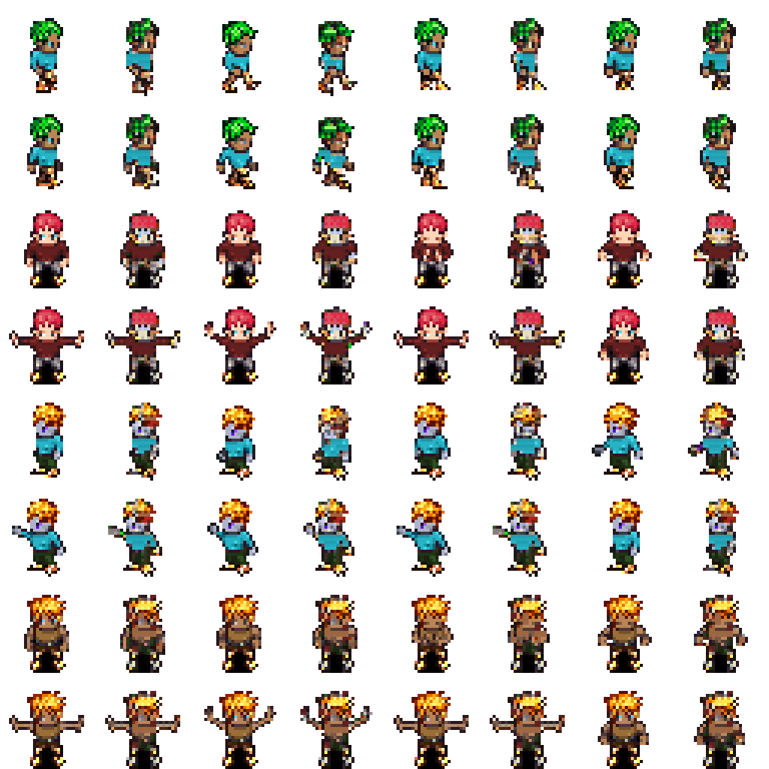
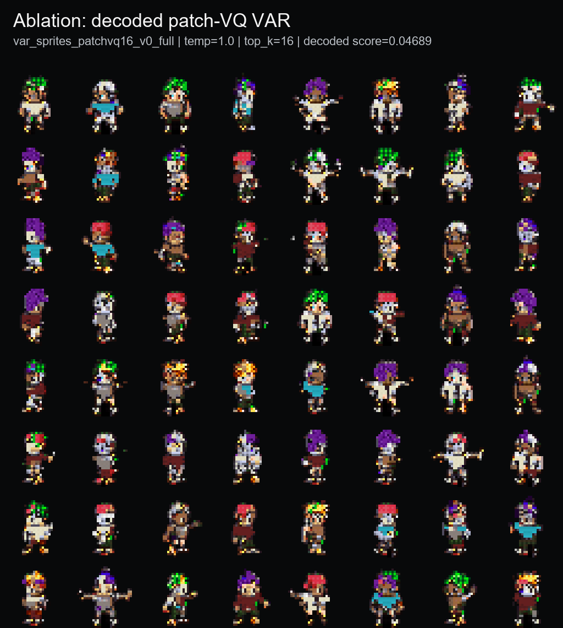
BACKUP: LEARNED TOKENS AND DATA MIXING
Why the final model stayed deterministic and real-only.
Ablation
Result
Decision
Neural VQ-VAE
soft/ghosted reconstructions
not promoted
Patch-VQ
143/512 codes used; coherent but blocky
learned-token ablation
Generated-keep
good self-reference score
not direct real-validation winner
Real + generated
0.00755 real-val score
worse than real-only
OpenGameArt mixed
0.00778 real-val score
worse than real-only
Backup
backup 4/5

Slide 19
BACKUP: REPRODUCIBILITY
Where the evidence and next commands live.
Evidence
Artifact
Pending stretch runs
Main narrative
reports/final/final_report_narrative.md
Internal decision table
reports/final/model_decision_table.md
modal run modal_train.py --action prepare-sprites-palette8
modal run modal_train.py --action train-sprites-palette8-ladder
modal run modal_train.py --action prepare-sprites-palette32
modal run modal_train.py --action train-sprites-palette32-ladder
modal run modal_train.py --action train-sprites-scale4-ladder
Known metrics
reports/final/known_metrics_comparison.md
External baselines
reports/final/external_baseline_comparison.md
Memorization audit
reports/final/memorization_audit_summary.md
Stretch plan
reports/final/proposal_leftovers_stretch_plan.md
Commands
reports/final/reproducibility_commands.md
Branch: codex/pixelvar-external-baselines
Backup
backup 5/5

