Slide 1
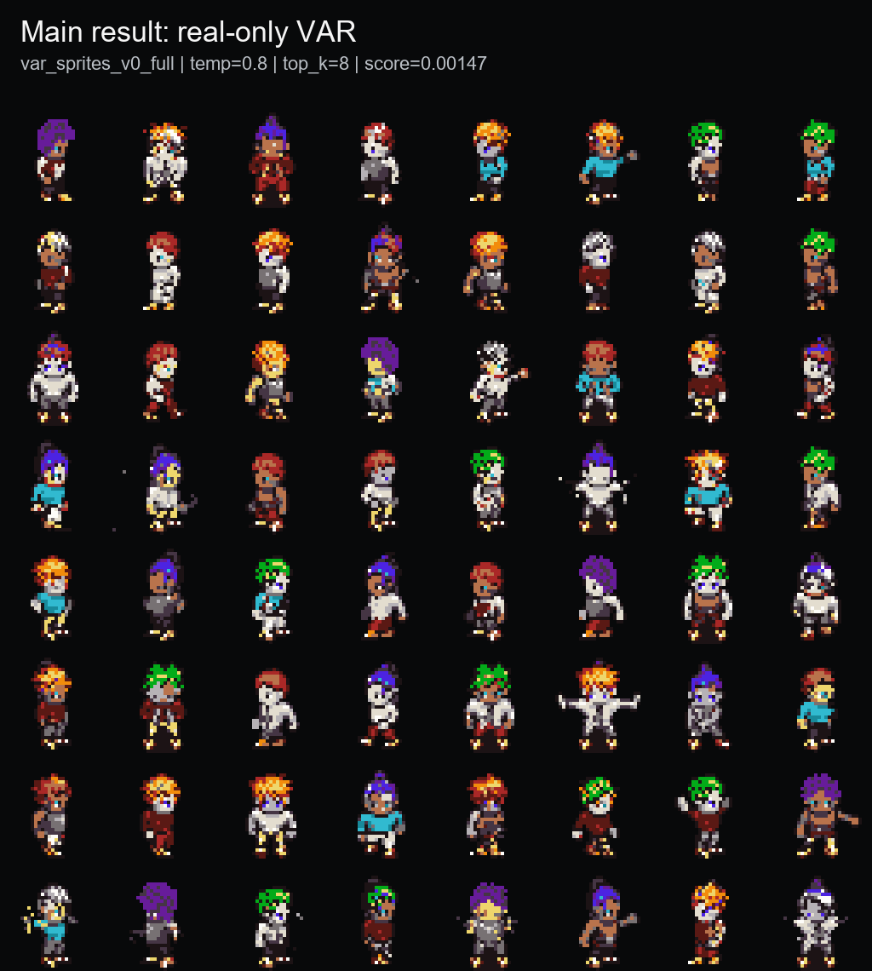
PixelVAR
Coarse-to-fine pixel-art sprite generation in palette-token space
Final project presentation | COMP547 Deep Unsupervised Learning | June 2026
32x32
16+alpha
1,365
0.00147
sprite resolution
fixed token vocabulary
coarse-to-fine tokens
best sprite-feature score
Main claim: a working palette-safe, audit-aware 32x32 sprite generator, not a broad SOTA claim.
Goal and headline result
1/22

Slide 2
PROPOSAL CONTRACT
The core proposal path is complete; three items remain honest gaps.
Proposal item
Status
What happened
Dataset curation + 32x32 preprocessing
DONE
MSD replacement, Pokemon path, OpenGameArt path
Palette-index generation, 16-color main path
DONE
Transparent token + fixed palette tokens
VAR Option A, coarse-to-fine generation
DONE
Main model trained and evaluated
HMAR / masked refinement Option B
DONE
1/2/4/8 refinement ablation completed
Flat AR + Flat MaskGIT baselines
DONE
Both implemented and measured
Standard metrics + audit
DONE
FID/KID/PRDC/MS-SSIM plus memorization audit
Multi-scale neural VQ-VAE tokenizer
PARTIAL
Implemented, but quality gate failed; Patch-VQ tested
8/16/32 palette + scale ablations
SETUP
Runners added; GPU metrics pending
User study and 64x64
NOT DONE
Postponed after finishing 32x32 proposal evidence
Proposal scope
2/22

Slide 3
PIPELINE
The project became an end-to-end sprite generation and evaluation system.
Data
Tokenizer
Pyramid
Models
Evaluation
MSD replacement
93,312 sprites
Group-safe splits
>
32x32 RGBA
alpha token 0
palette tokens 1..16
>
1x1 -> 2x2 -> 4x4
8x8 -> 16x16 -> 32x32
1,365 total tokens
>
VAR, HMAR,
Flat AR, MaskGIT,
Patch-VQ branch
>
Sprite-feature score
FID/KID/PRDC/MS-SSIM
memorization audit
74,664
9,360
9,288
0
B200
train sprites
validation sprites
test sprites
cross-split exact duplicates
Modal training path
System map
3/22

Slide 4
REPRESENTATION
Palette consistency is built into the model contract, not repaired after generation.
Continuous image models produce RGB first and quantize later.
PixelVAR generates the palette-index grid directly.
Can create off-palette colors before cleanup
Transparent token 0, color tokens 1..16
Can blur edges or anti-alias details
Decoded pixels are palette-safe by construction
Harder to reason about exact pixel constraints
Coarse-to-fine generation matches sprite structure
1.0000
0..16
No RGB
palette consistency
token range
generation space
Expected and important
Tokenizer decision
4/22

Slide 5
ARCHITECTURE
PixelVAR predicts the next scale, while HMAR tests masked refinement inside each scale.
1x1
1
Path
Generation rule
Outcome
2x2
4
Option A: VAR
Predict target scale tokens in parallel conditioned on coarser scales
Main winner
4x4
16
8x8
64
Option B: HMAR
Mask and refine tokens within each scale for T steps
Strong ablation, not promoted
16x16
256
Flat AR
Raster-scan 32x32 final grid without hierarchy
Raw FID winner, memorizing
32x32
1024
Flat MaskGIT
Mask final grid and decode in parallel iterations
Failed under current setup
Total sequence length: 1 + 4 + 16 + 64 + 256 + 1024 = 1,365 tokens.
Model design
5/22

Slide 6
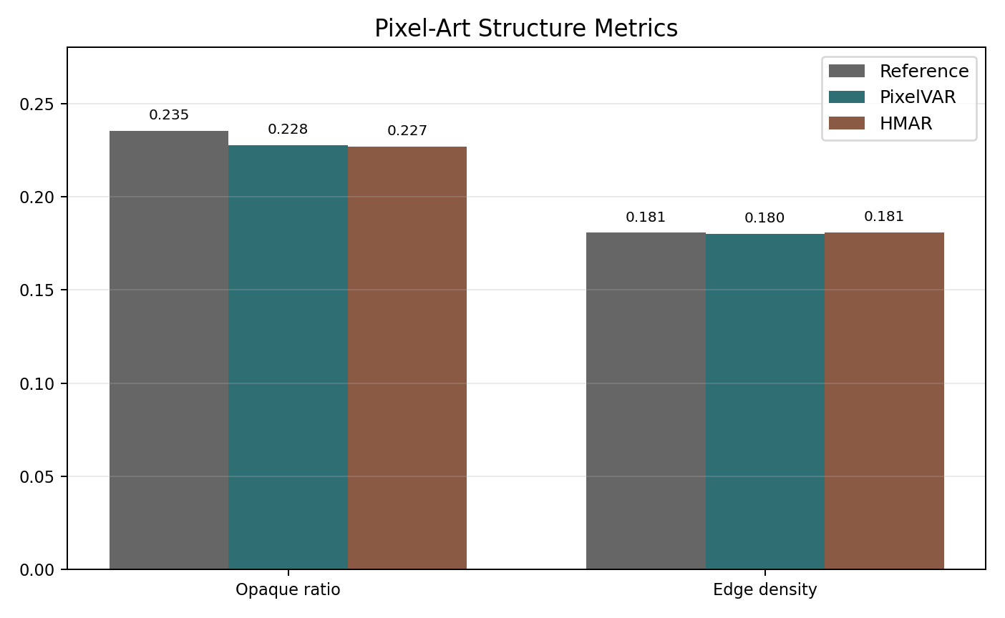
MAIN RESULT
The selected PixelVAR checkpoint matches sprite structure and stays palette-safe.
0.00147
0.2291
0.1808
sprite-feature score
opaque ratio
edge density
lower is better
real val 0.2354
real val 0.1811
Best sampling setting: temperature=0.8, top_k=8. The structure metrics are close to validation, but the sample sheet is still qualitative evidence, not a user study.
Main model
6/22

Slide 7
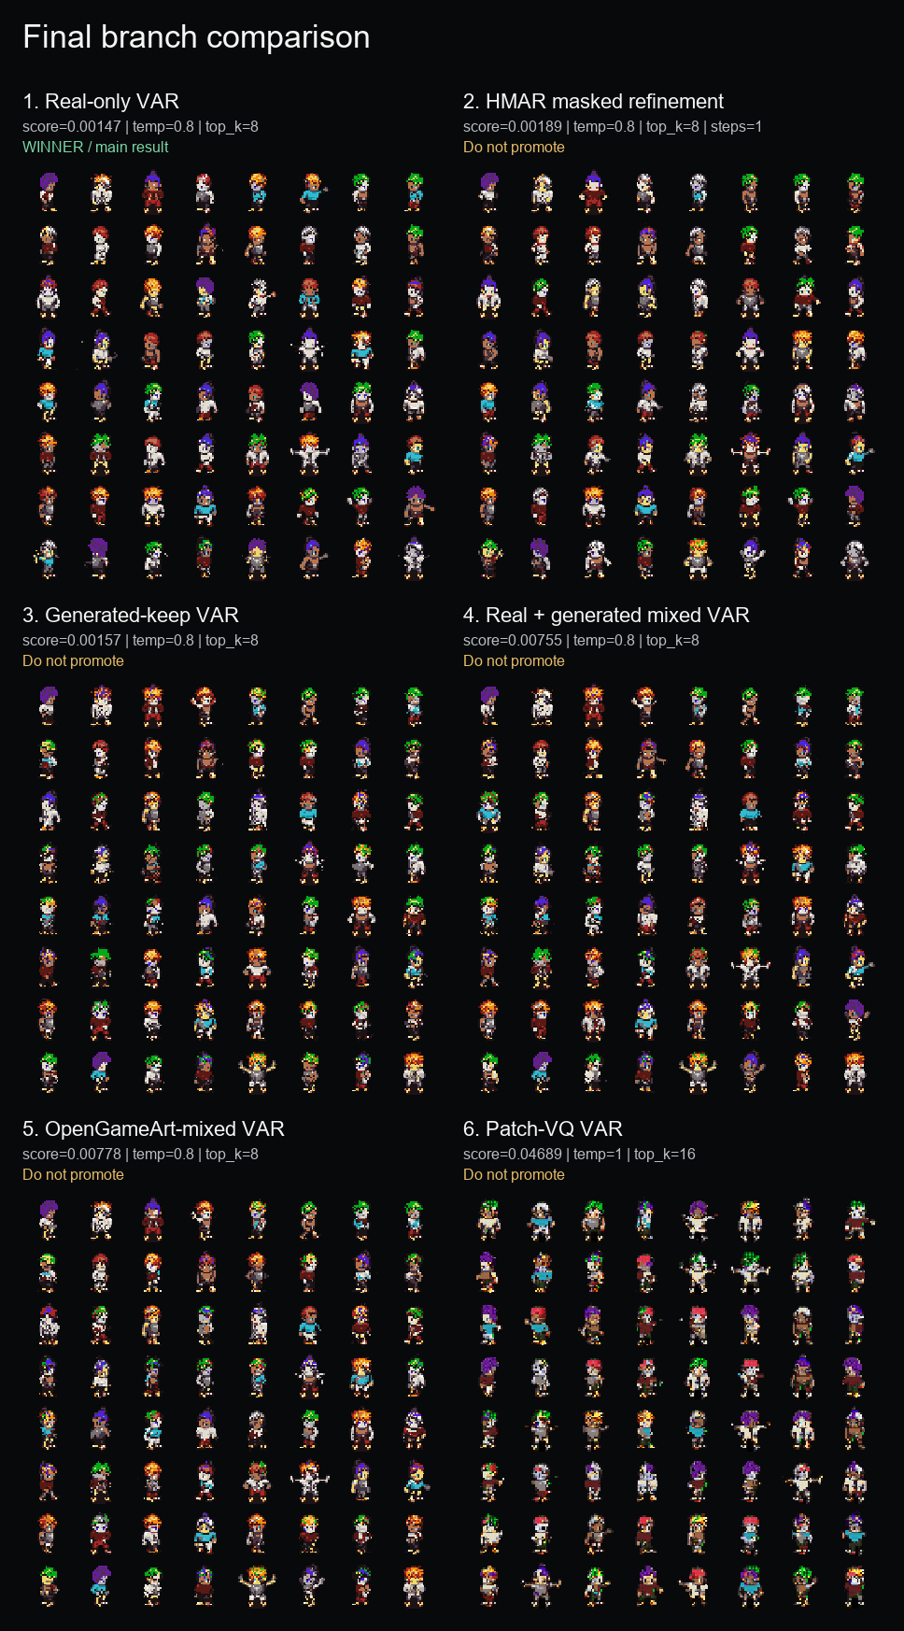
MODEL INVENTORY
We implemented a ladder from simple token baselines to hierarchical variants.
Complexity
Model
What happened
1
Flat raster AR
Simplest sequential baseline; raw metrics strong but memorizes
2
Flat MaskGIT
Final-grid masked baseline; weak coverage and diversity
3
Deterministic palette VAR
Main coarse-to-fine model and final result
4
Generated/mixed VAR variants
Data expansion ablations; did not beat real-only
5
HMAR masked refinement
Hierarchical masked refinement; close but not better
6
Patch-VQ VAR
Learned 2x2 patch-token branch; coherent but blockier
7
Neural VQ-VAE path
Implemented but not promoted due reconstruction quality
The final claim is not based on one model run. It comes from an explicit internal model ladder plus follow-up audits.
Implemented models
7/22

Slide 8
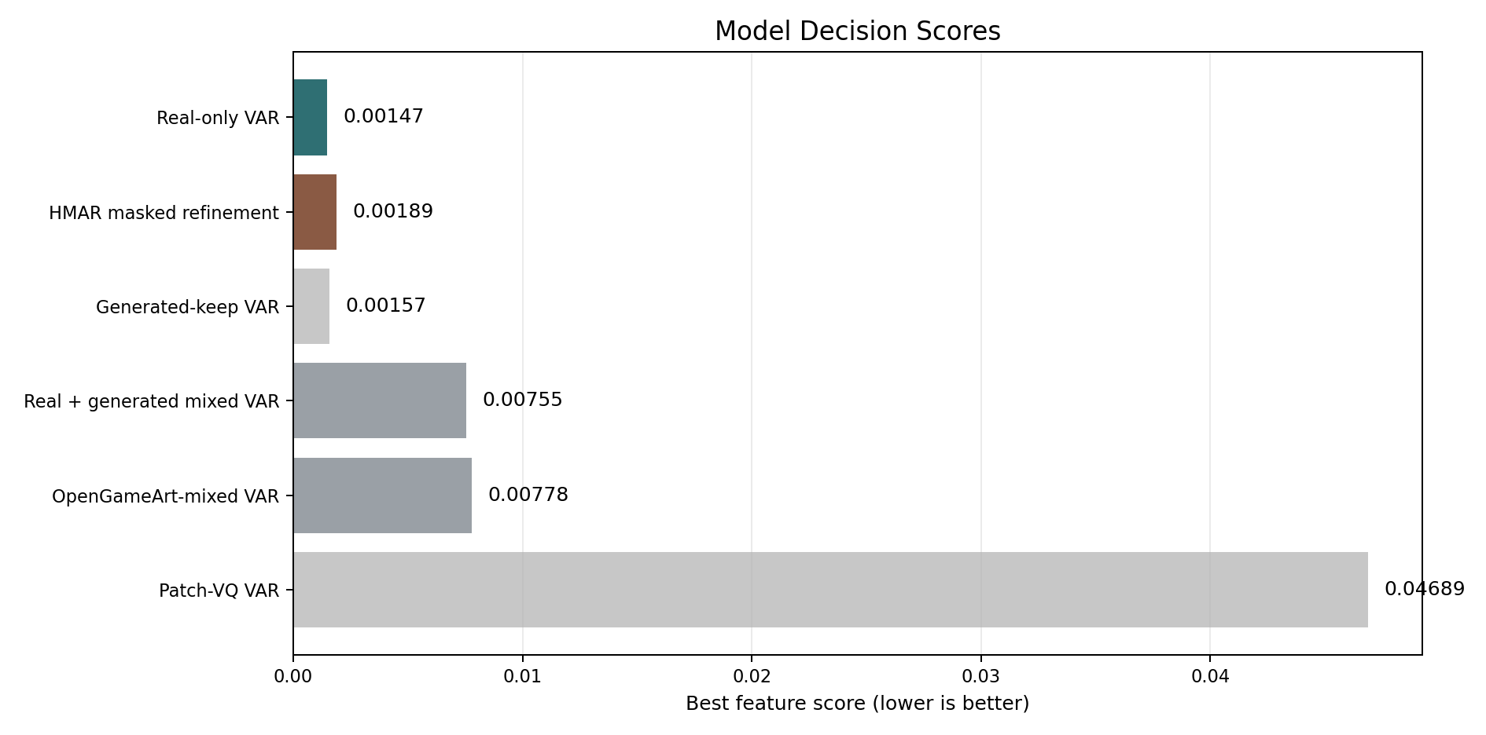
INTERNAL DECISION
Among directly comparable real-validation branches, real-only PixelVAR is the winner.
Rank
Branch
Score
Decision
1
Real-only VAR
0.00147
main result
2
HMAR refinement
0.00189
strong ablation
3
Generated-keep VAR
0.00157
not same reference
4
Real + generated
0.00755
worse
5
OpenGameArt mixed
0.00778
worse
6
Patch-VQ VAR
0.04689
separate evaluator
Generated-keep and Patch-VQ are useful ablations, but they are not direct winner comparisons. The fair winner table is the shared real-validation palette-token evaluator.
Branch comparison
8/22

Slide 9
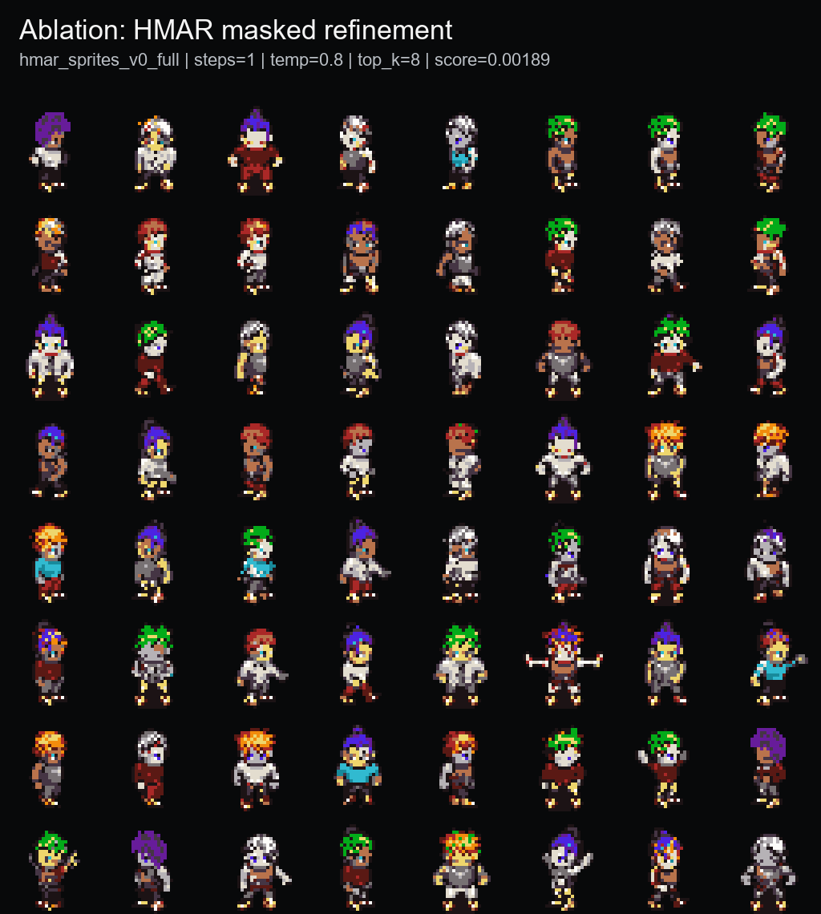
HMAR ABLATION
Masked refinement worked, but more refinement was not automatically better.
VAR main
0.00147
HMAR step 1
0.00189
HMAR step 2
0.00374
HMAR step 4
0.00366
HMAR step 8
0.00822
Best HMAR setting was one refinement step: temp=0.8, top_k=8.
Four and eight steps moved farther from validation structure.
Conclusion: HMAR is a successful proposal branch, not the final promoted model.
Option B
9/22

Slide 10
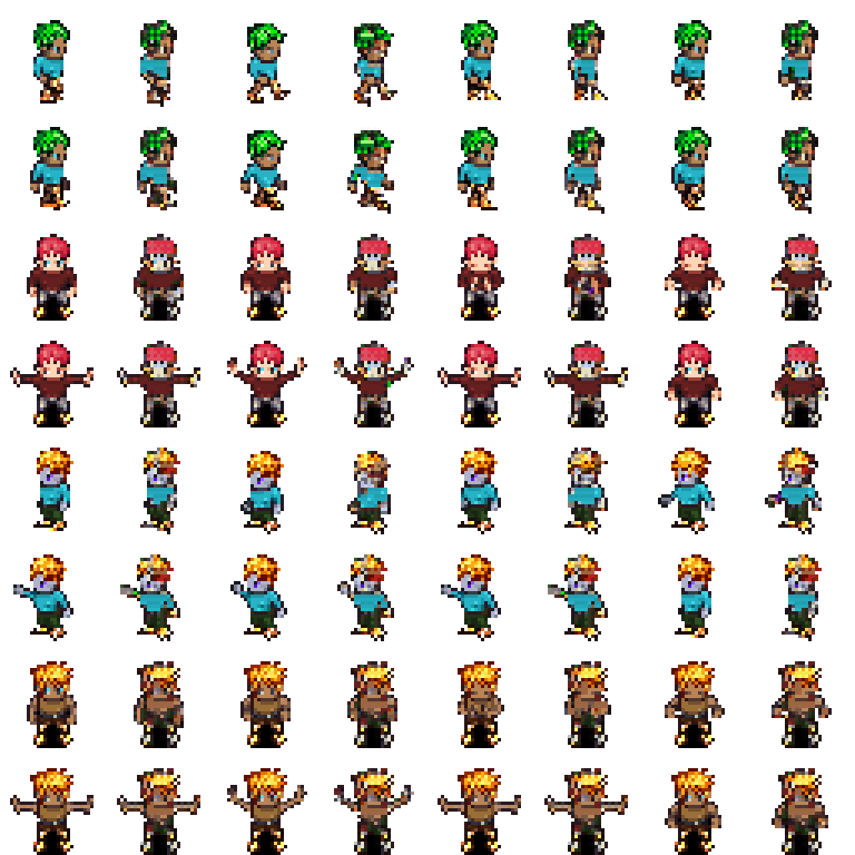
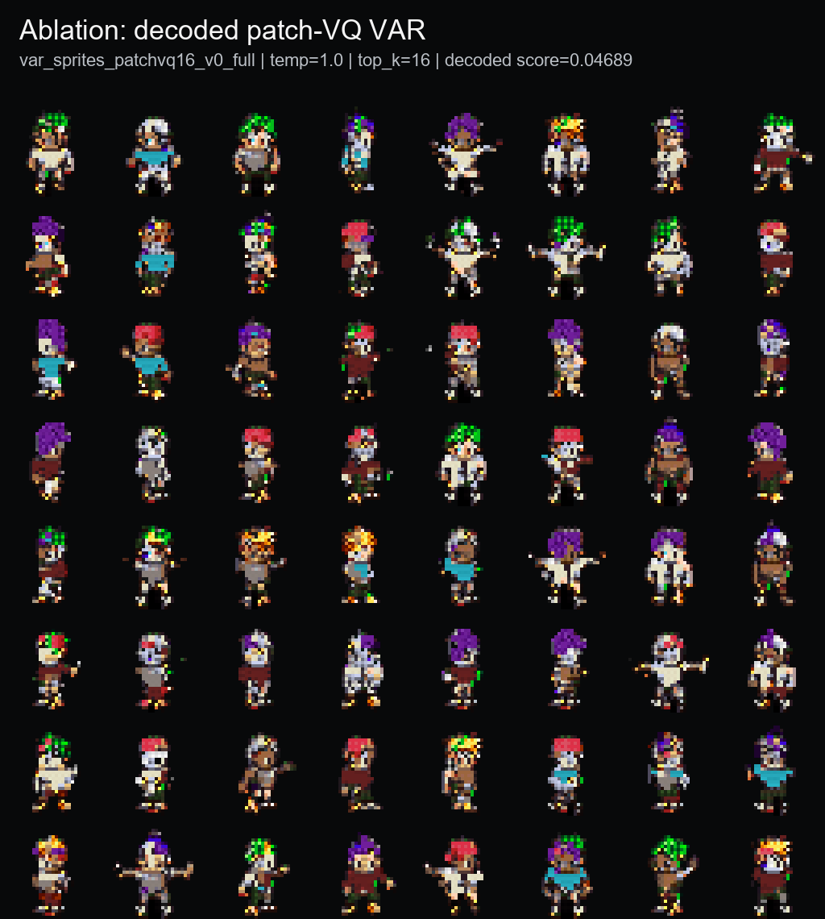
LEARNED-TOKEN BRANCH
VQ-style tokenization was explored, but the deterministic palette path stayed cleaner.
143/512
Patch-VQ codes used
0.969
VAR token accuracy
0.04689
decoded feature score
Neural VQ-VAE reconstruction was too soft for pixel art. Patch-VQ gave a working learned-token ablation, but outputs were blockier than the palette-token main model.
VQ and Patch-VQ
10/22

Slide 11
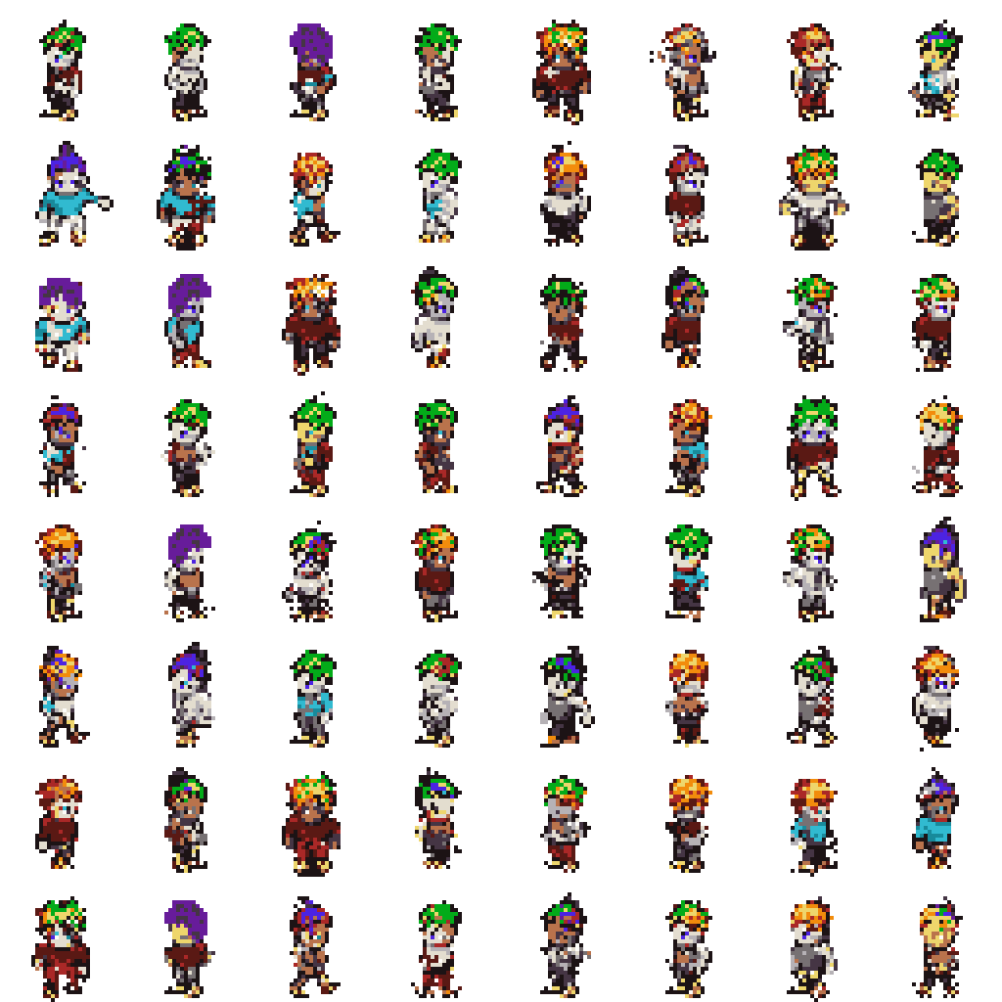
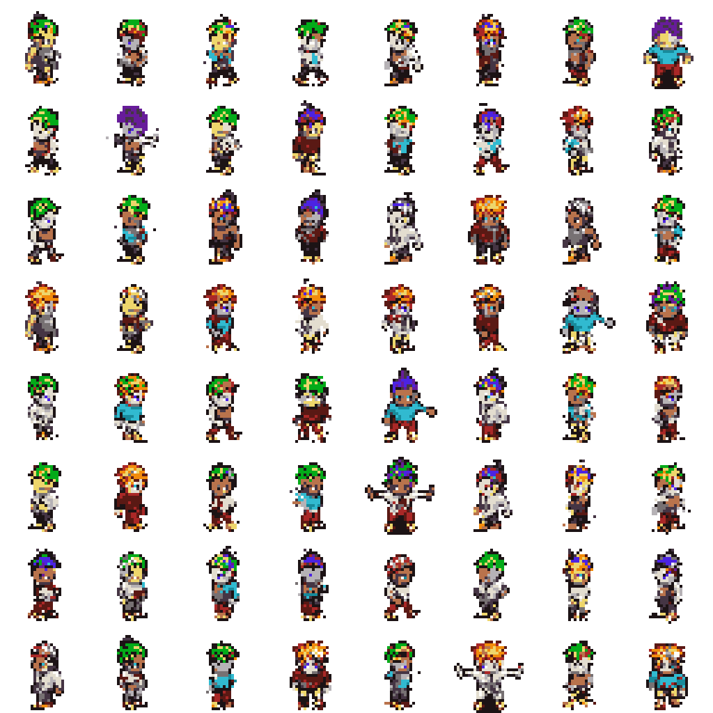
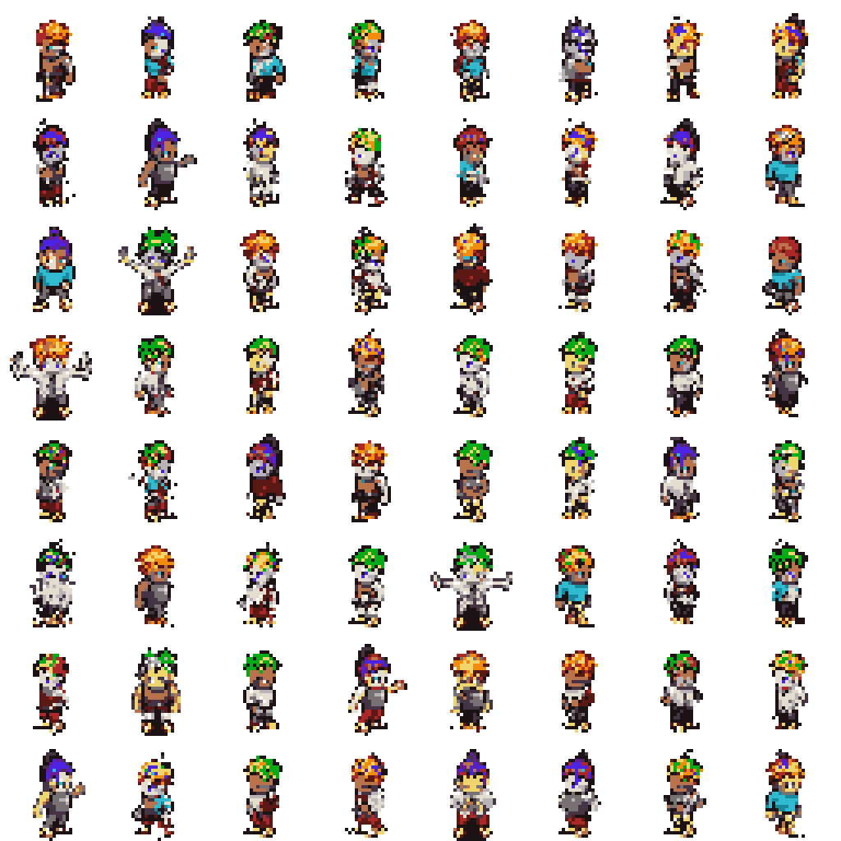
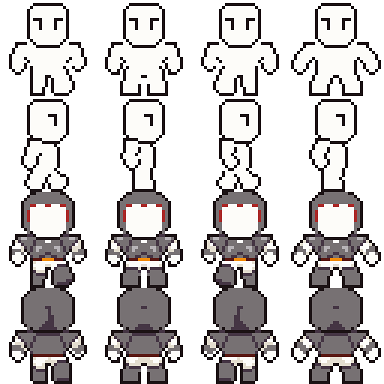
DATA EXPANSION
More data did not beat the real-only PixelVAR validation result.
Experiment
Training data
Score
Decision
Real-only VAR
Real MSD Sprites
0.00147
main
Generated-keep VAR
Filtered 170K generated set
0.00157
self-reference
Real + generated
Real + filtered generated
0.00755
worse
OpenGameArt mixed
Real + generated + OGA
0.00778
worse
OpenGameArt added a reproducible public-data path, but its distribution did not improve the main MSD validation score.
Dataset ablations
11/22

Slide 12
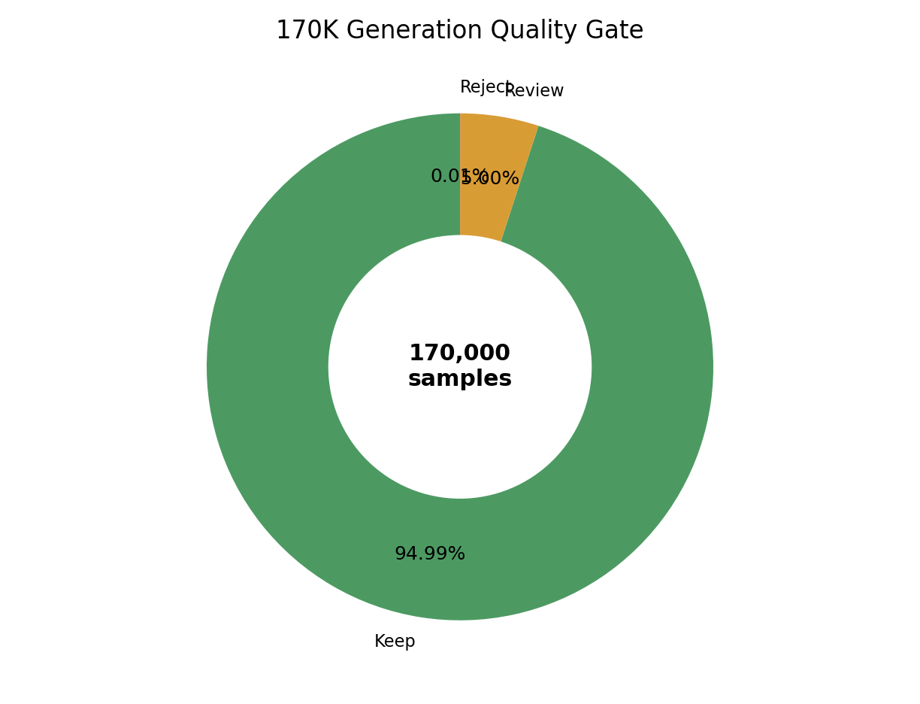
SCALE GENERATION
The model generated 170K samples without collapsing under the automatic quality gate.
170,000
161,479
generated samples
automatic keep
94.99%
8,500
21
review bucket
reject bucket
5.00%
0.01%
This is not a human preference study. It is evidence that large-scale sampling remained stable and that the automatic quality gate rejected very few outputs.
Large sample pass
12/22

Slide 13
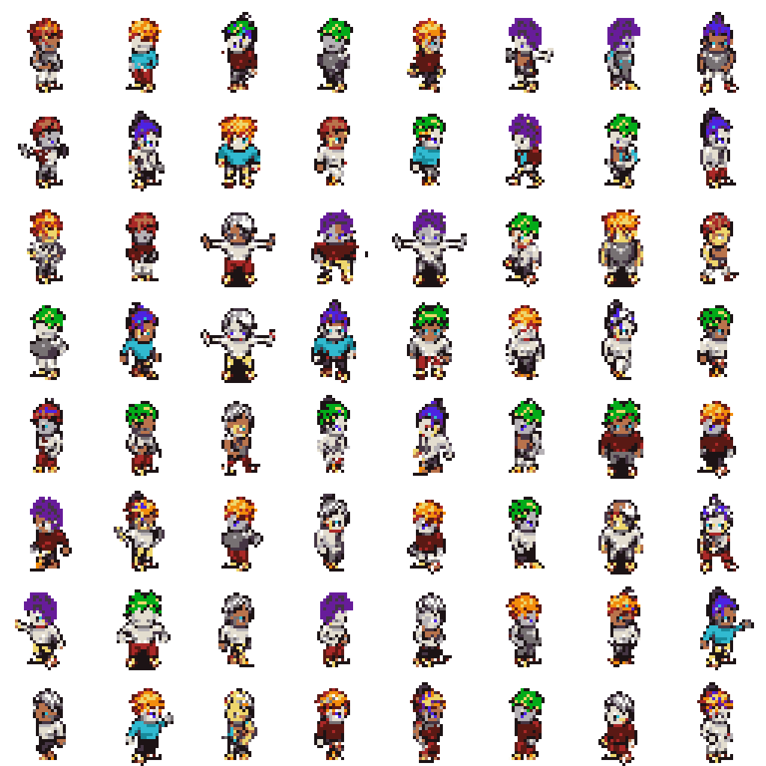
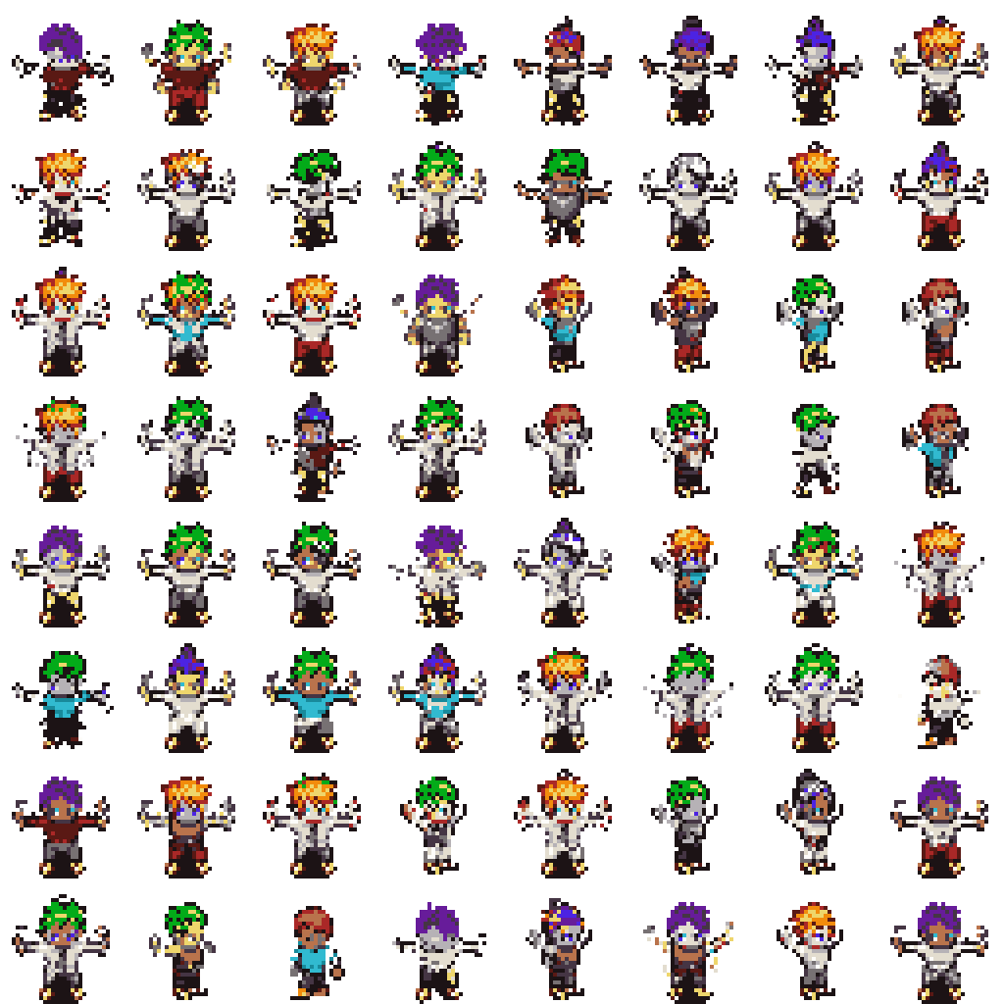
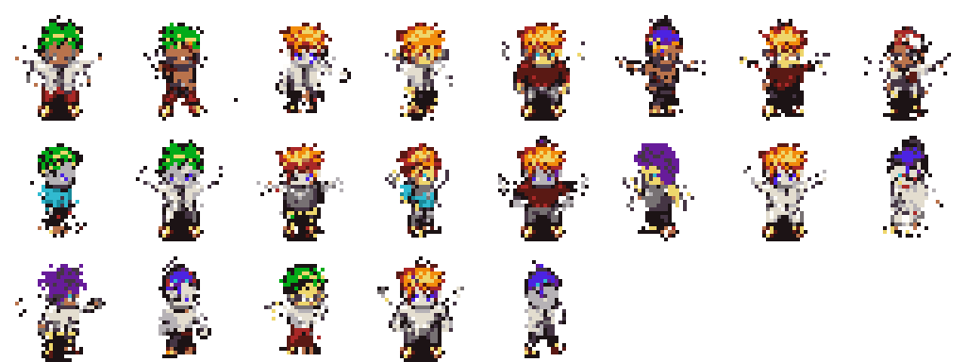
GENERATED EVIDENCE
The keep, review, and reject buckets make the 170K claim inspectable.
Reject: very rare failures
The important framing is usable generated-set scale, not manually verified perfection.
Keep: random usable samples
Review: unusual silhouettes
Visual quality gate
13/22

Slide 14
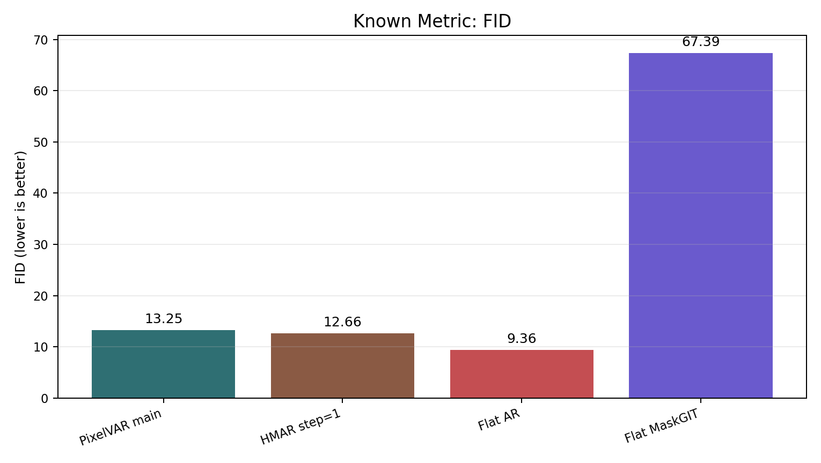
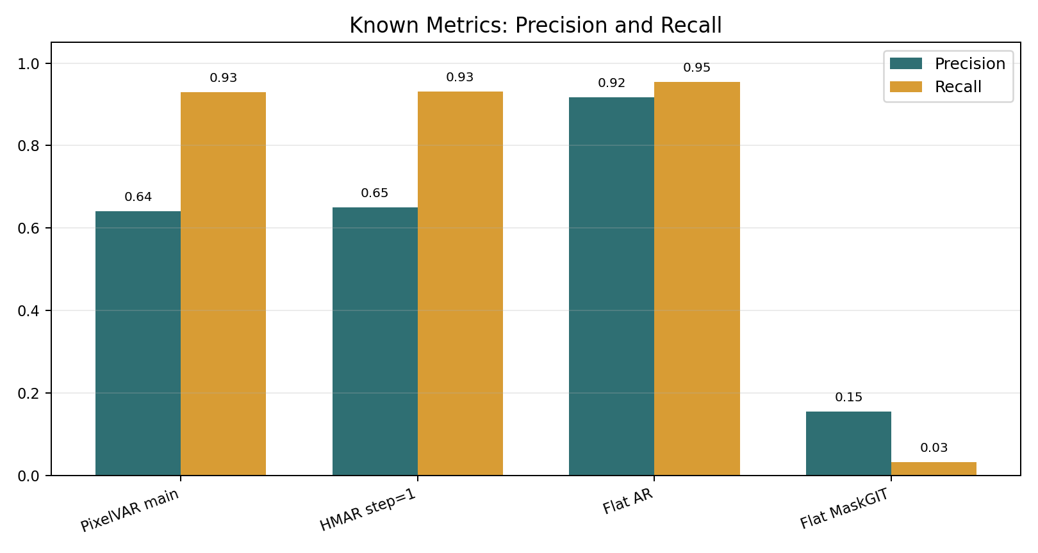
KNOWN METRICS
Raw Inception metrics alone would select Flat AR, which is exactly why audit matters.
Method
FID
Precision
Recall
Coverage
Flat raster AR
9.36
0.917
0.954
0.852
HMAR step=1
12.66
0.649
0.931
0.616
PixelVAR main
13.25
0.641
0.929
0.605
Flat MaskGIT
67.39
0.155
0.032
0.045
Standard evaluation
14/22

Slide 15
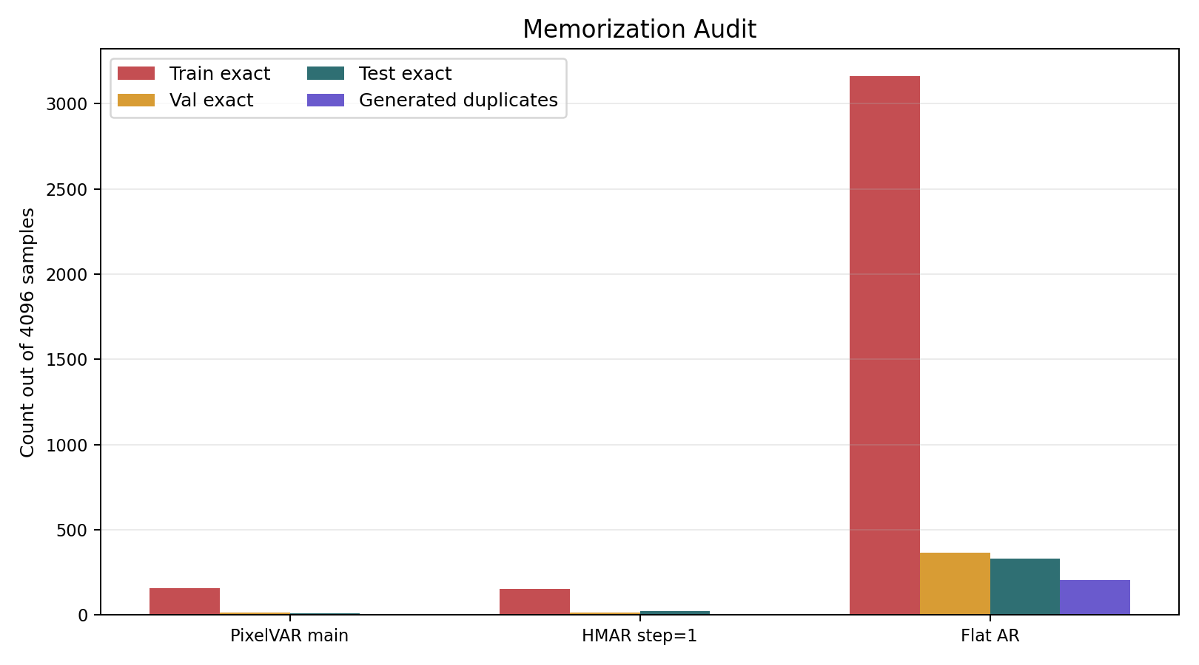
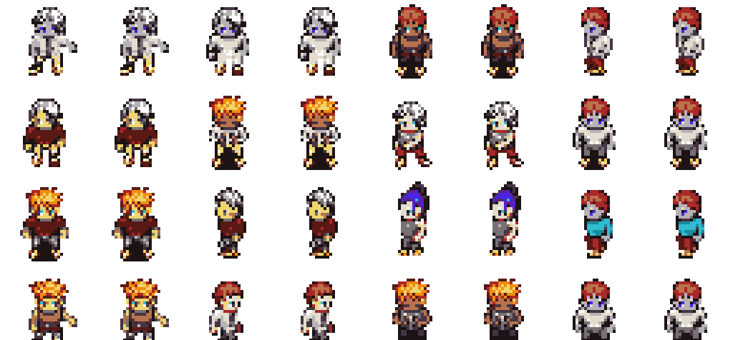
MEMORIZATION AUDIT
Flat AR was suspiciously good; exact-match audit shows it was memorizing.
Model
Train exact
Val exact
Test exact
Decision
PixelVAR main
157
13
11
keep, disclose
HMAR step=1
154
15
22
keep, disclose
Flat AR
3,162
365
333
memorizing
The processed dataset had zero cross-split exact duplicate hashes. Held-out exact matches are therefore not explained by simple split leakage.
Audit-adjusted comparison
15/22

Slide 16
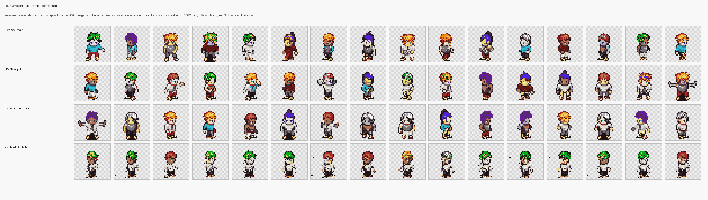
SAMPLE COMPARISON
The four-way sheet makes the metric/audit story visible.
PixelVAR and HMAR produce coherent sprite rows with low-but-nonzero exact matches.
Flat AR looks strong visually and numerically, but the exact-match counts are too high.
Flat MaskGIT shows low coverage and repeated weak structure in this setup.
Qualitative comparison
16/22

Slide 17
EXTERNAL BASELINES
Targeted and practical external generators were run under the same 32x32 PNG protocol.
PixelVAR 256
46.5
Bottom line: none of the external diffusion-style baselines closes the gap under our normalized protocol.
Pokemon LoRA 256
154.0
SSD-1B diffusion 256
158.6
Baseline
Why included
Decision
SD-piXL 16
497.7
SD-piXL
Most targeted low-res palette method
valid attempt; poor run
SSD-1B
Generic practical SDXL-family baseline
weak/moderate
FID lower is better
Pokemon LoRA
Best accessible sprite-specific practical generator
best external visual baseline
PixelVAR 256
0.891
Pokemon LoRA 256
0.051
MDIGAN
Related character sprite work
cite, not direct numeric row
SSD-1B diffusion 256
0.035
SD-piXL 16
0.000
External metrics
17/22

Slide 18
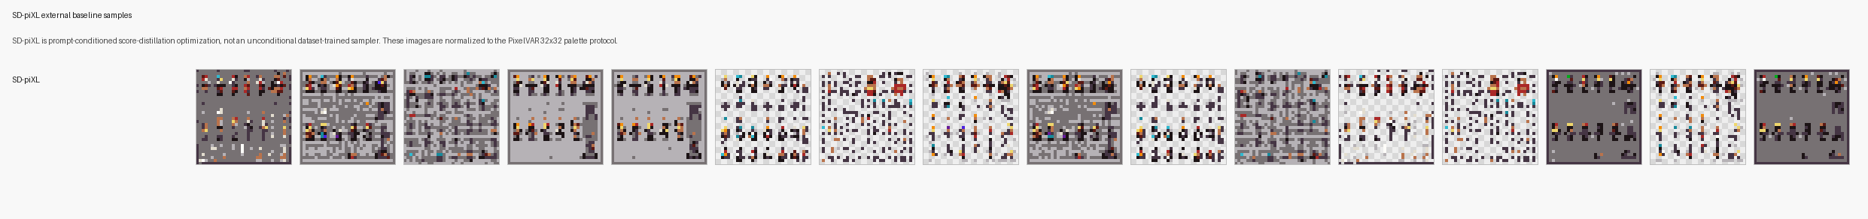
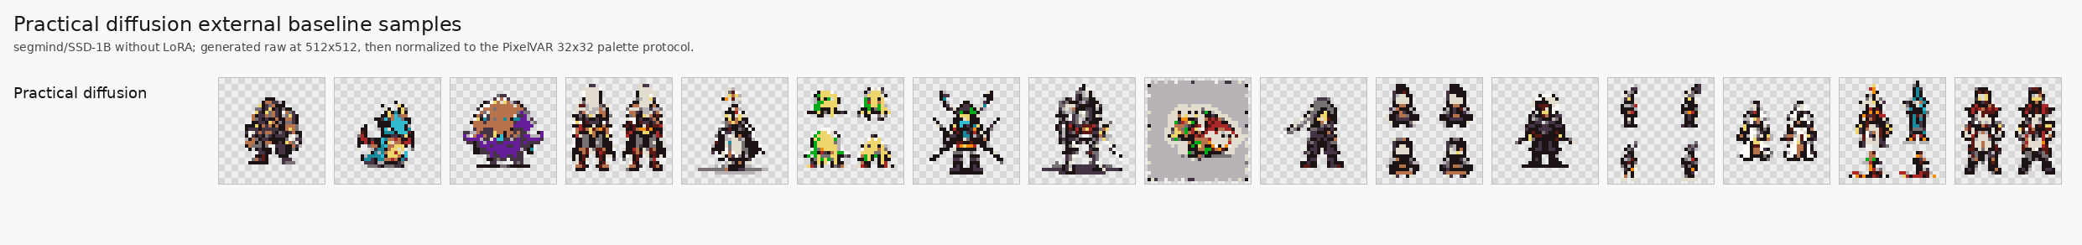
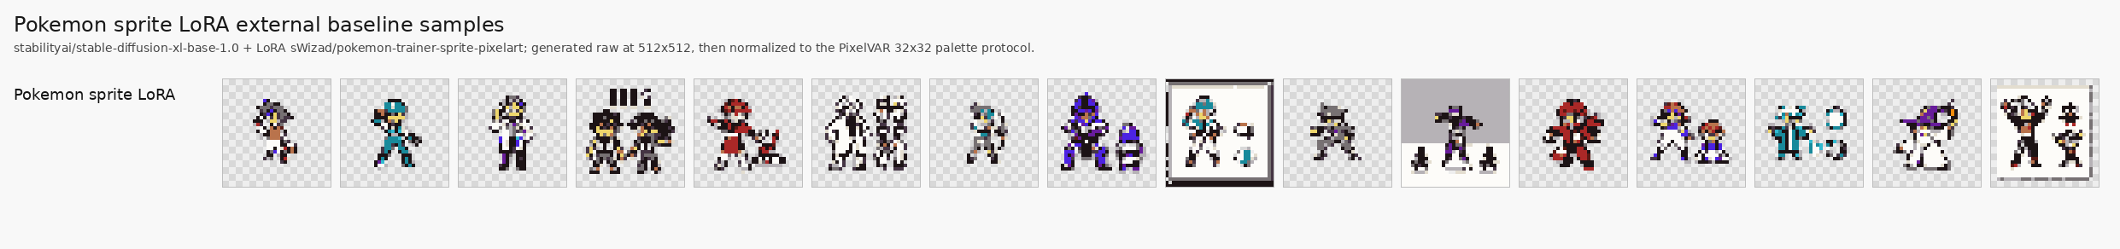
EXTERNAL VISUALS
The external sheets explain why protocol caveats matter.
Method
Visual read
Main caveat
SD-piXL
Noisy tiled color fields
Prompt/image-conditioned optimization; slow; 16-image metric batch
SSD-1B diffusion
Some recognizable sprites, many lineup/crop failures
Generic text-to-image, not sprite-dataset trained
Pokemon sprite LoRA
Best looking external baseline
Pokemon trainer style; frames/fragments/paired characters remain
PixDiff-PIG
Not run
No runnable public code/weights found in this pass
MDIGAN
Not metric row
Conditional paired-pose imputation, not unconditional generation
External samples
18/22

Slide 19
LEFTOVERS AND STRETCH
The remaining proposal/stretch items are now explicit instead of hidden.
Item
Current status
Reason / next action
8/16/32 palette ablation
SETUP DONE
8-color and 32-color configs/actions added; GPU metrics pending
64x64 cost
4-scale hierarchy ablation
SETUP DONE
Compare [1,4,16,32] against main 6-scale schedule
1,365
tokens at 32x32
64x64 generation
NOT RUN
Sequence length rises from 1,365 to 5,461 tokens
User study n >= 20
NOT DONE
Needs survey/UI, randomized samples, collection and analysis
5,461
tokens at 64x64
Neural VQ-VAE tokenizer
PARTIAL
Implemented but reconstruction quality did not pass pixel-art gate
About 4x longer sequence before extra training, sampling, audit, storage, and evaluation cost.
Open work
19/22

Slide 20
METRIC FRAMING
We used multiple metrics because no single score is reliable for tiny sprites.
Metric family
What it tells us
How to read it
The serious claim is audit-adjusted, not cherry-picked.
Sprite-feature score
Opaque ratio, edge density, entropy, silhouette, token histogram
Main proposal-internal selector; lower is better
Palette consistency
Opaque pixels belong to fixed palette
Expected 1.0 for token models; do not oversell
FID / KID
Inception-feature distribution distance
Known metric, but imperfect for 32x32 pixel art
Raw known metrics: Flat AR wins.
Precision / recall
Fidelity and coverage
Useful only with audit context
Audit-adjusted view: Flat AR is memorizing.
Density / coverage
PRDC-style neighborhood coverage
Higher is better
Sprite-feature view: PixelVAR wins among comparable proposal branches.
MS-SSIM
Generated-sample diversity proxy
Lower usually means more diverse
External view: diffusion baselines trail PixelVAR under normalized protocol.
Exact-match audit
Train/val/test token-map copies
Disqualifies suspicious raw winners
Evaluation grammar
20/22

Slide 21
REPRODUCIBILITY
The final artifacts are backed by commands, reports, and saved evidence.
Evidence
Artifact
Next Modal commands
Main narrative
reports/final/final_report_narrative.md
Decision table
reports/final/model_decision_table.md
modal run modal_train.py --action prepare-sprites-palette8
modal run modal_train.py --action train-sprites-palette8-ladder
modal run modal_train.py --action prepare-sprites-palette32
modal run modal_train.py --action train-sprites-palette32-ladder
modal run modal_train.py --action train-sprites-scale4-ladder
Known metrics
reports/final/known_metrics_comparison.md
External comparison
reports/final/external_baseline_comparison.md
Memorization audit
reports/final/memorization_audit_summary.md
Stretch plan
reports/final/proposal_leftovers_stretch_plan.md
Commands
reports/final/reproducibility_commands.md
Current branch: codex/pixelvar-external-baselines. Last implementation pass added the runnable proposal-leftover ablation setup.
Artifacts
21/22

Slide 22
FINAL CONCLUSION
PixelVAR completed the main 32x32 palette-token proposal path and survived a broader audit than the raw metrics alone.
Main
Strong
Caution
real-only 16-color / 6-scale VAR
HMAR step=1 ablation
Flat AR memorization
Best proposal-internal sprite-feature score: PixelVAR main, 0.00147.
Known FID/KID were reported, but audit prevents a misleading Flat AR winner claim.
External diffusion-style baselines did not beat PixelVAR under the normalized 32x32 protocol.
Future work is clear: pending palette/scale runs, user study, and 64x64.
Final claim
22/22

