Slide 1
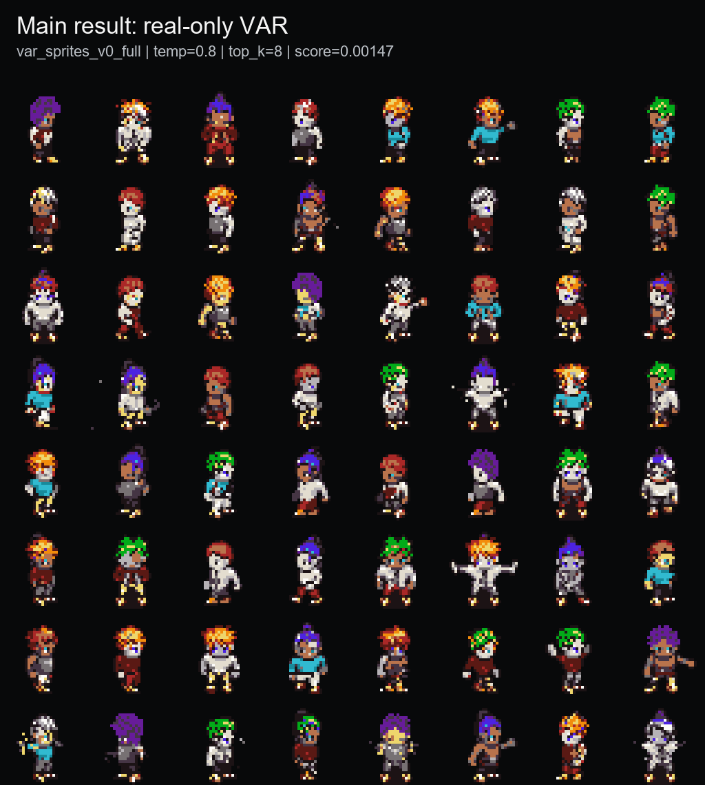
PixelVAR
Coarse-to-fine pixel-art sprite generation via palette tokens
Rubric-aligned final presentation | COMP547 Deep Unsupervised Learning | June 2026
32x32
16+alpha
0.00147
sprite output
palette-token vocab
best sprite-feature score
Thesis: generate transparent pixel-art sprites directly in discrete palette-index space, then evaluate honestly with baselines, ablations, and memorization audit.
Opening
1/17 main

Slide 2
PROBLEM + MOTIVATION
Pixel art is not just low-resolution RGB.
Why it matters
Why it is hard
Our framing
Game sprites are labor-intensive assets. A usable generator should produce compact transparent characters, not just pretty pixel-ish pictures.
Every pixel is visible. Small palette changes, anti-aliasing, noisy backgrounds, or broken silhouettes can make an output unusable.
Instead of generating continuous RGB and quantizing later, PixelVAR learns to generate palette-index tokens directly.
Transparent background is part of the object, not cleanup.
Palette consistency should be native to generation, not a post-hoc repair.
A single misplaced pixel can break outlines or pose readability.
Rubric: problem statement and motivation
2/17 main

Slide 3
RELATED WORK
PixelVAR sits between pixel-art-specific generators and hierarchical image-token models.
Family
Example
Why it is not enough
Pixel-art GANs
Coutinho / MDIGAN
conditional or pose-based; not the same unconditional generation task
Diffusion
SD-piXL, PixDiff-PIG, LoRAs
continuous, prompt-first, or image-first; needs repair/normalization
Discrete tokenizers
Pixel VQ-VAE
useful representation direction, but not a complete generator by itself
Hierarchical AR
VAR / HMAR
strong coarse-to-fine idea, but not aimed at tiny transparent palette sprites
Our niche: next-scale prediction for tiny transparent palette-constrained sprites.
Flat AR and MaskGIT still matter, but they belong in the baseline/evaluation section, not the opening literature table.
Rubric: related work
3/17 main

Slide 4
PROPOSAL CONTRACT AND FINAL PIVOT
What we promised, what changed, what we completed.
Proposal component
Final state
Evidence / reason
Tokenizer pivot
32x32 sprite dataset + preprocessing
DONE
MSD replacement, grouped splits, Pokemon/OpenGameArt support paths
Proposed neural multi-scale VQ-VAE -> implemented/tried, but reconstructions were too soft or ghosted for pixel art. Main result uses deterministic palette-token pyramids because crisp exact pixels are the domain requirement.
VAR Option A
DONE
main checkpoint: var_sprites_v0_full
HMAR Option B
DONE
1/2/4/8 refinement-step ablation
Baselines + known metrics
DONE
Flat AR, MaskGIT, metrics, audit, external rows
User study / 64x64
FUTURE
not claimed; disclosed as next proof
Code state
Present codex/pixelvar-external-baselines as the final working branch. Do not describe main as the final code state; main is older than the completed reports, Modal actions, evaluation artifacts, scripts, and tests.
This slide prevents the wrong interpretation: the VQ-VAE path was not hidden; it was tested, judged too soft for the domain, and kept as a learned-token ablation rather than the main result.
P1 0:45 - proposal contract
4/17 main

Slide 5
METHOD
PixelVAR generates a six-scale palette-token pyramid from coarse silhouette to final sprite.
1x1
1
Path
Generation rule
Role
2x2
4
PixelVAR
predict each next scale conditioned on coarser scales
main result
4x4
16
HMAR
mask/refine tokens within each scale for T steps
proposal Option B
8x8
64
16x16
256
Flat AR
raster-scan final 32x32 grid
simple baseline
32x32
1024
Flat MaskGIT
masked final-grid parallel decoding
masked baseline
Token contract
Meaning
Why this matters
0
transparent background
The model never has to repair palette membership or alpha afterward. The representation makes transparency and color membership native parts of generation.
1..16
fixed palette colors
mask
HMAR missing token, separate from transparency
This is the core 30-point methodology slide: representation, hierarchy, and baseline paths in one place.
1,365
total tokens across 1x1..32x32 scales
P2 1:05 - methodology
5/17 main

Slide 6
EXPERIMENTAL SETUP
Evaluation uses a fixed 32x32 sprite protocol, grouped splits, and three layers of metrics.
93,312
74,664
9,360
9,288
MSD replacement sprites
train
validation
test
Data protocol
Metrics
Baselines
All main outputs are 32x32 transparent RGBA sprites decoded from palette-token maps. Splits are grouped by character attributes to reduce leakage.
Three layers: sprite-specific feature score, standard image metrics, and exact-match audit. Acronyms stay in backup unless asked.
Internal: HMAR, Flat AR, Flat MaskGIT, generated/mixed, Patch-VQ. External: SD-piXL, SSD-1B, Pokemon sprite LoRA.
The audit is not an appendix-only detail; for tiny sprites it is part of whether a quantitative conclusion is trustworthy.
P2 0:45 - setup
6/17 main

Slide 7
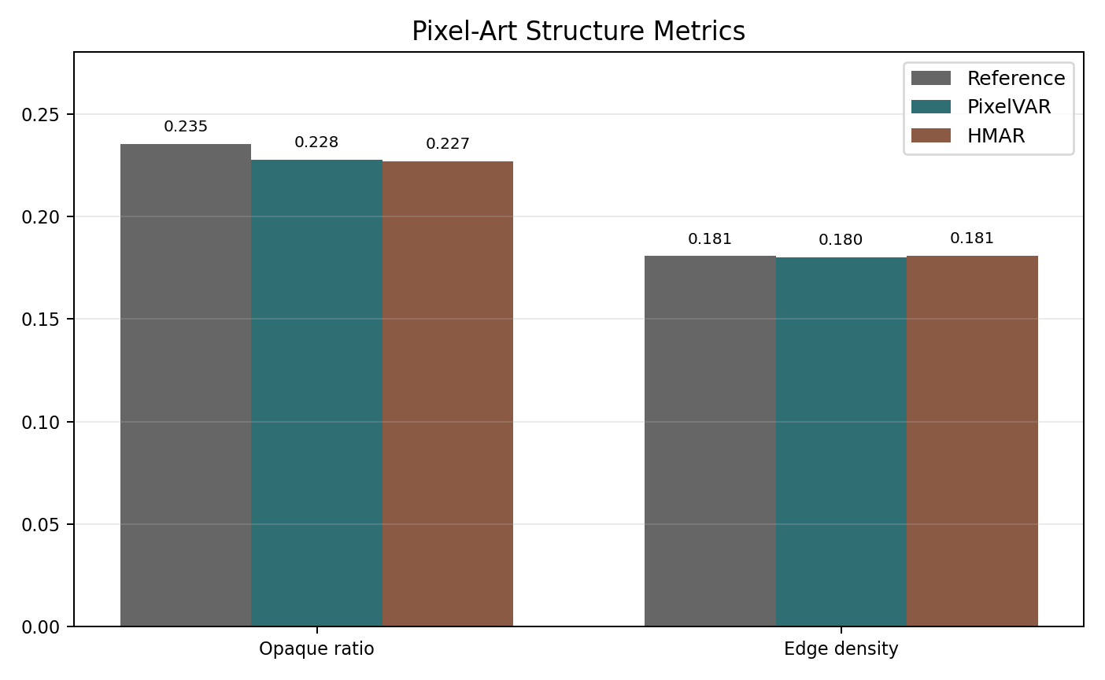
MAIN RESULT
The selected PixelVAR checkpoint produces compact, palette-safe 32x32 sprites.
0.00147
1.0000
0.1808
sprite-feature score
palette consistency
edge density
lower is better
expected from tokens
real val 0.1811
Best sampling: temperature=0.8, top_k=8. Palette consistency is important, but it is expected from the discrete representation, so we do not oversell it.
P2 0:55 - main result
7/17 main

Slide 8
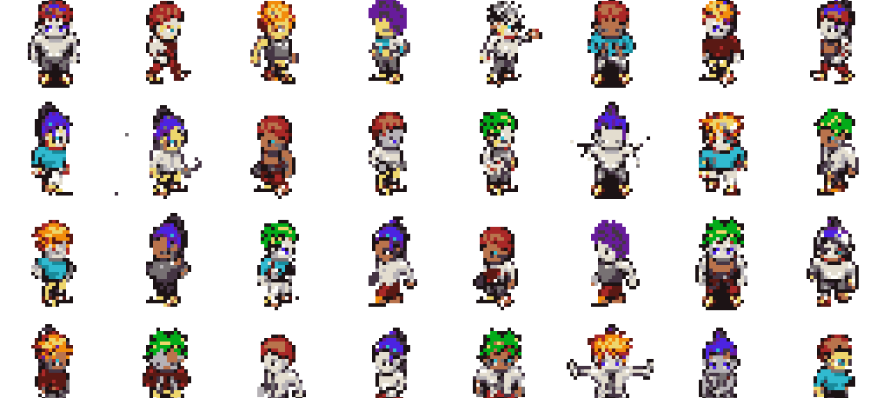
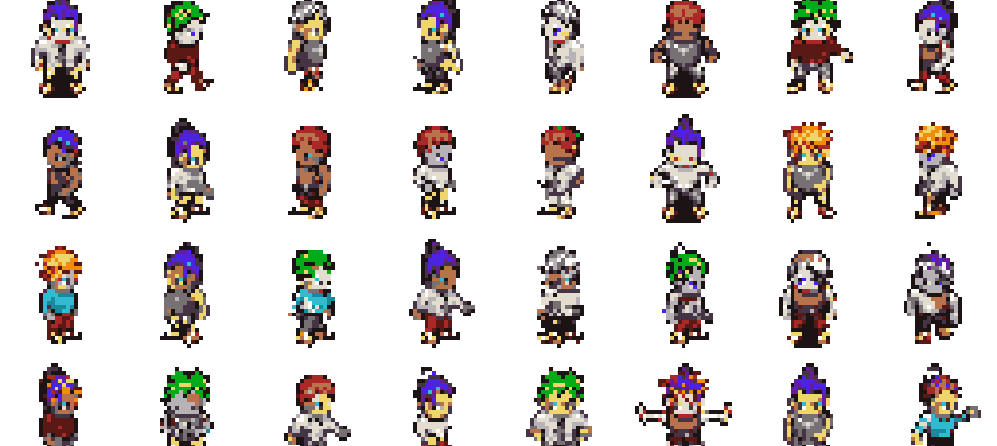
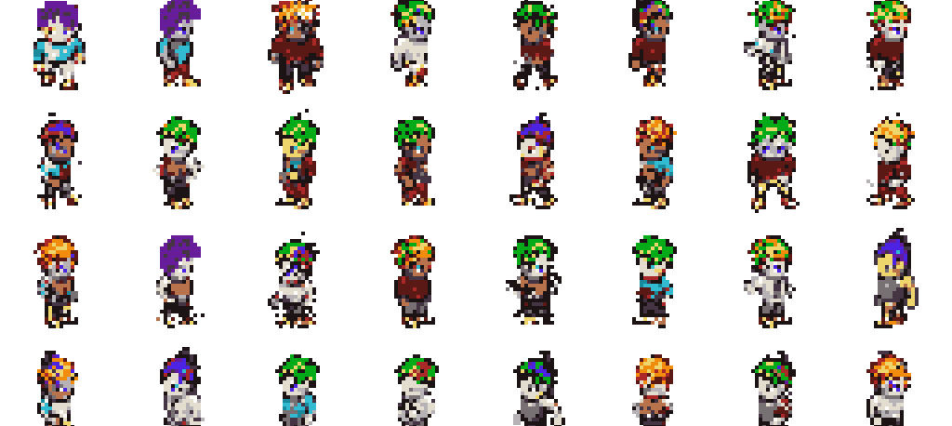
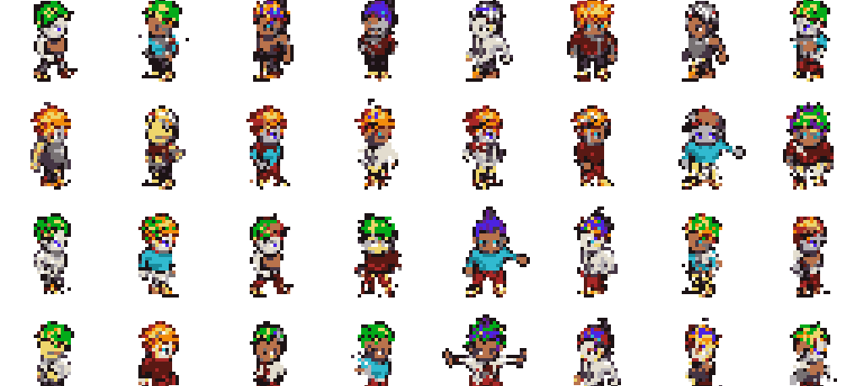
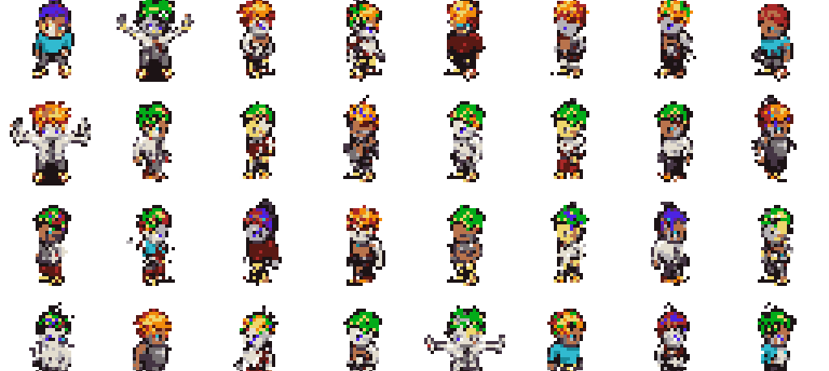
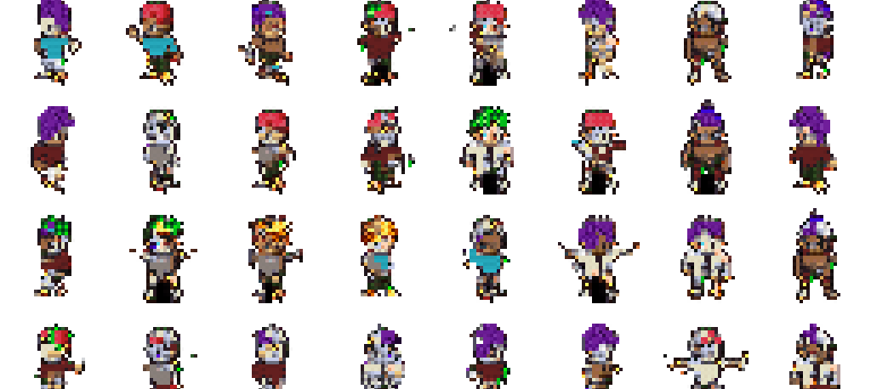
INTERNAL SAMPLE COMPARISON
The selected model was chosen against several implemented branches, not one cherry-picked grid.
Real-only VAR
HMAR step=1
Generated-keep VAR
0.00147, main result
0.00189, close but behind
0.00157 self-reference; not direct real-val winner
Real + generated VAR
OpenGameArt-mixed VAR
Patch-VQ VAR
0.00755, larger data did not help
0.00778, public-data path worked but mismatched
0.04689, learned-token ablation was blockier
Read: these are qualitative examples tied to the model-decision table. Only the real-validation comparable branches should be used for the main winner claim.
Main: model samples
8/17 main

Slide 9
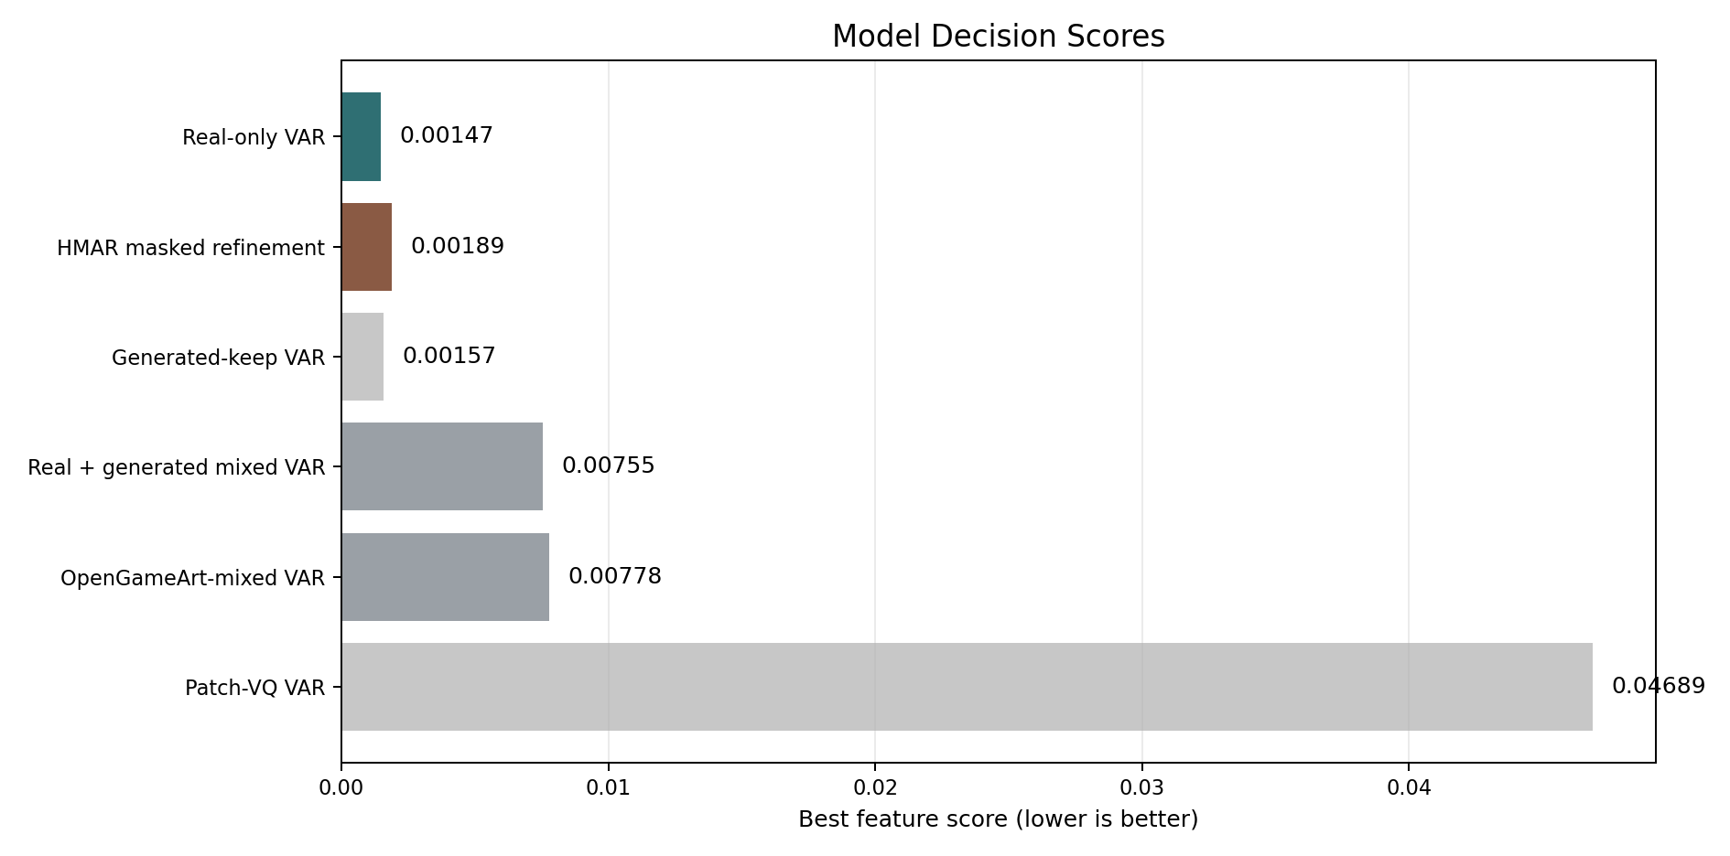
ABLATIONS
HMAR worked, but more refinement did not help.
PixelVAR main
0.00147
HMAR step 1
0.00189
HMAR step 2
0.00374
HMAR step 4
0.00366
HMAR step 8
0.00822
Branch
Decision
Generated/mixed data
larger data did not improve real-validation score
Main lesson: more refinement and more data were not automatically better in this low-resolution palette-token regime.
OpenGameArt mixed
pipeline useful, distribution mismatch
Patch-VQ
learned-token path worked but was blockier
P3 0:50 - ablations
9/17 main

Slide 10
PIXEL-ART DOMAIN METRICS: FULL INTERNAL TABLE
Palette consistency is perfect by construction; structure and exact-match metrics carry more interpretive weight.
Method
Palette
Opaque
Ref opaque
Edge
Ref edge
Unique colors
Pixel NN L2
Exact rate
PixelVAR main
1.0000
0.2276
0.2353
0.1802
0.1807
11.9294
5.2384
0.000732
HMAR step=1
1.0000
0.2269
0.2353
0.1809
0.1807
11.8301
5.2180
0.000488
Flat raster AR
1.0000
0.2321
0.2353
0.1790
0.1807
11.0378
3.4928
0.011230
Flat MaskGIT
1.0000
0.1942
0.2353
0.1631
0.1807
11.8718
9.5599
0.000000
How to read it
PixelVAR and HMAR match reference edge density closely. Flat AR has great-looking metrics partly because it reproduces data. MaskGIT under-fills sprites and loses coverage.
Domain metrics
10/17 main

Slide 11
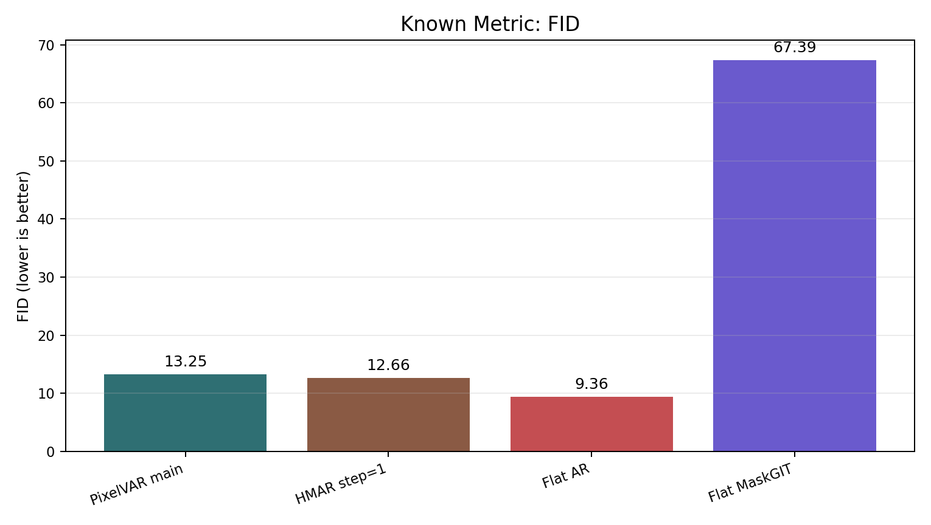
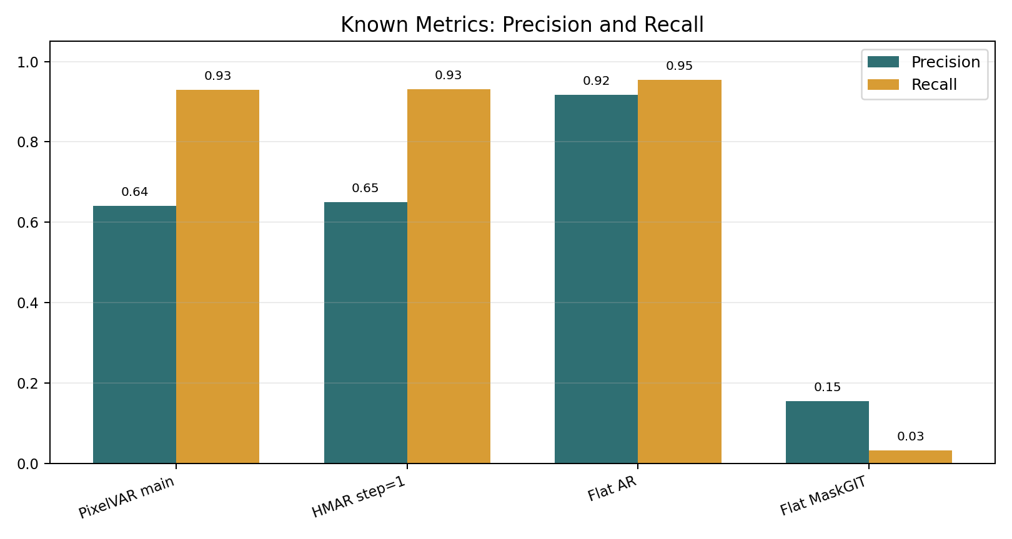
KNOWN IMAGE METRICS: FULL INTERNAL TABLE
Raw Inception metrics favor Flat AR, but that result is not trustworthy without the audit.
Method
FID
KID
Prec.
Recall
Density
Coverage
MS-SSIM
Exact rate
Flat raster AR
9.3558
0.002975
0.9172
0.9541
0.7654
0.8518
0.8281
0.0112
HMAR step=1
12.6555
0.005209
0.6494
0.9314
0.4136
0.6165
0.8309
0.0005
PixelVAR main
13.2516
0.006010
0.6406
0.9292
0.4093
0.6050
0.8323
0.0007
Flat MaskGIT
67.3908
0.061825
0.1545
0.0317
0.0455
0.0454
0.9426
0.0000
Conservative reading: HMAR and PixelVAR are the strongest non-memorizing candidates measured; PixelVAR wins sprite-feature, HMAR slightly wins some Inception metrics.
Known metrics
11/17 main

Slide 12
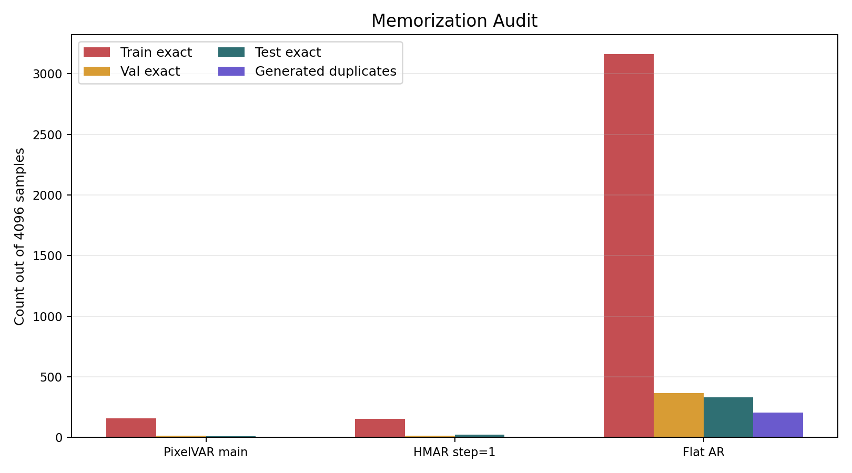
METRICS + AUDIT
Raw FID would pick Flat AR; the exact-match audit changes the conclusion.
Method
FID
Val exact
Test exact
Audit-adjusted read
Flat raster AR
9.36
365
333
memorizing
HMAR step=1
12.66
15
22
keep, disclose
PixelVAR main
13.25
13
11
keep, main result
Flat MaskGIT
67.39
0
0
weak coverage
The dataset had zero cross-split exact duplicate hashes, so held-out exact matches are not explained by simple split leakage.
P3 1:10 - centerpiece result
12/17 main

Slide 13
EXPANDED METRIC SCOREBOARD
More metrics make the conclusion stronger only when the audit is included.
Internal model
Feat.
FID
KID
Prec.
Rec.
Cov.
MS
Exact
Read
PixelVAR main
0.00147
13.25
0.00601
0.641
0.929
0.605
0.832
13 val / 11 test
main selected branch
HMAR step=1
0.00189
12.66
0.00521
0.649
0.931
0.616
0.831
15 val / 22 test
close non-memorizing branch
Flat AR
-
9.36
0.00298
0.917
0.954
0.852
0.828
3162 train; 365 val; 333 test
raw-metric winner, audit failure
Flat MaskGIT
-
67.39
0.06183
0.155
0.032
0.045
0.943
0 exact
weak coverage
External row
N
FID
KID
Prec.
Rec.
Cov.
MS
Read
PixelVAR paired
256
46.48
0.00748
0.910
0.871
0.891
-
same sample count reference row
Pokemon LoRA
256
154.02
0.13659
0.117
0.121
0.051
0.542
best practical external visual row
SSD-1B diffusion
256
158.58
0.10216
0.055
0.492
0.035
0.411
recognizable sometimes, low precision
SD-piXL
16
497.71
0.51765
0.000
0.000
0.000
0.493
targeted attempt, failed adapted protocol
Do not compare every row as apples-to-apples: internal rows use the 4096-image known-metrics audit; external rows are normalized image-folder comparisons with different sample counts.
Main: metric results
13/17 main

Slide 14
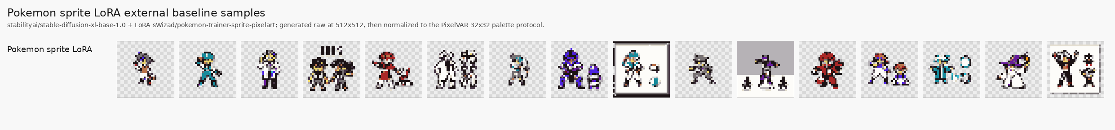
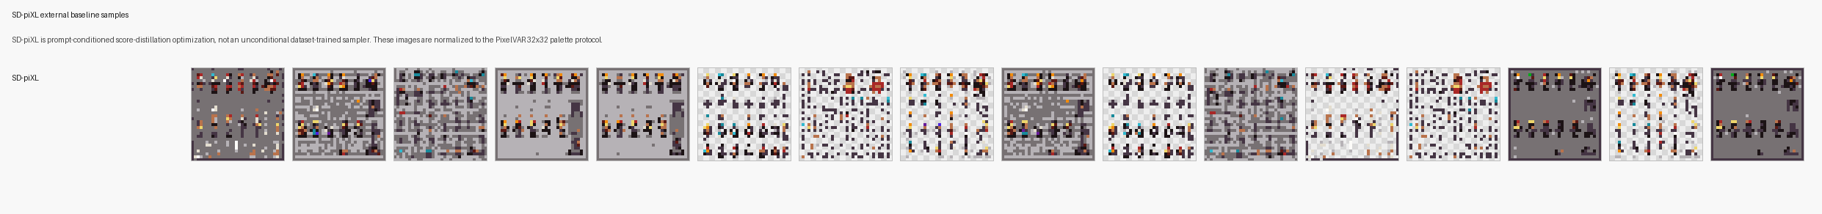
EXTERNAL BASELINES
External generators failed the normalized 32x32 sprite protocol.
PixelVAR 256
46.5
PixelVAR
clean
Pokemon LoRA 256
154.0
SSD-1B diffusion 256
158.6
SD-piXL 16
497.7
FID lower is better
Pokemon
frames
PixelVAR 256
0.891
Pokemon LoRA 256
0.051
SSD-1B diffusion 256
0.035
SD-piXL 16
0.000
SD-piXL
failure
Coverage higher is better
We do not claim perfectly equal baselines. The safe claim is narrower: accessible diffusion-style baselines did not beat PixelVAR under our normalized 32x32 RGBA protocol.
P3 0:55 - external baselines
14/17 main

Slide 15
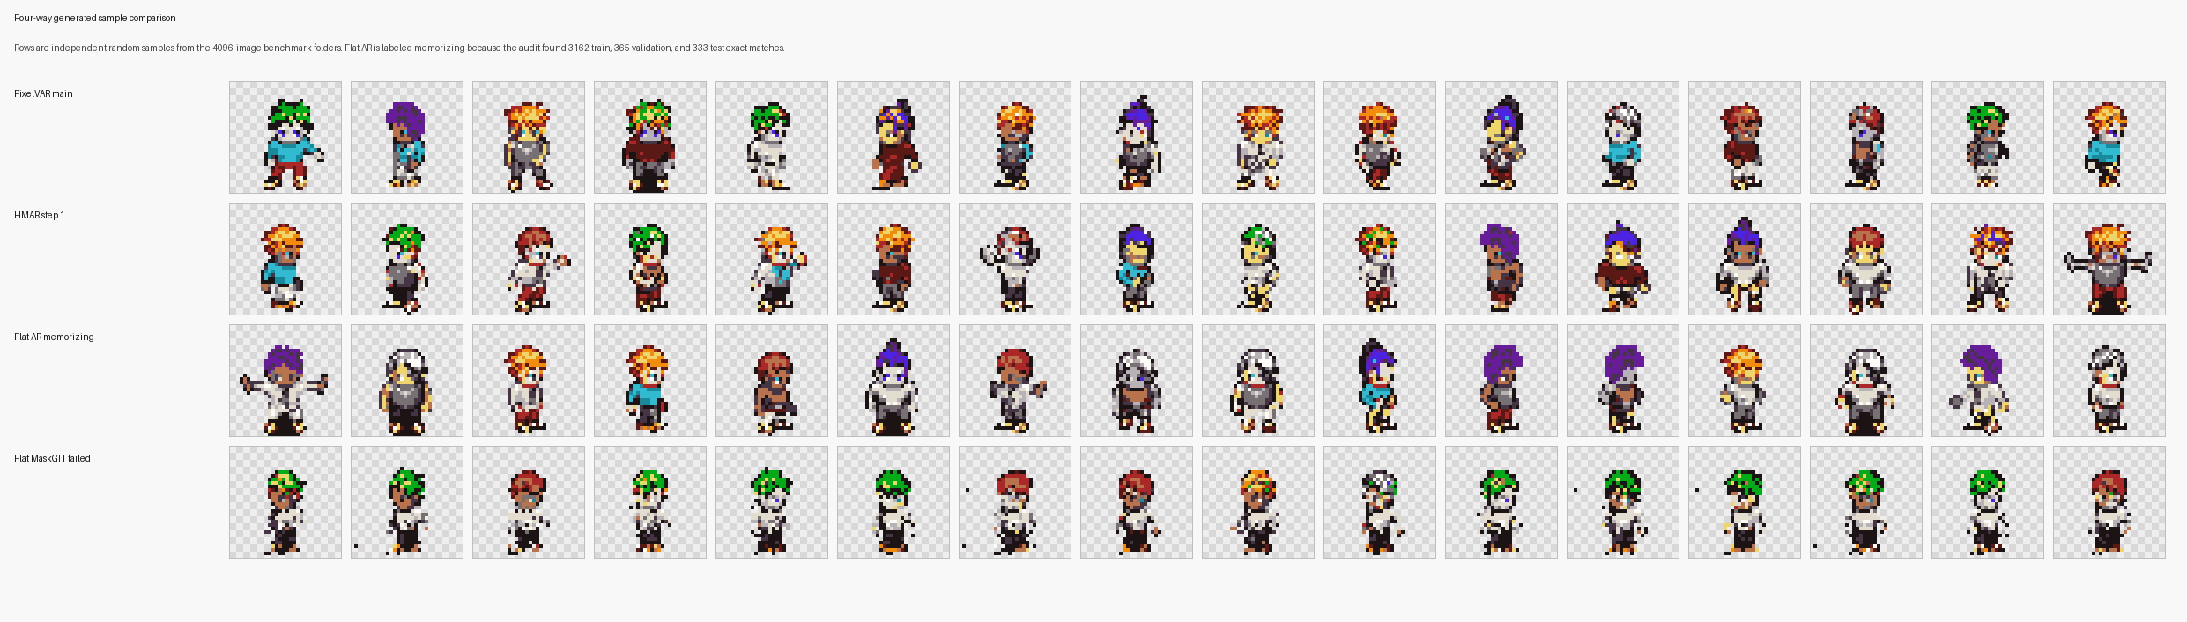
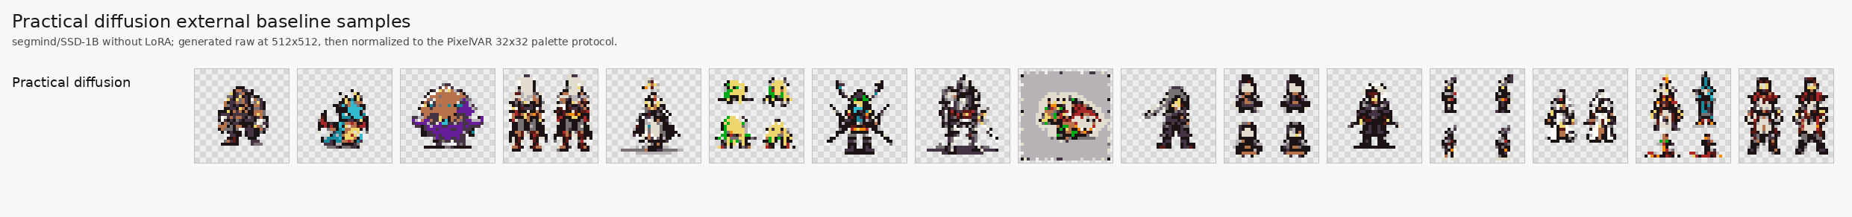
BASELINE SAMPLE COMPARISON
The visuals explain why the metric table needs audit and task-fit caveats.
Internal baselines
PixelVAR and HMAR both produce coherent sprites. Flat AR looks deceptively good but memorizes. Flat MaskGIT has poor coverage and repeated forms.
SD-piXL: tiled/noisy failure
SSD-1B: recognizable sometimes
Pokemon LoRA: best visual external row
Safe read: external rows are useful pressure tests, not perfectly equal architecture comparisons. PixelVAR still wins the normalized 32x32 protocol rows.
Main: baseline samples
15/17 main

Slide 16
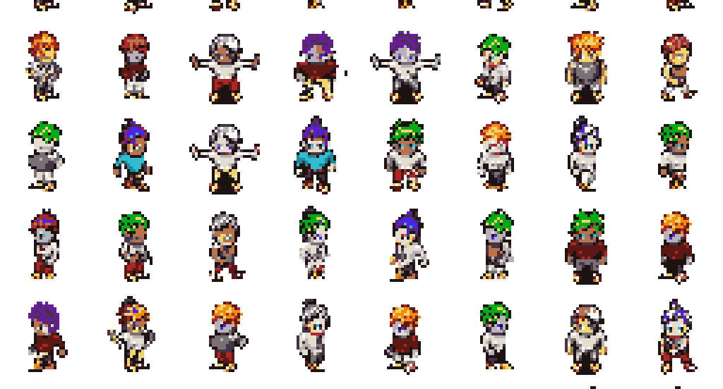
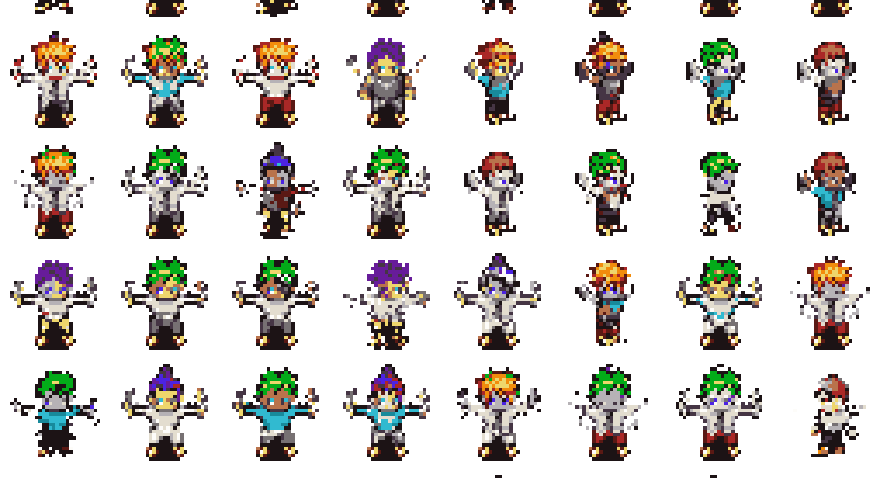
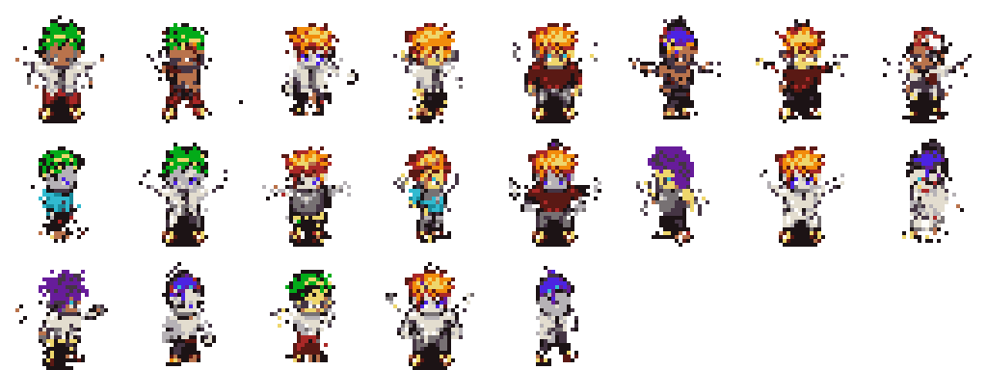
SCALE RESULT
A 170K generation pass shows the sampler remained stable at proposal scale.
170,000
161,479
8,500
21
generated samples
automatic keep
review bucket
reject bucket
94.99%
5.00%
0.01%
This is not a human preference study. It only shows the sampler stayed stable at the proposal-scale generation volume and that the automatic gate found very few obvious rejects.
P3 0:30 - generation scale
16/17 main

Slide 17
LIMITATIONS AND NEXT PROOF
The final claim is intentionally narrow: strong 32x32 palette-token generation with audit-aware evaluation.
Finished
Not finished
Next proof
VAR main model, HMAR refinement path, Flat AR/MaskGIT baselines, known metrics, memorization audit, external attempts, and 170K generation.
User study, completed 8/32 palette metrics, completed 4-scale metrics, and 64x64 generation. These are not claimed as results.
Run remaining ablations, inspect metrics and sample sheets, collect user study, then revisit 64x64 once the 32x32 story is finished.
Use this as the close: strong 32x32 result, honest limits, and clear next proof.
Safe claim boundary
What to say
Main claim
strongest completed comparable proposal branch on our sprite-feature evaluator
Audit claim
raw FID promotes Flat AR, but exact-match audit shows memorization
External claim
accessible diffusion-style baselines did not beat PixelVAR under normalized 32x32 protocol
SOTA claim
do not claim broad SOTA
P1 0:55 - close
17/17 main

