Slide 1


HIDDEN BRAIN
1905071 – Tareq Ahmed
1905072 – Mahir Labib Dihan

Slide 2
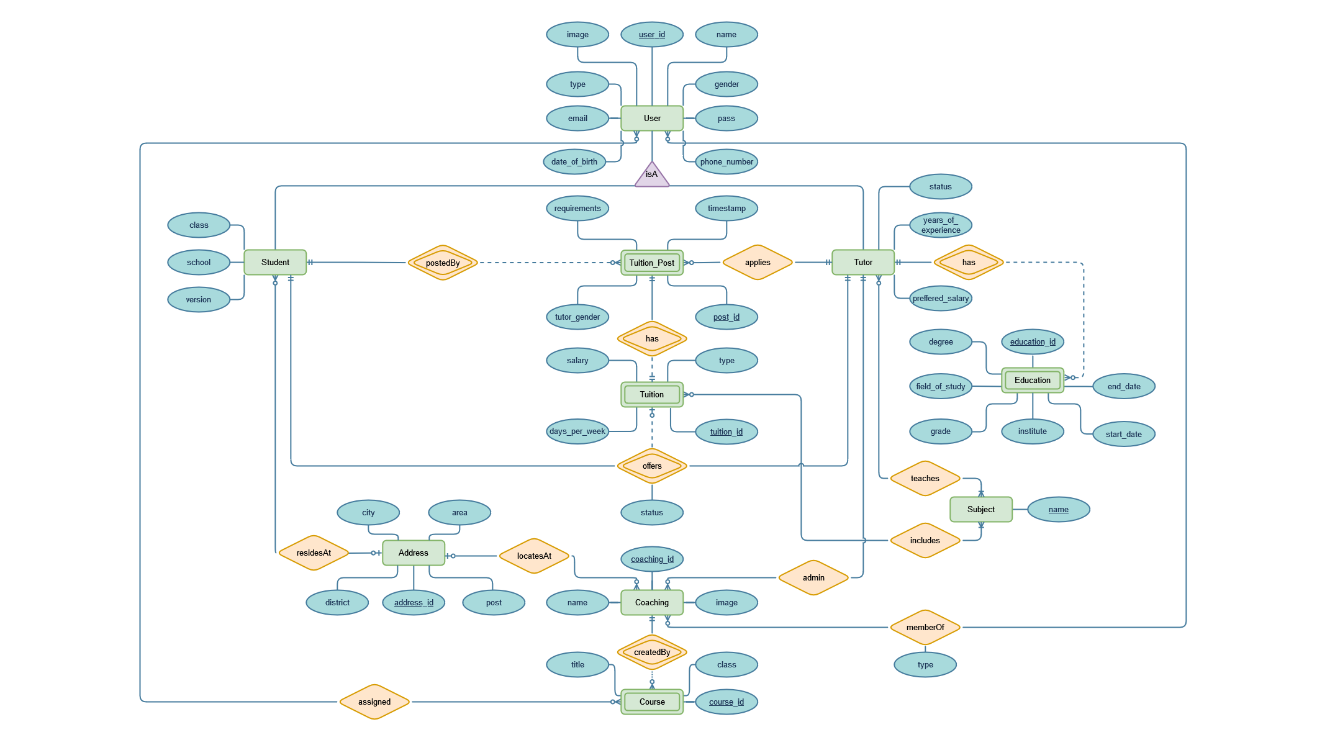

Slide 3

Entities:
User (user_id, name, email, pass, image, gender, type, phone_number, date_of_birth)
Student (student_id, school, version, class, address_id)
Tutor (tutor_id, status, years_of_experience, preferred_salary)
Tuition_Post (post_id, student_id, tuition_id, timestamp, desired_tutor_gender)
Tuition (tuition_id, salary, days_per_week,type)
Coaching (coaching_id, image, name)
Course (course_id, coaching_id, title, class)
Address (address_id, city, district, area, post)
Education (education_id, tutor_id, degree, field_of_study, grade, institute, start_date, end_date)
Subject (name)

Slide 4
Relations:
offers (student_id, tutor_id, tuition_id, status)
memberOf (user_id, coaching_id, type)
assigned (tutor_id,course_id)
applies (tutor_id,post_id)
teaches (tutor_id,sub_name)
includes (tuition_id,sub_name)

Slide 5
Student:
Create profile, edit profile, add profile picture, change password etc.
Post tuition requests and offer tuition to interested tutors.
Search for tutors and offer them tuitions or cancel tuition offers.
Search for coachings, send request to join as a student or cancel join request.
See list of tutors and coachings.
See list of courses assigned by coachings.

Slide 6
Tutor:
Create profile, edit profile, add profile picture, change password, add educational qualification etc.
See all tuition posts and apply to them.
Get tuition offers and accept/reject them.
Search for coachings, send request to join as a tutor or cancel join request.
See list of students and coachings.
See list of courses assigned by coachings.

Slide 7
Coaching:
Tutors can create coachings and became its admin.
Admin can approve join requests of students and tutors in his coaching. Can remove them if they want.
Admin can create/delete courses and assign courses to students and tutors.
List of courses offered by the coaching.
List of students-tutors studying/teaching in the coaching.

Slide 8
THANK YOU

