Slide 1
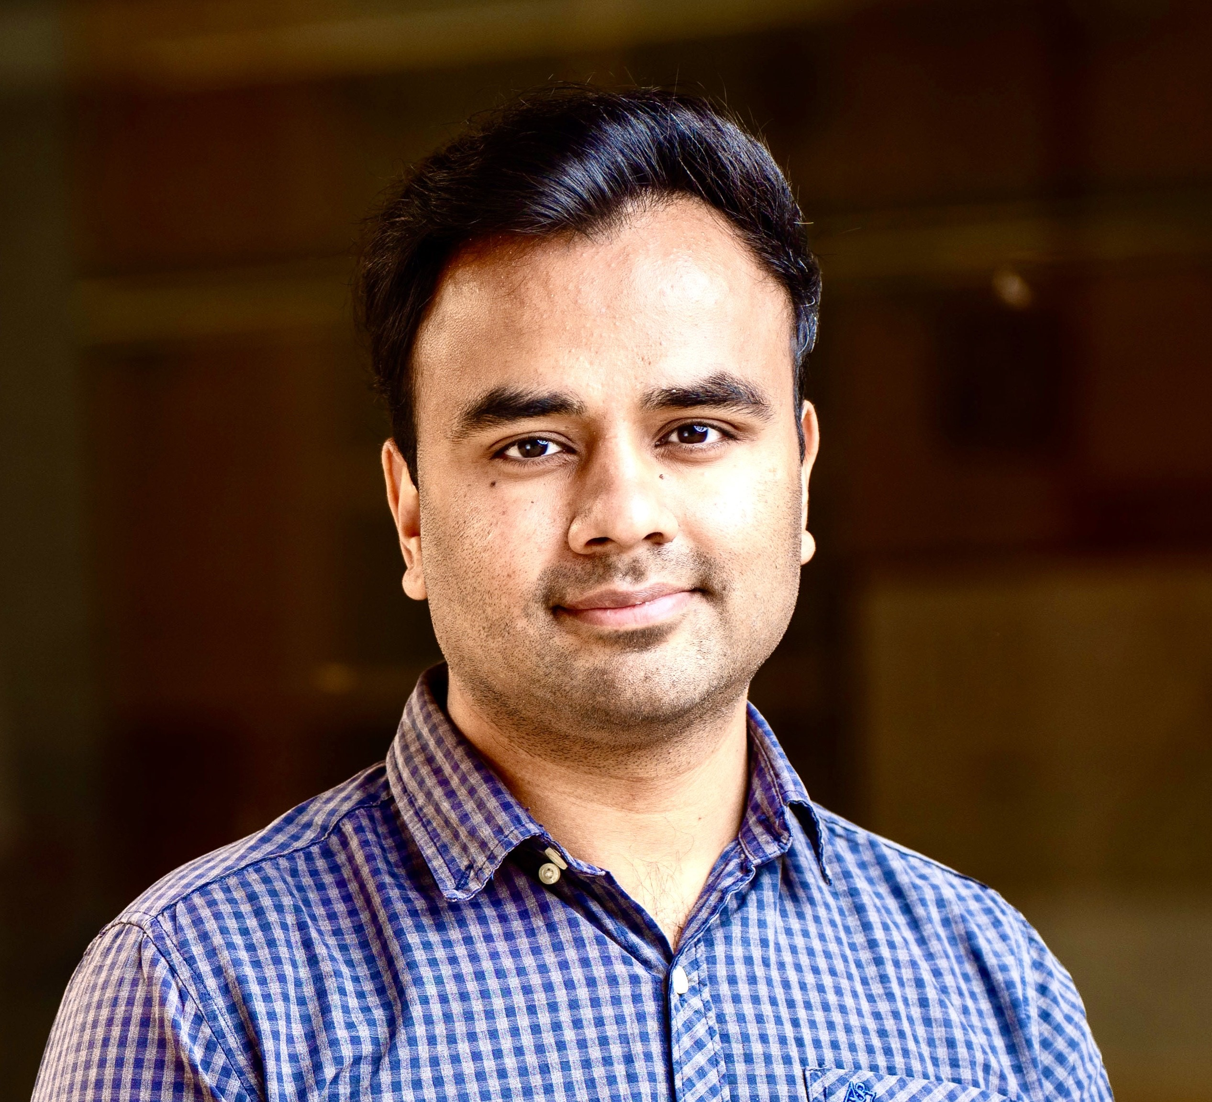










Hussain Ahmad
PhD in Software Security and Scalability
Cybersecurity
Software Engineering
Cloud Computing
Machine Learning
Electronic Engineering
Self-Adaptive Systems

Slide 2
PhD Research
Research Area: Towards Self-Adaptive Cybersecurity and Scalability in Software Engineering

Slide 3
Industry Experience
Chief Project Officer
Providing consultation in Cybersecurity and AI for ICT projects, having secured an AUD 100k Seed-Start grant from the Department of State Development to enhance digital operations through advanced R&D and technology integration.

Slide 4
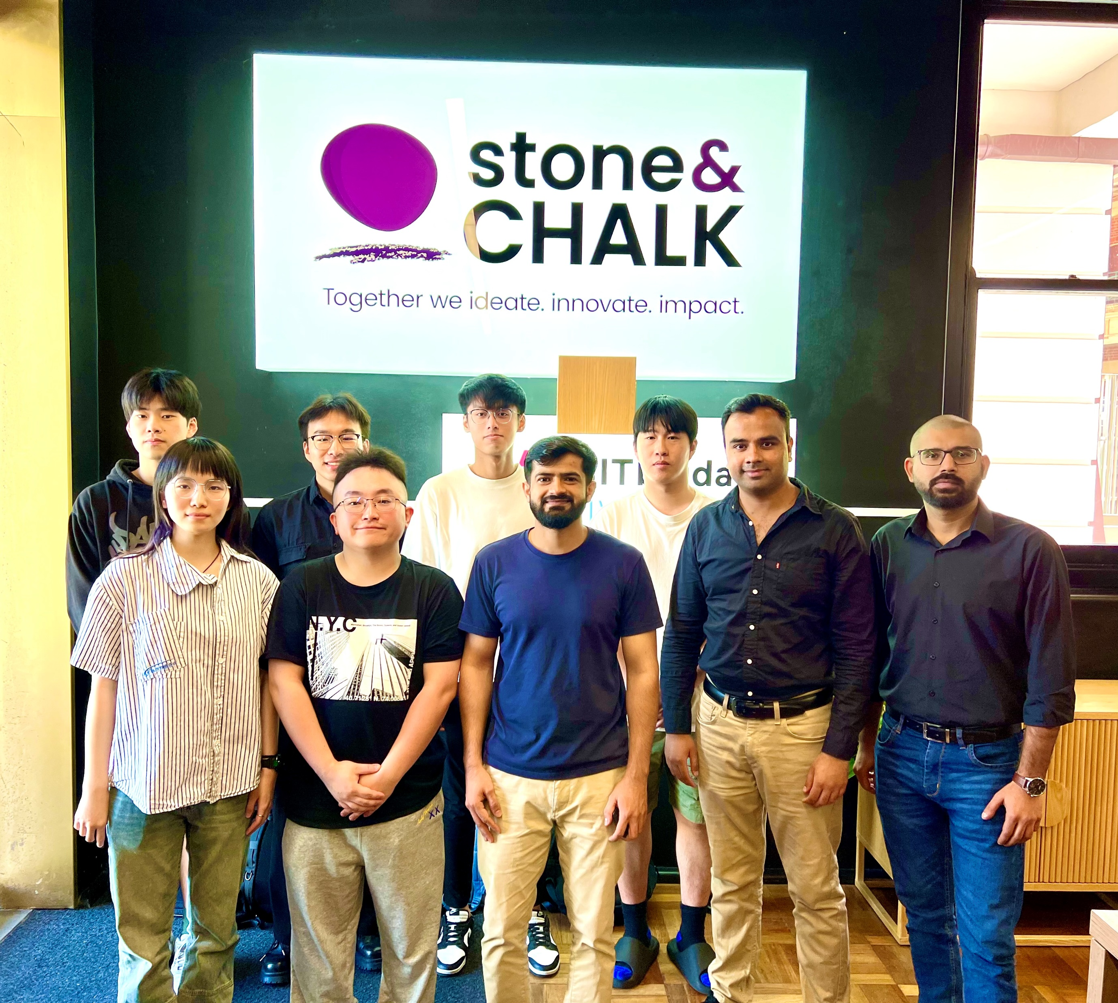
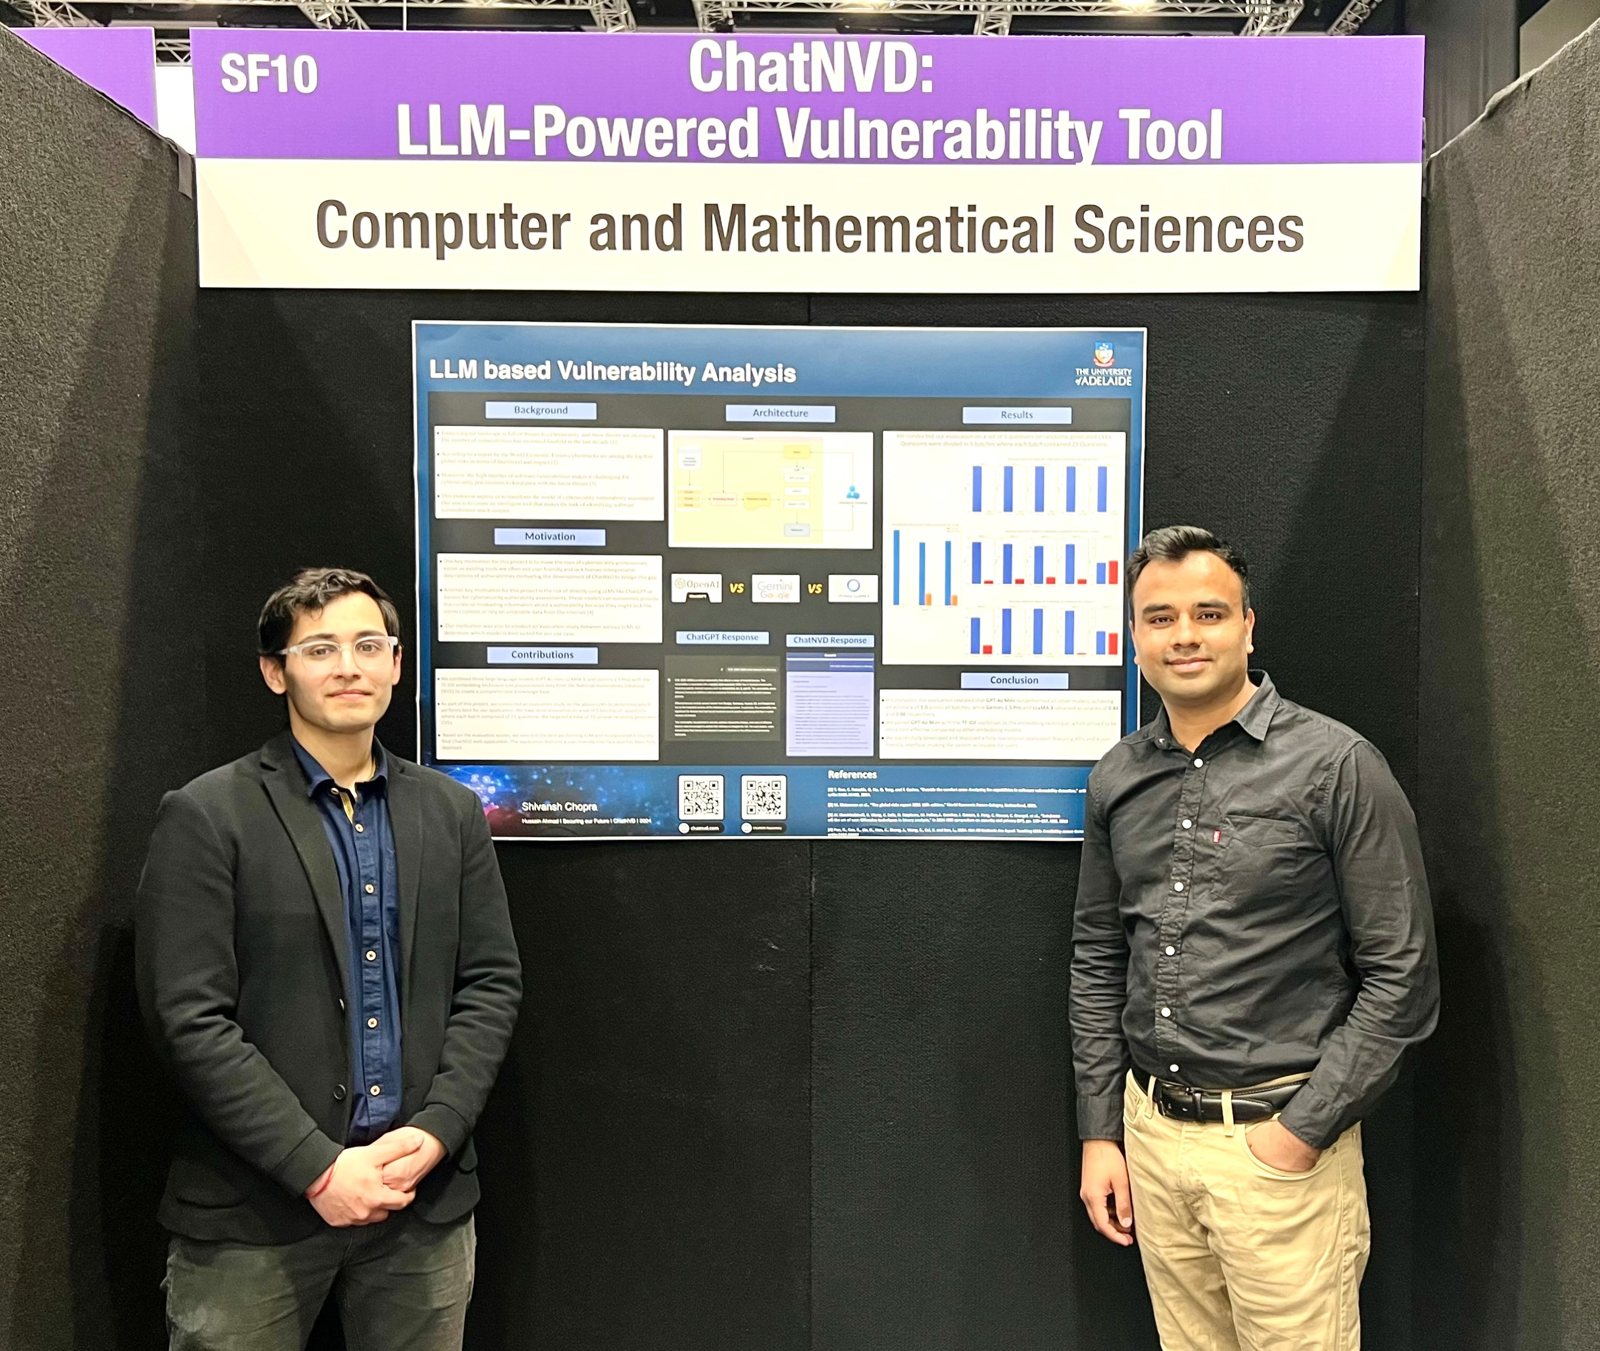
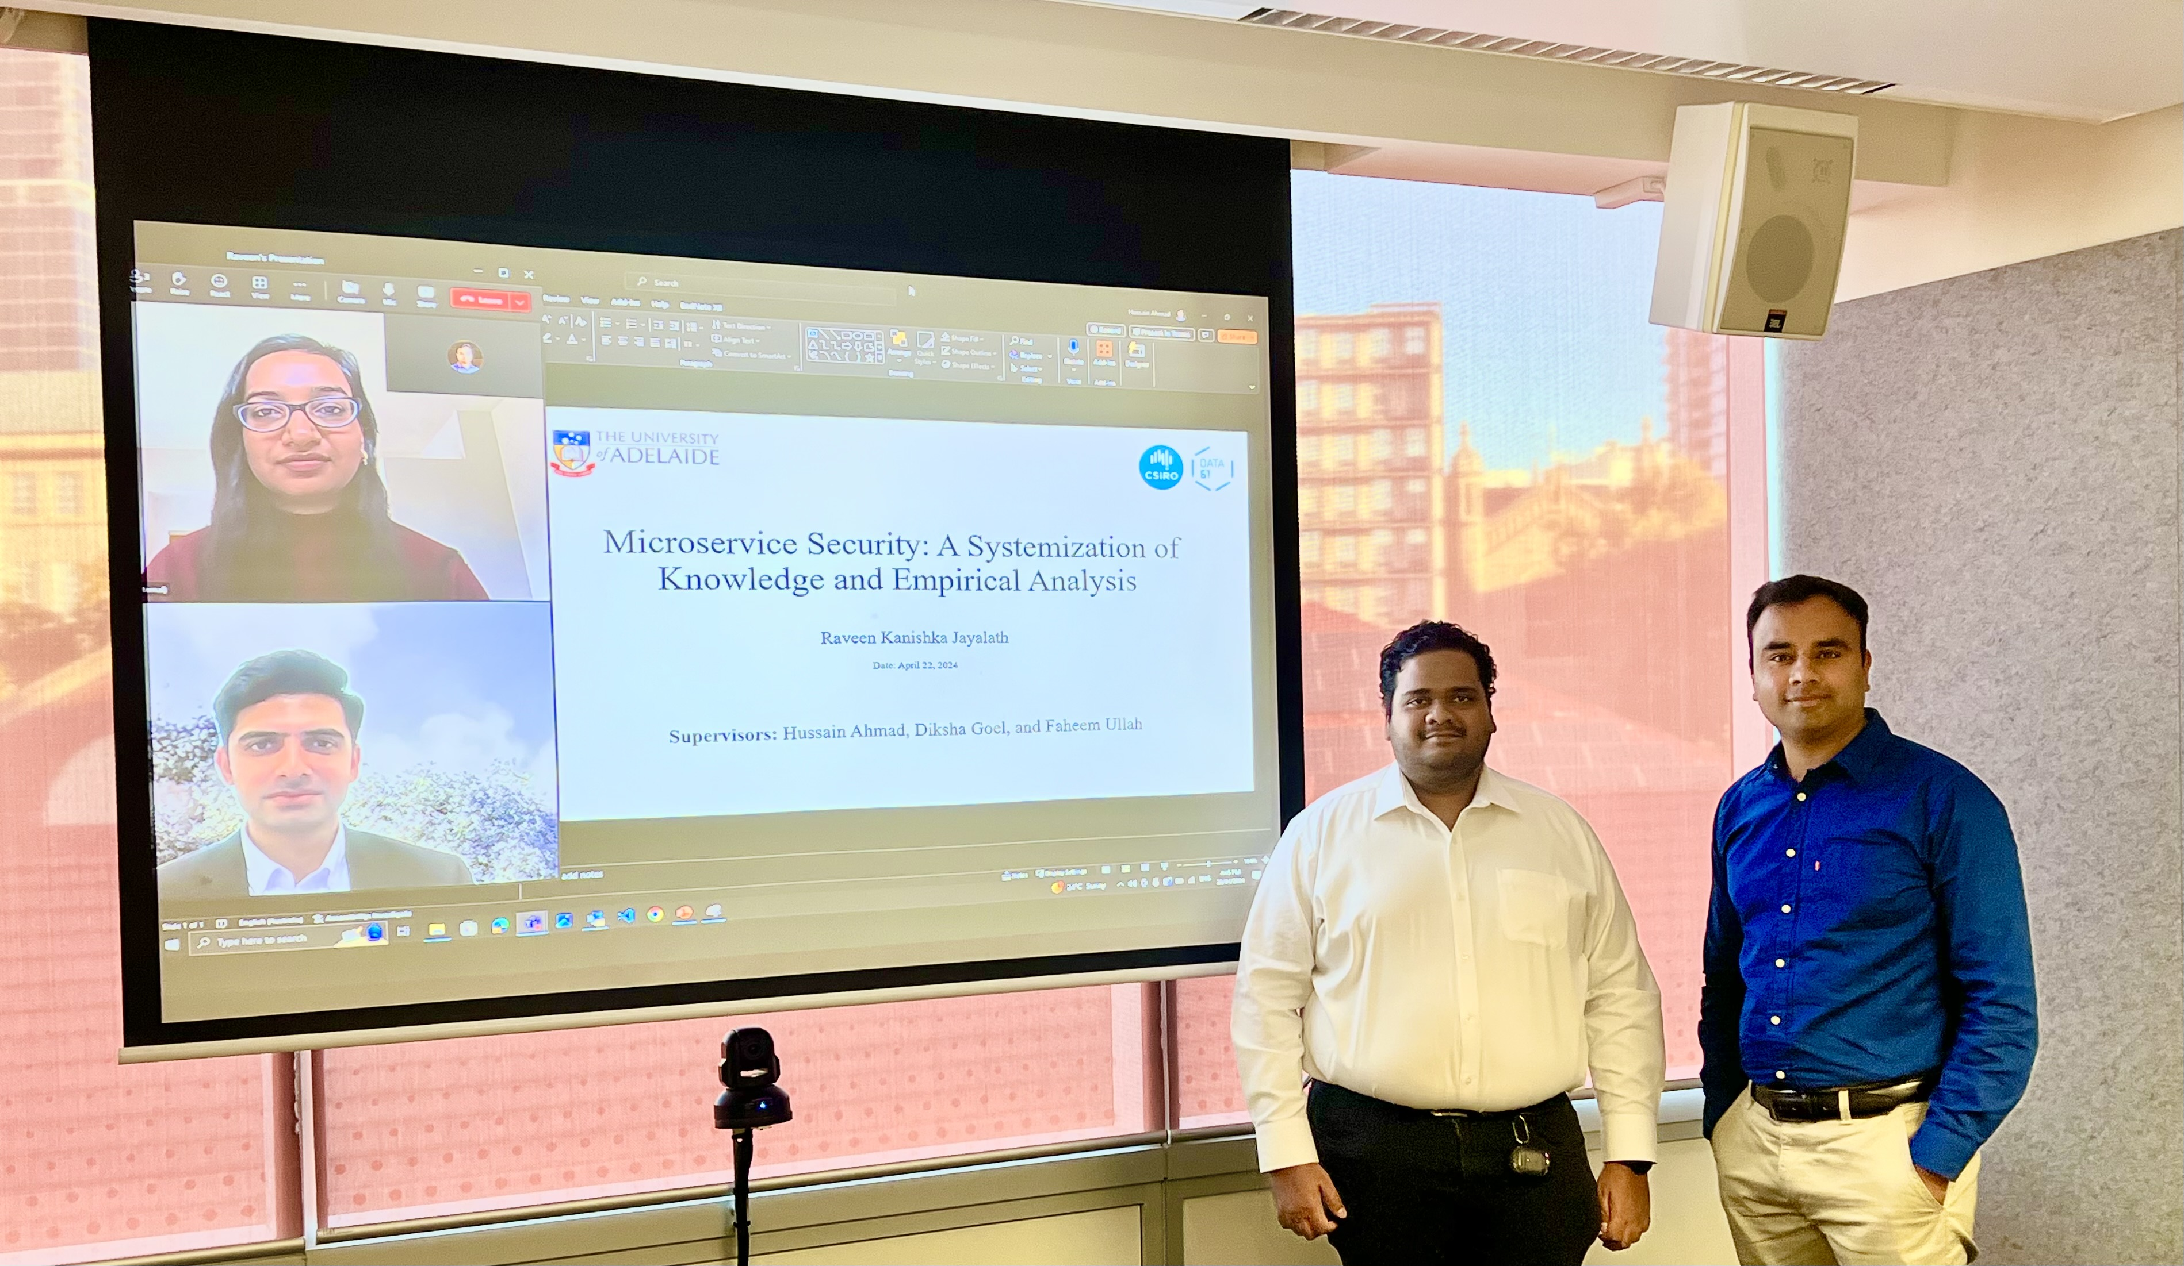
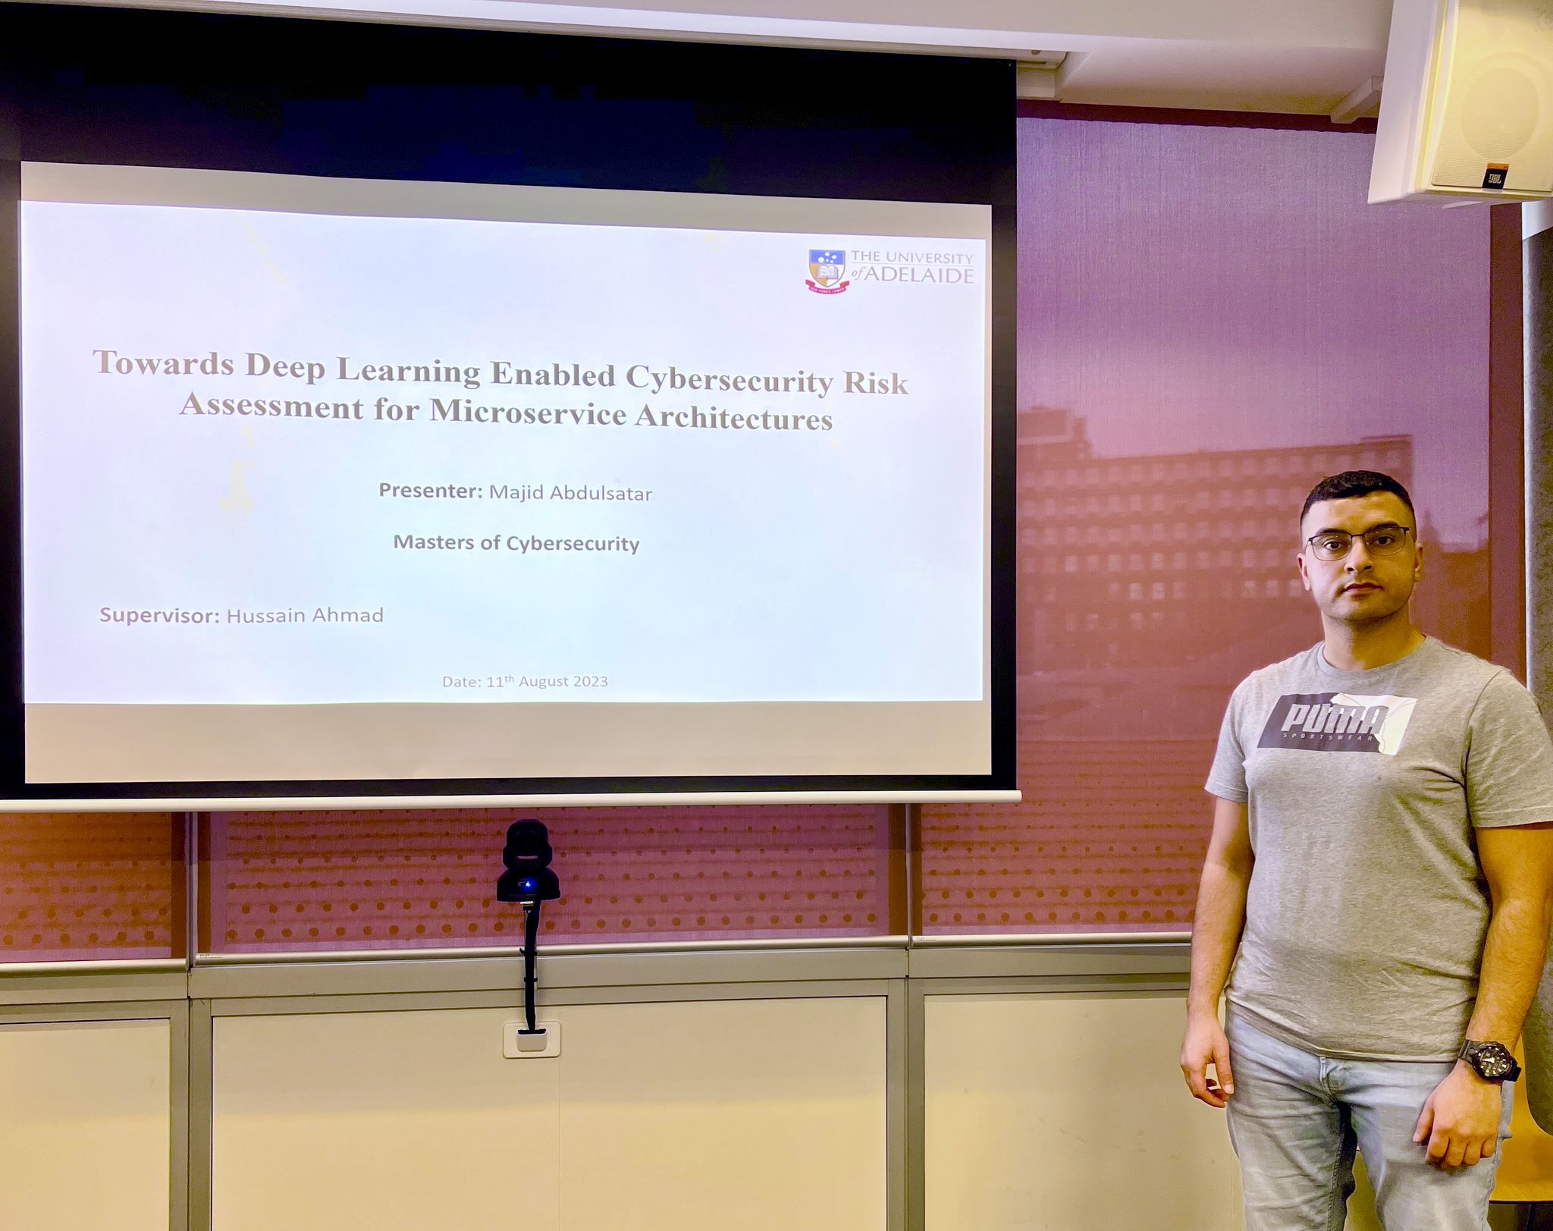
Supervisory Activities

Slide 5
Leadership Roles

Slide 6
Awards and Achievements

