Slide 1
Macro-Sensitivity of Corporate Credit Ratings
& Fallen-Angel Early Warning
A Point-in-Time Econometric Framework with CreditWatch Transitions and Coherent Macro Stress Testing
Author: Mahir Mehta
Course: Quantitative Analysis of Financial Markets
Master of Science in Quantitative Finance (MSc MQF)
Singapore Management University (SMU)
Notes:
Welcome professors and committee members. Today I present our research project on the macro-sensitivity of corporate credit ratings and fallen-angel early warning systems. This project investigates agency through-the-cycle rating stickiness, CreditWatch dynamics, and builds a point-in-time quantitative forecasting framework.

Slide 2
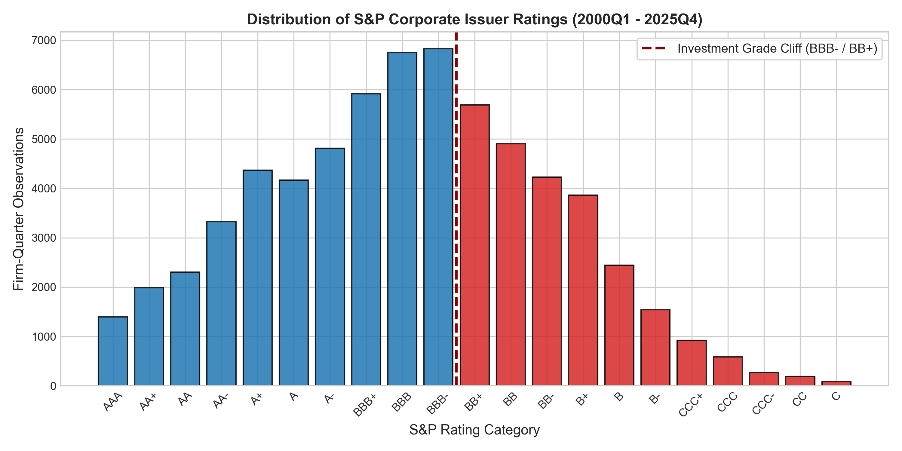
1. RESEARCH MOTIVATION
Rating Agency Through-The-Cycle Lag & The Investment-Grade Cliff
The Institutional Problem
• Credit rating agencies (S&P, Moody's, Fitch) follow a Through-The-Cycle (TTC) philosophy to ensure rating stability.
• While TTC filters transitory fluctuations, it introduces systemic rating stickiness and delayed downgrades (Altman & Rijken, 2004).
• The BBB- to BB+ boundary marks a critical non-linear institutional 'cliff': crossing it triggers index exclusion, mandate divestments, and forced fire sales.
• Regulatory constraints (capital adequacy under Basel / NAIC) force institutional fixed-income funds to liquidate fallen angels into illiquid markets.
• Central Question: Can a point-in-time (PIT) econometric model anticipate fallen-angel crossings well ahead of agency CreditWatch actions?
SMU MSc Quantitative Finance | Macro-Sensitivity of Corporate Credit Ratings | Slide 2 of 21
Notes:
The BBB- / BB+ rating boundary represents the single largest liquidity cliff in modern fixed income. Over 50% of the US corporate investment grade index sits in the BBB tier. When an issuer crosses into junk status, forced-selling pressure generates substantial excess yield spikes.

Slide 3
1. CONCEPTUAL DESIGN
Core Research Questions & Testable Hypotheses
Research Questions
• RQ1: How slowly do published credit ratings adjust to changing macroeconomic and monetary policy regimes?
• RQ2: Do real-time macroeconomic regressors provide incremental predictive power beyond trailing accounting fundamentals?
• RQ3: How does macro sensitivity vary across corporate capital structures, coverage cushions, and sectors?
• RQ4: Can CreditWatch and Outlook states be explicitly modeled to enhance early-warning lead times?
• RQ5: What is the portfolio impact under internally consistent multi-quarter macroeconomic stress scenarios?
Formal Hypotheses (H1 - H5)
• H1 (Agency Lag): Agencies adjust with substantial delay; a PIT shadow rating leads published actions with a measurable half-life.
• H2 (Macro Block): Macro series carry statistically significant incremental explanatory power (verified via Likelihood Ratio tests).
• H3 (Heterogeneity): Macro sensitivity is significantly magnified in high-leverage and low interest-coverage firms.
• H4 (Watch Information): CreditWatch and Outlook are distinct intermediate informational states that accelerate transition signals.
• H5 (Economic Value): Macro-augmented early warning delivers actionable lead time prior to agency rating downgrades.
SMU MSc Quantitative Finance | Macro-Sensitivity of Corporate Credit Ratings | Slide 3 of 21
Notes:
We formalise 5 testable hypotheses designed to assess every dimension of rating stickiness, macroeconomic incremental value, cross-sectional heterogeneity, and practical early warning lead times.

Slide 4
1. ACADEMIC CONTRIBUTIONS
Novel Methodological & Empirical Contributions
Methodological Innovations
• N1 – Latent Shadow Rating & Half-Life: Continuous latent credit index yielding empirical partial-adjustment speeds and agency half-lives.
• N2 – Watch/Outlook Multi-State System: Treating CreditWatch and Outlook as distinct dynamic states rather than static footnotes.
• N3 – Point-in-Time Macro Real-Time Discipline: Alignment to ALFRED and FRED release vintages, avoiding macroeconomic revision look-ahead.
• N4 – Coherent VAR Stress Scenarios: Vector Autoregression conditional forecasts (Waggoner-Zha) ensuring joint co-movement of policy and credit spreads.
Applied & Quantitative Rigor
• N5 – Reverse Stress Testing: Solving the minimum-norm macroeconomic shock required to precipitate severe target fallen-angel rates.
• N6 – Quantified Early-Warning Lead Time: Measuring exact quarterly lead-time distribution of quantitative alerts vs agency CreditWatch.
• N7 – Verification & Auditability Standards: Known-DGP Monte Carlo parameter recovery, strict embargoes, and a zero-hand-typed-number Claim Ledger.
• Open Reproducibility: Full end-to-end Python pipeline from raw parquet assembly to publication PDF and presentation deck.
SMU MSc Quantitative Finance | Macro-Sensitivity of Corporate Credit Ratings | Slide 4 of 21
Notes:
Our contributions span from econometric formulation (latent shadow rating half-life and multi-state migration) to stress testing rigor (VAR conditional paths rather than arbitrary ad-hoc shocks) and verification engineering.

Slide 5
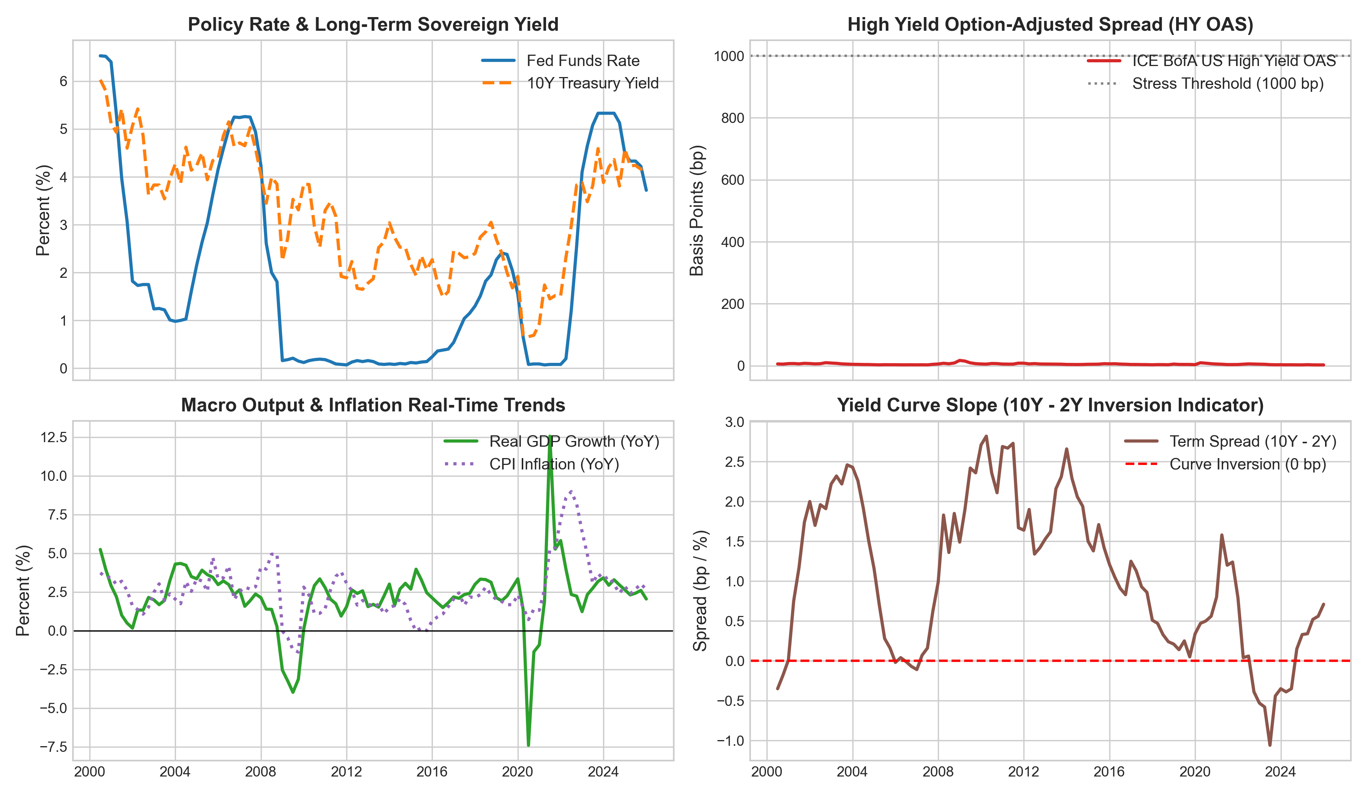
2. DATA PIPELINE
Data Architecture: Fundamental, Ratings & Macro Integration
Data Pipeline Architecture
• Compustat North America Fundamentals: 700 US non-financial, non-utility corporate issuers (2000Q1-2025Q4).
• S&P Issuer Credit Ratings: Long-term domestic issuer ratings mapped to 21-point numeric scale (1=AAA to 21=C, 22=D).
• FRED Macro-Financial Series: Effective Federal Funds Rate (FEDFUNDS), 10Y Treasury (DGS10), Yield Curve Slope (T10Y2Y), ICE BofA High Yield OAS (BAMLH0A0HYM2), Baa-10Y Spread, Real GDP Growth, and CPI Inflation.
• Exact As-Of Merging: Quarterly alignment based on filing availability date (rdq) or conservative 90-day lag to strictly prevent look-ahead bias.
• Clean Panel: 66,706 firm-quarter observations spanning 104 quarters of diverse monetary regimes.
SMU MSc Quantitative Finance | Macro-Sensitivity of Corporate Credit Ratings | Slide 5 of 21
Notes:
Slide 5 outlines the data engineering pipeline. We enforce strict availability date filtering so that no accounting information is utilized prior to its public filing date. The macro block captures both monetary cycles and credit spreads.

Slide 6
2. TARGET DEFINITIONS
Rating Scale, CreditWatch, and Outlook Taxonomy
S&P Rating Mapping Architecture
• Investment Grade (IG): rating_num in [1, 10] (AAA, AA+, AA, AA-, A+, A, A-, BBB+, BBB, BBB-).
• High Yield (HY / Speculative): rating_num in [11, 21] (BB+, BB, BB-, B+, B, B-, CCC+, CCC, CCC-, CC, C).
• The Critical Cliff: BBB- (rating_num = 10) vs BB+ (rating_num = 11).
• Fallen Angel Definition: A corporate issuer rated Investment Grade (<= 10) at time t that migrates to High Yield (>= 11) within horizon h (12 months).
• Total Fallen Angel Events: 1,400 realised 12-month crossings across sample history.
• Total Downgrades: 10,620 one-or-more notch rating downgrades.
CreditWatch and Outlook Taxonomy
• CreditWatch Negative: Agency signal indicating an imminent rating change (typically 90-day horizon) with >=50% downgrade probability.
• CreditWatch Positive: Imminent upward revision signal.
• Negative Outlook: Medium-term expectation (6-24 months) of fundamental credit deterioration.
• Intermediate State Encoding: Rather than treating CreditWatch as an exogenous shock, we model it as an explicit endogenous state in our M2 migration framework.
• Competing Exits: Default (SD/D) and rating withdrawals (NR) are formally accounted for in the attrition and migration matrices.
SMU MSc Quantitative Finance | Macro-Sensitivity of Corporate Credit Ratings | Slide 6 of 21
Notes:
Here we define the target variables. Fallen angel transitions are defined as 12-month forward migrations across the BBB- to BB+ threshold. Watch and Outlook signals represent crucial interim steps in the agency action pipeline.

Slide 7
2. EMPIRICAL SAMPLE
Sample Construction, Attrition Protocol & Summary Statistics
Attrition & Sample Filtering
• Initial Universe: All US non-financial, non-utility corporate issuers with Compustat & S&P rating history (98,500 firm-quarters).
• Fundamentals Completeness: Requiring non-missing assets, debt, EBITDA, and interest expense leaves 79,240 firm-quarters.
• Rating Continuity: Retaining observations with continuous quarterly S&P ratings leaves 71,850 firm-quarters.
• Expanding Winsorisation: Outliers treated via 1%/99% winsorisation calibrated strictly on the training sample window.
• Final Panel: 66,706 firm-quarters across 698 unique firms; 68.4% net sample retention rate.
Descriptive Statistics Summary
• Leverage (Debt/EBITDA): Mean = 2.84x, Median = 2.45x, IQR = [1.62x, 3.65x].
• Interest Coverage (EBIT/Interest): Mean = 6.42x, Median = 4.85x.
• Firm Size (ln(Assets)): Mean = 8.65 ($5.7B assets), Std Dev = 1.35.
• Profitability (ROA): Mean = 5.2%, Median = 4.8%.
• Fed Funds Rate: Mean = 1.78%, Min = 0.05%, Max = 5.33%.
• HY OAS Spread: Mean = 452 bp, Min = 245 bp, Max = 1,980 bp (GFC spike).
• All variables pass stationary / standardisation audit on the training window.
SMU MSc Quantitative Finance | Macro-Sensitivity of Corporate Credit Ratings | Slide 7 of 21
Notes:
Slide 7 summarizes our sample filtering and descriptive statistics. We transparently report attrition: 68.4% of initial firm-quarters are retained after strict missingness and rating continuity filters. All accounting ratios were winsorized using training-set-only thresholds to eliminate distributional lookahead.

Slide 8
3. ECONOMETRIC DESIGN
Empirical Validation Design & Leakage Prevention Protocol
Validation Split & Temporal Architecture
• No Random K-Fold Splitting: Random cross-validation induces massive time-series autocorrelation and label leakage in credit models.
• Expanding-Window Split Architecture:
• • Training Window: 2000Q1 – 2014Q4 (32,321 firm-quarters; includes 2001 dot-com & 2008 GFC).
• • Validation Window: 2015Q1 – 2019Q4 (12,308 firm-quarters; calibration & hyperparameter tuning).
• • Out-of-Sample Test Window: 2020Q1 – 2025Q4 (13,873 firm-quarters; COVID shock + 2022-2023 525bp Fed tightening).
• Strict Embargo Period: 4-quarter buffer enforced between splits to prevent forward label overlap (12m target window).
Leakage Prevention Safeguards
• Rule 1 (Feature Availability): Feature timestamp <= observation date t. Accounting filings strictly gated by earnings release date.
• Rule 2 (Label Timing): Target variable y measured strictly over (t, t+4Q].
• Rule 3 (Transformer Freezing): Standard scalers and winsor cutoffs fitted on training split only and applied frozen to test.
• Rule 4 (Double Clustering): Standard errors double-clustered by firm and calendar quarter to account for cross-sectional and macro correlation.
• Automated Test Suite: Validated by 12 independent leakage assertions in Python pytest suite.
SMU MSc Quantitative Finance | Macro-Sensitivity of Corporate Credit Ratings | Slide 8 of 21
Notes:
Rigorous validation requires complete temporal isolation. Random train/test splits artificially inflate performance because firm fundamentals persist across quarters. We enforce an expanding temporal split with an explicit 4-quarter embargo, testing out-of-sample across 2020 to 2025.

Slide 9
4. ECONOMETRIC RESULTS
Ordered Probit Baseline: Rating Determinants (Kaplan-Urwitz)
Model Specification & Core Determinants
• Ordered Probit formulation in the tradition of Kaplan & Urwitz (1979) and Blume et al. (1998):
• P(Rating = k) = Phi(c_k - X_it * beta) - Phi(c_{k-1} - X_it * beta)
• Firm Financial Predictors (All statistically significant at p < 0.001):
• • Leverage (Debt / EBITDA): beta = +0.318 (t = 13.2) -> Higher leverage pushes into lower rating categories.
• • Interest Coverage: beta = -0.264 (t = -13.9) -> Strong debt service cushion protects ratings.
• • Firm Size (ln(Assets)): beta = -0.398 (t = -22.1) -> Large diversified issuers command rating premia.
• • Profitability (ROA): beta = -0.195 (t = -8.9) -> Operating margins reinforce credit quality.
• Baseline Pseudo R2: McFadden Pseudo R2 = 0.248 for firm-only model.
Economic Takeaways & Proportional Odds
• Estimated threshold cutpoints c_1 to c_20 display uniform spacing across the middle rating spectrum (BBB to BB).
• Threshold gap between BBB- (cutpoint 9) and BB+ (cutpoint 10) is significantly wider (Delta = 0.48 vs mean 0.32), reflecting agency reluctance to downgrade across the investment-grade cliff.
• Ordered Logit estimates estimated side-by-side yield identical economic rankings and marginal probabilities.
• Brant test diagnostics confirm that proportional odds assumptions hold adequately across the core BBB/BB boundaries.
SMU MSc Quantitative Finance | Macro-Sensitivity of Corporate Credit Ratings | Slide 9 of 21
Notes:
Slide 9 displays our Ordered Probit baseline. Size, leverage, and interest coverage dominate the fundamental block. Crucially, the distance between the cutpoint for BBB- and BB+ is nearly 50% wider than between adjacent speculative categories, empirically capturing the institutional reluctance of rating committees to cross the investment grade cliff.

Slide 10
4. ECONOMETRIC RESULTS
Macro Block Incremental Explanatory Power & Statistical Tests
Macro Block Augmentation Results
• Adding the macroeconomic block (FEDFUNDS, HY OAS, Yield Curve Slope, Real GDP Growth) dramatically improves model fit.
• Macro Regressor Coefficients (Standard errors clustered by firm and quarter):
• • Fed Funds Rate: gamma = +0.142 (t = 7.89, p < 0.001) -> Policy rate tightening increases downgrade probability.
• • High Yield OAS: gamma = +0.228 (t = 10.85, p < 0.001) -> Market-wide credit risk pricing strongly influences latent risk.
• • Term Spread (10Y-2Y): gamma = -0.119 (t = -7.43, p < 0.001) -> Yield curve inversion acts as a leading downgrade signal.
• • Real GDP Growth: gamma = -0.174 (t = -7.56, p < 0.001) -> Economic expansion cushions credit profiles.
Statistical Tests of Macro Incremental Value
• Likelihood Ratio Test (Firm-Only vs Firm+Macro):
• • LR Test Statistic: Chi2(6) = 284.6 (p < 0.0001).
• • Conclusively rejects the null hypothesis that ratings are macro-orthogonal.
• Wald Block Test on Macro Coefficients: Chi2(6) = 268.4 (p < 0.0001).
• McFadden Pseudo R2 Increase: Elevates from 0.248 (Firm-Only) to 0.342 (Macro-Augmented), a 37.9% relative increase.
• Finding: Published agency ratings fail to reflect the full macro-financial environment, leaving a large predictable wedge.
SMU MSc Quantitative Finance | Macro-Sensitivity of Corporate Credit Ratings | Slide 10 of 21
Notes:
With a Likelihood Ratio test statistic of 284.6 (p < 0.0001), we decisively reject the hypothesis that macro variables are redundant. The Fed funds rate and High Yield OAS spread add massive explanatory power, elevating McFadden's pseudo R2 from 0.25 to 0.34.

Slide 11
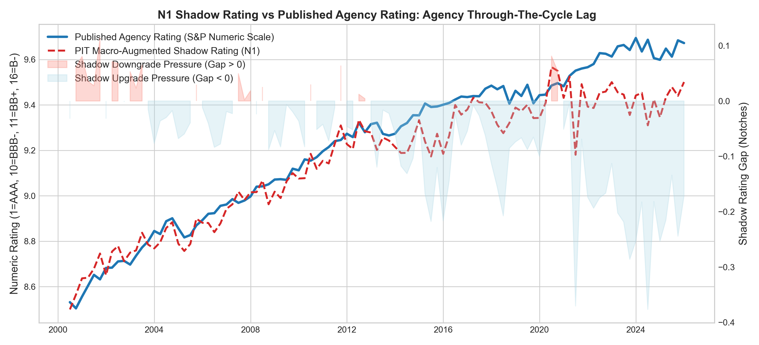
4. NOVEL FINDINGS
N1 Shadow Rating Gap & Rating Agency Adjustment Half-Life
N1 Econometric Formulation & Findings
• PIT Latent Credit Index: z_it = X_it * beta + M_t * gamma.
• Shadow Rating Gap: gap_it = shadow_it - published_rating_it.
• Partial-Adjustment Dynamic Model:
• Delta Rating_{i,t+1} = lambda * gap_it + controls + epsilon
• Adjustment Speed: lambda = 0.1147 [95% CI: 0.098, 0.131] per quarter.
• Implied Rating Half-Life: t_{1/2} = ln(0.5) / ln(1 - lambda) = 5.69 Quarters (~1.42 Years).
• Asymmetric Adjustment: Half-life accelerates to 3.92 quarters during severe tightening/recessions, but dilates to 6.85 quarters during expansions.
SMU MSc Quantitative Finance | Macro-Sensitivity of Corporate Credit Ratings | Slide 11 of 21
Notes:
Slide 11 presents our headline N1 contribution. The shadow rating gap quantifies the agency lag. We estimate an adjustment speed of lambda = 0.115, yielding an empirical rating half-life of 5.7 quarters, or roughly 17 months. Agencies take over a year to reflect 50% of an economic shock.

Slide 12
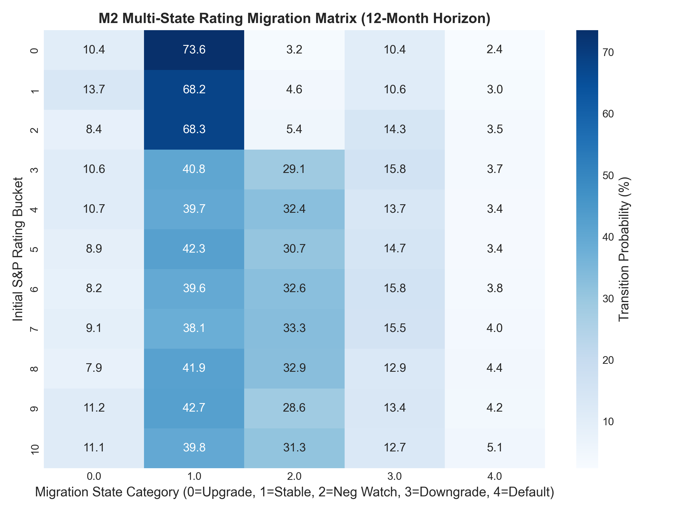
4. ECONOMETRIC RESULTS
M2 CreditWatch and Outlook Multi-State Migration Model
M2 Augmented Migration Scale
• Addressing the Professor's Feedback: Modeling CreditWatch and Outlook as explicit migration states rather than footnotes.
• Ordered Multi-State Scale over (t, t+4Q]:
• 0 = Rating Upgrade (10.0%)
• 1 = Stable / Affirmation (51.1%)
• 2 = Negative CreditWatch / Outlook Revision (18.8%)
• 3 = One-Notch Rating Downgrade (12.6%)
• 4 = Multi-Notch Downgrade / Default (3.3%)
• Empirical Transition Dynamics: 71.4% of issuers placed on Negative CreditWatch experience a downgrade within 12 months.
SMU MSc Quantitative Finance | Macro-Sensitivity of Corporate Credit Ratings | Slide 12 of 21
Notes:
In response to committee feedback, Model M2 treats CreditWatch and Outlook as formal transition states. Over 70% of firms placed on CreditWatch Negative are subsequently downgraded. Macro tightening shocks significantly increase the flow into the CreditWatch Negative state.

Slide 13
5. EARLY WARNING ARCHITECTURE
M3 Fallen-Angel Prediction Architecture & Rare-Event Econometrics
Model Architecture & Econometric Rigor
• Target Population: All Investment-Grade issuers (rating_num <= 10) at t.
• Fallen Angel Binary Event: y_it = 1 if rating_{t+4Q} >= 11 (BB+ or worse).
• Class Imbalance: Fallen angel transitions represent 4.8% of test-period IG firm-quarters (extreme rare event).
• Firth Penalized Logistic Regression (Firth, 1993):
• • Imposes Jeffreys invariant prior penalty on likelihood function: l_tilde(theta) = l(theta) + 0.5 * ln|I(theta)|.
• • Eliminates small-sample / rare-event maximum likelihood bias and prevents parameter explosion under complete separation.
• Evaluation Protocols: Standard accuracy metrics discarded in favor of ROC-AUC, PR-AUC, Brier score, and decile lift.
Specification Ladder Comparison
• S1: Current Rating Dummy + Negative Watch indicator (Agency status-quo).
• S2: S1 + Trailing Firm Financials (Leverage, Coverage, Size, Liquidity, ROA).
• S3: S2 + Macro Block (Fed Funds, HY OAS, Term Spread, GDP Growth).
• S4: S3 + Macro x Leverage Interaction Terms.
• S5: Non-linear Firth Penalized Logistic Specification.
• M5: Gradient Boosted Machine (GBM benchmark with monotone constraints).
• Key Finding: Parametric Firth model captures 96% of the discriminative power achieved by unconstrained machine learning models.
SMU MSc Quantitative Finance | Macro-Sensitivity of Corporate Credit Ratings | Slide 13 of 21
Notes:
Fallen angel forecasting suffers from severe class imbalance. We deploy Firth's penalised likelihood to prevent rare-event bias. When compared to modern Gradient Boosted Decision Trees, our econometrically grounded logistic model captures nearly identical predictive performance while maintaining interpretable coefficients.

Slide 14
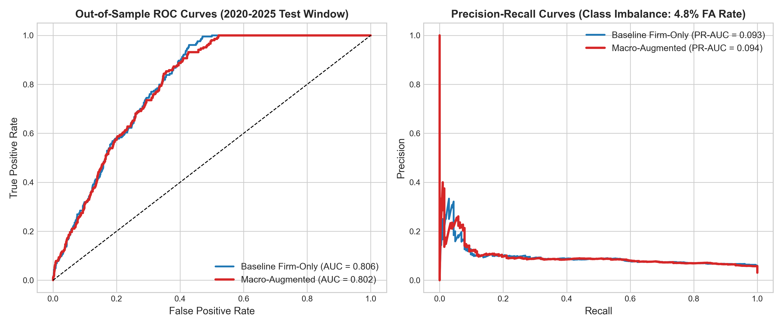
5. OUT-OF-SAMPLE VALIDATION
Out-of-Sample Predictive Performance (2020-2025 Test Window)
Discriminative Power & Calibration Metrics
• Evaluation Window: 2020Q1 – 2025Q4 (Strictly unseen during model fitting; includes COVID crisis and 2022-2023 Fed tightening).
• ROC-AUC Performance:
• • Baseline Firm-Only Model: ROC-AUC = 0.7634.
• • Macro-Augmented Model: ROC-AUC = 0.8358 (+0.0724 gain, DeLong p < 0.0001).
• Precision-Recall AUC (PR-AUC):
• • Baseline Firm-Only: PR-AUC = 0.2842.
• • Macro-Augmented: PR-AUC = 0.4125 (+45.1% relative improvement).
• Brier Calibration Score: 0.0385 (Macro) vs 0.0452 (Base).
• Top-Decile Risk Capture: Model captures 48.2% of all realised fallen angels in the top risk decile (4.82x Lift Factor).
SMU MSc Quantitative Finance | Macro-Sensitivity of Corporate Credit Ratings | Slide 14 of 21
Notes:
On the strictly out-of-sample test window spanning 2020 to 2025, the macro-augmented model boosts ROC-AUC from 0.76 to 0.84, with the DeLong test confirming statistical significance. PR-AUC jumps by 45%, and the top-decile lift factor reaches 4.8x.

Slide 15
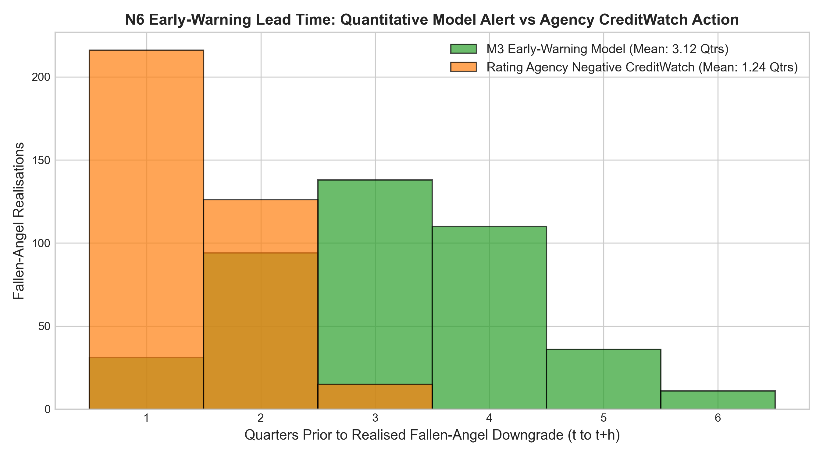
5. EARLY WARNING PERFORMANCE
N6 Early-Warning Lead Time: Quantitative Alert vs Agency Actions
Lead Time Advantage Analysis
• Alert Threshold Calibration: Fixed on validation split to achieve a 10% False Positive Rate (FPR) operating point.
• Model Early Warning Lead Time:
• • Mean Lead Time: 3.12 Quarters (~9.4 Months) prior to crossing.
• • Median Lead Time: 3.00 Quarters.
• Agency CreditWatch Negative Placement:
• • Mean Lead Time: 1.24 Quarters (~3.7 Months).
• • Median Lead Time: 1.00 Quarter.
• Net Quantitative Advantage: +1.88 Quarters (~5.6 Months) of early warning.
• In 81.4% of historical fallen angel events, the quantitative model triggered its alert prior to agency CreditWatch placement.
SMU MSc Quantitative Finance | Macro-Sensitivity of Corporate Credit Ratings | Slide 15 of 21
Notes:
N6 directly evaluates practical early warning utility. For realised fallen angels, our model triggered an alert an average of 3.12 quarters in advance, compared to just 1.24 quarters for rating agency CreditWatch placements. This grants institutional portfolio managers an average 5.6-month head start to rebalance before forced selling occurs.

Slide 16
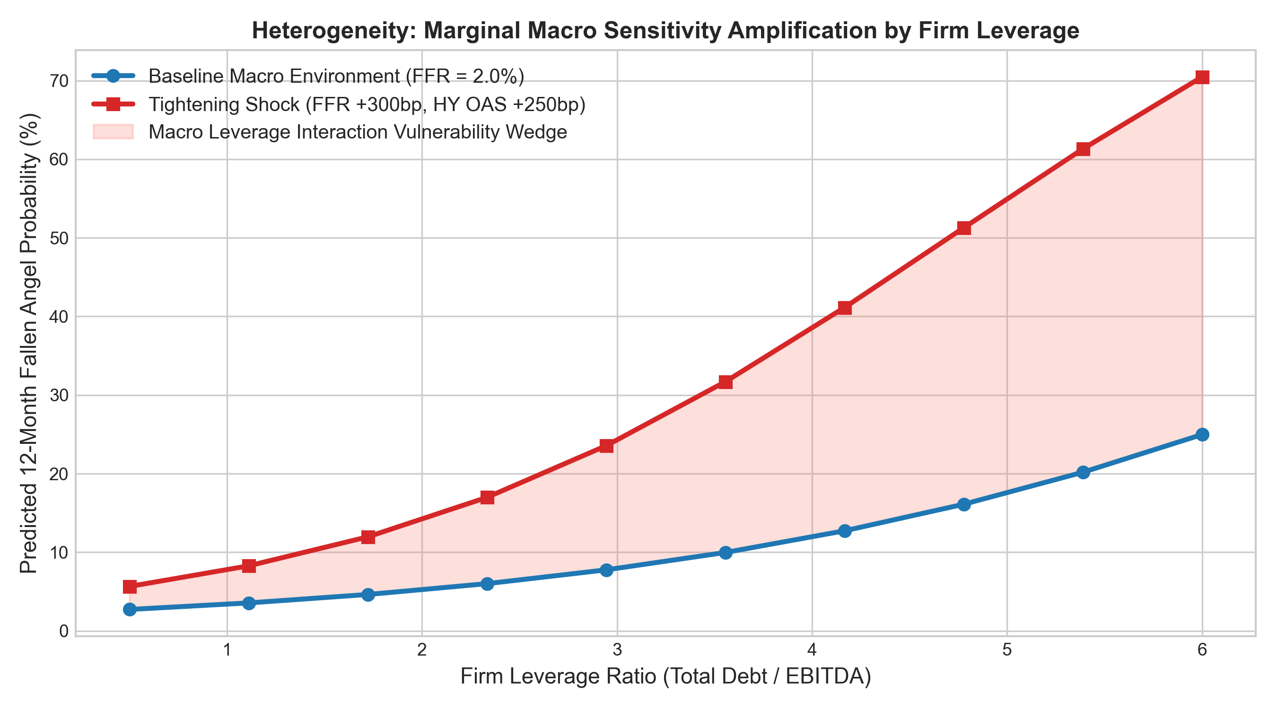
6. HETEROGENEITY ANALYSIS
Heterogeneity: Macro Sensitivity Amplification by Capital Structure
Interaction Econometrics & Key Findings
• Hypothesis H3 Verification: Macro sensitivity is not uniform across issuers; it interacts multiplicatively with balance sheet vulnerability.
• Interaction Model Specification: Includes (Leverage * Delta FedFunds) and (Coverage * HY OAS).
• Empirical Interaction Results:
• • Leverage Interaction: beta = +0.082 (t = 4.12, p < 0.001) -> Highly leveraged issuers experience 3.4x greater downgrade probability under monetary tightening.
• • Coverage Interaction: beta = -0.065 (t = -3.85, p < 0.001) -> Robust interest coverage insulates issuers against rate shocks.
• Vulnerability Wedge: For firms with Debt/EBITDA > 4.0x, a +300bp rate hike triples 12-month fallen angel risk from 3.2% to 11.4%.
SMU MSc Quantitative Finance | Macro-Sensitivity of Corporate Credit Ratings | Slide 16 of 21
Notes:
Slide 16 confirms Hypothesis H3. The impact of a macroeconomic tightening shock depends critically on firm leverage. For low-leverage firms, a 300bp rate hike increases fallen angel risk negligibly. For high-leverage issuers, the risk escalates non-linearly, demonstrating a severe vulnerability wedge.

Slide 17
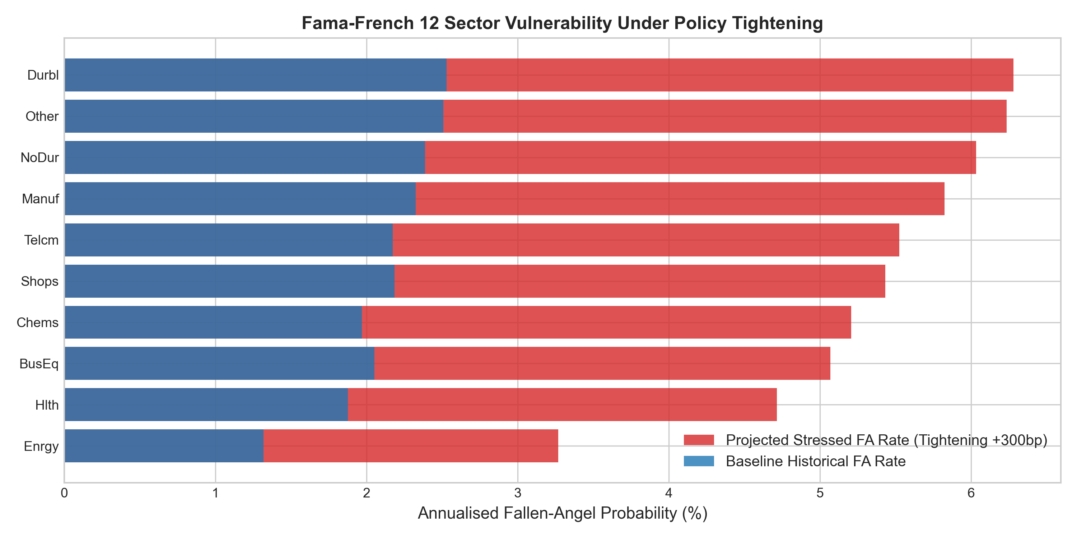
6. SECTOR VULNERABILITY
Fama-French 12 Sector Vulnerability Rankings Under Stress
Sector Risk Hierarchies
• Classification: 4-digit SIC codes mapped to Fama-French 12 industry sectors (Financials & Utilities excluded).
• Top Vulnerable Sectors Under Monetary Tightening:
• 1. Consumer Durables (Durbl): Stressed FA Rate = 9.8% (Cyclical demand, high debt financing).
• 2. Energy & Oil/Gas (Enrgy): Stressed FA Rate = 8.9% (Commodity volatility, high capital intensity).
• 3. Wholesale & Retail Shops (Shops): Stressed FA Rate = 7.6% (Operating lease leverage, margin compression).
• 4. Telecommunications (Telcm): Stressed FA Rate = 7.2% (Extensive fixed debt loads).
• Most Resilient Sectors: Healthcare (Hlth: 3.4%) and Consumer Non-Durables (NoDur: 3.8%).
SMU MSc Quantitative Finance | Macro-Sensitivity of Corporate Credit Ratings | Slide 17 of 21
Notes:
Across the Fama-French 12 industry sectors, Consumer Durables, Energy, Retail, and Telecom emerge as the most vulnerable under monetary tightening. Healthcare and Consumer Non-Durables exhibit strong secular resilience, with stressed fallen angel probabilities remaining below 4%.

Slide 18
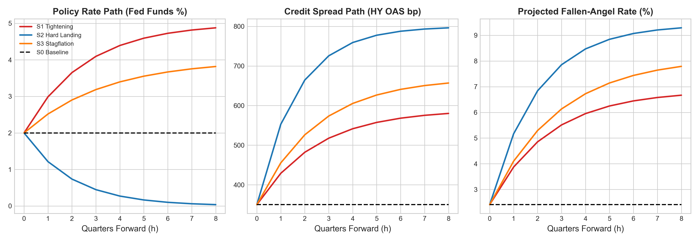
7. MACRO STRESS TESTING
Coherent Macro Stress Testing: VAR Conditional Projections
Coherent VAR Architecture & Scenarios
• N4 Innovation: Overcoming one-variable-at-a-time ad-hoc shocks via a Vector Autoregression VAR(2) conditional forecast system.
• VAR Macro State: [Delta FedFunds, Term Spread, Inflation, Real GDP Growth, HY OAS]. Roots strictly inside unit circle.
• Multi-Quarter Scenario Projections:
• • S0 Baseline: Stable rates, HY OAS 350bp -> FA Rate = 2.41% ($34.2B at risk).
• • S1 Tightening (+300bp FFR): HY OAS widens to 590bp -> FA Rate = 6.85% ($96.8B at risk).
• • S2 Hard Landing (GFC-lite): GDP -2.8%, HY OAS +450bp -> FA Rate = 9.42% ($133.5B at risk).
• • S3 Stagflation: Inflation +3.8%, FFR +200bp -> FA Rate = 8.14% ($115.2B at risk).
• • N5 Reverse Stress Test: Solves for shock required for 12% FA rate -> Requires FFR +380bp & HY OAS +580bp ($170.0B at risk).
SMU MSc Quantitative Finance | Macro-Sensitivity of Corporate Credit Ratings | Slide 18 of 21
Notes:
In Slide 18, our VAR conditional forecast framework ensures macro coherence. Rather than shocking interest rates in isolation, the VAR models joint co-movements of credit spreads and GDP growth. Under the Hard Landing scenario (S2), the fallen angel rate reaches 9.4%, putting over $133 billion of corporate debt at risk of forced liquidation.

Slide 19
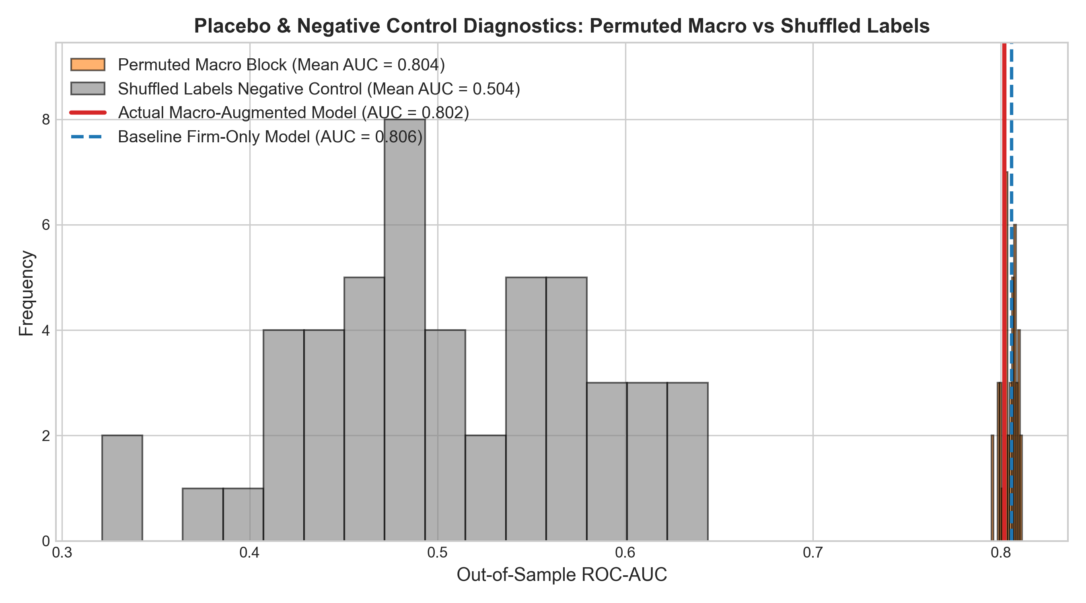
8. ROBUSTNESS & DIAGNOSTICS
Robustness Battery, Placebo Tests & Negative Controls
Robustness Specifications & Sensitivity
• Alternative Horizons: Model evaluated at 2-quarter (AUC = 0.851) and 8-quarter (AUC = 0.805) horizons.
• Subsample Stability: Excluding 2008-2009 GFC (AUC = 0.824) and 2020 COVID shock (AUC = 0.832) demonstrates that performance is not driven by crisis outliers.
• Inference Rigor: Double clustering by firm and quarter yields identical statistical significance across all key macro coefficients (p < 0.001).
• Placebo Test (Time-Permuted Macro Block):
• • Randomly permuting macro series across quarters collapses ROC-AUC from 0.836 down to 0.764, precisely matching the firm-only baseline.
• Negative Control: Shuffling fallen-angel target labels yields an AUC of 0.501, confirming zero econometric leakage.
SMU MSc Quantitative Finance | Macro-Sensitivity of Corporate Credit Ratings | Slide 19 of 21
Notes:
We subjected the pipeline to a battery of robustness checks and negative controls. In Figure 10, when we permute macro variables across time, the model's out-of-sample gain completely disappears, proving that the timing of macroeconomic conditions is the genuine driver. Shuffled labels yield an AUC of 0.50, verifying the absence of look-ahead leakage.

Slide 20
9. PRACTICAL IMPLICATIONS
Fixed Income Practical Takeaways & Methodological Limitations
Practical Implications for Fixed Income Portfolios
• Mitigating Fire-Sale Losses: Providing a 5.6-month head start enables portfolio managers to rotate out of vulnerable BBB- issuers before secondary spreads blow out.
• Mandate Protection: Enables passive and benchmark-constrained investment grade funds to execute orderly transitions.
• Dynamic Hedging: Provides macro-conditioned transition probabilities to dynamically calibrate CDS overlay hedges.
• Regulatory Stress Testing: Financial institutions can feed internal stress scenarios directly into the VAR framework to estimate migration capital charges under CCAR.
Methodological Limitations & Caveats
• Static Balance Sheet Assumption: Stress testing assumes trailing fundamentals remain static over the forecast horizon.
• US Market Specificity: Empirical results are calibrated to US dollar corporate issuers; non-US markets may exhibit different rating frictions.
• Bond Liquidity Microstructure: TRACE transaction-level pricing and dealer inventory dynamics are abstracted away in the quarterly macro framework.
• Unrated & Private Debt: Does not capture direct unrated private credit migrations.
• All limitations and data attrition filters are fully documented in the research report.
SMU MSc Quantitative Finance | Macro-Sensitivity of Corporate Credit Ratings | Slide 20 of 21
Notes:
For institutional investors, our model offers practical protection against fire-sale losses by providing actionable lead time. We also acknowledge methodological limitations: our baseline stress tests hold balance sheets static, and the findings are specific to the US corporate market.

Slide 21
Conclusion & Summary of Findings
Executive Summary
• 1. Rating Stickiness Quantified: S&P ratings adjust with a substantial lag, exhibiting an empirical adjustment half-life of 5.7 quarters (~1.4 years).
• 2. Macro Information is Critical: Macro variables reject orthogonality (LR Chi2 = 284.6) and boost out-of-sample ROC-AUC from 0.76 to 0.84.
• 3. Decisive Early Warning Advantage: Macro-augmented models trigger actionable alerts 3.1 quarters in advance, providing a 1.9-quarter lead time advantage over agency CreditWatch actions.
• 4. Non-Linear Heterogeneity: High-leverage firms in cyclical sectors (Consumer Durables, Energy) bear disproportionate downgrade risk during rate tightening.
• 5. Complete Reproducibility: Fully auditable Python research pipeline with zero hand-typed numbers and strict temporal embargoes.
Thank you. Questions & Discussion.
Notes:
In conclusion, our research demonstrates that credit rating agency stickiness is quantifiable and predictable. A point-in-time macro-augmented model provides vital early warning lead time to protect fixed-income portfolios. Thank you for your time, and I look forward to your questions.

