Slide 1

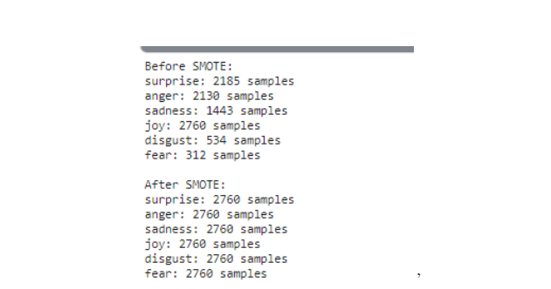
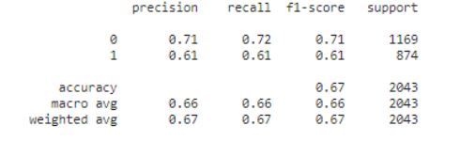
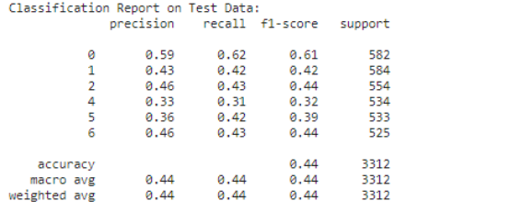
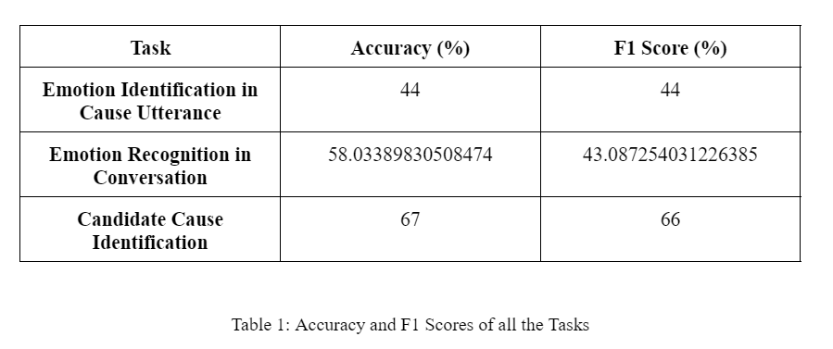
This is a Scientific Poster Template created by Graphicsland & MakeSigns.com
Your poster title would go on these lines
Emotion Cause Analysis in Conversations using Textual Data
Group 25: Mahisha Ramesh, Mayank Jha, Shaina Mehta, Vatsal Lakhmani
Author Name, RN¹; Author Name, Ph.D², Author Name, RN^{2,3}; Author Name, Ph.D^{1,4}
¹Name of University, City, State; ²Name of University, City, State; ³Name of University, City, State; ⁴Name of University, City, State;
Department of Computer Science and Engineering, Indraprastha Institute of Information Technology, Delhi, India
Introduction
Data Pre-processing and Model Training of Emotion Recognition in Conversation
In casual discussions, understanding human emotions and their underlying causes has drawn more attention in recent years. Accurately extracting emotion-cause pairs from text significantly impacts several disciplines, including affective computing, psychology, social robots, and human-computer interaction. Several causes lead to the motivation to investigate emotion-cause pair extraction in conversations: 1) Enhanced Interaction between Humans and Computers, 2) Developments in Affective Computing, 3) Psychological insight, 4) Real-World Applications.
The following procedure is the complete reimplementation of the paper [13]. The following steps have been followed for Emotion Recognition in Conversation (ERC) is as follows:
For each conversation, each user has been concatenated with the utterance. Here the ERC task is considered as the sequence labeling task.
Then the previous utterances and future utterances of the words have been taken and are concatenated with each other. These utterances are tokenized by the RoBERTa tokenizer in Huggingface.
Then they are trained on the RoBERTa model using AdamW optimizer, with batch size 40, cross entropy loss function, and learning rate of 0.01 till 10 epochs and its accuracy and F1 score is calculated.
Figure 1: Class imbalance removed using SMOTE for all emotions
Figure 2: Candidate Cause or Not Classification
Objective
This project aims to create a deep-learning model for emotion recognition in conversation (ERC), identifying emotion from the cause utterance in conversation and Cause pair identification in the conversations of textual data. This method will help different researchers create better AI-based conversational systems in the future.
Data Pre-processing and Model Training of Candidate Cause Identification in Conversation
Figure 3: Classification Report of Emotion Identification
Dataset
The following procedure is the complete reimplementation of the paper [13]. The following steps have been followed for Emotion Recognition in Conversation (ERC) is as follows:
Utilized GloVe word embeddings for semantic representation.
Preprocessed text data and labeled candidate cause or not based on emotion-cause pairs.
Split the dataset into 70% training, 15% validation, and 15% testing.
Constructed a feedforward neural network with two hidden layers of 64 neurons, ReLU activation, and dropout.
Trained the model with binary cross-entropy loss and Adam optimizer over 10 epochs.
Evaluated performance on the testing set for accuracy and predictions.
From the above tables, one can infer that the performance of all the models is not much upto the mark as well as it is not much suitable for the real-time applications.
The dataset used in this project is from the competition SemEval 2024 Task 3 Subtask 1, proposed by [2] and [8]. This dataset is based on the American TV show Friends. The trial and testing part of the dataset does have labels. Hence, we will only use the training part of the dataset. As a result, the dataset consists of 1374 conversations, out of which we are taking 1099 conversations for training, 137 for validation, and remaining for testing.
Conclusion and Future Work
This project discusses emotion recognition in conversation, identifying emotion from the cause utterance in conversation and Cause pair identification in the conversations of textual data using deep learning techniques. From the results one can infer that the performance of all the models are not upto the mark and are not suitable for real time applications. In the future, we are going to improve upon it by using Large Language Models plus we are going to perform ECPE tasks on real time dataset as well as used these rules for building the conversational bot.
Methodology
References
Data Pre-processing and Model Training of Emotion Recognition from the Cause Utterance
Results
[1] Wang, F., Ding, Z., Xia, R., Li, Z., & Yu, J. (2022). Multimodal emotion-cause pair extraction in conversations. IEEE Transactions on Affective Computing.
[2] S. Zahiri and J. D. Choi. Emotion Detection on TV Show Transcripts with Sequence-based Convolutional Neural Networks. In The AAAI Workshop on Affective Content Analysis, AFFCON'18, 2018.
[3] S. Poria, D. Hazarika, N. Majumder, G. Naik, E. Cambria, R. Mihalcea. MELD: A Multimodal Multi-Party Dataset for Emotion Recognition in Conversation. ACL 2019.
[4] Vardhan Mathur, S., Jindal, A. R., Mittal, H., & Shrivastava, M. (2024). LastResort at SemEval-2024 Task 3: Exploring Multimodal Emotion Cause Pair Extraction as Sequence Labelling Task. arXiv e-prints, arXiv-2404.
[5] Wang, F., Ma, H., Xia, R., Yu, J., & Cambria, E. (2024, June). SemEval-2024 Task 3: Multimodal Emotion Cause Analysis in Conversations. Proceedings of the 18th International Workshop on Semantic Evaluation (SemEval-2024), 2022–2033. Retrieved from https://aclanthology.org/2024.semeval2024-1.273.
[6] Kim, T., & Vossen, P. Emoberta: Speaker-aware emotion recognition in conversation with roberta. arXiv 2021. arXiv preprint arXiv:2108.12009.
All the models have been trained on Kaggle Notebook and Jupter Notebook. And their Accuracy and F1 Scores have been calculated. The classification report and the accuracy and F1 scores are given in table 1:
The following steps are followed for data pre-processing and training of Emotion Recognition from the Cause Utterance.
Emotion and cause pairs are extracted from the dataset and emotions are considered as labels and cause is considered as input. Then SMOTE technique is applied to prevent class imbalance.
Then the text is converted to its distributive representation using GloVe embeddings.
Then, the model is trained on Bi-LSTM with Attention with batch size of 32, using adam optimizer, cross entropy loss function till 20 epochs and its accuracy and F1 score is calculated.
Table 1: Accuracy and F1 Scores of all the Tasks

