Slide 1
JSE 2026 – LLM Experimentation
- NAME:
- class :
School
Topic: LLM
Instructor : Vinaykumar

Slide 2
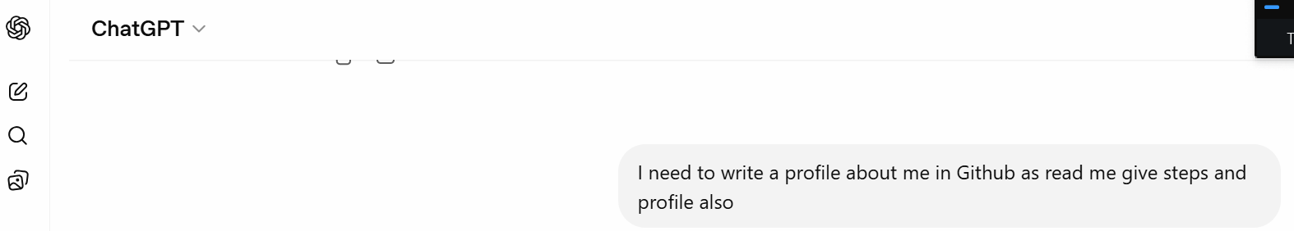
This is my input prompt the LLM – drafting about my profile
Prompt : I need to write a profile about me in Github as read
me give steps and profile also

Slide 3
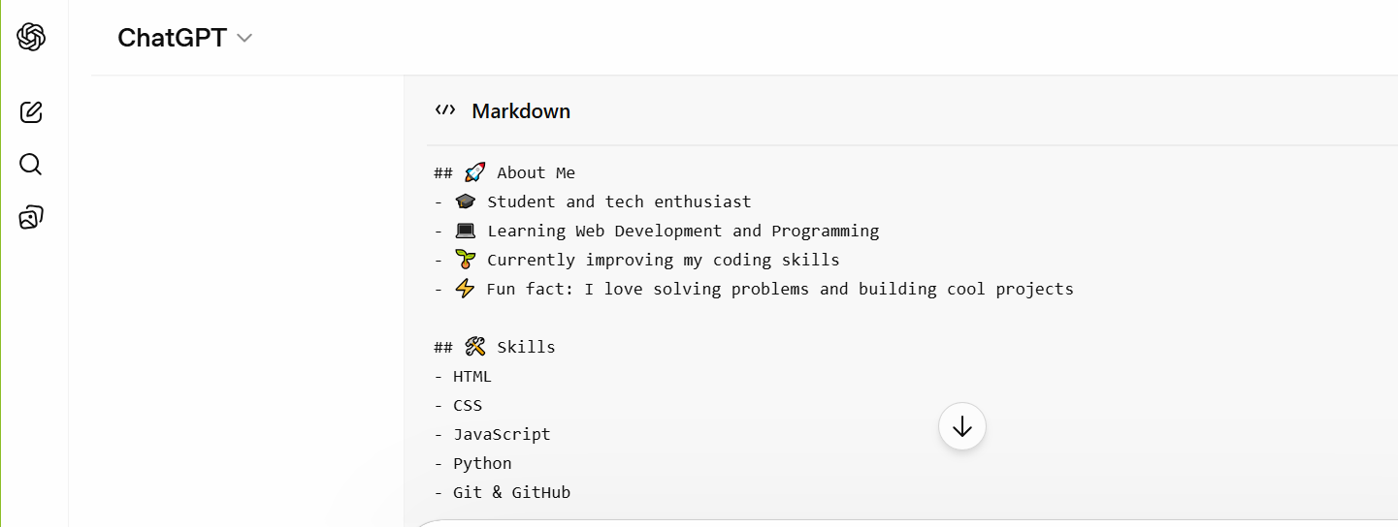
Prompt output :
https://github.com/mahithabobk-source/Manvitha-/tree/main

