Slide 1
MULTIMODAL EMOTION RECOGNITION (MER) WITH DEEP NETWORKS
GUIDE:
Y. BHANU SREE
(Assistant Professor)
Dept of Computer Science Engineering
TEAM NO: 15
P. Mahitha - 16071A05A7 M. Keerthi - 16071A0592
D. Keerthana – 16071A0575
V. Suma Sree – 16071A05B8

Slide 2
ABSTRACT
The need for machines to react towards human emotions is required and is the need of the hour in the current digital era.
We developed a system which takes either audio or video as input and gives the status of emotion. We classified emotions into 7 categories like happy, sad, fearful, disgust, calm, angry and surprise.
For Audio, we used Ravdess dataset and implemented Time-distributed CNN which extracts features like MFCC, Mel-Scale, Spectrogram for emotion recognition. By implementing these we achieved an accuracy of 96% on training and about 78% on validation.
For video, we used Fer2013 dataset and implemented CNN model which synthesizes features like haar features, HOG sliding windows, HOG features and Facial landmarks to detect the emotion. By applying these we achieved an accuracy of about and about 89% accuracy on training and 76% on validation.
In future we can integrate these modules in interactive devices such as smartphones, smart wearables, voice assistants, Google home, Alexa, Microsoft Cortana and other IoT devices.

Slide 3
INTRODUCTION
Emotion Recognition is the process of identifying human emotion. Human emotions can be analysed by various approaches like Facial expressions, audio, text, body movement and gestures etc.,
The idea behind creating this project was to build a Multimodal Emotion Recognition (MER) deep learning model that could detect emotions under any circumstances of either video or speech.
Unimodal systems cannot provide more information about the user and to various exterior factors. This has led to the development of multimodal systems rather than unimodal systems.
For multimodal systems to give accurate results using different types of data, fusion techniques are used. Various fusion techniques which can be used are feature-level, hybrid multimodal, decision- level, rule-based, classification-based, model-level, and estimation-based fusions.
Emotion recognition systems can be deployed into diverse applications. The information obtained from these systems is being used in fields like health, education, tourism, and commerce, etc.

Slide 4
EXISTING SYSTEM
There are several approaches that are proposed to recognize human emotions based on facial expressions or speech, relatively limited work has been done to fuse these two, and other, modalities to improve the accuracy and robustness of the emotion recognition system.
The traditional Multimodal Emotion Recognition model are trained using Machine Learning Classifiers namely, Random Forests, Gradient Boosting, Support Vector Machines, Naive Bayes and Logistic Regression. However, Emotion Recognition using Machine Learning has its own limitations.
Deep neural networks may overcome this limitation by collecting the useful features from the Multimodal data by itself instead of passing the features explicitly to the model.
In existing system, SER is implemented using RNN, LSTM. If we implement using CNN, however LSTM or RNN layers must be applied at the end.
In existing system, FER is implemented using CNN and researchers are trying to extract different hybrid features and architectures.

Slide 5
LITERATURE SURVEY
SNO | TITLE | AUTHORS | APPROACH | DRAWBACK | PAPER | YEAR
1 | MULTIMODAL SPEECH EMOTION RECOGNITION USING AUDIO AND TEXT | Seunghyun Yoon, Seokhyun Byun, and Kyomin Jung | Dual RNN’s, IEMOCAP Dataset | Four Emotions, Accuracy ranging from 68.8% to 71.8%. | IEEE | 2018
2 | MULTI-MODAL EMOTION RECOGNITION ON IEMOCAP WITH NEURAL NETWORKS. | Samarth Tripathi, Homayoon Beigi | LSTM, IEMOCAP dataset, Robust | Four Emotions, Combined Accuracy of 71.04% | IEEE | 2018
3 | Multimodal Speech Emotion Recognition and Ambiguity Resolution | Gaurav Sahu | 6 MLClassifiers, LSTM-based Classifier,IEMOCAP Dataset | Performance of ML model is better than DNN | IEEE | 2019
4 | Multimodal Sentiment Analysis using Hierarchical Fusion with Context Modeling | N. Majumdera,D. Hazarikab,A.Gelbukha,E.Cambriac, S. Poriac | RNN, CNN, Bimodal Fusion, IEMOCAP Dataset | Four Emotions | ELSEVIER | 2018
5 | Investigation of Multimodal Features, Classifiers and Fusion.Methods for Emotion Recognition | Zheng Lian, Ya Li, Jianhua Tao, Jian Huang | DNN Classifiers, Bottle Neck Features, BS-Fusion, AFEW Dataset, 7 emotions | Accuracy is 60.34% | IEEE | 2018

Slide 6
LITERATURE SURVEY
SNO | TITLE | AUTHORS | APPROACH | DRAWBACK | PAPER | YEAR
6 | Multimodal Big Data Affective Analytics: A Comprehensive Survey Using Text, Audio, Visual and Physiological Signals | Nusrat J. Shoumya, Li-Minn Angb, Kah Phooi Sengc, D M Motiur Rahamana,Tanveer Ziaa | Brief survey on various data and data models, current state-of art researches in multimodal big data affective analytics. | - | ELSEVIER | 2019
7 | Analysis of the efficacy and reliability of the Moodies app for detecting emotions through speech: Does it actually work? | Jose M. Arana ,Fernando Gordillo, Jeannete Darias, Lilia Mestas | Moodies app, designed for the voice detection of the speaker’s emotions. | Analyses emotion in dimensional terms but no in categorical terms, difficulty in distinguishing between the emotions of anger and sadness and those of fear and disgust | ELSEVIER | 2019

Slide 7
LITERATURE SURVEY
SNO | TITLE | AUTHOR | APPROACH | DRAWBACK | PAPER | YEAR
8 | Multi-modal Correlated Network for Emotion Recognition in Speech | Minjie Ren, Weizhi Nie*, Anan Liu*, Yuting Su | Audio-Visual Information Fusion, AEFW Dataset, 2D-CNN,3D-CNN | Accuracy is around 60% | ELSEVIER | 2019
9 | A survey of emotion recognition methods with emphasis on E-Learning environments | Maryam Imani, Gholam Ali Montazer | Facialexpressions, body gestures, user’s text, effects of emotions in learning | - | ELSEVIER | 2019
10 | A snapshot research and implementation of multimodal information fusion for data-driven emotion recognition | Yingying Jianga , Wei Li, M. Shamim Hossain, Min Chena, Abdulhameed Alelaiwi , Muneer Al-Hammadi | Datasets, Feature Extraction, Deep networks | - | ELSEVIER | 2019
11 | Enhanced speech emotion detection using deep neural networks | S. Lalith, Shikha Tripathi, Deepa Gupta | Preprocessing, feature extraction, classification | Reduced emotion recognition performace | SPRINGER | 2018

Slide 8
LITERATURE SURVEY
SNO | TITLE | AUTHORS | APPROACH | DRAWBACK | PAPER | YEAR
12 | Speech emotion recognition research: an analysis of research focus | Mumtaz Begum Mustafa1 · Mansoor A. M. Yusoof2,3 · Zuraidah M. Don4 · Mehdi Malekzadeh5 | It analyses research in speech emotion recognition (“SER”) from 2006 to 2017 in order to identify the current focus of research, and areas in which research is lacking. | - | Springer | 2018
13 | A review of depression and suicide risk assessment using speech analysis | Nicholas Cummins, Stefan Scherer, Jarek Krajewski, Sebastian Schnieder , Julien Epps, Thomas F. Quatieri | Automatic Analysis of Speech for prediction of depressio n and suicidality. | - | ELSEVIER | 2018

Slide 9
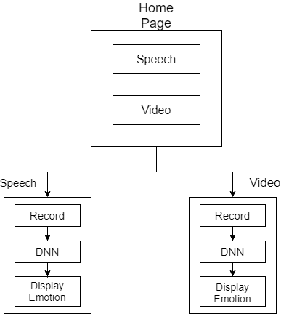
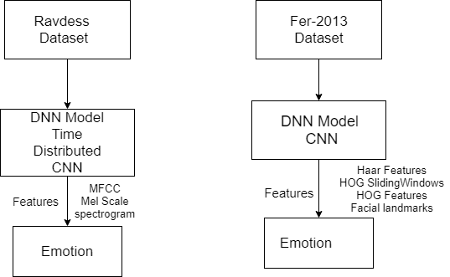
PROPOSED SYSTEM

Slide 10
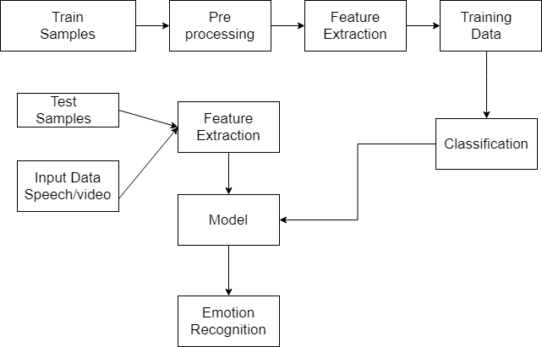
SYSTEM ARCHITECTURE

Slide 11
METHODOLOGY
The proposed human emotion recognition system is of five components:
1. input data
2. pre-processing techniques
3. feature extraction and selection
4. classification
5. emotion recognition
We divide the dataset in the ration of 80:20 (80=training set & 20=testing set). On training dataset pre-processing techniques are applied. From the pre-processed speech signal, we extract the useful features required for emotion recognition.
In the next step, Deep Neural Network algorithms like Time-distributed CNN and CNN are implemented on the data. Hence the Emotion Recognition Model is created in .hdf5 or .pickle format.
The input signal is recorded and we synthesize the features which are useful for emotion recognition.The recorded data is given as input for the emotion recognition model. In the final stage, one of the 7 emotions is identified and displayed on the webpage.

Slide 12
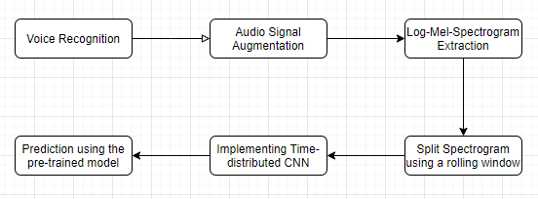
METHODOLOGY FOR SER
The speech emotion recognition pipeline is built in the following way :

Slide 13
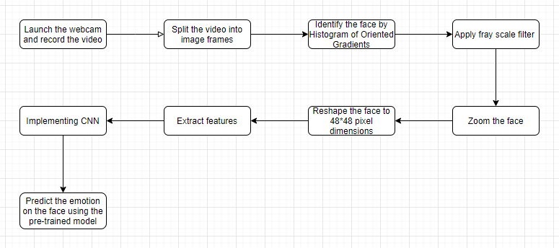
METHODOLOGY FOR FER
The video processing pipeline was built the following way :

Slide 14
ALGORITHM EXPLANATION
Time-Distributed Convolutional Neural Network for SER:
Speech being a sequential data, Time-Distributed Neural Network is used to process the emotion of a human being.
For Audio Emotion Recognition, the principle thought of a Time-Distributed Convolutional Neural System is to apply a moving window (fixed size and time-step) up and down the log-mel-spectrogram.
Each one of these windows will be the section of a convolutional neural system, created by Four Local Feature Learning Blocks (LFLBs) and the yield of each of these convolutional systems will be taken care of into a repetitive neural system formed by 2 cells of “LSTM” to learn long-term contextual dependencies.
At last, a completely associated layer with softmax activation function is utilized to predict the emotion recognized in the voice.

Slide 15
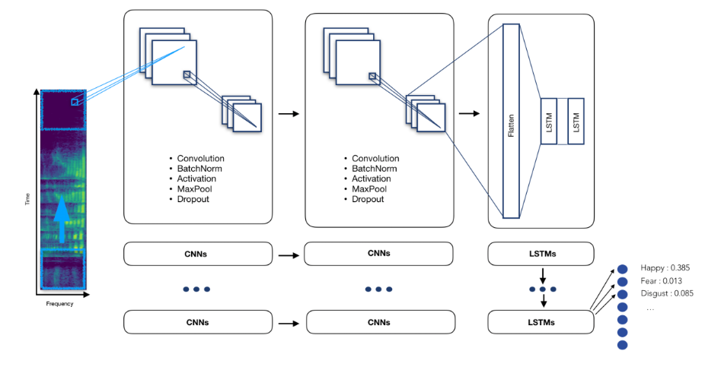
ALGORITHM EXPLANATION

Slide 16
ALGORITHM EXPLANATION
Convolutional Neural Network for FER:
For Facial Emotion Recognition, the aim of using Convolutional Neural Networks is to diminish the pictures into a structure which is simpler to process, without losing features which are basic for getting a decent prediction.
The face emotion recognition is done in the following way:
Detect faces using Opencv face cascade classifier and extract facial features.
Creating a simple model using convolution layers and maxpooling.
Preventing overfitting using batch normalization.
Adding more convolutional layers.
Using deeper CNN models such as Inception and Xception to increase accuracy.
We implemented XCeption model to reduce overfitting.

Slide 17
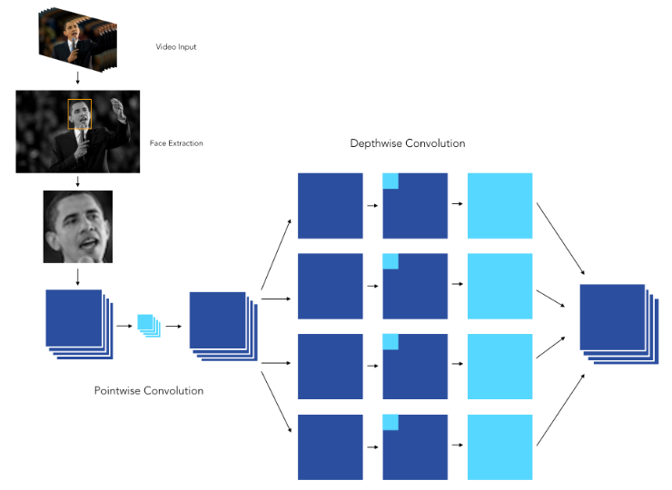
ALGORITHM EXPLANATION

Slide 18
REQUIREMENTS
HARDWARE REQUIREMENTS
SOFTWARE REQUIREMENTS
Windows 8 or above
Android Studio
Firebase
Pycharm or Jupyter Notebook
Deep Learning Algorithms like CNN, RNN, LSTM
Datasets like RAVDESS Emotional speech database, Emo-DB(Berlin database of Emotional speech), Fer-2013, SemEval2019 etc.,
Processor – i5
Hard Disk – 5 GB
Memory – 8 GB RAM
Nvidia (GPU)

Slide 19
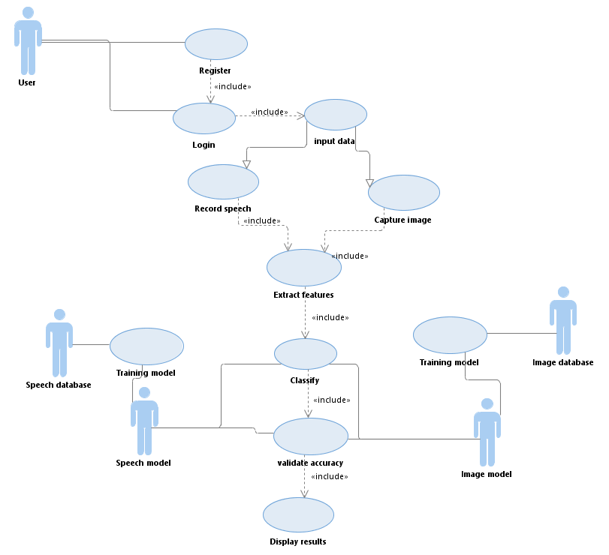
USECASE DIAGRAM

Slide 20
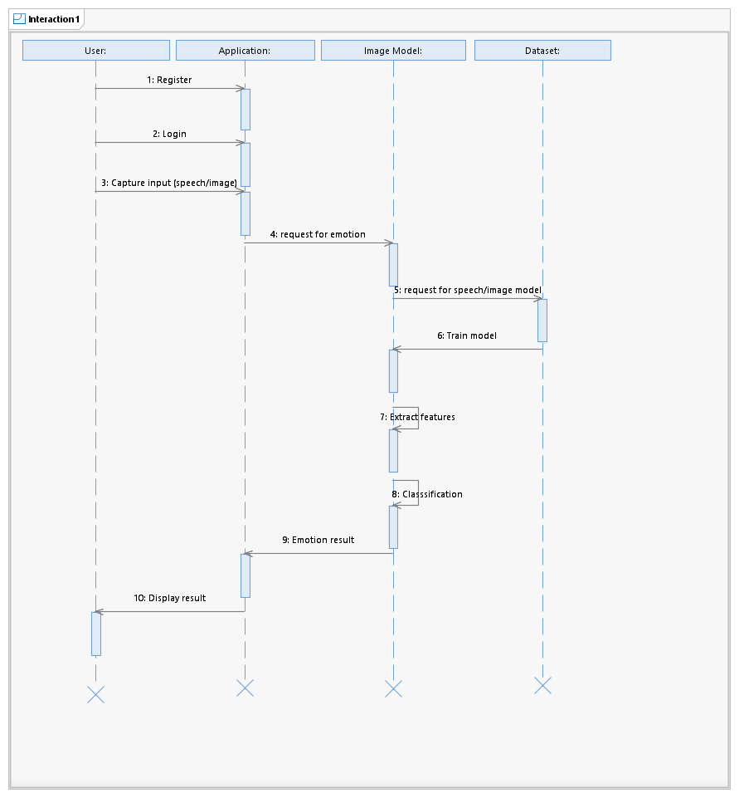
SEQUENCE DIAGRAM

Slide 21
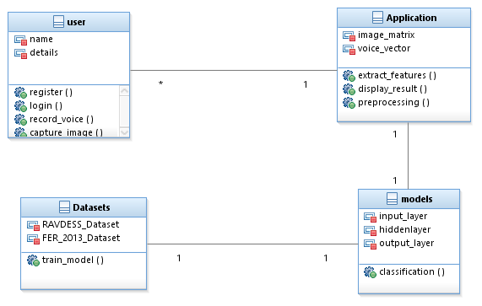
CLASS DIAGRAM

Slide 22
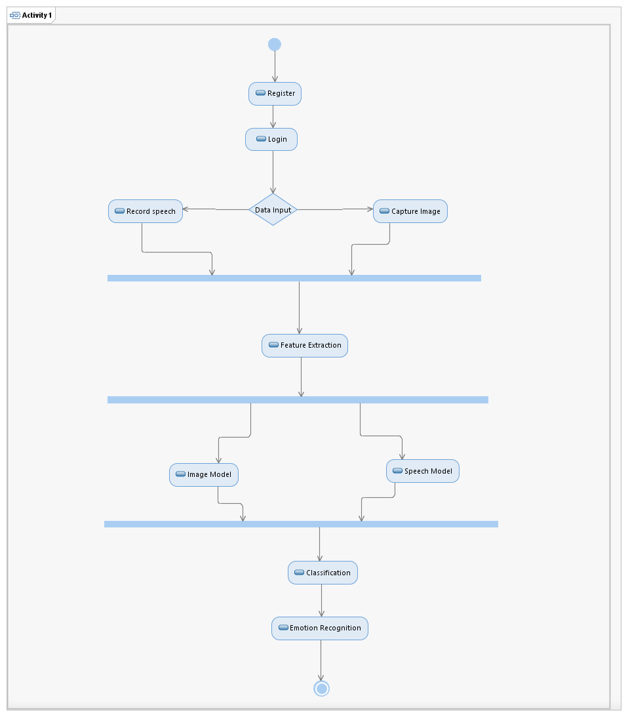
ACTIVITY DIAGRAM

Slide 23
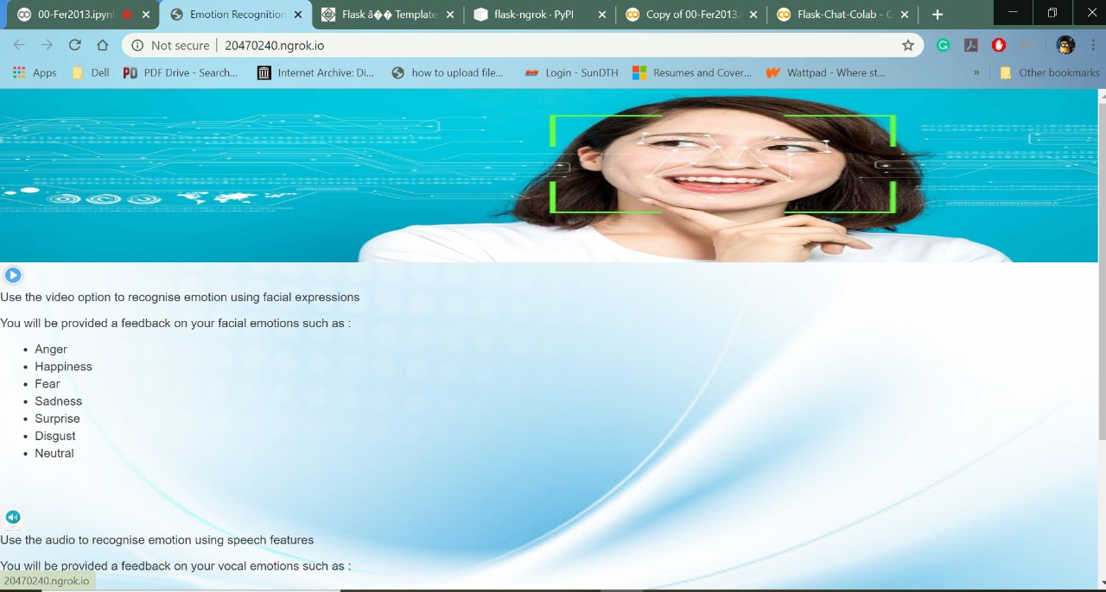
IMPLEMENTATION SCREENSHOTS - SER

Slide 24

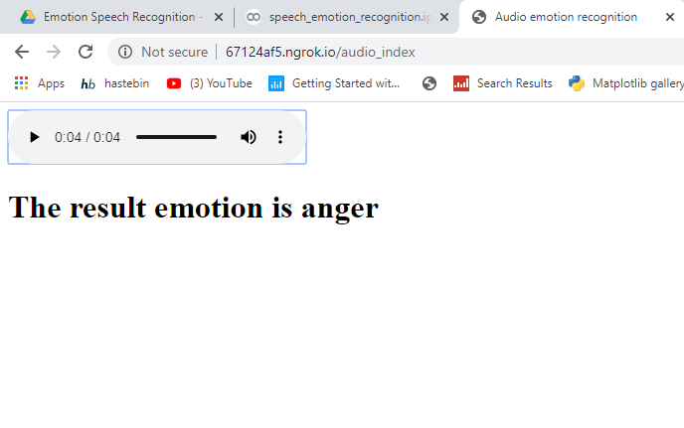
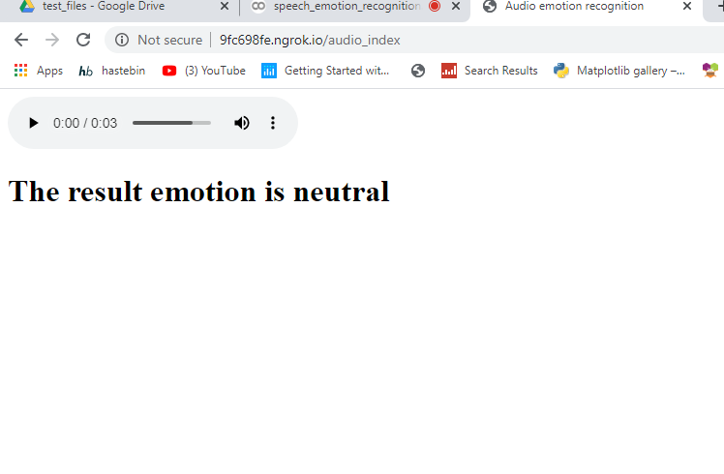
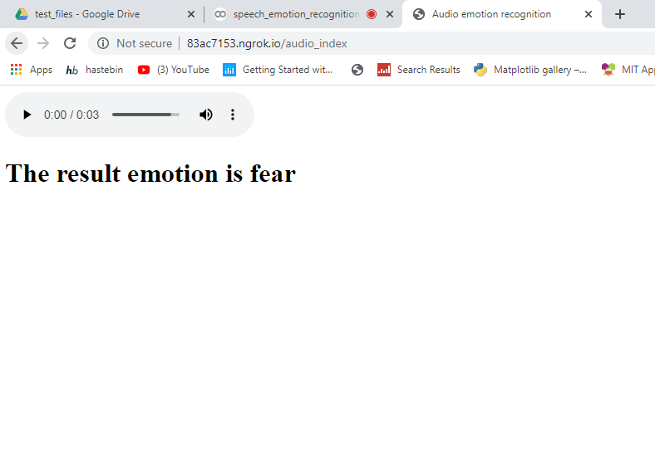
SER OUTPUTS IN WEBPAGE

Slide 25
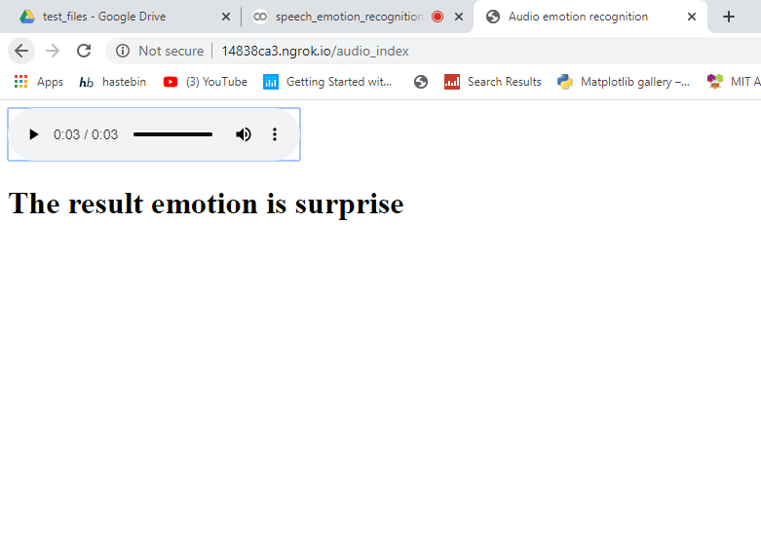
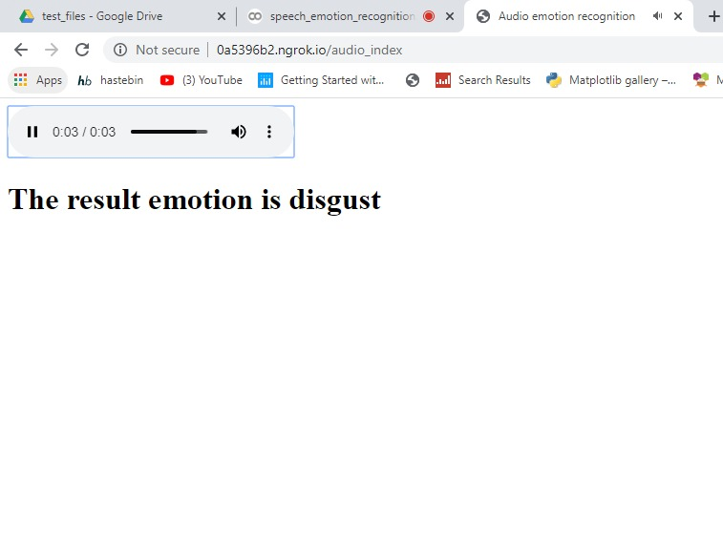
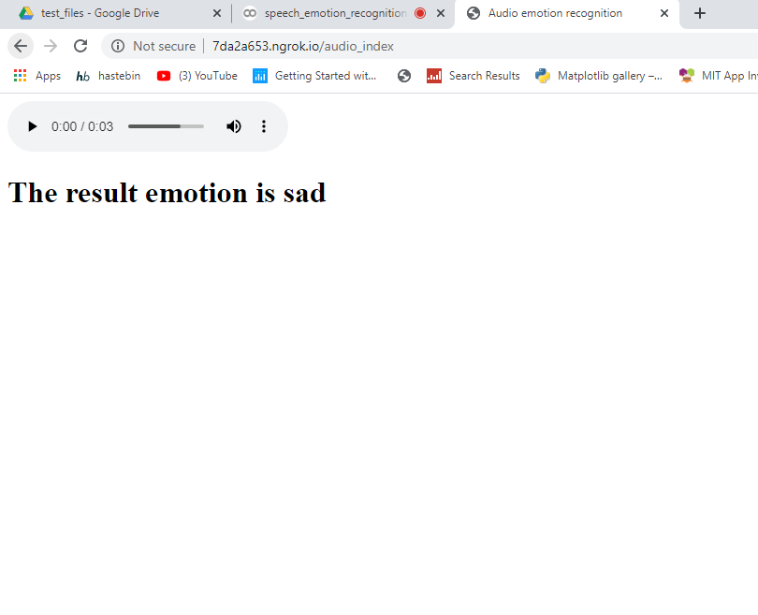
SER OUTPUTS IN WEB PAGE

Slide 26
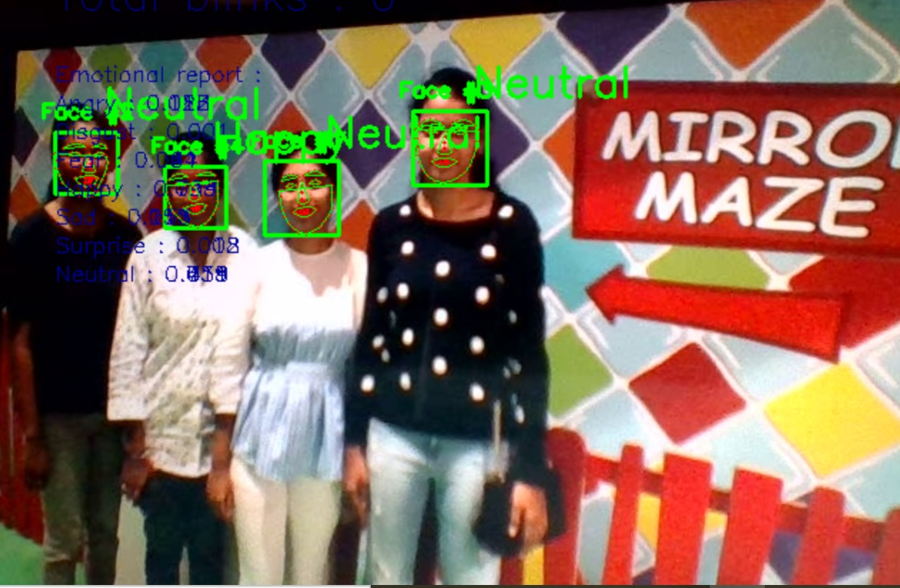
IMPLEMENTATION SCREENSHOTS - FER
FACE EMOTION RECOGNITION RESULT IN WEBPAGE

Slide 27
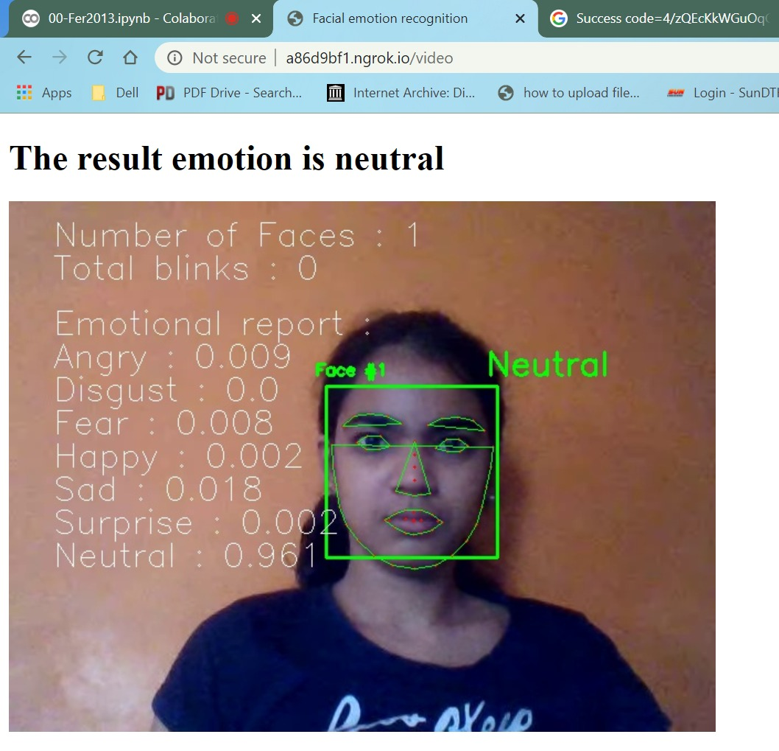
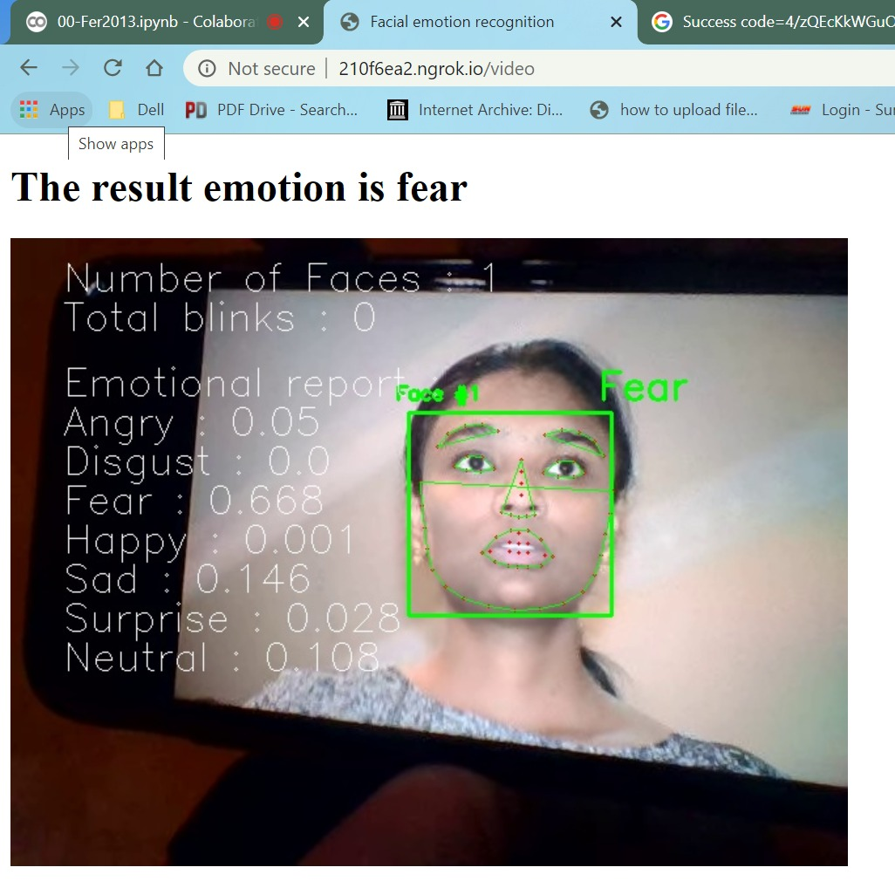
FER OUTPUTS IN WEB PAGE

Slide 28
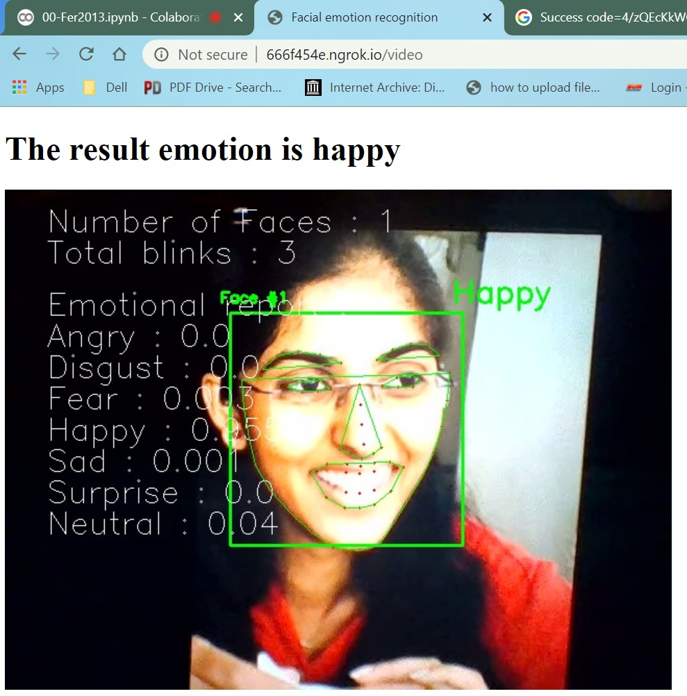
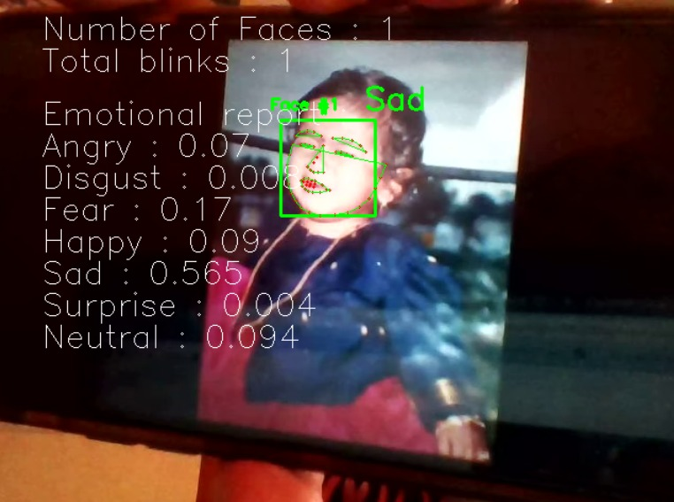
FER OUTPUTS IN WEB PAGE

Slide 29
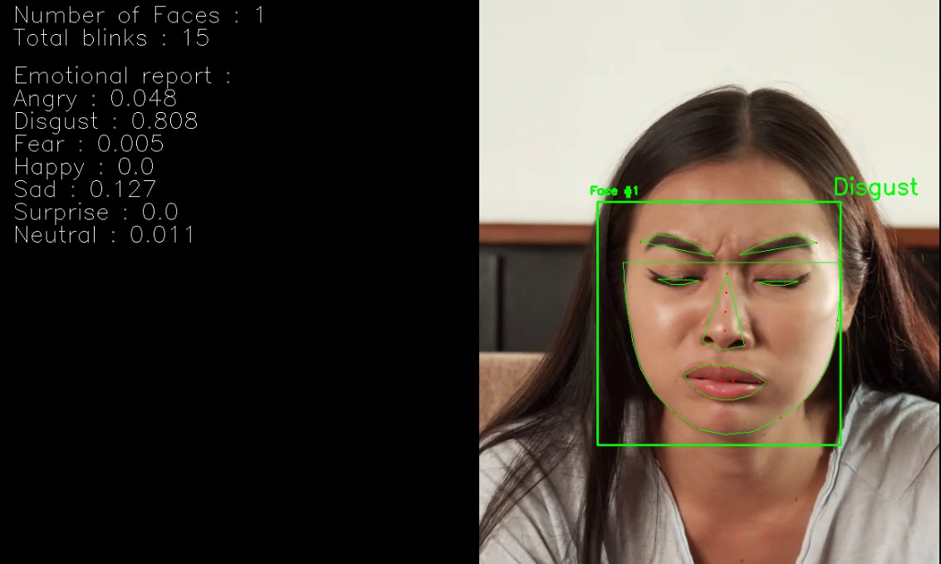
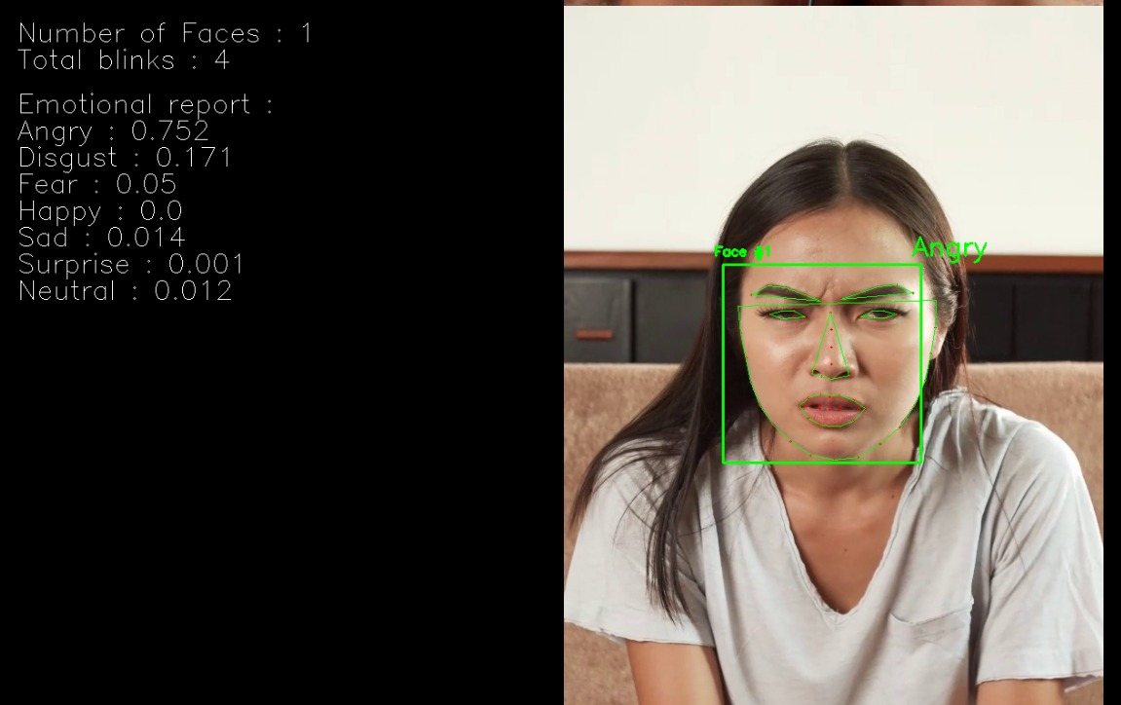
FER OUTPUTS IN WEB PAGE

Slide 30
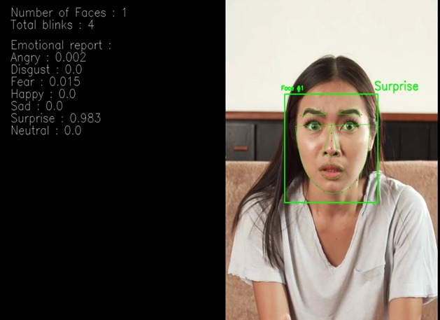
FER OUTPUTS IN WEB PAGE

Slide 31
TESTCASE TEMPLATE
Sno | TestCase ID | TestCase Name | Expected Result | Actual Result | Status
1 | TC001 | Audio file format | SER Model shouldn't support .mp3, .mp4, .ogg audio file formats. | Failed to support.mp3, .mp4, .ogg file formats | PASS
2 | TC002 | Audio file format | SER Model should support .wav file formats only. | It supports .wav file format. | PASS
3 | TC003 | Size of Audio file | SER model shouldn't allow larger audio files as input. | Failed to take large audio files. | PASS
4 | TC004 | Length of Audio file | Model should take audio file of length less than 5 sec while recording the live audio. | Unable to record an audio file of length > 5sec. | PASS

Slide 32
TESTCASE TEMPLATE
Sno | TestCase ID | TestCase Name | Expected Result | Actual Result | Status
5 | TC005 | Video file format | FER model should support .mp4 video file formats. | .mp4 format is supported. | PASS
6 | TC006 | Video file format | FER Model should support .webm video file formats. | .webm format is supported. | PASS
7 | TC007 | Video file format | FER Model should support .ogg video file formats | .ogg format is supported. | PASS
8 | TC008 | Length of Video file | Model should take video file of length as desired by user. | Records video until user clicks stop button. | PASS

Slide 33
APPLICATIONS
Aircraft cockpits to provide analysis of Psychological state of pilot to avoid accidents.
Recognize stress in speech for better performance, lie detection etc.
Can be used along with Uber and Ola applications to know the Psychological state of the driver to avoid accidents or harm to the passengers.
To improve the ability for a medical professional to discern what the patient is actually feeling can be useful in the healing process.
Used to analyze behavioral study of call attendants with the customers which helps to improve the quality of Customer service.
Useful to recommend products to customers based on their emotion towards that product.
Can improve human assistance services in co-ordination with Alexa, Google Home, Microsoft Cortana to stabilize human emotions in day to day life.

Slide 34
CONCLUSION
In this current approach, we developed a Multimodal Emotion recognition (MER) system which classifies 7 universal emotions. The Deep Neural Network models were trained and evaluated to recognize emotional states from various features.
For Speech Emotion Recognition, we implemented Time-distributed Convolutional Neural Networks on RAVDESS dataset and extracted features like MFCC, Mel-Scale, Spectrogram. We acheived an accuracy of 96% on training set and 78% of accuracy on testing set.
For Face Emotion Recognition, we implemented Convolutional Neural Networks on FER-2013 dataset and extracted features like haar features, HOG liding Window, HOG Features, Facial Landmarks. We achieved an accuracy about 90% on training set and 79% on testing set. From this result, we can see that CNN often perform better with more data and it suffers from the problem of very long training times.

Slide 35
FUTURE SCOPE
In future, we can do fusion of audio, video and text emotion recognition models and embed into an application to detect emotions under any circumstances.
We can integrate this system in several applications where emotion plays an important role.
The suicidal rate of people can also be decreased when these applications can find the emotional status (like depressed state) of the person well before.
Can improve human assistance services in co-ordination with Alexa, Google Home, Microsoft Cortana to stabilize human emotions in day to day life.

Slide 36
REFERENCES
[1] Seunghyun Yoon, Seokhyun Byun, and Kyomin Jung, Multimodal speech emotion recognition using audio and text. Accepted as a conference paper at IEEE SLT 2018.
[2] Samarth Tripathi, Homayoon Beigi, Multi-modal emotion recognition on IEMOCAP with neural networks. Submitted on (arXiv:1804.05788) 16 Apr 2018.
[3] Gaurav Sahu, Multimodal speech emotion recognition and ambiguity resolution. In arXiv:1904.06022, Submitted on 12 Apr 2019.
[4] N. Majumdera, D. Hazarikab, A. Gelbukha, E. Cambriac, S. Poriac, Multimodal sentiment analysis using hierarchical fusion with context modeling. Accepted 28 July 2018, Elsevier.
[5] Zheng Lian, Ya Li, Jianhua Tao and Jian Huang, Investigation of multimodal features, classifiers and fusion methods for emotion recognition. Published on September 2018.
[6] Nusrat j. Shoumy, li-minn ang, Kah Phooi Seng, d.m.Motiur Rahaman, Tanveer Zia, Multimodal big data affective analytics: a comprehensive survey using text, audio, visual and physiological signals.
[7] Jose M. Arana, Fernando Gordillo, Jeannete Darias, Lilia Mestas, Analysis of the efficacy and reliability of the moodies app for detecting emotions through speech: does it actually work?

Slide 37
REFERENCES
[8] Minjie Ren, Weizhi Nie, Anan Liu, Yuting Su, Multi-modal correlated network for emotion recognition in speech. In visual Informatics, Volume 3, Issue 3, September 2019.
[9] Maryam Imani, Gholam Ali Montazer, A survey of emotion recognition methods with emphasis on e-learning environments. Published in J. Netw. Comput. Appl. 2019.
[10] Yingying Jiang, Wei Li, M. Shamim Hossain, Min Chen, Abdulhameed Alelaiwi,Muneer Al-Hammadi, A snapshot research and implementation of multimodal information fusion for data-driven emotion recognition. In Elsevier, Accepted on 9 June 2019.
[11] S. Lalitha, Shikha Tripathi, Deepa Gupta, Enhanced speech emotion detection using deep neural networks. In International Journal of Speech Technology, Issues on march,2019.
[12] Mumtaz Begum Mustafa, Mansoor A. M. Yusoof, Zuraidah M. Don, Mehdi Malekzadeh, Speech emotion recognition research: an analysis of research focus. In International Journal of Speech Technology, Issued on Jan, 2018.
[13] Nicholas Cummins, Stefan Scherer, Jarek Krajewski, Sebastian Schnieder, Julien Epps, Thomas F. Quatieri, A review of depression and suicide risk assessment using speech

Slide 38


