Slide 1

SYMPTOM CHECKER CHATBOT
Project Name: Symptom Checker Chatbot
Tagline: An AI-powered assistant to analyze symptoms
Team Name: StackSmashers
Event: DevCraft: Simon’s Command Line
Date: 6/4/2026
Domain: Health Care

Slide 2
Problem Statement
The increasing lack of immediate access to basic healthcare guidance often leads people to ignore or misunderstand their symptoms. Many individuals are unsure whether their condition is serious or requires medical attention. There is a need for a simple system that can analyze symptoms and provide preliminary health suggestions. The problem is to develop a user-friendly application that predicts possible diseases and offers basic recommendations. This system aims to improve awareness and help users take timely health decisions.

Slide 3
Target Audience
General public needing quick health guidance
Students (especially staying away from homes)
Elderly people for regular health monitoring
People in remote areas with limited healthcare access
Working professionals for quick and convenient advice

Slide 4
Existing Solutions
Search engines (Google) for symptom checking
Health applications and symptom checker apps
Medical websites and health blogs
Online doctor consultations (telemedicine)
Many lack personalization and are complex or costly

Slide 5
Gaps & Opportunities
Existing tools are often complex and not localized for diverse languages
Lack of integration with telemedicine services
Limited personalization based on user history
Opportunity to provide affordable, accessible, and multilingual support

Slide 6
Your Solution
Web-based symptom checker
Predicts disease based on user input
Provides medicines, precautions, and doctor advice
Simple, fast, and user-friendly
Helps in early awareness and decision-making

Slide 7
Key Features
Symptom-based disease prediction
Severity and duration analysis
Medical history consideration
Medicine suggestions
Precautions and doctor advice

Slide 8
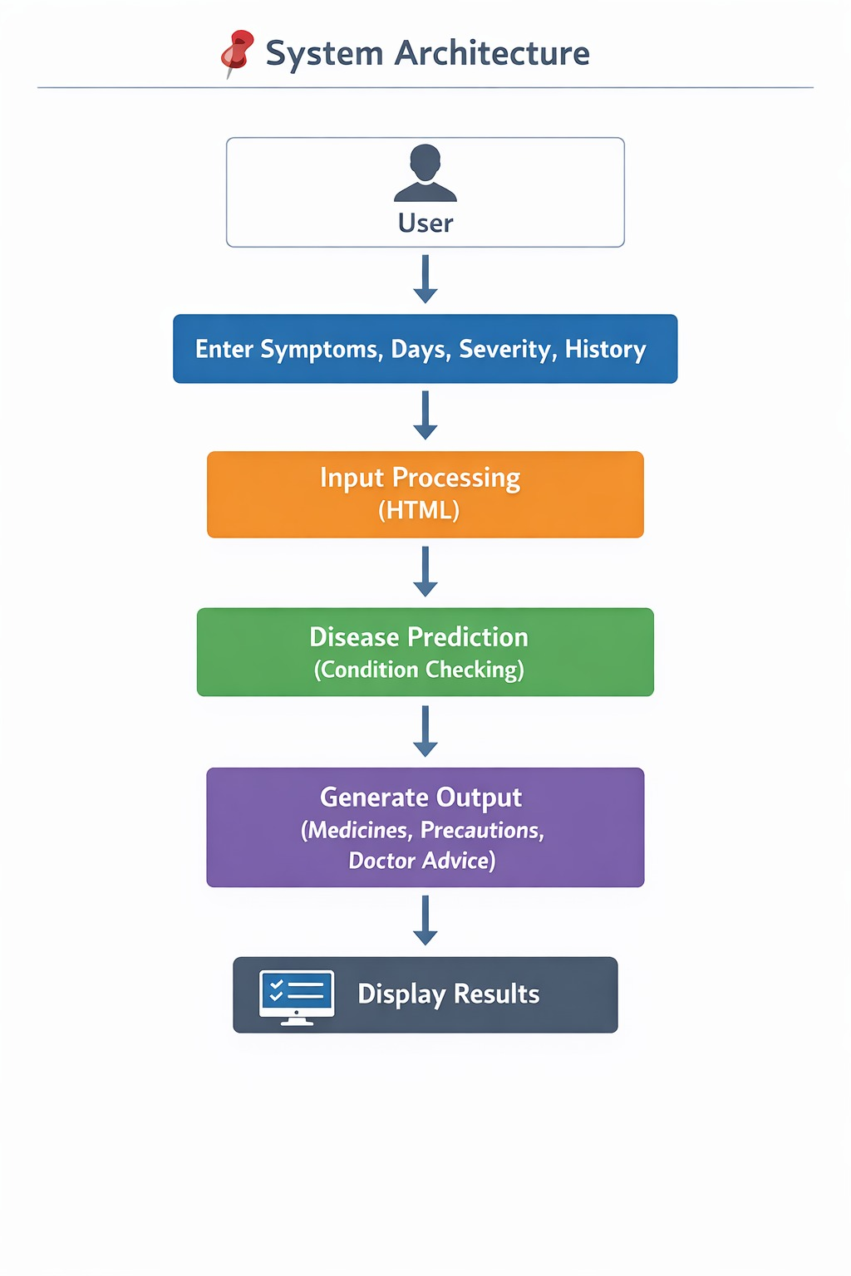
System Architecture

Slide 9
Tech Stack
HTML is used to design the user interface and input forms
Java is used as the backend for processing data
The system analyzes symptoms using predefined logic
It predicts possible diseases based on inputs
Displays results like medicines, precautions, and suggestions

Slide 10
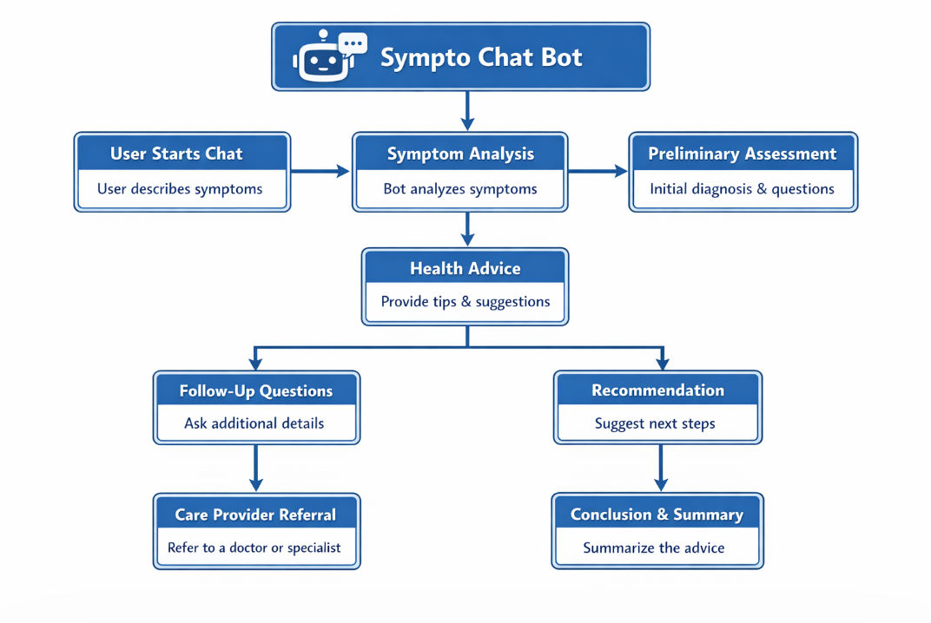
Workflow

Slide 11
Impact
Reduces unnecessary hospital visits
Provides early detection of serious conditions
Empowers rural and underserved communities
Saves time and cost for patients
Promotes health awareness and self-car

Slide 12
Future Scope
Wearable Device Integration – Connect with smartwatches and fitness trackers for real-time health monitoring.
Voice & Multilingual Support – Enable voice-based symptom entry and regional language accessibility.
Predictive Health Analytics – Use AI to forecast potential health risks based on user data trends.
Mental Health Module – Expand into stress and mood tracking for holistic well-being.
Blockchain-Based Data Security – Ensure transparent, tamper-proof medical record management.

Slide 13
Team Info
Member 1: html development
Member 2: Frontend developer
Member 3: Backend developer
Member 4: Healthcare domain expert

