Slide 1
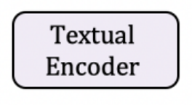

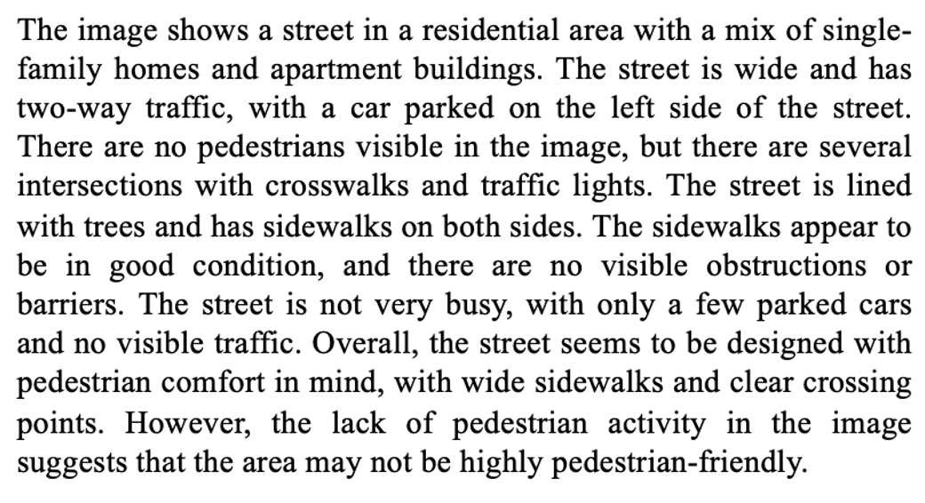
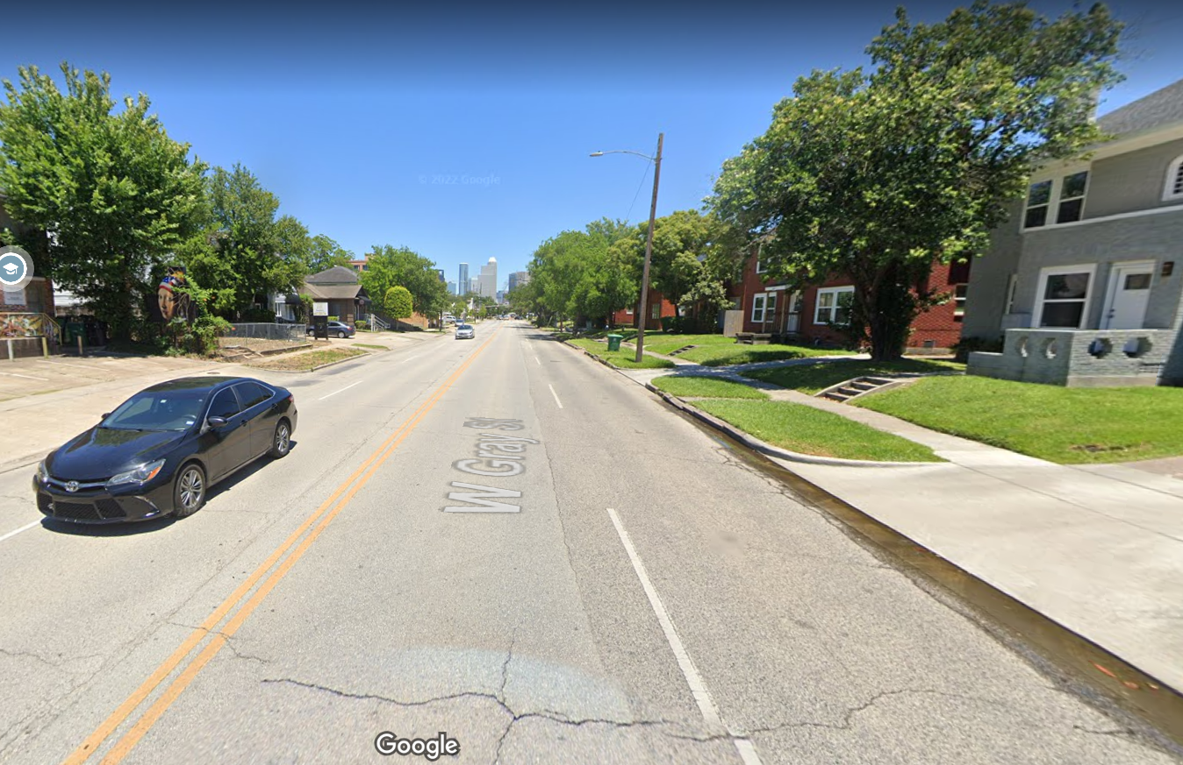

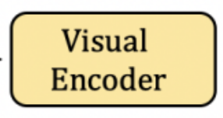

Describe | the | street | environment ..
Textual Descriptions
Adaptor
Class Label
C
T₁
T₂
T₃
T₄
T₅
T_{N}
Labels
...
GOOD
MEDIUM
POOR
...
MULTI-HEAD ATTENTION LAYER
E_{CLS}
E₁
E₂
E₃
E₄
E₅
...
E_{N}
CLS
Tok 1
Tok 2
Tok 2
Tok 4
Tok 5
...
Tok N
Single sentence Input

