Slide 1

DEPARTMENT: COMPUTER SCIENCE AND ENGINEERING
SUBJECT :SUMMER INTERNSHIP (21CSE48A)
TOPIC:ATM TRANSACTION MANAGEMENT SYSTEM
SUBMITTED TO:MS. N SASIKALA(SENIOR ASSISTANT PROFESSOR )
IMPLEMENTED BY:
R.HARSHAVARDHAN REDDY(1NH21CS191)
N.MAHITH KUMAR (1NH21CS170)
P.CHARAN KUMAR(1NH21CS180)
Rahul Pankaj(1NH21CS194)

Slide 2
OBJECTIVES:
ATMs can be used to withdraw money or to deposit money or even to know the information of an account like the balance amount, etc.
They are convenient and easy to use,and it allows consumers to perform quick self-service transactions.
Card readers, cash dispensers, PIN pads, receipt printers and monitors are some of the basic hardware components that go into all ATMs.
Many ATMs also have components for wireless connectivity, check scanning, or even dispensing gift cards.

Slide 3
Program code:-
#include <stdio.h>
unsigned long amount=1000, deposit, withdraw;
int choice, pin, k;
char transaction ='y';
void main()
{
while (pin != 1520)
{
printf("ENTER YOUR SECRET PIN NUMBER:");
scanf("%d", &pin);
if (pin != 1520)
printf("PLEASE ENTER VALID PASSWORD\n");
}
do

Slide 4
{ printf("*******Welcome to ATM Service*************\n"); printf("1. Check Balance\n"); printf("2. Withdraw Cash\n"); printf("3. Deposit Cash\n"); printf("4. Quit\n"); printf("******************?**************************?*\n\n"); printf("Enter your choice: "); scanf("%d", &choice); switch (choice) { case 1: printf("\n YOUR BALANCE IN Rs : %lu ", amount); break; case 2: printf("\n ENTER THE AMOUNT TO WITHDRAW: "); scanf("%lu", &withdraw); if (withdraw % 100 != 0) { printf("\n PLEASE ENTER THE AMOUNT IN MULTIPLES OF 100"); } else if (withdraw >(amount - 500))

Slide 5
{
printf("\n INSUFFICENT BALANCE");
}
else
{
amount = amount - withdraw;
printf("\n\n PLEASE COLLECT CASH");
printf("\n YOUR CURRENT BALANCE IS%lu", amount);
}
break:
case 3:
printf("\n ENTER THE AMOUNT TO DEPOSIT");
scanf("%lu", &deposit);
amount = amount + deposit;
printf("YOUR BALANCE IS %lu", amount);
break;
case 4:
printf("\n THANK U USING ATM");
break;
default:

Slide 6
printf("\n INVALID CHOICE");
}
printf("\n\n\n DO U WISH TO HAVE ANOTHER TRANSCATION?(y/n): \n");
fflush(stdin);
scanf("%c", &transaction);
if (transaction == 'n'|| transaction == 'N’)
k = 1;
}
while (!k);
printf("\n\n THANKS FOR USING OUT ATM SERVICE");
}

Slide 7
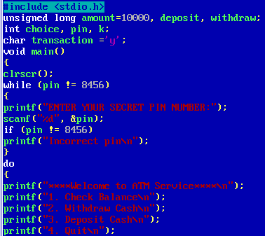
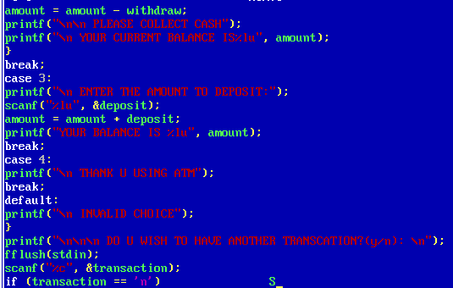
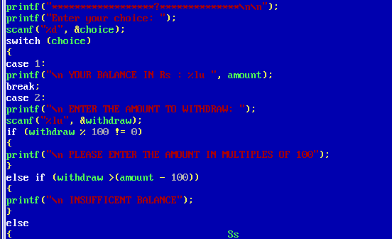

Program in turbo c

Slide 8
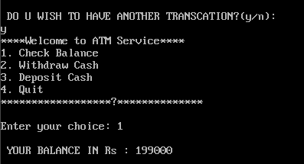
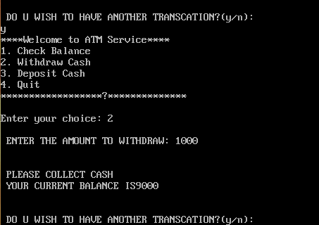
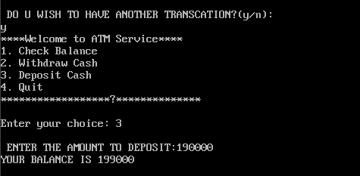
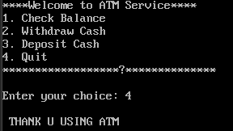
Output:-
Check balance
Withdraw cash
Deposit cash
Quit

Slide 9
Acknowledgement:-
I am very grateful for the strong support and guidance provided to me by my instructor . Who helped me in preparing this project I am very thankful.

