Slide 1
INDIAN PREMIER LEAGUE
Predictions with Big Data Analytics
BATCH-A TEAM -7

Slide 2
Team Members
VALLETI MAHI VIGNESH | CB.EN.U4AIE22056
T.LAKSHMAN | CB.EN.U4AIE22067
G.SURYA TEJA | CB.EN.U4AIE22069
Y. RAMA KRISHNA PRASAD | CB.EN.U4AIE22070

Slide 3
FIRST EDITION
IPL OVERVIEW
2008
FORMAT
The Indian Premier League (IPL) premier Twenty20 cricket league in India. Renowned for its high-energy matches and star-studded teams representing cities, the IPL has become a global cricketing phenomenon. With innovative formats and top international players, it blends entertainment and competition, captivating a massive fan base. The IPL has redefined modern cricket, elevating it beyond a sport to a cultural spectacle.
Twenty20
NUMBER OF TEAMS
TEN ( 10 )
ADMINISTRATOR
BCCI
( Board of Control for Cricket in India )
HEADQUARTERS
Cricket Centre, Churchgate,
Mumbai, Maharashtra

Slide 4



TEAMS PLAYING
CHENNAI SUPER KINGS
MUMBAI INDIANS
DELHI CAPITALS
PUNJAB KINGS
GUJRAT TITANS
RAJASTHAN ROYALS
KOLKATA KNIGHT RIDERS
ROYAL CHALLENGERS BANGALORE
LUCKNOW SUPER GIANTS
SUNRISERS HYDERABAD
DEECAN CHARGES
KOCHI TUSKERS KERLA

Slide 5
PROBLEM STATEMENT
Every team dreams of winning the final trophy, turning that dream into a concrete goal that drives their actions. Achieving it requires not only excelling in favorable conditions but also meticulous planning for unfavorable scenarios. Success comes to those who anticipate challenges, adapt their strategies, and remain resilient, using data-driven approaches to overcome adversity and achieve their goals.

Slide 6
OBJECTIVES
ANTICIPATE UNFAVORABLE SCENARIOS:
by identifying patterns and trends from historical data to predict challenges and adapt strategies accordingly.
UTILIZE BIG DATA ANALYTICS :
to process and analyze vast amounts of cricket data for better insights into team performance, player form, and match conditions.
IMPROVE DECISION-MAKING:
by providing teams with data-driven insights to make informed tactical decisions in real-time during matches.

Slide 7
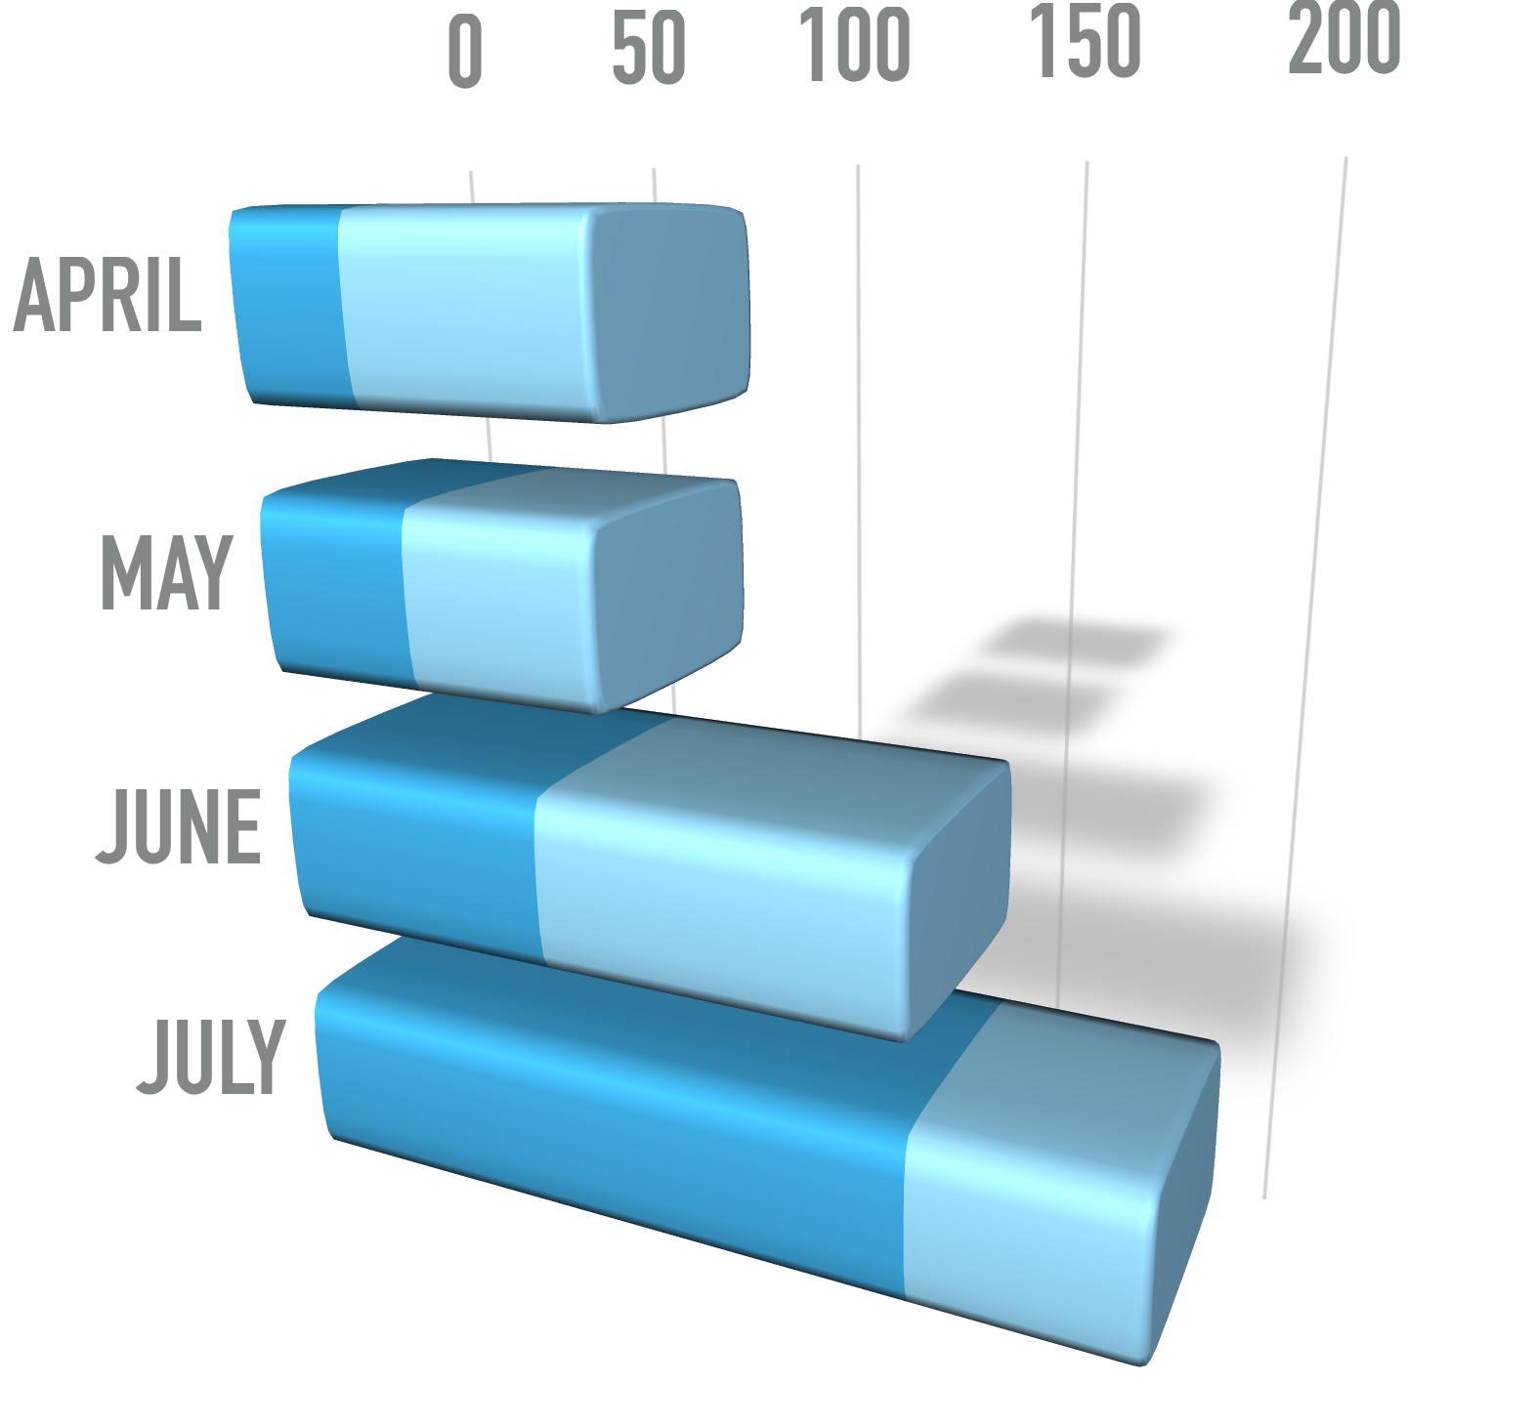
DATASET OVERVIEW
The dataset is used to derive insights such as team win percentages, head-to-head records, venue statistics, and player performances.
match_id : Unique identifier for each match.
season : The IPL season in which the match was played.
date : The date on which the match took place.
team1 : The name of the first team.
team2 : The name of the second team.
venue : The location where the match was held
toss_winner : The team that won the toss.
toss_decision : The decision made by the toss-winning team (bat or field).

Slide 8
DATASET OVERVIEW
The dataset is used to derive insights such as team win percentages, head-to-head records, venue statistics, and player performances.
winner : The team that won the match.
result : The result type (e.g., runs, wickets).
result_margin : The margin by which the match was won.
player_of_match : The player awarded as the Player of the Match.
city : The city where the match was played.

Slide 9
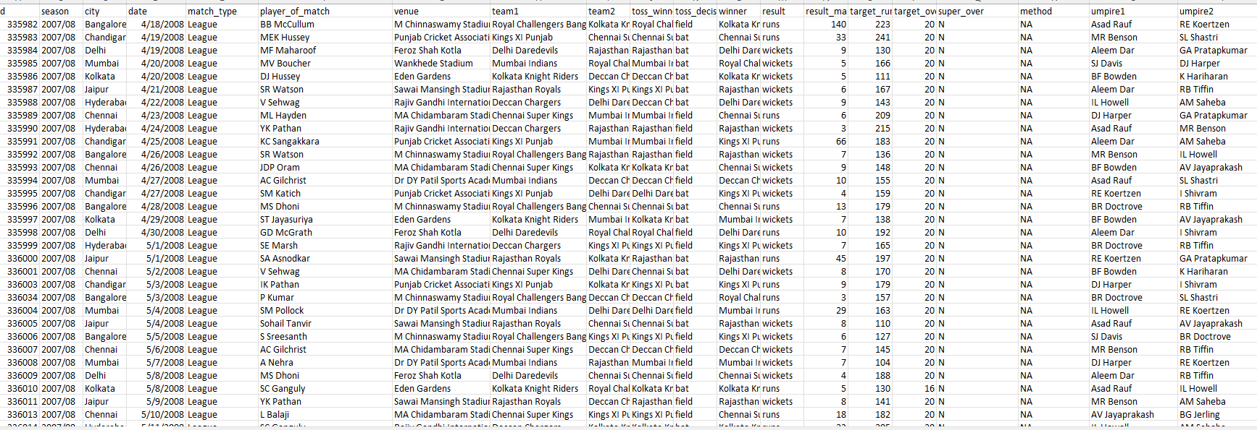
DATASET SNAPSHOT OF MATCHES.CSV

Slide 10
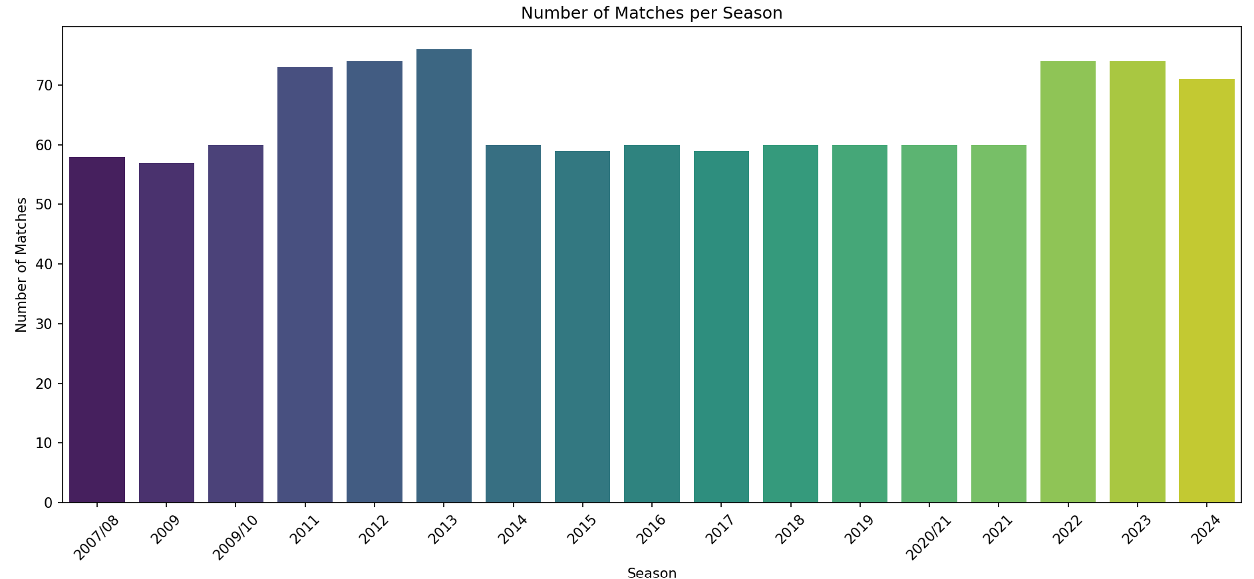
Dataset visualization

Slide 11
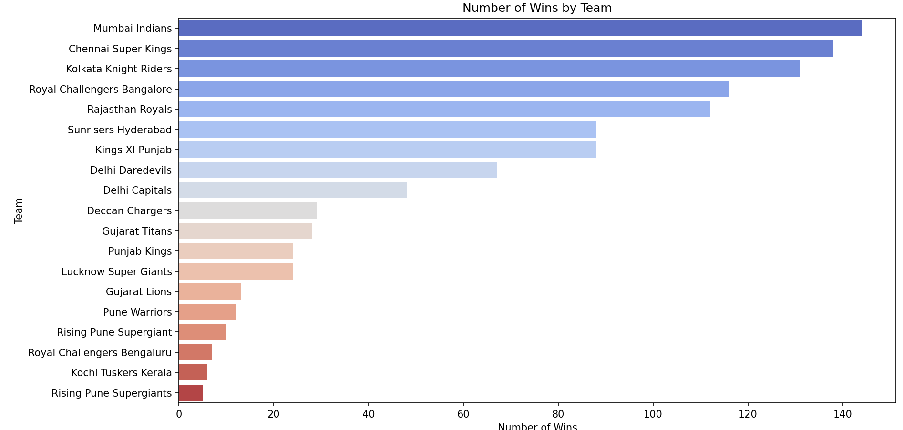
Dataset visualization

Slide 12
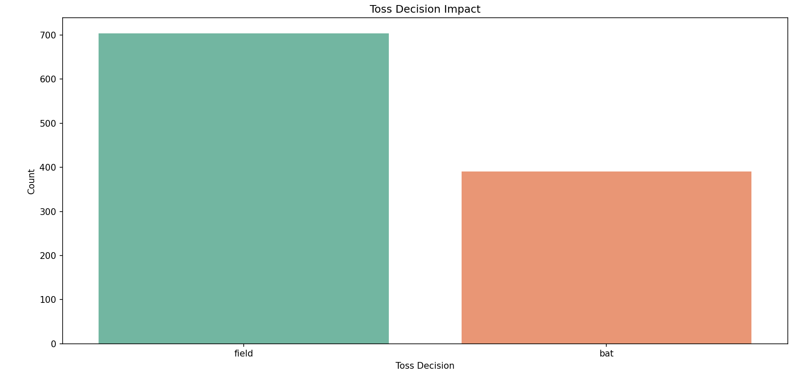
Dataset visualization

Slide 13
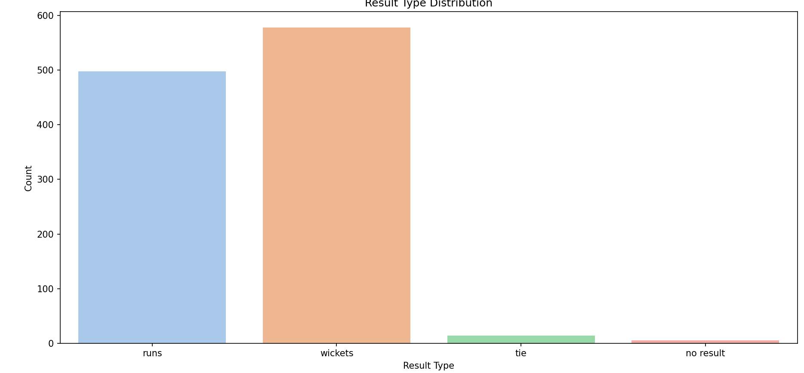
Dataset visualization

Slide 14
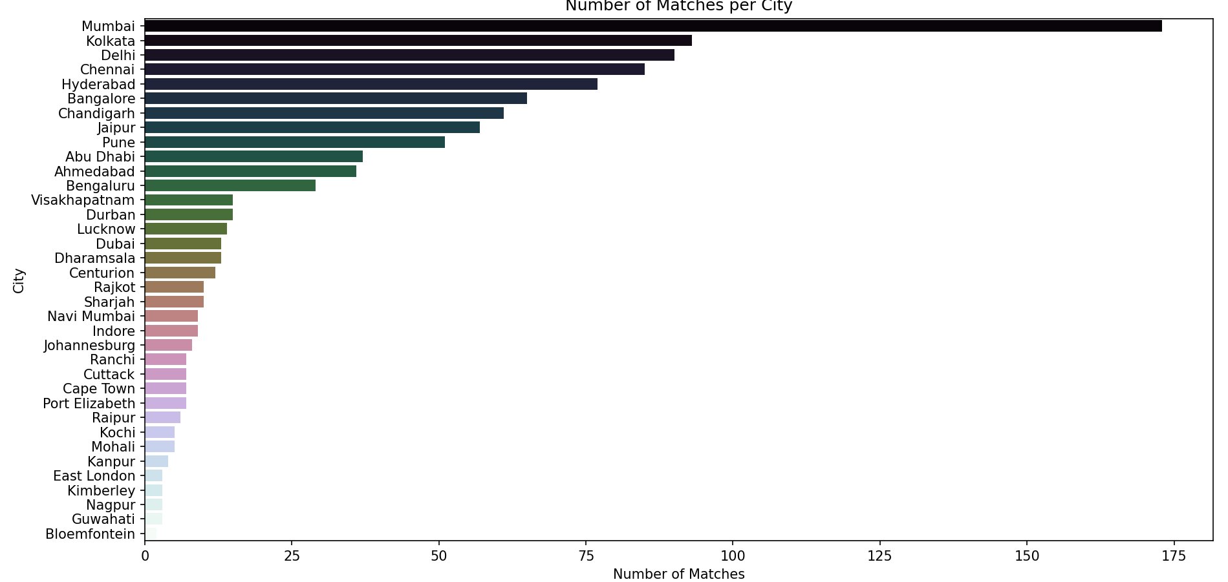
Dataset visualization

Slide 15
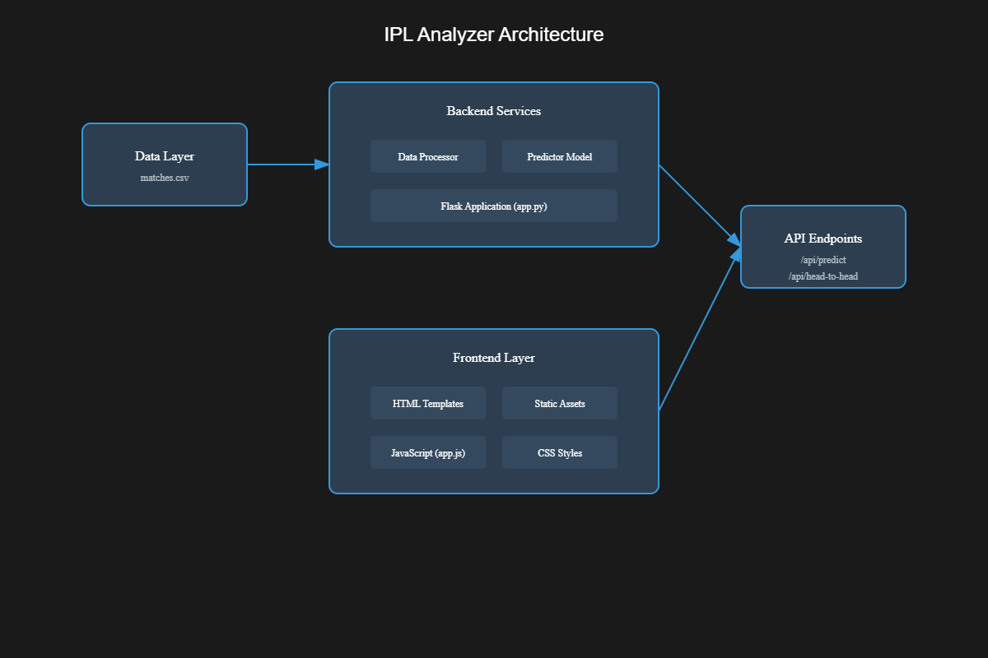
IPL Analyzer Architecture

Slide 16
Data – Pre Processing
Date conversion to datetime format and year extraction
Handling missing values by filling NaN values in player_of_match and city columns
Feature engineering to create derived columns like batting_first and batting_second
Label encoding for categorical features like team names, venues, and toss decisions
Data filtering to remove rows with missing winners
Feature creation for model training

Slide 17
Random Forest classification
Random Forest is an ensemble learning method for classification (and regression) that operates by constructing multiple decision trees during training. It then outputs the mode (most frequent class) of the individual trees' predictions as the final result.
Decision Tree: A single model that makes predictions by splitting the dataset based on feature values (like "Did team bat first?", "Is the venue home ground?", etc.).
Random Forest: Combines many decision trees to improve accuracy and prevent overfitting. Each tree in the forest makes a prediction, and the majority vote becomes the final prediction.

Slide 18
Random Forest Workflow
Random Forest works by:
Splitting the data into multiple subsets and training different decision trees.
Each tree may focus on different aspects of the data, improving overall prediction accuracy.
The final prediction is determined by the majority voting of these individual trees.
Factors affecting
Toss winner (team that won the toss)
Toss decision (batting or bowling)
Home team (home advantage or not)
Venue (different grounds may favor different teams)
Match type (league, playoff, final)
Batting first or second (important factor in T20 games)
Players of the teams (key players in form)

Slide 19
Visual Explanation of Random Forest in IPL Prediction
(A) Tree 1: Decision based on toss and toss decision
This tree might focus on which team won the toss and what decision they made (to bat or bowl first).
Example: If the team won the toss and chose to bat, it checks past data of similar matches.
Final node: Predicts the match result based on this feature set.
(B) Tree 2: Decision based on venue and team performance
This tree might focus on the venue and historical performance of the teams at that venue.
Example: If a team has consistently won at a particular stadium, this tree may predict a win for that team.
Final node: Gives a prediction based on venue statistics.

Slide 20
Visual Explanation of Random Forest in IPL Prediction
C) Tree 3: Decision based on batting first or second
This tree could focus on whether a team is batting first or second.
Example: If a team performs better when batting first, the tree predicts a win when they bat first.
Final node: Provides a prediction based on batting order.
(D) Majority Voting:
After each tree in the forest makes its own prediction, the model performs majority voting.
If 7 out of 10 trees predict Team A will win, the final prediction of the Random Forest is that Team A will win.

Slide 21

Visual Explanation of Random Forest in IPL Prediction
Imagine we're predicting the outcome of a match between Team A and Team B, and the data looks like this:
Using this kind of data, Random Forest would look at historical patterns for similar matches to make a prediction.
One tree might say: "Team A tends to win when they bat first in Delhi."
Another tree might say: "Team B often wins when they bowl first in Mumbai."
The final prediction would combine these insights to make a more accurate prediction.

Slide 22
THANK YOU

