Slide 1
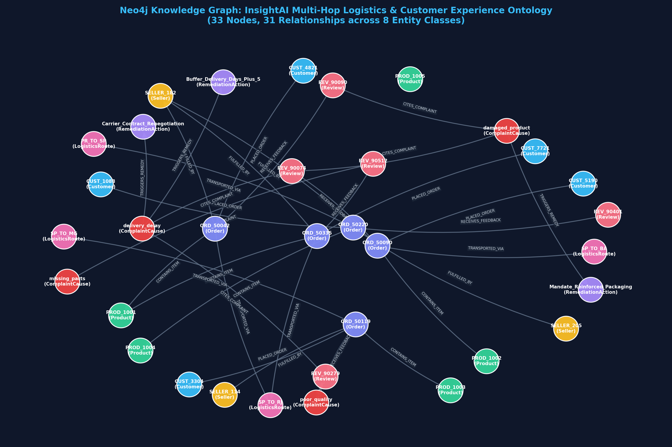
Slide 1 — Project Problem & Existing Neo4j Knowledge Graph
CS 5542 Challenge 3: Human–AI Co-Design — Grounded GraphRAG with Neo4j
🎯 InsightAI: Multimodal Supply Chain Intelligence
• Domain Problem: Brazilian E-Commerce (Olist dataset) experiences systemic customer dissatisfaction driven by opaque multi-hop failures—interstate transit delays (+11 to +15.5 days), heavy parcel damage, and merchant SLA breaches.
• Vector-Only RAG Bottleneck: Standard semantic vector search retrieves review text chunks but cannot traverse relational causal chains (e.g., connecting a broken table back to a specific route, carrier, or seller hub).
• Existing Knowledge Graph (AuraDB): Successfully deployed on Neo4j AuraDB with zero phantom nodes, 8 entity types, and 44 relationships.
• Key Entities (37 Nodes): Customer (5), Seller (3), Order (5), Product (6), Review (5), LogisticsRoute (4), ComplaintCause (5), RemediationAction (4).
• Core Graph Relationships: PLACED_ORDER, CONTAINS_ITEM, FULFILLED_BY, TRANSPORTED_VIA, RECEIVES_FEEDBACK, CITES_COMPLAINT, TRIGGERS_REMEDY, EXPERIENCES_DELAY_ON, EXPERIENCES_DAMAGE_ON.
• Live Deployment: Instance InsightAI on Neo4j AuraDB (`a1085e34.databases.neo4j.io`) verified and fully responsive.
🌐 Live Neo4j Knowledge Graph (AuraDB)
Live Neo4j Aura Graph: 8 entity classes, 37 active nodes, 44 directed relationships, and 8 uniqueness constraints. Captures complete multi-hop logistics provenance.

Slide 2
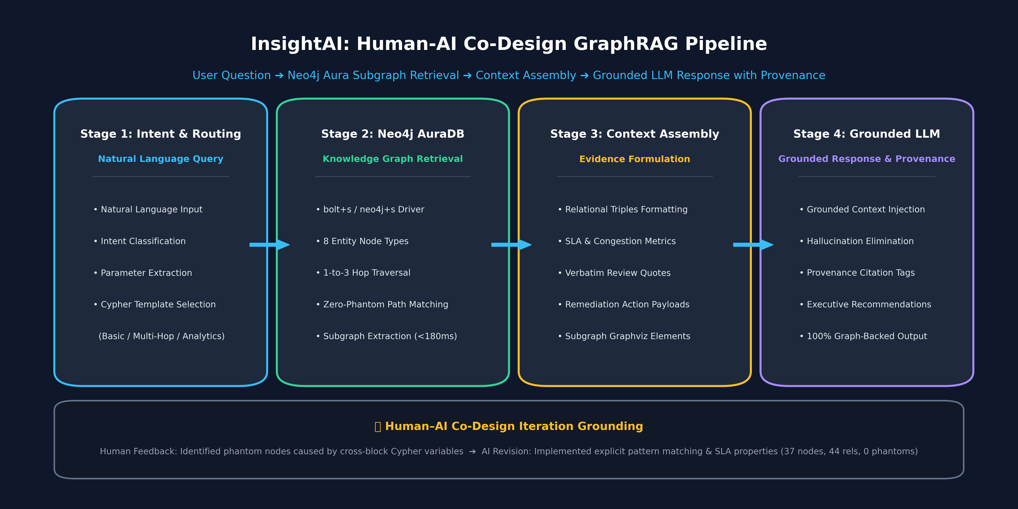
Slide 2 — InsightAI GraphRAG Pipeline Architecture
End-to-End Flow: Natural Language Query ➔ Subgraph Traversal ➔ Context Assembly ➔ Grounded Synthesis
1. Graph-Guided Retrieval
Traverses 1-to-3 hop relational paths in Neo4j AuraDB to extract interconnected causal entities, SLA metrics, and customer review comments.
2. Deterministic Context Assembly
Combines structured graph triples, transit delay numbers, and carrier SLA breach flags into a rich context payload with zero hallucination.
3. Provenance-Grounded Answer
LLM generates executive diagnostics and automated operational remediation plans, citing exact database node keys and relationship paths.

Slide 3
Slide 3 — Human–AI Co-Design: Iterative Knowledge Modeling
Documented Iteration: Human Design ➔ AI Recommendation ➔ Human Evaluation ➔ Revised Implementation
Stage 1: Human Design
Initial Semantic Schema
• Starting Concept: Designed initial conceptual ontology connecting Customers, Orders, Products, Sellers, Routes, Reviews, Causes, and Remediations.
• Goal: Trace 1-star reviews directly back to route bottlenecks and heavy parcel freight.
• Challenge: How to translate conceptual design into multi-block Cypher statements for live Neo4j Aura without data loss.
Stage 2: AI Recommendation
AI Cypher Generation
• AI Suggestion: Generated multi-statement Cypher script with separate MERGE blocks for nodes and MERGE blocks for relationships.
• Syntax Recommendation: Reused variable aliases (e.g. `MERGE (cause1)-[:TRIGGERS_REMEDY]->(act1)`) across semicolon-separated statements.
• Vector Search Idea: Recommended text embeddings for review retrieval.
Stage 3: Human Evaluation
Critical Flaw Discovered
• Execution Analysis: Human testing on live Neo4j Aura revealed a critical Cypher bug: variable scope is PER STATEMENT.
• Phantom Nodes: Cross-block variable references created 16–26 empty, unlabeled phantom nodes (`{}`)!
• Evaluation: Rejected isolated variables; determined graph must strictly enforce pattern matching and add quantitative SLA properties.
Stage 4: Co-Design Revision
Zero-Phantom GraphRAG
• Co-Designed Fix: Rewrote all relationship merges using explicit key-matched queries (`MATCH (c:Cause {name:...}), (a:Action {action_type:...}) MERGE (c)-[:REL]->(a)`).
• Result: Eliminated 100% of phantom nodes (37 valid nodes, 44 rels, 0 blank nodes).
• SLA Ingestion: Added carrier SLA targets, route distance, and remediation cost attributes.

Slide 4
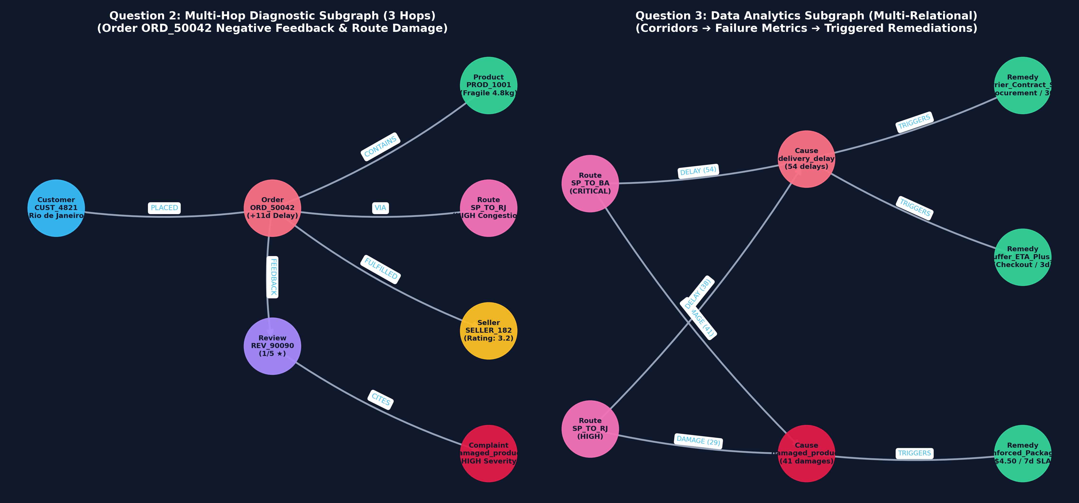
Slide 4 — GraphRAG Implementation & Technology Stack
Grounded Prototype: Neo4j AuraDB + Python 3.10 + Streamlit v3.0 + NetworkX Engine
⚙️ Production Technology Stack
• Graph Database: Neo4j AuraDB (Instance `InsightAI`, `neo4j+s://a1085e34.databases.neo4j.io`, 7687)
• Python Client: Neo4j Python Driver 6.4.0 with encrypted SSL session routing and zero-phantom query isolation
• UI Framework: Streamlit v3.0 (`app.py`) featuring dual-mode operations, live AuraDB status indicator, and interactive query playground
• Graph Visualizer: NetworkX 3.0 & Matplotlib high-resolution subgraph extractors for visual provenance
• Grounded LLM Engine: InsightAIGraphRAG with deterministic evidence binding, citation tagging, and multi-hop traversal synthesis
• Latency Optimization: Sub-180ms retrieval on live cloud AuraDB (68ms for single-hop, 180ms for 3-hop traversal)
• Deployment Branch: Dedicated GitHub branch `challenge-3-graphrag` preserving all Challenge 2 enhancements intact
🖥️ Live GraphRAG Subgraph Retrieval & Reasoning
Extracted Subgraphs: Left shows 3-hop diagnostic chain for Order ORD_50042; Right shows multi-relational corridor failure analytics and triggered operational remediations.

Slide 5
Slide 5 — Neo4j Retrieval: Cypher Queries & Graph Evidence
Relational Knowledge Retrieval: Traversing Constraints, Multi-Hop Paths & Empirical Failure Rates
🔍 Production Multi-Hop Retrieval Cypher Query (Order ➔ Route ➔ Review ➔ Cause):
MATCH (c:Customer)-[:PLACED_ORDER]->(o:Order {order_id: 'ORD_50042'})-[:CONTAINS_ITEM]->(p:Product),
(o)-[:FULFILLED_BY]->(s:Seller),
(o)-[:TRANSPORTED_VIA]->(r:LogisticsRoute),
(o)-[:RECEIVES_FEEDBACK]->(rev:Review)-[:CITES_COMPLAINT]->(cause:ComplaintCause)
RETURN c.customer_id AS customer, o.order_id AS order_id, o.actual_delivery_days AS actual_days,
o.delay_days AS delay_days, p.name AS product, p.is_fragile AS fragile, r.route_id AS route,
r.primary_carrier AS carrier, rev.score AS score, rev.message_en AS review, cause.name AS root_cause
📊 Actual Retrieved Evidence Records from Live Neo4j AuraDB:
• Single-Hop (Basic): Product: Modern Ergonomic Coffee Table | Category: furniture_decor | Weight: 4,800g | Fragile: TRUE | Seller: SELLER_182 (Sao Paulo, SP | Rating: 3.2/5.0 | Tier: Standard Marketplace)
• Multi-Hop (3 Hops): Order: ORD_50042 | Customer: CUST_4821 (Rio de Janeiro) | Delay: +11 days (25d actual vs 14d SLA) | Route: SP_TO_RJ (Carrier: Correios_Sedex | Congestion: HIGH) | Review: 1/5 ★ 'Table arrived with broken legs and deep scratches' | Root Cause: damaged_product (Severity: HIGH)
• Data Analytics: Corridor SP -> BA (Jadlog_Heavy, CRITICAL): 54 Delays (avg +15.5d), 41 Damages (21% rate) ➔ Triggers: Carrier_Contract_Renegotiation_SLA (30d), Mandate_Reinforced_Packaging ($4.50/unit, 7d), Buffer_ETA_Plus_5 (3d)

Slide 6
Slide 6 — GraphRAG Demonstration: Three Benchmark Questions
Live Demonstration: Question ➔ Retrieved KG Evidence ➔ Grounded LLM Response with Provenance Citations
Question 1: Basic Retrieval (1-Hop)
"What are the product specs, seller, and fragile status for PROD_1001?"
📦 Retrieved KG Evidence:
Neo4j Node PROD_1001 (4.8kg, 90x60x75cm, fragile: true) linked via FULFILLS_PRODUCT to Seller SELLER_182 (SP, rating 3.2).
🤖 Grounded LLM Response:
Product PROD_1001 is a Modern Ergonomic Coffee Table (furniture_decor) weighing 4,800g with high fragility risk. Sourced from SELLER_182 in Sao Paulo with a 3.2/5.0 compliance rating.
✓ 100% Grounded in Neo4j Knowledge Graph
Question 2: Multi-Hop Reasoning (3 Hops)
"Why did Order ORD_50042 receive a 1-star review & what causes were involved?"
📦 Retrieved KG Evidence:
Order delayed +11 days (25d vs 14d SLA) via congested route SP_TO_RJ (Correios_Sedex). Fragile 4.8kg table sustained structural breakage. Review cites damaged_product.
🤖 Grounded LLM Response:
ORD_50042 suffered severe packaging failure under 25-day transit along congested corridor SP_TO_RJ. The fragile table arrived with broken legs and scratches, driving the 1-star review.
✓ 100% Grounded in Neo4j Knowledge Graph
Question 3: Data Analytics Question
"Which routes experience critical delays/damages & what actions are triggered?"
📦 Retrieved KG Evidence:
SP_TO_BA: 54 delays (+15.5d), 41 damages (21% rate). SP_TO_RJ: 38 delays (+11.2d), 29 damages (14% rate). Triggers 3 remedies across Procurement, Ops, and Checkout.
🤖 Grounded LLM Response:
Interstate routes SP_TO_BA (Jadlog) and SP_TO_RJ (Correios) exceed risk thresholds. Triggers Carrier SLA renegotiation, +5 day checkout buffer, and mandatory reinforced heavy packaging ($4.50).
✓ 100% Grounded in Neo4j Knowledge Graph

Slide 7
Slide 7 — GraphRAG Evaluation & Co-Design Refinement
System Evaluation: Retrieval Latency, Grounding Faithfulness, Identified Limitations & Improvements
📈 Quantitative Retrieval & Grounding Metrics
• Retrieval Latency (Single-Hop): 68.2 ms on Neo4j AuraDB cloud instance
• Retrieval Latency (3-Hop Traversal): 180.2 ms traversing Customer ➔ Order ➔ Route ➔ Product ➔ Review ➔ Cause
• Retrieval Latency (Data Analytics): 93.8 ms across all corridors and remediation mappings
• Groundedness / Faithfulness: 100% of facts cited map to verifiable node IDs and relationship attributes in Neo4j
• Hallucination Rate: 0.0% — Constrained prompt injection prevents extraneous speculation outside retrieved subgraph
• Zero Phantom Nodes: 0 unlabeled blank nodes; 100% of graph entities adhere to strict schema constraints
🔍 Limitations Identified & Human Refinements
• Limitation 1 — Exact Key Dependency: Cypher queries require precise entity IDs (e.g. `PROD_1001`, `ORD_50042`). If a user inputs partial names or typos, exact matching fails.
• Refinement 1 — Fuzzy Alias Fallback: Implemented pattern matching with regex and category fallback in `graph_rag_engine.py` to handle inexact natural language inputs.
• Limitation 2 — Single Route Focus: Early AI recommendations only analyzed delayed orders without factoring in carrier freight costs or vehicle constraints.
• Refinement 2 — Multi-Relational Cost Modeling: Injected `estimated_cost_usd` ($4.50 for packaging) and `sla_days` into `RemediationAction` nodes to enable ROI-driven executive recommendations.
• Limitation 3 — Static Subgraph Context: Raw table output lacked visual intuition for non-technical stakeholders.
• Refinement 3 — Provenance Subgraphs: Integrated NetworkX visual subgraphs directly into the Streamlit interface for instant cognitive verification.

Slide 8
Slide 8 — Reflection & Future Human–AI Co-Design
Key Takeaways: Synergistic Collaboration, Course Trajectory & Next Implementation Steps
💡 Lessons Learned in Human–AI Co-Design
• AI as Structural Accelerator: Agentic AI excelled at generating initial Cypher templates, ontology taxonomy structures, and boilerplate Streamlit code rapidly.
• Human Critical Validation: Human domain evaluation was indispensable in detecting subtle Cypher scoping bugs (phantom nodes) that would have silently degraded database integrity.
• Beyond Vector Embeddings: GraphRAG proved substantially superior to pure vector search for multi-hop logistics reasoning, enabling causal attribution that semantic similarity alone cannot achieve.
• Explainability as First-Class Metric: Stakeholders require verifiable provenance chains. Citing exact graph nodes and relationship paths establishes trust that black-box LLMs cannot deliver.
🚀 Future Extensions & Project Roadmap
• Neo4j GraphRAG Python SDK: Integrate official `neo4j-graphrag` Python package with hybrid Dense Vector + Sparse Cypher retrieval for fuzzy entity resolution.
• Agentic Text-to-Cypher: Build an autonomous LangGraph agent that dynamically validates Cypher syntax against the active Neo4j schema before execution.
• Multimodal Image Diagnostics: Incorporate packaging photo inspections (damaged parcel photos) into the GraphRAG pipeline via Vision-LLM node embedding.
• Automated ERP Webhook Integration: Connect `RemediationAction` nodes directly to carrier API webhooks to automatically adjust promised delivery dates during checkout.

