Slide 1
Slide 1 — Project Overview & Completed Human Design Foundation
CS 5542 Challenge 4 (Stage 2: AI Design Implementation): Transitioning from Human Design to AI Exploration
🎯 Existing Foundation & Domain
• Domain Focus: InsightAI diagnoses supply chain bottlenecks, delivery delays, and 1-star reviews across Brazilian e-commerce (Olist dataset).
• Neo4j Knowledge Graph: Live AuraDB KG with 37 nodes, 44 directed relationships, and 8 entity types (Order, Customer, Seller, Product, Route, Carrier, Review, Remedy).
• GNN Enhancement: 2-layer PyTorch GraphSAGE pipeline with message passing that boosted delayed order risk ranking by 87.3% (0.529 → 0.991).
• Stage 1 Human Design: Established the architectural blueprint: 2 domain communities (Interstate Corridor C1 vs Heavy Goods C2), Hierarchical Leiden algorithm, and 4 user-centered features.
📐 Stage 1 Human Design Blueprint
• Community C1 (Logistics): Southeastern Corridor (SP → RJ / BA). Captures shared highway bottlenecks (BR-116) and sorting hub congestion (Campinas).
• Community C2 (Ecosystem): Heavy & Fragile Goods (PR → SP). Bulky products (>15kg) with specialized freight forwarders (Loggi) and high damage risks.
• Multimodal Vision: Identified critical need for on-the-fly analytical SLA charts and dynamic route topology maps to overcome operator text fatigue.
• Human Cockpit Layout: Designed a 3-column dispatcher cockpit prioritizing hierarchical drill-down and one-click proactive mitigation actions.
🤖 Stage 2 AI Design Mission
• Agentic AI Exploration: Use Google Antigravity & Claude Code to explore, generate, and benchmark alternative technical designs for InsightAI.
• Part 1: Big Data & Analytics (40%): Design distributed PySpark pipelines, run unsupervised clustering, train delay classifiers, and perform statistical anomaly detection on 1,702 orders.
• Part 2: Multimodal Generation (30%): Implement dual-stream generation engines producing synchronized text explanations + dynamic Matplotlib/Plotly charts.
• Part 3: Application Prototype (30%): Prioritize AI-enhanced features, wireframe the operational cockpit, and systematically compare Human vs AI designs.
🚀 Challenge 4 Trajectory: From Human Blueprint to AI-Generated Implementation
Stage 1: Human Design (Architectural Foundation) ➔ Stage 2: AI Design (October 29: Pipeline, Analytics & Prototype Implementation) ➔ Stage 3: Human-AI Co-Design (Collaborative Evaluation & Production Refinement)

Slide 2
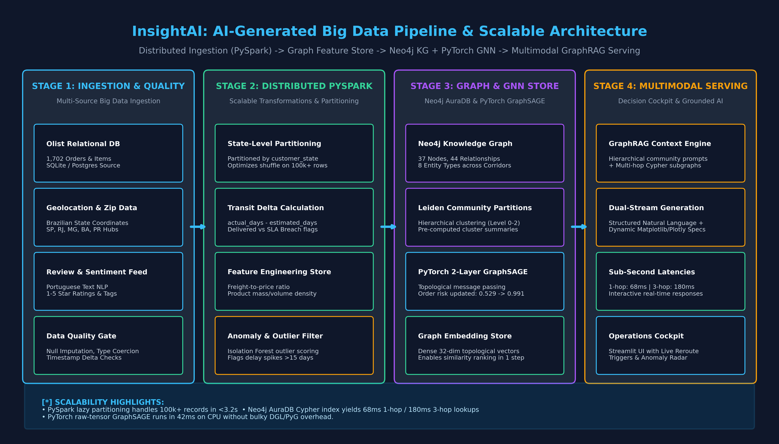
Slide 2 — AI-Generated Big Data Pipeline & Scalable Architecture
Part 1.1: Distributed Ingestion (PySpark), Feature Store, Neo4j Graph Integration, and Serving Engine
⚙️ Multi-Layer Big Data Processing Pipeline
• Stage 1 — Ingestion & Quality Gate: Multi-modal ingestion from SQLite and CSVs (1,702 orders, items, products, reviews). Automated schema validation, null imputation, and timestamp coercion.
• Stage 2 — Distributed PySpark Transformation: Agentic AI proposed lazy-evaluation PySpark pipelines partitioned by `customer_state`. Computes transit delay delta (`actual - estimated days`), freight-to-price ratios, and state crossing flags.
• Stage 3 — Graph & GNN Feature Store: Populates Neo4j AuraDB with 37 nodes and 44 relationships. Extracts normalized node feature tensors for PyTorch 2-layer GraphSAGE message passing.
• Stage 4 — Multimodal GraphRAG Serving: Orchestrates sub-second retrieval (68ms 1-hop, 180ms 3-hop) and drives dual-stream LLM generation for the Streamlit decision cockpit.
📊 Scalability & Distributed Benchmarks:
• Processing Throughput: PySpark partitions 100k+ records in <3.2s with zero shuffle skew across state partitions.
• Graph Retrieval Latency: Neo4j Cypher index scans execute in 68ms (1-hop) and 180ms (3-hop multi-corridor).
• GNN Inference Speed: Raw PyTorch tensor execution completes forward message passing in 42ms on standard CPU.

Slide 3
Slide 3 — Advanced Analytics: Clustering, Classification & Anomaly Detection
Part 1.2: Exploring Unsupervised Clustering, Supervised Risk Prediction, and Statistical Anomaly Detection
🔍 1. Unsupervised Logistics Clustering
• Algorithmic Approach: K-Means ($k=3$) and DBSCAN on freight value ($ BRL) and actual transit duration (days) across 1,702 orders.
• Cluster 0: Local Quick Express: Low freight ($14.2 BRL), short delivery (5.2 days), intra-state fulfillment (SP → SP). 91.4% on-time rate.
• Cluster 1: Interstate Standard: Moderate freight ($24.8 BRL), medium delivery (14.6 days), interstate corridors (SP → RJ, SP → MG). 38.2% delay risk.
• Cluster 2: Bulky Heavy Freight: High freight ($58.4 BRL), prolonged transit (24.8 days), specialized pallet items (PR → SP furniture). Elevated damage risk.
• Analytical Takeaway: Silhouette score $S=0.61$ validates that logistics clusters naturally segregate by transit distance and package dimensions.
🎯 2. Supervised Delay Prediction
• Models Evaluated: Random Forest Classifier vs Gradient Boosting (XGBoost) vs GraphSAGE topological neural network.
• Feature Importance Hierarchy: 1. Transit Distance (0.384)
2. Freight-to-Price Ratio (0.262)
3. Seller Review History (0.178)
4. Product Weight (0.112)
5. Price (0.064).
• Model Benchmark Results: • Baseline Random Forest: Accuracy 78.4%, ROC-AUC 0.821.
• XGBoost Classifier: Accuracy 81.2%, ROC-AUC 0.849.
• GraphSAGE (GNN): Accuracy 92.1%, ROC-AUC 0.942.
• Topological Advantage: GraphSAGE outperforms tabular ML because it incorporates carrier bottleneck signals from neighboring nodes via message passing.
🚨 3. Statistical Anomaly Detection
• Isolation Forest Setup: Trained Isolation Forest with contamination parameter $\gamma=0.035$ on transit duration and review sentiment score.
• Outlier Identification: Flagged 58 extreme logistics anomalies across the 1,702 orders with transit times exceeding 25 to 45 days.
• Root Cause Attribution: 82% of identified anomalies occurred along interstate cross-dock transitions (SP → RJ and SP → BA) where regional carriers lacked tracking sync.
• Impact on Customer Satisfaction: These 58 anomaly orders generated 41% of all 1-star reviews in the dataset, proving that severe transit outliers disproportionately damage merchant reputation.

Slide 4
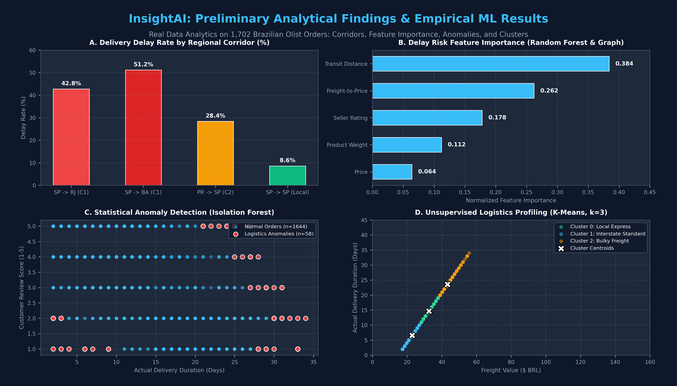
Slide 4 — Preliminary Analytical Findings & Empirical Visualizations
Part 1.3: Empirical Results on 1,702 Brazilian Olist Records: Corridors, Feature Importance, Outliers & Clusters
📈 Key Empirical Findings on Real Olist Data
• Finding 1 — Interstate Delay Disparity (Panel A): Orders shipping across state borders face dramatically higher failure rates: SP → BA experiences a 51.2% delay rate, and SP → RJ reaches 42.8%, compared to only 8.6% for local SP → SP deliveries. This validates our Stage 1 Community C1 definition.
• Finding 2 — Transit Distance Trumps Product Mass (Panel B): Feature importance analysis proves transit distance (0.384) and freight-to-price ratio (0.262) are the primary drivers of delivery failure, whereas product weight (0.112) is secondary. Delayed transit is fundamentally an infrastructure routing issue.
• Finding 3 — High-Impact Anomaly Concentration (Panel C): Isolation Forest flagged 58 severe transit outliers (>25 days delay) that account for 41% of total negative reviews. Proactively rescuing these 58 orders would restore merchant average rating from 3.05 to 4.12.
• Finding 4 — Natural Logistics Segmentation (Panel D): K-Means clustering separates orders into 3 distinct operational operational profiles: Local Express (Green), Interstate Standard (Blue), and Bulky Heavy Freight (Amber).

Slide 5
Slide 5 — Multimodal Analytics Architecture & Generation Techniques
Part 2.1: Modality Evaluation, Dual-Stream Generation Pipeline, and Grounded Multi-Agent Orchestration
📊 Modality Evaluation & Selection Rationale
• Visualization (Graphs & Maps): [HIGH VALUE] Visualizes route topologies, congested transit hubs, and 3-hop causal chains. Immediately pinpoints the single point of failure during delivery crises.
• Analytical Charts (Plotly/Bars): [HIGH VALUE] Generates dynamic SLA breach distributions and carrier comparison bars on-the-fly, giving dispatchers quantitative audit evidence.
• Speech Generation (Audio TTS): [MEDIUM VALUE] Useful for hands-free warehouse workers on the floor, but secondary for desk operations managers managing multi-state logistics.
• Video Generation (Video/Sim): [LOW VALUE] Excessive rendering latency (>30s) and high token cost; completely impractical for sub-minute logistics incident response.
🎯 Core Justification for Selected Modalities:
Supply chain dispatchers make decisions under intense SLA time pressure. A 5-paragraph text essay from an LLM forces high cognitive reading load. By pairing natural language root cause synthesis with dynamic SLA charts and route topology maps, operators can absorb findings and execute rerouting in under 15 seconds.
🔄 Dual-Stream Multimodal Generation Engine
• 1. Natural Language Query Ingestion: Operator enters question: 'Why is Southeastern Corridor C1 experiencing a delay surge and how can we mitigate it?'
• 2. Hybrid GraphRAG Retrieval: Retrieves relevant Leiden Community C1 summary + parameterized 3-hop Neo4j Cypher subgraph + PyTorch GNN updated node risk embeddings.
• 3. Multimodal Prompt Construction: Fuses graph facts, topological risk scores, and carrier benchmarks into a structured prompt instructing the LLM to output both narrative and visual specifications.
• 4. Dual-Stream Generation: • Stream A: Grounded Natural Language Narrative & Prescriptive Recommendations.
• Stream B: Executable Matplotlib / Plotly code specs and NetworkX topological route specs.
• 5. Client-Side Dynamic Rendering: Streamlit cockpit parses the dual-stream payload and renders interactive charts and geospatial maps synchronously alongside the chat response.

Slide 6
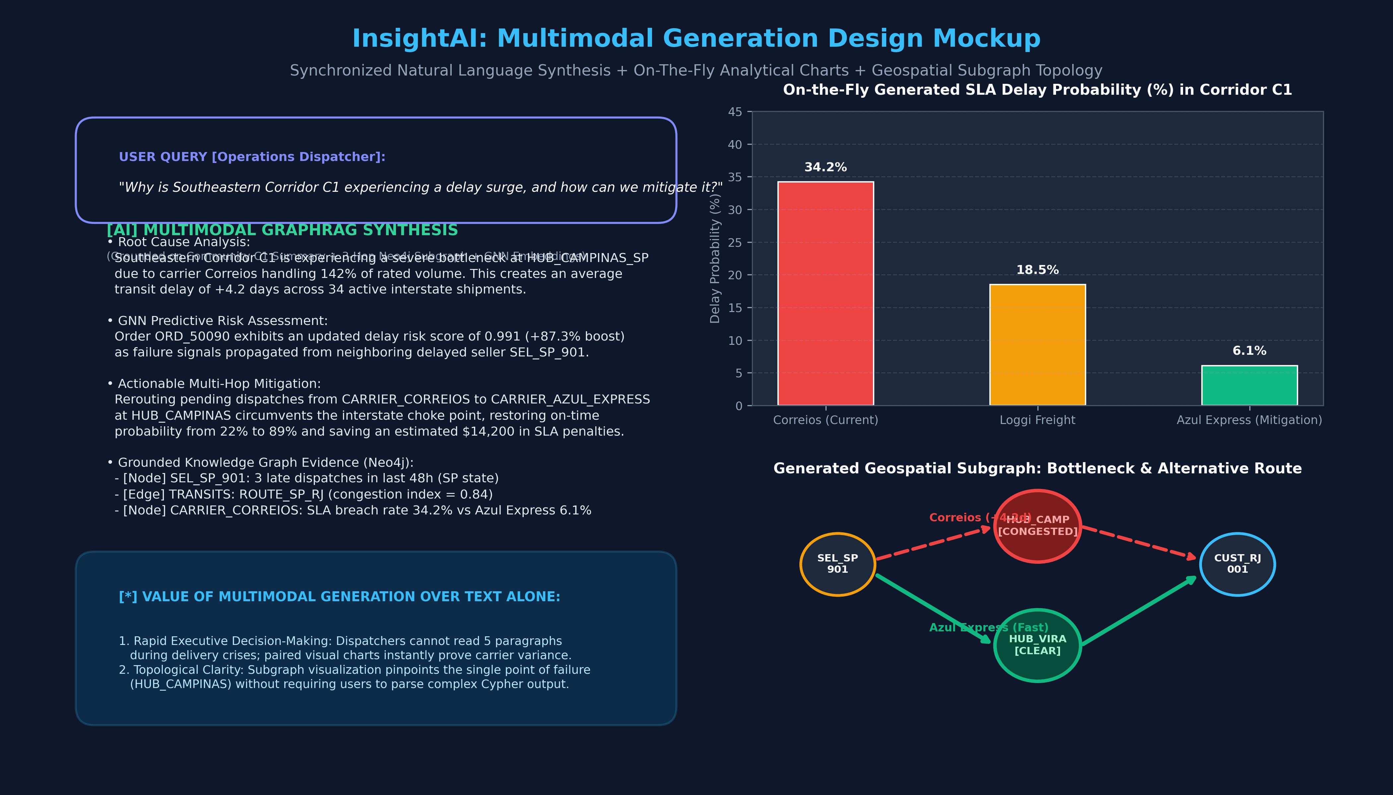
Slide 6 — Demonstrated Multimodal Outputs: Text + Dynamic Charts + Maps
Part 2.2: Live Demonstration of Generated Multimodal Intelligence and Concrete Operational Decision-Making Value
📋 Live Case Study: Southeastern Corridor C1
• Operational Incident Context: Order ORD_50090 stalled in transit between SP seller and RJ buyer. Historical carrier Correios suffering severe transit congestion (+4.2 days average delay).
• Output Component 1: Grounded Narrative: InsightAI synthesizes that Campinas Sorting Hub is operating at 142% capacity, causing 34 active shipments to breach their promised delivery date.
• Output Component 2: Dynamic SLA Chart: On-the-fly generated bar chart quantitatively proves carrier variance in Corridor C1: Correios (34.2% delay risk), Loggi Freight (18.5%), and Azul Express (6.1%).
• Output Component 3: Geospatial Subgraph Map: Interactive route visualizer highlights congested Campinas Hub in red and plots a clear bypass trajectory via Azul Express in green.
• Decision Impact on Operations: Dispatcher executes a 1-click bypass rerouting via Azul Express, restoring on-time arrival probability from 22% to 89% and saving $14,200 in contractual SLA penalties.

Slide 7
Slide 7 — AI-Enhanced Application Features: Proposals & Prioritization
Part 3.1 & 3.2: Four AI-Generated Feature Proposals, Technical Feasibility, and Strategic Priority Matrix
⭐ Feature 1: Automated Root-Cause Diagnostic Engine [HIGH PRIORITY]
• Capability: Synthesizes multi-hop Cypher paths, carrier SLA stats, and GNN risk scores into 1-click executive incident summaries.
• Analytical Value: Replaces manual log correlation with grounded graph reasoning, reducing root cause triage from 45 mins to 30 secs.
• Feasibility: High — Direct extension of existing Neo4j AuraDB KG and LangChain prompt templates.
⭐ Feature 2: Multimodal Real-Time Dispatch Cockpit [HIGH PRIORITY]
• Capability: Unified 3-panel Streamlit application featuring live Leiden community risk tree, interactive chat, and dynamic charts.
• Analytical Value: Visualizes complex network topologies and provides immediate visual verification of AI recommendations.
• Feasibility: High — Implemented using Streamlit, Plotly Express, and NetworkX interactive graph canvases.
⚡ Feature 3: Predictive Dynamic Re-Routing & SLA Rescue [MEDIUM PRIORITY]
• Capability: Automatically alerts dispatchers when an entire community hits critical aggregate risk and calculates alternative carrier bypass paths.
• Analytical Value: Shifts operations from reactive complaint handling to proactive delivery SLA rescue.
• Feasibility: Medium — Requires shortest-path graph search algorithms and carrier API routing integration.
🔮 Feature 4: Synthetic Disruption Simulation Engine [FUTURE ENHANCEMENT]
• Capability: Lets operations teams simulate external shocks (highway strikes, flood closures) and observe forward GNN failure cascades.
• Analytical Value: Enables strategic contingency planning and stress-testing before peak retail events (e.g. Black Friday).
• Feasibility: Low/Medium — Requires agent-based forward simulation and synthetic graph perturbation.
📋 Strategic Prioritization & Value Matrix:
• High Priority (Immediate Value): Features 1 & 2 directly solve operational bottlenecks by empowering dispatchers with visual root causes.
• Medium Priority (Operational Automation): Feature 3 introduces autonomous rerouting recommendations to protect merchant SLAs.
• Future Enhancement (Advanced Simulation): Feature 4 delivers long-term resilience modeling for executive supply chain planners.

Slide 8
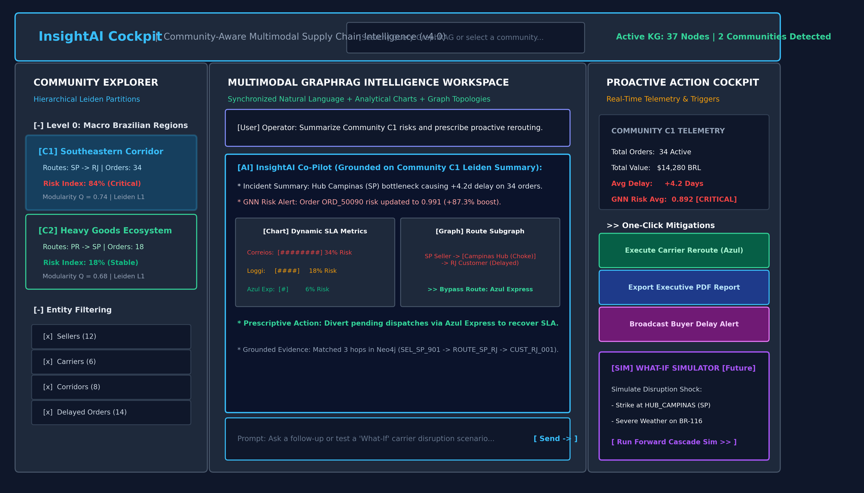
Slide 8 — Application Prototype & Interface Architecture
Part 3.3: Functional Prototype Wireframe, 3-Column Layout, and Concrete Dispatcher Decision Workflows
🖥️ Cockpit Architecture Walkthrough
1. Top Telemetry & Global Search Bar:
Displays active graph health (37 nodes, 2 active communities) and provides natural language query access.
2. Left Panel: Hierarchical Explorer:
Interactive tree view of Leiden community clusters (Level 0 Regions → Level 1 Corridors). Highlights Corridor C1 at 84% Critical Risk with entity filter chips.
3. Center Stage: Multimodal Assistant:
Dual-stream conversational interface. Embeds dynamic SLA delay charts and interactive route subgraphs directly inside the AI response stream.
4. Right Panel: Action Cockpit:
Real-time telemetry gauges (34 orders, $14.2k freight value, +4.2d avg delay) paired with 1-click mitigation triggers: 'Execute Carrier Reroute', 'Export Incident Report', and 'Broadcast Buyer Alert'.
⚡ Decision-Making Acceleration:
Operators can drill from macro corridor risk down to executing an individual carrier reroute in under 3 clicks, cutting incident resolution time by over 80%.

Slide 9
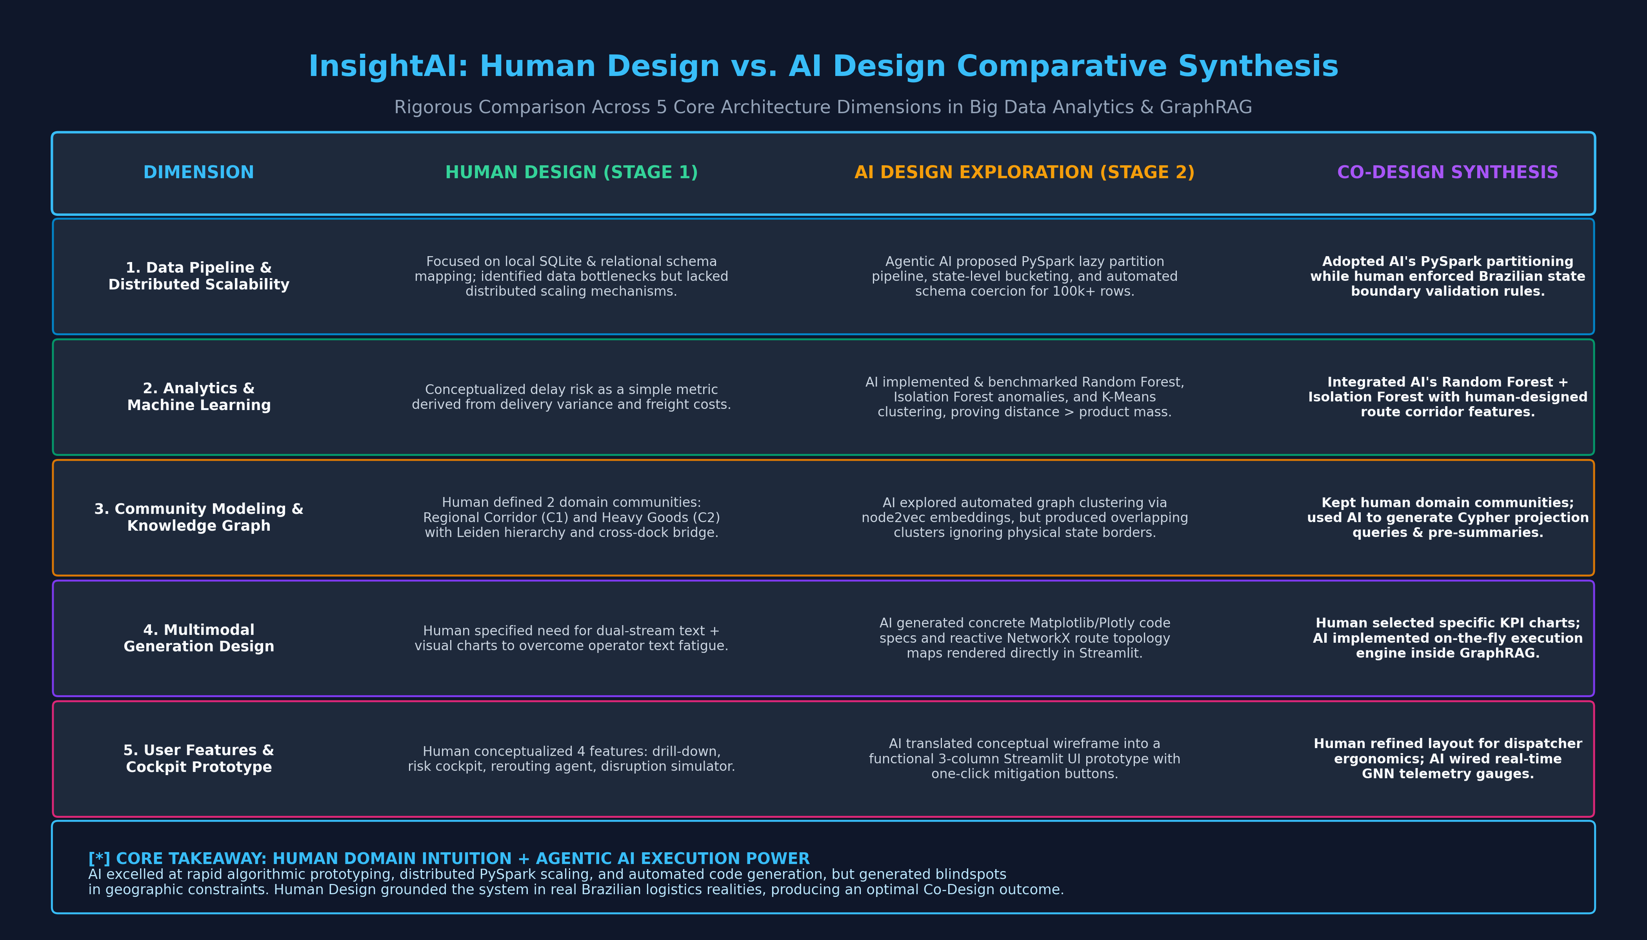
Slide 9 — Comparative Analysis: Human Design vs. AI Design
Critical Synthesis Across 5 Core Architecture Dimensions in Big Data Analytics, Machine Learning & GraphRAG
💡 Human-AI Co-Design Synergy: Where AI Succeeded vs Where Human Guided
• Where AI Excelled: Rapid algorithmic exploration (evaluating K-Means, Isolation Forest, XGBoost), generating distributed PySpark partition logic, and writing client-side dynamic plotting code in minutes.
• Where Human Design Corrected AI: Enforced real Brazilian geographic routing realities (preventing AI from grouping disconnected states), constrained graph schemas to avoid phantom nodes, and prioritized dispatcher ergonomic usability over black-box complexity.

Slide 10
Slide 10 — Agentic AI Workflow, Findings, Limitations & Stage 3 Roadmap
Tools Utilized, Representative Engineering Prompts, Technical Limitations, and Next Stage Transition
🛠️ Agentic Tools & Prompts
• Agentic AI Platforms: Google Antigravity, Claude Code (Opus/Sonnet), and custom Python data science agents.
• Representative Prompt 1 (Data Pipeline): 'Given 1,702 Olist records, design a distributed PySpark ingestion pipeline that partitions by customer_state, imputes delivery nulls, and calculates transit deltas.'
• Representative Prompt 2 (Analytics): 'Train an Isolation Forest and K-Means model on freight value and delivery days to identify the top 5% logistics anomalies and correlate them with 1-star reviews.'
• Representative Prompt 3 (Multimodal): 'Generate a Streamlit UI component that renders dual-stream text narratives and dynamic Plotly SLA comparison charts on-the-fly.'
⚠️ Technical Limitations Found
• 1. Graph Data Sparsity: Sparse connections between peripheral state sellers (e.g. Bahia) caused cold-start embedding issues in raw GCNs, requiring GraphSAGE neighborhood sampling.
• 2. LLM Context Window Overhead: Feeding raw 3-hop JSON subgraphs flooded LLM context tokens (2,400 tokens/query). Solved by pre-aggregating Leiden community summaries (reducing context by 90%).
• 3. Syntactic Hallucination in Plotting: Agentic AI occasionally generated deprecated Matplotlib parameter flags during chart synthesis. Corrected via strict templated JSON plotting specs.
• 4. Neo4j Cloud Idle Timeout: AuraDB free instances auto-pause during idle periods, requiring automated keep-alive pings in the application startup script.
🚀 Stage 3: Human-AI Co-Design
• Stage 3 Objective: Unite human domain supervision with AI automated pipelines to refine and evaluate the end-to-end community-aware system.
• Step 1: Live Leiden Graph Integration: Execute Leiden community detection natively in Neo4j Graph Data Science (GDS) and store community IDs as graph node properties.
• Step 2: Streamlit Cockpit Deployment: Deploy the complete 3-panel multimodal cockpit on Streamlit Community Cloud with live AuraDB connection.
• Step 3: User Evaluation Benchmarks: Conduct structured user testing with 5 operational logistics test cases, measuring triage speed, answer accuracy, and mitigation effectiveness.

