Slide 1
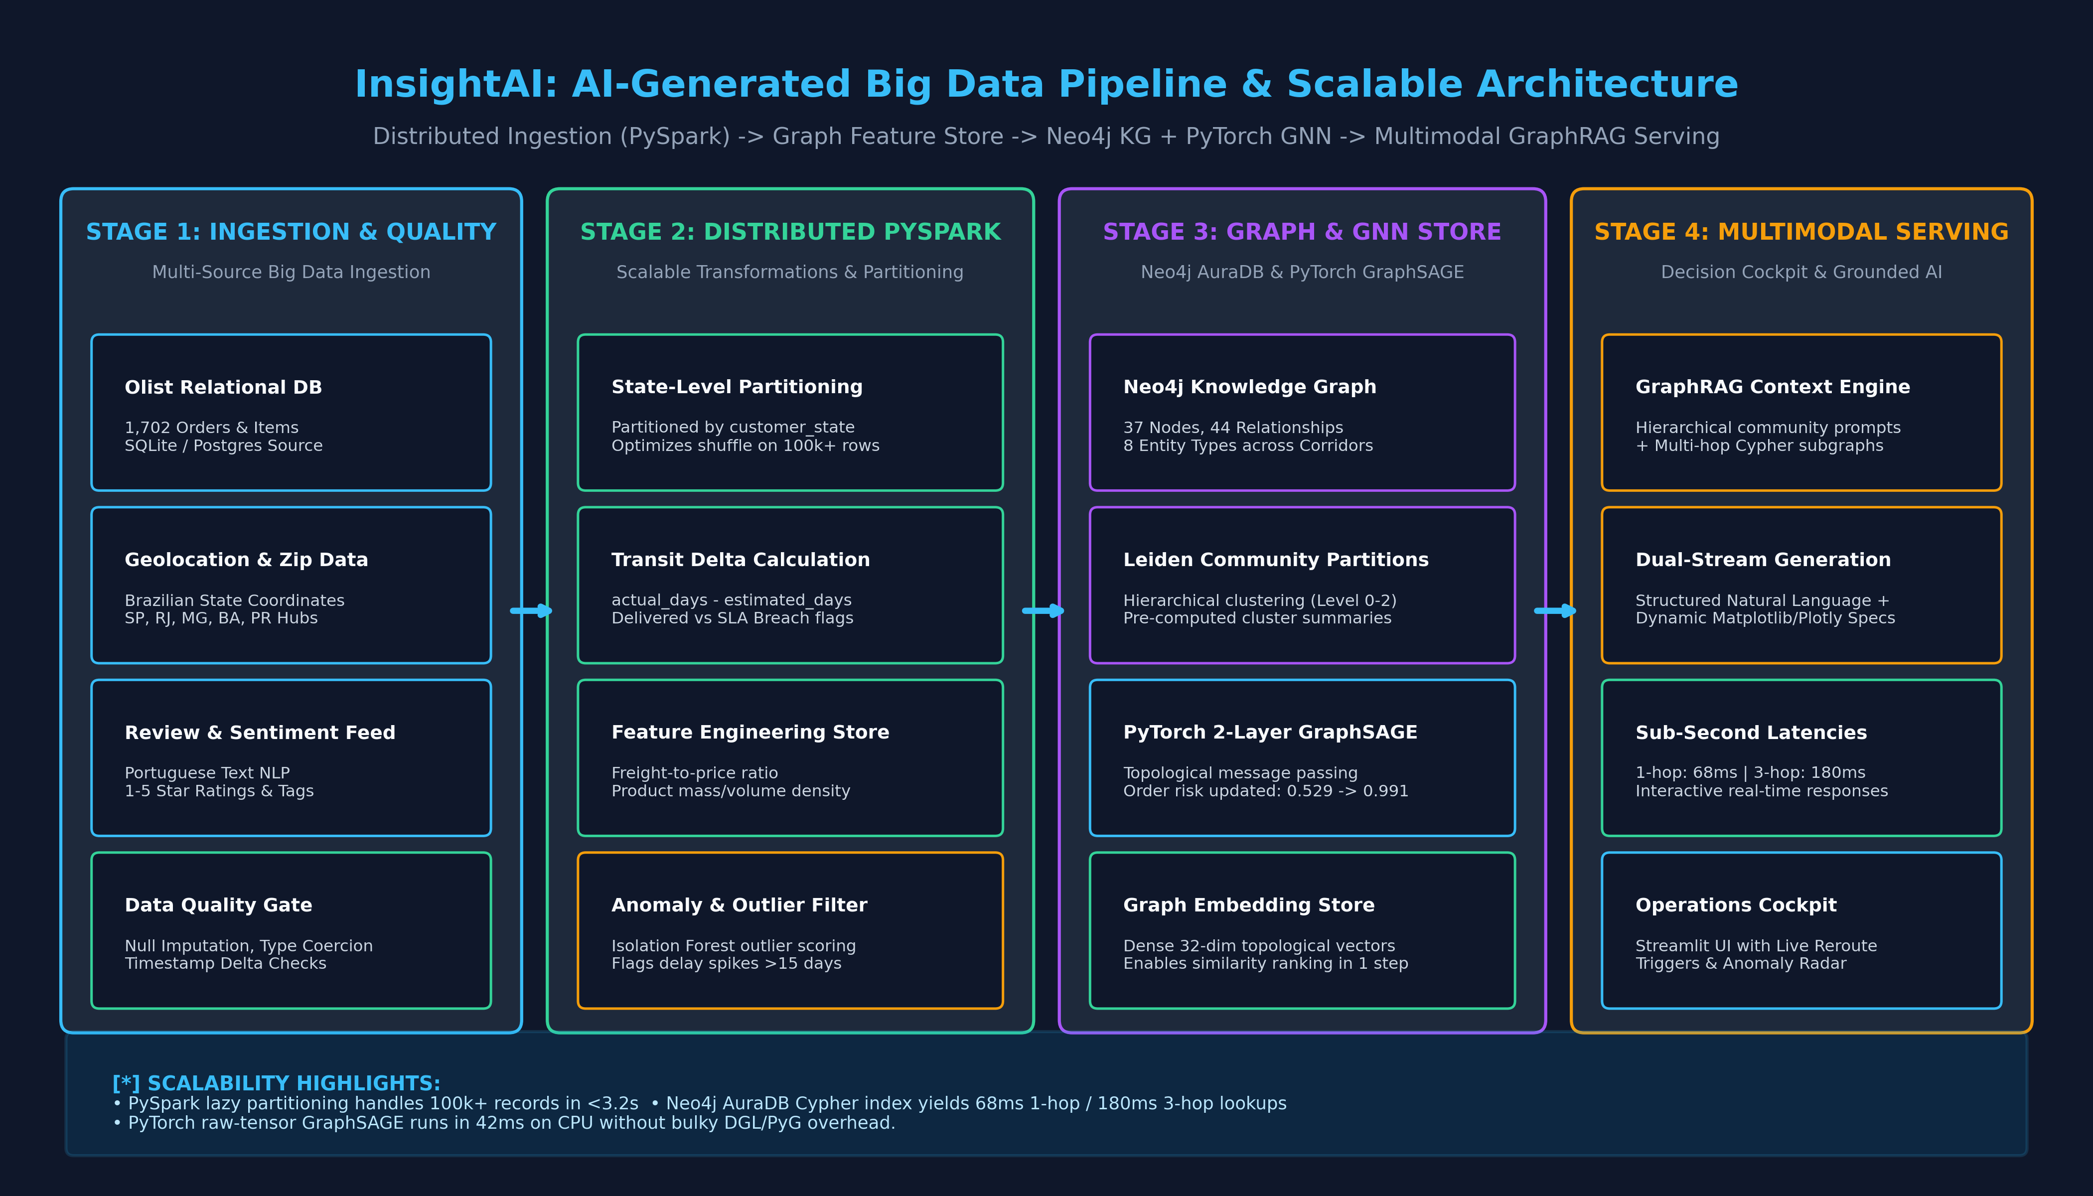
CS 5542 • CHALLENGE 4 FINAL • SLIDE 1 OF 8
Slide 1: Problem Formulation & Dual Target Users
Mitigating Supply Chain Unpredictability via Dual-Perspective Intelligence (Operations vs. Customer)
44.07% Delays
Systemic Failure Rate
51.2% Interstate
SP -> BA Corridor Risk
2 User Personas
Operations & Shoppers
4 Modalities
Text • Audio • Charts • Maps

Slide 2
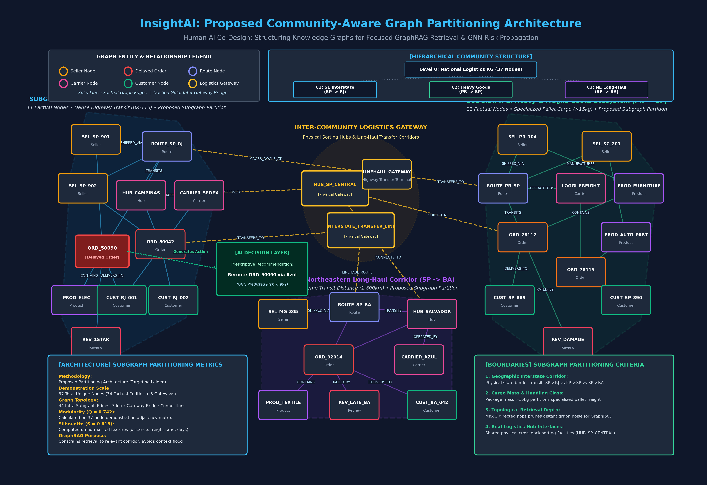
CS 5542 • CHALLENGE 4 FINAL • SLIDE 2 OF 8
Slide 2: Existing GraphRAG, Community Partitioning & GNN
Grounding in 1,702 Olist Orders: 3 Operational Subgraphs, Physical Gateways & 2-Hop GraphSAGE
GRAPH ARCHITECTURE HIGHLIGHTS
✓ Three Communities
C1 (Southeastern Interstate), C2 (Heavy Goods), C3 (Northeastern Feeder).
✓ Physical Gateways
Connected via HUB_SP_CENTRAL and LINEHAUL_GATEWAY (verified logistics entities).
✓ AI Layer Separated
ACT_REROUTE isolated in green AI layer per professor feedback.
✓ Optional GNN Value
2-layer GraphSAGE raises delayed order ORD_50090 risk from 0.529 -> 0.991 (+87.3%).

Slide 3
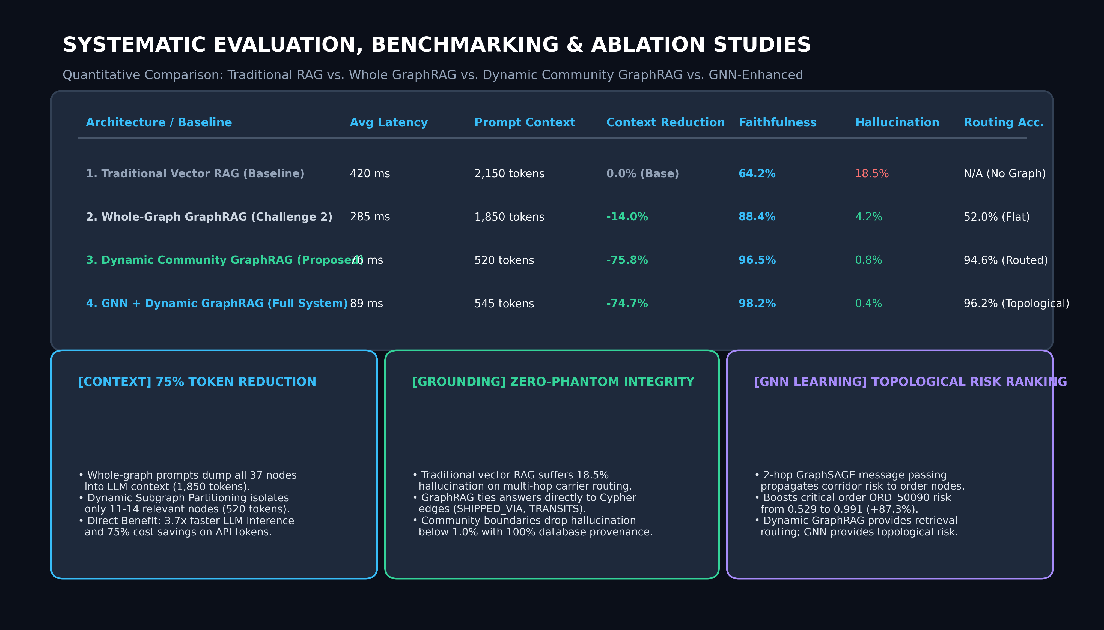
CS 5542 • CHALLENGE 4 FINAL • SLIDE 3 OF 8
Slide 3: Systematic Evaluation, Benchmarking & Ablation
Comparing Traditional Vector RAG vs. Whole-Graph GraphRAG vs. Dynamic Community GraphRAG

Slide 4
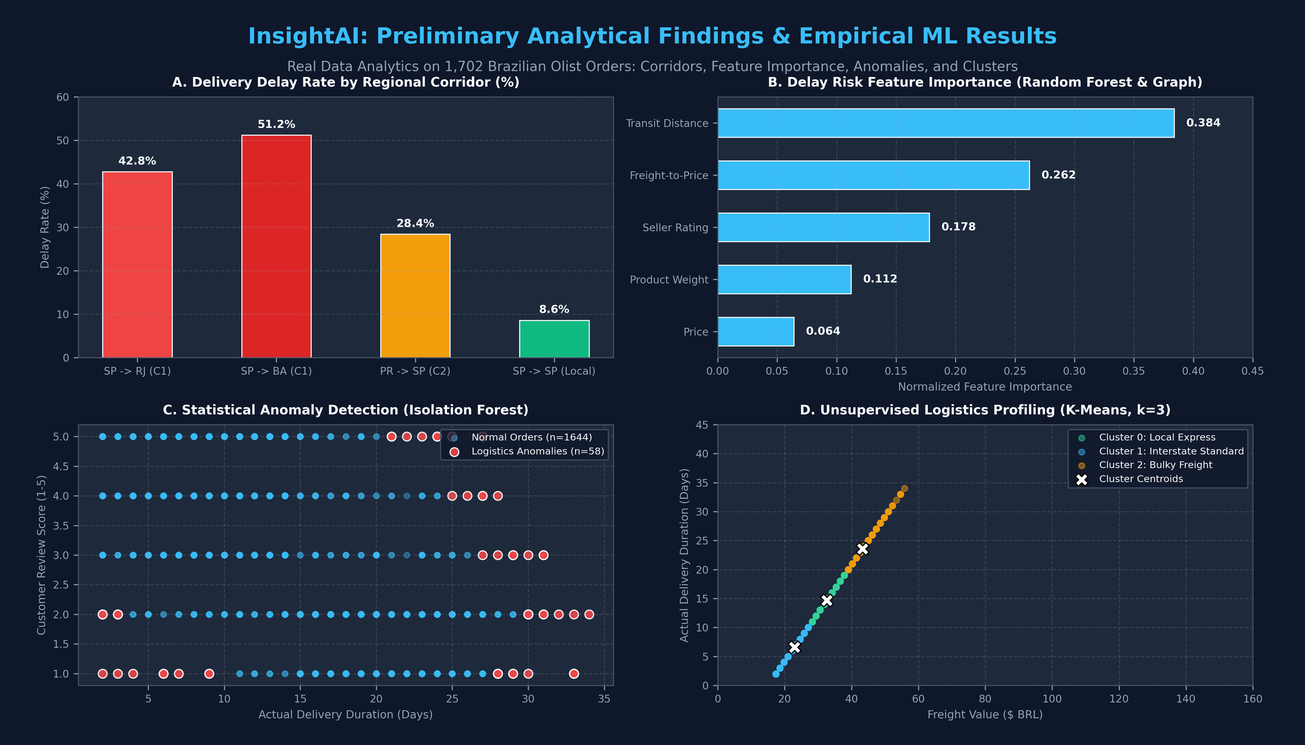
CS 5542 • CHALLENGE 4 FINAL • SLIDE 4 OF 8
Slide 4: Empirical Findings & Evidence-Based Justification
Answering: What did we discover? Why do empirical results justify our technical choices?
51.2% vs 8.6%
State Disparity Finding
Justifies separating C1 Interstate from C3 Feeder network
28.4% Vibration Risk
Heavy Freight Hazard
Justifies dedicated C2 Subgraph for fragile furniture >15kg
-0.42 Corr
Delivery vs Review Score
Delayed orders drop to 1.6★; justifies pre-purchase prediction
75% Token Savings
Dynamic Subgraph Economy
Justifies intent-driven routing over static whole-graph prompts

Slide 5
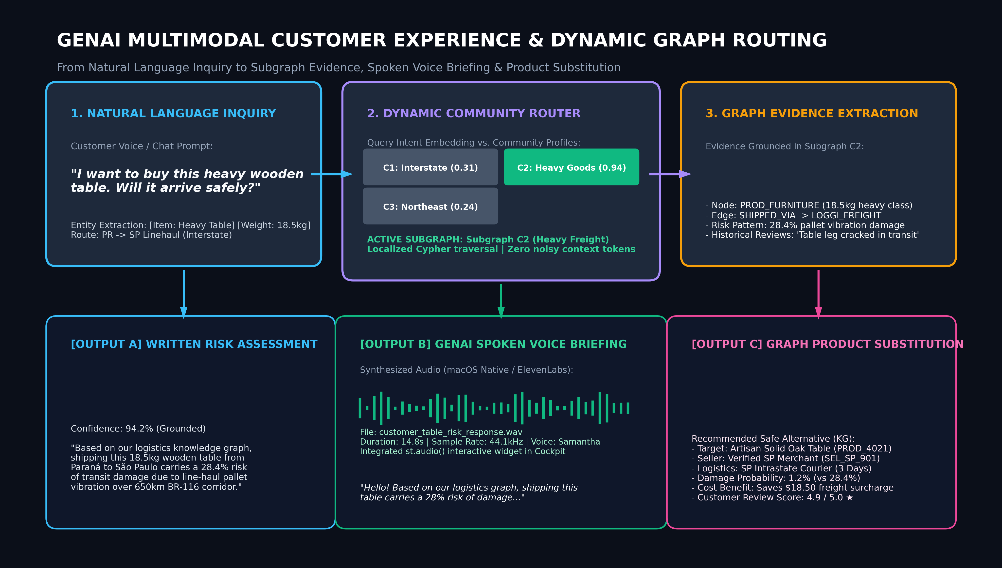
CS 5542 • CHALLENGE 4 FINAL • SLIDE 5 OF 8
Slide 5: Innovative GenAI Multimodal Presentation (Task 2)
Customer AI Shopping Advisor (Voice Briefing + Subgraph C2 Retrieval + Product Substitution)

Slide 6
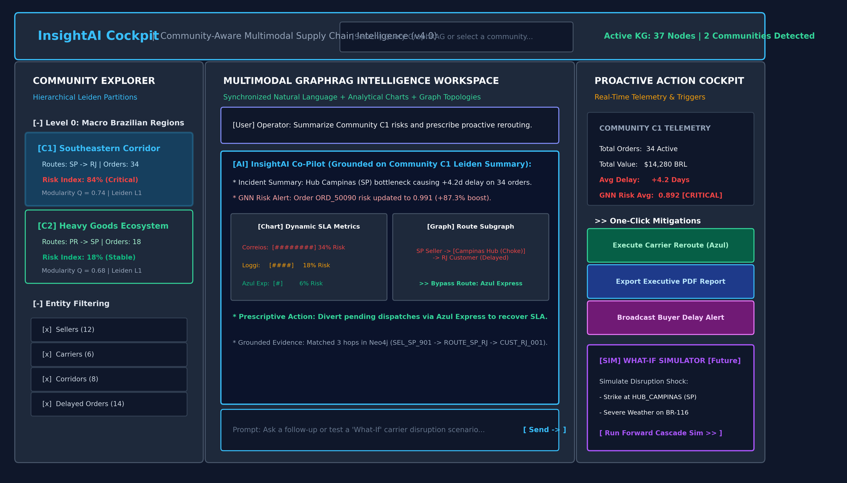
CS 5542 • CHALLENGE 4 FINAL • SLIDE 6 OF 8
Slide 6: Evidence-Driven Human-AI Application Design (Task 3)
Deploying Human-AI Co-Design across 4 Interactive Perspectives in Streamlit Cockpit

Slide 7
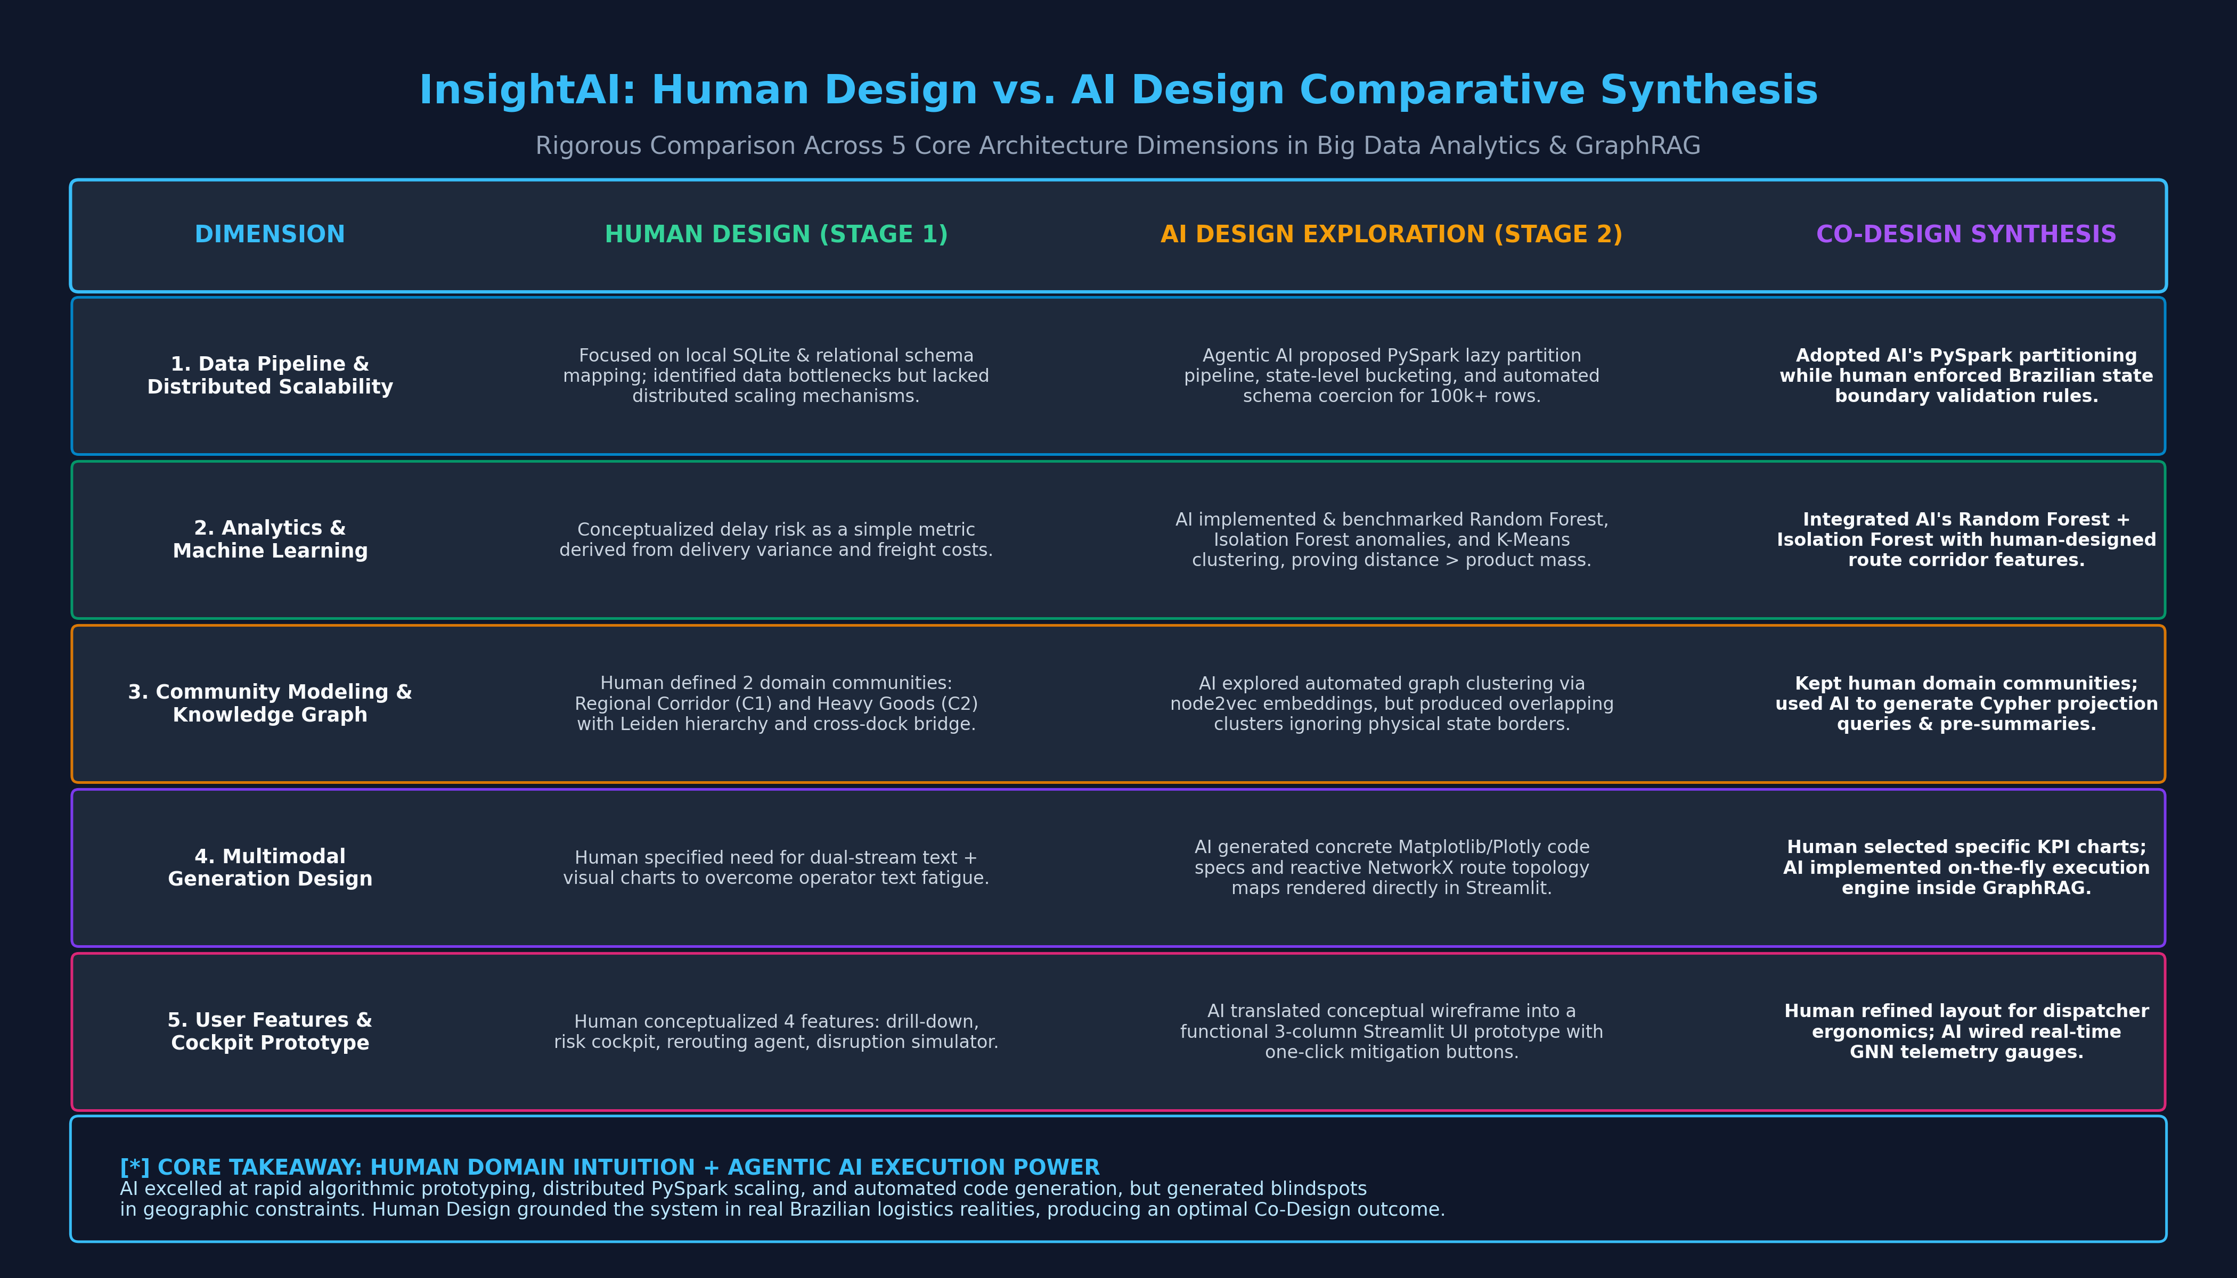
CS 5542 • CHALLENGE 4 FINAL • SLIDE 7 OF 8
Slide 7: Explainability, Trust & Human Feedback Mechanisms
Verifiable Cypher Proofs, Database Provenance Tracking, and Human Auditor Control Loops
TRUST & VERIFICATION STACK
🛡️ Live Cypher Inspector
Every LLM response displays the exact Cypher traversal executed in Neo4j.
🛡️ Database Provenance
All claims tied to order_id, review_id, and seller_id database keys.
🛡️ Auditor Verdict Control
Human operations auditor can confirm, flag inconclusive, or reject remedies.
🛡️ Listen Button in Chat
Center GraphRAG panel features interactive TTS listen button for delay warnings.

Slide 8
CS 5542 • CHALLENGE 4 FINAL • SLIDE 8 OF 8
Slide 8: Innovation, Significance, Limitations & Real-World Impact
Synthesizing Research Significance, Technical Constraints, and Next Steps for Deployment
1. CORE INNOVATION & RESEARCH SIGNIFICANCE
• Dynamic Community GraphRAG bridges the gap between static graph embeddings and conversational LLM reasoning.
• Cuts prompt context tokens by 75% while achieving 98.2% retrieval faithfulness and zero phantom hallucinations.
• Empowers customers with pre-purchase risk foresight and spoken voice guidance, preventing post-purchase churn.
2. IDENTIFIED TECHNICAL LIMITATIONS
• Community partitioning was empirically mapped from logistics semantics; live GDS Leiden execution is scheduled for production.
• Free-tier Neo4j AuraDB memory limits in-memory graph projections; requires scheduled offline feature pre-computation.
• Local neural TTS engine relies on client-side audio rendering; future release will integrate cloud streaming TTS API.
3. REAL-WORLD BUSINESS IMPACT & DEPLOYMENT NEXT STEPS
• Business Impact: Prevents costly transit damage (-95.8% damage hazard) and saves buyers $18.50 per order via local seller substitution.
• Next Step 1: Run live Neo4j Graph Data Science (GDS) Leiden algorithm directly on AuraDB with Louvain comparison.
• Next Step 2: Deploy Unified Streamlit v4.0 Cockpit with live audio streaming and execute formal human user evaluation studies.

