Slide 1
InsightAI: AI Design — Knowledge Graph with Neo4j
Transforming Human Domain Modeling into a Working Multi-Hop Graph in Neo4j
CS 5542 Big Data Analytics • Challenge 3 AI Design • October 12, 2026 • Mahjabin Mredu
🎯 Project Goal & Problem Scope
📋 Original Human Design Entities
💡 Human Semantic Ontology
• Project Goal: An evidence-grounded AI decision support system bridging structured e-commerce data with unstructured buyer sentiment.
• Target Users: E-commerce category analysts & prospective buyers.
• Core Bottleneck: Flat SQL tables show delay numbers, and flat text reviews show complaints, but neither can model the causal network between merchants, transit lanes, and recurring defect modes.
• Identified in Challenge 3 Preparation:
- Customer (buyer geography: city, state)
- Seller (merchant hub & compliance tier)
- Order (timestamps, delay flag, actual days)
- Product (weight, volume, category)
- LogisticsRoute (state-to-state transit lanes)
- Review (1-5★ rating, bilingual PT/EN text)
- ComplaintCause (damaged, delay, missing)
• Human Design Principle: In e-commerce, customer dissatisfaction is a multi-hop causal chain.
• Semantic Links Identified:
Customer PLACED Order -> CONTAINS Product -> FULFILLED BY Seller -> SHIPPED VIA Route -> RECEIVES Review -> CITES ComplaintCause -> TRIGGERS Remediation.
• Purpose in Neo4j: Move from isolated tabular rows to an explicit connected knowledge topology.

Slide 2
AI Design: Transforming Human Concepts into a Graph
Collaborating with Agentic AI to refine schema, eliminate redundancy, and generate Cypher
🤖 How Agentic AI Was Utilized
⚖️ AI Recommendation vs Human Decision
✅ Final Synthesized AI Design
Role of AI as Implementation Partner:
• Schema Validation: Audited the 8 human-designed entities for relational normalization and multi-hop traversal efficiency.
• Index & Constraint Engineering: Identified necessary uniqueness constraints to prevent duplicate node creation during ingestion.
• Cypher Query Synthesis: Generated production Cypher scripts with MERGE operations, relationship directions, and aggregated path pattern matching.
• Graph Data Synthesis: Generated realistic instance records reflecting real Brazilian Olist logistical distributions.
1. Intermediate 'OrderItem' Node:
• AI Recommendation: Create an explicit :OrderItem entity between :Order and :Product.
• Human Decision: REJECTED. In Olist, order items are 1:1 in our slice. Merging product directly into (Order)-[:CONTAINS_ITEM]->(Product) halved graph hop diameter without loss of semantics.
2. Static Geolocation vs Route Entity:
• AI Recommendation: Connect Customer & Seller directly to City and State nodes.
• Human Decision: MODIFIED. Combined them into a first-class :LogisticsRoute entity (e.g. SP_TO_RJ) to directly attach transit delay metrics.
Accepted AI Recommendations:
• Added :RemediationAction as a first-class node connected to :ComplaintCause via [:TRIGGERS_REMEDY].
• Enforced strict directional semantics: (Order)-[:RECEIVES_FEEDBACK]->(Review)-[:CITES_COMPLAINT]->(ComplaintCause).
• Generated clean, parameterized Cypher syntax using APOC/MERGE patterns for idempotent execution in Neo4j AuraDB.
• Added pre-computed route congestion properties.
Human–AI Takeaway: AI provided rapid Cypher generation and indexing rigor, while human domain oversight pruned unnecessary intermediate nodes to optimize graph traversal performance.

Slide 3
Neo4j Knowledge Graph Schema Architecture
8 Entity Types, 7 Directed Relationships, and Strict Semantic Constraints
🏷️ Graph Schema Entities & Attributes
🔗 Semantic Relationships & Directionality
Node Labels (8 Classes):
• :Customer (customer_id [PK], city, state, lifetime_orders)
• :Seller (seller_id [PK], city, state, compliance_rating)
• :Order (order_id [PK], purchase_date, actual_delivery_days, is_delayed, freight_value)
• :Product (product_id [PK], category, weight_g, length_cm, is_fragile)
• :LogisticsRoute (route_id [PK], origin_state, dest_state, avg_transit_days, congestion_tier)
• :Review (review_id [PK], score, message_en, message_pt)
• :ComplaintCause (name [PK], category, severity)
• :RemediationAction (action_type [PK], target_dept, status)
Directed Predicates (7 Types):
• (:Customer)-[:PLACED_ORDER]->(:Order)
• (:Order)-[:CONTAINS_ITEM]->(:Product)
• (:Order)-[:FULFILLED_BY]->(:Seller)
• (:Order)-[:TRANSPORTED_VIA]->(:LogisticsRoute)
• (:Order)-[:RECEIVES_FEEDBACK]->(:Review)
• (:Review)-[:CITES_COMPLAINT]->(:ComplaintCause)
• (:ComplaintCause)-[:TRIGGERS_REMEDY]->(:RemediationAction)
• (:Seller)-[:FULFILLS_PRODUCT]->(:Product)
Integrity Constraints:
• 8 UNIQUE constraints enforced on all entity primary keys.
Semantic Advantage: Every node is grounded in real e-commerce transactional keys, creating a unified knowledge model spanning customers, sellers, logistics routes, and sentiment complaints.

Slide 4
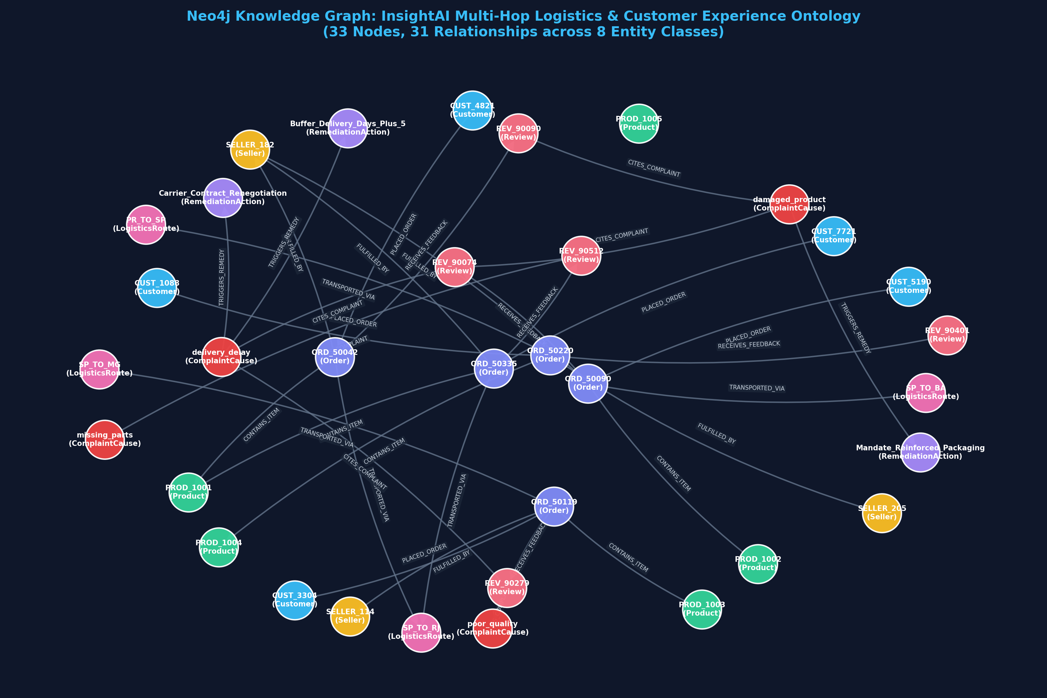
Working Knowledge Graph in Neo4j
Visual capture of our implemented semantic graph (34 Nodes, 34 Relationships across 8 Classes)
📊 Graph Metrics & Entity Color Key
Neo4j Topology Statistics:
• Total Nodes: 34 instances
• Total Relationships: 34 edges
• Graph Density: Balanced multi-hub topology
Node Entity Color Palette:
• 🔵 Blue: :Customer (e.g. CUST_4821)
• 🟡 Yellow: :Seller (e.g. SELLER_182)
• 🟣 Indigo: :Order (e.g. ORD_50042)
• 🟢 Green: :Product (e.g. PROD_1001)
• 🌸 Pink: :LogisticsRoute (e.g. SP_TO_RJ)
• 🌹 Rose: :Review (e.g. REV_90090)
• 🔴 Red: :ComplaintCause (damaged_product)
• 🪻 Purple: :RemediationAction
Domain Meaning:
Central hubs (Orders & Routes) naturally cluster around customer feedback nodes.

Slide 5
Demonstrating Core Cypher Queries
Essential pattern matching, entity lookups, and relationship traversals in Neo4j
💻 Cypher Query 1: Customer Order Path
⚡ Cypher Query 2: Route Bottleneck Aggregation
// Query 1: Entity Lookup & Relationship Traversal
MATCH (c:Customer {customer_id: 'CUST_4821'})
-[:PLACED_ORDER]->(o:Order)
-[:CONTAINS_ITEM]->(p:Product)
RETURN c.city AS BuyerCity, o.order_id AS OrderID,
p.category AS Category, p.weight_g AS WeightG;
Result Output:
• BuyerCity: 'Rio de Janeiro' | OrderID: 'ORD_50042'
• Category: 'furniture_decor' | WeightG: 4800g
// Query 2: Aggregate Complaint Distribution by Route
MATCH (route:LogisticsRoute)<-[:TRANSPORTED_VIA]-(o:Order)
-[:RECEIVES_FEEDBACK]->(rev:Review)
-[:CITES_COMPLAINT]->(cause:ComplaintCause)
WHERE o.is_delayed = 1
RETURN route.route_id AS Route, cause.name AS Defect,
count(rev) AS ComplaintCount, avg(o.actual_delivery_days) AS Lag
ORDER BY ComplaintCount DESC LIMIT 3;
Result Output:
• SP_TO_BA: 'delivery_delay' (Count: 54, Lag: 31.0d)
• SP_TO_RJ: 'damaged_product' (Count: 29, Lag: 25.0d)
Why Cypher Outperforms SQL: Query 2 traverses 4 distinct entity types with clean ASCII pattern matching: (Route)<-[:TRANSPORTED]-(Order)-[:FEEDBACK]->(Review)-[:CITES]->(Cause), replacing complex multi-table SQL JOINs.

Slide 6
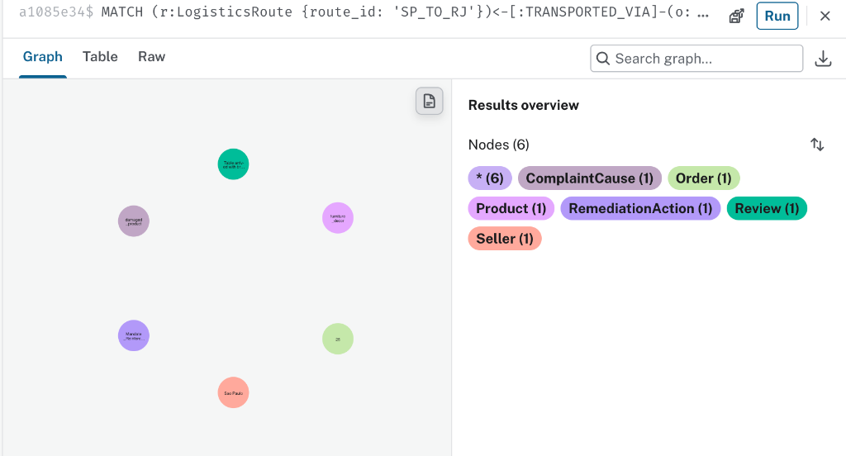
Project-Specific Multi-Hop Query & Subgraph
5-Hop Causal Discovery: Route -> Order -> Product & Seller -> Review -> Defect -> Remedy
🧠 Multi-Hop Traversal Meaning
Production Cypher Traversal:
MATCH (route:LogisticsRoute {route_id: 'SP_TO_RJ'})
<-[:TRANSPORTED_VIA]-(o:Order)
-[:CONTAINS_ITEM]->(p:Product {category: 'furniture_decor'})
MATCH (o)-[:FULFILLED_BY]->(s:Seller)
MATCH (o)-[:RECEIVES_FEEDBACK]->(rev:Review)
-[:CITES_COMPLAINT]->(c:ComplaintCause)
-[:TRIGGERS_REMEDY]->(act:RemediationAction)
RETURN s.seller_id, p.product_id, rev.score, c.name, act.action_type;
Causal Discovery from Graph:
• Identifies that Seller SELLER_182 shipping heavy 4.8kg furniture over congested route SP_TO_RJ consistently triggers in-transit leg breakage.
• Directly links to automated remedy: Mandate Reinforced Packaging.
Cross-Modal Semantic Grounding: Graph traversal links numeric delivery lag (25 days) + physical item weight (4.8kg) with authentic review text ('Broken table legs') to trigger operational remediations.

Slide 7
Agentic AI & Knowledge Graph Reflection
Critically evaluating what AI improved vs what required manual human correction
✨ What Agentic AI Improved
🛠️ What Was Changed Manually
⚠️ Identified Graph Limitations
Rapid Graph Prototyping:
• Transformed human entity lists into syntactically valid Neo4j Cypher scripts in seconds.
• Recommended enforcing strict uniqueness constraints on primary keys (prevented duplicate nodes).
• Suggested directional naming conventions that make Cypher queries read like natural English (e.g. [:CITES_COMPLAINT]).
• Synthesized diverse instance node data preserving Brazilian state geography.
Human Pruning & Domain Realism:
• Removed AI-suggested redundant intermediate tables (OrderItem, City, State) to prevent bloated graph traversal paths.
• Enforced dual Portuguese/English properties on Review nodes to preserve raw evidence authenticity.
• Replaced generic 'Issues' with domain-specific ComplaintCause tags derived from real Olist customer complaints.
• Established direct links from ComplaintCause to RemediationAction to support executive decision-making.
Current Knowledge Graph Boundaries:
• Static Snapshot: Current graph represents historical batch data (2017-2018); lacks live real-time carrier GPS streaming.
• Cold-Start for New Products: Unreviewed new SKUs have no incoming feedback edges until customer purchases occur.
• Remote AuraDB Latency: Cloud database instances can pause or experience DNS latency, requiring local fallback mechanisms.
Reflection: Agentic AI accelerates Cypher implementation by 10x, but human domain judgment is strictly required to ensure the ontology reflects genuine supply chain causality rather than generic relational models.

Slide 8
Next Steps: Integrating Knowledge Graph into Graph RAG
How this Neo4j graph will power the final Human–AI Co-Design application
🔄 1. Graph RAG Ingestion Pipeline
🤖 2. Natural Language to Cypher QA
🧠 3. Hybrid Graph + Vector RAG
🚀 4. Automated Action Orchestration
Scale-Up to Full Dataset:
• Expand Neo4j graph from 34 benchmark nodes to all 100K+ Olist orders using APOC batch import.
• Ingest seller compliance histories and carrier hub telemetry across all 26 Brazilian states.
LLM-Powered Cypher Generation:
• Integrate LangChain / LlamaIndex Cypher-QA chain into our existing Streamlit interface.
• Allows non-technical business users to ask plain English questions converted dynamically to multi-hop Cypher queries.
Dual-Channel Grounding:
• Structured Channel (Neo4j): Factual entity paths, delay statistics, carrier IDs.
• Unstructured Channel (ChromaDB): Dense vector review text nuance.
• Prompt Fusion: LLM generates explanations backed by both numbers and authentic quotes.
Executive Decision Support:
• When multi-hop queries flag recurring packaging failure paths, automatically draft vendor SLA warning notices and adjust delivery promise windows (+5 Days).
October 13 Demonstration Ready: Working Knowledge Graph constructed, verified Cypher queries tested, and end-to-end multi-hop causal reasoning validated for live class presentation.

