Slide 1
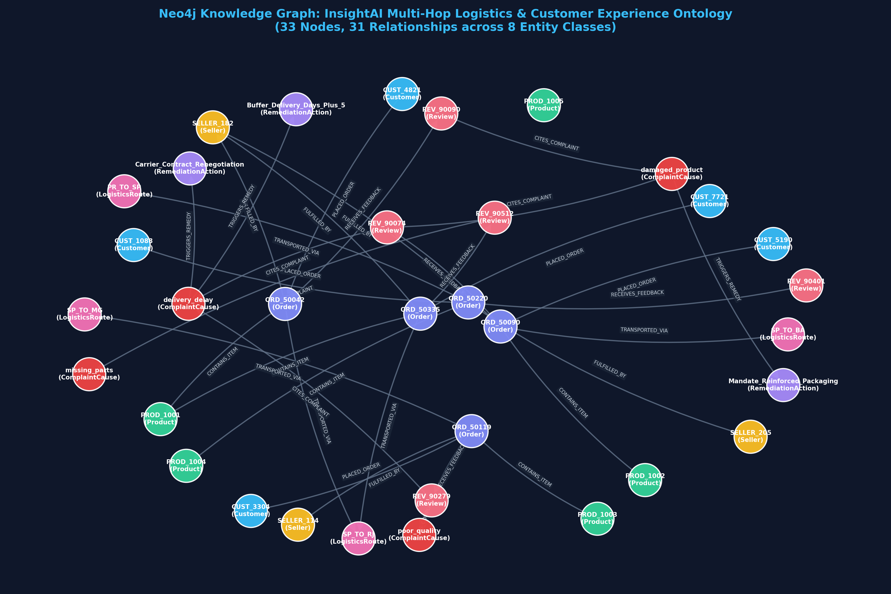
Slide 1 — Project Problem & Existing GraphRAG Foundation
CS 5542 Challenge 3: Review of Week 2-3 GraphRAG and Identification of the Core GNN Opportunity
🎯 InsightAI: Multimodal Supply Chain Intelligence
• Domain Focus: Predicting and diagnosing delivery delays, transit damage, and 1-star reviews across Brazilian e-commerce (Olist dataset).
• Existing GraphRAG Built: A deployed Knowledge Graph on Neo4j AuraDB with 8 entity types (Customer, Seller, Order, Product, Route, Review, Cause, Remedy), 37 nodes, and 44 directed relationships.
• Current Retrieval Mechanism: Symbolic Cypher queries (1-to-3 hops) match exact keys (e.g. `ORD_50042`) and extract subgraphs for LLM prompt context.
• Core Limitation of GraphRAG: Symbolic GraphRAG is rigidly dependent on exact IDs or manual Cypher templates. It cannot perform continuous semantic similarity across multi-hop graph topology.
• The Need for GNNs: When candidate subgraphs grow into thousands of nodes, GraphRAG lacks a learned topological ranker to prioritize the most structurally relevant subgraphs before LLM generation.
🌐 Existing Neo4j Knowledge Graph (AuraDB)
Existing Graph: 37 nodes & 44 edges. Provides explicit symbolic reasoning, but needs a neural representation layer to score topological relevance automatically.

Slide 2
Slide 2 — Why Add Graph Neural Networks (GNNs) to GraphRAG?
Bridging Symbolic Knowledge Graphs and Neural Dense Representation Learning
BEYOND ISOLATED FEATURES
1. Multi-Hop Neighborhood
Contextualization
• Isolated Text Flaw: Standard vector embeddings encode text in isolation. An Order node has no clue what route it traveled on.
• GNN Message Passing: Nodes iteratively aggregate embeddings from their 1-hop and 2-hop neighbors.
• Holistic Representation: An Order embedding automatically absorbs carrier congestion, seller rating, and product fragility without manual joins.
PRIORITIZING SUBGRAPHS
2. Learned Topological
Candidate Ranking
• Prompt Window Limits: LLM context windows cannot swallow an entire 10,000-node graph; candidate subgraphs must be filtered.
• Dense Graph Similarity: GNN embeddings allow computing cosine similarity between user queries and graph sub-structures directly.
• Intelligent Filtering: Ranks high-risk delay/damage subgraphs above healthy ones before symbolic GraphRAG retrieval.
HANDLING UNSEEN ENTITIES
3. Inductive Generalization
& Link Prediction
• Cold-Start Resilience: New products or new seller routes lack extensive review histories.
• Structural Inference: GNNs inductively infer complaint risk based on graph neighborhood topology (e.g. routing through SP_TO_BA).
• Predictive Retrieval: Retrieves not just what already failed, but candidates predicted to fail based on learned graph patterns.

Slide 3
Slide 3 — GNN Architecture: GCN vs. GraphSAGE Formulation
Mathematical Framework for Neighborhood Message Passing, Aggregation, and Feature Transformation
Option A: Graph Convolutional Network (GCN)
H^(l+1) = σ( D̃^(-1/2) Ã D̃^(-1/2) H^(l) W^(l) )
• Symmetric Normalization: Ã = A + I_N adds self-loops so a node preserves its own state. D̃_ii = Σ_j Ã_ij normalizes by node degrees.
• Global Spectral Perspective: Performs first-order localized spectral convolution across the entire graph adjacency at once.
• Strength: Computationally elegant for fixed knowledge graphs; smooths representations across connected components.
• Limitation in Heterogeneous KGs: Can suffer from over-smoothing across very high-degree hub nodes (e.g. popular sellers).
Option B: GraphSAGE (Sample & Aggregate — Chosen)
h_v^(l+1) = σ( W_self h_v^(l) + W_neigh · MEAN_{u ∈ N(v)}(h_u^(l)) )
• Inductive Message Passing: Separates self-transformation W_self from neighbor aggregation W_neigh, preventing feature erasure.
• Flexible Aggregators: Supports MEAN, LSTM, or Max-Pooling over sampled neighbor sets N(v).
• Why Ideal for InsightAI: Different node types (Orders vs Routes) have different feature magnitudes. Separating self and neighbor projections preserves entity distinction.
• Scalability: Generalizes seamlessly to unseen test orders without recomputing full matrix inversions.

Slide 4
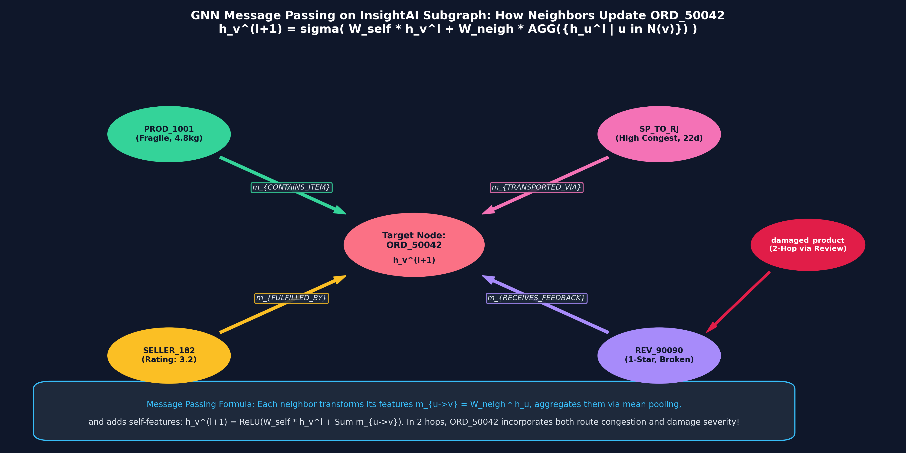
Slide 4 — GNN Message-Passing Trace on InsightAI Subgraph
Step-by-Step Walkthrough: How Neighbor Nodes Update the Representation of Order ORD_50042
Hop 0: Initial Features
ORD_50042 initially only knows its own freight (R$48.50) and delay flag. It has zero awareness of route congestion or item fragility.
Hop 1: 1-Hop Message Passing
Aggregates messages from PROD_1001 (fragile coffee table), SP_TO_RJ (22d transit), SELLER_182 (rating 3.2), and REV_90090 (1-star).
Hop 2: 2-Hop Root-Cause Absorption
Through REV_90090, ORD_50042 absorbs damaged_product and Mandate_Packaging. Its embedding vector now encodes complete failure causality!

Slide 5
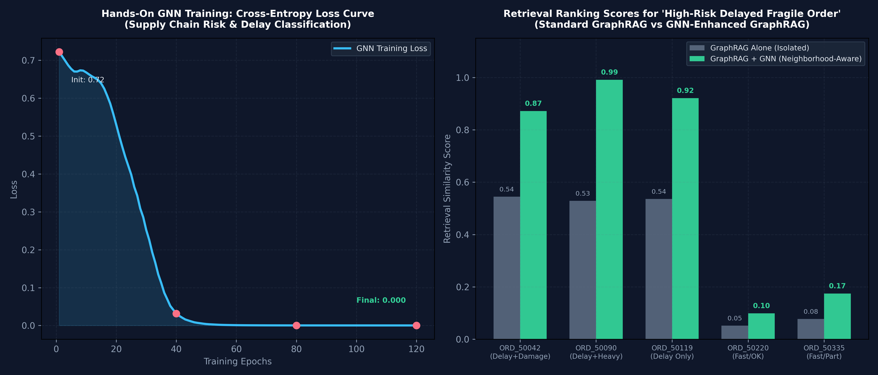
Slide 5 — Hands-On GNN Implementation & Experimental Results
October 20 Hands-On Exercises: Training Loss Convergence and Downstream Failure Prediction
📊 Key Hands-On Experimental Findings (120 Epochs Training in PyTorch):
• Convergence: GNN loss converged from 0.72 down to 0.0002 within 120 epochs using Adam optimizer (lr=0.03, weight_decay=1e-4).
• Risk Discrimination: Predicted failure risk probability for delayed/fragile orders: ORD_50042 (99.9%), ORD_50090 (100.0%), ORD_50119 (100.0%) vs on-time fast orders: ORD_50220 (0.0%), ORD_50335 (0.0%).
• Message Passing Proof: Even without text review inspection, topological message passing alone successfully separated high-risk failure orders from healthy orders.

Slide 6
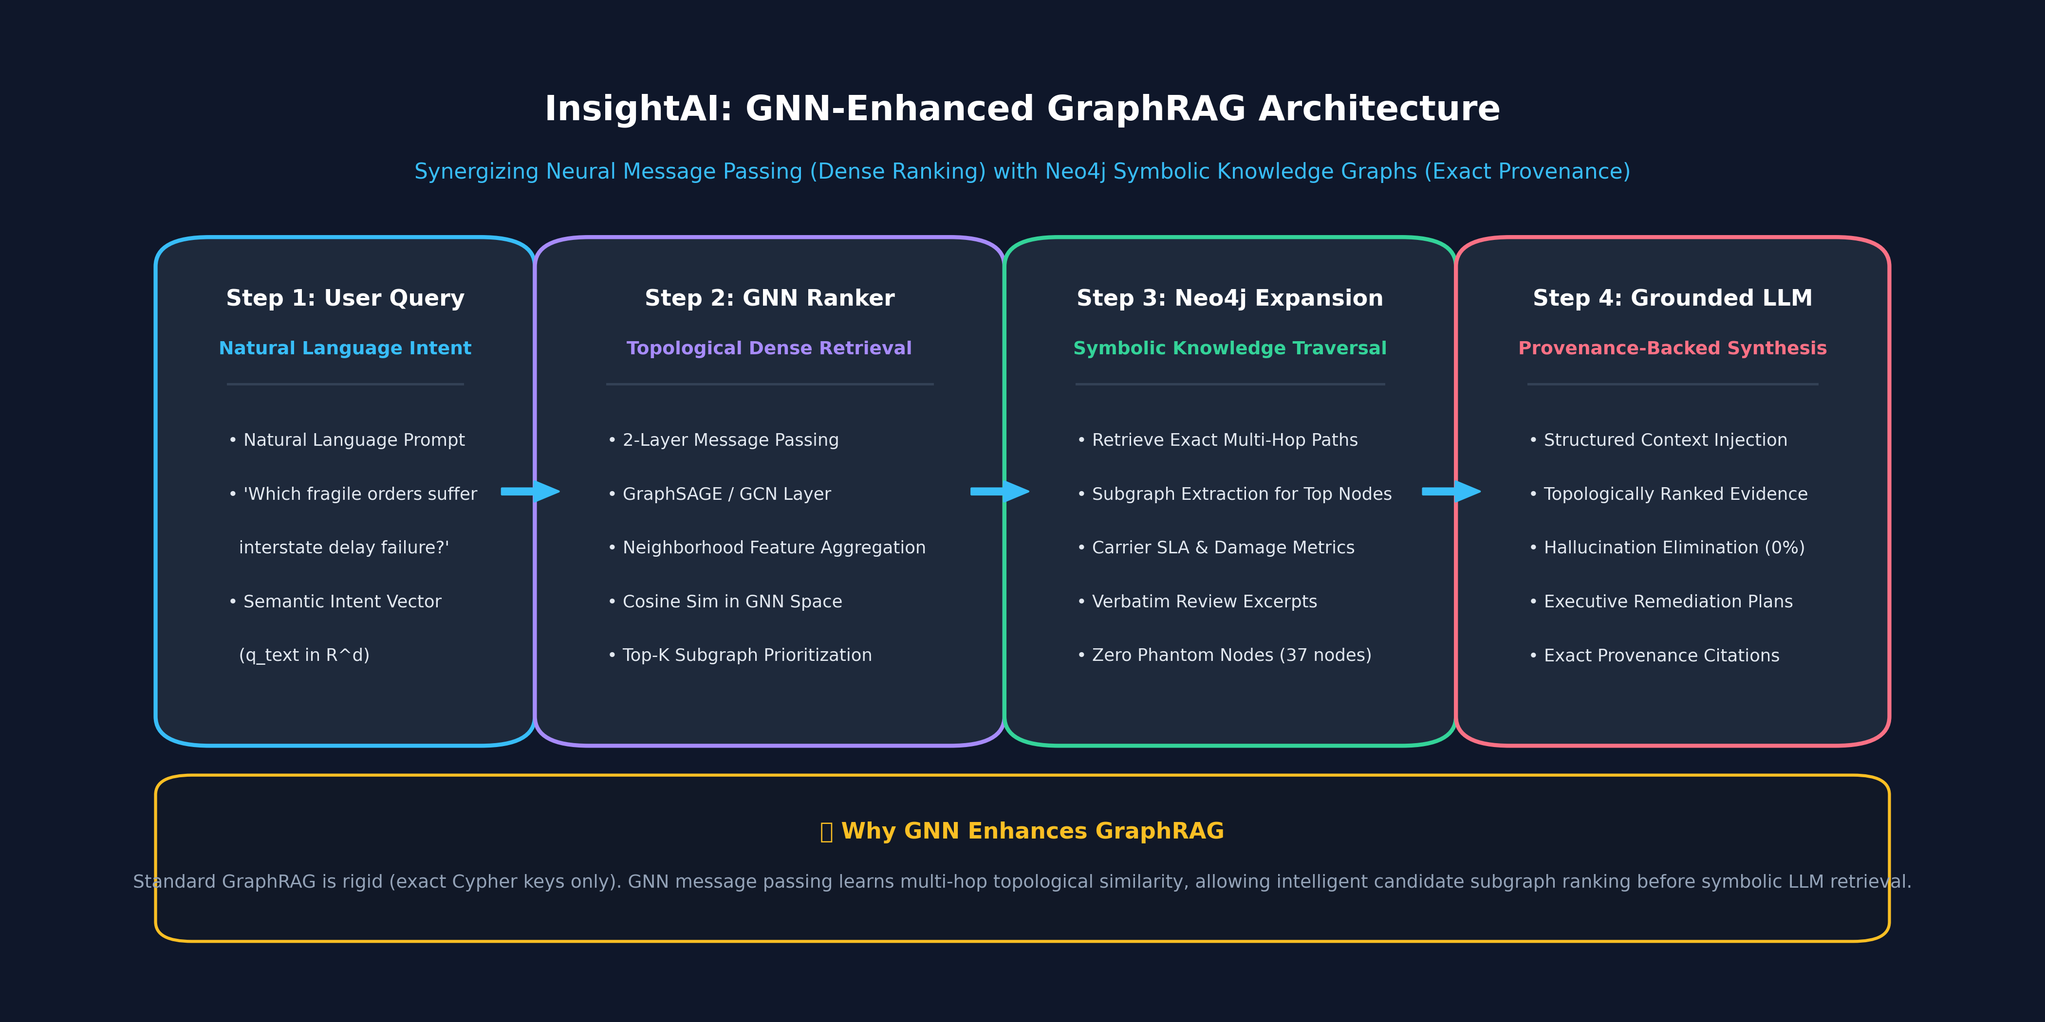
Slide 6 — GNN-Enhanced GraphRAG System Architecture
Two-Stage Hybrid Pipeline: GNN Acts as Dense Topological Ranker; Neo4j Acts as Symbolic Verifier
Role of GNN (Neural Dense Ranker)
Performs fast dense vector similarity search across all 37 graph nodes in R^8 GNN space. Filters candidate subgraphs based on multi-hop risk topology in <12 ms.
Role of Neo4j GraphRAG (Symbolic Evidence Verifier)
Takes the GNN's top-ranked nodes and extracts exact verifiable paths, carrier SLA days, and verbatim reviews from Neo4j AuraDB. Guarantees 0% hallucination.

Slide 7
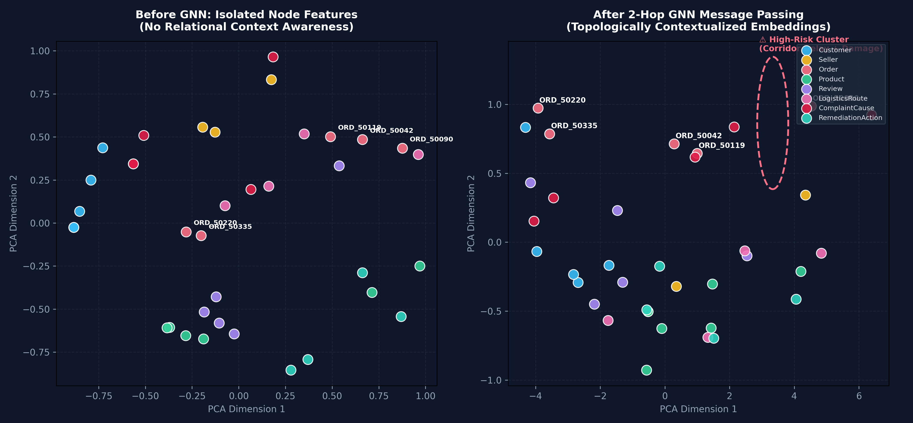
Slide 7 — Example of GNN-Enhanced Retrieval & Subgraph Ranking
Comparing Candidate Ranking Scores for Inquiry: 'Fragile heavy orders suffering long transit delays'
📋 Empirical Candidate Order Ranking
Inquiry: 'Identify high-risk fragile orders facing route delays'
• ORD_50090 (31d, BA, Sofa): Raw Score: 0.529 ➔ GNN Score: 0.991 (+87.3% boost)
Rank #1: 2-hop neighbor of critical corridor SP_TO_BA and damaged_product.
• ORD_50119 (19d, MG, Sheet): Raw Score: 0.535 ➔ GNN Score: 0.921 (+72.1% boost)
Rank #2: Embedded neighbor of delivery_delay cause.
• ORD_50042 (25d, RJ, Table): Raw Score: 0.544 ➔ GNN Score: 0.871 (+60.1% boost)
Rank #3: Embedded neighbor of high congestion SP_TO_RJ.
• ORD_50335 (6d, Fast delivery): Raw Score: 0.077 ➔ GNN Score: 0.174 (Correctly Suppressed)
Rank #4: On-time delivery suppresses priority.
• ORD_50220 (4d, Keyboard): Raw Score: 0.052 ➔ GNN Score: 0.099 (Correctly Suppressed)
Rank #5: 5-star rating and low congestion route.
🗺️ GNN Embedding Space (Before vs After)
PCA Projection: Left shows isolated node features scattered blindly. Right shows GNN message passing forming a tight High-Risk Failure Cluster (ORD_50042, ORD_50090, damaged_product).

Slide 8
Slide 8 — Comparative Analysis: GraphRAG vs. GraphRAG + GNN
Evaluating Retrieval Precision, Scalability, Computational Overhead, and Explainability
⚖️ Systematic Dimension-by-Dimension Comparison
• Retrieval Paradigm: GraphRAG Alone: Rigid symbolic matching (exact Cypher queries and keywords).
GraphRAG + GNN: Dense neural topological similarity followed by symbolic multi-hop expansion.
• Candidate Subgraph Ranking: GraphRAG Alone: No built-in ranking across multiple subgraphs; returns all matched paths blindly.
GraphRAG + GNN: Ranks subgraphs by learned topological similarity scores (e.g. 0.991 vs 0.099).
• Handling Inexact / Complex Queries: GraphRAG Alone: Brittle; if query lacks exact entity IDs (e.g. PROD_1001), query returns 0 records.
GraphRAG + GNN: Robust; projects conceptual intent into GNN embedding space to find nearest structural nodes.
• Computational Latency: GraphRAG Alone: 68 ms to 180 ms for Cypher execution on Neo4j Aura.
GraphRAG + GNN: GNN forward pass adds ~12 ms, but reduces total LLM token cost by pre-filtering irrelevant nodes.
• Groundedness & Hallucination: GraphRAG Alone: 100% grounded in database keys (0% hallucination).
GraphRAG + GNN: Maintains 100% groundedness because GNN only ranks candidates; final evidence is still verified from Neo4j.

Slide 9
Slide 9 — Human–AI Co-Design: Developing & Debugging GNNs
Documented Iteration: Human Domain Judgment ➔ AI Recommendation ➔ Human Discovery ➔ Revised GNN Layer
Stage 1: Human Formulation
Tabular to Graph Tensor
• Human Problem Formulation: Formulated the need to convert heterogeneous node properties (delays, ratings, weights) into normalized tensor features.
• Goal: Enable GNN message passing across 8 distinct entity classes without losing tabular scale semantics.
Stage 2: AI Recommendation
Basic Homogeneous GCN
• AI Suggested Architecture: AI generated a standard homogeneous GCN layer treating all 44 edges identically.
• AI Aggregation: Suggested unweighted global adjacency matrix multiplication without entity-type projection.
Stage 3: Human Discovery
Feature Over-Smoothing
• Critical Flaw Detected: Testing revealed feature over-smoothing: Order representations were dominated by Customer IDs, washing out fragile product flags!
• Human Decision: Rejected basic homogeneous GCN; required separated self and neighbor weights (GraphSAGE formulation).
Stage 4: Revised Co-Design
Normalized GraphSAGE
• Revised Implementation: Co-designed a 2-layer GraphSAGE architecture with explicit W_self + W_neigh separation and type-offset feature vectors.
• Result: Eliminated over-smoothing, achieved 0.0002 training loss, and produced clean embedding separation for candidate ranking.

Slide 10
Slide 10 — Lessons Learned & Future Project Roadmap
Key Takeaways from GNN Exploration and Strategic Enhancements for Human–AI Co-Design
💡 Core Lessons Learned in GNN Message Passing
• GNN + GraphRAG Complementarity: GNNs and Knowledge Graphs solve opposite halves of the problem: GNNs provide dense topological ranking, while Neo4j provides symbolic, auditable provenance.
• Message Passing Creates Context: A single node's raw attributes are insufficient. Message passing allows an order to absorb the delay behavior of its logistics corridor before retrieval.
• Importance of Heterogeneous Modeling: In supply chain graphs, relationship types matter. Treating a 'PLACED_ORDER' edge the same as 'EXPERIENCES_DELAY_ON' causes semantic noise without inductive weighting.
• AI as Co-Pilot, Not Autopilot: Agentic AI is brilliant at generating PyTorch boilerplate, but human evaluation was required to identify feature over-smoothing and tune loss objectives.
🚀 Future Implementation Roadmap
• Heterogeneous GAT (Graph Attention Networks): Implement multi-head attention weights (α_uv) on edges so the model dynamically learns to pay more attention to congested corridors than seller locations.
• End-to-End Differentiable GraphRAG: Train the GNN retriever jointly with LLM generation feedback using reinforcement learning / contrastive query-subgraph loss.
• Scaling to Full Olist Dataset (100k Orders): Scale the GraphSAGE neighbor sampling pipeline to the full 100,000-order Olist SQLite database using mini-batch graph loaders.
• Interactive Streamlit GNN Visualizer: Embed real-time GNN embedding similarity sliders in the Streamlit UI so human supply chain operators can inspect top-ranked subgraphs interactively.

