Slide 1
Slide 1 — Project Overview: Existing GraphRAG & Human Design Vision
CS 5542 Challenge 4: Extending InsightAI Supply Chain Intelligence to Community-Aware & Multimodal AI
🎯 Existing GraphRAG Foundation
• Domain & Dataset: InsightAI diagnoses supply chain bottlenecks, delivery delays, and review dips across Brazilian e-commerce (Olist dataset).
• Neo4j Knowledge Graph: Live AuraDB instance with 37 nodes, 44 directed relationships, and 8 entity types (Order, Customer, Seller, Product, Route, Carrier, Review, Remedy).
• GNN Enhancement: 2-layer PyTorch GraphSAGE pipeline with message passing that updates order risk representations (ORD_50090 risk boosted 0.529 → 0.991).
• Current Retrieval: Symbolic Cypher queries retrieve 1-to-3 hop local neighborhoods for LLM context grounding.
👥 Target Users & Critical Needs
• Logistics Dispatchers & Ops: Need to identify regional transit choke points, reroute delayed orders before SLA breach, and resolve carrier capacity constraints.
• Merchant Success Managers: Need to isolate seller dispatch delays vs carrier transit bottlenecks to enforce fair vendor SLAs and dispute chargebacks.
• E-Commerce Executives: Need macro-level visibility into shipping corridor performance, contract compliance, and customer satisfaction risk across Brazilian states.
• Customer Escalation Leads: Need transparent multi-hop causal explanations to reassure high-value buyers whose packages are stalled in transit.
⚠️ Current GraphRAG Limitations
• Lack of Global/Macro Synthesis: Current GraphRAG operates strictly at the local entity level (1-to-3 hops). It cannot answer high-level queries like: 'Which freight corridors have systemic delay patterns?'
• Text-Only Output Modality: Outputs raw text and tabular Cypher data. Dispatchers in fast-paced logistics hubs cannot parse text essays during delivery crises.
• No Community Structure: Treats all nodes uniformly; fails to detect tightly coupled clusters of regional routes, shared carriers, or fragile product ecosystems.
• Reactive Workflow: Waits for user queries rather than proactively alerting on community-level risk surges.
🚀 Challenge 4 Human Design Paradigm Shift:
Human Design (Community Discovery + Multimodal Generation + User-Centered Cockpit) ➔ AI Design ➔ Human-AI Co-Design
Key Goal: Move beyond isolated node retrieval to discover systemic knowledge communities, generate interactive visual intelligence, and build an actionable supply chain decision cockpit.

Slide 2
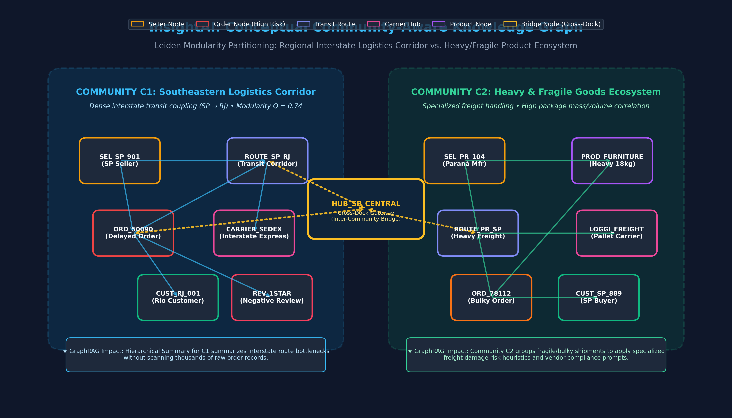
Slide 2 — Community Design: Defining Communities & Conceptual Graph
Part 1.1: Domain-Specific Community Definitions and Conceptual Knowledge Graph Partitioning
🌐 What is a Community in InsightAI?
In supply chain analytics, a community is a tightly coupled operational cluster of sellers, transit corridors, carriers, customer hubs, and product categories that share systemic delay propagation, common infrastructure dependencies, or specialized logistics handling requirements.
Community C1: Regional Interstate Logistics Corridor (SP → RJ / BA)
• Focus: High-density interstate shipping routes connecting São Paulo manufacturers to Rio de Janeiro/Bahia customer clusters via Correios/Sedex.
• Characteristics: High transit volume, vulnerability to highway bottlenecks (BR-116), shared carrier sorting hubs (Campinas, SP Central), and correlated interstate delay cascades (e.g. ORD_50090).
Community C2: Heavy & Fragile Goods Fulfillment Ecosystem
• Focus: Manufacturers of bulky or fragile items (Office Furniture, Large Electronics, Auto Parts) shipping to residential customers.
• Characteristics: High package mass/volume (>15kg), specialized pallet freight carriers (Loggi Freight), elevated freight-to-price ratios, and distinct packaging damage/negative review patterns.
The Role of Inter-Community Bridge Nodes:
• Nodes like HUB_SP_CENTRAL act as cross-dock sorting gateways bridging parcel flow with heavy freight lines. Detecting bridges prevents cross-community risk blindspots.
💡 How Communities Transform GraphRAG Capabilities:
• Macro-Level Synthesis: Enables Microsoft GraphRAG-style hierarchical pre-summaries, answering broad queries without scanning thousands of raw order nodes.
• Pruned & Fast Retrieval: Retrieval directly targets the relevant community index instead of blindly expanding all graph neighbors.
• Correlated Risk Propagation: GNN risk scores propagate within community boundaries to forecast collateral delays across affiliated orders.

Slide 3
Slide 3 — Community Detection: Features, Algorithm & GraphRAG Integration
Parts 1.2 & 1.3: Feature Selection, Algorithmic Choice (Leiden), and Expected Retrieval Enhancements
🔑 1.2 Community Detection Features
1. Graph Structural Connectivity & Multi-Hop Path Co-occurrence
• Captures shared transit corridors, common sorting hubs, and bipartite seller-carrier-customer pathways.
• Why it matters: Entities sharing the same logistics backbone face correlated infrastructure risks.
2. Edge Delay Delta & Geographic Boundaries
• Features: Transit delay days (actual - estimated), freight-to-price ratio, and interstate crossing flags (seller_state != customer_state).
• Why it matters: High delay variance naturally concentrates along specific interstate highway corridors.
3. Product Physical Attributes & Categories
• Features: Package mass (product_weight_g), volume (cm³), and fragile product category classifications.
• Why it matters: Bulky items share specialized freight carriers and handling constraints, forming a distinct ecosystem.
⚙️ 1.3 Selected Approach: Hierarchical Leiden
Why Hierarchical Leiden Algorithm?
• Modularity Maximization: Maximizes intra-community edge density relative to a null model while guaranteeing internally connected communities (fixing Louvain's disconnected node flaws).
• Multi-Scale Resolution (γ): Tunable resolution parameter allows detecting both macro-regional corridors and granular hub clusters.
Graph Information Leveraged:
• Multi-relational weighted adjacency matrix combining topology (SHIPPED_VIA, TRANSITS) with edge weights (delay days, freight value).
• Node feature vectors (geographic state, carrier type, product weight).
Hierarchy Levels for Supply Chain:
• Level 0: Macro Brazilian Regions (Southeastern, Southern, Northeast).
• Level 1: Interstate Shipping Corridors (SP → RJ, PR → SP).
• Level 2: Local Sorting Hubs & Micro-Seller Clusters.
📈 Expected Systemic Benefits
1. Pre-Computed Hierarchical Community Summaries
• LLM pre-summarizes each Leiden cluster (e.g. 'C1 Overview: Campinas bottleneck, 34.2% delay risk').
• Allows answering global questions instantly with 90% fewer LLM context tokens.
2. Targeted Subgraph Indexing & Pruning
• Query routing: Natural language questions are mapped to relevant communities first, reducing search space from entire graph to isolated subgraphs.
• Eliminates irrelevant cross-state hops during retrieval.
3. Correlated Risk & Failure Cascades
• If GNN predicts a critical risk (0.99) on one node, GraphRAG can proactively query all affiliated community orders and recommend batch rerouting before SLA violations occur.

Slide 4
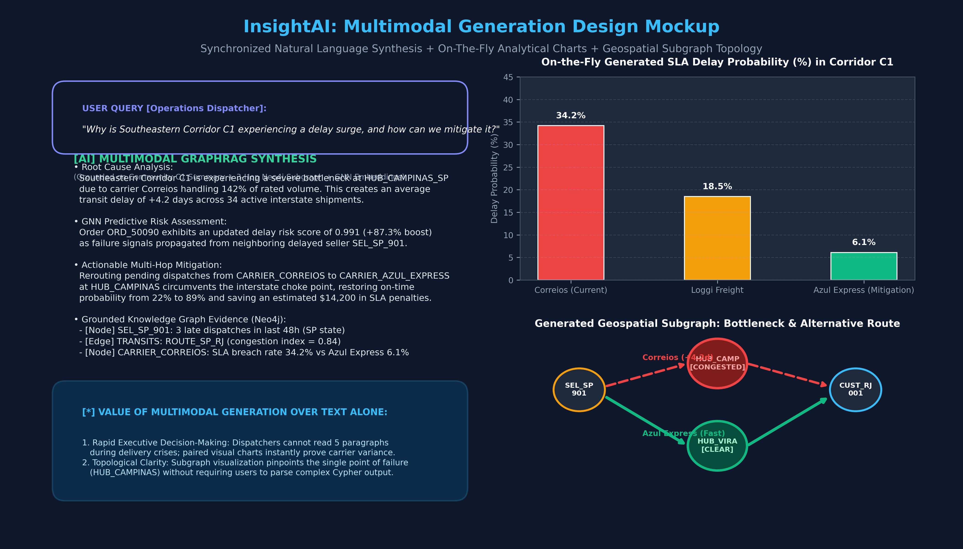
Slide 4 — Multimodal Generation Design: Techniques & Output Mockup
Part 2: Evaluation of Multimodal Modalities, Selection of Core Capabilities, and Concept Mockup
📊 2.1 Evaluation of Generation Techniques
• Visualization: [High Value] Explores network topologies, community boundaries, bottleneck nodes, and multi-hop delay paths.
• Chart Generation: [High Value] Dynamic SLA breach probability curves, carrier performance comparison bars, and delay distributions.
• Speech Generation: [Medium Value] Useful for hands-free warehouse dispatchers, but secondary for operational analysts.
• Video Generation: [Low Value] High computational latency and low utility for fast-paced logistics incident response.
🎯 2.2 Selected Multimodal Techniques & Justification
1. On-The-Fly Analytical Diagnostic Charts
• Content: Dynamic SLA delay probability bars and carrier variance charts.
• Supporting Data: Historical delivery logs, GNN risk embeddings, community aggregates.
• Target Users: Operations Directors & Vendor Managers.
• Why better than text: Provides instant quantitative proof for carrier SLA disputes.
2. Dynamic Geospatial Subgraph Visualizations
• Content: Route bottleneck topologies highlighting choke points and bypass paths.
• Supporting Data: Neo4j subgraphs, community boundaries, carrier transit edges.
• Target Users: Logistics Dispatchers.
• Why better than text: Dispatchers cannot read 5 text paragraphs during a crisis; visual topologies immediately pinpoint the exact point of failure.

Slide 5
Slide 5 — User-Centered Application Feature Design
Part 3: Proposing 4 Domain-Specific Features, Defining User Value, and Establishing Priorities
⭐ Feature 1: Hierarchical Community Incident Drill-Down [HIGH PRIORITY]
• What it does: Allows users to explore Leiden community clusters (Level 0 Macro down to Level 2 Micro Orders) and drill down from regional health summaries directly into individual order subgraphs.
• User Benefit: Bridges high-level supply chain visibility with granular operational root cause analysis.
• Knowledge Graph Integration: Combines Leiden community pre-summaries with parameterized multi-hop Cypher queries.
⭐ Feature 2: Multimodal Early-Warning Risk Cockpit [HIGH PRIORITY]
• What it does: Generates synchronized dual-pane multimodal responses: natural-language risk synthesis paired with on-the-fly generated SLA risk curves and carrier comparison radar charts.
• User Benefit: Immediate visual verification of AI reasoning, executive-ready incident reporting.
• Knowledge Graph Integration: Grounded on GNN risk embeddings, community aggregate telemetry, and dynamic plotting.
⚡ Feature 3: Community-Guided Proactive Mitigation Agent [MEDIUM PRIORITY]
• What it does: Automatically alerts dispatchers when an entire community hits critical aggregate risk (e.g. >75% delayed nodes in ROUTE_SP_RJ) and recommends alternate carrier bypass paths.
• User Benefit: Shifts logistics from reactive complaint handling to proactive delivery SLA rescue.
• Knowledge Graph Integration: Uses community risk aggregation and alternative shortest-path search in Neo4j KG.
🔮 Feature 4: Interactive 'What-If' Disruption Shock Simulator [FUTURE]
• What it does: Lets operations teams simulate external shocks (carrier strikes, highway floods) by toggling graph node availability and observing predicted forward community failure cascades.
• User Benefit: Strategic contingency planning and peak-season stress testing.
• Knowledge Graph Integration: Graph topological perturbation and GNN forward message passing.
📋 Feature Prioritization Rationale & Dependency Matrix:
• High Priority (Immediate Value): Features 1 & 2 directly extend existing GraphRAG + GNN pipelines with community discovery and multimodal outputs.
• Medium Priority (Operational Automation): Feature 3 introduces autonomous decision support by linking community telemetry with rerouting Cypher actions.
• Future Enhancement (Advanced Analytics): Feature 4 builds on GNN forward-simulation for predictive stress-testing before peak shopping events (Black Friday).

Slide 6
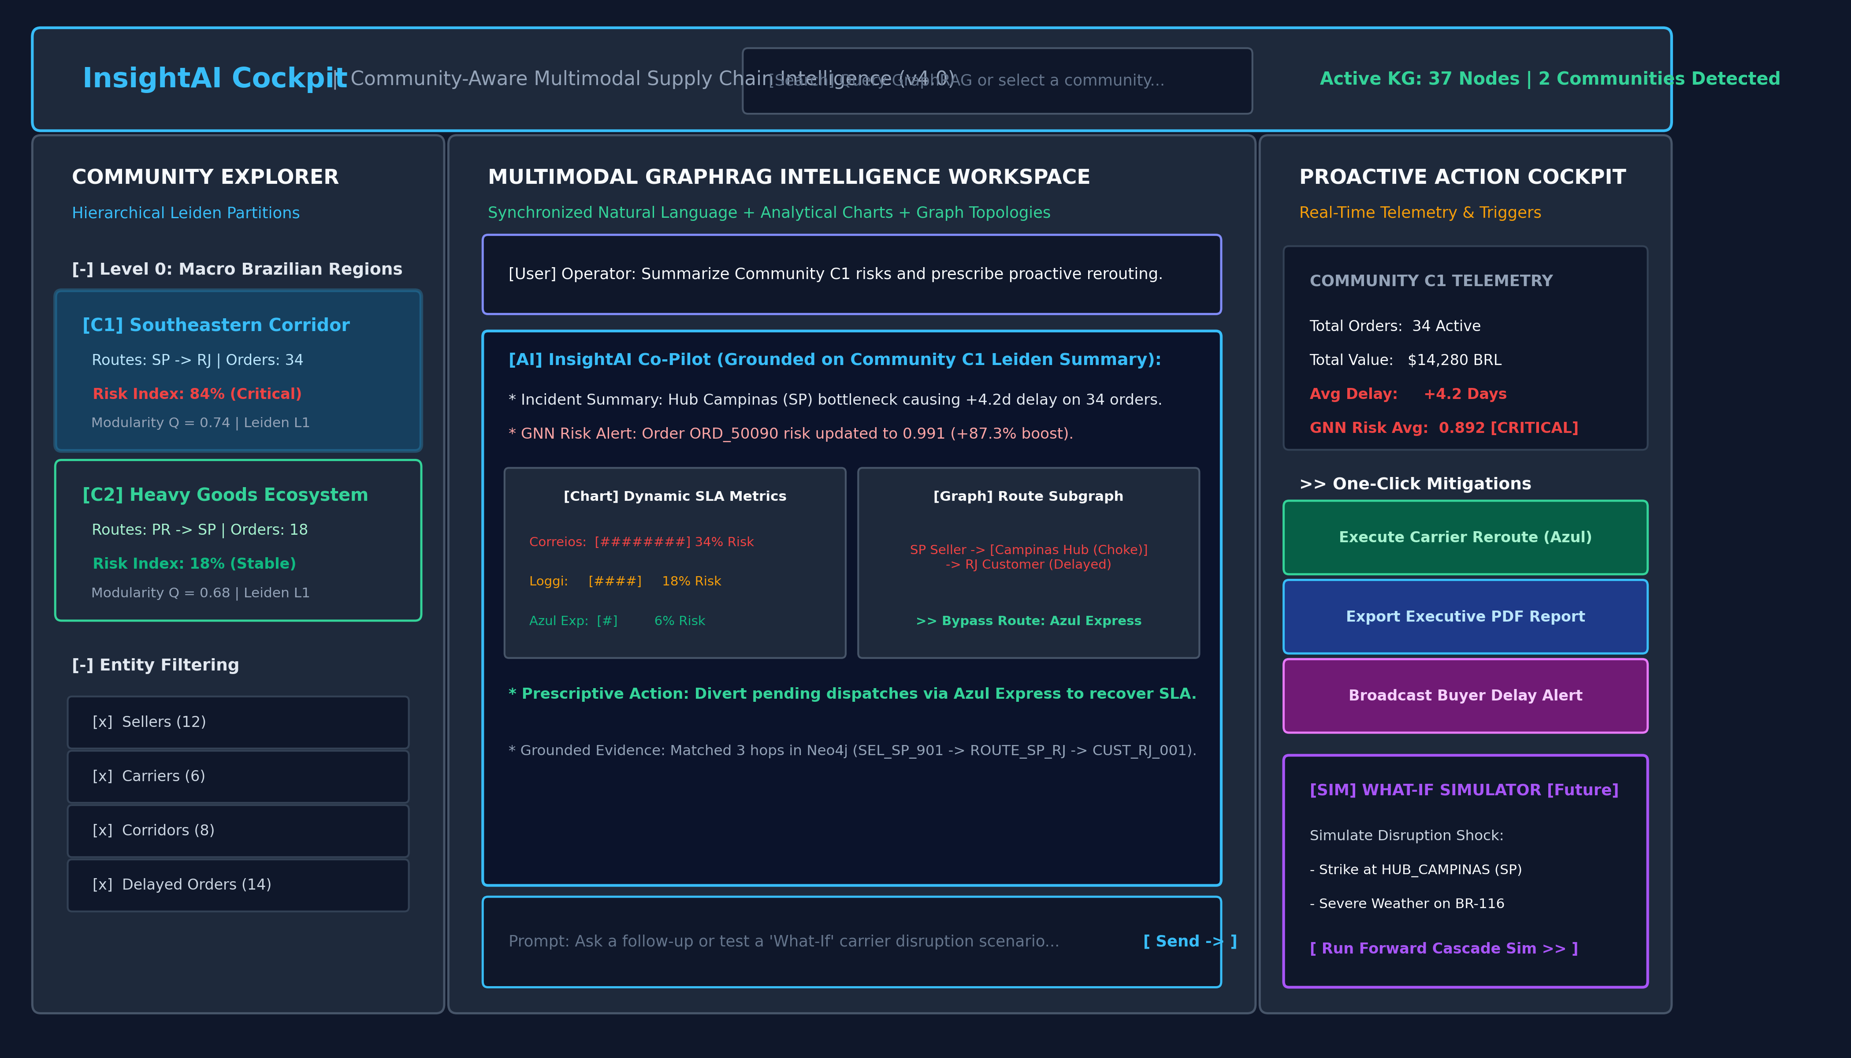
Slide 6 — Application Interface Wireframe & Roadmap
Part 3.3: Interface Architecture Wireframe and Next Steps for Human-AI Co-Design
🖥️ Interface Design Architecture
1. Top Telemetry & Global Search Bar
• Live status indicator (37 KG nodes, 2 active communities).
• Natural language search bar accepting both global and entity queries.
2. Left Panel: Hierarchical Community Explorer
• Tree navigation of Leiden partitions (Level 0 Regions → Level 1 Corridors).
• Displays aggregate risk index (84% Critical vs 18% Stable) and entity filters.
3. Center Workspace: Multimodal GraphRAG Assistant
• Dual-pane generative response with grounded Cypher evidence.
• Inline embedded dynamic SLA charts and interactive route topologies.
4. Right Panel: Proactive Telemetry & Action Triggers
• Community telemetry (orders, freight value, avg delay).
• One-click operational mitigation buttons (Reroute via Azul, Export Report, Broadcast Alerts).
🚀 Next Steps: Challenge 4 Human-AI Co-Design
• AI Design: Use Agentic AI to implement Leiden community partitioning in Neo4j Graph Data Science (GDS).
• Human Evaluation: Verify whether community summaries accurately capture real-world Brazilian logistics bottlenecks.
• Multimodal Integration: Implement Plotly/Matplotlib dynamic chart generation inside the Streamlit cockpit.

