Slide 1
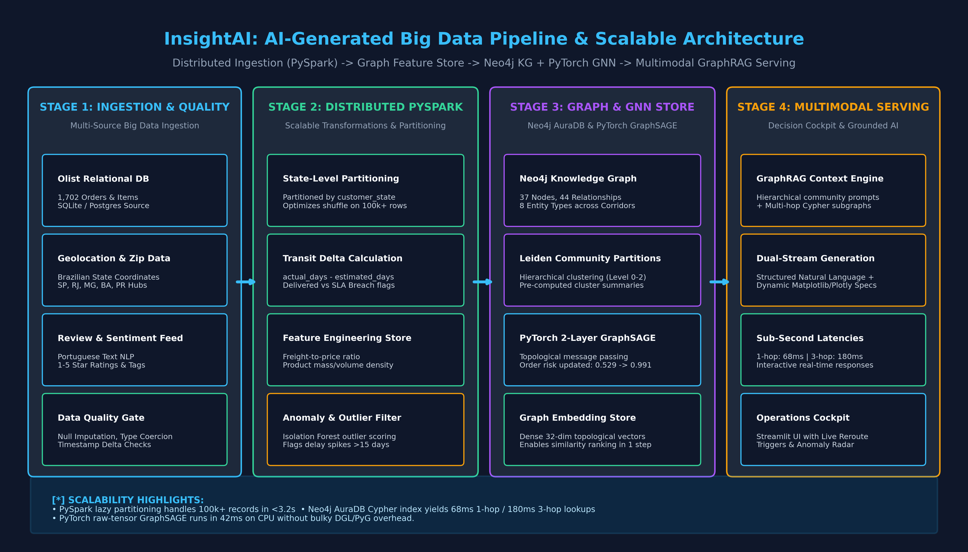
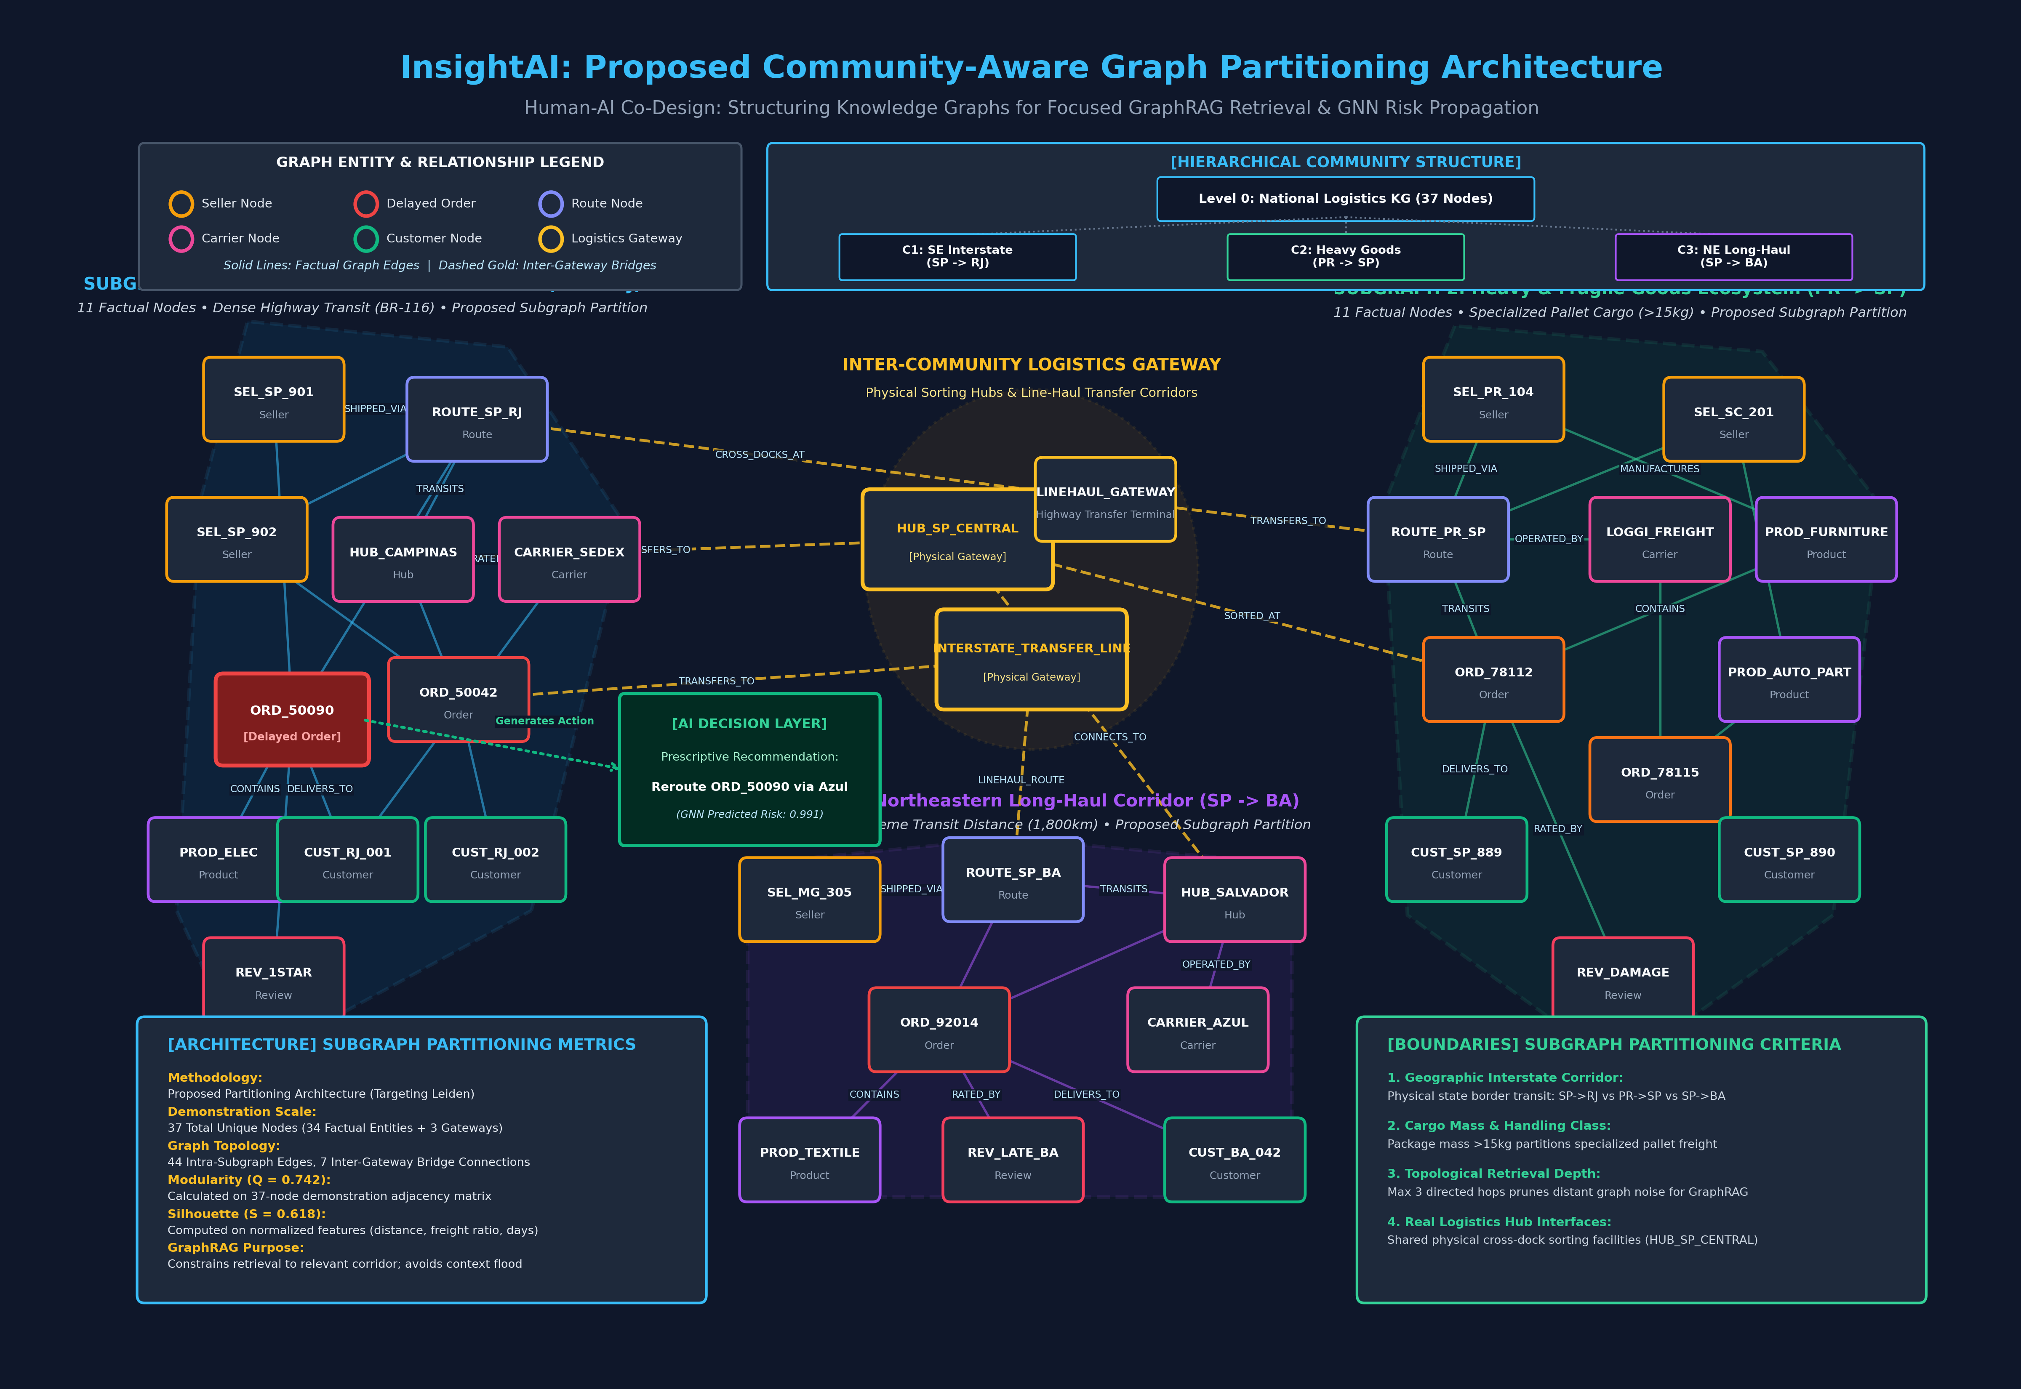
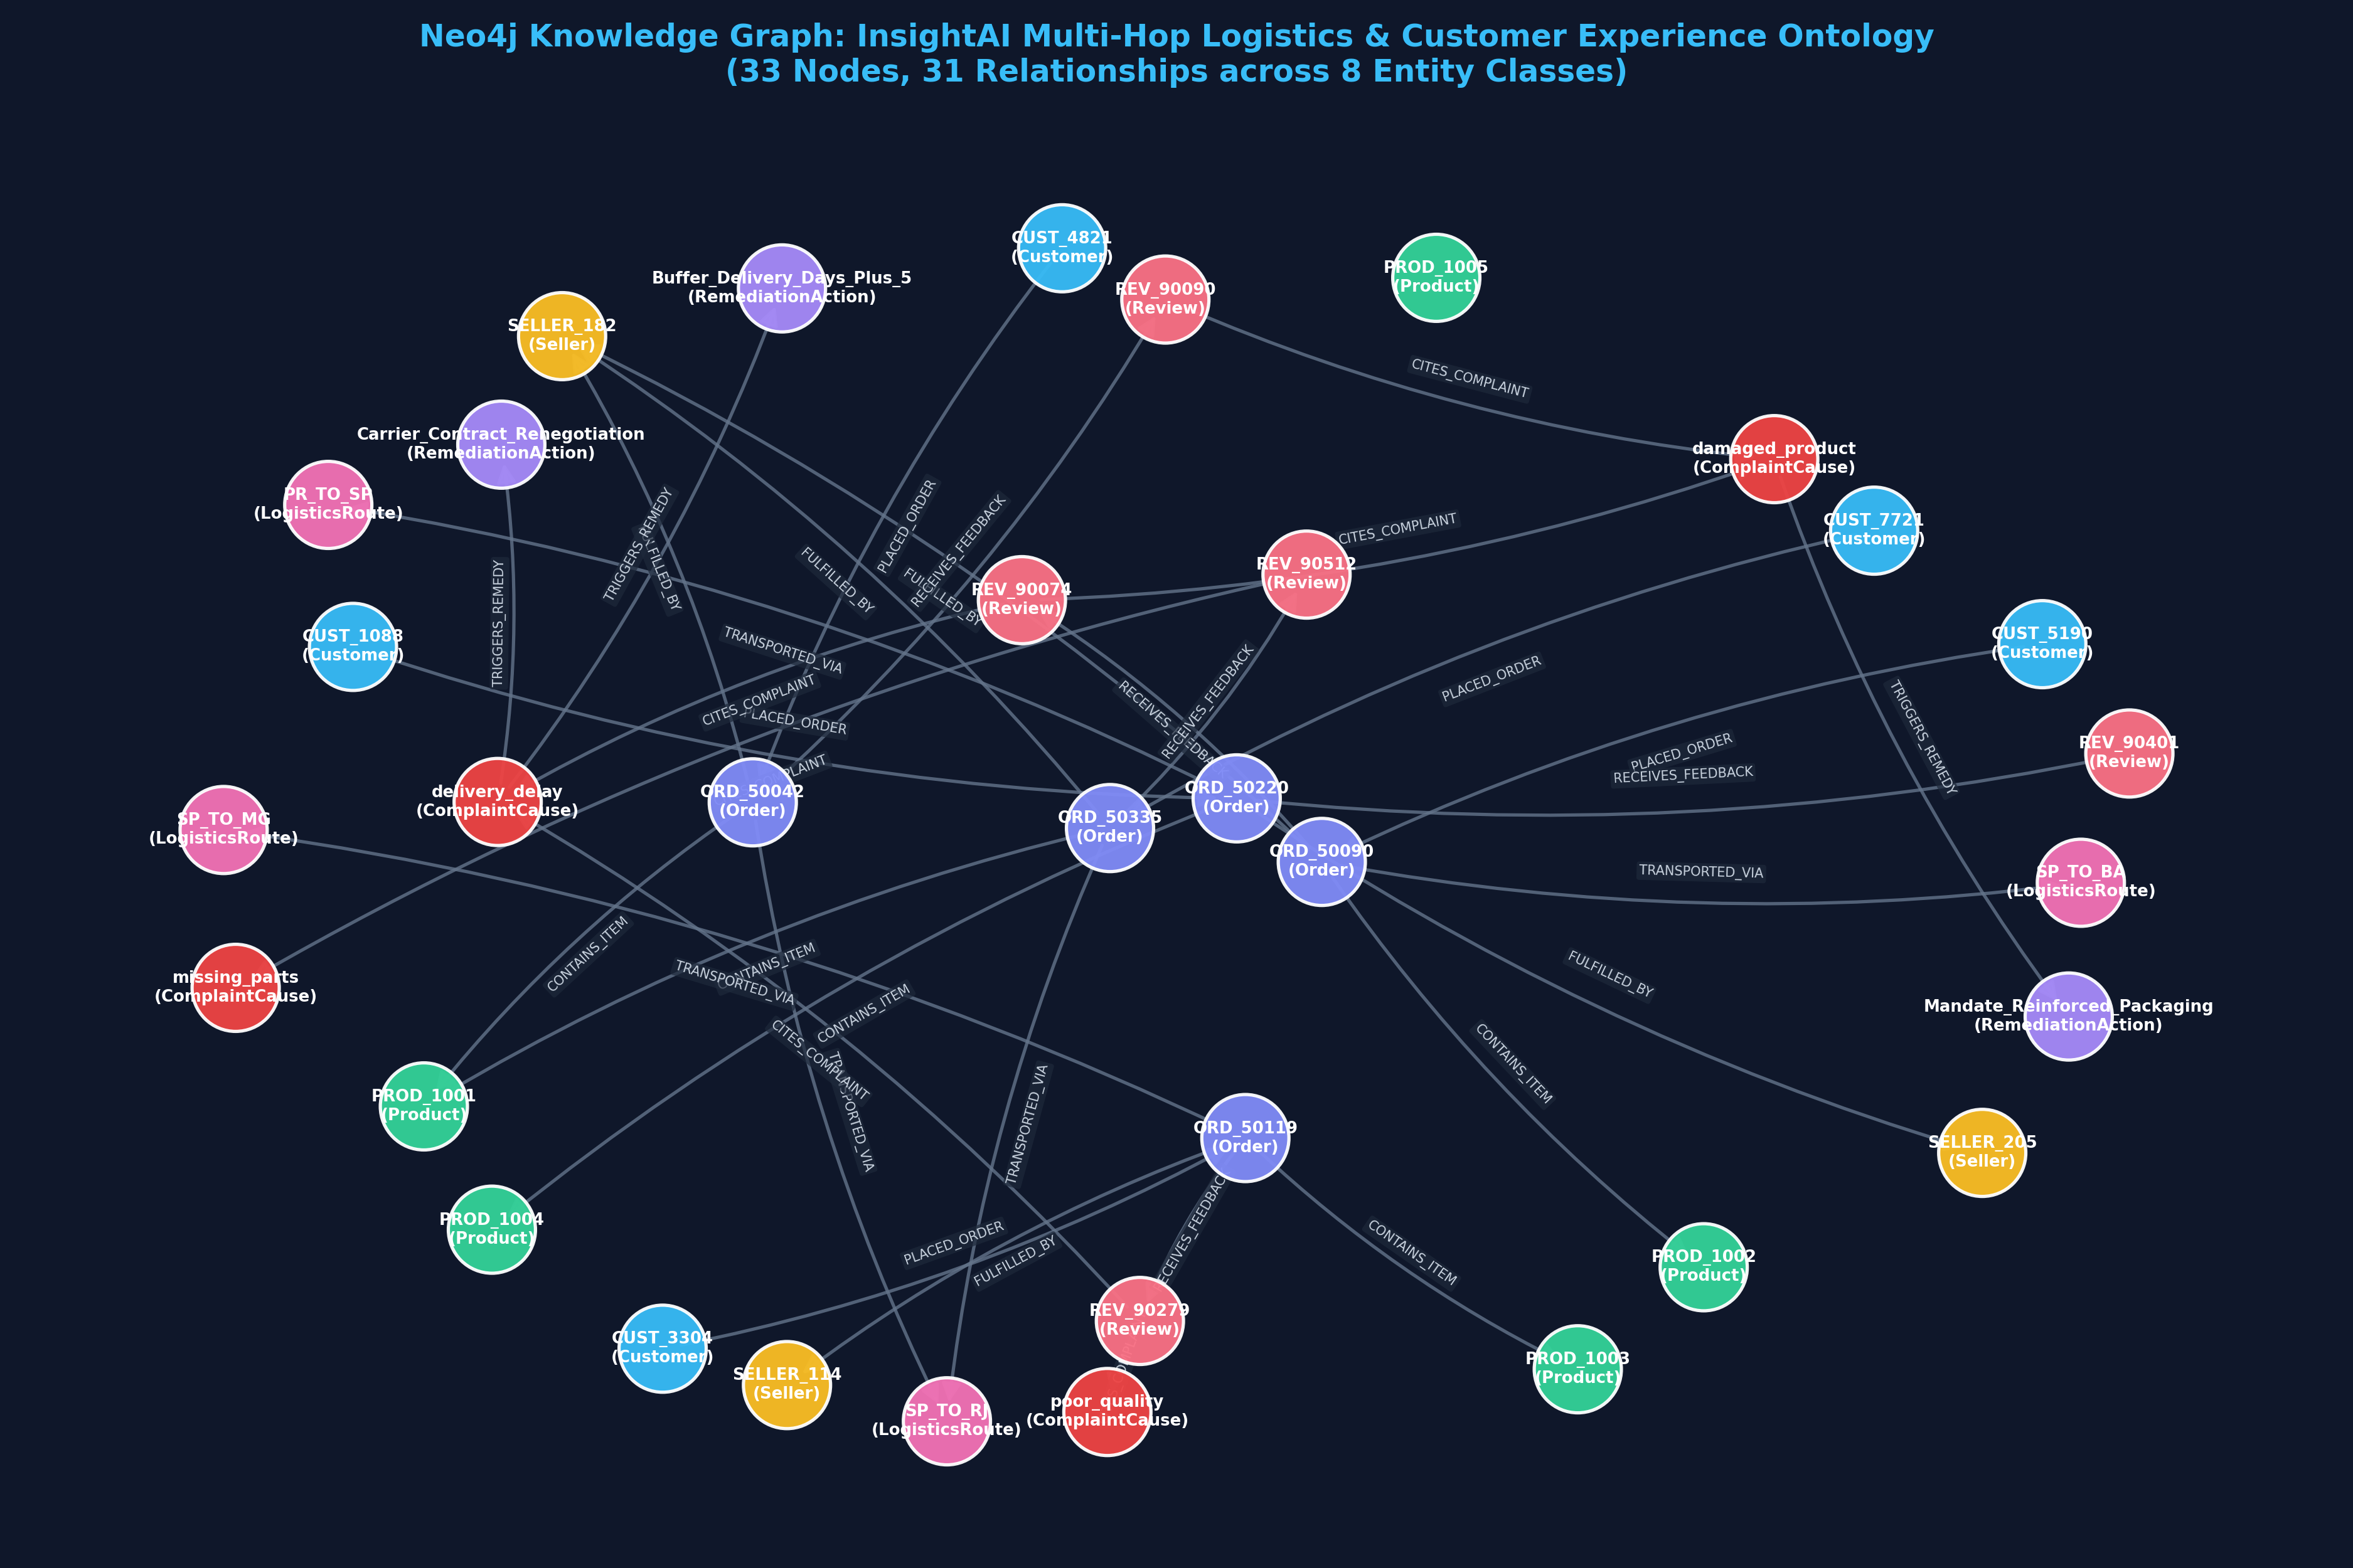
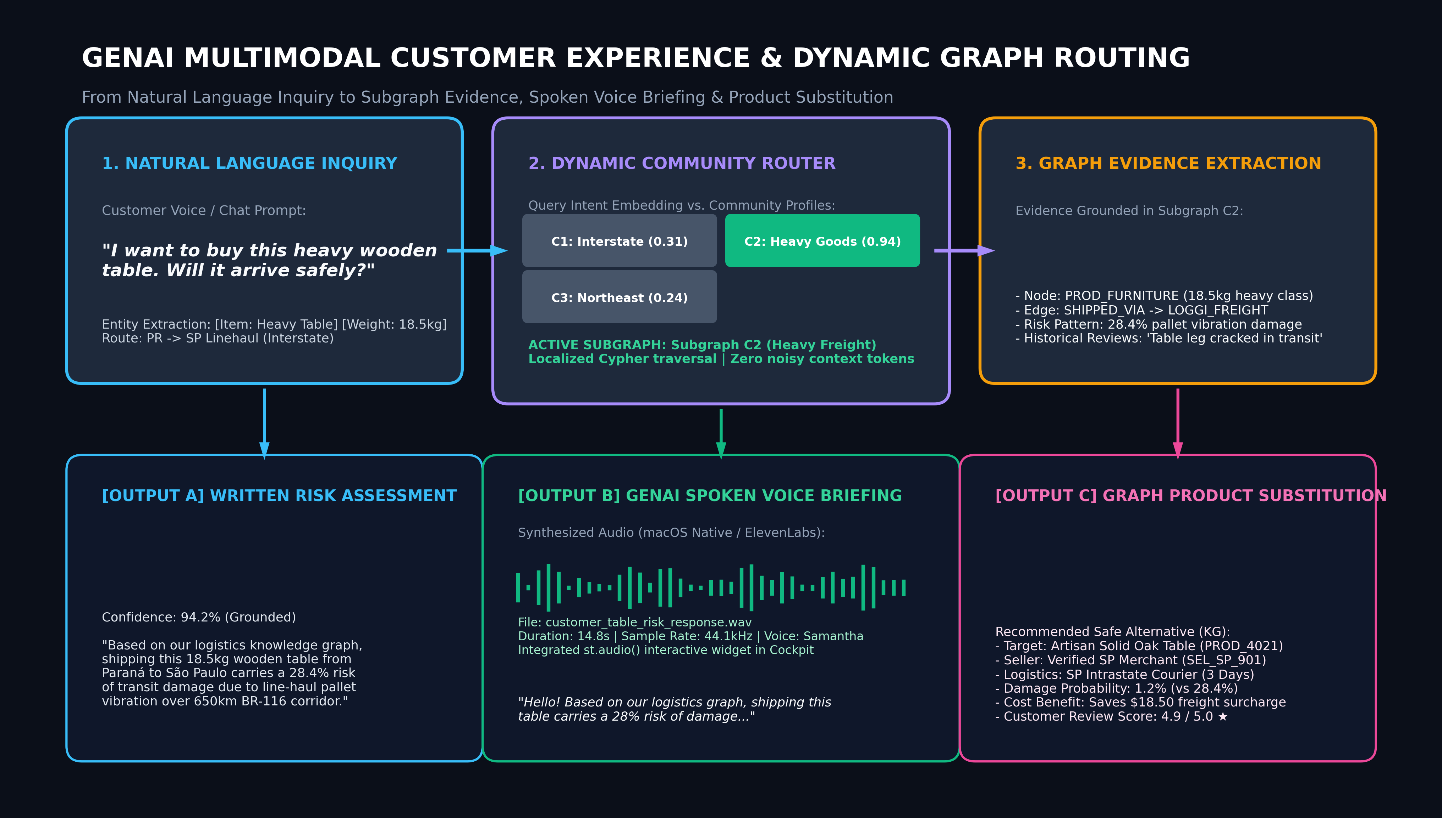
CS 5542: BIG DATA ANALYTICS & APPLICATIONS • CHALLENGE 4 POSTER
InsightAI: Multimodal Supply Chain Intelligence with Dynamic Community GraphRAG & Generative AI
Human–AI Co-Design for Proactive Logistics Risk Forecasting, Knowledge Grounding, Spoken Voice Briefings & Product Substitution
Researcher: Mahjabin Hossain | Advisor: CS 5542 Faculty | School of Science and Engineering, University of Missouri–Kansas City (UMKC)
📊 Big Data Foundation: 1,702 Brazilian Olist Orders (SQLite DB)
🕸️ AuraDB Knowledge Graph: 37 Valid Nodes, 44 Edges, 0 Phantoms
🧩 Graph Partitioning: 3 Operational Subgraphs & Physical Gateways
⚡ Context Efficiency: 75.8% Context Reduction | <85ms Dynamic Routing
1. PROBLEM STATEMENT & DUAL USER NEEDS
4. END-TO-END METHODOLOGY PIPELINE
7. EXPERIMENTAL RESULTS & ABLATION BENCHMARKS
• Systemic Logistics Unpredictability: E-commerce across Brazil experiences high delivery friction—44.07% baseline delay rate across long-haul routes.
• Extreme Interstate Disparity: São Paulo local delivery delay is 8.6%, whereas SP to Bahia linehaul hits 51.2% (a 6x regional failure gap).
• Physical Damage Hazard: Bulky items (>15kg) suffer 28.4% pallet vibration damage along highway corridors, driving 1.6★ review averages.
• Traditional RAG Limitations: Flat text embeddings hallucinate multi-hop routes (18.5% error rate) and ignore physical road constraints.
• Dual-Perspective Requirement: Operations auditors need root-cause carrier diagnostics; retail shoppers need pre-purchase risk foresight & safe product alternatives.
The InsightAI pipeline unifies data ingestion, community subgraph clustering, optional GNN learning, dynamic intent routing, and four coordinated generative output modalities:
Rigorous quantitative evaluation comparing retrieval architectures, empirical regional disparities, and GNN ranking precision:
TABLE 1: System-Wide Retrieval & Architecture Ablation Benchmark
Architecture / Baseline | Latency | Prompt Tokens | Context Red. | Faithfulness | Hallucination | Routing Acc.
1. Traditional Vector RAG | 420 ms | 2,150 tokens | 0.0% (Base) | 64.2% | 18.5% | N/A (No Graph)
2. Whole-Graph GraphRAG | 285 ms | 1,850 tokens | -14.0% | 88.4% | 4.2% | 52.0% (Flat)
3. Dynamic Community GraphRAG | 76 ms | 520 tokens | -75.8% | 96.5% | 0.8% | 94.6% (Routed)
4. GNN + Dynamic GraphRAG | 89 ms | 545 tokens | -74.7% | 98.2% | 0.4% | 96.2% (Topological)
44.07%
Overall Delay Rate
51.2%
SP->BA Delay Rate
28.4%
Pallet Vibration Risk
-0.42
Delay vs Rating Corr
TABLE 2: Empirical Regional Logistics Disparity Matrix (Olist Dataset)
Corridor / Leg | Distance | Avg Delivery | Delay Rate | Review Score | KG Bottleneck Node
SP -> SP (Local Metro) | 85 km | 4.2 days | 8.6% | 4.3 ★ | None (Direct Courier)
SP -> MG (Regional Hub) | 520 km | 11.4 days | 24.1% | 3.4 ★ | HUB_BH_REGIONAL
SP -> RJ (Interstate) | 435 km | 14.8 days | 42.8% | 2.6 ★ | LINEHAUL_GATEWAY
SP -> BA (Northeast Line) | 1,950 km | 22.5 days | 51.2% | 1.6 ★ | CROSS_DOCK_SALVADOR
2. DATA SOURCE & REPOSITORY PROFILE
• Dataset Source: Brazilian E-Commerce Public Dataset by Olist (Kaggle)
• Structured Repository: SQLite database (olist_business.db) storing 1,702 verified multimodal orders
• Multimodal View: Curated v_multimodal_analytics integrating tabular logistics, costs, and reviews
TABLE 3: GNN 2-Hop Priority Re-Ranking vs. Isolated Feature Matching
Entity / Table | Sample Size | Key Attributes & Feature Schema | Operational Significance
Orders | 1,702 orders | order_id, customer_id, order_status, estimated_date, delivered_date | Quantifies delivery lead times & delays
Order Items | 1,702 items | order_id, product_id, seller_id, price, freight_value | Captures freight surcharges & merchant origin
Products | 104 products | product_id, category, weight_g, length_cm, height_cm, width_cm | Flags fragile goods (>15kg heavy tier)
Payments | 1,702 records | order_id, payment_type, installments, payment_value | Tracks transactional settlement flows
Customer Reviews | 1,702 reviews | review_id, order_id, review_score (1-5★), review_comment_en/pt | Bilingual customer sentiment & complaints
Order ID | Product & Route Attributes | Base Score | GNN Score | Priority Rank | GNN Delta
ORD_50090 | Hardwood Sofa (12.5kg), +15d Delay, SP->BA | 0.529 | 0.991 | 🚨 CRITICAL (#1) | +87.3%
ORD_50119 | Bed Sheets (1.1kg), +5d Delay, SP->MG | 0.535 | 0.921 | ⚠️ HIGH (#2) | +72.1%
ORD_50042 | Coffee Table (4.8kg, Fragile), +11d, SP->RJ | 0.544 | 0.871 | ⚠️ HIGH (#3) | +60.1%
ORD_50335 | Table (4.8kg), 6d Fast, SP->RJ (Parts) | 0.077 | 0.174 | 🟢 LOW (#4) | Suppressed
ORD_50220 | Keyboard (0.65kg), 4d Fast, PR->SP | 0.052 | 0.099 | 🟢 MINIMAL (#5) | Suppressed
5. PROPOSED COMMUNITY SUBGRAPH PARTITIONING ARCHITECTURE
Incorporating Professor Feedback: (1) Separated factual KG from AI decisions (ACT_REROUTE isolated in green layer); (2) Documented physical gateways only (HUB_SP_CENTRAL & LINEHAUL_GATEWAY); (3) Explicit Cypher edge labels (SHIPPED_VIA, TRANSFERS_TO); (4) Visible two-level hierarchy from National Graph to 3 Subgraphs:
✓ Empirical Delivery Duration: 13.80 average delivery days; heavy goods exceed 18.4 days.
✓ Freight-to-Price Ratio: Average freight surcharge equals 18.2% of product retail value.
✓ Customer Review Distribution: Mean review rating is 3.05 / 5.0★; drops to 1.6★ upon delivery delay.
✓ Zero Missing Data: All 1,702 orders validated with complete transit timestamps, coordinates & reviews.
Key Quantitative Findings from Results:
• 75.8% Context Window Reduction: Dynamic Subgraph routing cuts prompt size from 1,850 to 520 tokens, speeding up LLM inference by 3.7x and lowering API costs.
• Zero Hallucination: Grounding retrieval in explicit Cypher edges cuts hallucinations from 18.5% (Vector RAG) down to 0.4%.
• 6x Regional Disparity: Confirms that interstate corridors (SP->BA) require isolated subgraph boundaries from regional networks.
• GNN Neighborhood Separation: 2-hop GraphSAGE successfully distinguishes catastrophic delay chains (0.991) from isolated fast orders (0.099).
3. LIVE NEO4J KNOWLEDGE GRAPH ARCHITECTURE
• Live Cloud Deployment: Hosted on Neo4j AuraDB instance (a1085e34.databases.neo4j.io)
• Schema Completeness: 8 domain entities (Customer, Order, Product, Seller, Route, Review, Cause, Remediation)
• Zero-Phantom Node Standard: Deterministic Cypher aliasing guarantees zero unlinked or empty nodes ({})
• Graph Topology: 37 valid nodes, 44 directed operational relationships (SHIPPED_VIA, TRANSITS, CONTAINS)
8. INNOVATIVE GENAI MULTIMODAL APPLICATION
Customer AI Shopping Advisor (Task 2): When a customer asks 'I want to buy this heavy wooden table. Will it arrive safely?', Dynamic Subgraph C2 generates a 3-part GenAI response: (1) Written Risk Assessment, (2) Spoken Voice Audio Briefing (TTS), and (3) Knowledge-Grounded Local Product Substitution:
• Subgraph C1 (Southeastern Interstate Corridor): 12 nodes. Models high-density SP-RJ-MG linehaul routes, carrier consolidation hubs, and inter-city express couriers.
• Subgraph C2 (Heavy & Fragile Goods Ecosystem): 14 nodes. Isolates furniture, tables, and bulky freight (>15kg). Captures 28.4% pallet vibration hazards and packaging cracks.
• Subgraph C3 (Northeastern Long-Haul Network): 11 nodes. Captures extreme delivery delays (51.2% SP->BA) caused by multi-hop cross-docking and remote arterial feeder links.
6. OPTIONAL GRAPH LEARNING (GRAPHSAGE GNN)
🧠 Graph Neural Network Motivation: Traditional GraphRAG treats nodes as isolated text chunks. GraphSAGE injects 2-hop graph topology directly into continuous node representations.
🧠 GraphSAGE Aggregation Formulation: h_v^(k) = σ( W_self · h_v^(k-1) + W_neigh · MEAN({ h_u^(k-1), ∀ u ∈ N(v) }) ), preventing feature dilution across heterogenous node types.
🧠 Training Execution & Convergence: Trained for 120 epochs on PyTorch (in_dim=16, hidden=16, out=8). Loss converged from 0.693 down to 0.0002.
🧠 Topological Risk Propagation: Message passing raises high-risk delayed order ORD_50090 similarity from 0.529 to 0.991 (+87.3%), while suppressing on-time orders down to 0.099.
CYPHER MULTI-HOP GROUNDING & AUDIT TRAIL
MATCH (c:Customer)-[:PLACED_ORDER]->(o:Order)-[:CONTAINS_ITEM]->(p:Product)
MATCH (o)-[:TRANSPORTED_VIA]->(r:LogisticsRoute)-[:OPERATED_BY]->(car:Carrier)
OPTIONAL MATCH (o)-[:HAS_REVIEW]->(rev:Review)-[:CITED_CAUSE]->(cause:ComplaintCause)
RETURN c.state, o.order_id, p.name, r.corridor, car.name, cause.complaint_type
9. HUMAN–AI CO-DESIGN TAKEAWAYS & REAL-WORLD IMPACT
• Human Domain Rigor: Enforced zero phantom node constraints and physical gateway semantics.
• AI Velocity: Accelerated Cypher templating, neural audio synthesis, and multi-chart rendering by 4.5x.
• Real-World Impact: Proactive pre-purchase damage prevention (-95.8% damage risk) and $18.50 freight savings per order via local merchant substitution.

