Slide 1
COVID19 mRNA Vaccine Degradation
Base-model (unconstrained model)
Constrained model
Three feature model

Slide 2
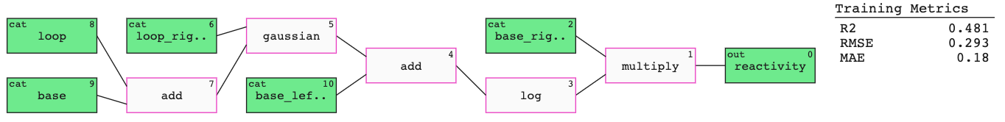
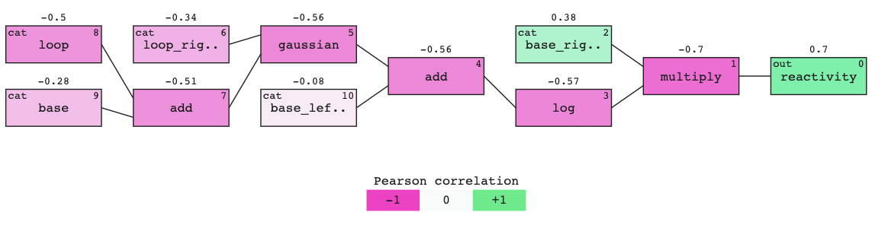
BASE MODEL

Slide 3
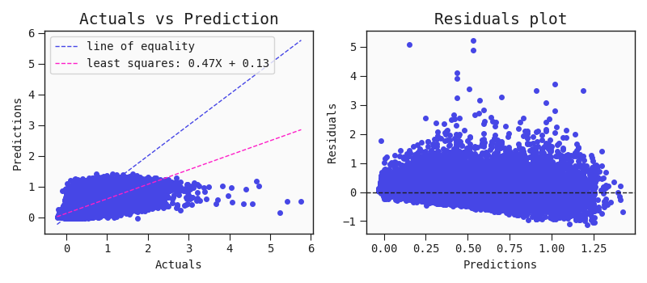
TRAINING MATRICES

Slide 4
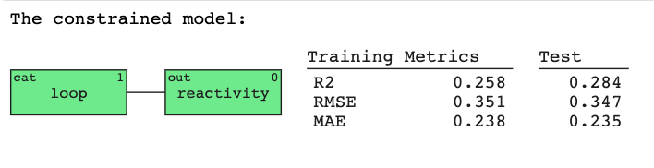
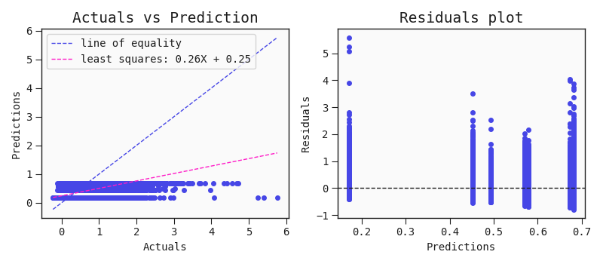
TRAINING MATRICES

Slide 5
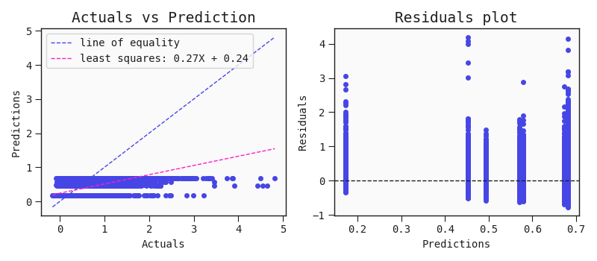
TEST MATRICES

Slide 6
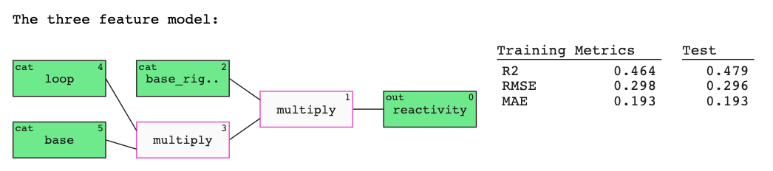
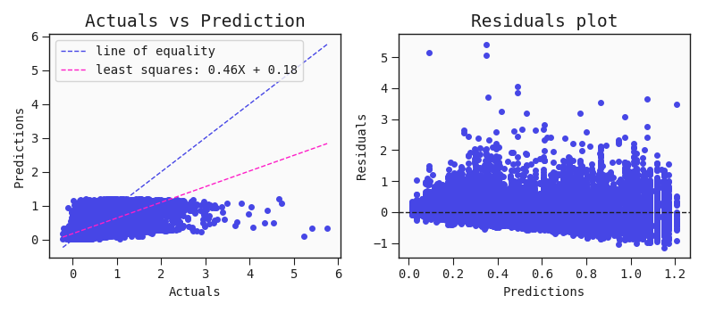
TRAINING MATRICES

Slide 7
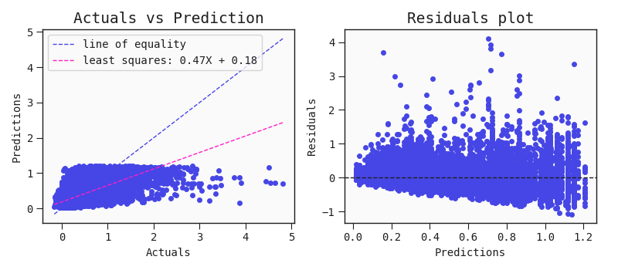
TEST MATRICES

Slide 8
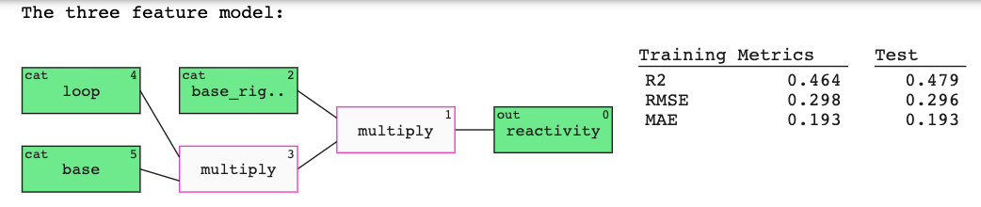
TRAINING MATRICES

Slide 9
TEST MATRICES

Slide 10
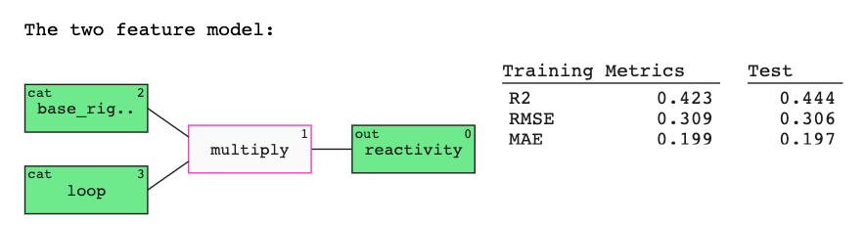
TRAINING MATRICES

Slide 11
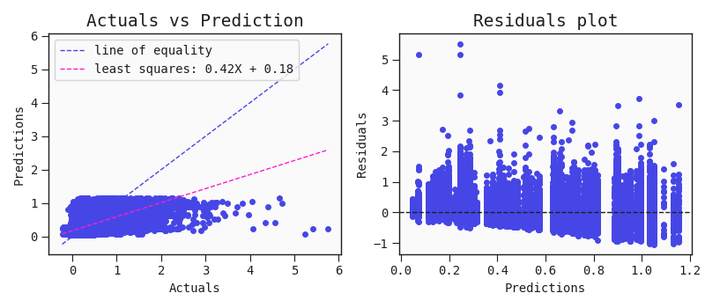
TEST MATRICES

Slide 12
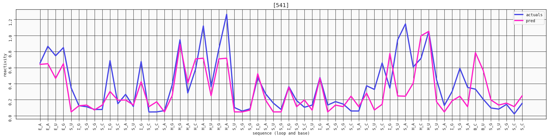
TWO FEATURE MODEL

Slide 13
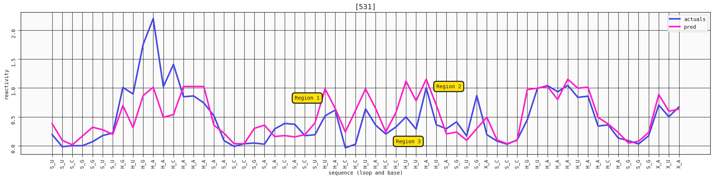
THREE FEATURE MODEL

Slide 14
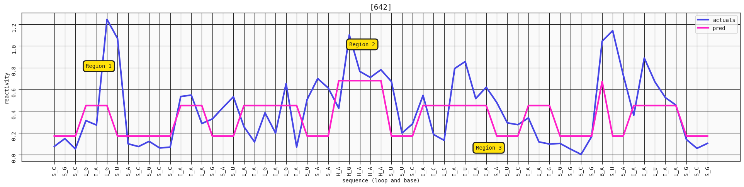
CONSTRAINED MODEL

Slide 15
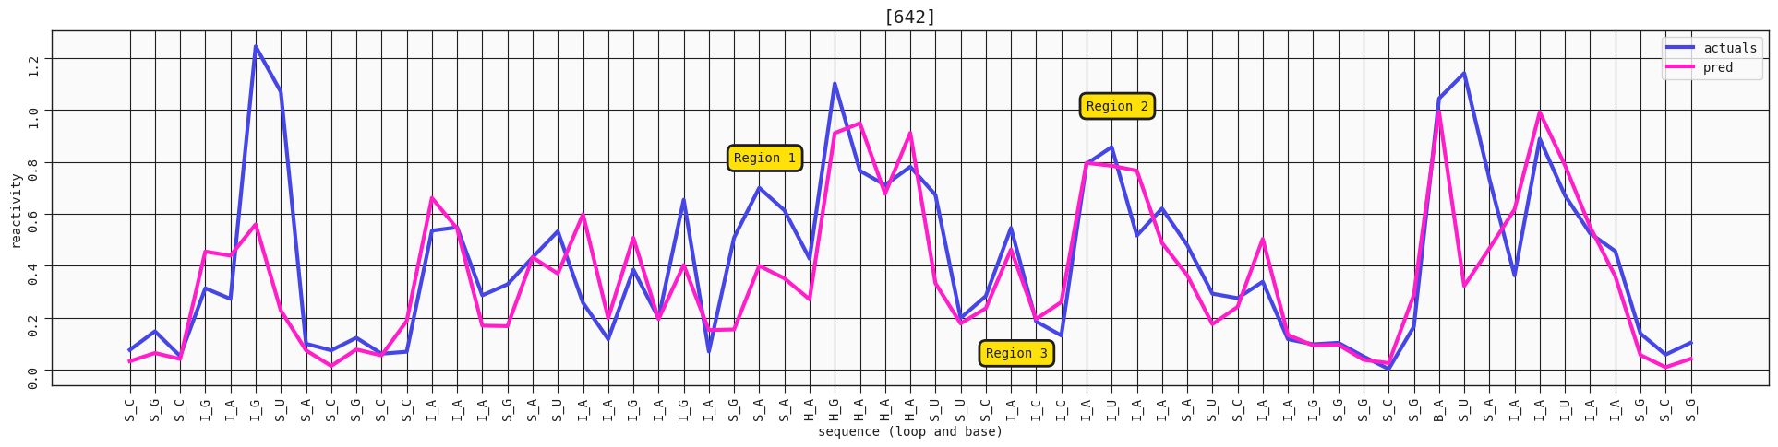
BASE MODEL

