Slide 1
Convolutional Neural Network applied to 2D Ising Model
Mahlet Molla
PHYS 514 Project
Dec. 6, 2023

Slide 2
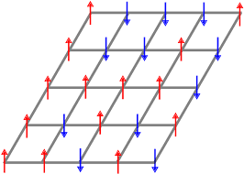
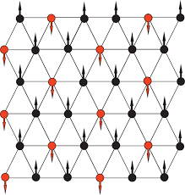
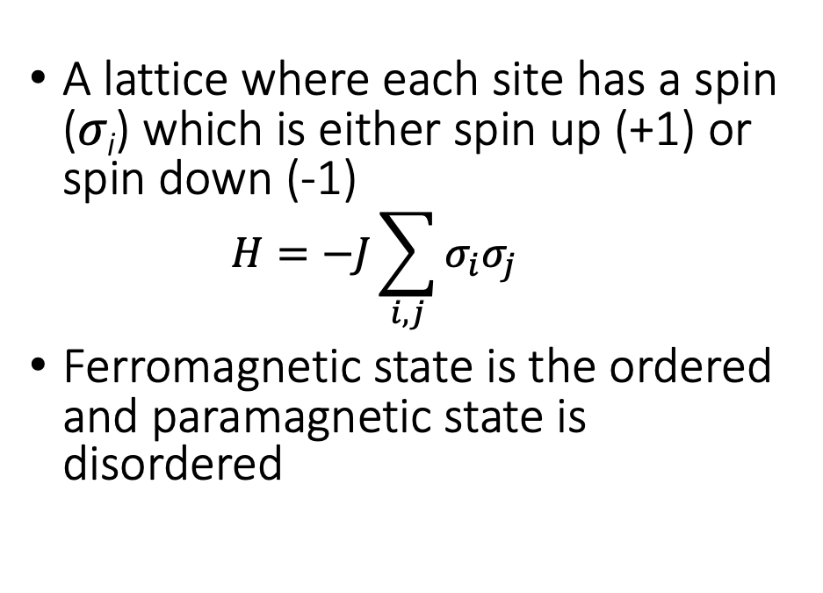
2D Ising Model
A lattice where each site has a spin (𝜎_{i}) which is either spin up (+1) or spin down (-1)
  $$H=−J\sum_{i, j}{σ_{i}σ_{j}}$$
Ferromagnetic state is the ordered and paramagnetic state is disordered

Slide 3
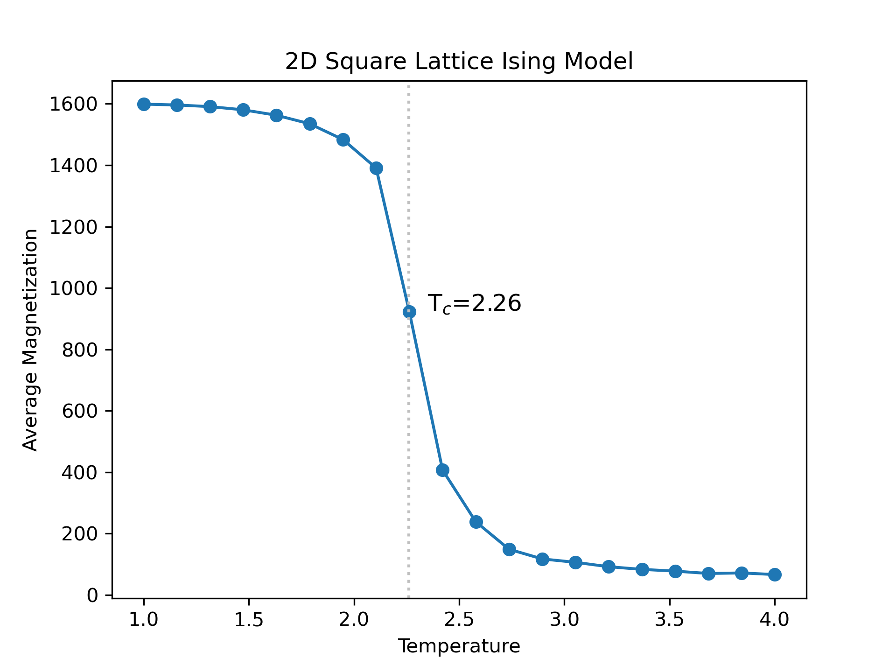
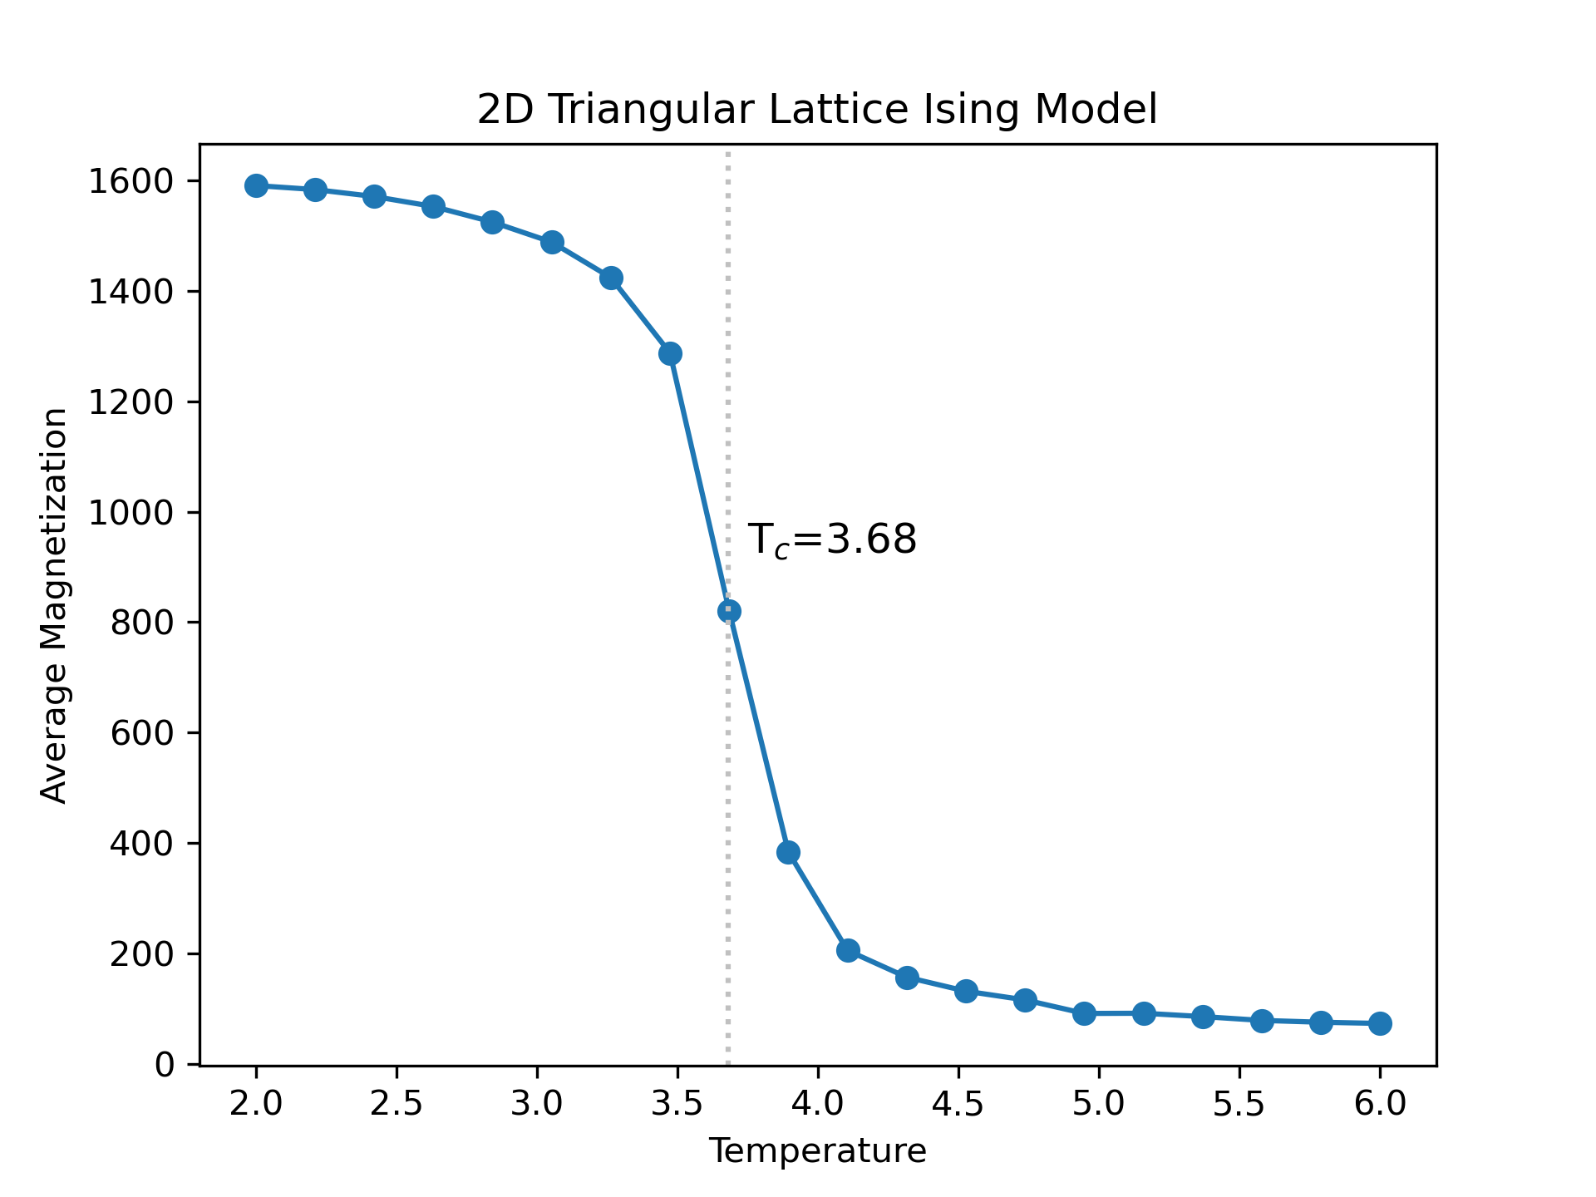
Average Magnetization vs Temp.
Notes:
Triangular lattice has more neighbors -> added complexity and greater critical temperature
For scaling, use binder cumulant which is function of average magnetization

Slide 4
Markov Chain Monte Carlo (MCMC)
Initialize lattice with each site on lattice is randomly to be chosen as spin up or spin down. On step k, pick a random site to consider flipping its spin from 𝜎_{i} to -𝜎_{i}
To determine if flipping spin is energetically favorable, calculate ΔE between old and new configuration
  ΔE ≤ 0 ⇨ Flip spin
  ΔE > 0 ⇨ Flip spin if it follows exp(-β ΔE), otherwise reject spin flip
Move on to step k+1 and repeat for all steps and range of temperatures.
Notes:
Allows for efficient survey of all possible configurations that is also consistent with equilibrium statistical mechanics.

Slide 5
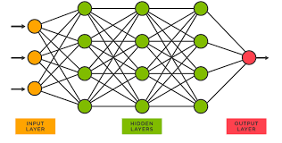
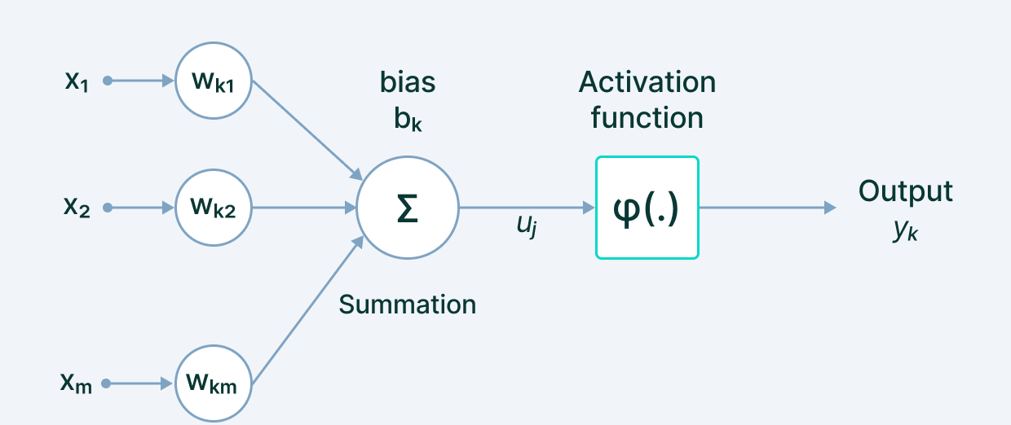
Neural Networks
Notes:
Weight: model can prioritize features that have a bigger contribtution towards learning
Summation with bias to activation function that introduces nonlinearilty to system and allows modeling of more complex relationships
Activation function -> threshold for synaps

Slide 6
Convolutional Neural Networks (CNN)
Notes:
Convolutional layer uses filters that extract specific feature to perform convolution operations on input matrix
Pooling layer reduces spatial size of input while retaining important information -> Max pooling: max element of specific region of feature map
Feature extraction portion is concluded with application of activation function (Rectified Linear Unit)
Classification begins with fully connected layer
\
Output -> binary value

Slide 7
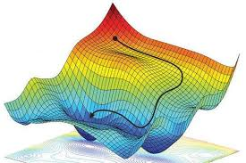
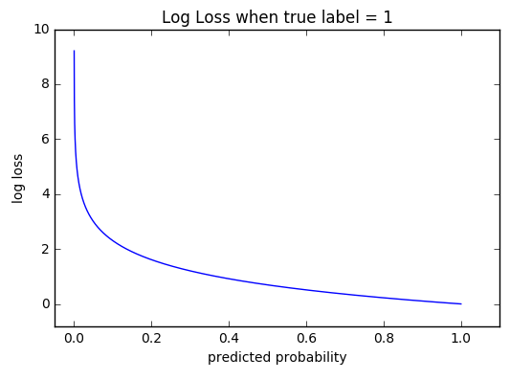
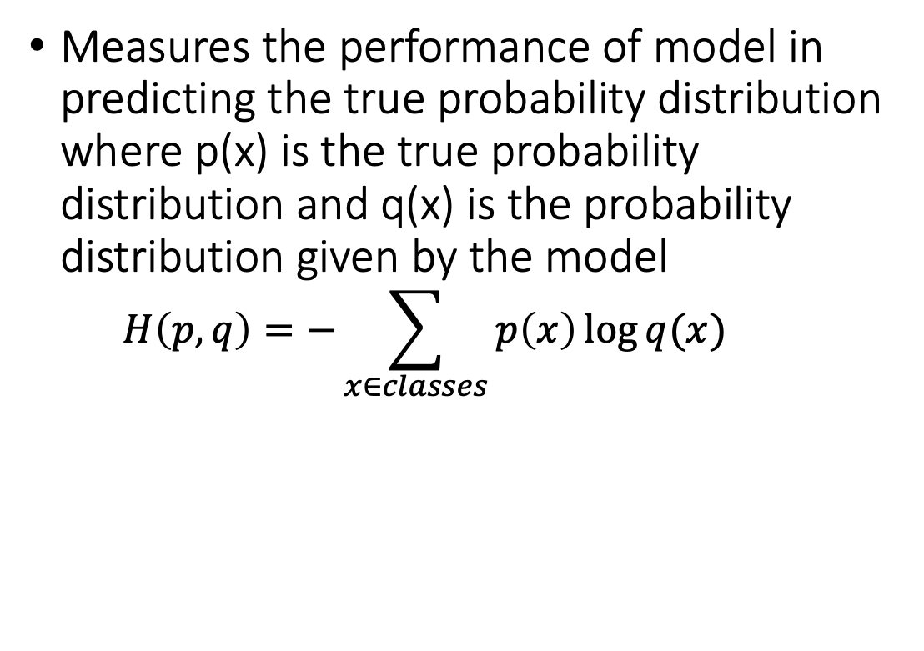
Cross-Entropy Loss
Measures the performance of model in predicting the true probability distribution where p(x) is the true probability distribution and q(x) is the probability distribution given by the model
  $$H\left(p,q\right)=−\sum_{x∈classes}{p\left(x\right)\log{q(x)}}$$
Notes:
Value increases as predicted probability varies from correct label

Slide 8
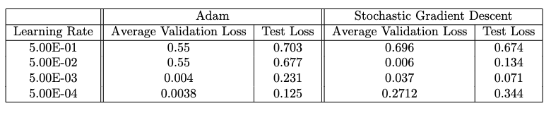
Learning rate and Optimization algorithm
Learning rate: step-size at each iteration of the optimization algorithm

Slide 9
Conclusion
Convolutional Neural Network can correctly predict phase of triangular lattice configuration by learning on a square lattice configuration
Learning rate and optimization algorithm affect performance of model prediction
  SGD has greater learning-rate dependence than Adams optimization
Future steps: test on more complex configurations, modify the CNN architecture, alter hyperparameters

Slide 10
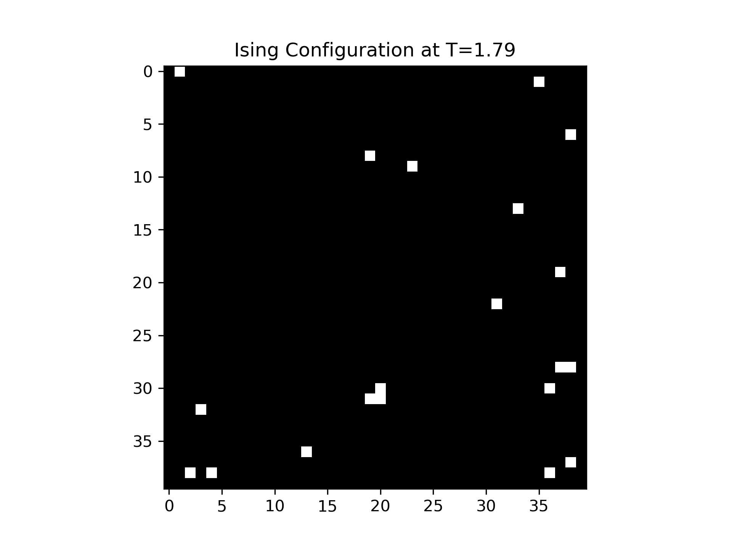
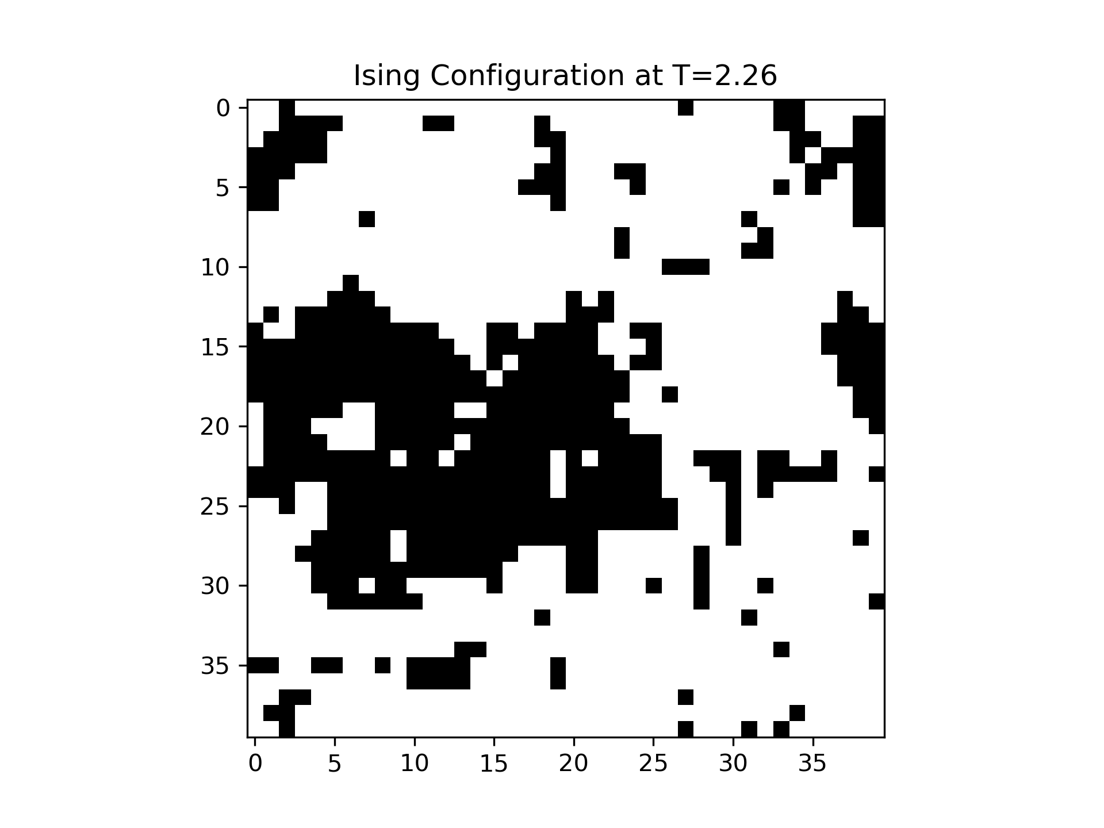
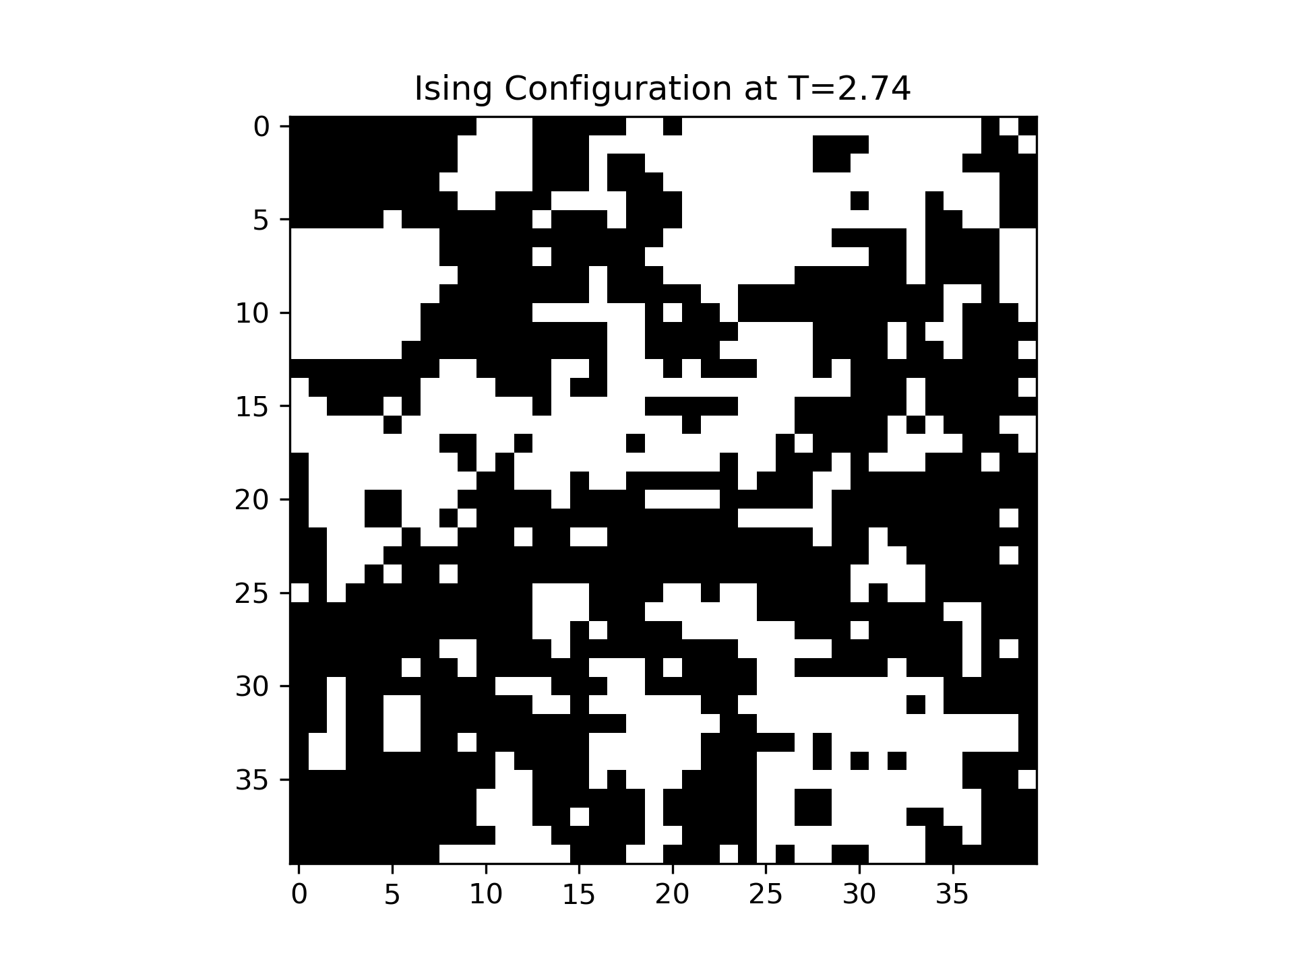
Square Lattice Configurations
Ordered
Critical
Disordered

Slide 11
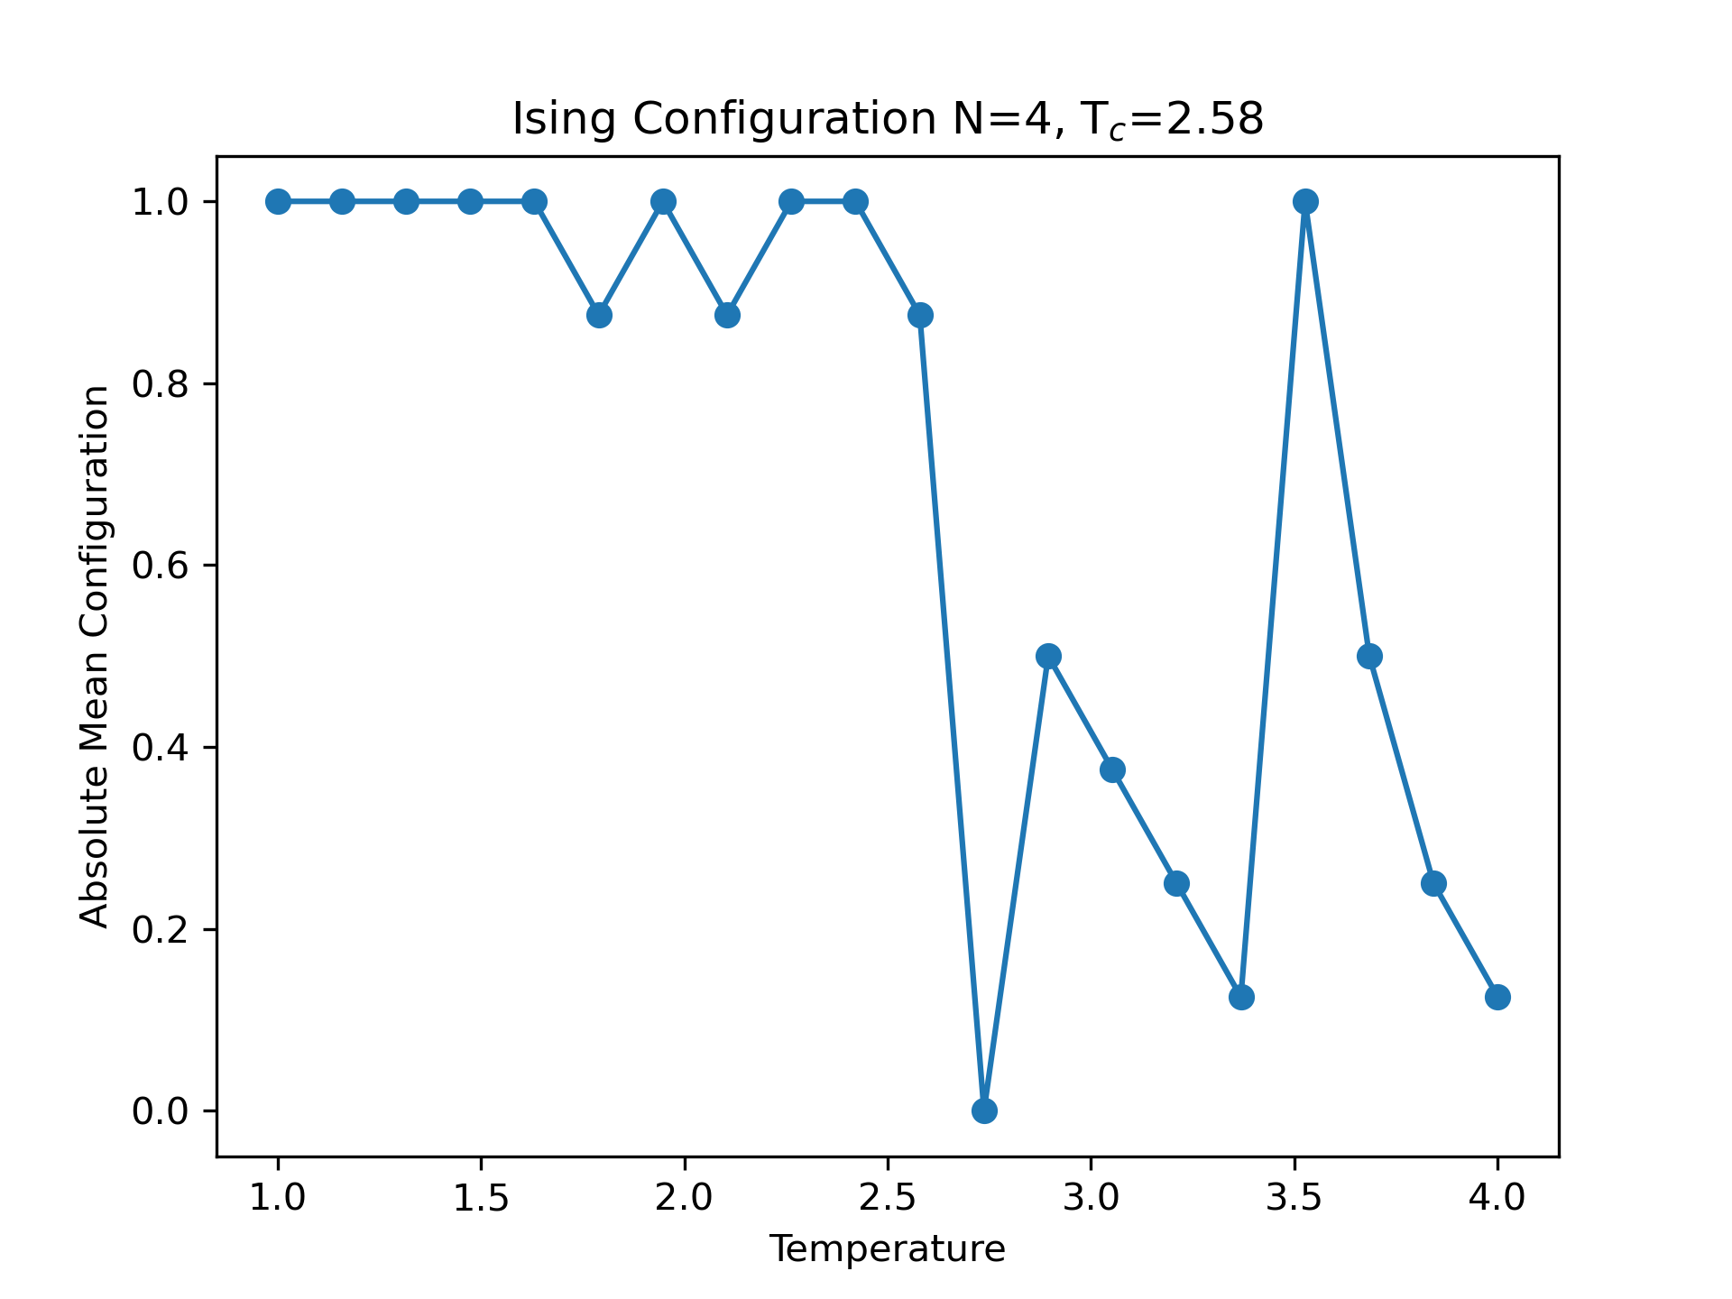
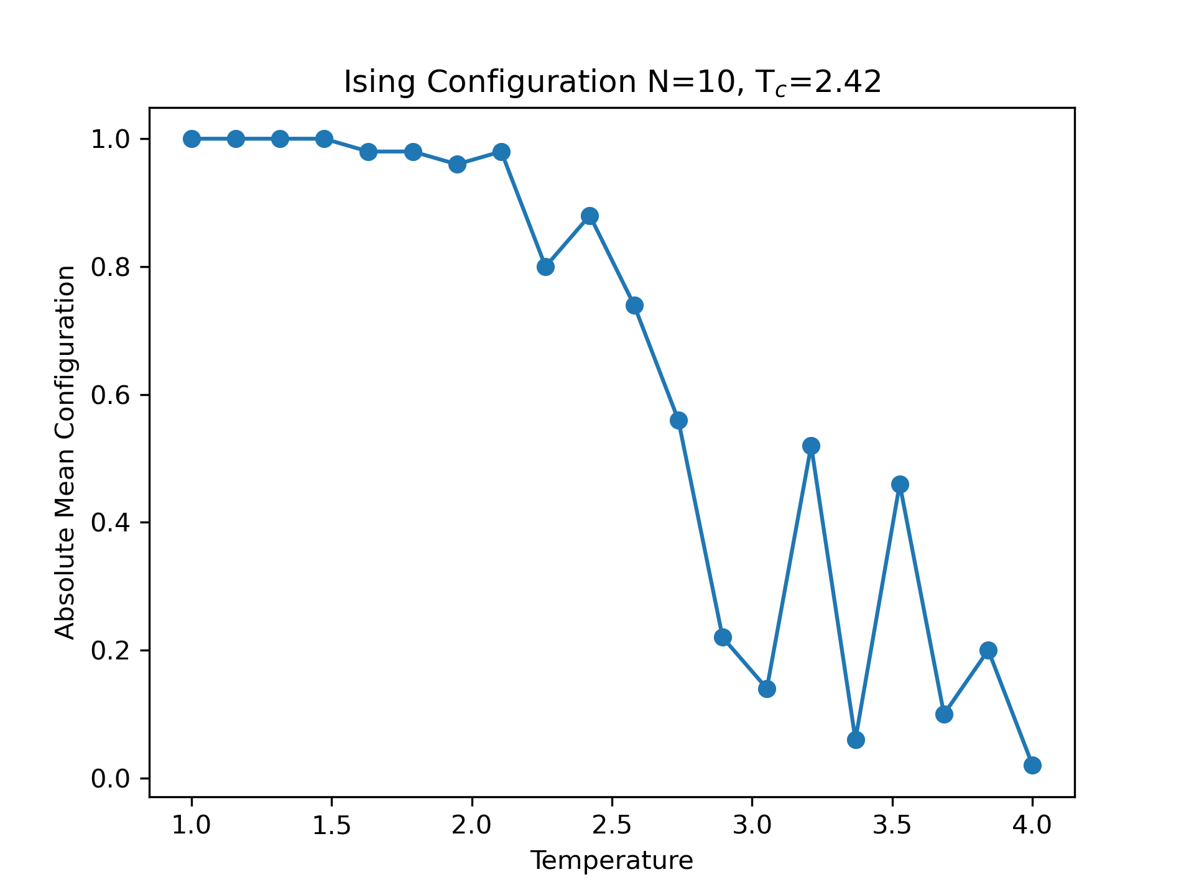
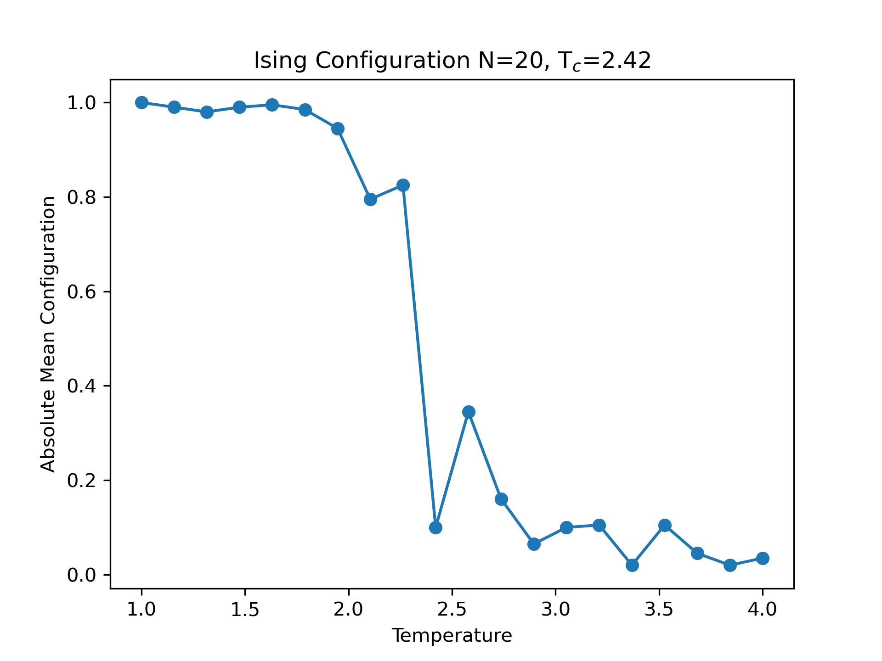
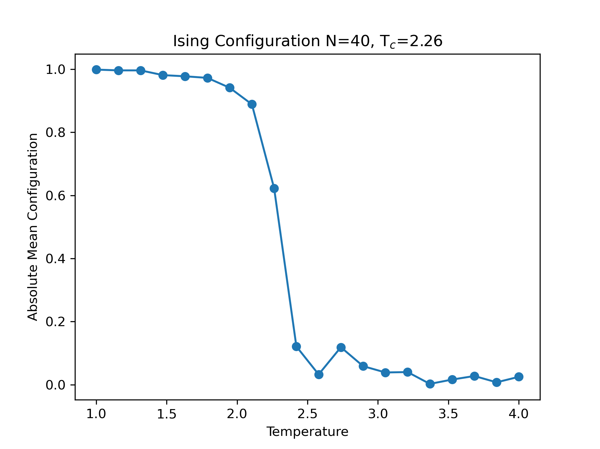
Finite-size Effects of MCMC

Slide 12
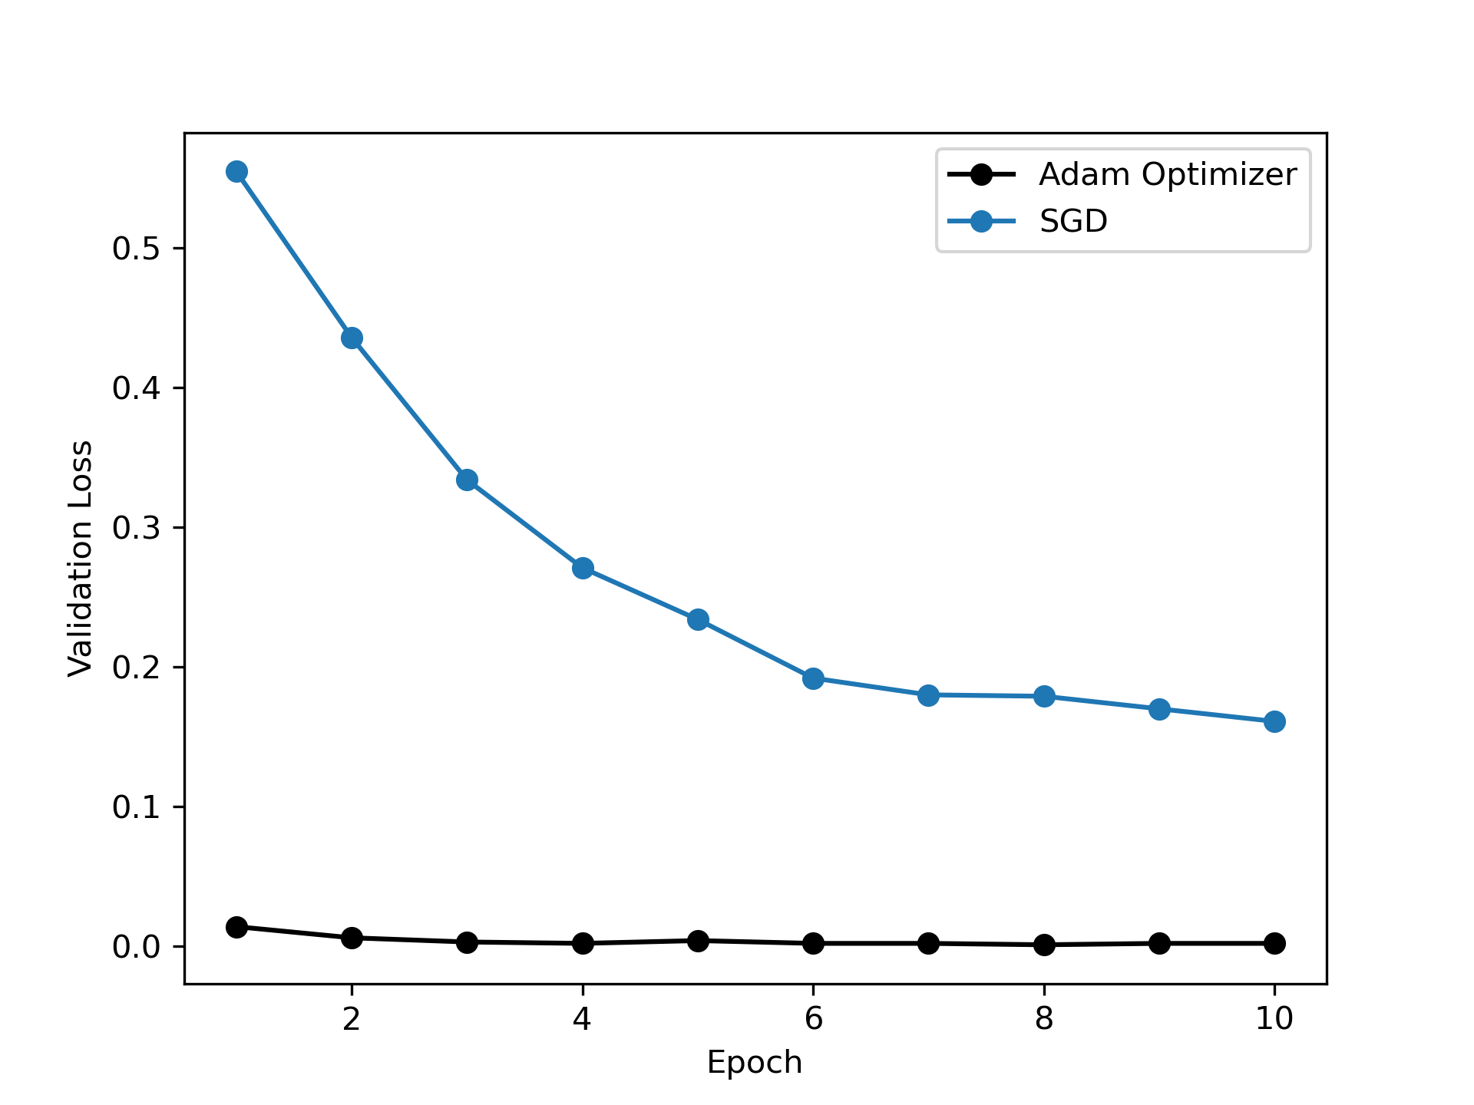
Learning rate and Optimization algorithm

Slide 13
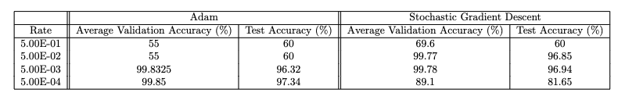
Learning rate and Optimization algorithm

