Slide 1

Cancer Research UK
InstantRun

Slide 2
Agenda
Our solution
AWS Architecture

Slide 3
Our Solution

Slide 4
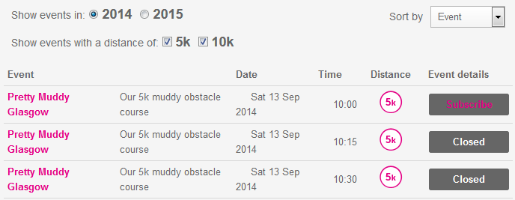





Buy directly from the event search
One-click registration & payment
One-click registration
Full
registration

Slide 5



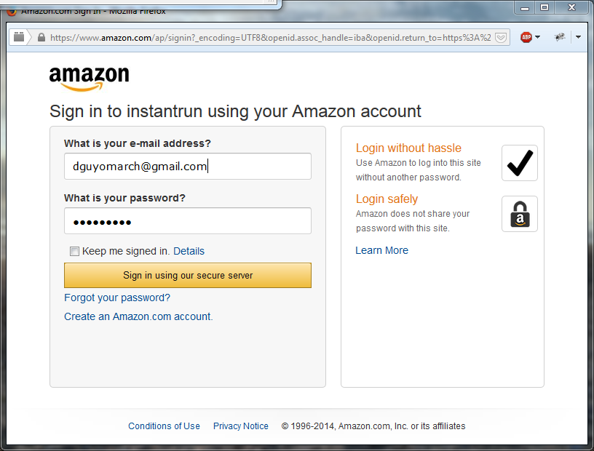
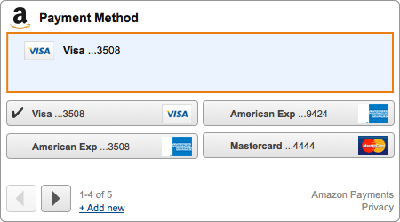
One-click Subscription & Payment

Slide 6
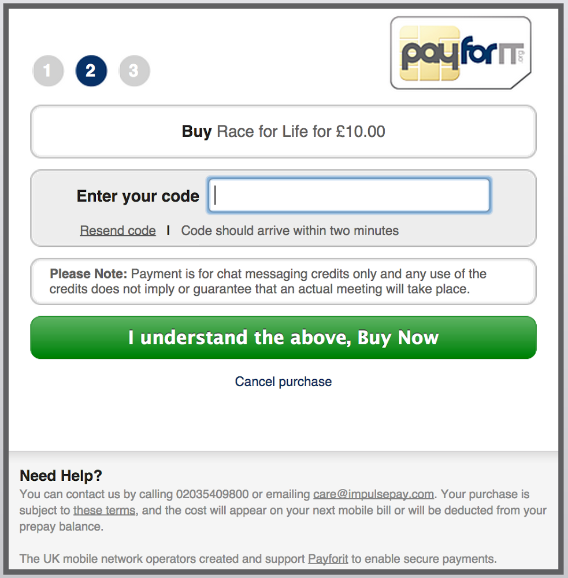
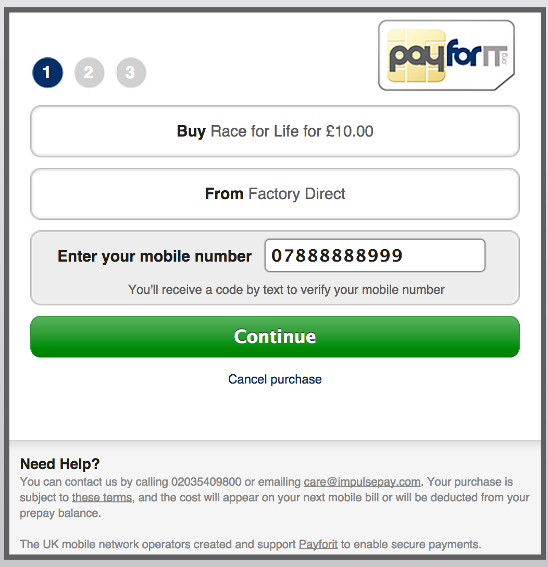


After One-Click registration or full registration process
Payment through
mobile carriers
56521
Instant Run
Your code is 56521

Slide 7
Future Improvements
User dashboard
Avoid user to give her details again and again
Improving user experience by leveraging existing data
Advertising on races near her location
Extra revenue generation

Slide 8
Future Improvements
Social interactions
“Tell your friends you are running”

Slide 9
AWS Architecture

Slide 10









instantrun.uk.to
443
Static.instantrun.uk.to
9080
80
Node.js backend
API
Server
Cloudfront distribution
Based on CPU
Auto Scaling group
security group
3360
Amazon S3 bucket
security group

Slide 11
Registration process

Slide 12

Improvements
CRUK Registration leveraging social network

Slide 13
Step 2 : Payment ideas
Paypal
Google wallet / Amazon Pay
Carrier charges
PayOne : http://www.payone.com/
Stripe
Delay the payment of a virtual product at any point before the event

Slide 14
EXTRA points

Slide 15
Collaborative
Tell your friends you are running using

Slide 16
Analytics
Where does the user quit ? (which field exactly)
http://www.lunametrics.com/blog/2012/11/13/track-form-abandonment-google-analytics/#sr=d&m=n&cp=d&ct=-tmc&ts=1415739360
$(document).ready(function() { var currentPage = jQuery.url.attr("path"); $(':input').blur(function () { if($(this).val().length > 0){ //pageTracker._trackEvent("Form: " + currentPage, "input_exit", $(this).attr('name'));//old GA Tracking code _gaq.push(['_trackEvent', "Form: " + currentPage, "input_exit", $(this).attr('name')]);//new GA Tracking code } }); });

Slide 17
Current Situation
Credit Card payment
Long subscription form
5-steps process
No User dashboard
User has to enter her information for each race

