Slide 1
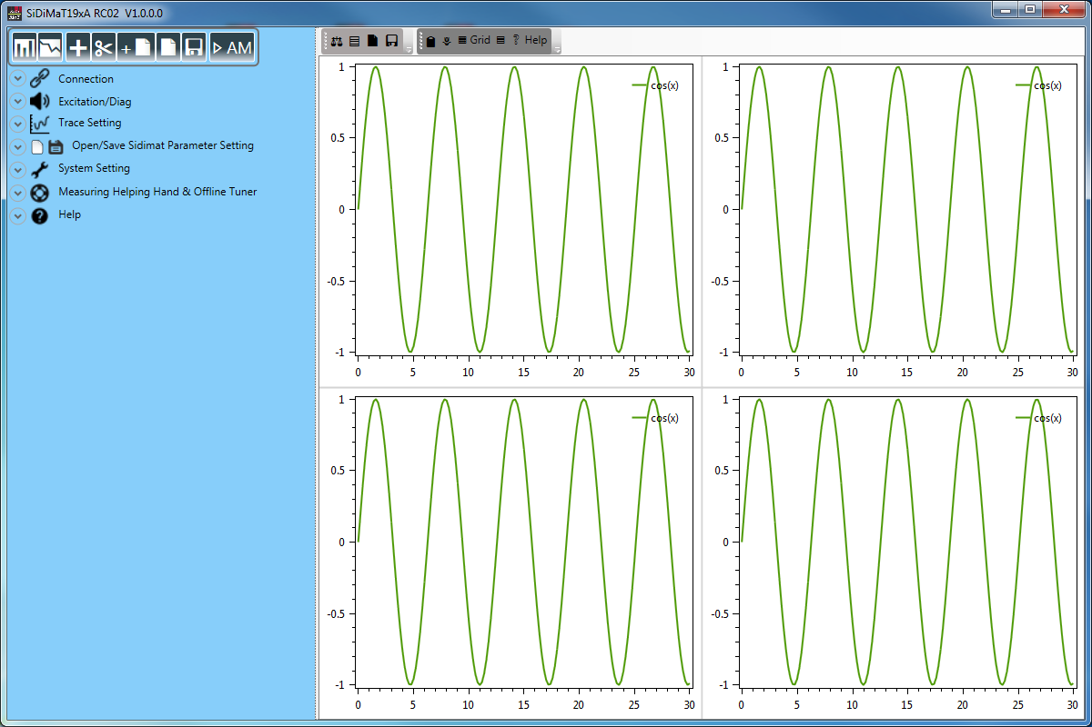
Control Buttons
Control Panel
Graphs Panel

Slide 2
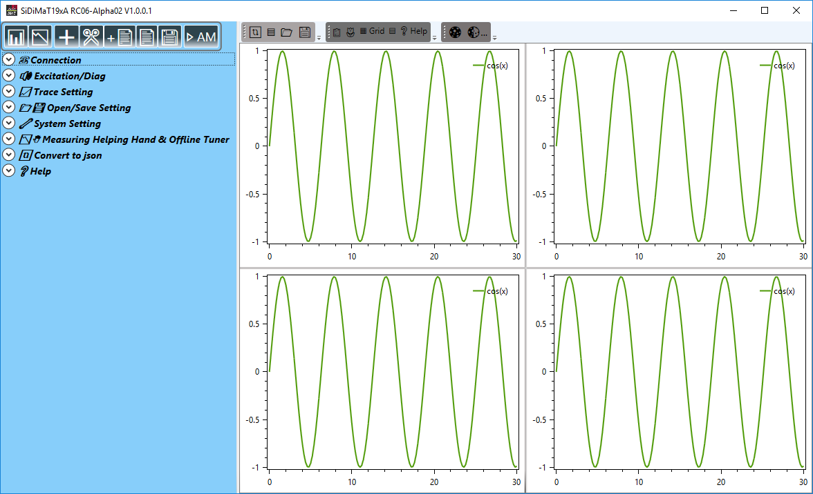
Control Buttons
Control Panel
Graphs Panel

