Slide 1

Hollywood Blockbuster Case Study
Mahmood Reza Yassin

Slide 2

Analysis of Hollywood Data
1. Correction of misclassified data in the training spreadsheet
2. Exploratory data analysis
3. Mapping categorical input features (one-hot-encoding & factorization)
4. Feature selection (univariate selection & feature importance algorithms)
5. Machine Learning models
Logistic regression
Random forest with one-hot-encoding and factorization of input features
Support vector machine (SVM)
Neural network (regression and classification problems)
6. Learning-curve analysis and recommendations to improve the accuracy of ML models

Slide 3
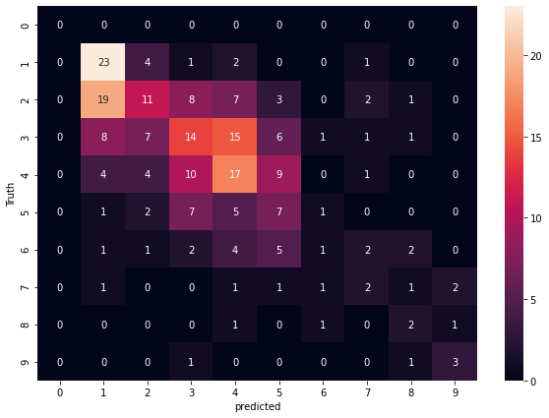
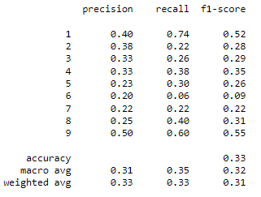
Random Forest Model
The maximum average F-Score of 0.31 on test dataset belongs to the Random Forest model with factorization.

Slide 4
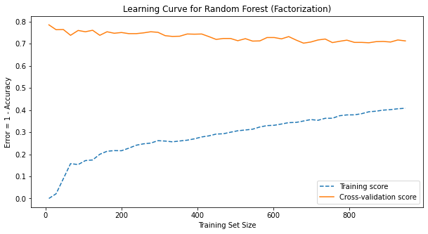
High Bias – Random Forest Model
As shown in the learning curve below, the training error is very high, suggesting that there is a high bias problem. To solve this issue, we need to add more features to the training data or use more complicated models such as neural networks with high number of layers and neurons. Analyzing the "board_rating_reason" and adding more features related to the words in this column may improve the accuracy of the training dataset. It is very important to mention that adding more features to the ML model may lead to overfitting if we do not have enough data for learning algorithm!

Slide 5
High Variance – Random Forest Model
As shown below, there is a big difference between the cross-validation error and training error, suggesting that we have high-variance problem due to overfitting of the model on training data. One way to solve this problem is to use L₂-regularization or dropout techniques. However, the practical way to solve this problem is to collect more training data, especially for classes with Category higher than 6. As discussed in the Jupyter notebook, the ML models do not have high performance for predicting the class of categories higher than 6. One reason to explain this issue is the low number of training data corresponding to these classes.

