Slide 1
Chinook Data Analysis By: Zahra Mahmoodabadi

Slide 2
agenda
Introduction
An Initial study on chinook data
Key variables plot
Normal variables in data
Remove outliers data
Hypothesis tests
Confidence interval

Slide 3

Introduction

Slide 4
Introduction
A sample database designed for a digital media store.
Data Model: Represents a digital media store with tables for: Artists, Albums, Media Tracks, Invoices, Customers

Slide 5
An Initial study on chinook data
How many records each table has
Remove Duplicate data,
Manage Missing Values

Slide 6
Selecting Key variables

Slide 7
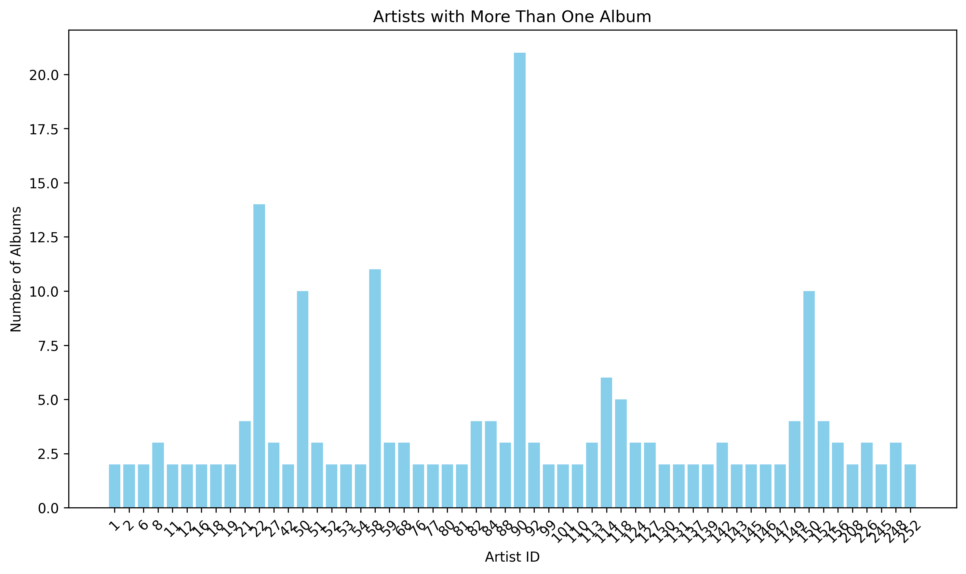
Artists
Total Artists: 275
150 of 275 artists had just 1 album

Slide 8
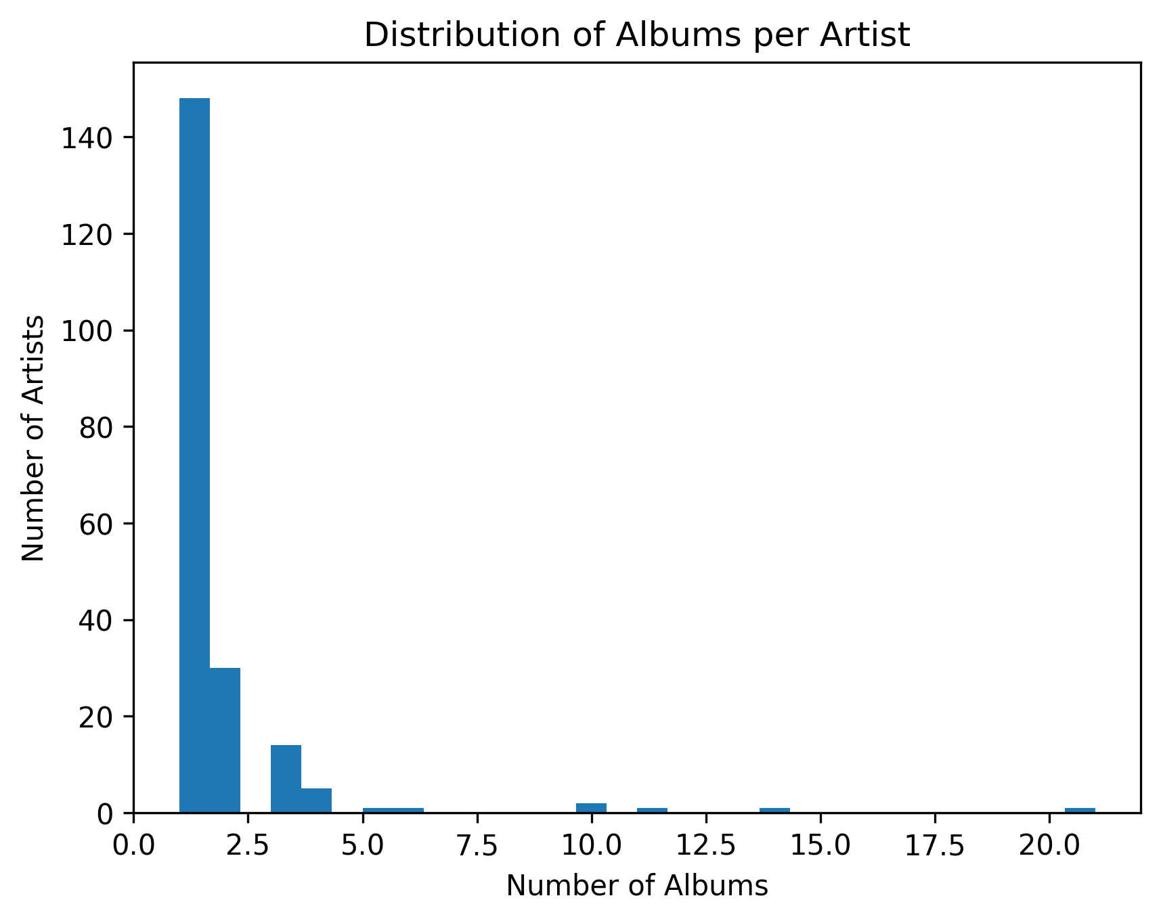
Albums per artist
Total Albums: 347

Slide 9
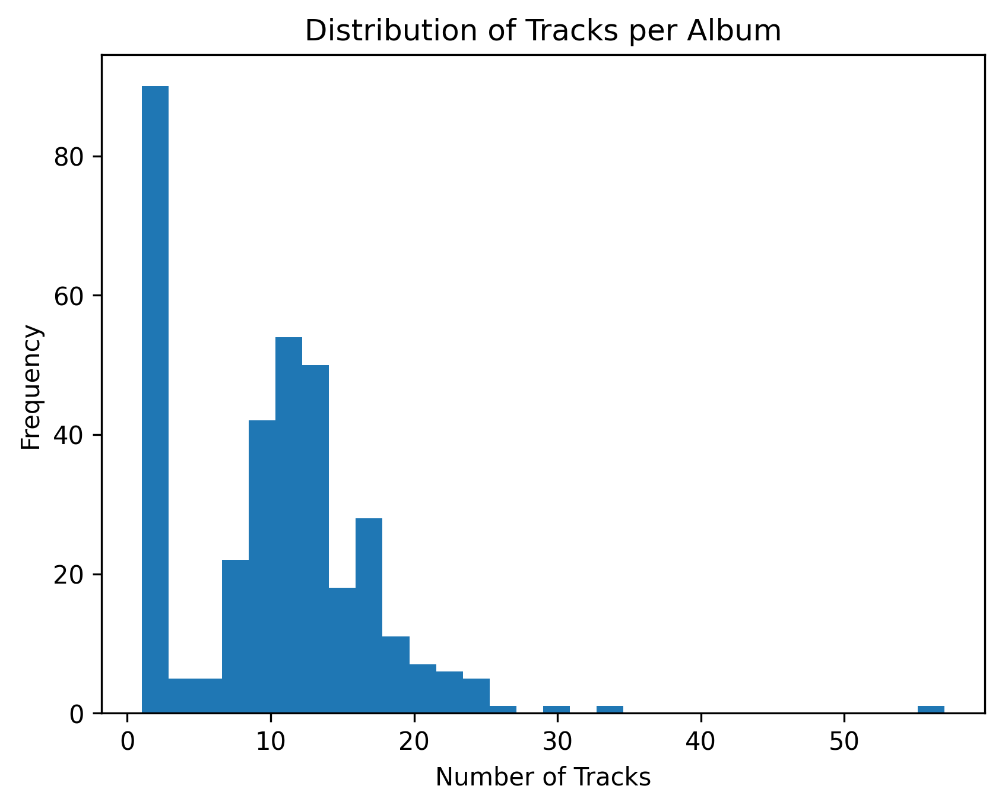
Distribution of tracks by album
Total Tracks: 3503
For example there are more than 80 albums that have just 1 track.

Slide 10
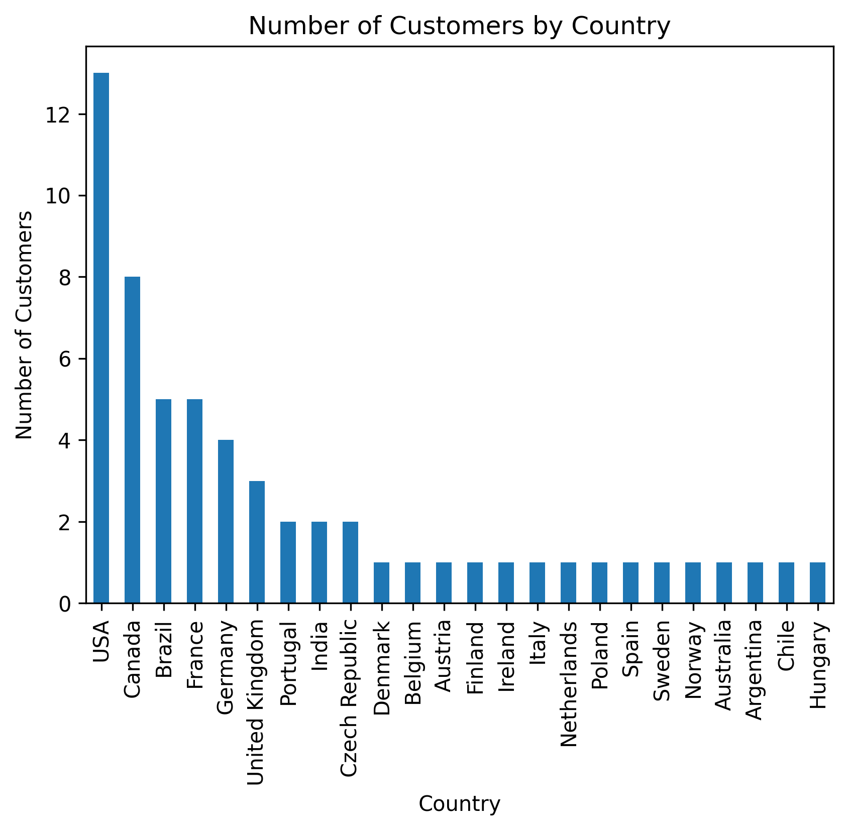
distribution of customers by countries
Total Customers: 59
More than 12 of 59 customers are from USA

Slide 11
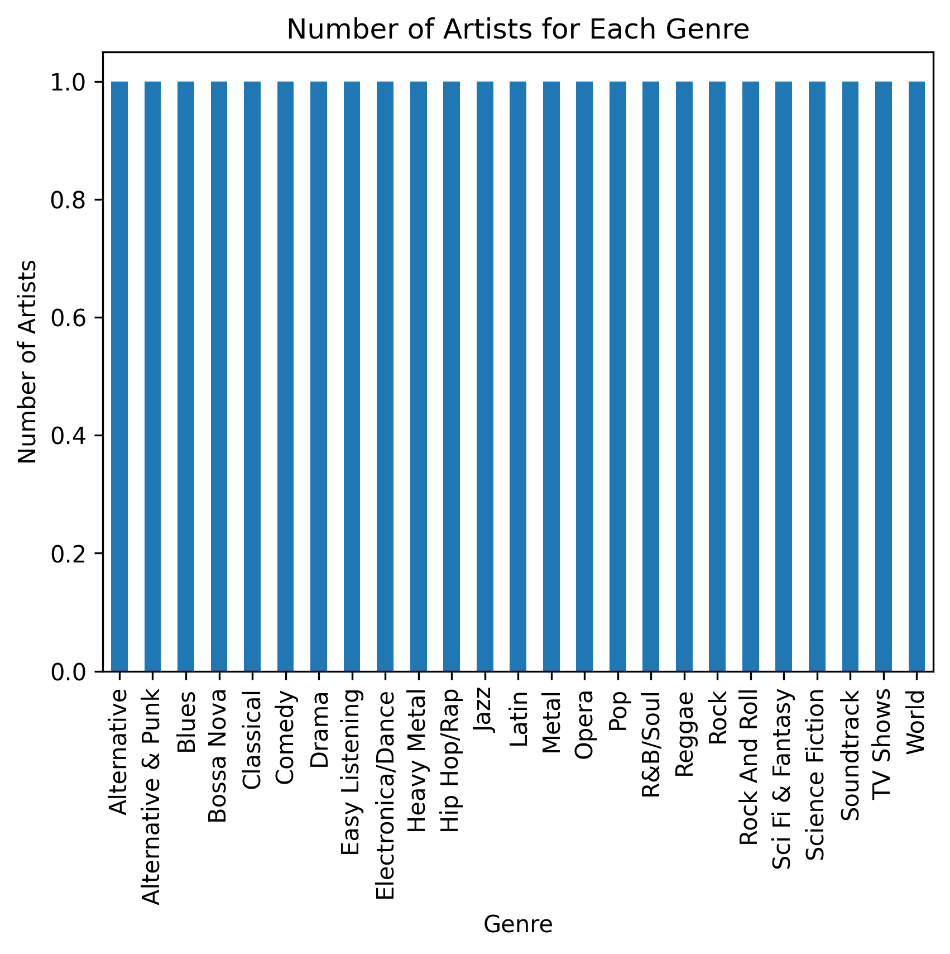
Number of artists based on genre
Which genres the highest number of artists
There is only 1 artist for each genre

Slide 12
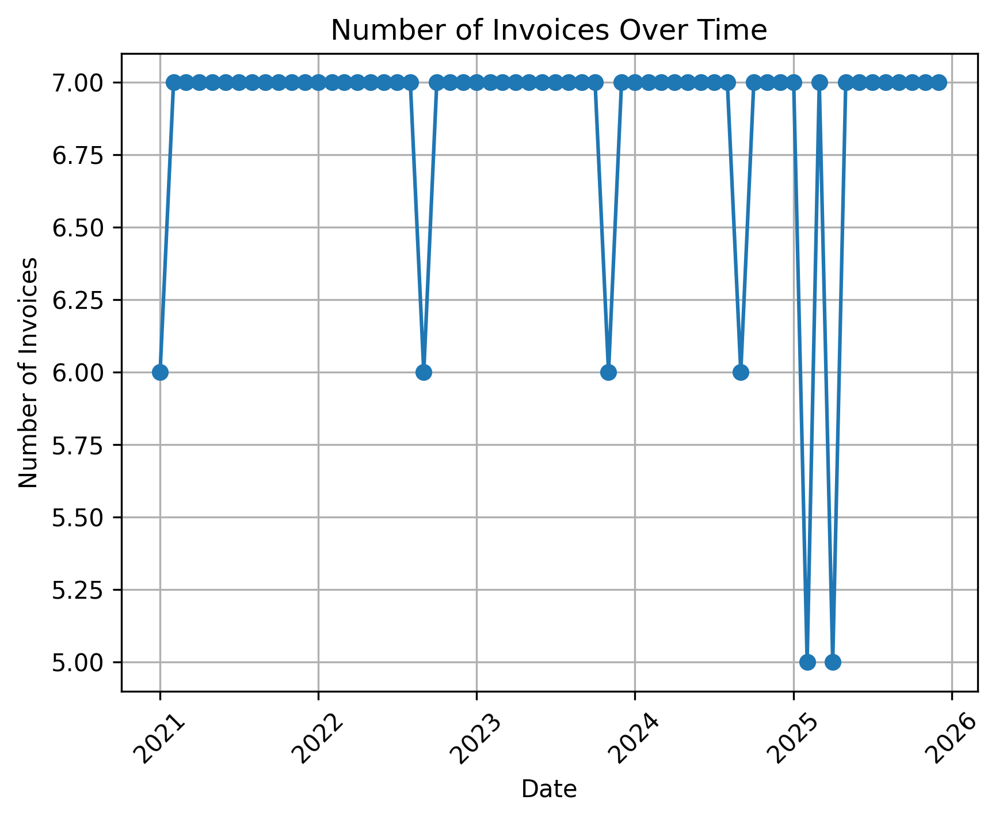
Number of Invoices Over Time
Show changes in the number of invoices over time
In the first month of the years there are minimum orders for musics

Slide 13
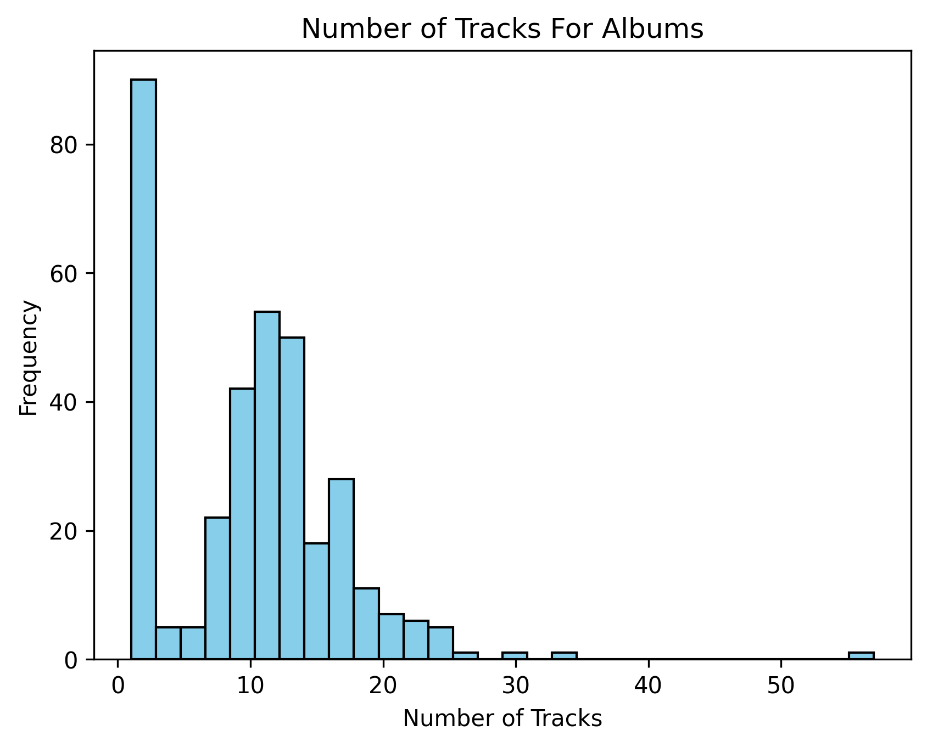
Number of Tracks for each Album
More than 80 albums have just 1 track

Slide 14
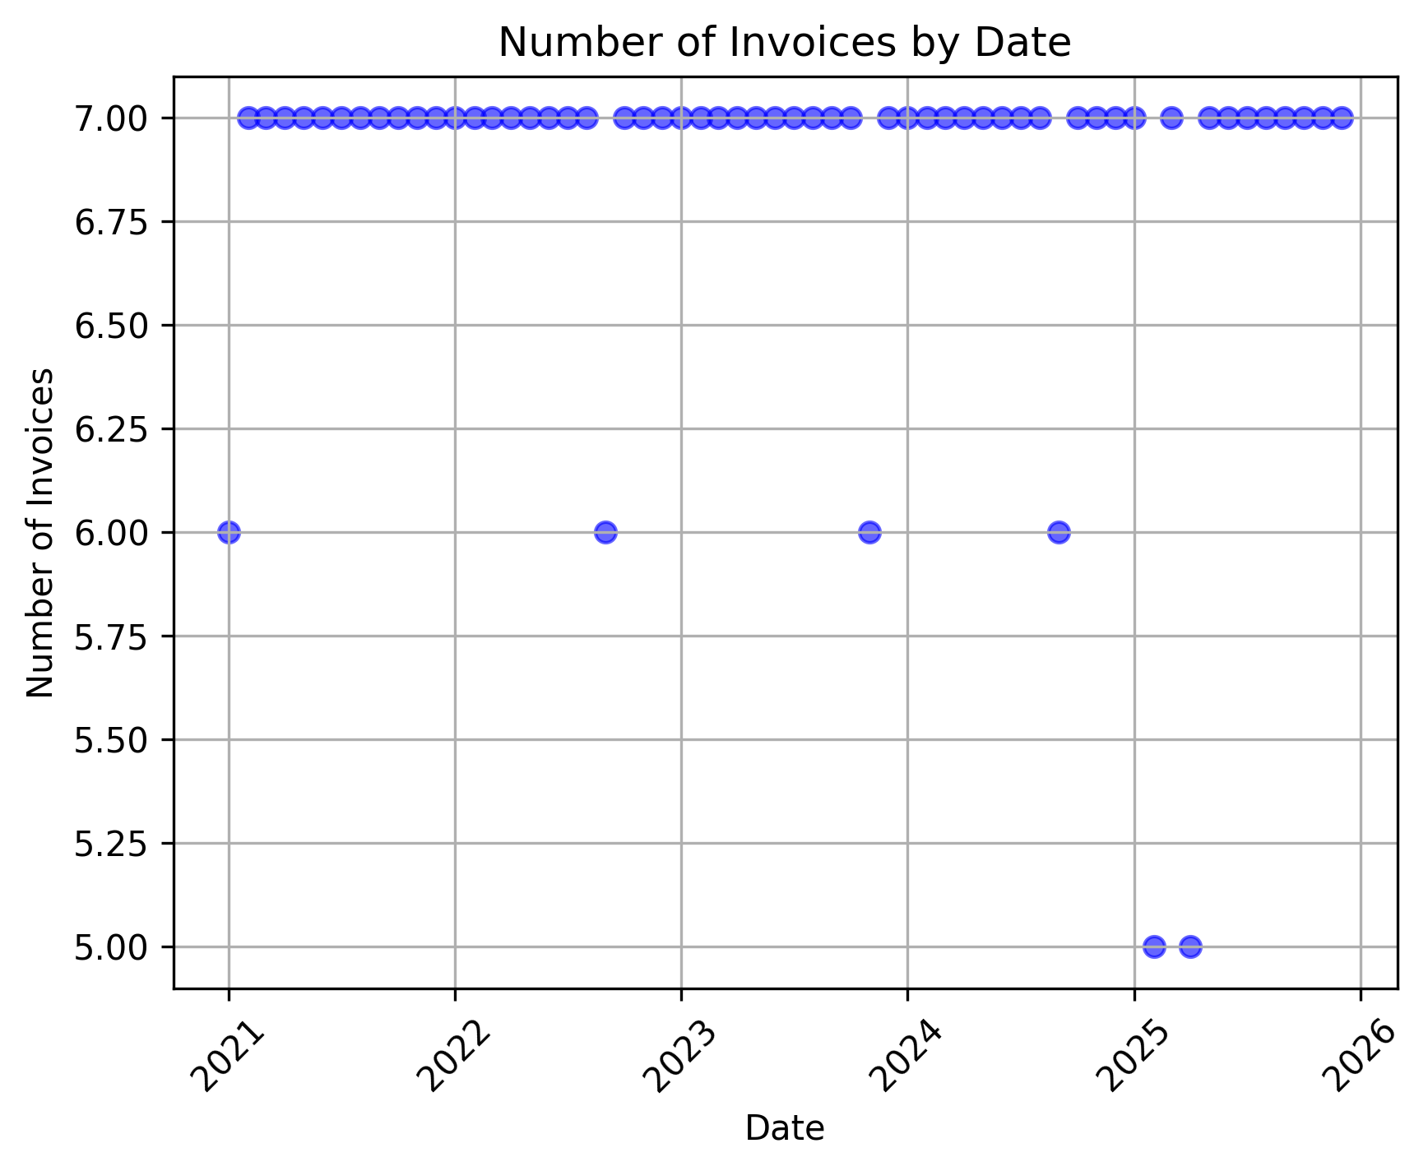
Scatter plot
Using a scatter plot, we can see if there is a relationship between the date and the number of invoices
The total number of invoices are 7 in most dates, except a little number of dates that has 6 invoices

Slide 15
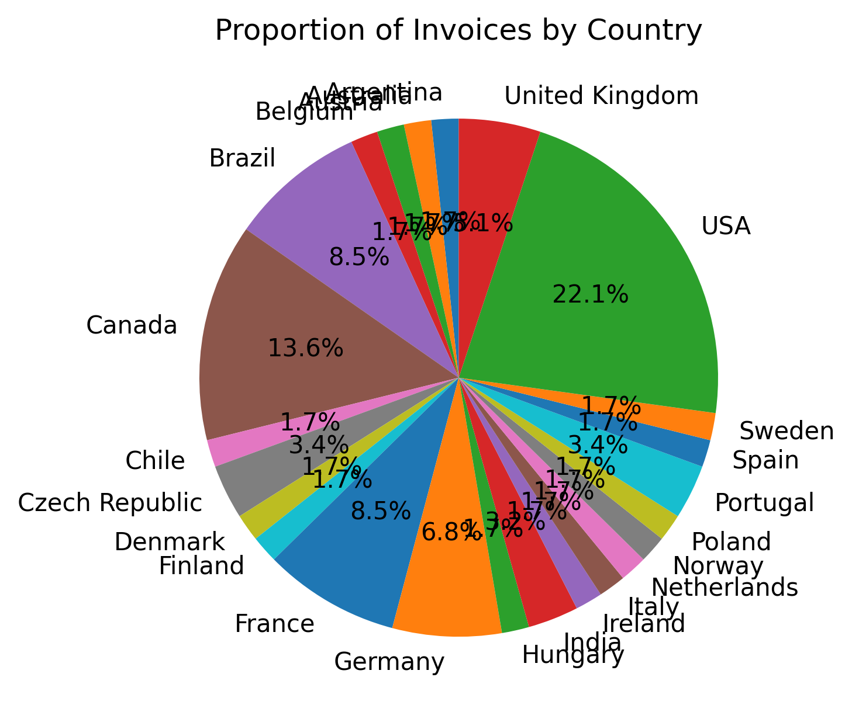
Proportion of invoices by country
The USA with more than 22% has the most number of invoices

Slide 16
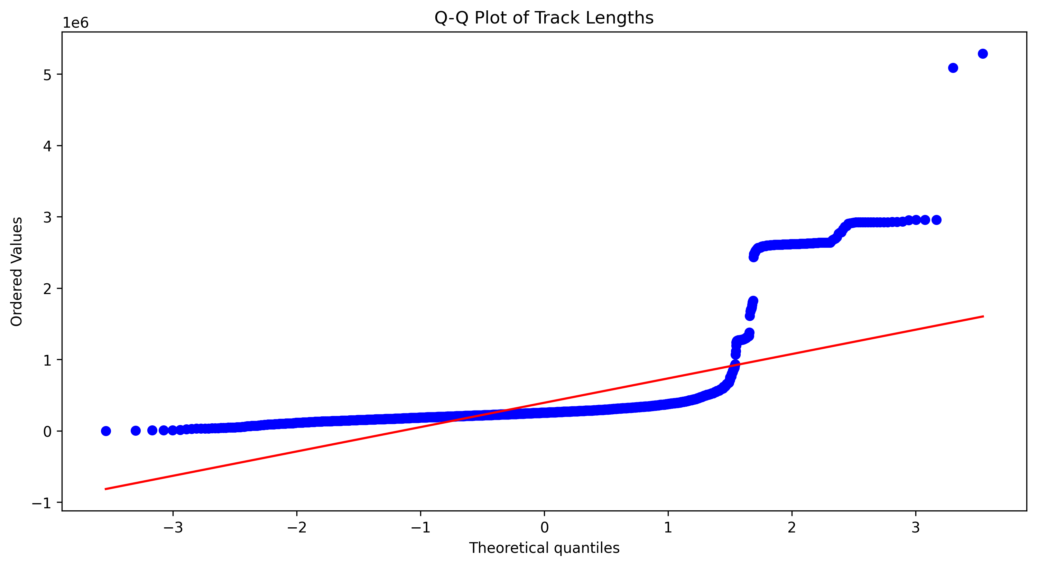
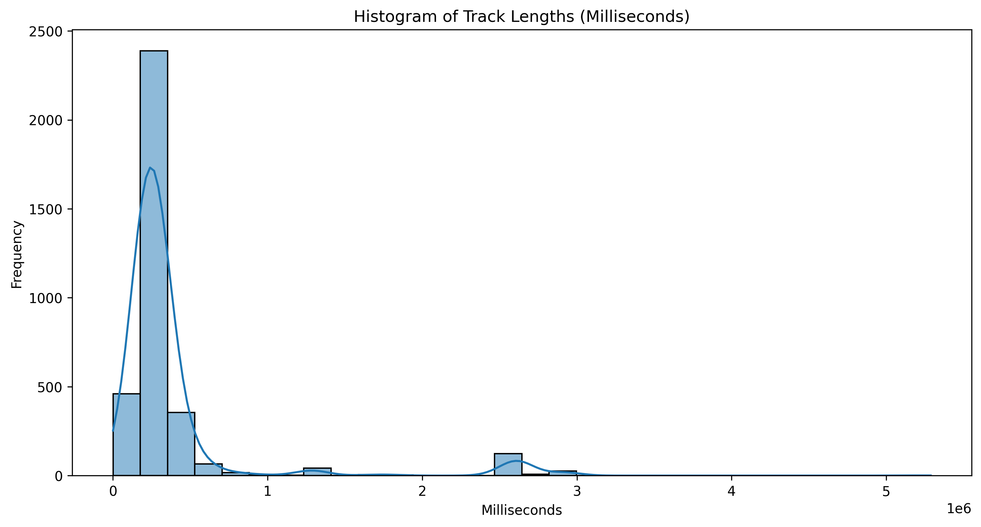
Normality test
The distribution of customers in countries
Based on Shapiro test, it’s not normal
The distribution of tracks per albums
Based on Kolmogorov-Smirnov Test it’s not normal
Histogram and QQ plot of Track Lengths (Milliseconds)

Slide 17
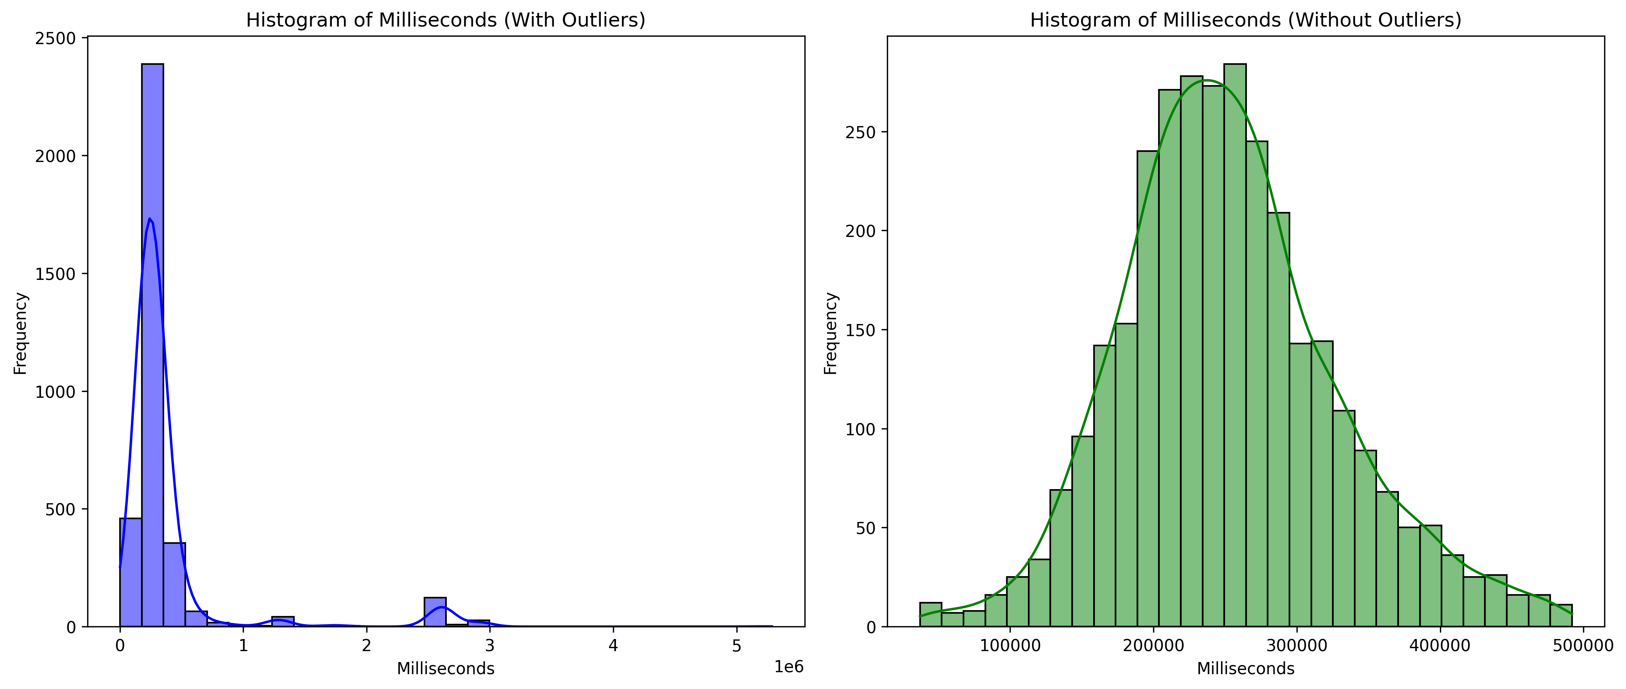
Remove outliers
Remove outliers from duration of tracks

Slide 18
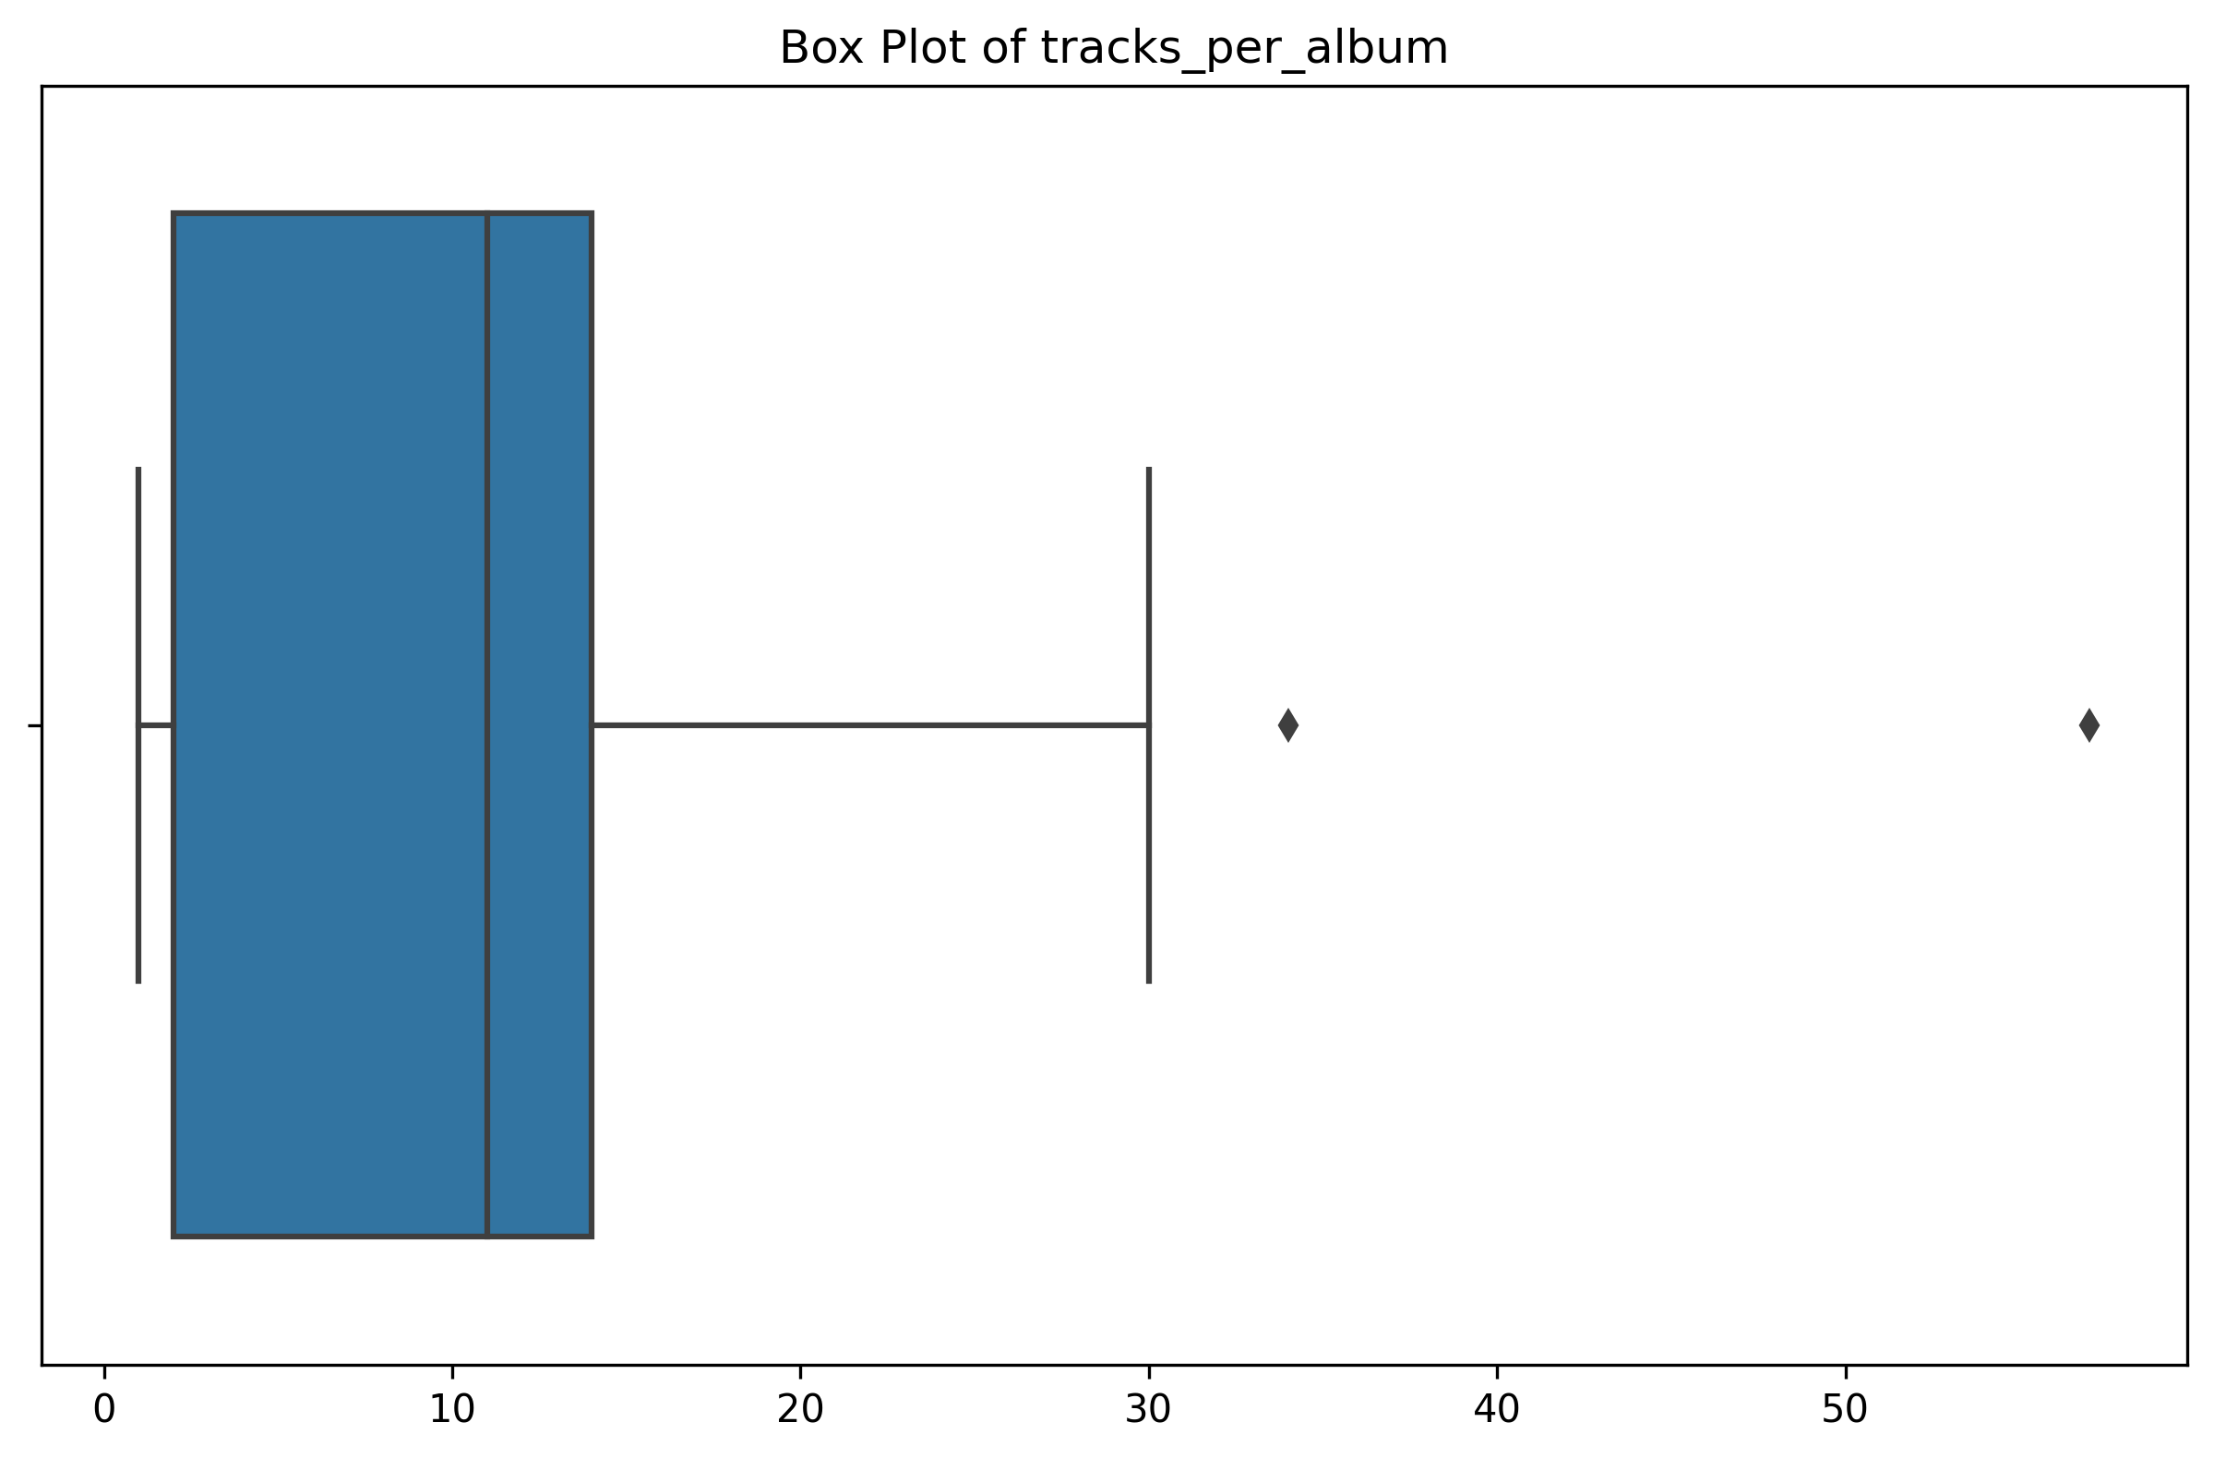
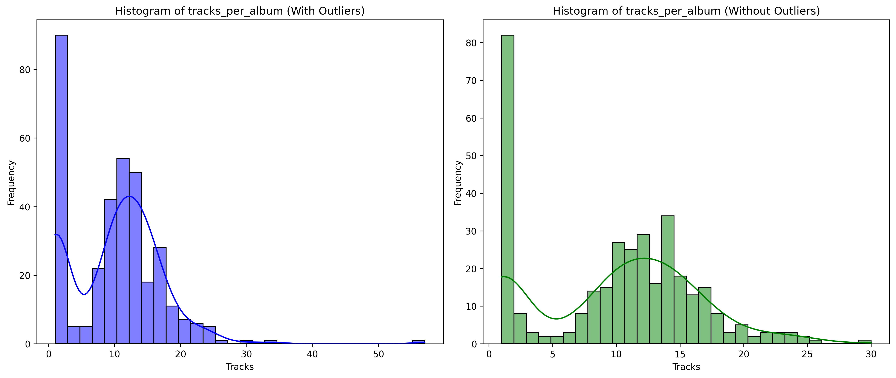
…Remove outliers
Box Plot of tracks per album

Slide 19
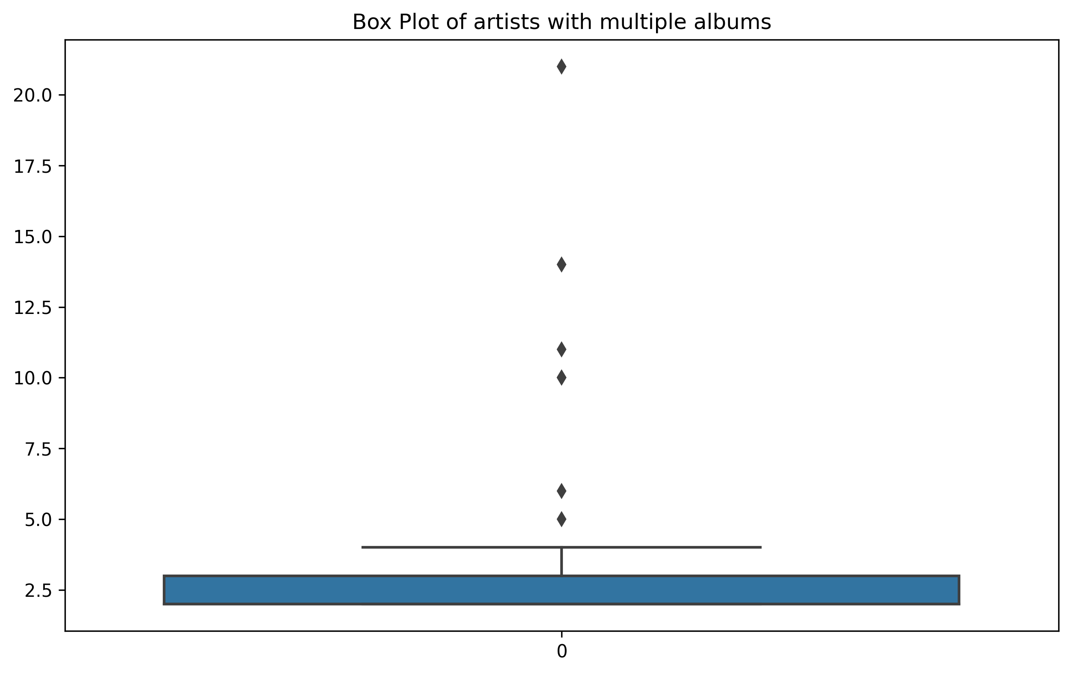
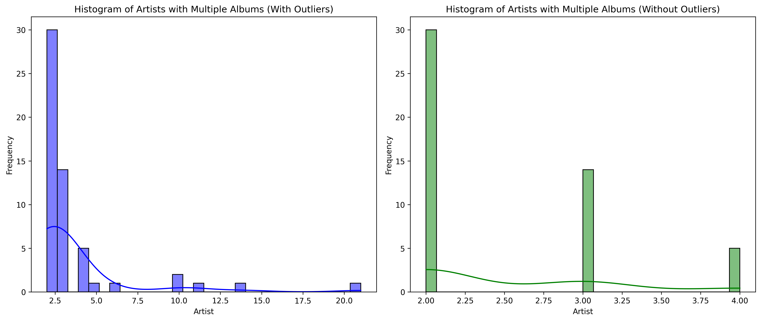
…Remove Outliers
Artists with multiple albums

Slide 20
Hypothesis test
Compare the average price of top three genres
Using Anova test
Fail to reject the null hypothesis: No significant differences between groups.
Genre Name | Quantity | UnitPrice | Average
Rock | 835 | 826.65 | 0.99
Latin | 386 | 382.14 | 0.99
Metal | 264 | 261.36 | 0.99

Slide 21
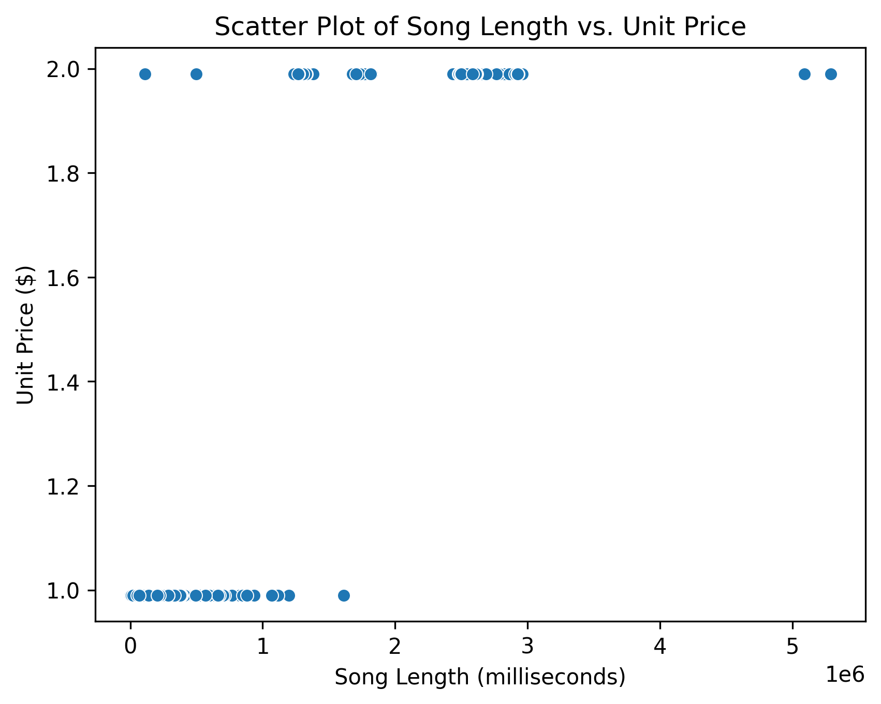
…Hypothesis test
Relation between Milliseconds and UnitPrice
Pearson test: There is a significant correlation between song length and unit price.

Slide 22
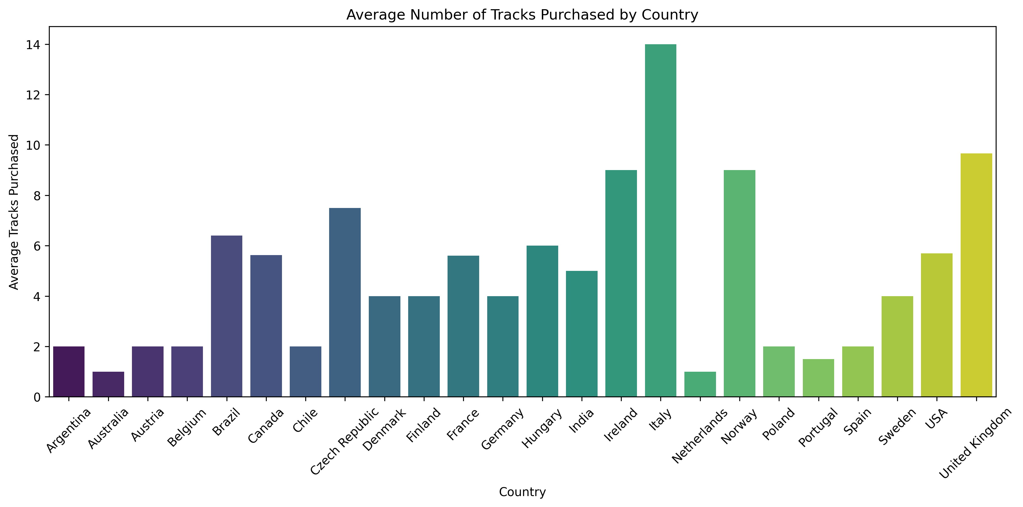
…Hypothesis test
Chi-square test: There is a significant association between genre and media type.
Chi-square test*: Reject the null hypothesis: There is an association between media type and purchase frequency.
Anova Test*: There is no significant difference in the average number of tracks purchased across different countries.

Slide 23
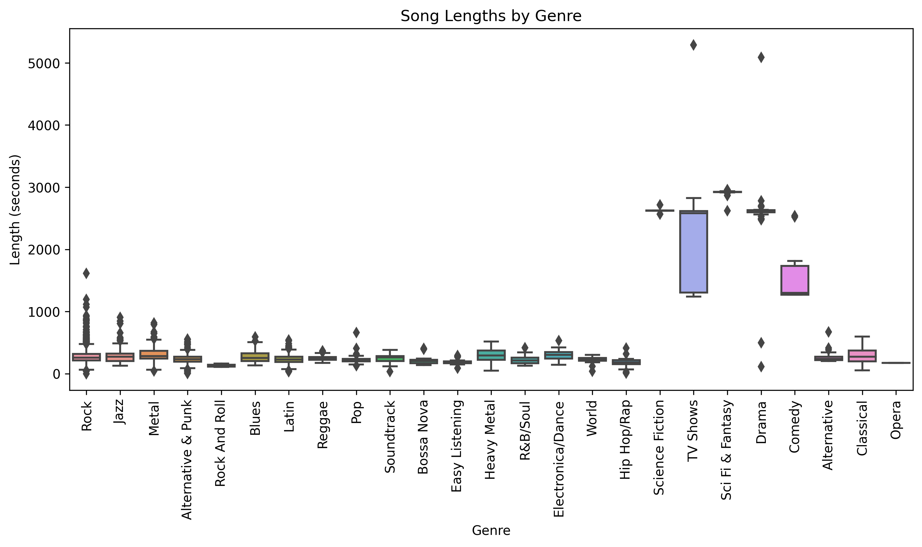
confidence interval
Is the average length of songs the same across different genres?
Hip Hop/Rap: (152.53489172764037, 203.81767970093105) seconds
Jazz: (269.55851534194574, 313.95223850420814) seconds
One way Anova test: Reject the null hypothesis: There are significant differences between groups.

Slide 24
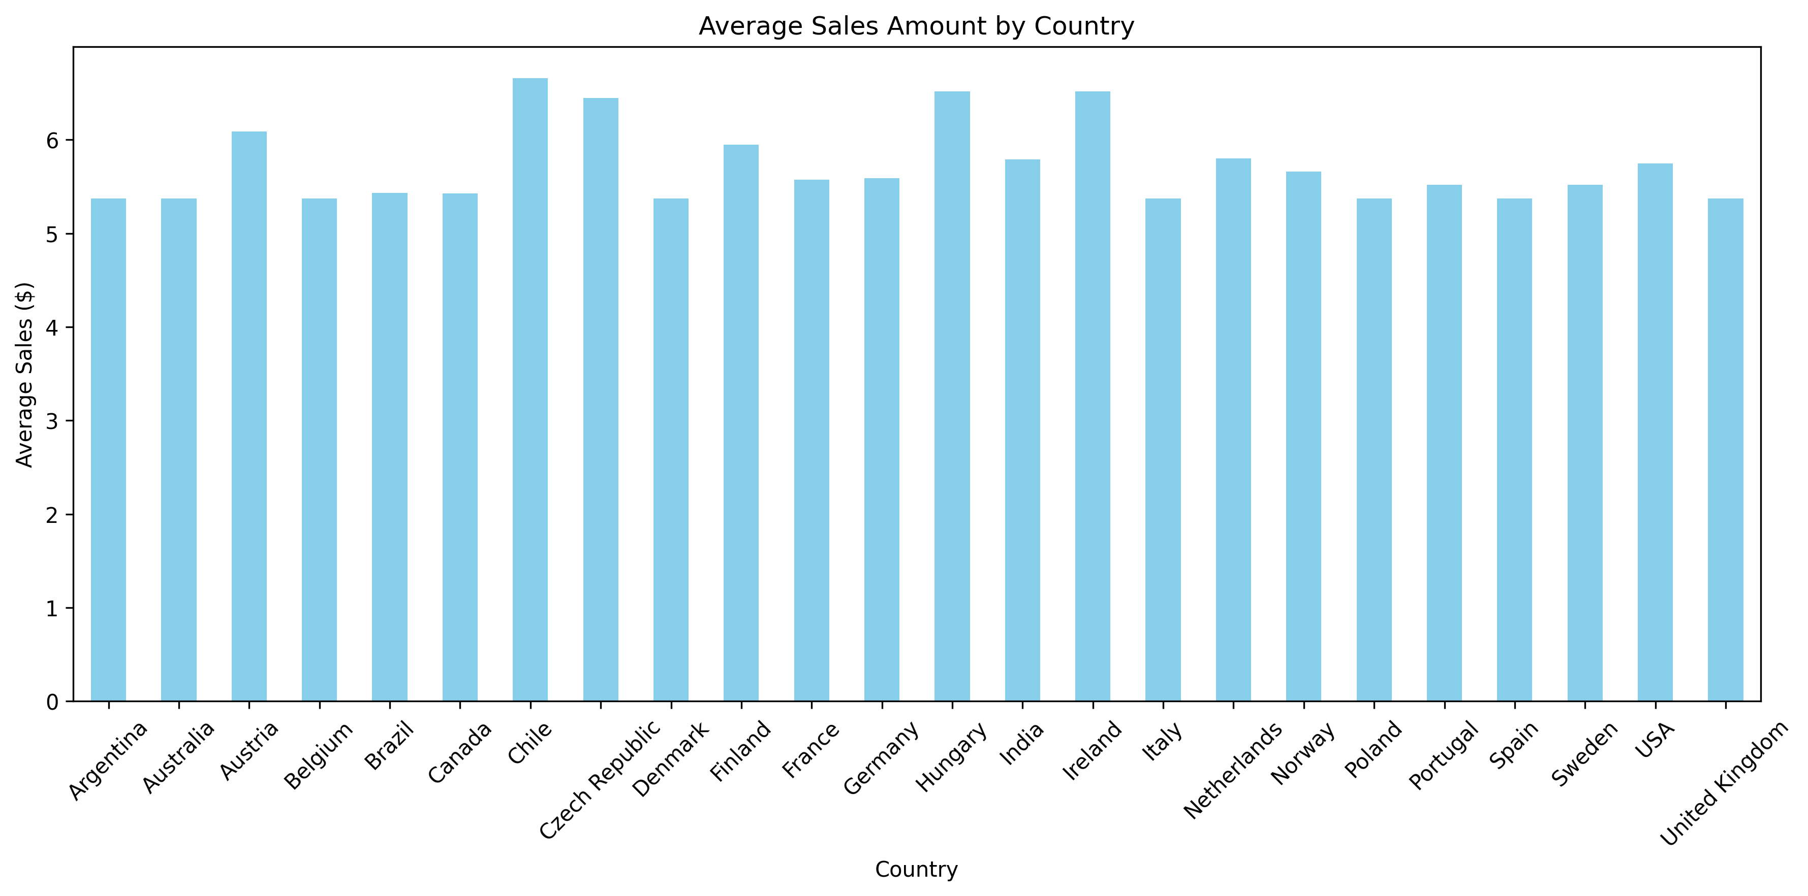
…confidence interval
What is the average sales amount in different countries?
Poland: Average Sales = 5.37, 95% CI = (1.94, 8.81)
Portugal: Average Sales = 5.37, 95% CI = (3.10, 7.93)
Spain: Average Sales = 5.37, 95% CI = (1.94, 8.81)

Slide 25
Thank you

