Slide 2
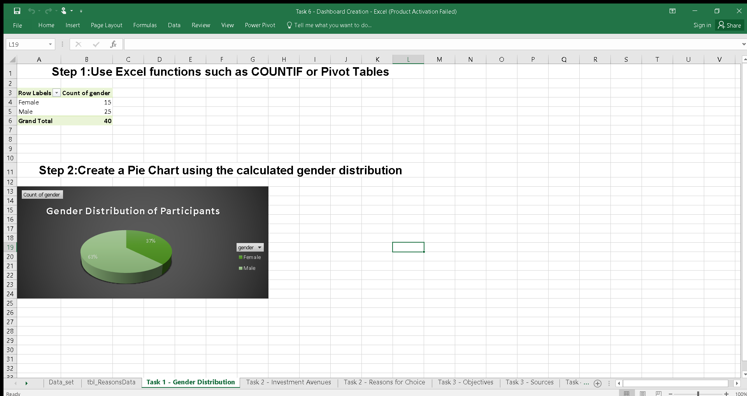
Photo Album
Task 1 – Gender Distribution Analysis
Used a pivot table and pie chart to analyze gender representation among participants.
by DECRYPT

Slide 3
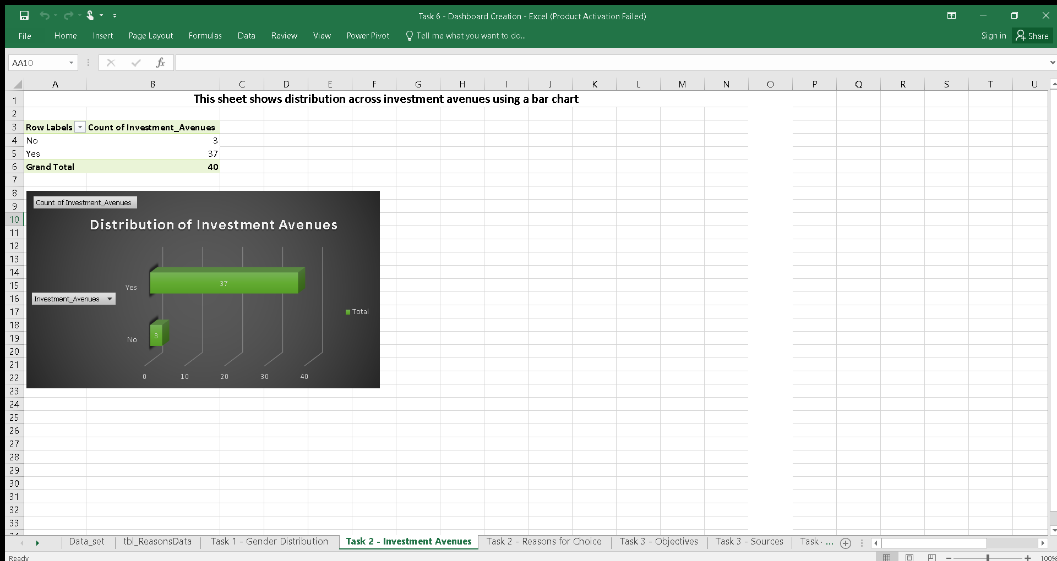
Task 2 – Investment Preferences
Visualized preferred investment avenues and reasons using bar and stacked bar charts.

Slide 4
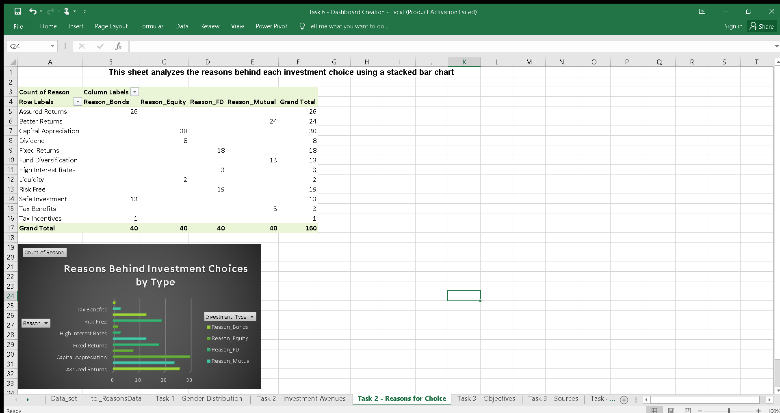
Task 2 – Investment Preferences
Visualized preferred investment avenues and reasons using bar and stacked bar charts.

Slide 5
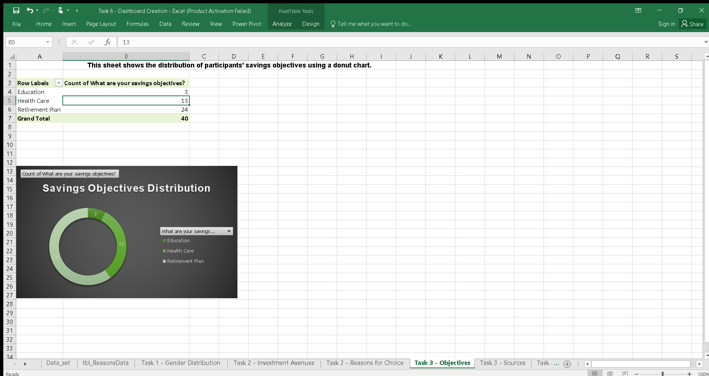
Task 3 – Savings Objectives & Information Sources
Used a donut chart and horizontal bar chart to show goals and sources of financial decisions.

Slide 6
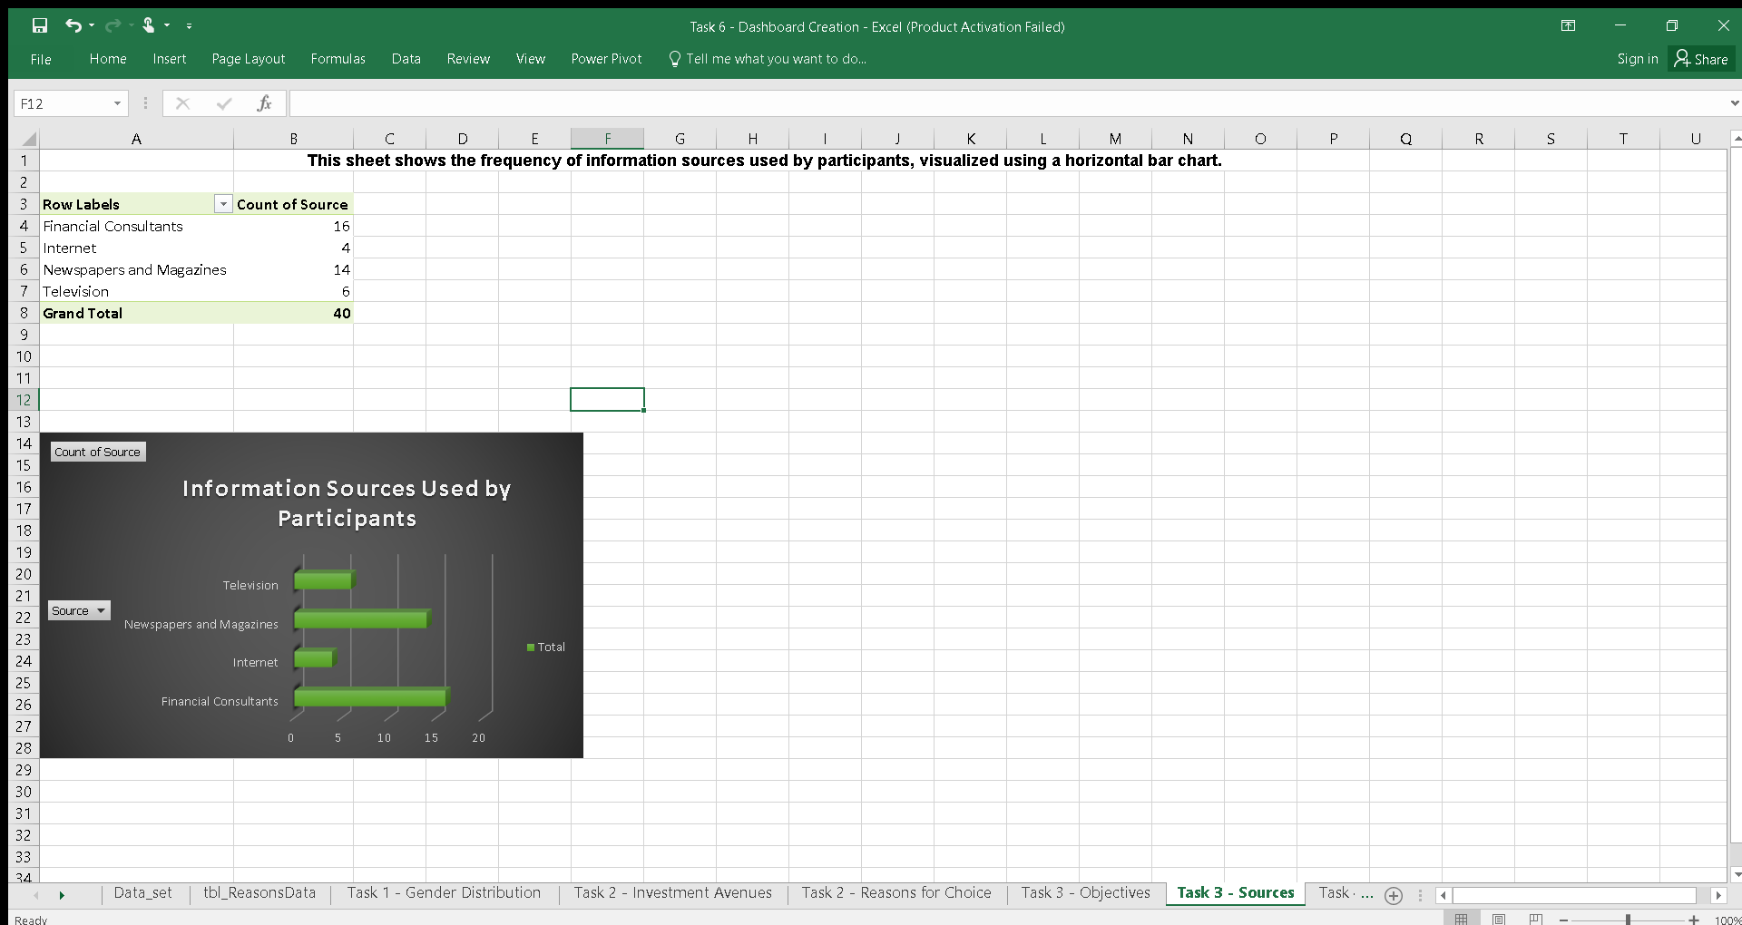
Task 3 – Savings Objectives & Information Sources
Used a donut chart and horizontal bar chart to show goals and sources of financial decisions.

Slide 7
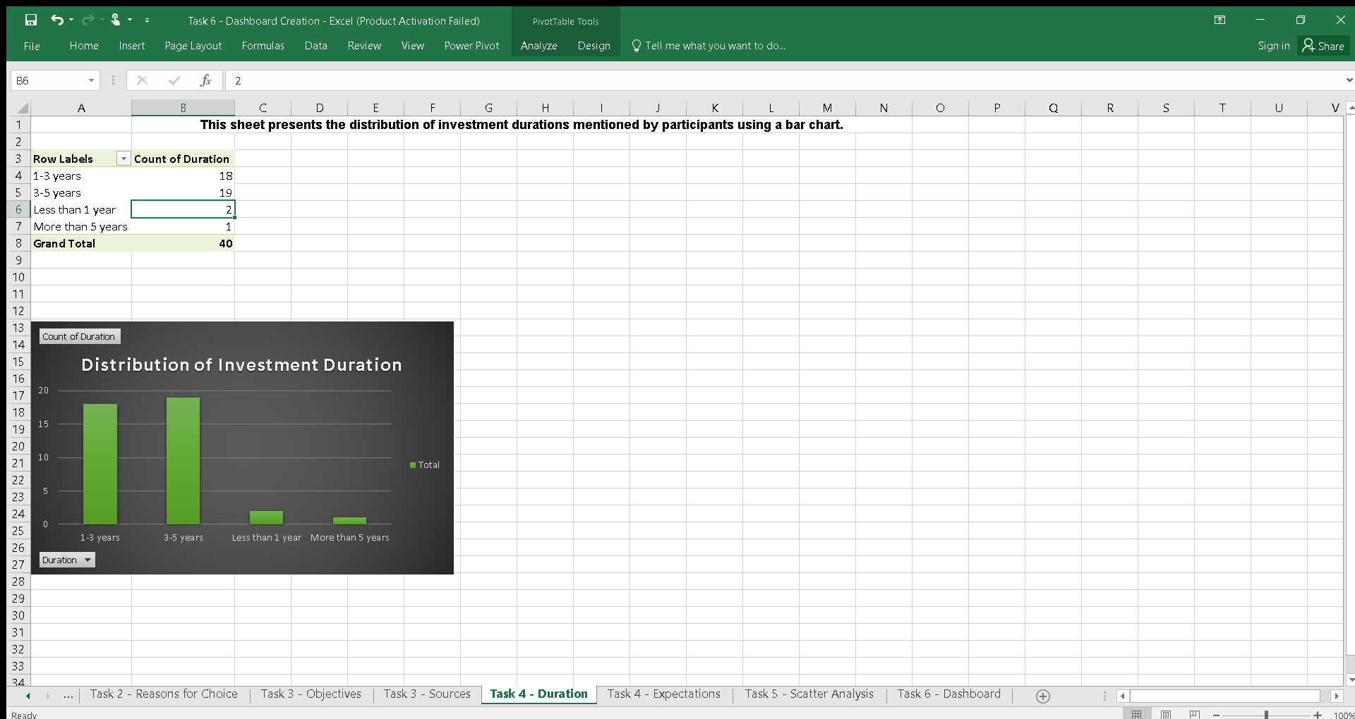
Task 4 – Duration & Expectations
Analyzed investment durations and participants' expectations with bar and radar charts.

Slide 8
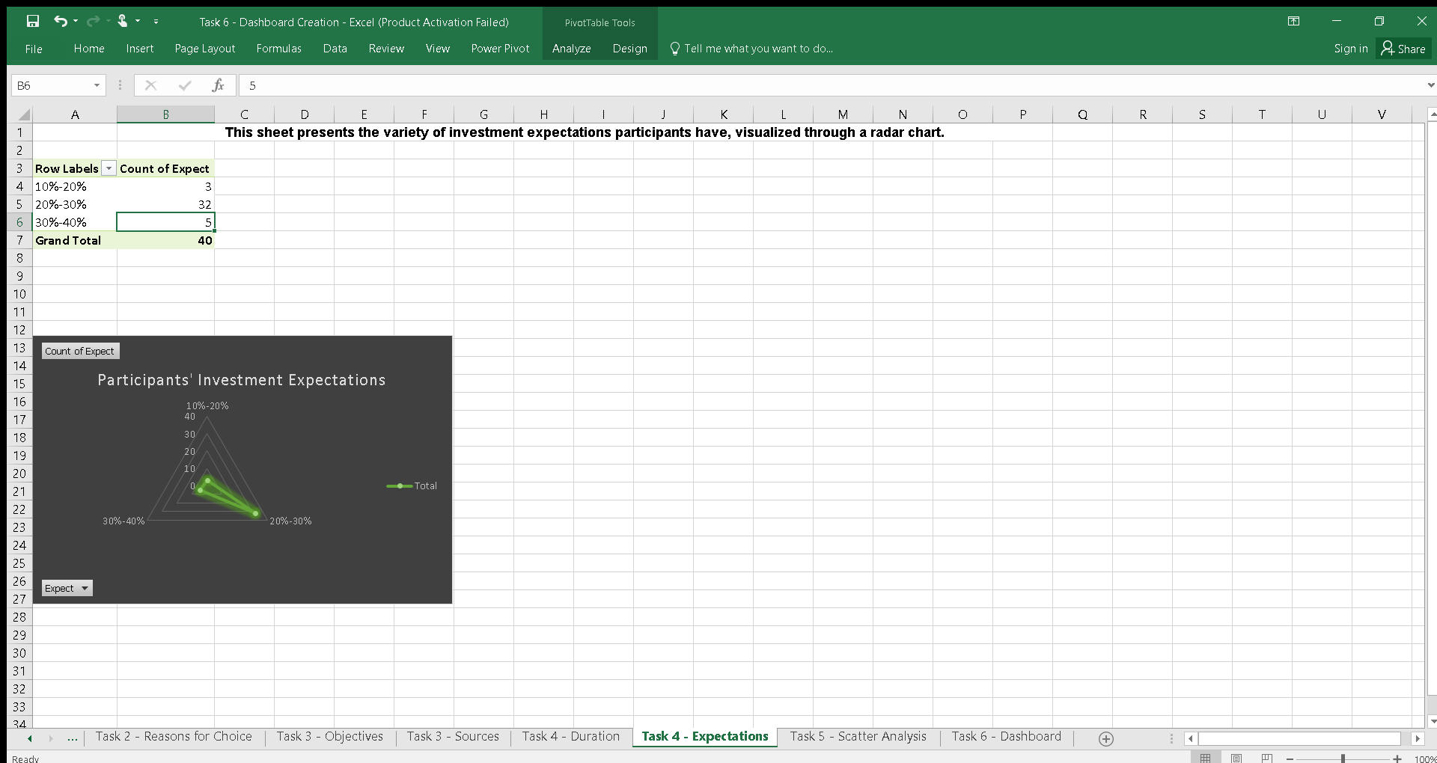
Task 4 – Duration & Expectations
Analyzed investment durations and participants' expectations with bar and radar charts.

Slide 9
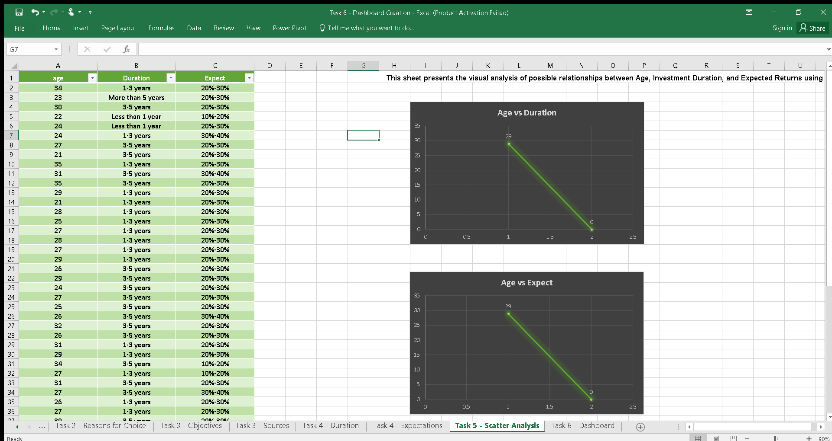
Task 5 – Correlation Analysis
Explored relationships between age, duration, and expectations using scatter plots.

Slide 10
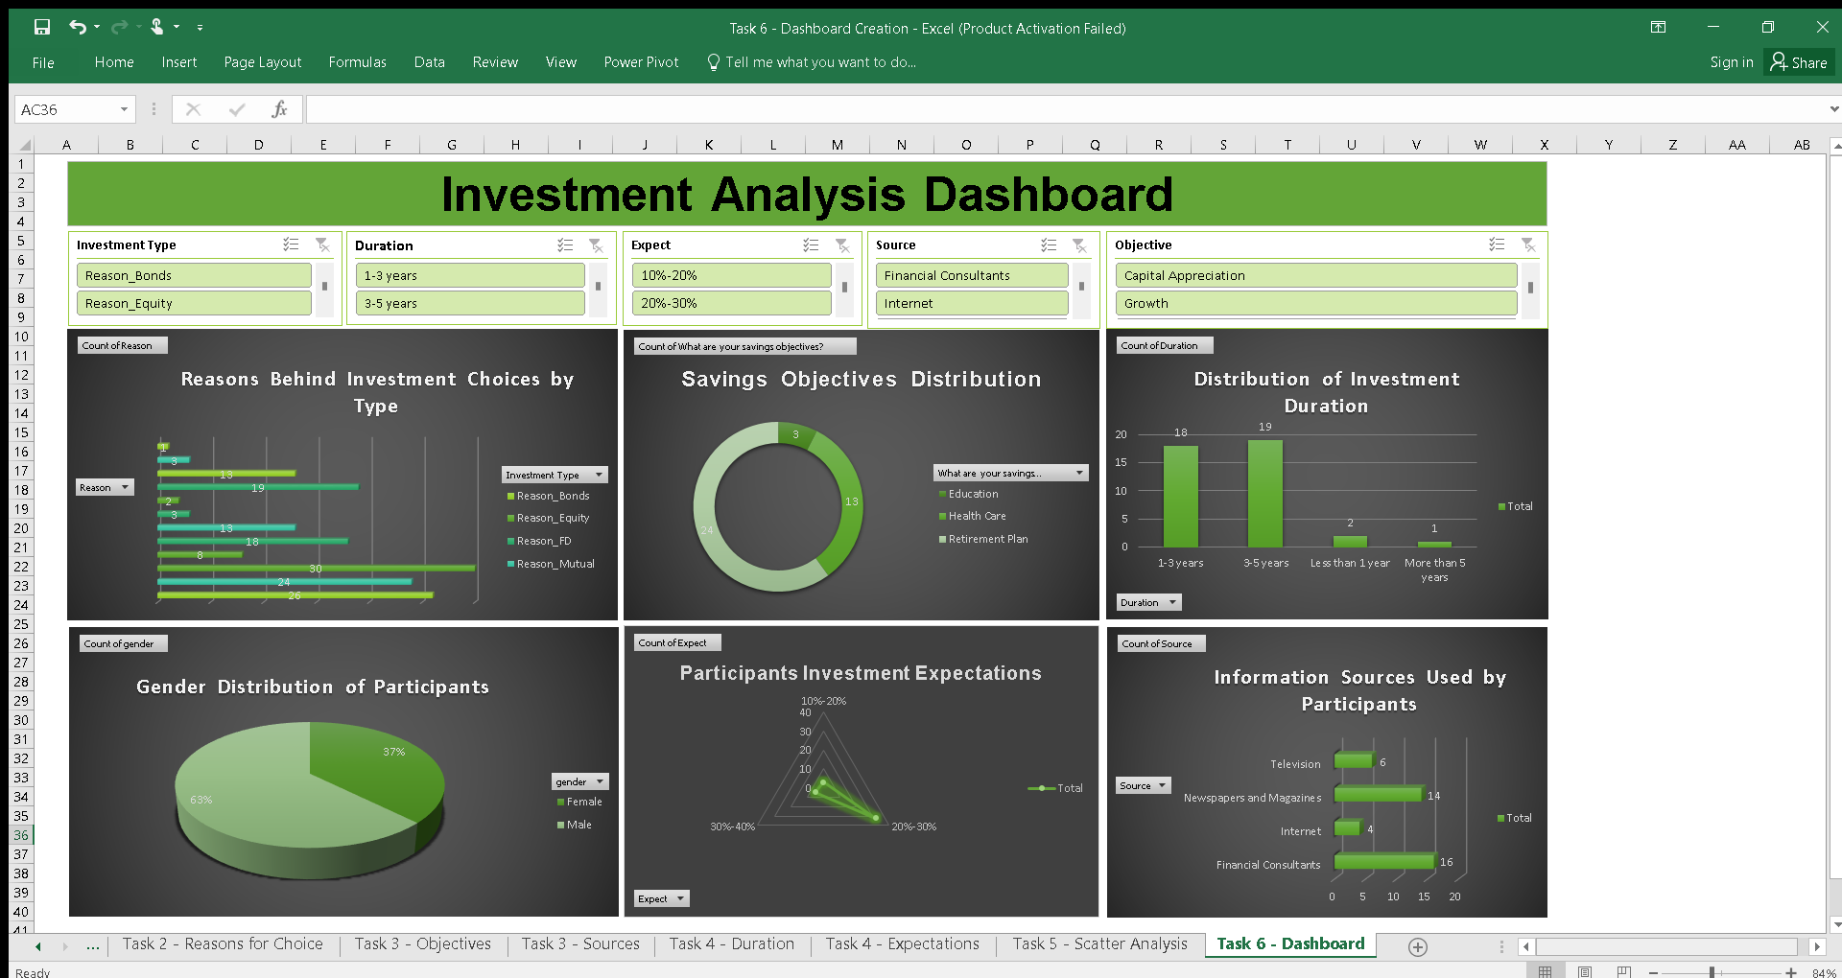
Task 6 – Dashboard Creation
Built an interactive Excel dashboard summarizing all insights with slicers and visual clarity.

