Slide 1
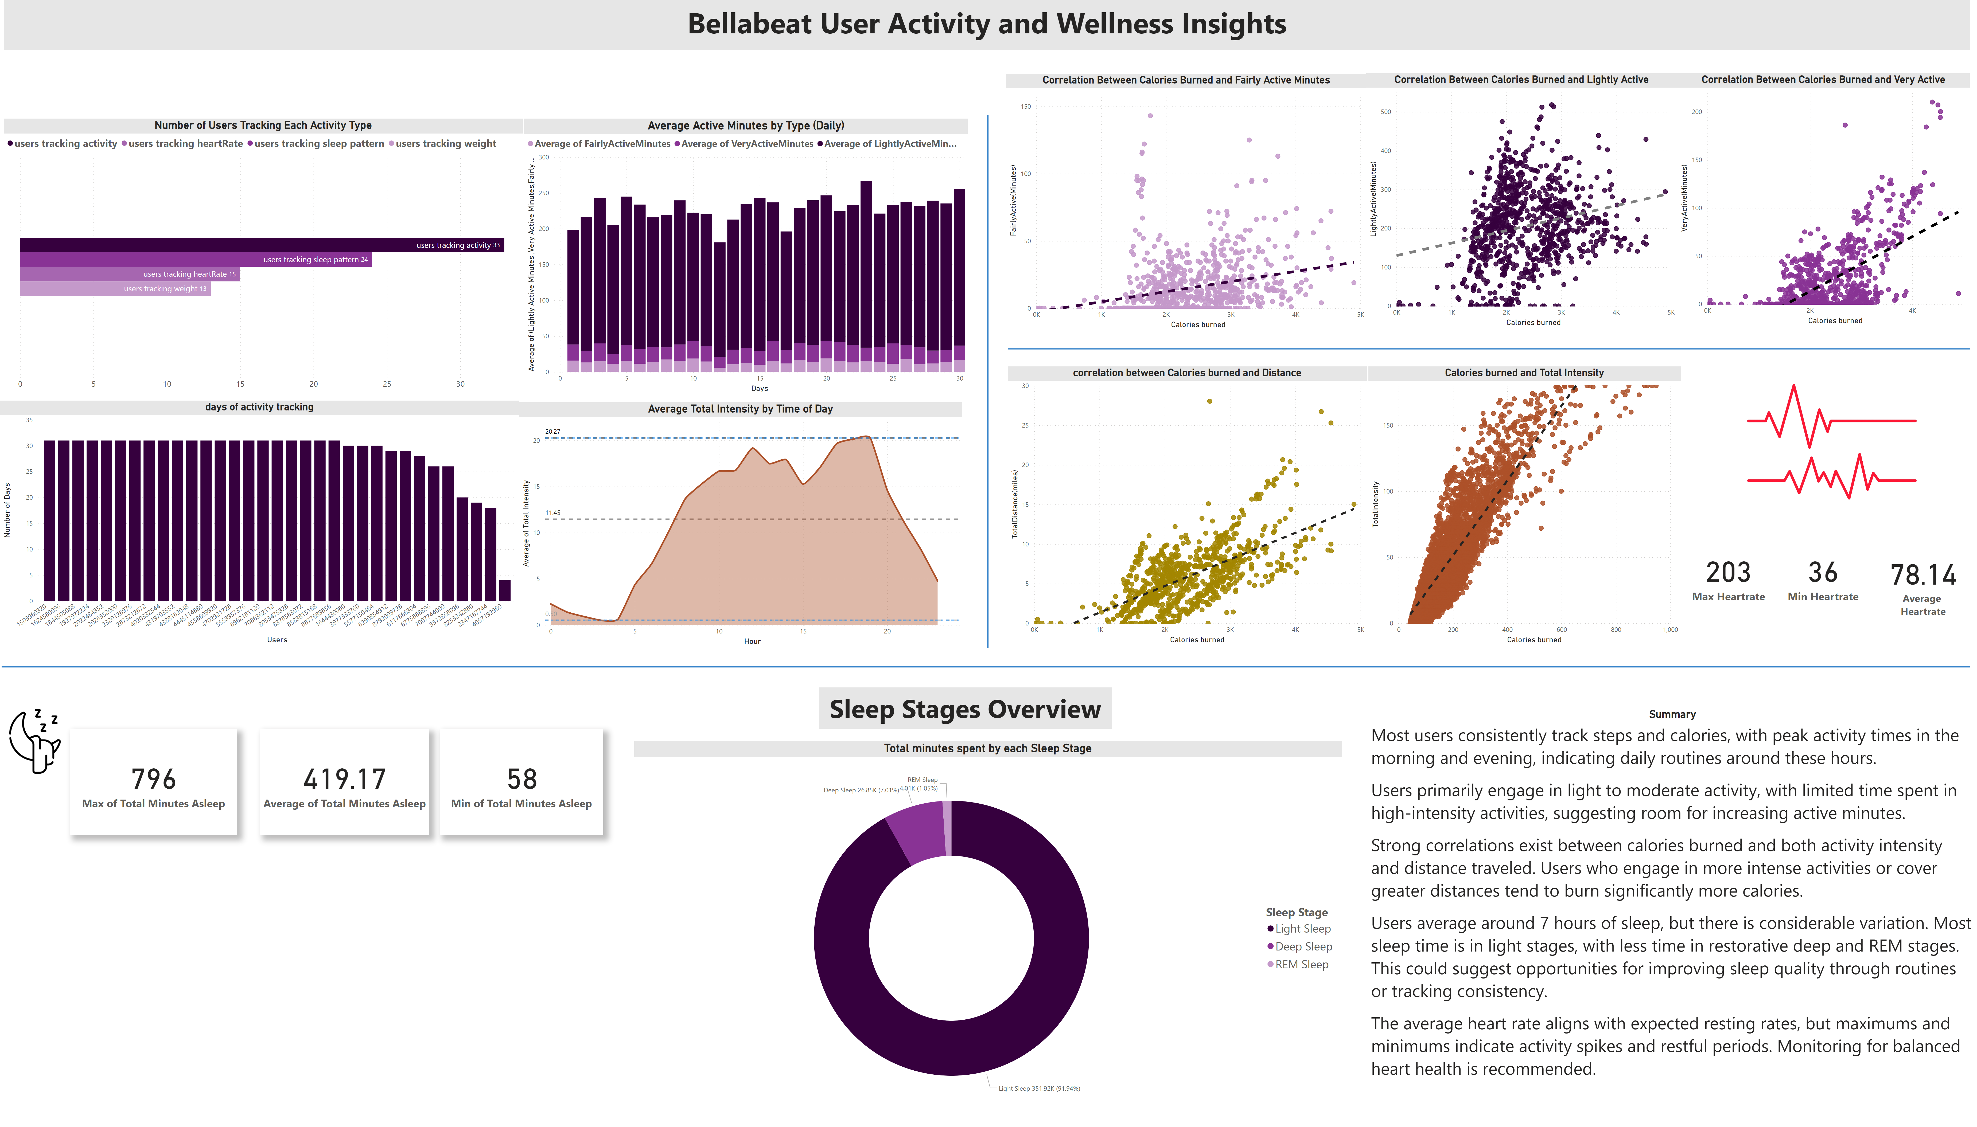
Page 1
Notes:
Number of Users Tracking Each Activity Type
No alt text provided
Average Active Minutes by Type (Daily)
No alt text provided
Average Total Intensity by Time of Day
No alt text provided
days of activity tracking
No alt text provided
Correlation Between Calories Burned and Fairly Active Minutes
No alt text provided
Correlation Between Calories Burned and Lightly Active
No alt text provided
Correlation Between Calories Burned and Very Active
No alt text provided
correlation between Calories burned and Distance
No alt text provided
Calories burned and Total Intensity
No alt text provided
card
No alt text provided
card
No alt text provided
card
No alt text provided
image
No alt text provided
shape
No alt text provided
image
No alt text provided
textbox
No alt text provided
Total minutes spent by each Sleep Stage
No alt text provided
card
No alt text provided
card
No alt text provided
card
No alt text provided
shape
No alt text provided
shape
No alt text provided
textbox
No alt text provided
Summary
No alt text provided

